Slide 1

Agenda:
Prework for Today
Sprint 4 Demos
Sprint 4 Retrospective
Breakout Session: Sprint 4 Retrospective
Prework for Next Class
Discussion & Questions welcome at any time but please be present with no phones or email during our time together

Slide 2
Prework For Next Class
Complete through activity 4 prior to next class
Those scheduled to demo on Wednesday please be a couple of minutes early to class

Slide 3
Sprint Demos

Slide 4
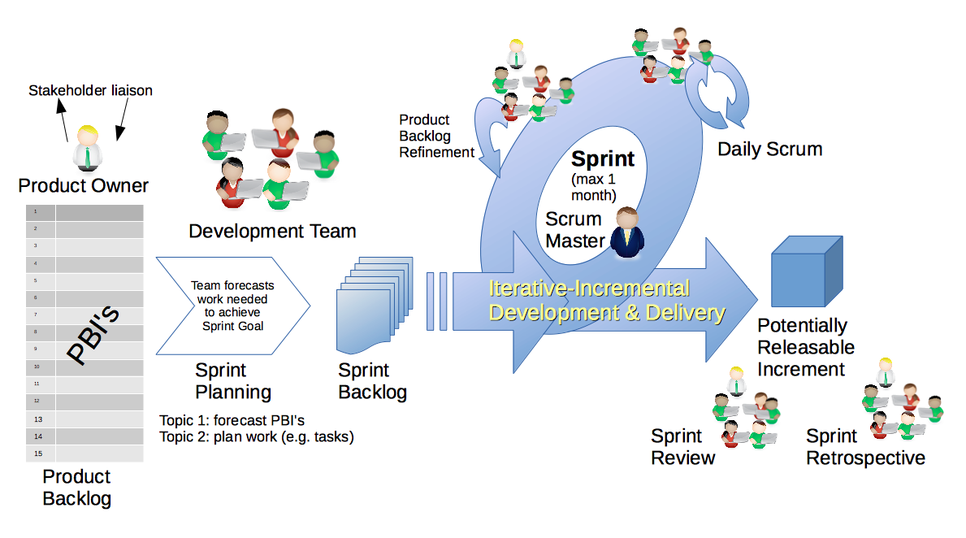
Scrum Process – Sprint Review & Demo
By Dr ian mitchell - Own work, CC BY-SA 4.0, Link

Slide 5
Demo Guidelines – Presenter
Everyone will give at least one demo of their work during the semester.
Your demo should be 2 to 5 minutes and can include any or all of the following:
Show your application running
Comment on your implementation
Show the source code
Explain how you organized the code
Talk about any challenges
You should not prepare slides or a presentation
**You will also need to complete the Demo assignment in Blackboard.

Slide 6
Demo Guidelines – Listener
Everyone will be listening to many demos during the semester.
Your listener responsibilities include:
Actively listening and watching what is being demoed
Come up with a meaningful yet easy to answer question
Ask your question if the presenter does not get sufficient questions from other listeners
Do not ask hard question or attempt to review the presenters code
Clap for the presenter at the end of the demo and thank them for presenting
Optionally follow up with the presenter later if you have what could be more difficult questions or if you have suggestions

Slide 7
Sprint Demos

Slide 8
FaceDraw Recognition:
Jacob & Megan
Open Mic Demos?

Slide 9
Complete Sprint Demo Assignment

Slide 10
Scrum Process – Sprint Retrospective
By Dr ian mitchell - Own work, CC BY-SA 4.0, Link

Slide 11
Submission Percentage

Slide 12
Class Retrospective
Feedback from Assignments & Reflections:
Very nice submission percentage! Well done
Assignments are graded and you should have access to grades and quiz answers
Very nice implementations of FaceDraw

Slide 13
Breakout Session: Sprint 4 Retrospective
As a scrum team consider:
How does your team feel now that the sprint is over?
Would having assignments due before Spring Break been a positive or a negative?
What could be done for future classes to make sprint 4 more manageable?
What improvements should we make as a class, team, or individual in sprint 5?

Slide 14
Prework for Next Class
Complete through activity 6 and working on activity 7 prior to next class
Be prepared for team Discussion 5
Be prepared for Lab

Slide 15
Scrum Process – Sprint Planning
By Dr ian mitchell - Own work, CC BY-SA 4.0, Link

Slide 16
Review Activities List and Assignments

Slide 17
Scrum Team Planning Review
As a scrum team:
Review sprint 5 activities & assignments in detail
Discuss and identify questions/concerns
Scrum master share your team’s top 2 questions/concerns during report out

Slide 18
Review Demo Schedule

Slide 19
Prework For Next Class
Complete through activity 4 prior to next class
Those scheduled to demo on Wednesday please be a couple of minutes early to class

Slide 20
End of Session

