Slide 1
This is Your Scrum Process
“With great power there must also come great responsibility”
-Peter Parker (aka Spider-Man)

Slide 2

Review Final Project Sprint 7 Requirements
Review Final Project Sprint 7 requirements with a focus on Backlog Grooming, Product Owner, Stories, and Story Backlog.

Slide 3
Backlog Grooming
Backlog Grooming includes:
Creating and Deleting
Prioritizing
Estimating
Spitting or Consolidating

Slide 4
INVEST to Write Good User Stories
Independent: Self contained, not dependent on other user stories
Negotiable: Leave space for discussion, discovery and invention
Valuable: Has immediate value to stakeholder.
Estimable: Constrained in size and scope, just enough information
Small: Ideally 1-2 days work with larger efforts being decomposed
Testable: Acceptance criteria makes clear when work is done

Slide 5
Sprint Planning Goal
By the end the class next Tuesday each team member will have committed to multiple meaningful User Stories that are estimated at a total effort 12 or more Story Points per person
Steps:
Update “Done” definition making sure that it includes deployed, tested, and able to be demoed in the production environment
Come into Sprint Planning with a fully Groomed Story Backlog of at least 10 story points per team member
Team members REQUEST stories, stories are assigned, and team members COMMIT to delivering stories by end of sprint
You and your scrum team are responsible for have Done defined and having a fully Groomed Backlog prior to class on Tuesday.
The Product Owner maintains and updates the prioritized Product and Sprint Backlogs.
Each team member is responsible for requesting and committing to stories. Stories must be deliverable within the sprint. It should be a high priority to assign a story to a single team member.

Slide 6
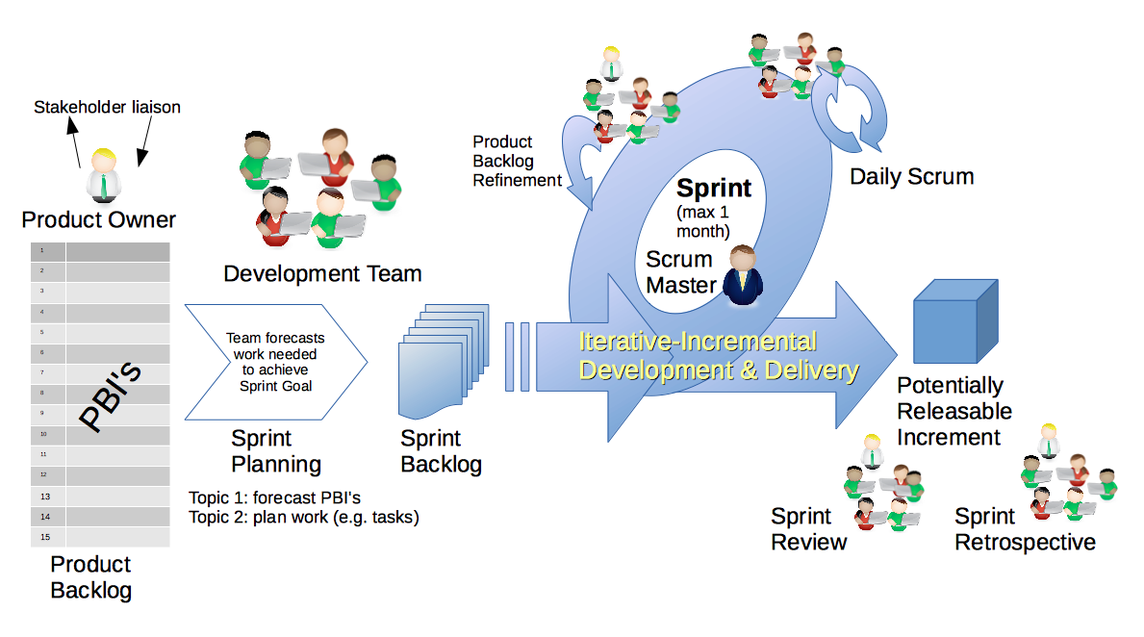
Scrum Process
By Dr ian mitchell - Own work, CC BY-SA 4.0, Link

Slide 7
Backlog Grooming and Sprint Planning
Steps:
Priorities & Roles Assignment (review)
Epic Backlog Grooming
Story Backlog Grooming
Sprint Planning (Tuesday)
Commitment to Sprint Backlog (Tuesday)
Celebrate! (Tuesday)

Slide 8
Step 1: Roles & Priorities
Agile Priorities (associated scrum role):
Customer (Product Owner)
Technology (Architect)… optional
Process (Scrum Master)
Recall that one person can play multiple roles.
Recall that it is different/difficult for us because we are playing the role of the customer as well as the delivery team.
Roles report-out questions:
Who will be the Scrum Master & Product Owner for sprint 8

Slide 9
Step 2: Epic Backlog Grooming
User Stories, Epics and Backlogs
Agile Glossary [link]… review User Story format

Slide 10
Step 2: Epic Backlog Grooming
Actions & Requirements:
Product Owner to lead the review and/or creation of Epics
There must be one list of Epics managed by the Product Owner
Each Epic must deliver customer functionality and value
Epics should be written in User Story format
Epics must be prioritized and forced ranked
Each product must have at least three Epics
Epic to support sustainable product: As a product user I need for the product to continue to evolve after the semester (sustainability)
Epic Backlog Grooming report questions (Scrum Master / Product Owner):
Create you Epic backlog that includes at least two Epics

Slide 11
Step 3: Story Backlog Grooming
By Dr ian mitchell - Own work, CC BY-SA 4.0, Link

Slide 12
Step 3: Story Backlog Grooming
Review Done, User Stories, and Story Backlog:
“Done” must be well defined and for us includes at a minimum:
Successfully deployed and integration tested in the production environment
Demoed to the Product Owner
Available to be demoed to the class
User Stories must:
Be written in User Story format from a customer / user perspective
Deliver user (customer) value
Be associated with Epic
Product Product Backlog is:
Managed by to Product Owner
The team’s master list of prioritized (force ranked) User Stories
The team’s master list of all important project work (spikes, continuous improvement, etc.)
Notes:
How will you handle dependancies?

Slide 13
Step 3: Story Backlog Grooming
Requirements:
Product Owner to lead the creation, force ranking, and estimating of User Stories.
Each User Story must have an estimated effort in Story Points
For our purposes assume 1 Story Point is approximately equal to 1 hour of effort
Each User Story must be deliverable in a single sprint
Since sprint 8 brings us to the end of the semester, include a focus on including stories that will create a sustainable product
Stories to support New Epic:
As a product user I need for the product to continue to evolve after the semester (sustainability)

Slide 14
Step 3: Story Backlog Grooming
Requirements & Actions:
Update Product Backlog by:
Creating new User Stories
Prioritize and force rank important stories (anything that might make it to the Sprint Backlog)
Provide Story Point estimates for important stories
Product Backlog report out questions (Product Owner):
What is your team’s definition of done?
What is the total number of user stories in your Product Backlog (stories)?
What is the total number of story points in your Product Backlog (stories)?
How many story points per team member?
How will you handle sprint 6 committed stories that are not Done next Tuesday?
Notes:
How will you handle dependencies?

