Slide 1

Object-Oriented Programming Session: Week 7 Session 1 Instructor: Eric Pogue
Agenda:
Review this week’s Assignments
Introduce the week’s Learning Objectives
Topics
Leaving time for you to start working on “Create a Picture Viewer” tutorial

Slide 2
Review Questions Assignment
Week 7 Questions Assignment [link]
Notes:
Week 7 Questions Assignment:
http://www.epogue.info/CPSC-24500/Week07/2017SpringW07QuestionsAssignment.docx

Slide 3
Review Programming Assignment
Week 7 Programming Assignment [link]
Notes:
Week 7 Programming Assignment:
http://www.epogue.info/CPSC-24500/Week07/2017SpringW07ProgrammingAssignment.pdf

Slide 4
Learning Objectives – Week 7
Using Visual Studio 2017, C#, and .NET we will:
Review and implement information hiding
Download documents from remote Web (HTTP) servers
Parse data expressed in XML format
Perform basic drawing operations
Separate an application’s functionality among classes
Separate code among files and libraries that you can reuse in other applications
Review a Model-View-Controller application

Slide 5
Encapsulation & Information Hiding
Encapsulation is used to hide data from outside classes. C# has three primary (five total) types of access modifiers to encapsulate data. In order to better encapsulate our code and implement data hiding prioritize our access modifiers:
Private: only elements of the same class has access
Protected: only elements off the same class and descendent classes have access
Public: any code has access
Notes:
Additional C# modifiers include:
Internal: only code in the same assembly has access
Protected Internal: Either code from the derived type or code in the same assembly has access

Slide 6
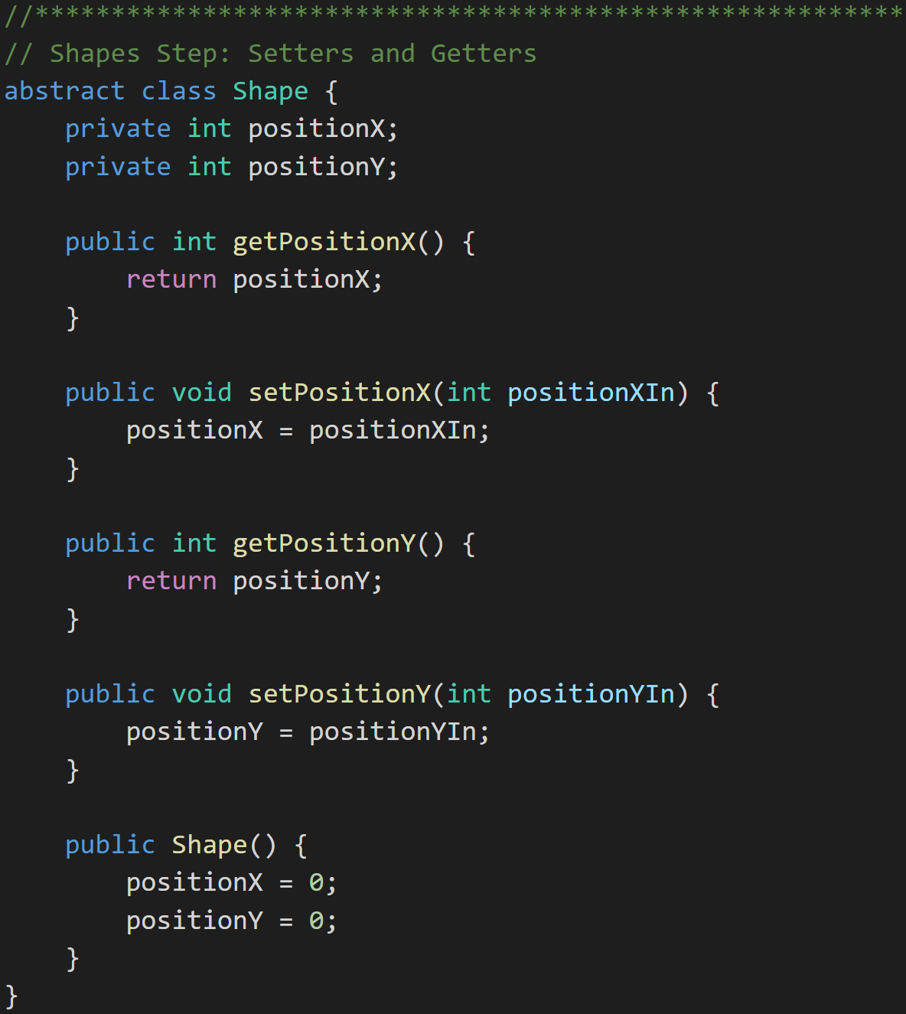
Review Java Setters & Getters
Setters and Getters are a practice where public Methods are put in place to control how private Attributes are updated.
They can be beneficial in:
Validation
Optimization
Converting types (English to metric)
Debugging breakpoints
Some libraries expect setters and getters
Shapes with Setters and Getters:
Notes:
Why use Setters & Getters? Because 2 weeks (months, years) from now when you realize that your setter needs to do more than just set the value, you'll also realize that the property has been used directly in 238 other classes. (Internet quote)

Slide 7
C# Setters & Getters
Setters and Getters are a practice where public Methods are put in place to control how private Attributes are updated.
They can be beneficial in:
Validation
Optimization
Converting types (English to metric)
Debugging breakpoints
Some libraries expect setters and getters

Slide 8
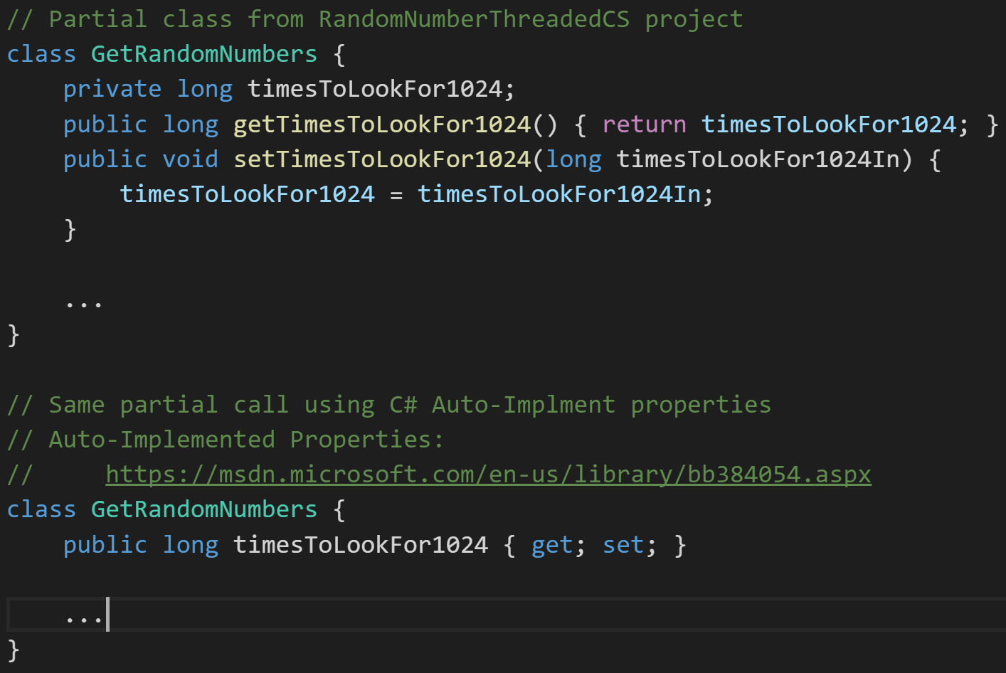
C# Auto-Implement Properties
A property is a member that provides a flexible mechanism to read, write, or compute the value of a private field. Auto-Implement Properties provide a very concise syntax for implanting setters and getters.
Notes:
Very concise, but really doesn’t protect us from the most challenging parts of hiding data.
public string FirstName { get; set; } = "Jane";
Why use Setters & Getters? Because 2 weeks (months, years) from now when you realize that your setter needs to do more than just set the value, you'll also realize that the property has been used directly in 238 other classes. (Internet quote)

Slide 9
Encapsulation & Information Hiding Recommedation
Make everything local to a Method
Make everything a Method Parameter
Make everything Private…
If you must make it Protected or Public, provide “real” setters and getters

Slide 10
Encapsulation & Information Hiding Suggestions
Make everything local to a Method
Make everything a Method Parameter
Make everything Private…
If you must make it Protected or Public, provide “real” setters and getters

Slide 11
Download documents from remote Web (HTTP) servers
Multiple .NET (C#) classes and methods are provided that wrap various network protocols. For Web (HTTP) the .NET environment provides the WebClient class which:
Is most often used to retrieve files
Can access multiple Internet file types including HTML, XML, JSON, etc.
Utilized HTTP or HTTPs for communication
Notes:
There are a multitude of network and Internet protocols. It is beyond the scope of this class to cover them in detail.

Slide 12
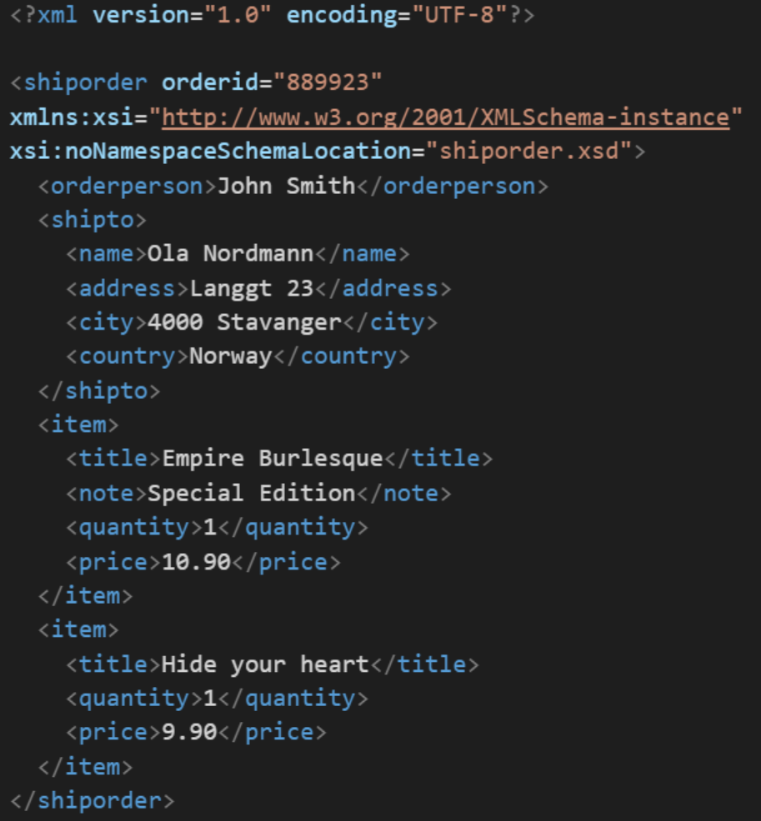
XML
In computing, XML (Extensible Markup Language) is a markup language that defines a set of rules for encoding documents in a format that is both human-readable and machine-readable. It is an open standard that:
Supports nearly all development languages and platforms
Allows us to cross between many applications
Can result in large files
Supports schema to validate data

Slide 13
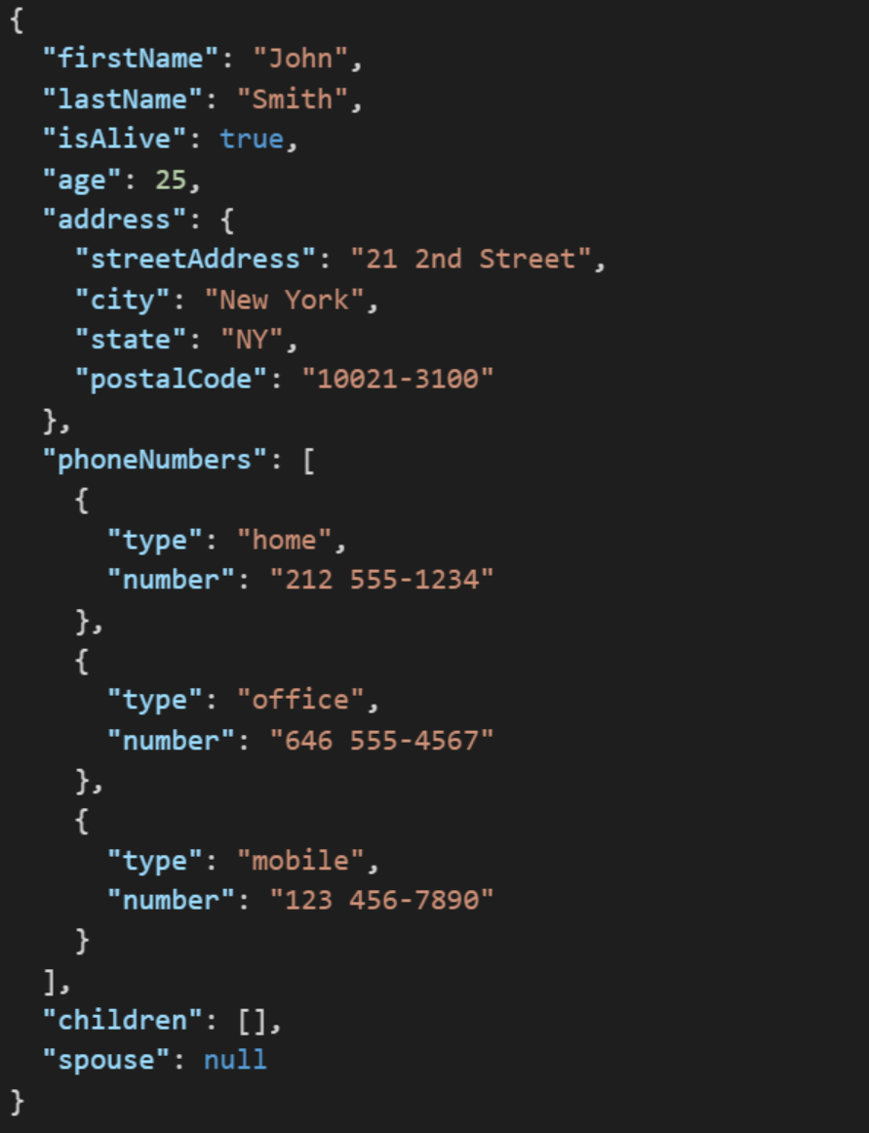
JSON
JSON (JavaScript Object Notation) is a lightweight data-interchange format. It is easy for humans to read and write. It is easy for machines to parse and generate. It is an open standard that:
Supports nearly all development languages and platforms
Allows us to cross between many applications
Can result in large files
Notes:
JSON is an open-standard format that uses human-readable text to transmit data objects consisting of attribute–value pairs. It is a very common data format used for asynchronous browser/server communication, including as a replacement for XML in some web service style systems.

Slide 14
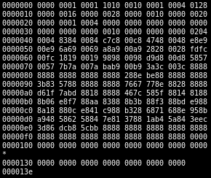
Binary Files
A binary file is a computer file that is not a text file. The term "binary file" is often used as a term meaning "non-text file". The can be open or closed formats that are generally:
Fast, small, and efficient*
Often not very portable across applications and platforms
Difficult to maintain backward compatibility
Notes:
Some people would say that binary files include all files, and that text files are just binary files that are being interpreted in a specific way.

Slide 15
Parse data expressed in XML format
Simple XML files can be parsed “by hand” without much difficulty. In addition, the .NET (C#) environment offers multiple classes that can assist in parsing XML including:
XmlReader
LINQ to XML [link]

Slide 16
Preview HideDataDownloadXML Example
Features:
Develop application entirely in Visual Studio 2017 and C#
Take in one command line argument that is the URL to download
Implement multiple C# classes that appropriately hide data
Download HTML and XML files from various URLs
Get ready for parsing XML

Slide 17
Object-Oriented Programming Session: Week 7 Session 1 Instructor: Eric Pogue
Agenda:
Review this week’s Assignments
Introduce the week’s Learning Objectives
Topics
Leaving time for you to start working on “Create a Picture Viewer” tutorial

Slide 18
End of Session
Course Number: CPSC-24500
Week: 7
Session: 1
Instructor: Eric Pogue

Slide 19
Object-Oriented Programming Session: Week 7 Session 2 Instructor: Eric Pogue
HideDataDownloadXML Example:
Develop application entirely in Visual Studio 2017 and C#
Take in one command line argument that is the URL to download
Utilize Web (HTTP) protocols to download HTML and XML files
Get ready for parsing XML
Implement multiple C# classes that appropriately hide data

Slide 20
Web (HTTP) Protocol
The Hypertext Transfer Protocol (HTTP) is an application protocol for distributed, collaborative, and hypermedia information systems. HTTP is the foundation of data communication for the World Wide Web [link]:
Network protocols like HTTP and HTTPs ARE used to protect data!
HTTP defines methods (sometimes referred to as verbs) to indicate the desired action to be performed on the identified resource including:
GET: requests a resource
POST: requests that the server accept the entity enclosed in the request
Many, many more
Most often uses a Web browser as a client
A variety of Web servers are available
TCP, IP, HTTP, HTTPs, HTML, XML, JSON
Web Server: A server that utilizes TCP/IP and responds on Port 80 from a given IP address using HTTP or HTTPs and generally returns HTML (or XML or JSON)
Notes:
TCP/IP: Transmission Control Protocol / Internet Protocol
HTTP: Hypertext Transfer Protocol
HTTPs: Hypertext Transfer Protocol Secure
SSL: Secure Sockets Layer
HTML: Hypertext Markup Language
XML: Extensible Markup Language
JSON:
Web Server: A server that utilizes TCP/IP and responds on Port 80 from a given IP address using HTTP and generally returns HTML.

Slide 21
End of Session
Course Number: CPSC-24500
Week: 7
Session: 2
Instructor: Eric Pogue

Slide 22
Object-Oriented Programming Session: Week 7 Session 3 Instructor: Eric Pogue
HideDataDownloadXML Example:
Develop application entirely in Visual Studio 2017 and C#
Take in one command line argument that is the URL to download
Utilize Web (HTTP) protocols to download HTML and XML files
Parsing XML
Implement multiple C# classes that appropriately hide data

Slide 23
End of Session
Course Number: CPSC-24500
Week: 7
Session: 3
Instructor: Eric Pogue

Slide 24
Object-Oriented Programming Session: Week 7 Discussion & Lecture Instructor: Eric Pogue
Agenda:
Reminder on Requesting Graded Homework Assignments
Review Week 7 To-do List
Recognize that it may be valuable to review items “8a” and “8b” before this “Week 7 session 1” video
Don’t forget your Bb postings
Discuss this week’s Assignments
Week 7 Questions Assignment
Week 7 Programming Assignment
Review the week’s Learning Objectives
Continue with More Learning Objective Topics

Slide 25
Learning Objectives – Week 7
Using Visual Studio 2017, C#, and .NET we will:
Review and implement information hiding
Download documents from remote Web (HTTP) servers
Parse data expressed in XML format
Separate an application’s functionality among classes
Separate code among files and libraries so that you can reuse in other applications
Review a Model-View-Controller application
Perform basic drawing operations… as time allows
Notes:
“git clone https://github.com/EricJPogue/CPSC-24500.git

Slide 26
Separate C# Files
C# code can be easily separated into files and be shared between application as source code. Pros and cons include:
Utilizing source code management (GIT) to manage it within or between applications
Sharing actual C# source code required (pro or con)
Compiling required in order to utilize shared code (con)
Utilizing C# required (con)
Very similar to how we did it with Java

Slide 27
Libraries and Components
The terms Libraries, Components, and Frameworks are often used interchangeably. For our purposes we will utilize the term Component. C# code can be compiled into Components that can then be utilized in other applications. Pros and cons include:
Distributing source code is optional (pro)
Hiding of information and implementation enforced (pro)
Multiple (often incompatible) methods including DLLS, COM, .NET, etc. on Windows (con)
Language agnostic (pro)
Notes:
Microsoft has a long history of providing (mostly incompatible) mechanisms to develop, deploy, and utilize component architectures. Over time component architectures have evolved into Service Oriented Architectures (SOA).
Components: A binary (compiled) package that contains local application functions/methods or APIs (Application Programming Interfaces) that can be utilized during development or run-time. JAR files are an example of a component. The functions/methods run locally on the same computer as the application. Note: the fact that they run on the same computer is why information hiding and components do not provide data security.
Service: A remote API that (generally) runs on a separate machine accessed by a network protocol (HTTP, REST, SOAP).

Slide 28
Service Oriented Architecture
Service Oriented Architectures (SOA) utilize standard network protocols to implement Encapsulation, Interface Inheritance (vs Implementation Inheritance), “limited” polymorphic abilities, operating system independence, and language independence. Pros and cons include:
Security can be enforced at the network level (pro)
“Components” do not have to run on the same operating system (pro)
“Components” can be run remotely at different companies (pro)
Cloud centric (pro)
Performance can be an issue (con)
Control and security is distributed (con… or pro)
Legal & Privacy (pro… or con)
Notes:
Components: A binary (compiled) package that contains local application functions/methods or APIs (Application Programming Interfaces) that can be utilized during development or run-time. JAR files are an example of a component. The functions/methods run locally on the same computer as the application. Note: the fact that they run on the same computer is why information hiding and components do not provide data security.
Service: A remote API that (generally) runs on a separate machine accessed by a network protocol (HTTP, REST, SOAP). XML or JSON are generally used within SOAP and REST.
Note: The Common Object Request Broker Architecture (CORBA) is a standard defined by the Object Management Group (OMG) designed to facilitate the communication of systems that are deployed on diverse platforms. It was a mostly failed attempt to implement “full” OOP across the network in a SOA implementation. Over time this gave way to simpler implementation (with less OOP functionality) like SOAP and REST.

Slide 29
Implement ShapeModel in DownloadAndParseXML
Features:
Develop application entirely in Visual Studio 2017 and C#
Take in one command line argument that is the URL to download
Utilize Web (HTTP) protocols to download HTML and XML files
Parsing XML
Implement multiple C# classes that appropriately hide data
Clone class source code
Review ToString method that was added to Shape class
Separate ShapeModel into separate file called ShapeModel.cs
Update source code in Git repository
Notes:
Steps:
git clone https://github.com/EricJPogue/CPSC-24500.git
Open DownloadAndParseXML solution
Add new ShapeModel class .cs file
Cut and past ShapeModel source into new file
Change NameSpace to ShapeModelXML
Update Program.cs to with “Using ShapeModelXML;”
Compile & debug
git add ShapeModel.cs
git commit
git push

Slide 30
Learning Objectives – Week 7
Using Visual Studio 2017, C#, and .NET we will:
Review and implement information hiding
Download documents from remote Web (HTTP) servers
Parse data expressed in XML format
Separate an application’s functionality among classes
Separate code among files and libraries so that you can reuse in other applications
Review a Model-View-Controller application
Perform basic drawing operations
Notes:
“git clone https://github.com/EricJPogue/CPSC-24500.git

Slide 31
Implement DownloadAndParseXML_MVC
Features:
Develop new application entirely in Visual Studio 2017 and C#
Implement ShapeController using “Project|Add New Item”
“Import” ShapeModel into ShapeController using “Project|Add Existing Item”
Implement ShapeConsoleView
Notes:
Recognize that we may have multiple Models, Views, and Controllers in a complex application. We could end up with names like “SimpleShapeModel_ShapeConsoleView_Controler”. We will keep it very simple for our example.
Steps:
Create a new Visual Studio 2017 project named “DownloadAndParseXML_MVC”
Add a new Class and .cs file called ShapeController
Create a new “ShapeController” in Main
“Import” ShapeModel from DownloadAndParseXML… copy ShapeModel.cs file
Add “Using ShapeModelXML;” to ShapeController
Enhance ShapeController with ShapeModel
Implemend ShapeConsoleView

Slide 32
Learning Objectives – Week 7
Using Visual Studio 2017, C#, and .NET we will:
Review and implement information hiding
Download documents from remote Web (HTTP) servers
Parse data expressed in XML format
Separate an application’s functionality among classes
Separate code among files and libraries so that you can reuse in other applications
Review a Model-View-Controller application
Perform basic drawing operations

Slide 33
Implement DrawShapes
Features:
Develop new application entirely in Visual Studio 2017 and C#
Create a new Windows Forms (.NET Framework) application called DrawShapes
Add a button called DrawNow with button text of “Draw”
Edit the button pressed code to draw Ovals and Rectangles
Create separate methods to draw and an Oval and a Rectangle
Draw a few Ovals and Rectangles

Slide 34
End of Session
Course Number: CPSC-24500
Week: 7
Session: 4
Instructor: Eric Pogue

Slide 35
Object-Oriented Programming Session: Week 7 Session 5 Instructor: Eric Pogue
InternetShapeDrawLite:
Develop new application entirely in Visual Studio 2017 and C#
Create a new Windows Forms (.NET Framework) application called EJPInternetShapeDrawLite
Override OnPaint()
Implement graphical “Hello World!!!”
Draw Rectangles
Draw Ovals
Implement Loading and Parsing of Shapes… by copy/past importing from previous example
Draw Shape in ShapeModel
Review application requirements… add comments
Compile & Test release build

Slide 36
End of Session
Course Number: CPSC-24500
Week: 7
Session: 5
Instructor: Eric Pogue

