Slide 1
Week 1 Lecture Topics
Define object-oriented programming
Position object-oriented programming within Software Development Lifecycle (SDLC)
Review object-oriented languages and tools
Demonstrate object-oriented programming concepts with example
Distinguish between a class and an object
Identify and define “six” object-oriented concepts
Identify the superclass and the subclass in an inheritance relationship
Demonstrate inheritance, ownership, and abstraction in snippets of Java code
Distinguish between aggregation and composition
Depict classes and their relationships using UML class diagrams
Explain common design patterns
Define and demonstrate the common software patterns
Identify and describe characteristics of bad software: rigidity, immobility, fragility
Describe how object-oriented programming is fundamentally different
Justify the choice to use an object-oriented approach in developing software
Notes:
You will notice very quickly that I prefer examples and actual source code over more philosophical discussion. Please feel free to ack for more development philosophy and background if you desire more.

Slide 2
Define Object-Oriented Programming [Link]
Object-oriented programming (OOP) is a programming model based on the concept of "objects", which contain both Attributes (data) and Methods (procedures) that operate on that those attributes.
Most popular OOP languages are class-based, meaning that objects are instances of classes.
It includes concepts, patterns, and principles for designing and implementing modern software products.
Notes:
I often start with definitions from Wikipedia and other sources.
Concepts – powerful features that prove indispensable to modern software development, brought to us automatically by object-oriented programming.
Patterns – tried-and-true templates for forging relationships between classes
Principles – guidelines that help you determine what classes are needed and how they should divide up the work

Slide 3
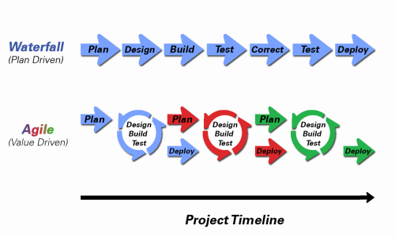
Position Object-Oriented Programming within Various Development Methodologies
Notes:
Development Methodology and Software Development Lifecycle (SDLC) are often used interchangeably.
The Iterative development methodology is not depicted here as even the mainstays and inventors of the Iterative development methodology seem to be moving toward agile. Plus as Waterfall “holdouts” move, they seem to be moving directly toward Agile.
Development Methodologies (SDLCs) are a future Bonus Topic. There is a optional slide and notes at the end of this deck.
Object oriented programming practices evolve and reprioritize depending on the development
In Waterfall (as well as in Iterative) object-oriented design often play a critical role in the (big upfront) design activities. UML diagrams and project artifacts are often important to the overall project success.
Practical reality has been that these design artifacts often do not reflect the actual implementation and are rarely maintained or updated.
The Agile practitioners do not reject these design artifacts. However, the focus on shorter time horizons, evolving architecture, and working code changes the value proposition for object-oriented practices to more focus on the build, test, enhance activities.
More later on Development Methodologies

Slide 4
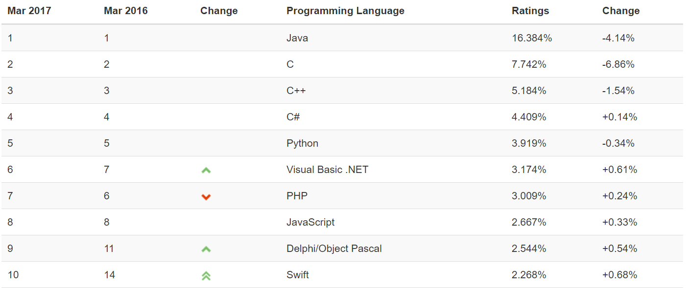
Review object-oriented languages and tools
The TIOBE index can be used to check whether your programming skills are still up to date or to make a strategic decision about what programming language should be adopted when starting to build a new software system. The full TIOBE is available online [Link].
TIOBE Index for March 2017:
Non-OOP Examples
Notes:
We will utilize mostly Java and C# for our object-oriented programming examples. We may or may not do any Python work. Since it is often ‘unnatural’ to show procedural programming examples in Java, C#, or Python, we will implement programs in C to demonstrate procedure programming examples.
Note that our reluctance to utilize C++ as a OOP learning tool is does not diminish the value of the C++ toolset. However, C++ is generally considered a very powerful set of tools with a steep learning curve. It’s a sharp knife… use it carefully.

Slide 5
Demonstrate object-oriented programming concepts with example
The body mass index (BMI) is a statistic developed by Adolphe Quetelet in the 1900’s for evaluating body mass. It is not related to gender and age. It uses the same formula for men as for women and children.
The body mass index is calculated based on the following formula:
BMI = weight [kg] / (height [m] * height [m])
Procedural BMI (body mass index):
Data:
Height
Weight
Procedures (or functions):
CalcBMI
Object-Oriented BMI:
Class BMI
Attributes
Height
Weight
Methods
CalcBMI
Notes:
I often start with definitions from Wikipedia and other sources.

Slide 6
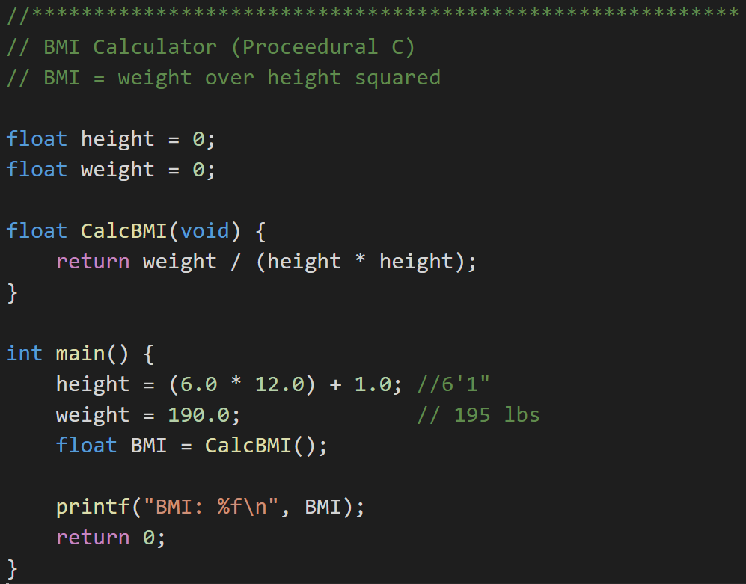
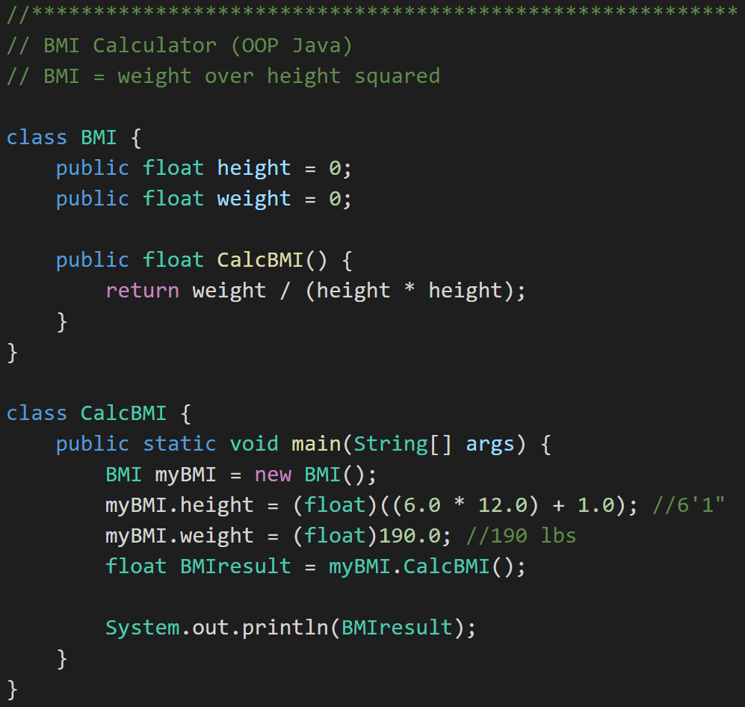
Example: Procedural vs. Object Oriented Programming
Procedural BMI (C):
Object Oriented BMI (Java):
Notes:
Do you see the logic issue? Hang onto that for a moment.

Slide 7
Distinguish between a class and an object
Procedural BMI:
Object Oriented BMI:
Notes:
Do you see the logic issue? Hang onto that for a moment.

Slide 8
Distinguish between a class and an object
Procedural BMI:
Object Oriented BMI:
Notes:
Do you see the logic issue? Hang onto that for a moment.

Slide 9
Week 1 Outcomes
Define object-oriented programming
Distinguish between a class and an object
Identify and define “six” object-oriented concepts
Identify the superclass and the subclass in an inheritance relationship
Demonstrate inheritance, ownership, and abstraction in snippets of Java code
Distinguish between aggregation and composition
Describe how object-oriented programming is fundamentally different
Justify the choice to use an object-oriented approach in developing software
Define and demonstrate the common software patterns
Depict classes and their relationships using UML class diagrams
Explain common design patterns
Identify and describe characteristics of bad software: rigidity, immobility, fragility

Slide 10
The Problem?
BMI formula assumes M (height) and KG (weight)
Procedural BMI:
Object Oriented BMI:
Notes:
Do you see the logic issue? Hang onto that for a moment.

Slide 11
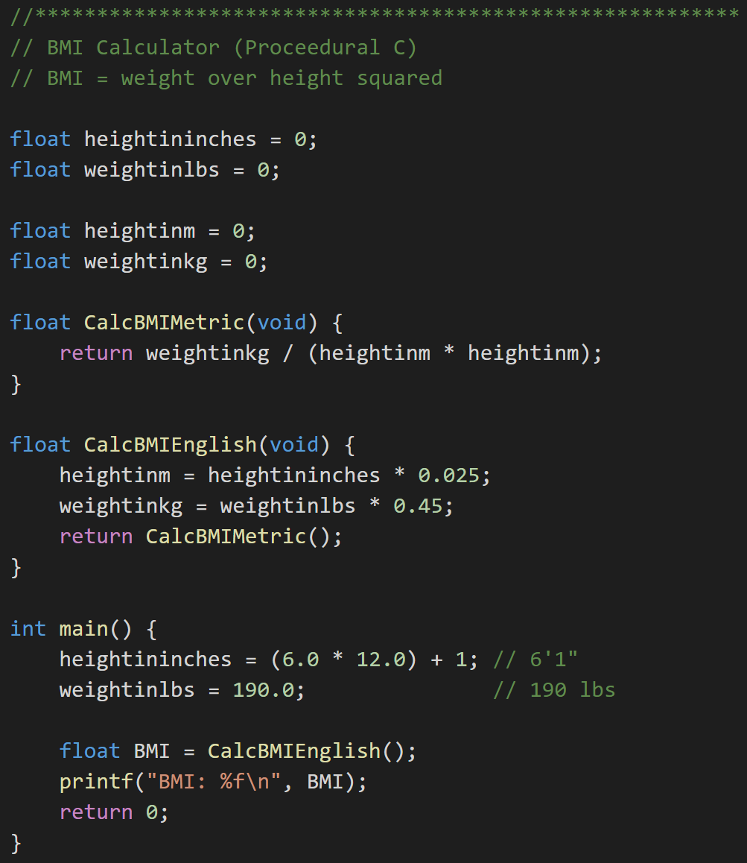
Revising BMI Implementations
Procedural BMI (revised):
Object Oriented BMI (revised):
Notes:
Now consider what it would be like to reuse this C procedural code. Important note: Object Oriented program is NOT necessarily optimized for writing new code. It IS optimized for reusing, supporting, testing, and enhancing code! How would this change if instead of ~20 lines of code, we have a thousand lines of code… or 10,000… or 1,000,000 lines? Software development and testing complexity grows exponentially as the size of the code grows.
Consider: : rigidity, immobility, fragility within the ongoing sdlc (software/systems development lifecycle)
Waterfall, Iterative, and Agile

Slide 12
Identify and define “six” (3plus) object-oriented concepts
Object-oriented concepts:
Encapsulation… and Information Hiding
Inheritance… and Abstraction
Polymorphism
Plus… Composition & Aggregation

Slide 13
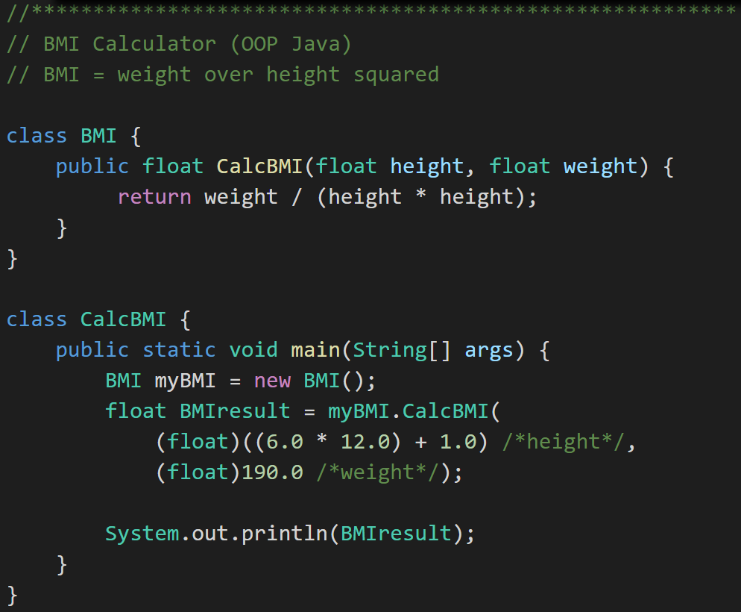
Encapsulation
Object Oriented BMI:
Encapsulated Object Oriented BMI:
Notes:
Consider: How would you add protective code around setting height to 0 in the first option? … in the second encapsulated example? Once again consider reuse, testing, and additional modification in thousands of lines off code.
Encapsulation is a feature of nearly all modern development languages… not just object-oriented languages.

Slide 14
Inheritance Options for Implement English BMI Units
Option #1:
Option #2:
BMI (metric)
BMI
BMI English
BMI Metric
BMI English
Notes:
Remember: Current implementation does not work with English units.

Slide 15
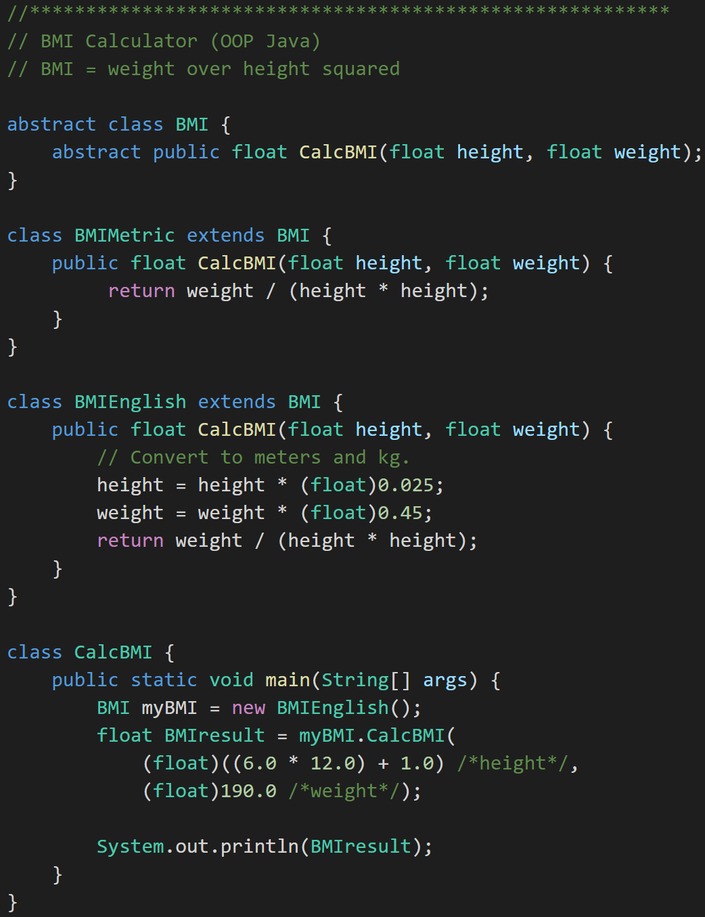
Inheritance to implement English units… And Abstraction
BMI
BMI Metric
BMI English
Notes:
Consider: How would you add protective code around setting height to 0 in the first option? … in the second encapsulated example? Once again consider reuse, testing, and additional modification in thousands of lines off code.
Encapsulation is a feature of nearly all modern development languages… not just object-oriented languages.

Slide 16
Week 1 Outcomes
Define object-oriented programming
Distinguish between a class and an object
Identify and define “six” object-oriented concepts
Identify the superclass and the subclass in an inheritance relationship
Demonstrate inheritance, ownership, and abstraction in snippets of Java code
Distinguish between aggregation and composition
Describe how object-oriented programming is fundamentally different
Justify the choice to use an object-oriented approach in developing software
Define and demonstrate the common software patterns
Depict classes and their relationships using UML class diagrams
Explain common design patterns
Identify and describe characteristics of bad software: rigidity, immobility, fragility

Slide 17
Identify the superclass and the subclass in an inheritance relationship
BMI
BMI Metric
BMI English
Superclass
Notes:
Consider: How would you add protective code around setting height to 0 in the first option? … in the second encapsulated example? Once again consider reuse, testing, and additional modification in thousands of lines off code.
Encapsulation is a feature of nearly all modern development languages… not just object-oriented languages.

Slide 18
Identify the superclass and the subclass in an inheritance relationship
BMI
BMI Metric
BMI English
Subclass
Notes:
Consider: How would you add protective code around setting height to 0 in the first option? … in the second encapsulated example? Once again consider reuse, testing, and additional modification in thousands of lines off code.
Encapsulation is a feature of nearly all modern development languages… not just object-oriented languages.

Slide 19
Identify the superclass and the subclass in an inheritance relationship
BMI
BMI Metric
BMI English
Abstraction
Notes:
Consider: How would you add protective code around setting height to 0 in the first option? … in the second encapsulated example? Once again consider reuse, testing, and additional modification in thousands of lines off code.
Encapsulation is a feature of nearly all modern development languages… not just object-oriented languages.

Slide 20
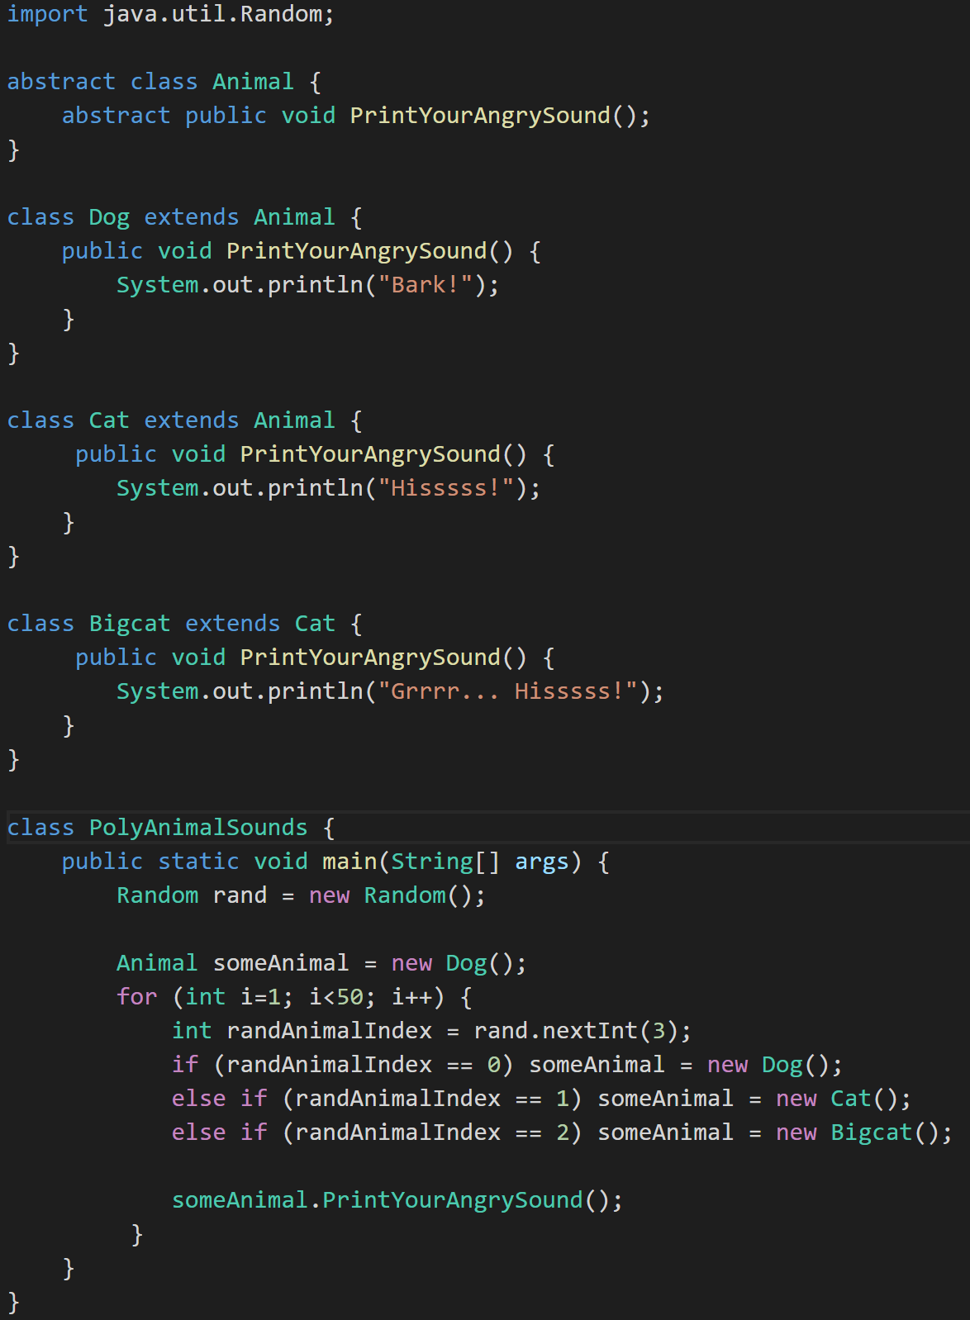
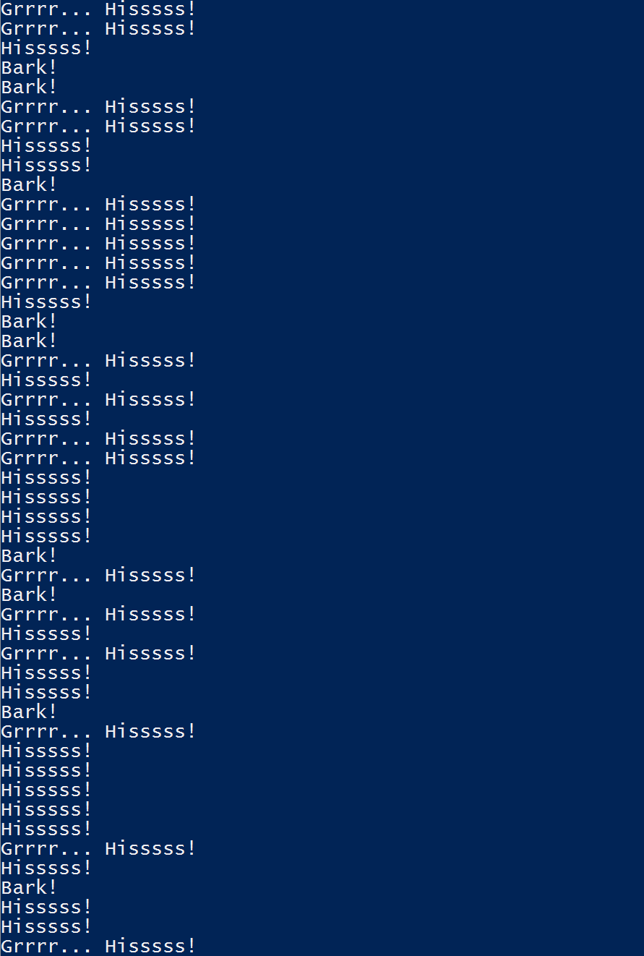
Polymorphism
Animal
Dog
Cat
Bigcat
Polymorphic

Slide 21
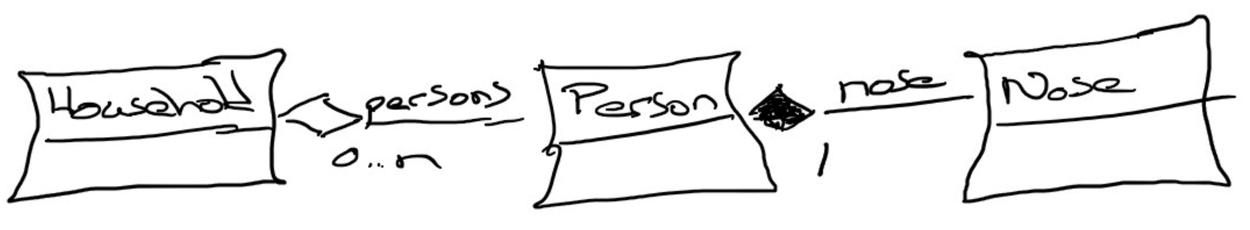
Composition & Aggregation
Composition: A relationship where an object will not exist without the parent object. For example, it is unlikely that the “Nose” object will exist after the “Person” object is gone.
Aggregation: A relationship where multiple objects will likely continue to exist independent of each other. For example, we might have a “Household” object and a “Person” object. It would be very reasonable to expect our “Person” object to continue to exist even if our “Household” object was deleted.
Our First UML:

Slide 22
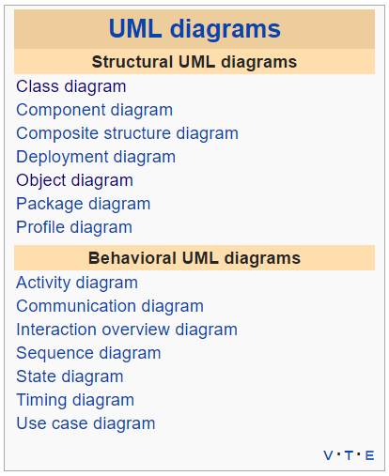
Unified Modeling Language [Link]
The Unified Modeling Language (UML) is a general-purpose, developmental, modeling language in the field of software engineering, that is intended to provide a standard way to visualize the design of a system.
For our purposes we will limit our UML usage to diagrams where:
Classes as boxes with three sections, the top of which specifies the name of the class, the middle of which specifies the data, and the bottom of which specifies the functions.
Lines between the classes.
A line with an arrow / triangle pointing to the parent – inheritance
A line with a filled diamond next to the owner – composition
A line with an open diamond next to the owner – aggregation
A line with no decorations – just an association (a using kind of relationship)
Notes:
UML can describe many different things and become quite complex. There is some debate, particularly in the Agile development methodology circles, as to the benefits of this documentation outweigh the cost. Most developers agree that at least a basic understanding of UML diagrams aids greatly in the impromptu “chalkboard” design discussions that occur constantly during the design, implementation, and testing of a project.
UML helps us see the design without having to wade through lots of text to understand it.

Slide 23
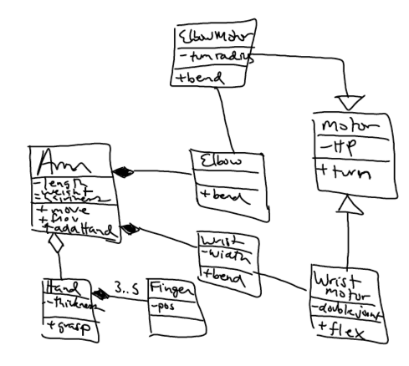
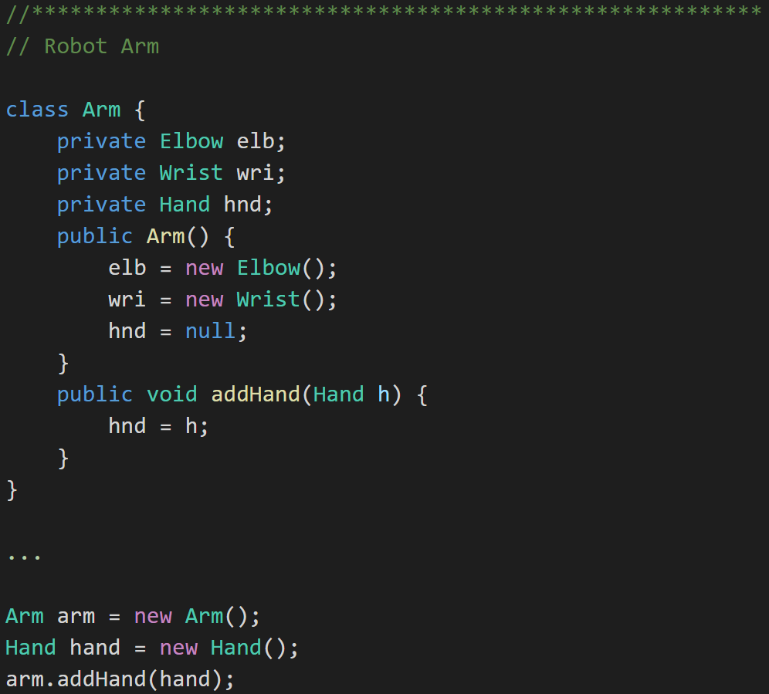
UML Example: Robot Arm
UML:
Java:
Notes:
UML can describe many different things and become quite complex. There is some debate, particularly in the Agile development methodology circles, as to the benefits of this documentation outweigh the cost. Most developers agree that at least a basic understanding of UML diagrams aids greatly in the impromptu “chalkboard” design discussions that occur constantly during the design, implementation, and testing of a project.
UML helps us see the design without having to wade through lots of text to understand it.

Slide 24
Explain common design patterns

Slide 25
Define and demonstrate the common software patterns

Slide 26
Identify and describe characteristics of bad software: rigidity, immobility, fragility

Slide 27
Describe how object-oriented programming is fundamentally different

Slide 28
Justify the choice to use an object-oriented approach in developing software

Slide 29
Bonus Slides
Waterfall vs Iterative vs Agile

Slide 30
Waterfall vs Iterative vs Agile
 | Waterfall | Iterative | Agile
References | United States Department of Defense: DOD-STD-2167A (1985) | Rational Unified Process (RUP) Open Unified Process | Scrum Kanban Scaled Agile Framework (SAFe)
Priorities | Planning and predictability | Architecture, modeling, and efficiency through early detection & fixing of issues | Responsiveness to feedback, efficiency through engineering practices, early detection & fixing of issues
Principles | Execute phases sequentially: Requirements Analysis Design Coding Testing and Operations Define and commit to Scope, Cost, and Timeline “early” Implement strict Change Control | Develop and test iteratively Manage requirements Use components Model visually Verify quality Control changes | Develop, test, deploy, and release iteratively Capture lightweight near term requirements Empower teams Allow requirements to evolve but maintain fixed timelines Apply engineering practices and systems thinking (e.g. TDD) Integrate early user feedback into remaining plan Maintain a collaborative approach between all stakeholders

Slide 31
Waterfall vs Iterative vs Agile (continued)
 | Waterfall | Iterative | Agile
Engineering Standards | None specified | Components and Modeling (UML) XP referenced periodically | XP DevOps
Optimization | Specialization & standardization based on skills, location, and/or technology | Architecture, modeling, and iterations | Fast customer feedback, small cross-functional teams, and working software
Planning Horizon Focus | Years – High Months – High Days – Low | Years – Medium Months – Medium Days – Medium | Years – Low Months – Medium Days – High
Scope and Requirements Management | Scope locked-in after Requirements Phase (approximately one-third through the project) | Requirements are stabilized during Elaboration Phase with smaller changes in later phases | Changes in requirements embraced utilizing lowest priority items as Scope buffer
Prevalent Issues | Timeline and cost overruns | Timeline and cost overruns | Reduced functionality release
Industry Success Rates | Low to Medium | Medium | Medium to High

Slide 32
Waterfall vs Iterative vs Agile (continued)
Optional
 | Waterfall | Iterative | Agile
Delivery Ownership | Ownership changes from role to role by phase with Project Manager being responsible for overall delivery | Project Manager responsible for completing iteration | Team centric with team responsible for delivery of working feature
Resource Utilization | Role and skill centric with tasks often being restricted to an individual or group | Role and skill centric with tasks often being restricted to an individual or group | Team centric with team members switching roles regularly
Status Reporting | Work progress (% complete) relative to plan | Work progress plus product features delivered by Iteration during Implementation | Product features demonstrated by Sprint and Iteration
Customer Feedback | At the end of the project when the product is released | At the end of the project plus internally with each iteration | At the end of each release and iteration plus internally with each sprint
Retrospection | After each release | After each iteration or milestone | After each sprint
Quality Control | Detection & fixing primarily last phase of project | Early detection & fixing in each iteration and in last phase of project | Early detection & fixing in each sprint followed by stabilization

