Slide 1

Object-Oriented Programming
Course Number: CPSC-24500
Week: 3
Instructor: Eric Pogue

Slide 2
Learning Objectives – Week 3
Explain the difference between lightweight and heavyweight components
Identify lightweight and heavyweight components
Describe how lightweight and heavyweight components render themselves
Explain what a layout manager does and identify and describe three of them
Specify layout managers for heavyweight and lightweight components
Use paint and paintComponent's Graphics object to draw a variety of shapes
Explain how to achieve true Model-View-Controller architecture by removing any reference from the view to the model and from the model to the view
Distinguish between extending a class and implementing an interface
Create an event handler that implements the ActionListener interface to respond to the user clicking on a button
Explain multiple ways to implement an event handler for a particular object and event (anonymous inner classes vs. named classes vs. having the frame itself serve as the handler)

Slide 3
**Learning Objectives – Week 3 / Session 1
Explain the difference between lightweight and heavyweight components
Identify lightweight and heavyweight components
Describe how lightweight and heavyweight components render themselves
Explain what a layout manager does and identify and describe three of them
Specify layout managers for heavyweight and lightweight components
Use paint and paintComponent's Graphics object to draw a variety of shapes
Explain how to achieve true Model-View-Controller architecture by removing any reference from the view to the model and from the model to the view
Distinguish between extending a class and implementing an interface
Create an event handler that implements the ActionListener interface to respond to the user clicking on a button
Explain multiple ways to implement an event handler for a particular object and event (anonymous inner classes vs. named classes vs. having the frame itself serve as the handler)

Slide 4
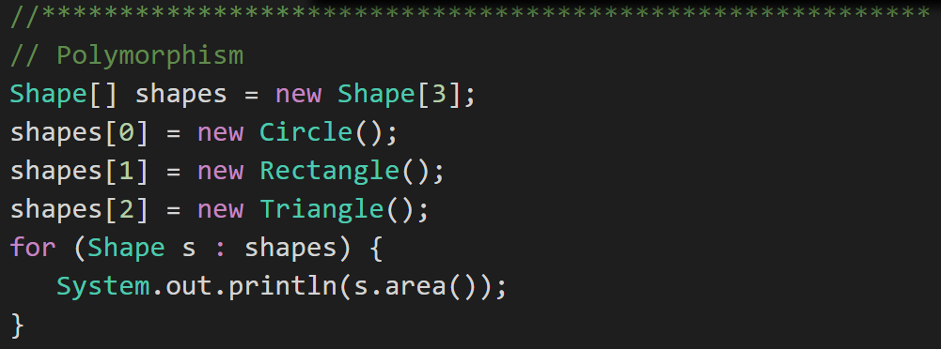
Lightweight and Heavyweight Components
Components: There are two kinds of graphics components in the Java programming language: heavyweight and lightweight. A heavyweight component is associated with its own native screen resource (commonly known as a peer). Components from the java.awt package, such as Button and Label, are heavyweight components.
Swing components depend less on the target platform and use less of the native GUI resource. Hence the Swing components that don't rely on native GUI are referred to as lightweight components. AWT components on the other hand are referred to as heavyweight components.
Notes:
These notes are from the Oracle site. There is also a nice article about on the Oracle site about mixing heavyweight and lightweight components at:
http://www.oracle.com/technetwork/articles/java/mixing-components-433992.html
Java platform graphics have been the Achilles heel of the Java platform since the mid-1990s. Programmers used to joke that AWT stood for Awful Windows Toolkit because the resulting applications were so slow to function and unpleasant to look at. IBM’s Standard Widget Toolkit (SWT) toolkit is an alternative to AWT and Swing that has taken root in the Eclipse Integrated Development Environment (IDE) world.
https://en.wikipedia.org/wiki/Standard_Widget_Toolkit
AWT and Swing are excellent learning tools; however, nearly all commercial user interface development has moved on to other tools and libraries. Native user interfaces or Web type interfaces using Java Script is seem to be the direction. Note: Java and Java Script have NOTHING to do with each other! It was completely a marketing ploy to give Java Script the Java name.

Slide 5
**Title
Title: Description

Slide 6
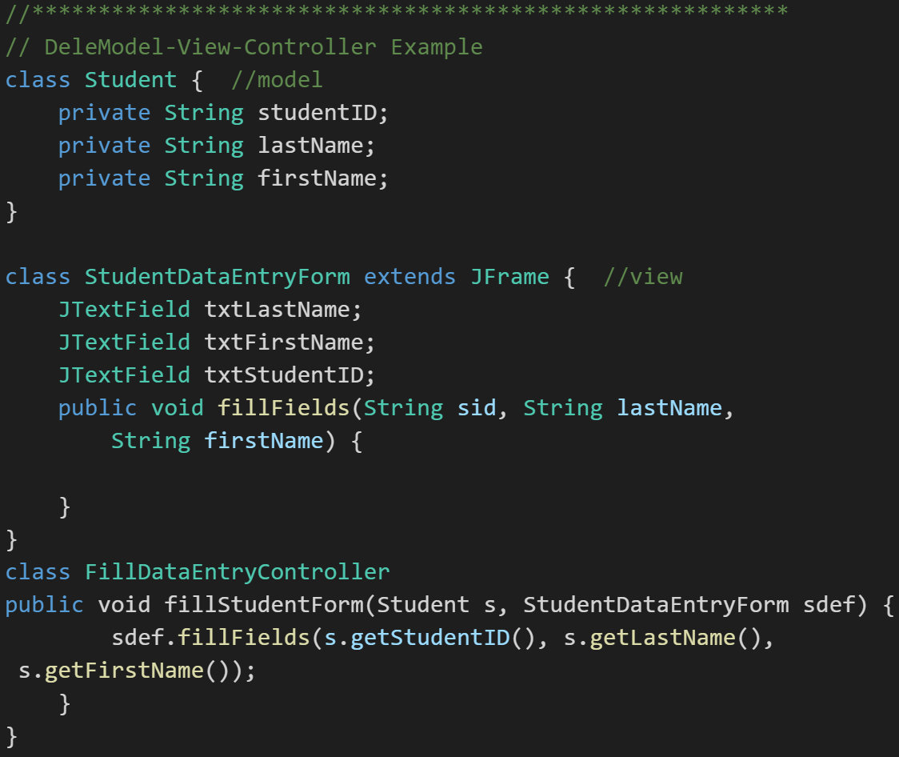
Model-View-Controller
Model-View-Controller (MVC): MVC is an important pattern, will be a primary focus of this course, and will be an important pattern for you to master in your career.
Segregation of our Model (data) from our View (user interface) is necessary to effectively develop, enhance, and maintain modern software.
Notes:
An example would be a system that manages student data. We would want to segregate the Model (data) from the View (UI) for several reasons including that there will likely be many different Views that access the same data including:
student view
faculty view
administrator view,
Web student view,
mobile student view, etc.
Evolution of UI and Data segregation
Document-View (View was responsible for View-Controller functionality)
Model-View-Controller
Model–View–Viewmodel
Learn this Pattern!

Slide 7
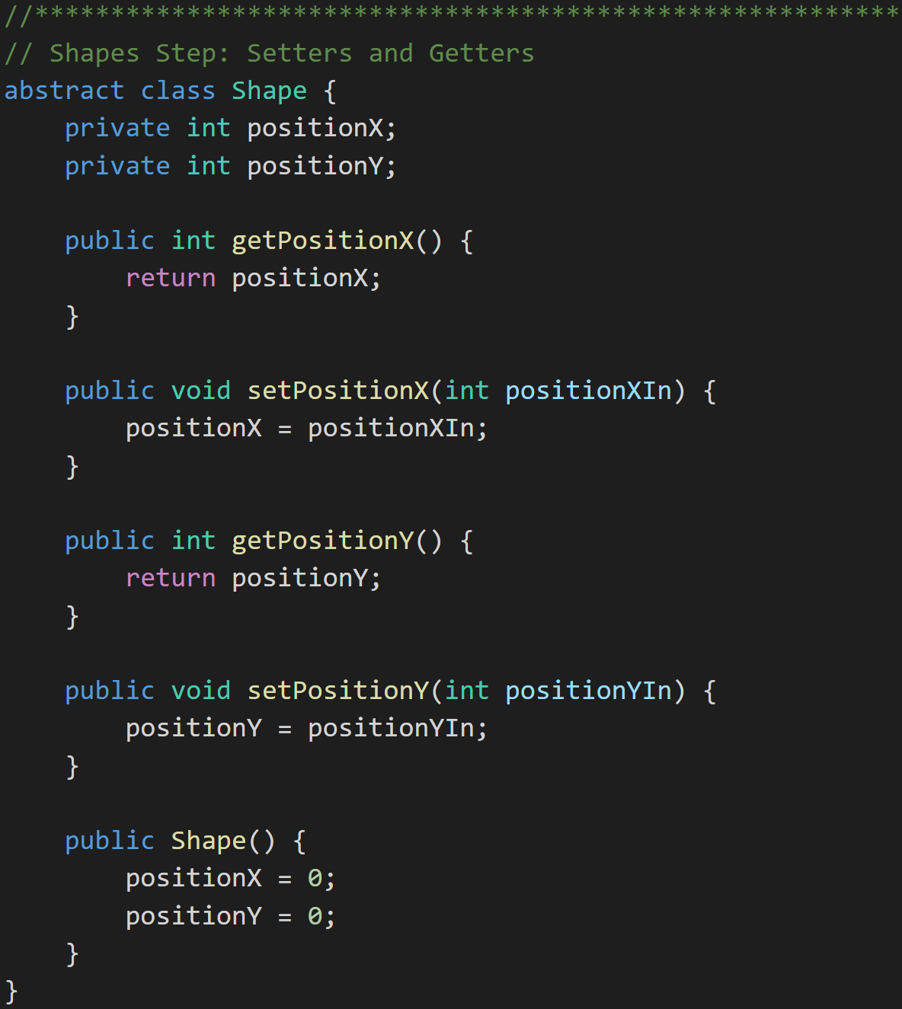
Encapsulation… and Setters & Getters
Setters and Getters:
Setters and Getters are a practice where public Methods are put in place to control how private Attributes are updated.
They can be beneficial in:
Validation
Optimization
Converting types (English to metric)
Debugging breakpoints
Some libraries expect setters and getters
Shapes with Setters and Getters:
Notes:
Why use Setters & Getters? Because 2 weeks (months, years) from now when you realize that your setter needs to do more than just set the value, you'll also realize that the property has been used directly in 238 other classes. (Internet quote)

Slide 8
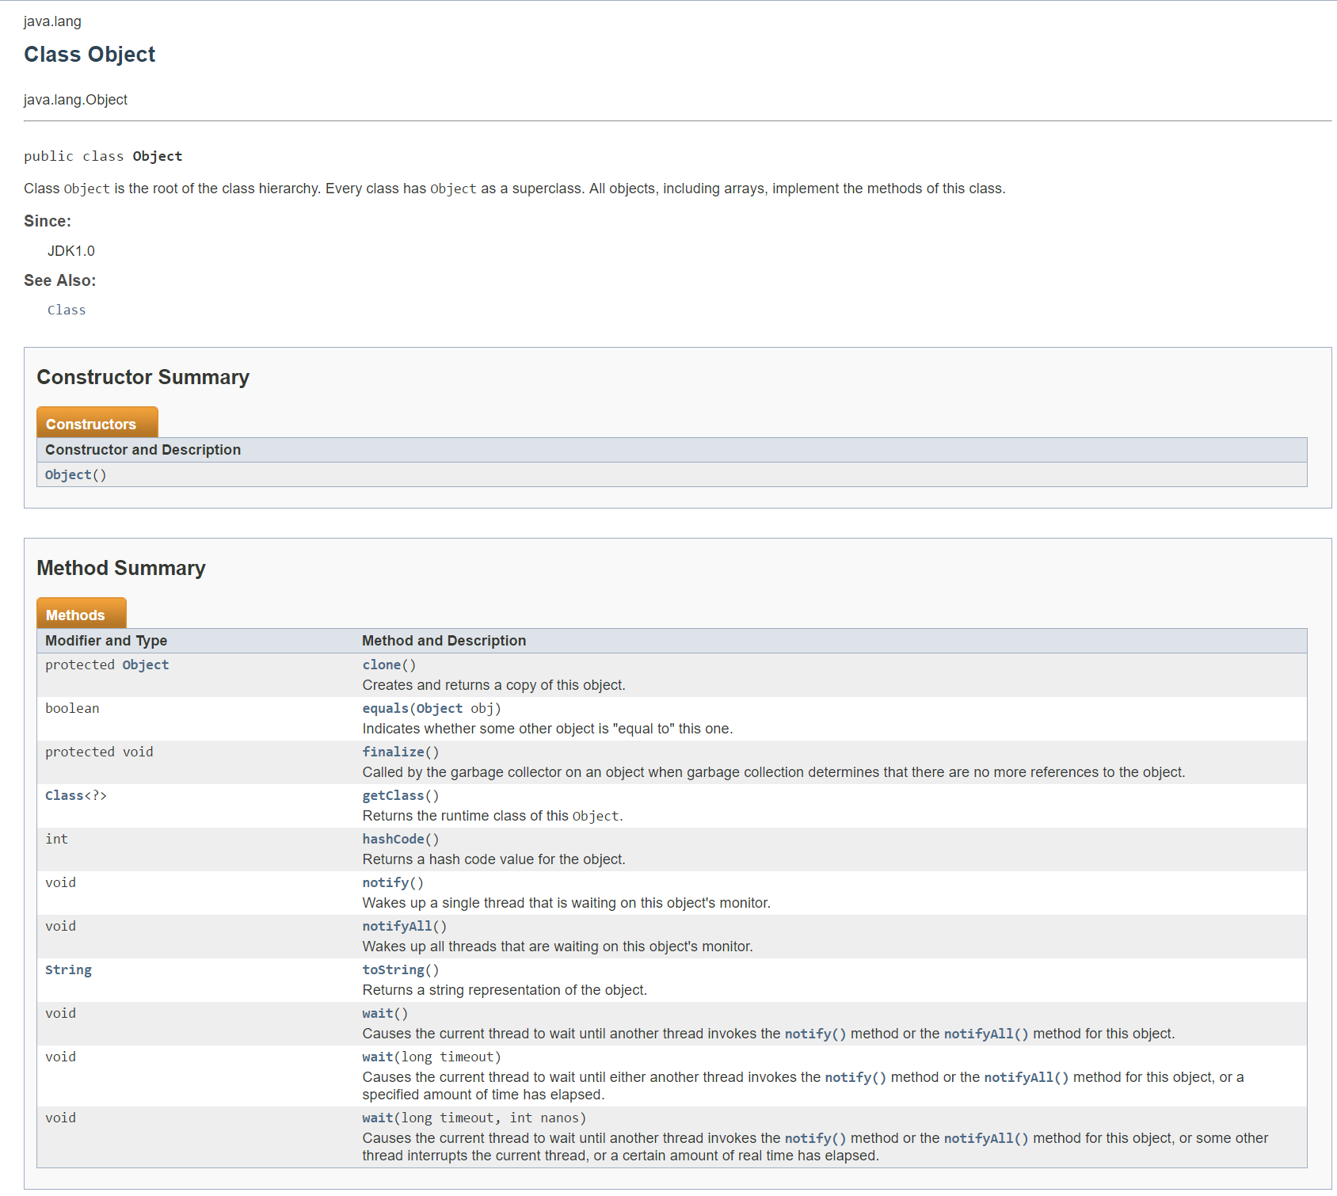
Java Root Class
java.lang.Object:
The Class named Object is the base class for ALL classes
It contains numerous methods including toString()
A little foreshadowing… the screen to the right was automatically generated using JavaDoc
Notes:
A package is a logical grouping of Java library classes. The java.lang package comes “for free” for all Java applications.
All java classes inherit from Object.
Note: Yes, I know, the terminology of having a base class called “Object” can be challenging. For our purposes objects are instances of classes. However we also recognize that the base Java class is also regrettably called “Object”. I will generally call it “the base java class” and not refer to it as “Object”.
Take note of the “toString()” method and recognize that EVERY java class can be expected to have a “toString” method. We will be overriding this method regularly in this week’s examples.

Slide 9
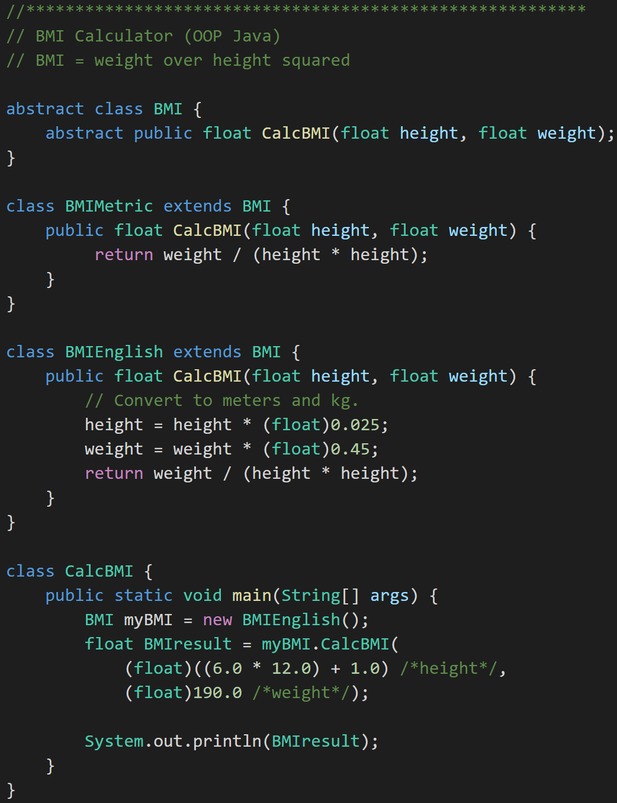
Overriding vs. Overloading
Overriding Method: Subclass implementing same method name and same parameters
Overloading Method: Same function name with different number of parameters. Only use this in specific situations like Constructors.
Overriding
Notes:
It’s regrettable that the naming is so close on these two concepts.
Method Overriding is what we have been doing as we create supperclasses and subclasses. We Override methods in the parent class to add functionality. For example, we overrode (override, overriding, overrode) the CalcBMI method of BMI when we implemented CalcBMI in BMIEnglish.
We will be Overriding methods constantly in this class. Overloading will be less common and less important, but we do need to understand what it is.
Overriding MUST have exactly the SAME parameters and return types.
Overriding MUST have at least one parameter or return type that is differenct.

Slide 10
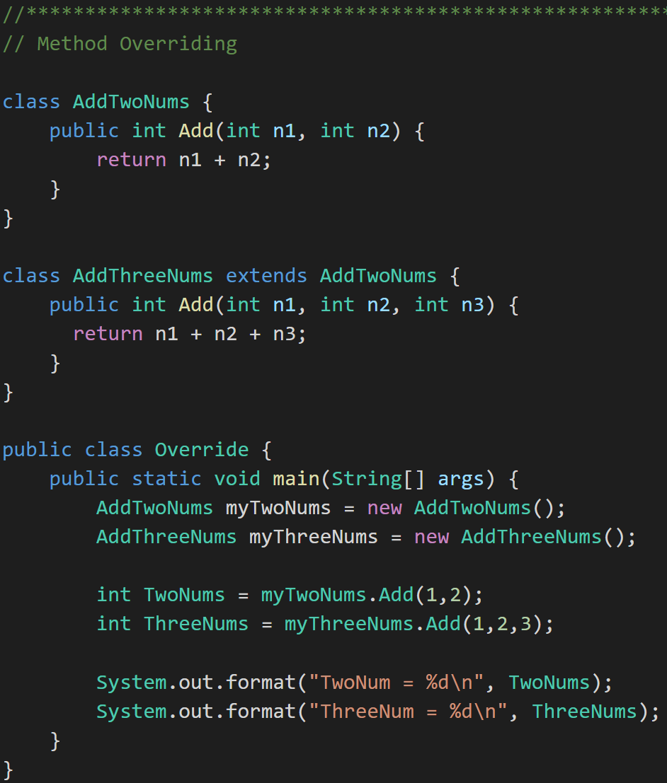
Overriding vs. Overloading
Overriding Method: Subclass implementing same method name and same parameters
Overloading Method: Same function name with different number of parameters. Only use this in specific situations like Constructors.
Overloading
Notes:
AddThreeNums overloads the Add method. It is important to understand Overloading; however, it is not as important or powerful as Overriding. Overloading is also only loosely related to object-oriented programming.
Note that we could have overloaded the Add method in AddTwoNums (without creating a subclass) and it still would be considered method overloading.

Slide 11
Java Environment Overview [link]
The Java Application Platform SDK includes:
Java API
Java Compiler (javac)
Java Runtime Environment (java)
Java Doc (Javadoc)
… And much much more.
Notes:
Java code (.java) –> Java compiler –> Java bytecodes – Java runtime Environment (JRE)
Java API is made up of LOTS of classes. Those classes are organized into Packages which are simply libraries of related classes.
JavaDoc example:
/**
This class does lots of good things.
@author Eric Pogue
*/
@author
@param
@return
Example: javadoc –d .\docs Shares.java

Slide 12
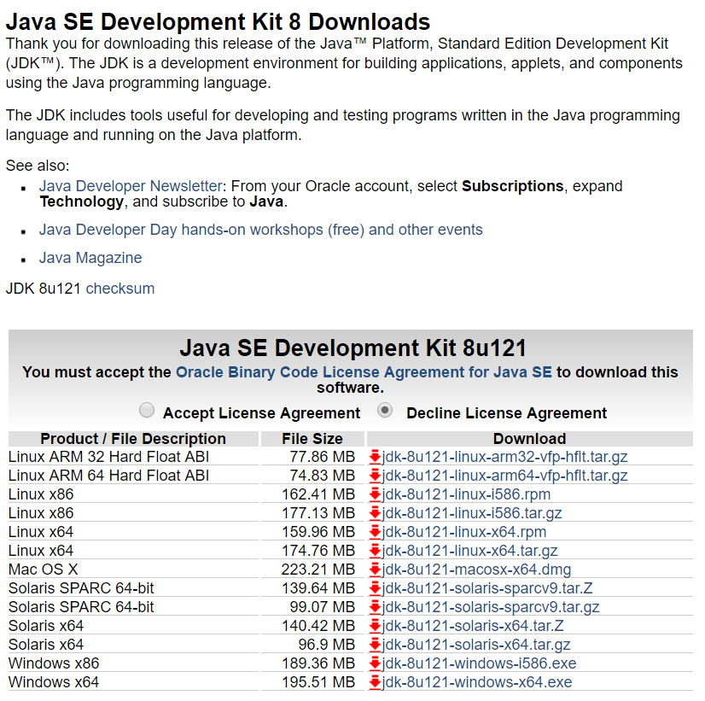
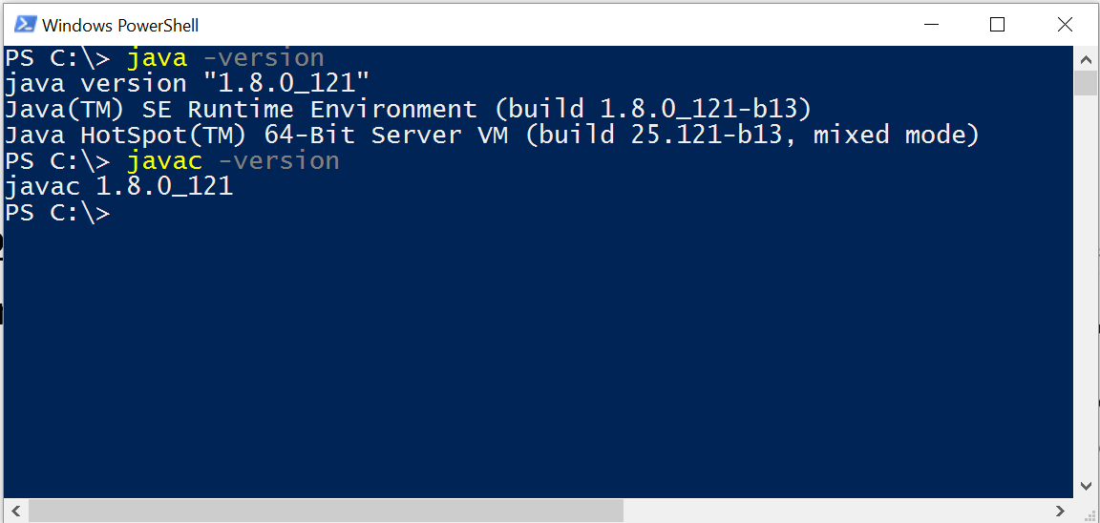
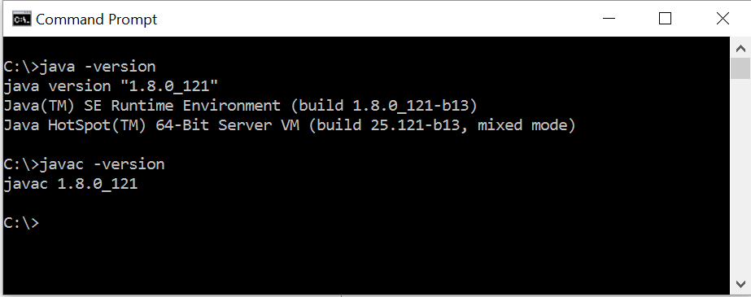
Install* Java Development Environment [link]
Standard Java tools for this class include:
Java SE Development Kit (SDK) 8 from Oracle
Text Editor
Notes:
We want to develop our understanding of object-oriented programming concepts, patterns, and principles in a way that is independent of any particular language or platform. However, in order to practice those concepts, patterns, and principles, we need to utilize at least one (and preferably several) language and environment.
If you don’t already have an appropriate Java development environment installed, you will need to install it. I would like you to actually set this up on your local computer and validate that it is installed properly. This will likely take quite a while depending on your internet download speed and if you run into any environment issues.
Steps:
#1: Select the appropriate Java SE install from the Oracle site:
http://www.oracle.com/technetwork/java/javase/downloads/jdk8-downloads-2133151.html
For example, I am using “Windows 10” and selected the “Windows x64” version.
#2: Validate your installation is installed properly and that you have access to the key tools. For examples, I am using the Windows 10 cmd prompt (and PowerShell) so I opened a command window and executed “java -version” and “javac -version” to verify the tools were in place.
Note that I did initially run into a “Path” challenge in Windows 10 where the prompt could not find the “javac” compiler. I found a pretty good YouTube video that showed how to update the Path to add the location of the “javac” compiler. It is located at: https://www.youtube.com/watch?v=Wp6uS7CmivE
You will want to verify you environment before implanting HelloWorld.

Slide 13
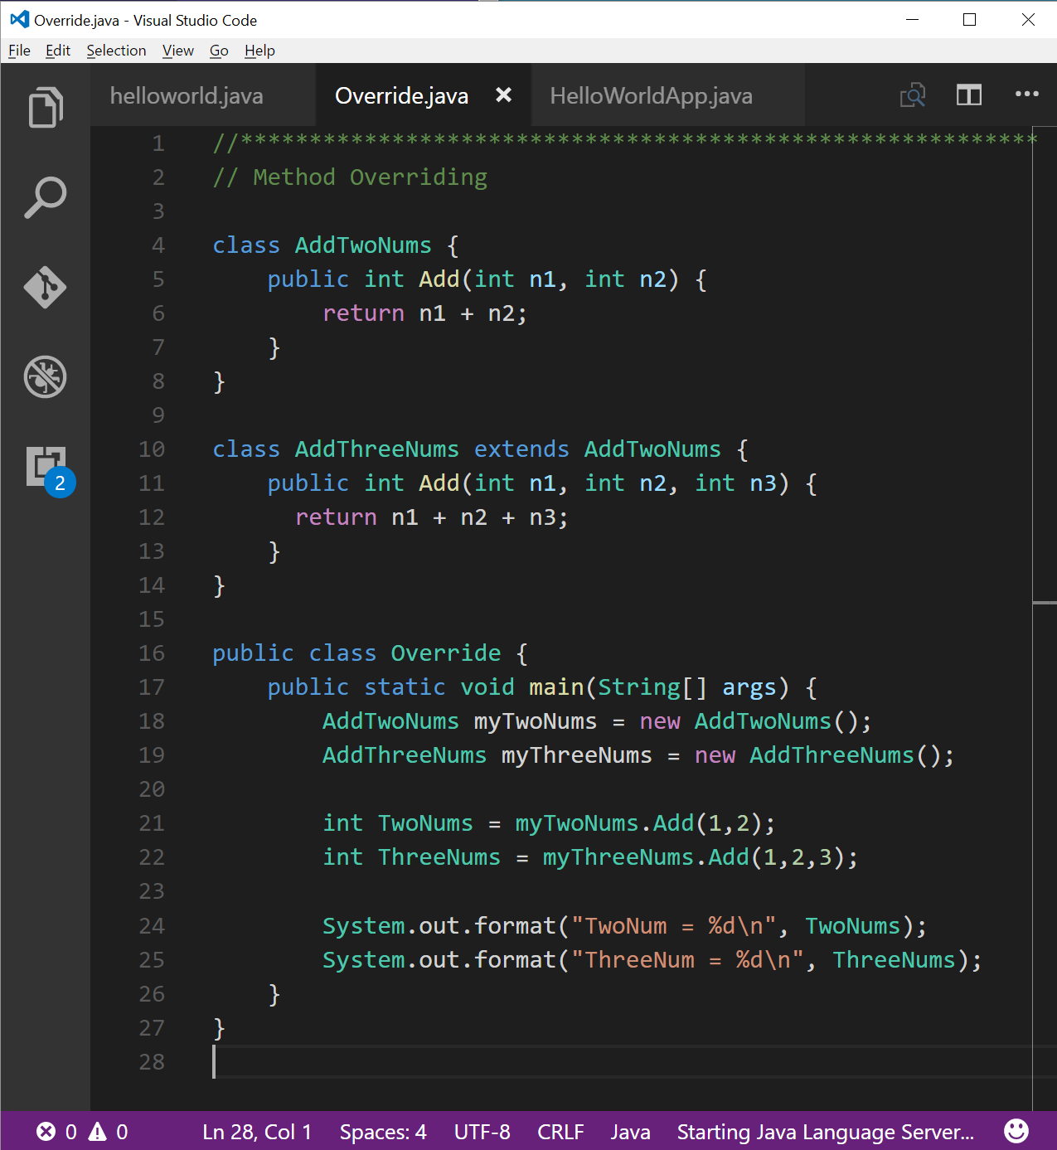
Install* Java Development Environment (continued)
Standard Java tools for this class include:
Java SE Development Kit (SDK) 8 from Oracle
Text Editor… Use any text editor you desire
Example: Microsoft Code [link]
Notes:
#3: Verify that your favorite text editor is working, or download the one you want to use.
For example, I have recently switched to using the Microsoft Code editor (note that it is cross platform and available for Mac and Linux). I have had mixed results, but if you want to use it, it is available for free download at:
http://code.visualstudio.com/
I will be using the command line Java JDK to review and grade your assignments. Make CERTAIN that the assignments you submit compile an run in this environments.

Slide 14
Java Integrated Development Environment
Source Code Editor (syntax highlighting, code completion, etc.)
Compiler
JRE
Debugger**
JavaDoc
Eclipse
Visual Studio
Notes:
We will likely take a look at Eclipse in the coming weeks; however, for now let’s focus on using just a text editor and command line tools.
Some editors have started introducing syntax highlighting, code completion, compilation integration, etc.
If you do want to install a Integrated Java Development Environment (Java IDE). It is best to install the JDK before installing IDE to be safe.

Slide 15
End of Session
Course Number: CPSC-24500
Week: 2
Session: 1
Instructor: Eric Pogue

