Slide 1

Object-Oriented Programming Session: Week 8 Session 1 Instructor: Eric Pogue
Agenda:
Review this week’s Assignments
Introduce the week’s Learning Objectives
Review Learning Objectives
Threading
Database
Network Programming
Review Session 1 Topics
Notes:
Our learning objectives from the syllabus assumed that we would not have focused quite so much on threading earlier in the session, so our threading discussion will be brief this week. Previous session of the course also focused somewhat more on database and SQL programming and a little less on network programming. With the continued expansion of Web Service and Cloud Computing in the industry, I am going to reverse that priority. We will still cover both topics; however, are focus will be Web Services and network programming while still recognizing the importance of databases.

Slide 2
Review Questions Assignment
Week 8 Questions Assignment [link]
Notes:
Week 7 Questions Assignment:
http://www.epogue.info/CPSC-24500/Week07/2017SpringW07QuestionsAssignment.docx

Slide 3
Review Programming Assignment
Week 8 Programming Assignment [link]
Notes:
Week 8 Programming Assignment:
http://www.epogue.info/CPSC-24500/Week08/2017SpringW08ProgrammingAssignment.pdf

Slide 4
Learning Objectives – Week 8
Describe what a thread is and why it can be useful to distribute tasks among multiple threads
Review our multi-threaded application development activities
Explain why it is important to synchronize threads that need to share data source access
Review Object Oriented Programming benefits including the associating Data & Functionality, Encapsulation & Information Hiding, Inheritance, and Polymorphism
Review databases, database servers, and the SQL language
Understand how databases support (or don’t support)work within a Object Oriented Programming environment
Understand client-server (two-tier), three-tier, and n-tier architectures
Introduce network programming concepts
Understand Web Services network programming
Develop a middle-tier data server using network programming
- We covered these topics in week 5/6 and week 1 respectively.

Slide 5
Performance Optimization and Threading
Performance is critical in application development… the focus of performance optimization continues to evolve, but the criticality remains very high! Multithreading is one very important way that we can optimize CPU performance; however, there are many other performance bottlenecks and optimization techniques:
CPU… threading
Memory… optimize disk usage, buy more memory
Disk IO… buffering, file size, or faster (more expensive) disks
Network bandwidth… “file” or package size
Network latency… pray for a miracle!
User Interaction and Capabilities
Notes:
I believe that performance optimization is one of the most important and challenging aspects of developing high quality software.
Consider mobile phone networks and satellite networks… and latency.
User experience.
Know the difference between latency and bandwidth and how it impacts network and application performance:
https://en.wikipedia.org/wiki/Network_performance
The following measures are often considered important:
Bandwidth commonly measured in bits/second is the maximum rate that information can be transferred
Latency the delay between the sender and the receiver decoding it, this is mainly a function of the signals travel time, and processing time at any nodes the information traverses
Throughput is the actual rate that information is transferred
Jitter variation in packet delay at the receiver of the information
Error rate the number of corrupted bits expressed as a percentage or fraction of the total sent
You can usually buy more bandwidth. Fixing a latency issue might require you to change the speed of light.

Slide 6
Threads & Multithreaded Applications
Multithreading: A technique by which a single set of code can be used by several processors or cores at different stages of execution.
Threads and application performance are becoming nearly synonymous
Moore’s law only remains achievable if we can effectively utilize multi-processor, multi-core, and multi-threaded applications
Our performance principles that we discuss will be applicable across platforms and environments
Our practical focus will be on Java multi-threading
Parallel processing has become the focus of the computing and software development industry
The rise of big data, artificial intelligence, virtual/augmented reality, and dedicated graphical processing units (GPUs) have made that a nearly guaranteed trend for years to come
Notes:
The difference between user perceived (real or perceived) is as important as actual performance. Optimizing application performance to reflect user capabilities is challenging and necessary. It doesn’t matter if you optimize an application to be 10 times faster if the bottleneck is how fast the user.
Multithreading is the primary method of optimizing CPU performance. It is unlikely to be of benefit if the bottleneck is elsewhere. For example, if you are disk bound, splitting your process into multiple threads is unlike to be of benefit.

Slide 7
Processors, Cores, and Threads
Computers have one or more Processors (CPUs)
Processors each have one or more Cores
Cores can create one or more Threads
An application running only on one thread of a dual cpu, quad-core, single thread can utilize only a portion of 1/8th of the processing power of that machine
Notes:
For this discussion we will using multithreading and multiprocessing terms synonymously for our purposes.
Modern central processing units (CPUs) are made up of cores. A core is like a mini-processor that works with its fellow cores to perform the work that applications request of the CPU. In the old days, a CPU had just one core, a single channel through which all requests would pass. This was how we optimized applications… CPU, memory, fast disk, slow disk. Today, though, with multiple CPUs and multiple cores, a CPU can pay attention to and do many things at once.
This architecture, in turn, allows today’s applications to perform multiple tasks at once. This ability is called multitasking. Multitasking enables an

Slide 8
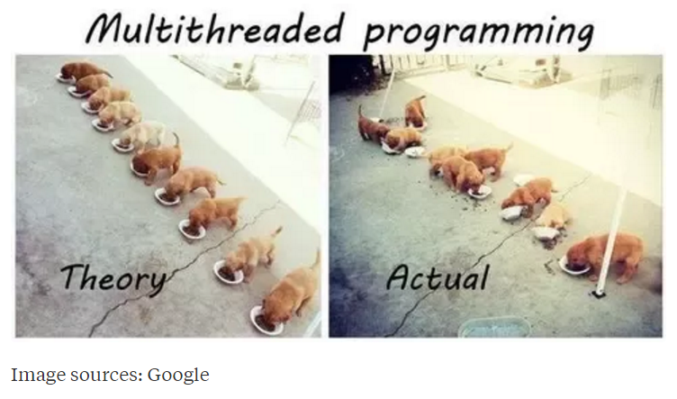
Multi-Threaded Development
Now for the bad news. Multi-Threaded Development is really hard!
Notes:
Rigidity - It is hard to change because every change affects too many other parts of the system
Fragility - When you make a change, unexpected parts of the system break
Immobility - It is hard to reuse in another application because it cannot be disentangled from the current application
Stadia add-in net change example.
Deadlock describes a situation where two or more threads are blocked forever, waiting for each other. Deadlock occurs when multiple threads need the same locks but obtain them in different order.

Slide 9
Multi-Threaded Development
Now for the bad news. Multi-Threaded Development is really hard!
Developing commercial quality multi-threaded applications makes Rigidity, Fragility, and Immobility much harder to avoid
Many of the 3rd party professional libraries that the industry had come to rely on came into question as multi-threading application became required
Testing becomes harder when a sequence of events becomes variable
What if your automated unit test results might be different depending on which thread finishes first?
What about deadlock?
Performance is so important that we will need to understand be able to effectively utilize, test, and deploy effective multi-threaded applications
Notes:
Rigidity - It is hard to change because every change affects too many other parts of the system
Fragility - When you make a change, unexpected parts of the system break
Immobility - It is hard to reuse in another application because it cannot be disentangled from the current application
Increased complexity is the primary disadvantage for developing multithreaded applications.
Some languages have come into existence in order to try to reduce the complexity of writing, enhancing, and supporting multithreaded applications. For example, Scala has implemented specific parallelization features in the core language that make it a first class threading language. Note that Scala also targets the Java runtime environment.
C++ would be an example of a language that has implemented a plethora of threading mechanisms for various platforms and implementations. Recent versions have introduced more common approaches.
Stadia add-in example.
Deadlock describes a situation where two or more threads are blocked forever, waiting for each other. Deadlock occurs when multiple threads need the same locks but obtain them in different order.
Interesting threading article:
http://blog.smartbear.com/programming/why-johnny-cant-write-multithreaded-programs/
When reviewing libraries look for something like “This class is immutable and thread-safe.” before you use it in multithreaded development.

Slide 10
FastPrime in C#
Write a performance optimized command line C# application that will programmatically find prime numbers and store those numbers sorted in an output file.
In FastPrime we will create a command line Java application that will:
Use multiple threads to find the prime numbers between two numbers
Sort those results and store them to a file
Perform some timings
… And do this all very fast
See the details in this week’s assignment

Slide 11
Learning Objectives – Week 8
Describe what a thread is and why it can be useful to distribute tasks among multiple threads
Review our multi-threaded application development activities
Explain why it is important to synchronize threads that need to share data source access
Review Object Oriented Programming benefits including the associating Data & Functionality, Encapsulation & Information Hiding, Inheritance, and Polymorphism
Review databases, database servers, and the SQL language
Understand how databases support (or don’t support)work within a Object Oriented Programming environment
Understand client-server (two-tier), three-tier, and n-tier architectures
Introduce network programming concepts
Understand Web Services network programming
Develop a middle-tier data server using network programming
Notes:
We are reviewing this so that we can relate it back to databases and client-server development.

Slide 12
Object-Oriented Programming [link]
Object-oriented programming (OOP) is a programming model based on the concept of "objects", which contain both Attributes (data) and Methods (procedures) that operate on that those attributes.
Most popular OOP languages are class-based, meaning that objects are instances of classes.
It includes concepts, patterns, and principles for designing and implementing modern software products.
Concepts – powerful features that prove indispensable to modern software development, brought to us automatically by object-oriented programming.
Patterns – tried-and-true templates for forging relationships between classes
Principles – guidelines that help you determine what classes are needed and how they should divide up the work
Notes:
I will often start with definitions from Wikipedia and other sources. If you are struggling with a topic and/or would like more information, it can often be valuable to review the references. You should be able to click on the [link] tag (possibly while holding the shift key down) in order open the reference in a browser. Please let me know if this is not working for you.
Walking through the slide, you will see that words and terminology will be important as we discuss and learn new concepts. During the course I am sure you will notice that at times I will struggle with the attribute/property vs. data and method vs. procedure distinction when I am talking. I would like for us to try to make that distinction in our work as we go through the term.
For the purposes of this class, “attributes” and “properties” will be used interchangeably to describe variable belonging to a class or object. Also “procedures” and “functions” will be used interchangeably.

Slide 13
The “six” (Three plus) Object-Oriented Concepts
Object-oriented concepts:
Encapsulation… and Information Hiding
Inheritance… and Abstraction
Polymorphism
Plus… Composition & Aggregation
Notes:
Helpful Interview Hint: Whenever you are asked a conceptual question about object-programming in an software development interview (and you will be), answer confidently “Encapsulation”, “Inheritance”, and “Polymorphism”.
When asked what is Encapsulation (or how would you implement it), say, “I would limit or minimize variable scope and keep data attributes private as often as possible.”
Now as we are going through our object-oriented examples, be thinking about how you would answer the “What is Inheritance?” and “What is Polymorphism?” interview questions. Note that answering them both with very brief examples can be very effective… and it is always best to use animals in you OOP interview examples.
Now we just need to make sure that we are able to effectively utilize these concepts after we get the job. Let’s start by walking through an example.

Slide 14
Encapsulation & Information Hiding
Encapsulation: Wrapping properties and methods into a class and minimizing the scope of those properties and methods.
Information Hiding: Minimize visibility/scope of data, attributes, functions, and methods.

Slide 15
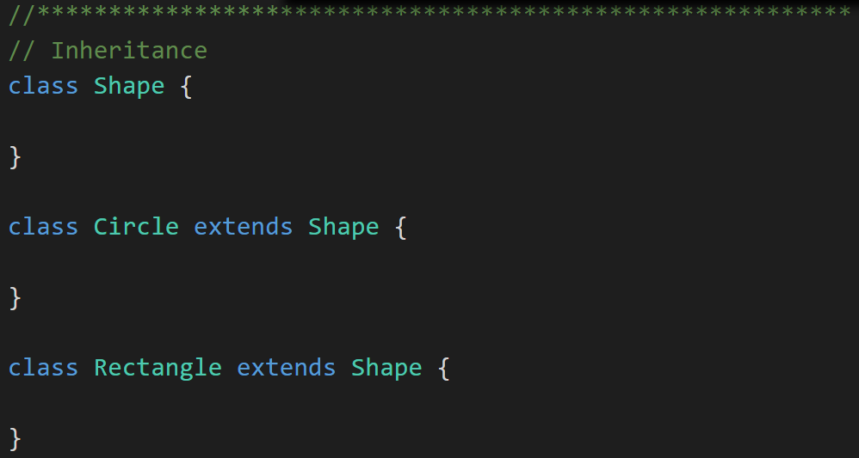
Inheritance & Abstraction
Inheritance: When one class acquires the properties and methods of another class it is called Inheritance.
Abstraction: Something is abstract when it is a concept but is not concrete or defined enough to actually be built. Generally, in OO design, we start with abstract things, and then we build on them through Inheritance.
Notes:
The first of many “Shape” examples. We will get to a Abstraction example in a few minutes.

Slide 16
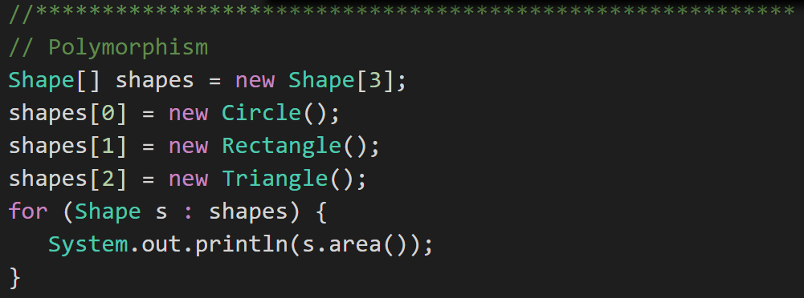
Polymorphism
Polymorphism: Polymorphism enables you to process collections of related things generically. This is particularly useful when you want to use a loop to march through a collection of items.
Notes:
Example of polymorphism: a for loop that moves through the entries of a list. The list might be of a collection of related kinds of object. We can refer to each of the objects in the list through a generic variable (whose data type matches the one that all are ultimately related to). But, when we invoke a particular function that all members of the family share, each will respond by performing that function in their own specific way. For example, we could have a collection of Shape objects. We could refer to each entry in the Shape list through a generic Shape variable, even though the actual entries in the list are specific kinds of shapes – Circle, Rectangle, etc. All Shape objects might have the ability to calculate their own area. When we refer to an object in the list through a generic Shape variable and tell it to calculate its area, thanks to polymorphism, the circle version of the area() function will be called when we’re dealing with a circle, and the Rectangle version of area() will be called when we’re dealing with a rectangle, etc.
The first time through the for loop, we’ll call the Circle.area() function – actually, we won’t; it will happen automatically. The next time through, we’ll call the Rectangle version, and then we’ll call the Triangle version.
Polymorphism is implemented behind the scenes using a Virtual Method Table (VMT). The VMT keeps track of where various related classes’ same-named functions are located in memory. Using the VMT, the operating system is able to figure out which code to implement when we tell each shape to fire its area() function.

Slide 17
Learning Objectives – Week 8
Describe what a thread is and why it can be useful to distribute tasks among multiple threads
Review our multi-threaded application development activities
Explain why it is important to synchronize threads that need to share data source access
Review Object Oriented Programming benefits including the associating Data & Functionality, Encapsulation & Information Hiding, Inheritance, and Polymorphism
Review databases, database servers, and the SQL language
Understand how databases support (or don’t support)work within a Object Oriented Programming environment
Understand client-server (two-tier), three-tier, and n-tier architectures
Introduce network programming concepts
Understand Web Services network programming
Develop a middle-tier data server using network programming
Notes:
We are reviewing this so that we can relate it back to databases and client-server development.

Slide 18
End of Session
Course Number: CPSC-24500
Week: 8
Session: 1
Instructor: Eric Pogue

Slide 19
Object-Oriented Programming Session: Week 8 Discussion & Lecture (session 2) Instructor: Eric Pogue
Agenda:
Thank you!
Quickly Review this Week’s:
To-do list
Programming Assignment
Questions Assignment
Review the week’s Learning Objectives
Continue with More Learning Objective Topics
Programming Examples preview

Slide 20
Learning Objectives – Week 8
Describe what a thread is and why it can be useful to distribute tasks among multiple threads
Review our multi-threaded application development activities
Explain why it is important to synchronize threads that need to share data source access
Review Object Oriented Programming benefits including the associating Data & Functionality, Encapsulation & Information Hiding, Inheritance, and Polymorphism
Review databases, database servers, and the SQL language
Understand how databases support (or don’t support)work within a Object Oriented Programming environment
Understand client-server (two-tier), three-tier, and n-tier architectures
Introduce network programming concepts
Understand Web Services network programming
Develop a middle-tier data server using network programming
Notes:
We are reviewing this so that we can relate it back to databases and client-server development.

Slide 21
Data Bases [link]
A database is an organized collection of data. It is the collection of schemas, tables, queries, views, and other objects. The data are typically organized to model aspects of reality in a way that supports business processes requiring information.
A database management system (DBMS) is a application that interacts with the user, other applications, and the itself to capture and manage data. A general-purpose DBMS is designed to allow the definition, creation, querying, update, and administration of databases. Well-known DBMSs include MySQL, PostgreSQL, Microsoft SQL Server, Oracle, Sybase, SAP HANA, and IBM DB2.
Schemas – defines that data constraints and definitions for tables and fields
Tables – collection of related data held in a structured format that consists of columns and rows
Views & Queries – used to create more easily accessible relationships without modifying the underlying physical schema
Notes:
I will often start with definitions from Wikipedia and other sources. If you are struggling with a topic and/or would like more information, it can often be valuable to review the references. You should be able to click on the [link] tag (possibly while holding the shift key down) in order open the reference in a browser. Please let me know if this is not working for you.
Databases and Database Management Systems (DBMS) are a HUGE topic and one of the cornerstones of most IT organizations. We are just going to be touching the surface today.
We often inadvertently refer to database management systems as databases. We should try to be specific in our conversation. In addition, we generally use the term database and DBMS to infer a relational database.
Databases are generally not portable between DBMS systems. However, a level of portability can be obtained by utilizing industry standard tools and languages like SQL.
Spreadsheets are often used… inappropriately in many cases.
A database is not generally portable across different DBMSs, but different DBMS can interoperate by using standards such as SQL and ODBC or JDBC to allow a single application to work with more than one DBMS. Database management systems are often classified according to the database model that they support; the most popular database systems since the 1980s have all supported the relational model as represented by the SQL language.
We generally attempt model our databases so that that they reflect real-world relationships. Optimal database design and optimal object-oriented design often diverge. When they do, you will need to make a judgement call.
Normalization vs De-normalization:
https://en.wikipedia.org/wiki/Database_normalization

Slide 22
Database Normalization [link]
Database Normalization, or simply normalization, is the process of organizing the columns (attributes) and tables (relations) of a relational database to reduce data redundancy and improve data integrity.
Normalization is also the process of simplifying the design of a database so that it achieves the optimum structure. It reduces and eliminates redundant data. In normalization, data integrity is assured. It can also cause a performance tradeoff.
It may be important when you are doing object-modeling in your application to consider the database relationships and normalizing that will be important.

Slide 23
Database Normalization Example:
Consider the non-normalized and normalized table structure for a simple “checkbook” transaction database:

Slide 24
Phone Number Database Example
For example, a PhoneNumber database could be set up with two Tables. One table of Names and the other table of PhoneNumbers. For this simple example we might end up with something like:
Schemas: Two tables one called Names and one called PhoneNumbers, text will be stored in UTF-8, we will allow duplicates, and set an index on Names.FirstName and Names.LastName.
Names Table: Three fields including FirstName and LastName of UTF-8 text, maximum length 40 characters, and can not be NULL. The third field will be an autoincrement unique ID that is an integer and does not allow duplicates. All three fields would be indexed for fast searching.
PhoneNumbers Table: Four fields including CountryCode, AreaCode, and Number which are all UTF-8 strings that can only contain numbers. Maximum lengths for each are 2, 3, and 7 respectively. The fourth field will be the unique ID of the person associated with the phone number. CountryCode can be NULL, other fields cannot. Fields will not be indexed as it will be rare that we have a phone number and want to lookup the person.
Views & Queries – A query that Joins a set of Names to all of their respective phone numbers and shows that in a view would be valuable.

Slide 25
Structured Query Language (SQL) [link]
Structured Query Language or SQL is a domain-specific language used in programming and designed for managing data held in a relational database management systems. SQL was initially developed at IBM by Donald D. Chamberlin and Raymond F. Boyce in the early 1970s.
Data Definition Language (DDL) – manages the table and index structure with common terms including CREATE, ALTER, RENAME, and DROP
Queries – The most common operation in SQL makes use of the SELECT statement and generally includes a WHERE clause
Many others…
Notes:
I will often start with definitions from Wikipedia and other sources. If you are struggling with a topic and/or would like more information, it can often be valuable to review the references. You should be able to click on the [link] tag (possibly while holding the shift key down) in order open the reference in a browser. Please let me know if this is not working for you.
Databases and Database Management Systems (DBMS) are a HUGE topic and one of the cornerstones of most IT organizations. We are just going to be touching the surface today.
We often inadvertently refer to database management systems as databases. We should try to be specific in our conversation. In addition, we generally use the term database and DBMS to infer a relational database.
Databases are generally not portable between DBMS systems. However, a level of portability can be obtained by utilizing industry standard tools and languages like SQL.
Spreadsheets are often used
Student
Course
Semester
Room
Prerequisite Courses
A database is not generally portable across different DBMSs, but different DBMS can interoperate by using standards such as SQL and ODBC or JDBC to allow a single application to work with more than one DBMS. Database management systems are often classified according to the database model that they support; the most popular database systems since the 1980s have all supported the relational model as represented by the SQL language.
Relationships are based on the shaping of columns between col
Table definition
guidelines that help you determine what classes are needed and how they should divide up the work
such as modelling the availability of rooms in hotels in a way that supports finding a hotel with vacancies.
Natural relationship among different parts of the data

Slide 26
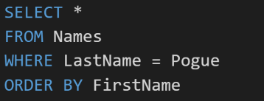
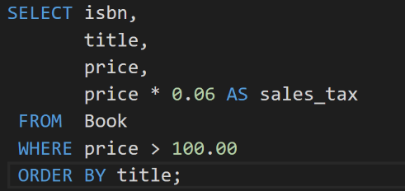
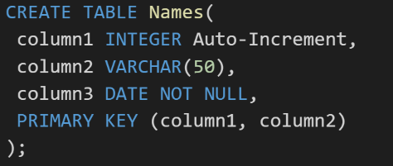
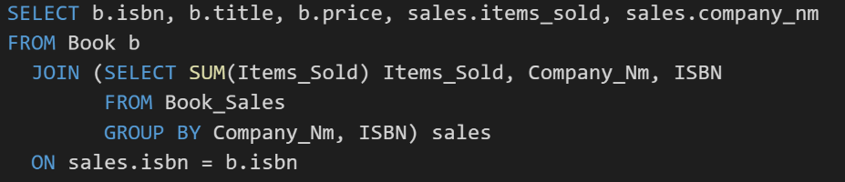
SQL Examples
Notes:
Very powerful language for managing data and is often used as an “embedded” language from within other environments like Java, C#, and Python.

Slide 27
Data Base Management Systems Pro & Cons
Many of the most powerful DBMS strengths can also be their greatest weaknesses… particularly as it come to object-oriented development:
Independent Data… vs Combining Functionality & Data
Ubiquitous access… vs Encapsulation and Data Hiding
Tables & Relationships… vs Inheritance
Joining Tables to Create Relationships… vs Polymorphism
Relationship Modeling… vs Object Modeling
SQL… vs Java or C# or Python

Slide 28
Data Base Management Systems with OOP
Live in harmony. Embrace the database while keep a focus on OOP concepts:
Store your data in a database
Enforce all important relationships in the database
Differentiate enterprise or shared data from application specific data… keep the shared data as small as is reasonable and have a separate person/team manage the shared data
Don’t utilize two-tier client-server architectures for anything more than small scale (less than 8 local users) application
… And be very very careful about using tools that automate the connection between you two-teir view elements and their associated database elements
Recombine you data, and functionality by creating three-tier application for more important applications
Don’t try to “automate” your object model to relationship model conversions
Never, never, never uses “smart” or cute naming conventions to represent relationships!

Slide 29
Two-tier and Three-tier Architectures
Application 1
Application 2
Application 3
Application 4
“Smart Naming”
Database 1
Database 2
Database 3
Database 4
Replication
Notes:
Replication is most often a bad idea.
“Smart Naming”

Slide 30
Two-tier and Three-tier Architectures
Application 1
Application 2
Database 1
Database 2
Notes:
Replication is most often a bad idea.
“Smart Naming”

Slide 31
Two-tier and Three-tier Architectures
Application 1
Application 2
Application 3
Application 4
Database 1
Database 2
Database 3
Database 4
Share Data APIs
Shared Database
Shared Database
Shared Database
Notes:
Cross-platform Enforced Encapsulation & Data Hiding!
Security
Sharing of business logic and processes.
Interface Inheritance
Very little benefit in Implementation Inheritance or Polymorphism

Slide 32
Two-tier and Three-tier Architectures
Application 1
Application 2
Application 3
Application 4
Share Data APIs
Shared Database
Database 1
Database 2
Shared Database
Database 3
Database 4
Shared Database

Slide 33
ShapeDrawDataServer Architecture
ShapeDraw
ShapeDraw
ShapeDrawDataServer (APIs)
ShapesXML
ShapeColorsXML
ShapesXML
ShapeColorsXML
Notes:
Replication is most often a bad idea.
“Smart Naming”

Slide 34
Review… Data Base Management Systems with OOP
Live in harmony. Embrace the database while keep a focus on OOP concepts:
Store your data in a database
Enforce all important relationships in the database
Differentiate enterprise or shared data from application specific data… keep the shared data as small as is reasonable and have a separate person/team manage the shared data
Don’t utilize two-tier client-server architectures for anything more than small scale (less than 8 local users) application
**… And be very very careful about using tools that automate the connection between you two-teir view elements and their associated database elements
Recombine you data, and functionality by creating three-tier application for more important applications
**Don’t try to “automate” your object model to relationship model conversions
**Never, never, never uses “smart” or cute naming conventions to represent relationships!

Slide 35
Learning Objectives – Week 8
Describe what a thread is and why it can be useful to distribute tasks among multiple threads
Review our multi-threaded application development activities
Explain why it is important to synchronize threads that need to share data source access
Review Object Oriented Programming benefits including the associating Data & Functionality, Encapsulation & Information Hiding, Inheritance, and Polymorphism
Review databases, database servers, and the SQL language
Understand how databases support (or don’t support)work within a Object Oriented Programming environment
Understand client-server (two-tier), three-tier, and n-tier architectures
Introduce network programming concepts
Understand Web Services network programming
Develop a middle-tier data server using network programming
Notes:
We are reviewing this so that we can relate it back to databases and client-server development.

Slide 36
Three-Tier Architecture Protocols & Formats
Three-Tier application architectures can use a variety of network protocols and formats including::
TCP/IP: Transmission Control Protocol / Internet Protocol
Sockets: Another term for TCP/IP
HTTP: Hypertext Transfer Protocol
HTTPs: Hypertext Transfer Protocol Secure
SSL: Secure Sockets Layer
XML or JSON: Extensible Markup Language
SQL
Aggregated Protocol Standards:
SOAP: Simple Object Access Protocol (HTTP/HTTPs/Sockets with XML)
REST: Representational State Transfer (HTTP/HTTPs with JSON)

Slide 37
ShapeDrawDataServer
Three-Tier application architectures can use a variety of network protocols and formats including::
TCP/IP: Transmission Control Protocol / Internet Protocol
Sockets: Another term for TCP/IP
HTTP: Hypertext Transfer Protocol
HTTPs: Hypertext Transfer Protocol Secure
SSL: Secure Sockets Layer
XML: Extensible Markup Language
SQL

Slide 38
ShapeDrawDataServer Architecture
ShapeDraw
TCP/IP: Transmission Control Protocol / Internet Protocol
Sockets: Another term for TCP/IP
ShapeDrawDataServer (APIs)
HTTP: Hypertext Transfer Protocol
XML: Extensible Markup Language
ShapesXML
ShapeColorsXML

Slide 39
Review ShapeDrawDataServer
Week 8 Programming Assignment [link]
Notes:
Week 8 Programming Assignment:
http://www.epogue.info/CPSC-24500/Week08/2017SpringW08ProgrammingAssignment.pdf

Slide 40
Object-Oriented Programming Session: Week 8 Session 3 Preview Instructor: Eric Pogue
ShapeDrawDataClient Application:
Develop application entirely in Visual Studio 2017 and C#
Take in one command line argument that is command to pass to ShapeDrawDataServer
Initiate a socket call to the server passing the command
Write out the response received from the sever
Wait for the user to press a key before shutting down… so that we can look at the response.

Slide 41
Object-Oriented Programming Session: Week 8 Session 4 Preview Instructor: Eric Pogue
ShapeDrawDataServerStart Application:
Develop application entirely in Visual Studio 2017 and C#
Listen for a socket request
Respond with “Hello World!!!”
Provide starting point for ShapeDrawDataServer and “get-shapeandcolors;” request
You may utilize this code as the starting point for your Week 8 assignment
Notes:
Starting point means that you should fully understand the code, but you can use it verbatim. You still must fix any errors or warning to get full credit.

Slide 42
End of Session
Course Number: CPSC-24500
Week: 8
Session: 2
Instructor: Eric Pogue

Slide 43
Object-Oriented Programming Session: Week 8 Session 3 Instructor: Eric Pogue
ShapeDrawDataClient Application:
Develop application entirely in Visual Studio 2017 and C#
Take in one command line argument that is command to pass to the server
Initiate a socket call to the server passing the command
Write out the response received from the sever to the console
Accept multiple requests as console input
Close the application when the user enters “end;” as console input

Slide 44
End of Session
Course Number: CPSC-24500
Week: 8
Session: 3
Instructor: Eric Pogue

Slide 45
Object-Oriented Programming Session: Week 8 Session 4 Instructor: Eric Pogue
Agenda:
Review Week 8 Learning Objectives
Develop ShapeDrawDataServerStart Application
Review ShapeDrawDataClient Application
Test ShapeDrawDataClient and Server together
Next Steps

Slide 46
Learning Objectives – Week 8
Describe what a thread is and why it can be useful to distribute tasks among multiple threads
Review our multi-threaded application development activities
Explain why it is important to synchronize threads that need to share data source access
Review Object Oriented Programming benefits including the associating Data & Functionality, Encapsulation & Information Hiding, Inheritance, and Polymorphism
Review databases, database servers, and the SQL language
Understand how databases support (or don’t support)work within a Object Oriented Programming environment
Understand client-server (two-tier), three-tier, and n-tier architectures
Introduce network programming concepts
Understand Web Services network programming
Develop a middle-tier data server using network programming
Notes:
We are reviewing this so that we can relate it back to databases and client-server development.

Slide 47
ShapeDrawDataServer Architecture
ShapeDraw
DataClient
ShapeDraw
TCP/IP: Transmission Control Protocol / Internet Protocol
Sockets: Another term for TCP/IP
ShapeDrawDataServer (APIs)
HTTP: Hypertext Transfer Protocol
XML: Extensible Markup Language
ShapesXML
ShapeColorsXML

Slide 48
Object-Oriented Programming Session: Week 8 Session 4 Instructor: Eric Pogue
ShapeDrawDataServerStart Application:
Develop application entirely in Visual Studio 2017 and C#
Listen for a socket request
Test Server and Client together
Reiterate that you may utilize this code as the starting point for your Week 8 assignment
Next Steps

Slide 49
End of Session
Course Number: CPSC-24500
Week: 7
Session: 4
Instructor: Eric Pogue

Slide 50
Object-Oriented Programming Session: Week 8 Session 5 Instructor: Eric Pogue
ShapeDrawDataServerLite Application:
Develop application entirely in Visual Studio 2017 and C#
Download and compile ShapeDrawDataClient
Create a new ShapeDrawDataServerLite application
Copy and past ShapeDrawDataServerStart into “Lite”
Compile, run, and test “Lite”
Implement EJPShape and EJPShapeModel from Week 7
Download and parse InternetShapeDraw.xml
Create empty EJPColorModel class that always returns “blue”… you will need to download and parse the ShapeDrawColors.xml file as part of your assignment
Return a subset of the xml that will be needed for the assignment

Slide 51
ShapeDrawDataServer Architecture
ShapeDraw
DataClient
ShapeDraw
TCP/IP: Transmission Control Protocol
Sockets: Another term for TCP/IP
ShapeDrawDataServer (APIs)
HTTP: Hypertext Transfer Protocol
XML: Extensible Markup Language
ShapesXML
ShapeColorsXML

Slide 52
End of Session
Course Number: CPSC-24500
Week: 8
Session: 5
Instructor: Eric Pogue

