Slide 1

Web and Distributed Programming Session: Week 1 Session 1 Instructor: Eric Pogue
Agenda:
Friendly Conversation & Good Natured Banter… let’s make sure that everyone gets a good seat where they can hear and speak comfortably
Welcome & Introductions*
Review Course Syllabus
Introduce this week’s Learning Objectives
Begin Exploring Distributed Computing and the World Wide Web
Assignments, Wrap-up, and Final Comments
Discussion & Questions welcome at any time… please be present with no phones or email during our discussion time
Notes:
*Your opportunity to give introductions will come after the syllabus overview.

Slide 2
Welcome & Introductions
This is:
Web and Distributed Programming
CS24700
MWF 2pm in Room AS-104-A
And I am:
Eric Pogue
Introduction Topics:
Full and Preferred Name
Family, Home, College background
Programming experience
Likely programming environment
Top two or three things that you would like to get out of this class
Hobby or two
Unique fun fact about yourself

Slide 3
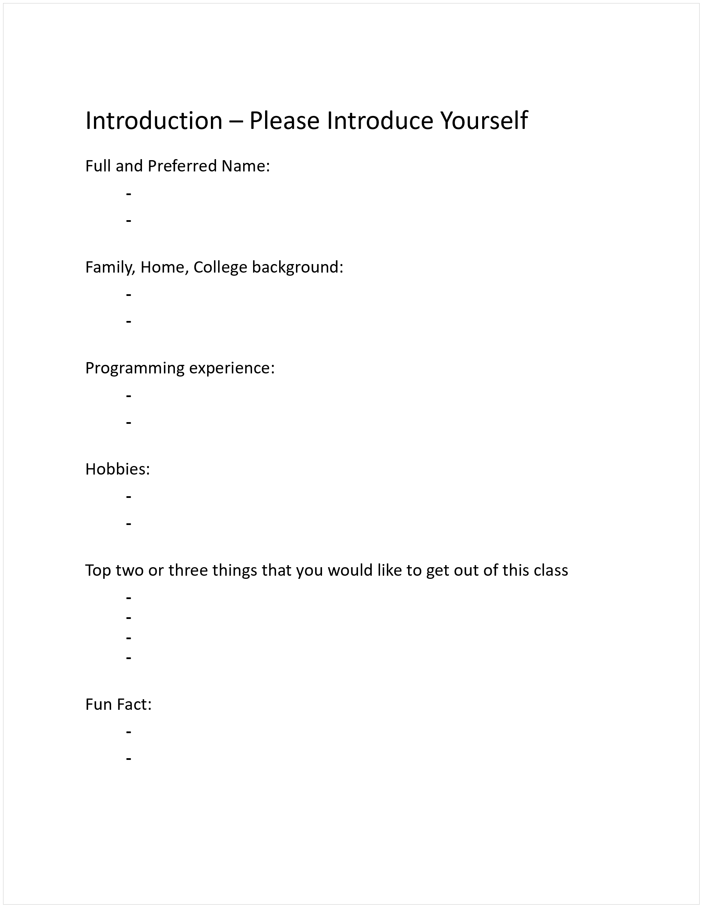

Slide 4
Welcome & Introductions
Full and Preferred Name:
Eric Pogue
Eric, Mr. Pogue, or Professor
Family, Home, College background:
Married with four+ children, recently relocated from Davenport, IA to Chicago area
Undergraduate in CS and Masters in Business… teaching online/evening for many years
Programming experience:
Decades in the industry as a developer, architect, project manager, manager, vp
Part of many teams that have delivered products to ten’s of millions of customers globally
Parsons Technology, Intuit, The Learning Company, Jasc Software, and John Deere
… and currently working on a startup with my oldest son
Notes:
Remind me to tell you a story about Bob Parsons who I worked for at Parsons Technology when we get to the section on DNS… Domain Name Services

Slide 5
Welcome & Introductions
Likely programming environment
Personal Laptop/Tablet, Windows 10, Chrome browser, and Visual Studio Code text editor
Hobbies:
Wilderness Canoeing & Camping (Quetico) and Triathlons
Top two or three things that you would like to get out of this class
help each of you be successful in this class
explore software development techniques together and motivate you to look deeper
and for us to find a little enjoyment and fun along the way*
… oh yes, and it would be wonderful if I could help you build something that made you proud during the semester
Fun Fact:
At one point I had the very dubious “honor” or being the most traveled John Deere employee to India with just over 40 trips over 5-6 years
Notes:
Optimism, good natured humor, and effectively working together is immensely important to delivering good software… and likely equally important to delivering just about any quality product
Even if you don’t intend to be a professional software developer, many of the things that we learn will be valuable in related areas.
Soooo… We have 16 weeks to learn something valuable and interesting. Let’s enjoy our time together and make the most out of it.

Slide 6
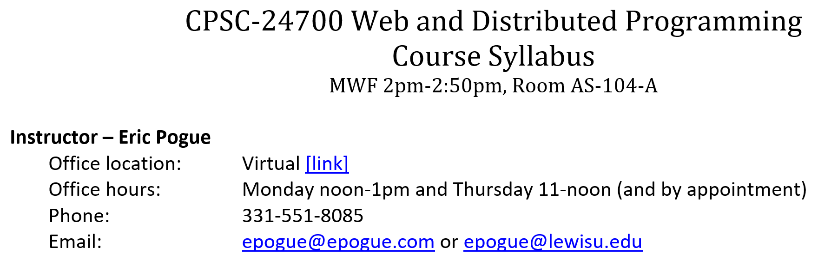
Notes:
I am only going to go through a few items in the course syllabus. Part of your assignment for our next session will be to read it and come with questions/comments.

Slide 7
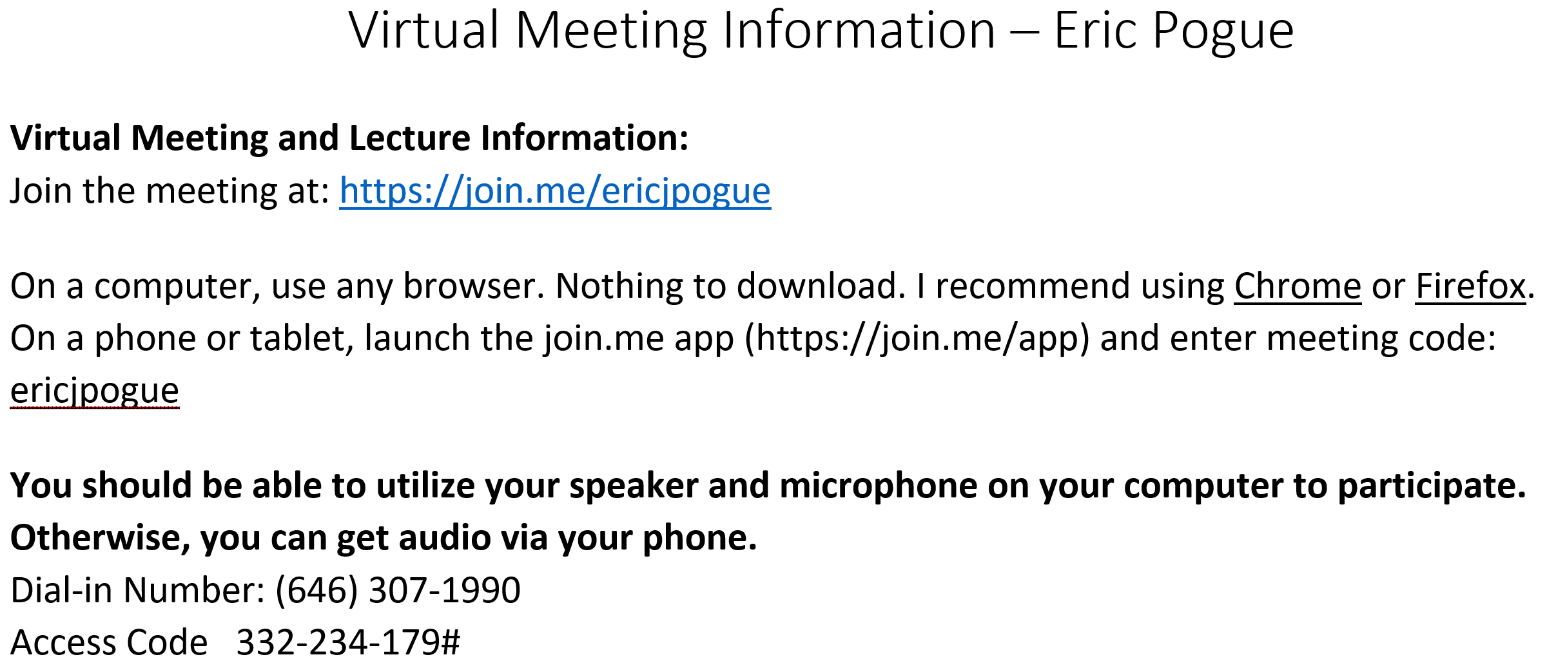
Notes:
I am only going to go through a few items in the course syllabus. Part of your assignment for our next session will be to read it and come with questions/comments.

Slide 8
Course Objectives
On the successful completion of this course we will be able to:
Understand the ideas of Distributed Computing & the World Wide Web
Create web pages with HTML5 and CSS
Utilize a cloud based computing platform (Microsoft Azure) to host a basic website
Understand the best Web design practices
Create dynamic and interactive web sites using JavaScript
Understand XML and Web services
Understand basic database concepts and make simple SQL queries
Write PHP scripts to process forms and interact with databases
Understand the basics of the various software development lifecycle processes
Provide an overview of Perl, Java, and Ruby
Understand the Hadoop framework and MapReduce programs… or alternatively the Angular JS JavaScriptJS framework

Slide 9
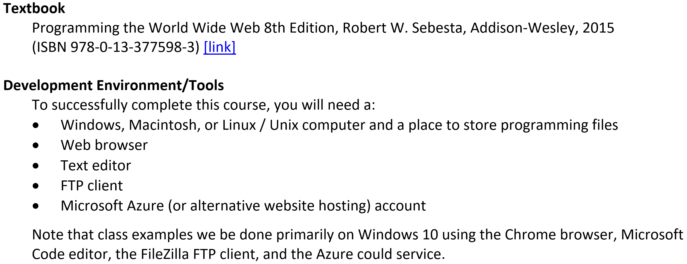

Slide 10
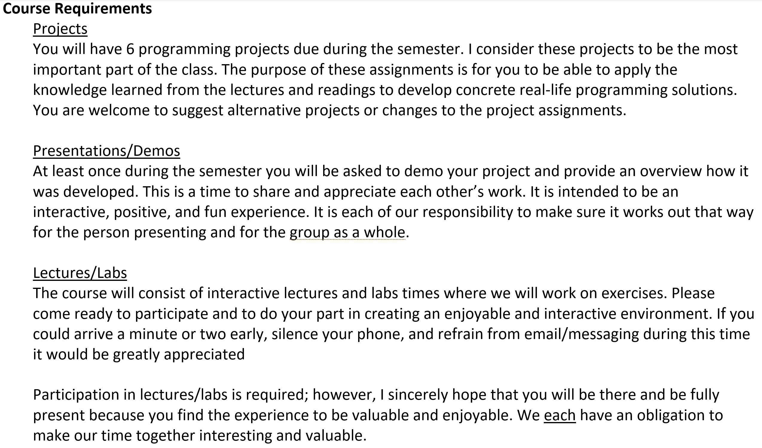

Slide 11
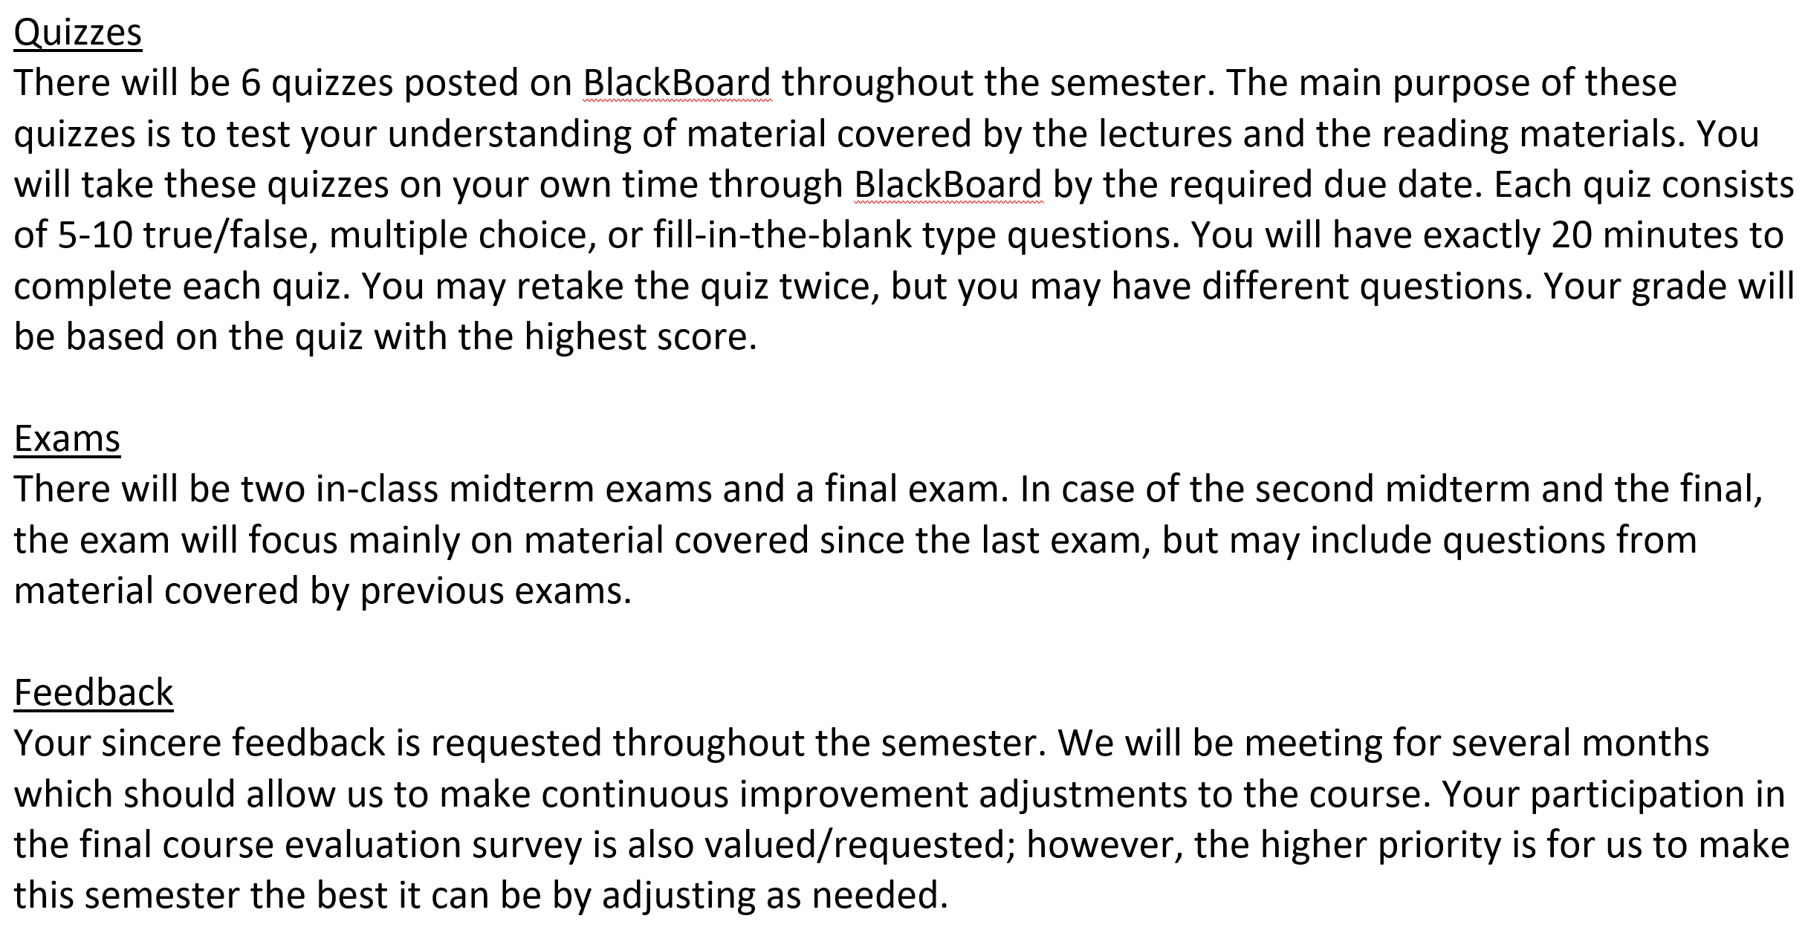

Slide 12
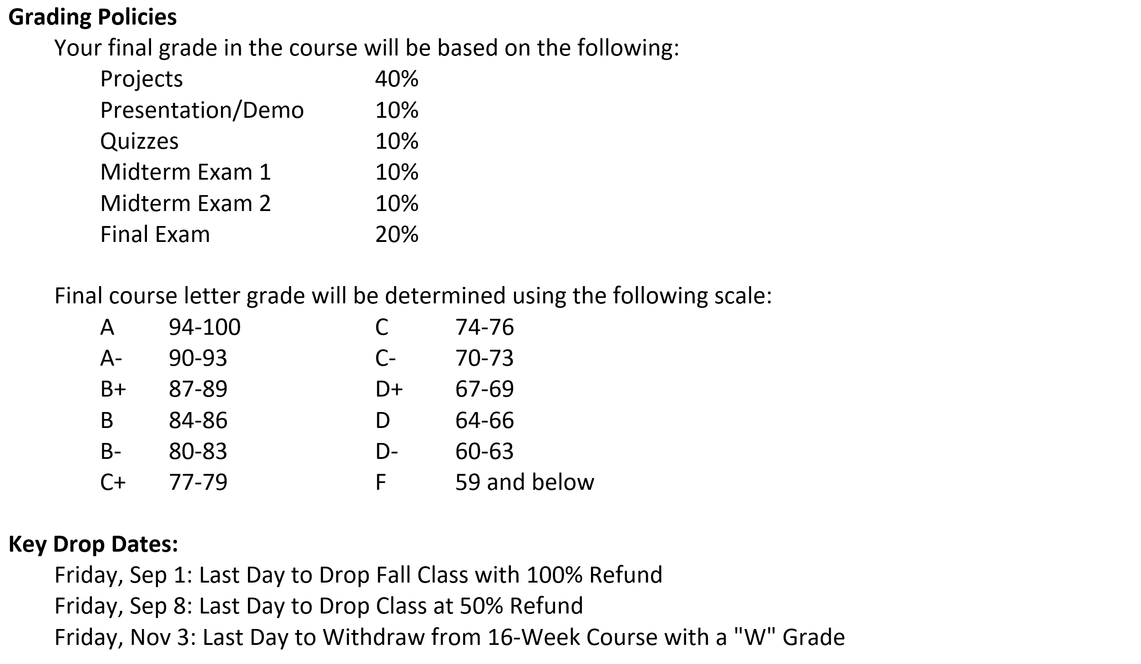

Slide 13
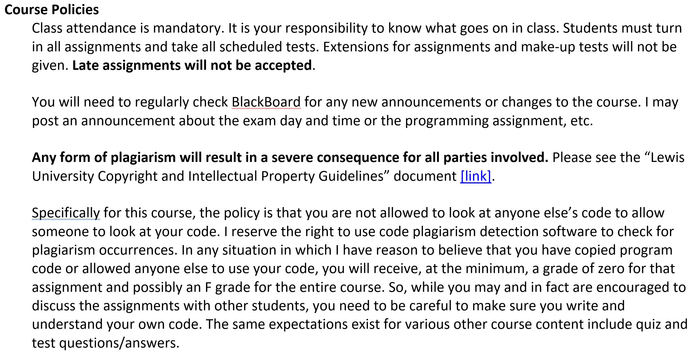

Slide 14
How to Be a Successful Programmer
Top-ten list on how to be a successful programmer, and successfully complete course project:
Start early on project assignments
Establish a physical work environment that allows you to focus for extended periods of time
Become comfortable with your development environment/tools
Read or re-read the project assignment and related materials
Suggest changes to the assignment if you feel there is a better (or more entertaining) way
Save and deploy working versions of your project regularly… this allows you to experiment without risking what you have already accomplished
Ask for help if you are stuck… often simply articulating the problem/question will lead you to finding your own answer
Look for similar examples… but write your own code that you understand
Come to class and participate in class exercises… ask questions during or after class
Review the textbook and review the lecture slides
Notes:
In my opinion programming and software development is a creative and analytical group activity.

Slide 15
Notes:
It’s time for your introductions. Feel free to share as much or as little as you would like.

Slide 16
Web and Distributed Programming Session: Week 1 Session 1 Instructor: Eric Pogue
Agenda:
Friendly Conversation & Good Natured Banter… let’s make sure that everyone gets a good seat where they can hear and speak comfortably
Welcome & Introductions*
Review Course Syllabus
Introduce this week’s Learning Objectives
Begin Exploring Distributed Computing and the World Wide Web
Assignments, Wrap-up, and Final Comments
Discussion & Questions welcome at any time… please be present with no phones or email during our discussion time

Slide 17
Course Objectives
On the successful completion of this course we will be able to:
Understand the ideas of Distributed Computing & the World Wide Web
Create web pages with HTML5 and CSS
Utilize a cloud based computing platform (Microsoft Azure) to host a basic website
Understand the best Web design practices
Create dynamic and interactive web sites using JavaScript
Understand XML and Web services
Understand basic database concepts and make simple SQL queries
Write PHP scripts to process forms and interact with databases
Understand the basics of the various software development lifecycle processes
Provide an overview of Perl, Java, and Ruby
Understand the Hadoop framework and MapReduce programs… or alternatively the Angular JS JavaScriptJS framework

Slide 18
Distributed Computing & the Web
Notes:
Time check… we need to start our Wrap-up at 2:45.
Why have I changed the “Worldwide Web” to the “Internet”? By the end of this class it is your responsibility to know the difference.

Slide 19
Web and Distributed Programming Session: Week 1 Session 1 Instructor: Eric Pogue
Agenda:
Friendly Conversation & Good Natured Banter… let’s make sure that everyone gets a good seat where they can hear and speak comfortably
Welcome & Introductions*
Review Course Syllabus
Introduce this week’s Learning Objectives
Begin Exploring Distributed Computing and the World Wide Web
Wrap-up, Assignments, and Final Comments
Discussion & Questions welcome at any time… please be present with no phones or email during our discussion time
Notes:
*Your opportunity to give introductions will come after the syllabus review.

Slide 20
Wrap-up
Wrap-up:
I will be available after class if you need anything
Please turn in your Introduction papers – Thank you for participating!

Slide 21
Assignment
Assignment (before next class):
Review Syllabus thoroughly
Read Ch.1.1 through 1.5 of Programming the World Wide Web 8th Edition, Robert W. Sebesta
Prepare for Wednesday Lab by verifying access to:
Personal laptop or a lab computer
Web browser
Text editor
Come ready to discuss on Wednesday

Slide 22
Final Questions or Comments?

Slide 23
End of Session
Course Number: CPSC-24700
Instructor: Eric Pogue

Slide 25
Sparse header
Sparse body

Slide 26
Dense Header
Describe what a thread is and why it can be useful to distribute tasks among multiple threads
Review our multi-threaded application development activities
Explain why it is important to synchronize threads that need to share data source access
Review Object Oriented Programming benefits including the associating Data & Functionality, Encapsulation & Information Hiding, Inheritance, and Polymorphism
Review databases, database servers, and the SQL language
Understand how databases support (or don’t support)work within a Object Oriented Programming environment
Understand client-server (two-tier), three-tier, and n-tier architectures
Introduce network programming concepts
Understand Web Services network programming
Develop a middle-tier data server using network programming
- We covered these topics in week 5/6 and week 1 respectively.

Slide 27
Default Header
Default Body

