Slide 1

Object-Oriented Programming Session: Week 4 Session 1 Instructor: Eric Pogue
Agenda:
Discuss last week’s FaceDraw Assignment
Review this week’s Mosaic Assignment
Introduce our Learning Objectives for the week
Review each Learning Objective
Closing comments and next steps

Slide 2
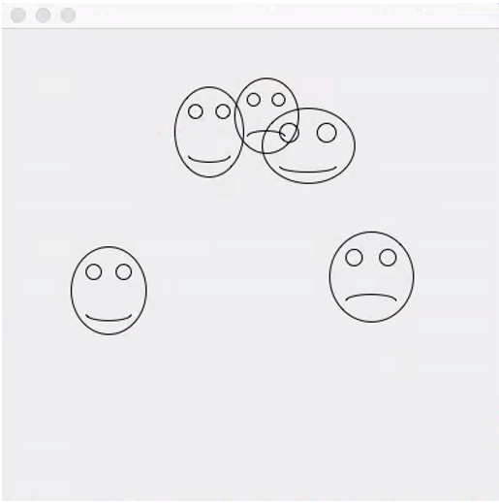
Discuss FaceDraw Assignment
FaceDraw and Learning Objectives: FaceDraw will be a challenging assignment this week. Our Learning Objects, Discussion, Lecture, and Examples will all be focused on helping you complete the assignment and learn the key concepts through delivering a concrete example.
In FaceDraw we will:
Create an application in Java that draws random faces on a window
Generate a random number between 3 & 10 and draw that many faces
Randomly generate reasonable and visually appealing face
Position itself to a reasonable size and location
Draw all faces so they are entirely within the window.
Draw each face with two eyes and a mouth.
The mouth should be randomly smiling, frowning, or in-between
Notes:
I’m looking for your feedback!

Slide 3
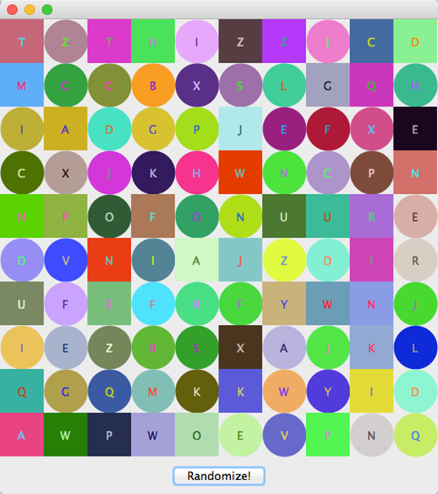
Review Mosaic Assignment
Mosaic and Learning Objectives: Mosaic will likely not be as challenging for you as FaceDraw was last week. Most of the elements that we will need for Mosaic we already learned last week. Therefore, this week’s objectives will be more forward looking.
In Mosaic we will:
Draw a set of random tiles
Draw random shapes, letters, and colors
Respond to a “Randomize” button
Display a new set of random tiles when the button is pushed
Implement a interesting and unique feature of our own choosing
Note: More details are available our W4Assignment document.
Notes:
Less theory and more practical development…

Slide 4
Learning Objectives – Week 4
Implement a menu system that enables the user to trigger a variety of actions in a familiar way
Implement code that responds to of events including: clicking the mouse, moving or dragging the mouse, and typing a key on the keyboard
Design multiple intuitive ways for a user to perform a particular task
Implement animation using a timer and a corresponding event handler
Create interactive applications that adhere to the Model-View-Controller pattern
Understand how Java achieves speedier input and output (IO) through a hierarchy file IO classes
Design and implement a controller class that outputs data to a text file
Design and implement a controller class that inputs data from a text file and builds a collection of objects from the data read data
Notes:
Any of these items would be a good candidate for your “interesting and unique” feature to add to your Mosaic assignment.

Slide 5
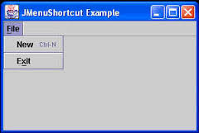
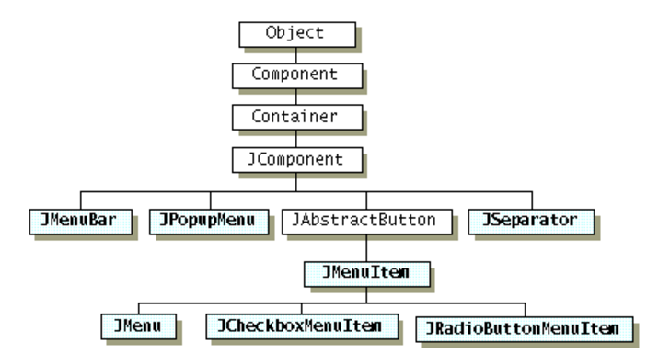
Menu Bars, Menus, and Menu Items
Java Menus are implemented with three related classes:
JMenuBar: the horizontal component across the top of the frame that contains Menus
JMenu: the user interface element that implements “File” in the image below
JMenuItem: the sub-items that can be selected from a Menu like “New” and “Exit” in the example below
The inheritance hierarchy for menu-related classes:
Notes:
Overview:
You create the JMenuBar. You create JMenu items that have captions (like File, Edit, etc.). You create JMenuItem objects that have captions (like Open, Close, Save, etc.) and add them to the JMenu’s. You associate ActionListener objects with each JMenuItem to describe what should happen when the JMenuItem is clicked. You add each JMenuItem to the JMenu. You add the JMenu to the JMenuBar. You then tell the frame to set its JMenuBar using setJMenuBar.

Slide 6
Mouse Clicking, Mouse Dragging, and Keystrokes
Nearly all graphical applications respond to Mouse Clicking and Keystrokes. Many applications also implement special behavior for Mouse Dragging. With Java in order to respond to these events we implement ActionListeners including:
MouseListener: Interface to implement to respond to Mouse Clicking
MouseMotionListener: Interface to implement to respond to Mouse Dragging
KeyListener: Interface to implement to respond to Keystrokes

Slide 7
MouseListener Interface
The MouseListener interface requires five methods to be implemented:
mouseClicked(MouseEvent e): Invoked when the mouse button has been clicked on a component
mouseEntered(MouseEvent e): Invoked when the mouse enters a component
mouseExited(MouseEvent e): Invoked when the mouse exits a component
mousePressed(MouseEvent e): Invoked when a mouse button has been pressed on a component
mouseReleased(MouseEvent e): Invoked when a mouse button has been released on a component
Notes:
Adapter Classes are an alternative to implementing all five methods. For our examples, I will be implementing all five, even if some of them seem unnecessary. You ware welcome to use Adapters in your assignments if you prefer.

Slide 8
MouseMotionListener Interface
The MouseMotionListener interface includes the following methods:
mouseDragged(MouseEvent e): Invoked when a mouse button is pressed on a component and then dragged
mouseMoved(MouseEvent e): Invoked when the mouse cursor has been moved onto a component but no buttons have been pushed
Notes:
.

Slide 9
KeyListener Interface
The KeyListener interface includes the following methods:
keyPressed(KeyEvent e): Invoked when a key has been pressed
keyReleased(KeyEvent e): Invoked when a key has been released
keyTyped(KeyEvent e): Invoked when a key has been typed
Notes:
.

Slide 10
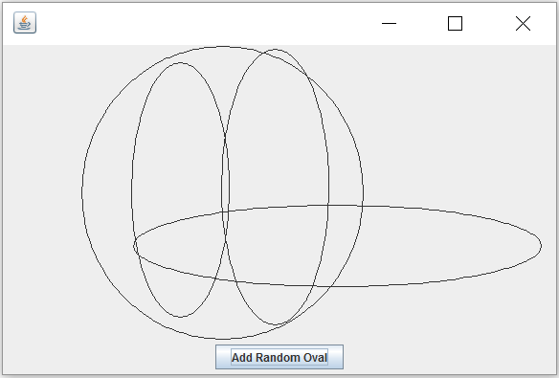
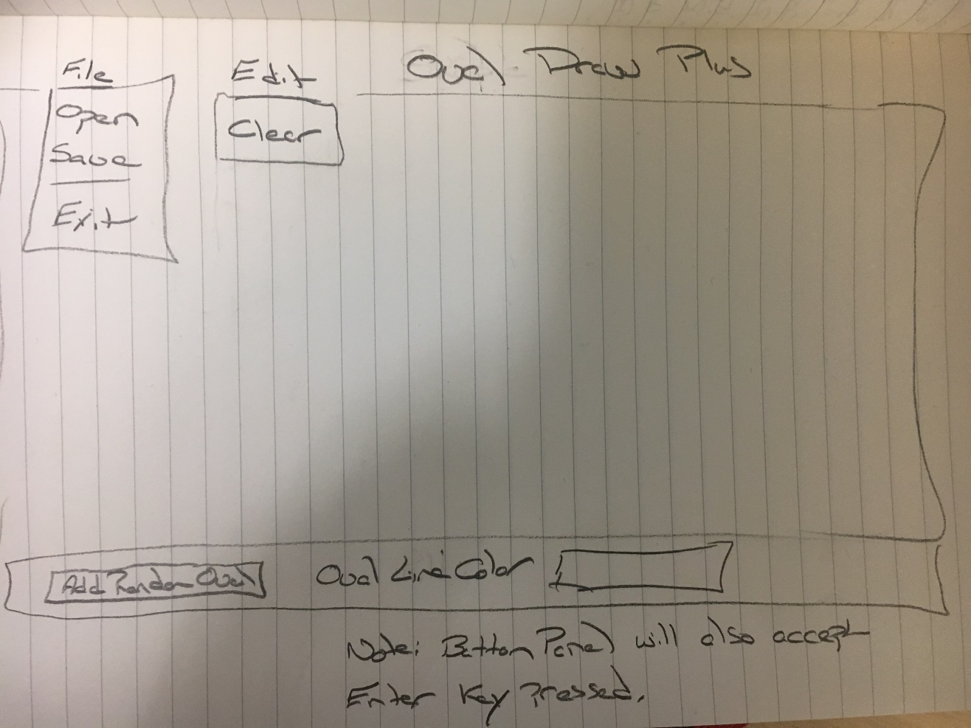
OvalDraw Plus User Interface Design
Notes:
Yes, this is often what a UI design looks like. In our first coding example this week, we are going to enhance the OvalDraw application to include menu elements to OvalDraw File|Exit and Edit|Clear. In addition, we will implement adding new random ovals with either a line color or a line weight. Finally, we will add file saving and opening and add the related Open and Save menu items to the application… more on that later.
I anticipate that we will also implement something with mouse clicking, mouse dragging, and timer also, but am uncertain what form that may take.

Slide 11
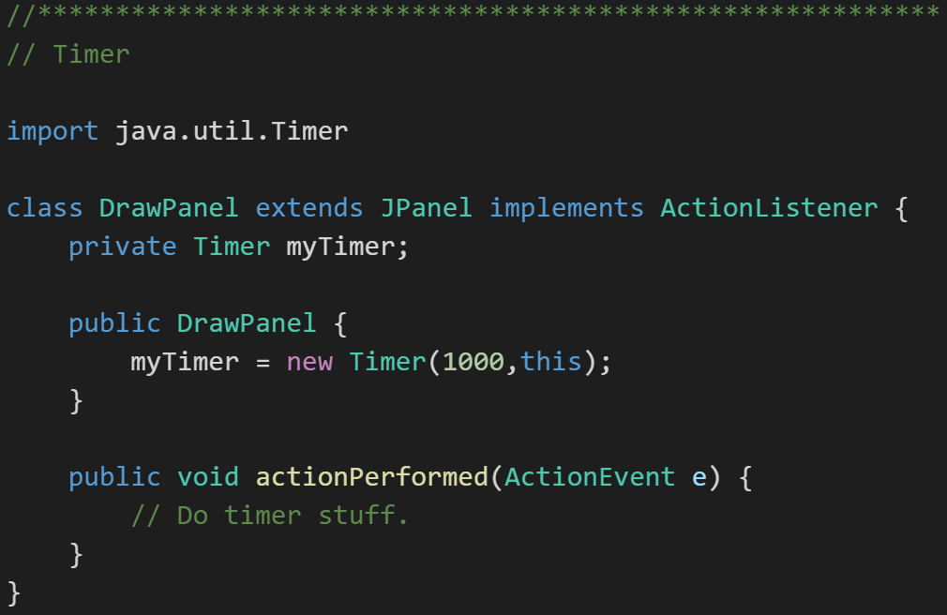
Timers
Timers are pretty straight forward to implement:
Implement the ActionListener Interface
Create a new timer passing in the object that implemented the ActionListener
Notes:
We will likely have a final programming example that will show some animation using timers. I’m not sure what form that example will take.

Slide 12
Model-View-Controller
Throughout our design and development activates we are working to create applications that segregate our View from our their Model & Data.
The Java environment makes this more challenging than it should be at times
Design tradeoffs need to be considered
The most import aspect of Model-View-Controller is that the Model has no visibility to the View

Slide 13
Learning Objectives – Week 4
Implement a menu system that enables the user to trigger a variety of actions in a familiar way
Implement code that responds to of events including: clicking the mouse, moving or dragging the mouse, and typing a key on the keyboard
Design multiple intuitive ways for a user to perform a particular task
Implement animation using a timer and a corresponding event handler
Create interactive applications that adhere to the Model-View-Controller pattern
Understand how Java achieves speedier input and output (IO) through a hierarchy file IO classes
Design and implement a controller class that outputs data to a text file
Design and implement a controller class that inputs data from a text file and builds a collection of objects from the data read data
Notes:
Any of these items would be a good candidate for your “interesting and unique” feature to add to your Mosaic assignment.

Slide 14
Serialization and Reading/Writing Text Files
Serialization is an object-oriented programming term that means converting an object to a byte steam usually to be written to or read from a file.
To write to a text file:
Create a File object, feeding the file’s path to the File class constructor
Create a FileWriter to access the File
Create a BufferedWriter to write data to the FileWriter efficiently
Use BufferedWriter’s write and newLine functions to commit the data to the file.
To read from a text file:
Create a File object, feeding the file’s path to the File class constructor
Attach a Scanner object to it
Use Scanner’s readLine and hasNextLine functions to read the file
Notes:
A buffered writer or buffered stream efficiently organization reads and writes for optimal disk performance. The danger is that if there is a power failure (or someone accidentally kicks your power strip) you could lose data. It is good to “flush the buffer” at critical times when using a buffered writer on mission critical projects. There is little or no danger in using a buffered reader.

Slide 15
OvalDraw Plus User Interface Design
Notes:
Our second programming example this week will be implementing Save & Open in our OvalDraw application.

Slide 16
Closing Comments & Next Steps
As promised, less theory and more development
Look for three follow-up development examples this week:
OvalDraw with User Experience Enhancements
OvalDraw reading and writing files
Something with Timers and Animation

Slide 17
End of Session
Course Number: CPSC-24500
Week: 4
Session: 1
Instructor: Eric Pogue

Slide 18
Object-Oriented Programming Session: Week 4 Session 2 Subject: More Interactive User Interfaces Instructor: Eric Pogue
Agenda:
Quick Review Learning Objectives we covered in Session 1
Overview of Session 2 Live Coding example and related Learning Objectives
Live User Interface Coding example
Review what we learned
Closing comments and next steps
Notes:
Quick note: I have changed the resolution of our videos starting with this session. I was using 1366x768 which made for more manageable video downloads, etc. As we head toward using Visual Studio and C#, I would like to move toward 1920x1080 to better allow us to see the integrated development environment (IDE). Let me know if the increased resolution causes difficulty in accessing or viewing the videos.

Slide 19
Learning Objectives – Week 4
Implement a menu system that enables the user to trigger a variety of actions in a familiar way
Implement code that responds to of events including: clicking the mouse, moving or dragging the mouse, and typing a key on the keyboard
Design multiple intuitive ways for a user to perform a particular task
Implement animation using a timer and a corresponding event handler
Create interactive applications that adhere to the Model-View-Controller pattern
Understand how Java achieves speedier input and output (IO) through a hierarchy file IO classes
Design and implement a controller class that outputs data to a text file
Design and implement a controller class that inputs data from a text file and builds a collection of objects from the data read data
Notes:
Any of these items would be a good candidate for your “interesting and unique” feature to add to your Mosaic assignment.

Slide 20
Learning Objectives – Week 4
Implement a menu system that enables the user to trigger a variety of actions in a familiar way
Implement code that responds to of events including: clicking the mouse, moving or dragging the mouse, and typing a key on the keyboard
Design multiple intuitive ways for a user to perform a particular task
Implement animation using a timer and a corresponding event handler
Create interactive applications that adhere to the Model-View-Controller pattern
Understand how Java achieves speedier input and output (IO) through a hierarchy file IO classes
Design and implement a controller class that outputs data to a text file
Design and implement a controller class that inputs data from a text file and builds a collection of objects from the data read data
Notes:
Any of these items would be a good candidate for your “interesting and unique” feature to add to your Mosaic assignment.

Slide 21
OvalDraw Plus User Interface Design
Notes:
Yes, this is often what a UI design looks like. In our first coding example this week, we are going to enhance the OvalDraw application to include menu elements to OvalDraw File|Exit and Edit|Clear. In addition, we will implement adding new random ovals with either a line color or a line weight. Finally, we will add file saving and opening and add the related Open and Save menu items to the application… more on that later.
I anticipate that we will also implement something with mouse clicking, mouse dragging, and timer also, but am uncertain what form that may take.

Slide 22
Learning Objectives – Week 4
Implement a menu system that enables the user to trigger a variety of actions in a familiar way
Implement code that responds to of events including: clicking the mouse, moving or dragging the mouse, and typing a key on the keyboard
Design multiple intuitive ways for a user to perform a particular task
Implement animation using a timer and a corresponding event handler
Create interactive applications that adhere to the Model-View-Controller pattern
Understand how Java achieves speedier input and output (IO) through a hierarchy file IO classes
Design and implement a controller class that outputs data to a text file
Design and implement a controller class that inputs data from a text file and builds a collection of objects from the data read data
Notes:
Any of these items would be a good candidate for your “interesting and unique” feature to add to your Mosaic assignment.

Slide 23
Closing Comments & Next Steps
I’m trying to get ups in a learning pattern where we:
See the concepts and patterns (theory)
Watch them being used in a “real-life” example
Implement a solution using what we have learned
Let me know how this is working, and how we can continue to improve

Slide 24
End of Session
Course Number: CPSC-24500
Week: 4
Session: 2
Instructor: Eric Pogue

Slide 25
Object-Oriented Programming Session: Week 4 Session 3 Subject: Clicks, Drags, Timers, and Animations Instructor: Eric Pogue
Agenda:
Quick Review Learning Objectives we covered in Session 1
Overview of Session 3 Live Coding example and related Learning Objectives
Clicks and drags… with FaceDraw-ish solution
Short break
Timers and animation
Review what we learned and week 4 assignment as time allows
Final comment & questions
Notes:
Start Recording!

Slide 26
Learning Objectives – Week 4
Implement a menu system that enables the user to trigger a variety of actions in a familiar way
Implement code that responds to of events including: clicking the mouse, moving or dragging the mouse, and typing a key on the keyboard
Design multiple intuitive ways for a user to perform a particular task
Implement animation using a timer and a corresponding event handler
Create interactive applications that adhere to the Model-View-Controller pattern
Understand how Java achieves speedier input and output (IO) through a hierarchy file IO classes
Design and implement a controller class that outputs data to a text file
Design and implement a controller class that inputs data from a text file and builds a collection of objects from the data read data
Notes:
Any of these items would be a good candidate for your “interesting and unique” feature to add to your Mosaic assignment.

Slide 27
Learning Objectives – Week 4
Implement a menu system that enables the user to trigger a variety of actions in a familiar way
Implement code that responds to of events including: clicking the mouse, moving or dragging the mouse, and typing a key on the keyboard
Design multiple intuitive ways for a user to perform a particular task
Implement animation using a timer and a corresponding event handler
Create interactive applications that adhere to the Model-View-Controller pattern
Understand how Java achieves speedier input and output (IO) through a hierarchy file IO classes
Design and implement a controller class that outputs data to a text file
Design and implement a controller class that inputs data from a text file and builds a collection of objects from the data read data
Review week 4 assignment as time allows

Slide 28
Mouse Clicking, Mouse Dragging, and Keystrokes
Nearly all graphical applications respond to Mouse Clicking and Keystrokes. Many applications also implement special behavior for Mouse Dragging. With Java in order to respond to these events we implement ActionListeners including:
MouseListener: Interface to implement to respond to Mouse Clicking
MouseMotionListener: Interface to implement to respond to Mouse Dragging
KeyListener: Interface to implement to respond to Keystrokes

Slide 29
MouseListener Interface
The MouseListener interface requires five methods to be implemented:
mouseClicked(MouseEvent e): Invoked when the mouse button has been clicked on a component
mouseEntered(MouseEvent e): Invoked when the mouse enters a component
mouseExited(MouseEvent e): Invoked when the mouse exits a component
mousePressed(MouseEvent e): Invoked when a mouse button has been pressed on a component
mouseReleased(MouseEvent e): Invoked when a mouse button has been released on a component
Notes:
Adapter Classes are an alternative to implementing all five methods. For our examples, I will be implementing all five, even if some of them seem unnecessary. You ware welcome to use Adapters in your assignments if you prefer.
The mouseClicked method is the most often overridden. The mousePressed and mouseReleased are most often used with dragging.
import java.awt.event.MouseListener;
import java.awt.event.MouseEvent;
public void mousePressed(MouseEvent e) {}
public void mouseReleased(MouseEvent e) {}
public void mouseEntered(MouseEvent e) {}
public void mouseExited(MouseEvent e) {}
public void mouseClicked(MouseEvent e) {}
addMouseListener(this);
MouseEvent:
int getX();
int getY();

Slide 30
MouseMotionListener Interface
The MouseMotionListener interface includes the following methods:
mouseDragged(MouseEvent e): Invoked when a mouse button is pressed on a component and then dragged
mouseMoved(MouseEvent e): Invoked when the mouse cursor has been moved onto a component but no buttons have been pushed
Notes:
Note: Dragging is quite challenging to implement… and not that often utilized.
import java.awt.event.MouseMotionListener;
import java.awt.event.MouseEvent;
MouseMotionListener
public void mouseDragged(MouseEvent e) {}
public void mouseMoved(MouseEvent e) {}
addMouseMotionListener(this);

Slide 31
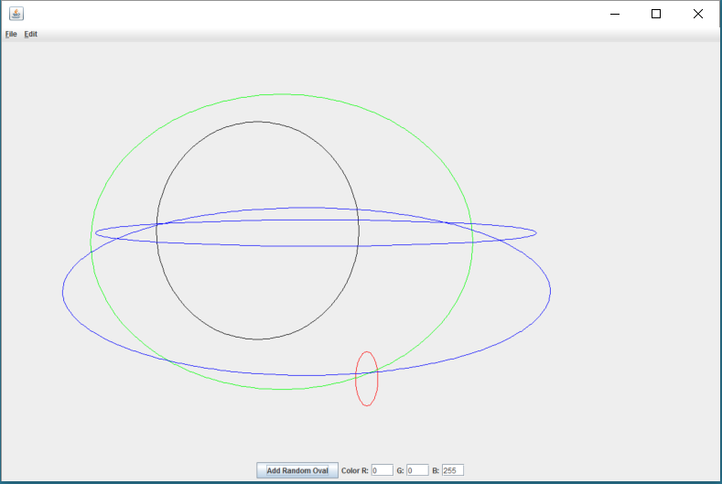
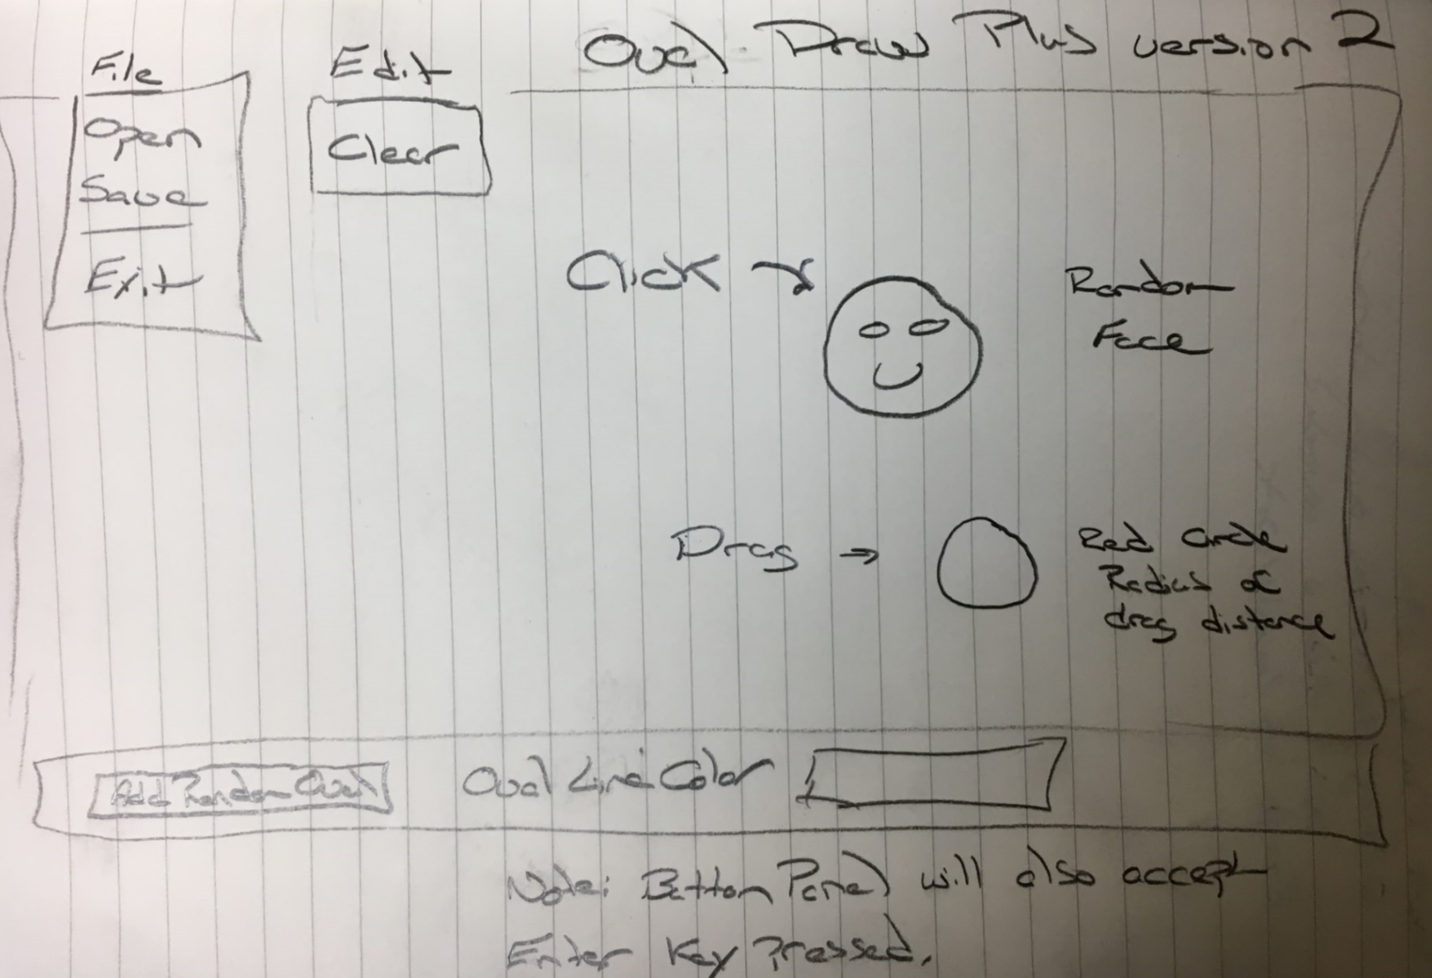
OvalDraw Plus With Clicking and Dragging
Notes:
Enhance OvalDraw to include drawing a random face (similar to FaceDraw) with clicked and to draw a red circle with a radius of the drag distance when the mouse is dragged.

Slide 32
OvalDraw Plus Enhancements Steps
Clone our current Git repository
Copy original files over to OvalDrawPlus folder
Compile library and ShapeDraw code
Quickly test application
Review ShapeDraw code… focus on ShapeDrawPanel
Minor code cleanup… and “compress” classes that we will not be looking at today
Implement MouseListener Interface
Implement MouseMotionListener Interface
Add random oval on click
Implement red circle on mouse drag… this is challenging
Implement FaceDraw on click… and remove step nine’s random oval draw
Review, final question, and commit/push

Slide 33
Quick Break
Course Number: CPSC-24500
Week: 4
Session: 3
Instructor: Eric Pogue

Slide 34
Timers
Timers are pretty straight forward to implement:
Implement the ActionListener Interface
Create a new timer passing in the object that implemented the ActionListener
Notes:
We will likely have a final programming example that will show some animation using timers. I’m not sure what form that example will take.
import java.util.Timer;
private Timer animationTimer;
animationTimer = new Timer(1000,this);
public void actionPerformed(ActionEvent e) {
System.out.println("actionPerformed(ActionEvent e)");
}

Slide 35
OvalDraw Plus Timer and Animated Faces
Implement ActionListener on ShapeDrawPanel
Implement Timer
Implent updateMouth in FaceDraw
Implement ArrayList for FaceDraw objects
Update FaceDraw mouths and redraw

Slide 36
Learning Objectives – Week 4
Implement a menu system that enables the user to trigger a variety of actions in a familiar way
Implement code that responds to of events including: clicking the mouse, moving or dragging the mouse, and typing a key on the keyboard
Design multiple intuitive ways for a user to perform a particular task
Implement animation using a timer and a corresponding event handler
Create interactive applications that adhere to the Model-View-Controller pattern
Understand how Java achieves speedier input and output (IO) through a hierarchy file IO classes
Design and implement a controller class that outputs data to a text file
Design and implement a controller class that inputs data from a text file and builds a collection of objects from the data read data
Review week 4 assignment as time allows

Slide 37
End of Session
Course Number: CPSC-24500
Week: 4
Session: 3
Instructor: Eric Pogue

