Slide 1
JavaScript and HTML Documents

Slide 2
Objectives
How HTML documents are represented
How we can reference HTML elements from JavaScript, create them, and modify them
How to handle events that occur in a web page
How to use the navigator object and the canvas element

Slide 3
Examples
Yahtzee Dice [link]
Yahtzee Dice with External JS [link]

Slide 4
Document Object Model

Slide 5

The Document Object Model
The Document Object Model (DOM) is an abstract model that defines the interface between HTML documents and application programs—an API
Documents in the DOM have a treelike structure

Slide 6
The Document Object Model
HTML elements → JavaScript objects
HTML attributes → JavaScript properties
Example: <input type = "text" name = "address"> would be represented as an object with two properties, type and name, with the values "text" and "address"
Note: Chrome offers DevTools that can show the tree of a document and other useful information [link]

Slide 7
Examples
Let’s see an example:
table2.html [link]

Slide 8
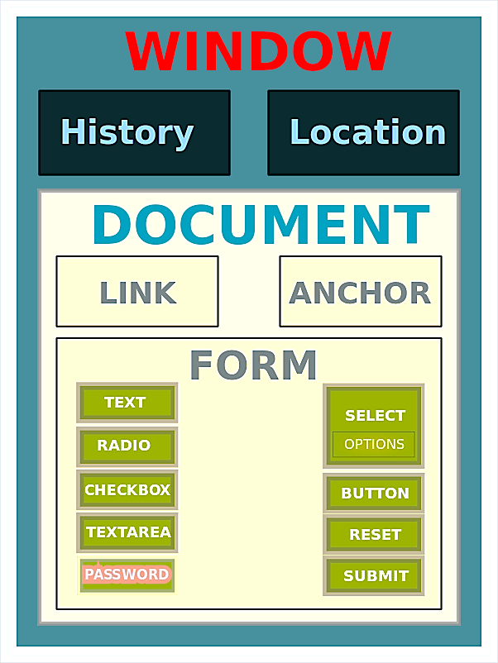
JavaScript Execution Environment
Window object represents the window in which the browser displays documents
provides the largest enclosing referencing environment for scripts
all global variables are properties of Window
Has some implicitly defined properties:
document - a reference to the Document object that the window displays
history - reference to browser history
location - reference to current URL

Slide 9
JavaScript Execution Environment
Every Document object has:
anchors
links
images
forms - an array of references to the forms of the document
Each Form object has an elements array, which has references to the form’s elements

Slide 10
Element Access in JavaScript
Example (one form and one widget): <form name = "myForm" action = "">
<input type = "button" id = "pushMe" name = "pushMe" />
</form>
There are several ways to do it:
Using the DOM address: document.forms[0].element[0]
Problem: if document changes, indexes will be wrong

Slide 11
Element Access in JavaScript
Example (one form and one widget): <form name = "myForm" action = "">
<input type = "button" id = "pushMe" name = "pushMe" />
</form>
Using Element names – requires the element and all of its ancestors (except body) to have name attributes: document.myForm.pushMe

Slide 12
Element Access in JavaScript
Example (one form and one widget): <form name = "myForm" action = "">
<input type = "button" id = "pushMe" name = "pushMe" />
</form>
Using the getElementById method: document.getElementById("pushMe")

Slide 13
Element Access
Checkboxes and radio button can be accessed through an implicit array, which has their name, e.g.:
<form id = "topGroup">
<input type = "checkbox" name = "toppings"
value = "olives" />
...
<input type = "checkbox" name = "toppings"
value = "tomatoes" />
</form>
...
var numChecked = 0;
var dom = document.getElementById("topGroup");
for (index = 0; index < dom.toppings.length; index++)
if (dom.toppings[index].checked]
numChecked++;

Slide 14
Event Handling

Slide 15
Events and Event Handling
An event is a notification that something specific has occurred, either with the browser or an action of the browser user
An event handler is a script that is implicitly executed in response to the appearance of an event
The process of connecting an event handler to an event is called registration

Slide 16
Webpage Events
Events that occur in a web page have an event name and a corresponding tag attribute
For example:
click is the name of an event that occurs when the user presses his mouse button onto a HTML element
onclick is the name of the tag attribute associated with that event

Slide 17
Webpage Events
Event | Tag Attribute
blur | onblur
change | onchange
click | onclick
dblclick | ondblclick
focus | onfocus
keydown | onkeydown
keypress | onkeypress
keyup | onkeyup
load | onload
mousedown | onmousedown
mousemove | onmousemove
mouseout | onmouseout
mouseover | onmouseover
mouseup | onmouseup
reset | onreset
select | onselect
submit | onsubmit
unload | onunload

Slide 18
Event handler registration
There are several ways of assigning handlers for an event:
One way is to assign an event handler script to an event tag attribute, e.g.:
onclick = "alert('Mouse click!');"
Or assign a function to an event tag attribute: onclick = "myHandler();"
Alternatively, you can assign a function name using JavaScript: document.getElemementById("mybutton").onclick = myHandler;
Note the syntax: no quotes or parameter list

Slide 19
Notes on writing event handlers
Don’t use document.write in an event handler, because the output may go on top of the display
The same attribute can appear in several different tags
Example: The onclick attribute can be in <a> and <input>

Slide 20
Event Handlers for Form Elements

Slide 21
The load and unload Events
Many times, you may want to do some initialization when a page loads or cleanup after the page unloads
This can be done by registering load and unload event handlers
The load event is triggered when the loading of a document is completed
The unload event is typically used to do some cleanup before a document is unloaded
It is common to set the handler by setting the onload tag attribute of the body element

Slide 22
Examples
load.html [link]

Slide 23
Handling Events from Button Elements
To handle events from (plain) buttons:
just use the onclick property
e.g. <input type=button value="Press me" onclick = "dostuff()">
some function defined in the <head>

Slide 24
Handling Events from Textbox and Password Elements
Useful textbox and password element events:
blur, focus, change, and select
The focus and blur events occur when the element acquires or loses focus, respectively.
One use of focus: prevent illicit changes to a text box, e.g.:
onfocus = “this.blur();”

Slide 25
Examples
nochange.html [link]

Slide 26
Start Session 16
Course Number: CPSC-24700
Instructor: Eric Pogue

Slide 27
Handling Events from Textbox and Password Elements
onchange event: detect when user enters text into the textbox
Can check for proper formatting
value is the string property containing the text in the textbox
The handler can check the format using a regular expression, e.g.:
var myPhone = document.getElementById(“phone”);
var pos = myPhone.value.search(/^\d{3}-\d{3}-\d{4}$/);
if (pos != 0) {
alert(“Wrong format! Correct form is: ddd-ddd-dddd”);
return false;
} else
return true;
}

Slide 28
Handling Events from Textbox and Password Elements
Checking form input is a good use of JavaScript, because it finds errors in form input before it is sent to the server for processing
This saves both Server time and Internet time
Things that must be done:
Detect the error and produce an alert message
Inform the user of the error and present the correct format
NOTE: To keep the form active after the event handler is finished, the handler must return false
Notes:
It’s important to note that input will also need to be validated on the server. Otherwise the sever will be susceptible to spoofing… having an non-browser send data to it that has not been validated. A server should never assume that data coming in is adequately validated.
Also, good practice would suggest attempting to reformat the content to better assist the user.

Slide 29
Examples
pswd_chk.html [link]
validator.html [link]

Slide 30
Checking Input Format in HTML5
HTML5 made validation easier.
-it introduced self-validating input types, e.g.:
<input type=“email” placeholder=name@domain.com />
Format is checked whenever the user presses the Submit button
This eliminates the need for JavaScript input validation in most cases
NOTE: Not all browsers support the feature

Slide 31
Handling Events from Radio Buttons
For radio buttons, the easy way is to
register the handler in the markup
(use a parameter to differentiate which button was set)
e.g., if planeChoice is the name of the handler and the value of a button is 172, then
onclick = "planeChoice(172)"

Slide 32
Handling Events from Radio Buttons
If the handler is registered in the JavaScript:
iterate through the button array and determine the checked value.
This is a multistep process:
1. Assign the address of the handler function to the event property of the JavaScript object associated with the HTML element, e.g.:
If the name of the buttons is planeButton, then we write
var dom = document.getElementById(″myForm″)
dom.planeButton[0].onclick = planeChoice;
dom.planeButton[1].onclick = planeChoice;
Note:
This registration must follow both the handler function and the HTML form.
If this is done for a radio button group, each element of the array must be assigned.

Slide 33
Handling Events from Radio Buttons
2. We can then implement the planeChoice function to determine whether which button is clicked by examining the checked property of each radio button object, e.g.:
var dom = document.getElementById(″myForm″);
for (var index = 0;
index < dom.planeButton.length; index++) {
if (dom.planeButton[index].checked) {
plane = dom.planeButton[index].value;
break;
}
}

Slide 34
Handling Events from Radio Buttons
The disadvantage of specifying handlers by assigning them to event properties is that there is no way to use parameters
So why do this?
It is good to keep HTML and JavaScript separate
The handler could be changed during use

Slide 35
Examples
radio_click.html [link]
radio_click2.html [link]

Slide 36
End of Session 16
Course Number: CPSC-24700
Instructor: Eric Pogue

Slide 37
The navigator object
Since different browsers support different features, we need to be able to detect the browser used by the user
The browser used can be accessed through the navigator object
2 useful properties:
The appName property has the browser’s name
The appVersion property has the version #
Note: the addVersion may not tell you exactly what you need
Microsoft has chosen to set the appVersion of IE9 to 5 (?)
Firefox has chosen to set the appVersion of Firefox to 5.0 (?) and the name to Netscape (?)

Slide 38
Examples
navigate.html

Slide 39
The Canvas Element

Slide 40
The canvas Element
The canvas element is a new element introduced by HTML5 to support graphics and animations.
It creates a rectangle into which bit-mapped graphics can be drawn using JavaScript.
It’s optional attributes are height, width, and id
The id attribute is necessary if something will be drawn
Example: <canvas id = ″myCanvas″ height = ″200″ width = ″400″> Your browser does not support the canvas element </canvas>

Slide 41
Examples
circles.html
parallel.html
rects.html

Slide 42
DOM Traversal

Slide 43
DOM Tree Traversal and Modification
The Document Object Model is a hierarchical model, i.e., it has a tree structure
You can traverse this tree by accessing different object properties:
parentNode
previousSibling
nextSibling
firstChild
childNodes
lastChild

Slide 44
DOM Tree Traversal and Modification
For example, if there is an unordered list with the id myList, the number of list items in the list can be displayed with:
var dom = document.getElementById("myList"); var listItems = dom.childNodes.length; document.write("Number of list items is: " +
listItems);
The tree can also be modified using different methods:
insertBefore, replaceChild, removeChild, appendChild

Slide 45
DOM 2 Event Model

Slide 46
DOM 2 Event Model
Document Object Model version 2 (DOM2) introduced a new way of handling events
In DOM2, events propagate through the document tree from the root of the tree to the target element and back
At each point, events can be captured and handled or canceled.

Slide 47
DOM 2 Event Model
Browser automatically pass an Event object to each event handler
The Event object provides properties associated with the event that occurred, e.g.:
Which mouse button was clicked?
What are the screen coordinates of the cursor?

Slide 48
DOM 2 - Event Propagation
The node of the document tree where the event is created is called the target node
The capturing phase (1st phase)
Events begin at the root and move toward the target node
Registered and enabled event handlers at nodes along the way are run
The target node phase (2nd phase)
If there are registered but not enabled handlers there for the event, they are run
The bubbling phase (3rd phase)
Event goes back to the root; all encountered registered but not enabled handlers are run

Slide 49
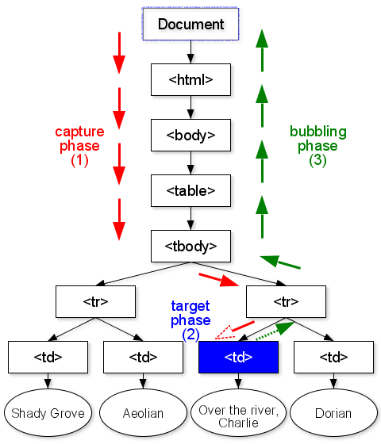
DOM 2 - Event Propagation
Event propagation example:

Slide 50
DOM 2 - Event Model
A few notes about DOM 2 events handling:
Not all events bubble (e.g., load and unload)
Any handler can stop further event propagation by calling the stopPropagation method of the Event object
DOM 2 model uses the Event object method preventDefault to stop default operations, such as submission of a form, if an error has been detected

Slide 51
DOM 2 Event Handlers
Event handler registration is done with the addEventListener method
3 parameters:
Name of the event, as a string literal
The handler function
A Boolean value that specifies whether the event is enabled during the capturing phase
Example code:
node.addEventListener("change", chkName, false);

Slide 52
DOM 2 Event Handlers
Some useful tips:
A temporary handler can be created by registering it and then unregistering it with removeEventListener
The currentTarget property of Event always references the object on which the handler is being executed
MouseEvents have two properties, clientX and clientY, that have the x and y coordinates of the mouse cursor, relative to the upper left corner of the browser window
Notes:
example: validator2.html

Slide 53
Examples
validator2.html

Slide 54
Summary
HTML pages are represented by the DOM, which has a tree structure
HTML elements can be accessed by the DOM address, the element name, or the getElementById method
Events that occur in the web page can be handled by assigning a function to either a corresponding tag attribute or using the addEventListener method.
DOM elements can be traversed, added, modified, or removed using appropriate object methods
In DOM2, events propagate through a three stage process of capturing, target node, and bubbling phases
The navigator object can be used to get information about user's browser
The canvas element can be used to draw to the screen through JavaScript

