Slide 1

Web and Distributed Programming Instructor: Eric Pogue Session: 39
Agenda:
Friendly Conversation & Good Natured Banter
Quick Review of Assignments From Last Class
Schedule through the end of the Semester
Cloud Computing & Map Reduce
Project 5 Discussion… do we need to make adjustments in scope/rubrics
Friday Class Presentations… Khaldoon, Daniel (Bewley) / Jimmy, and Ryan?
Project 5 Lab time
Discussion & Questions welcome at any time… please be present with no phones or email during our discussion time

Slide 2
Assignment by Monday, Dec 4
Assignment:
Compete Ch.13 on Web Application access to Databases
Continue to focus on Project 5… which is due one week from today
Final Lab – Complete Either:
Week 14a: Build a Node.js and MongoDB web app in Azure [link] OR
Week 14b Lab: Build a PHP and MySQL web app in Azure [link]

Slide 3
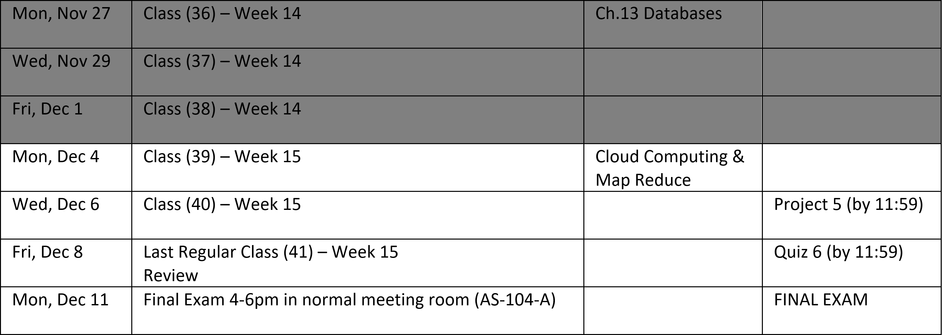
Schedule through the end of the Semester
Notes:
Database

Slide 4
Cloud Computing & Map Reduce

Slide 5
Project 5 Discussion… do we need to make adjustments in scope and/or rubrics
Notes:
I would like to include the work that you did on the Azure Labs in the Project 5 grade
Other ideas

Slide 6
Assignment by Monday, Dec 4
Assignment:
Continue to focus on Project 5… which is due one week from today
Cloud Computing and MapReduce
Signup for a Project 5 review timeslot for Friday… if you are not already presenting in class

Slide 7
Lab

Slide 8
End of Session
Course Number: CPSC-24700
Instructor: Eric Pogue

Slide 9
Assignment by Friday, Dec 1
Assignment:
Ch.13.1 to 13.6 on Web Application access to Databases
Work on Project 5 & Labs
Complete
Week 12 Lab: Static Website in Azure
Week 13a Lab: Create a Node.js web in Azure OR
Week 13b Lab: Create a PHP web app in Azure

