Slide 1

Object-Oriented Programming Session: Week 6 Session 1 Instructor: Eric Pogue
Agenda:
Review this week’s programming Assignment
Introduce the week’s Learning Objectives
Topics

Slide 2
FastPrime in C#
Write a performance optimized command line C# application that will programmatically find prime numbers and store those numbers sorted in an output file.
In FastPrime we will create a command line Java application that will:
Use multiple threads to find the prime numbers between two numbers
Sort those results and store them to a file
Perform some timings
… And do this all very fast
See the details in this week’s assignment

Slide 3
Learning Objectives – Week 6
Download and install Visual Studio... And implement Hello World in C#
Identify characteristics of Java, Python, and C#
Professional positioning
Write non-object-oriented programs that use sequence, selection, and repetition
Define a C# class, complete with properties, methods, and constructors
Use C# built-in text file objects to create and read text files
Use inheritance to create a hierarchy of classes that are related to each other
Create objects of classes and use them to carry out the work of your program
Work with C# lists
Deal with a list of related objects polymorphically

Slide 4
Microsoft Visual Studio
Microsoft Visual Studio is an integrated development environment (IDE) from Microsoft. It is used to develop computer programs for Microsoft Windows, as well as web sites, web apps, web services and mobile apps. It can produce both native code and managed code. [link]
Download and install Visual Studio and C# [link]
Download the Visual Studio Community 2017 edition with C# selected as your primary environment

Slide 5
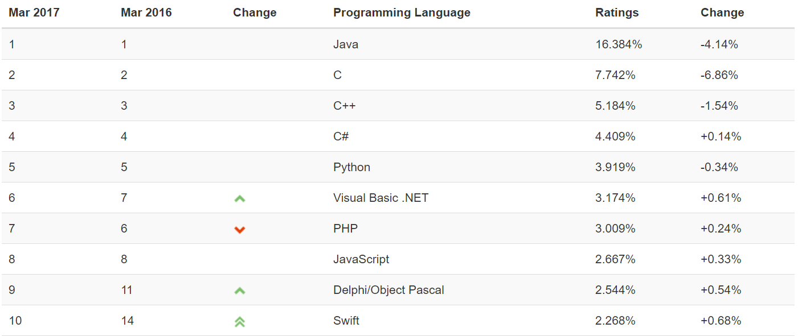
Object-Oriented Languages and Tools
The TIOBE index can be used to check whether your programming skills are still up to date or to make a strategic decision about what programming language should be adopted when starting to build a new software system. The full TIOBE is available online [link].
TIOBE Index for March 2017:
Notes:
We will utilize mostly Java and C# for our object-oriented programming examples. We may (or may not) do any Python work. Since it is often ‘unnatural’ to show procedural programming examples in Java, C#, or Python, we will implement programs in C to demonstrate procedure programming examples. Let me know if you have a desire to do some Python work… or work in another OOP language. If so, we can likely work something out.
Note that our reluctance to utilize C++ as a OOP learning tool is does not diminish the value of the C++ toolset. However, C++ is generally considered a very powerful set of tools with a steep learning curve. It’s a very sharp knife… use it carefully.

Slide 6
Java
Java is a general-purpose computer programming language that is concurrent, class-based, object-oriented, and specifically designed to have as few implementation dependencies as possible. [link]
Compiles to Java byte codes that run in the Java Virtual Machine (VM)
Achieved portability by running in VMs that exist on many platforms
Achieved dominance in the enterprise and for server side development
Plays a center role in Android development*
Served as a platform for multiple additional languages have been developed to compile to Java bytecode and run in the Java VM including Groovy and Scala
Achieved only minimal success in the development of commercial applications or applets
Syntax Notes: strongly typed, object-oriented, single inheritance, interface focused
Notes:
*The history of Google’s Android and Java is nothing short of a soap opera:
http://www.zdnet.com/article/the-real-history-of-java-and-android-as-told-by-google/
Android uses mostly the Java API but does not have the right to use the Java name. Be aware that Software and Legal Protections can be VERY complicated.

Slide 7
Python
An interpreted language, Python has a design philosophy which emphasizes code readability (notably using whitespace indentation to delimit code blocks rather than curly braces or keywords), and a syntax which allows programmers to express concepts in fewer lines of code than possible in languages such as C++ or Java. [link]
Achieves portability through interpreter running on various platforms
Achieved great success as a “quick-and-dirt” scripting tool
… and in the data sciences realm
Runs slower because it is interpreted
Shares a similar space to other scripting languages like Perl and PowerShell
Syntax Notes: loosely typed, indent sensitive (no brackets or semi-colons), object-oriented

Slide 8
C#... And .NET
C# (pronounced “see sharp”) is a general purpose programming language that implements strong typing, object-oriented (class-based), and component-oriented programming disciplines. It was developed by Microsoft within its .NET initiative. [link]
Compiles to .NET Common Language Runtime (CLR)
Portable between CLR implementations… but MS Windows focused
Portable between Windows desktop, cloud, XBOX, tablets, embedded, and phone
Focused on industrial strength client applications with a solid server-side presence
Syntax Notes: strongly typed, object-oriented, single inheritance

Slide 9
C#... And .NET (continued)
.NET Framework (pronounced dot net) is a software framework developed by Microsoft that runs primarily on Microsoft Windows. It includes a large class library and provides language interoperability (each language can use code written in other languages). Programs written for .NET execute in a software “managed code” environment named Common Language Runtime (CLR). [link]
Implementations for many languages are available for .NET and CLI including Python… but not “real” Java [link]
Provides and object-oriented platform that is language agnostic
ASP.NET is the “standard” .NET Web development environment
Achieving dominance on Windows desktop, competitive place in cloud (Azure), and XBOX

Slide 10
C#... And .NET (continued)
.NET Framework (pronounced dot net) is a software framework developed by Microsoft that runs primarily on Microsoft Windows. It includes a large class library and provides language interoperability (each language can use code written in other languages). Programs written for .NET execute in a software “managed code” environment named Common Language Runtime (CLR). [link]
Implementations for many languages are available for .NET and CLI including Python… but not “real” Java [link]
Provides and object-oriented platform that is language agnostic
ASP.NET is the “standard” .NET Web development environment
Achieving dominance on Windows desktop, competitive place in cloud (Azure), and XBOX

Slide 11
Professional Positioning
Become a professional software developer with depth in on or two areas (i.e. an expert in web application development in Java) and an understanding of several more (i.e. know a little system admin / devops and something about the healthcare industry).
Do NOT become the Java expert (only)
Languages and environments are tools, you will need to know several and be able to learn more
Branch out and play other related roles like business analyst, project manager, team leader, database analyst, product manager, architect, etc.
Know something about the domain
Get out and see your customers and business partners

Slide 12
End of Session
Course Number: CPSC-24500
Week: 6
Session: 1
Instructor: Eric Pogue

Slide 13
Object-Oriented Programming Session: Week 6 Session 2 Instructor: Eric Pogue
Download and install Visual Studio... And implement Hello World in C#
Identify characteristics of Java, Python, and C#
Professional positioning
Write non-object-oriented programs that use sequence, selection, and repetition
Define a C# class, complete with properties, methods, and constructors
Use C# built-in text file objects to create and read text files
Use inheritance to create a hierarchy of classes that are related to each other
Create objects of classes and use them to carry out the work of your program
Work with C# lists
Deal with a list of related objects polymorphically

Slide 14
FastPrime… plus Questions
Write a performance optimized command line C# application that will programmatically find prime numbers and store the numbers sorted in an output file.
In FastPrime we will create a command line Java application that will:
Use multiple threads to find the prime numbers between two numbers
Sort those results and store them to a file
Perform some timings
… And do this all very fast
Come to our Thursday lunch session with any questions… or email your question head of time
See the details in this week’s assignment.
Notes:
Application performance is ALWAYS a challenge. Learn how to optimize, test, and enhance the performance regularly. It can’t be built in at the end of a project!
Note that I have made updates to this week’s assignment. Please be sure to get the current version (it says “version 2” at the top) before you complete the assignment.

Slide 15
Performance Optimization and Threading
Performance is critical in application development… the focus of performance optimization continues to evolve, but the criticality remains very high! Multithreading is one very important way that we can optimize CPU performance; however, there are many other performance bottlenecks and optimization techniques:
CPU… threading
Memory… optimize disk usage, buy more memory
Disk IO… buffering, file size, or faster (more expensive) disks
Network bandwidth… “file” or package size
Network latency… pray for a miracle!
User Interaction and Capabilities
Notes:
I believe that performance optimization is one of the most important and challenging aspects of developing high quality software.
Consider mobile phone networks and satellite networks… and latency.
User experience.
Know the difference between latency and bandwidth and how it impacts network and application performance:
https://en.wikipedia.org/wiki/Network_performance
The following measures are often considered important:
Bandwidth commonly measured in bits/second is the maximum rate that information can be transferred
Latency the delay between the sender and the receiver decoding it, this is mainly a function of the signals travel time, and processing time at any nodes the information traverses
Throughput is the actual rate that information is transferred
Jitter variation in packet delay at the receiver of the information
Error rate the number of corrupted bits expressed as a percentage or fraction of the total sent
You can usually buy more bandwidth. Fixing a latency issue might require you to change the speed of light.

Slide 16
Threads & Multithreaded Applications
Multithreading: A technique by which a single set of code can be used by several processors or cores at different stages of execution.
Threads and application performance are becoming nearly synonymous
Moore’s law only remains achievable if we can effectively utilize multi-processor, multi-core, and multi-threaded applications
Our performance principles that we discuss will be applicable across platforms and environments
Our practical focus will be on Java multi-threading
Parallel processing has become the focus of the computing and software development industry
The rise of big data, artificial intelligence, virtual/augmented reality, and dedicated graphical processing units (GPUs) have made that a nearly guaranteed trend for years to come
Notes:
The difference between user perceived (real or perceived) is as important as actual performance. Optimizing application performance to reflect user capabilities is challenging and necessary. It doesn’t matter if you optimize an application to be 10 times faster if the bottleneck is how fast the user.
Multithreading is the primary method of optimizing CPU performance. It is unlikely to be of benefit if the bottleneck is elsewhere. For example, if you are disk bound, splitting your process into multiple threads is unlike to be of benefit.

Slide 17
Processors, Cores, and Threads
Computers have one or more Processors (CPUs)
Processors each have one or more Cores
Cores can create one or more Threads
An application running only on one thread of a dual cpu, quad-core, single thread can utilize only a portion of 1/8th of the processing power of that machine
Notes:
For this discussion we will using multithreading and multiprocessing terms synonymously for our purposes.
Modern central processing units (CPUs) are made up of cores. A core is like a mini-processor that works with its fellow cores to perform the work that applications request of the CPU. In the old days, a CPU had just one core, a single channel through which all requests would pass. This was how we optimized applications… CPU, memory, fast disk, slow disk. Today, though, with multiple CPUs and multiple cores, a CPU can pay attention to and do many things at once.
This architecture, in turn, allows today’s applications to perform multiple tasks at once. This ability is called multitasking. Multitasking enables an

Slide 18
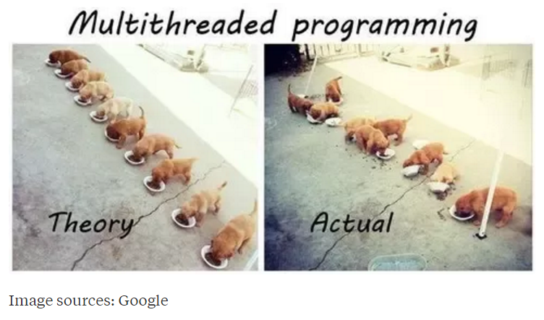
Multi-Threaded Development
Now for the bad news. Multi-Threaded Development is really hard!
Notes:
Rigidity - It is hard to change because every change affects too many other parts of the system
Fragility - When you make a change, unexpected parts of the system break
Immobility - It is hard to reuse in another application because it cannot be disentangled from the current application
Stadia add-in net change example.
Deadlock describes a situation where two or more threads are blocked forever, waiting for each other. Deadlock occurs when multiple threads need the same locks but obtain them in different order.

Slide 19
Multi-Threaded Development
Now for the bad news. Multi-Threaded Development is really hard!
Developing commercial quality multi-threaded applications makes Rigidity, Fragility, and Immobility much harder to avoid
Many of the 3rd party professional libraries that the industry had come to rely on came into question as multi-threading application became required
Testing becomes harder when a sequence of events becomes variable
What if your automated unit test results might be different depending on which thread finishes first?
What about deadlock?
Performance is so important that we will need to understand be able to effectively utilize, test, and deploy effective multi-threaded applications
Notes:
Rigidity - It is hard to change because every change affects too many other parts of the system
Fragility - When you make a change, unexpected parts of the system break
Immobility - It is hard to reuse in another application because it cannot be disentangled from the current application
Increased complexity is the primary disadvantage for developing multithreaded applications.
Some languages have come into existence in order to try to reduce the complexity of writing, enhancing, and supporting multithreaded applications. For example, Scala has implemented specific parallelization features in the core language that make it a first class threading language. Note that Scala also targets the Java runtime environment.
C++ would be an example of a language that has implemented a plethora of threading mechanisms for various platforms and implementations. Recent versions have introduced more common approaches.
Stadia add-in example.
Deadlock describes a situation where two or more threads are blocked forever, waiting for each other. Deadlock occurs when multiple threads need the same locks but obtain them in different order.
Interesting threading article:
http://blog.smartbear.com/programming/why-johnny-cant-write-multithreaded-programs/
When reviewing libraries look for something like “This class is immutable and thread-safe.” before you use it in multithreaded development.

Slide 20
Multi-Threaded Example
ThreadedRandomNumbers: Calculate 1,000,000,000 random numbers between 1 and 2,000,000. Print “We found number 1024!” to the console each time 1024 is generated. We would expect it to come up approximately 500 times.
Write a single threaded application
Divide the application into multiple threads and repeat
Consider the diminishing returns of adding additional threads
Implement by extending Thread
… and by implementing Runnable
Notes:
It’s good to have a trivial subject matter when starting with threaded applications. It’s challenging enough to learn a complex new topic when working with a random number or a prime number.
Bonus 10 points for anyone who can implement this application using “implements Runnable” and have it execute at the same speed as the “extending Thread” version… or explain why it performs consistently slower than the extends Thread implementation.

Slide 21
End of Session
Course Number: CPSC-24500
Week: 5
Session: 2
Instructor: Eric Pogue

Slide 22
Object-Oriented Programming Session: Week 5 Session 3 (assignment lunch & learn) Instructor: Eric Pogue
Agenda:
Quick Introductions
Discuss FastPrime Assignment
Potential topics… development philosophy, design, implementation questions, review threading sample application, others
Session feedback
Notes:
Start Recording!!!
Suggested steps:
Write a shell application that compiles, runs, and prints a message to the console… make sure that you compile and run the application regularly
Write down the key objects and methods that you believe that you will need
Write a working single threaded application that finds prime numbers… including inputs, timings, etc
Enhance it to use multiple threads
Test & Enhance
Submit
Ask for help at any time…

Slide 23
FastPrime… plus Questions
Write a performance optimized command line Java application that will programmatically find prime numbers [link] and store those numbers sorted in an output file.
In FastPrime we will create a command line Java application that will:
Use multiple threads to find the prime numbers between two numbers
Sort those results and store them to a file
Perform some timings
… And do this all very fast
See the details in this week’s assignment
Notes:
Application performance is ALWAYS a challenge. Learn how to optimize, test, and enhance the performance regularly. It can’t be built in at the end of a project!
Given our experience with ThreadedRandomNumbers you may want to experiment with extending Thread vs. implementing Runnable?

Slide 24
End of Session
Course Number: CPSC-24500
Week: 5
Session: 3
Instructor: Eric Pogue

Slide 25
Object-Oriented Programming Session: Week 5 Session 4 Instructor: Eric Pogue
Agenda:
Finish Multi-Threading Example… implement Runnable
Java Packages & JAR Files
Software Testing and JUnit

Slide 26
End of Session
Course Number: CPSC-24500
Week: 5
Session: 4
Instructor: Eric Pogue

