Slide 1

Web and Distributed Programming Instructor: Eric Pogue Session: 4
Agenda:
Friendly Conversation & Good Natured Banter… Dan?
Review Assignments
HTML5
Lab: “Hello World – HTLM EJP” (~20 min)
Assignments, Wrap-up, and Final Comments (~5 min)
Discussion & Questions welcome at any time… please be present with no phones or email during our discussion time

Slide 2

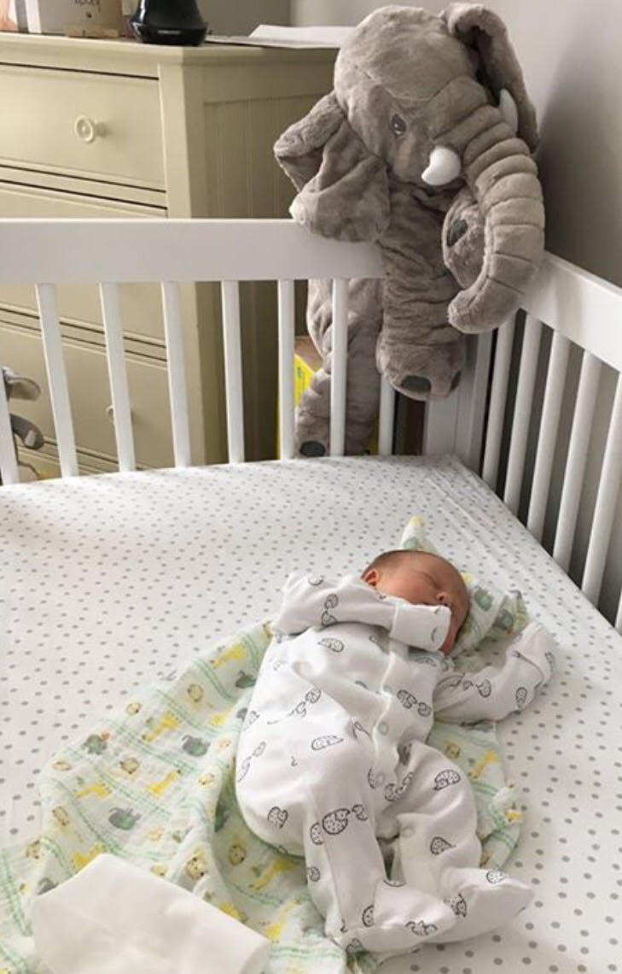
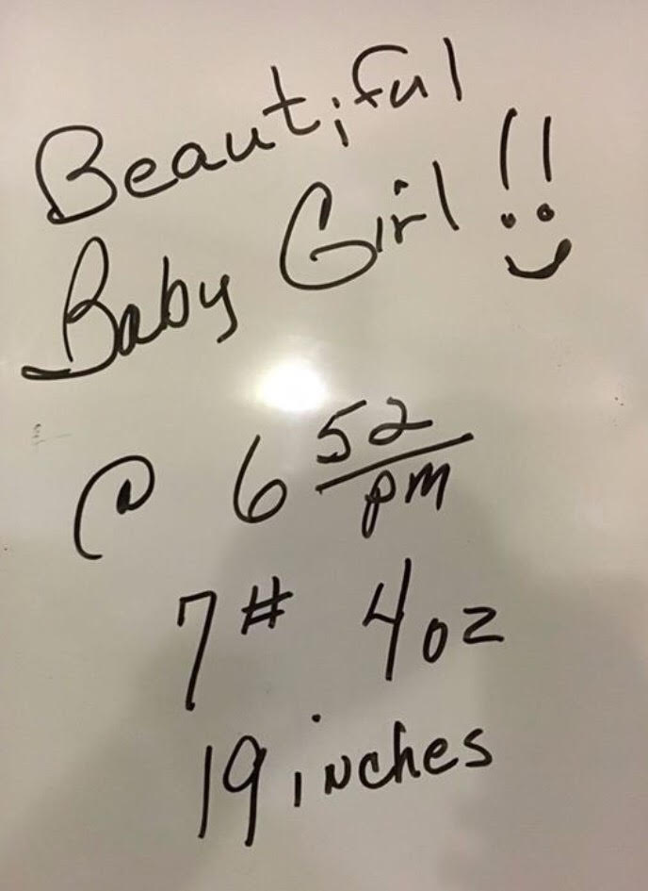
Amelia

Slide 3
Assignment Due Today
Assignment:
Ch.1.6 through 2.7
Lab Preparation… review a HTML5 Hello World implementation from the Web [link]
Notes:
Links:
https://www.w3schools.com/html/html5_intro.asp

Slide 4
Programming Web Pages with HTML5
Notes:
Time check… we need to start our Lab at 2:30.
Why have I changed the “Worldwide Web” to the “Internet”? By the end of this class it is your responsibility to know the difference.

Slide 5
Web and Distributed Programming Instructor: Eric Pogue Session: 4
Agenda:
Friendly Conversation & Good Natured Banter… Dan?
Review Assignments
HTML5
Lab: “Hello World – HTLM EJP” (~20 min)
Assignments, Wrap-up, and Final Comments (~5 min)
Discussion & Questions welcome at any time… please be present with no phones or email during our discussion time

Slide 6
Lab: “Hello World – HTML! EJP”
Log into your computer
Open your favorite text editor
Review HTML5 Hello World implementation from the Web [link]
Type in your own “Hello World – HTML! [your initials]”… Please be specific*
Type in your initials and not ‘[your initials]’
For “Hello World – HTML!”
Utilize an em dash ‘–’ in your HTML5/UTF-8 code [link]
Do you really understand the difference between ANSI and UTF-8? [link]
Utilize one space after punctuation marks like periods and exclamation points [link]
Save your file as a HTML utilizing dash-separated naming
‘hello-world-ejp.html’… please use your own initials
Recall why we do not want to utilize spaces in our file names [link]
Now launch your Web Browser and open the file you have just saved
Save this file to a safe place where you will be able to find it later… how will you choose to name your folders?
Submit the file through Blackboard
Notes:
Links:
https://www.w3schools.com/html/html5_intro.asp
Links from Hello World - Text:
http://www.accessc.com/articles/hyphen-en-dash-em-dash.html
http://www.differencebetween.net/technology/protocols-formats/difference-between-ansi-and-utf-8/ http://www.slate.com/articles/technology/technology/2011/01/space_invaders.html
https://en.wikipedia.org/wiki/Camel_case
https://www.thesitewizard.com/webdesign/create-good-filenames.shtml

Slide 7
Assignment for Friday
Assignment (before next class):
Review & Start Working on Project 1… it is due in two weeks

Slide 8
Wrap-up
Wrap-up:
Quiz 1 is due next Wednesday
You can take it up to three times
The best score out of the three will be taken
I would suggest taking it the first time early so that you can get more out of your study/lecture… we may take it the first time for our lab on Friday
I’m looking for a volunteer (or two) to look at Project 2 setting up a Website on Azure
How did the video work out?
Notes:
Are the videos something that we should incorporate into our class regularly?

Slide 9
Final Questions or Comments?

Slide 10
End of Session
Course Number: CPSC-24700
Instructor: Eric Pogue

