Slide 1

Web and Distributed Programming Instructor: Eric Pogue Session: 40
Agenda:
Thank you for a wonderful semester! … Please don’t hesitate to contact me in the future if I can be of assist stance
Final Review of Assignments
Review Schedule through the end of the Semester
Today’s Assignment
Presentations… Khaldoon, Daniel (Bewley) / Jimmy, and Ryan?
Project 5 / Week 14 Lab Architecture Review… if time allows
Discussion & Questions welcome at any time… please be present with no phones or email during our discussion time

Slide 2
Assignment by Friday, Dec 8
Assignment:
Review Final Exam Study Guide
Verify Project 5 review timeslots for Friday
Submit Project 5 today… you can continue to work on it up until your demo time on Friday
Review Cloud Computing and MapReduce slides

Slide 3
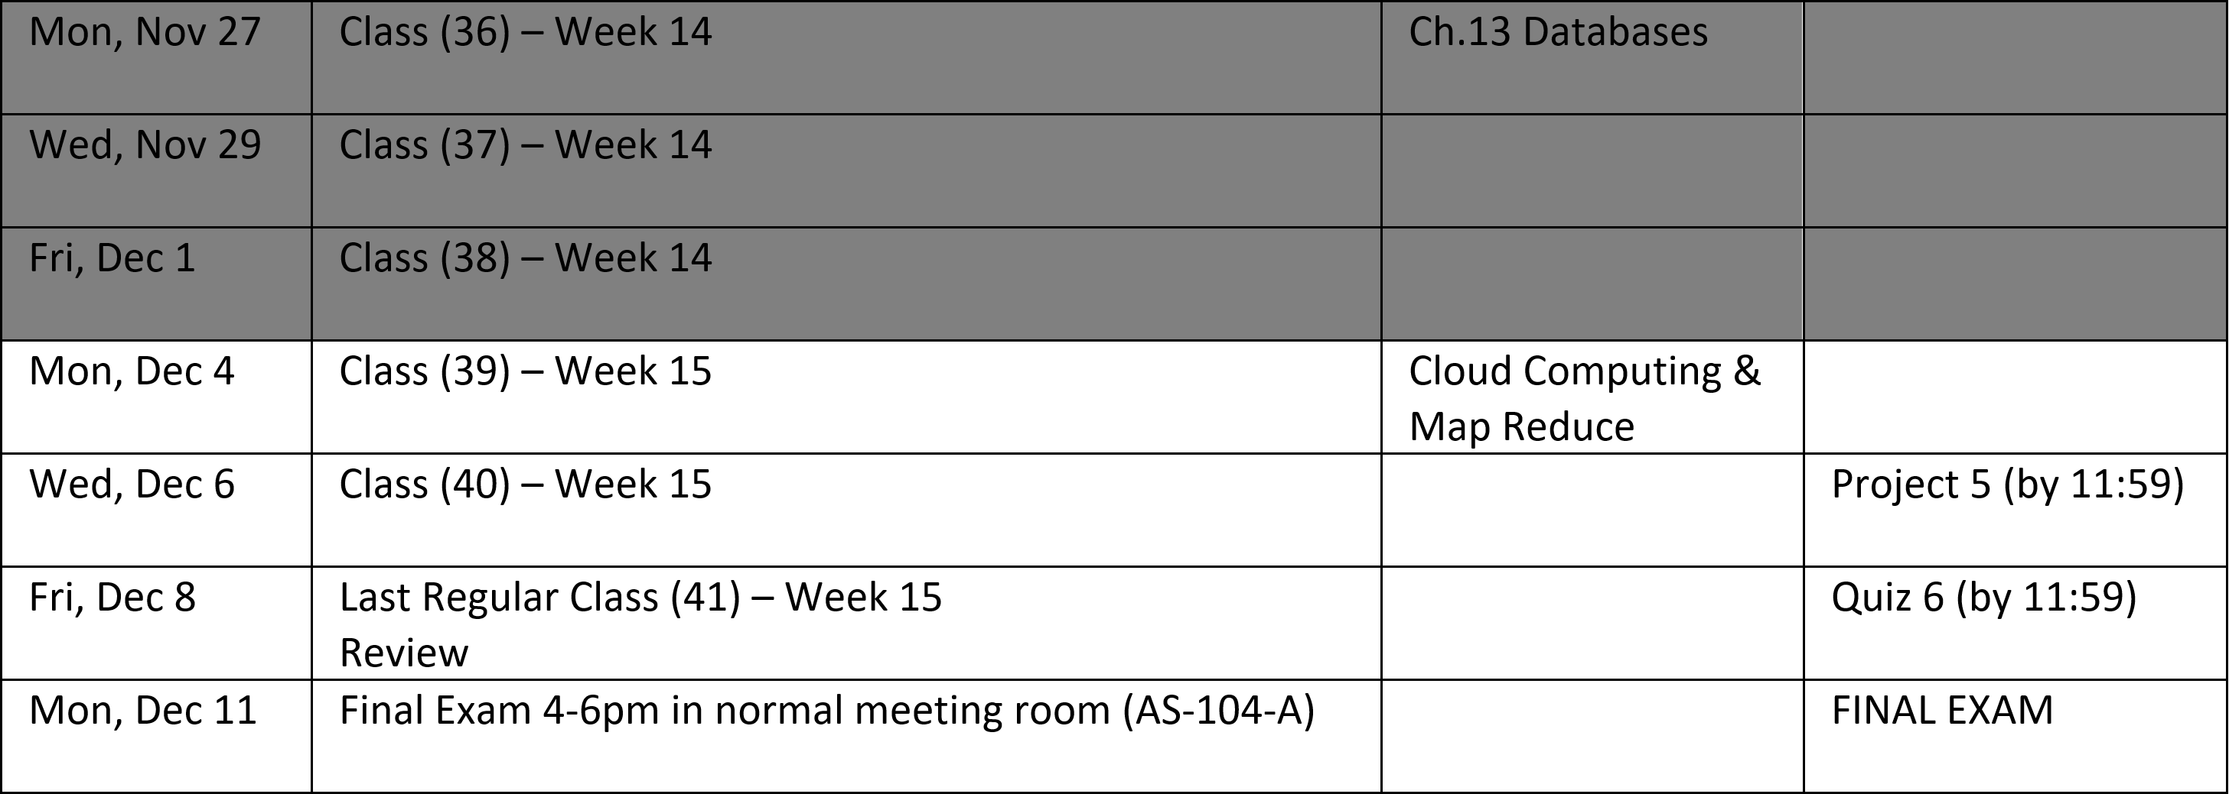
Schedule through the end of the Semester
Notes:
Database

Slide 4
Assignment by Monday, Dec 11
Assignment:
Turn in your project today (Friday)
Be reading for Final Exam Study Guide which is Monday from 4-6 in our normal room

Slide 5
Presentations

Slide 6
Project 5 / Week 14 Lab Architecture Review

Slide 7
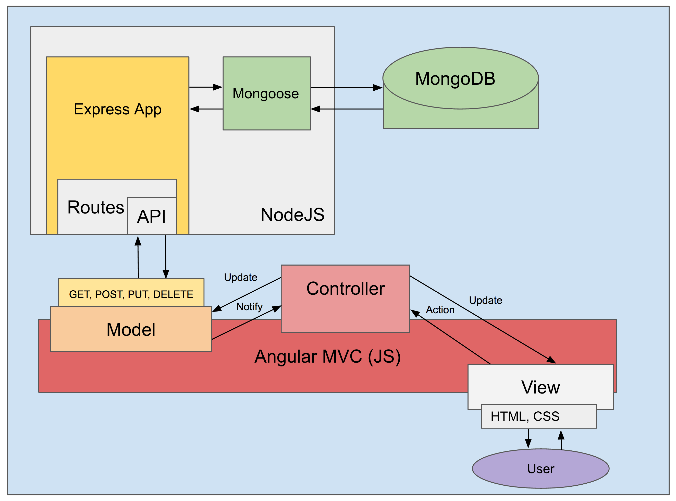
MEAN.JS
MongoDB,
ExpressJS,
AngularJS,
and Node.js
Model/View/Controller
Web Development Framework
Notes:
This is the developer/technology view… when talking with product managers or business people reverse the order and put the User at the top or left!

Slide 8
Development (Local Computer)
Test (Azure)…
Production (Azure)

Slide 9
End of Session
Course Number: CPSC-24700
Instructor: Eric Pogue

