Slide 1
Cloud Computing and Hadoop/MapReduce

Slide 2
Objectives
Discuss the concept of Cloud Computing
Explain the use of Distributed File Systems, in particular, Hadoop
Explain the MapReduce framework for large scale, distributed computing

Slide 3
Cloud Computing

Slide 4
What is Cloud Computing?
NIST Definition:
A model for enabling
ubiquitous, convenient, on-demand network access
to a shared pool of configurable computing resources (e.g., networks, servers, storage, applications, and services)
that can be rapidly provisioned and released with minimal management effort or service provider interaction.

Slide 5
Cloud Characteristics
On-demand self-service (dynamic provisioning)
Ubiquitous network access
Location independent resource pooling
Rapid elasticity (scalability)
Pay per use (utility-like service)
Notes:
On-demand self-service. A consumer can unilaterally provision computing capabilities, such as server time and network storage, as needed without requiring human interaction with each service’s provider.
Ubiquitous network access. Capabilities are available over the network and accessed through standard mechanisms that promote use by heterogeneous thin or thick client platforms (e.g., mobile phones, laptops, and PDAs).
Location independent resource pooling. The provider’s computing resources are pooled to serve all consumers using a multi-tenant model, with different physical and virtual resources dynamically assigned and reassigned according to consumer demand. The customer generally has no control or knowledge over the exact location of the provided resources. Examples of resources include storage, processing, memory, network bandwidth, and virtual machines.
Rapid elasticity. Capabilities can be rapidly and elastically provisioned to quickly scale up and rapidly released to quickly scale down. To the consumer, the capabilities available for rent often appear to be infinite and can be purchased in any quantity at any time.
Pay per use. Capabilities are charged using a metered, fee-for-service, or advertising based billing model to promote optimization of resource use. Examples are measuring the storage, bandwidth, and computing resources consumed and charging for the number of active user accounts per month. Clouds within an organization accrue cost between business units and may or may not use actual currency.

Slide 6
Delivery Models
Software as a Service (SaaS)
Use provider’s applications over a network
SalesForce.com
Platform as a Service (PaaS)
Deploy customer-created applications to a cloud
The networks, servers, storage and other services are provided
Google App Engine
Infrastructure as a Service (IaaS)
Rent processing, storage, network capacity, and other fundamental computing resources
Amazon EC2, S3
Notes:
Cloud Software as a Service (SaaS). The capability provided to the consumer is to use the provider’s applications running on a cloud infrastructure and accessible from various client devices through a thin client interface such as a Web browser (e.g., web-based email). The consumer does not manage or control the underlying cloud infrastructure, network, servers, operating systems, storage, or even individual application capabilities, with the possible exception of limited user-specific application configuration settings.
Cloud Platform as a Service (PaaS). The capability provided to the consumer is to deploy onto the cloud infrastructure consumer-created applications using programming languages and tools supported by the provider (e.g., java, python, .Net). The consumer does not manage or control the underlying cloud infrastructure, network, servers, operating systems, or storage, but the consumer has control over the deployed applications and possibly application hosting environment configurations.
Cloud Infrastructure as a Service (IaaS). The capability provided to the consumer is to rent processing, storage, networks, and other fundamental computing resources where the consumer is able to deploy and run arbitrary software, which can include operating systems and applications. The consumer does not manage or control the underlying cloud infrastructure but has control over operating systems, storage, deployed applications, and possibly select networking components (e.g., firewalls, load balancers).

Slide 7
Deployment Models
Private Cloud
The cloud infrastructure has been deployed, and is maintained and operated for a specific organization.
The operation may be in-house or with a third party on the premises.
Community Cloud
The cloud infrastructure is shared among a number of organizations with similar interests and requirements.
This may help limit the capital expenditure costs for its establishment as the costs are shared among the organizations.
The operation may be in-house or with a third party on the premises.

Slide 8
Deployment Models (cont.)
Public Cloud
The cloud infrastructure is available to the public on a commercial basis by a cloud service provider.
This enables a consumer to develop and deploy a service in the cloud with very little financial outlay compared to the capital expenditure requirements normally associated with other deployment options.
Hybrid Cloud
The cloud infrastructure consists of a number of clouds of any type, but the clouds have the ability through their interfaces to allow data and/or applications to be moved from one cloud to another.
This can be a combination of private and public clouds that support the requirement to retain some data in an organization, and also the need to offer services in the cloud.

Slide 9
Why Cloud Computing?
Without a Cloud:
Capital investment needed
Heavy fixed costs
Redundant expenditures
High energy cost, low CPU utilization
Dealing with unreliable hardware
Maintenance / replacement costs
High-levels of overcapacity (Technology and Labor)
Need to provide enough computing resources for most demanding applications at all times

Slide 10
Why Cloud Computing? (cont.)
Solution: supply computing resources like a utility
Efficient: economy of scale
All problems are outsourced to the cloud provider
The provider will share the overhead costs among many customers, amortizing the costs
You only pay for:
the amortized overhead
Your real CPU / Storage / Bandwidth usage

Slide 11
Cloud Computing Benefits
Cost Savings
Companies can reduce their capital expenditures and use operational expenditures for increasing their computing capabilities. This is a lower barrier to entry and also requires fewer in-house IT resources to provide system support.
Scalability/Flexibility
Companies can start with a small deployment and grow to a large deployment fairly rapidly, and then scale back if necessary. Also, the flexibility of cloud computing allows companies to use extra resources at peak times, enabling them to satisfy consumer demands.
Reliability
Services using multiple redundant sites can support business continuity and disaster recovery.
Maintenance
Cloud service providers do the system maintenance, and access is through APIs that do not require application installations onto PCs, thus further reducing maintenance requirements.
Mobile Accessible
Mobile workers have increased productivity due to systems accessible in an infrastructure available from anywhere.

Slide 12
Start of Session
Course Number: CPSC-24700
Instructor: Eric Pogue

Slide 13
Hadoop

Slide 14
Distributed Computing
Data intensive applications:
Data collection too large to transmit economically over Internet --- Petabyte data collections
Computation produces small data output containing a high density of information
Solution: Hadoop/MapReduce
Compute “near” the data
Aggregate the results and send back

Slide 15
What is Hadoop?
Hadoop is a software framework
Makes it easy to process vast amounts of data (>TBs), in-parallel on large clusters (1000s)
Hadoop includes:
Hadoop File System (HDFS) - distributes data
Map/Reduce - distributes application

Slide 16
Hadoop Software
Hadoop is open source software from Apache
Written in Java, but can interface with other languages
Runs on
Linux, Mac OS/X, Windows, and Solaris
Commodity hardware

Slide 17
Distributed File Systems
Hadoop is different from traditional distributed file systems (DFSs)
Traditional DFSs:
distribute files over a network.
provide performance, scalability, reliability, availability
Differences for Hadoop:
Assumes component failures are the norm (large number of commodity machines).
Files may be large (e.g., 100MB).
High, sustained bandwidth is more important than low latency.

Slide 18
Hadoop File System (HDFS)
HDFS is designed to store large files
Stores files as large blocks (64 to 128 MB)
Each block stored on multiple servers
Data is automatically re-replicated on need

Slide 19
Hadoop File System (HDFS)
HDFS provides automatic handling of hardware failures:
An HDFS instance may consist of hundreds or thousands of server machines, each storing part of the file system’s data.
Huge number of components
Each component has a non-trivial probability of failure
Some component of HDFS is always non-functional.
Detection of faults and quick, automatic recovery from them is a core architectural goal of HDFS.

Slide 20
HDFS Architecture
HDFS has a master/slave configuration
Master is a single NameNode
it manages the file system namespace
also regulates access to files by clients
In addition, there are multiple DataNodes
usually one per node in the cluster
these manage storage attached to the nodes that they run on
HDFS exposes a file system namespace and allows user data to be stored in files.

Slide 21
HDFS Architecture
Internally, a file is split into one or more blocks
These blocks are stored in a set of DataNodes.
The NameNode executes file system namespace operations, e.g.:
opening, closing, and renaming files and directories.

Slide 22
HDFS Architecture
NameNode also determines the mapping of blocks to DataNodes.
The DataNodes are responsible for serving read and write requests from the file system’s clients.
The DataNodes also perform block creation, deletion, and replication upon instruction from the NameNode.

Slide 23
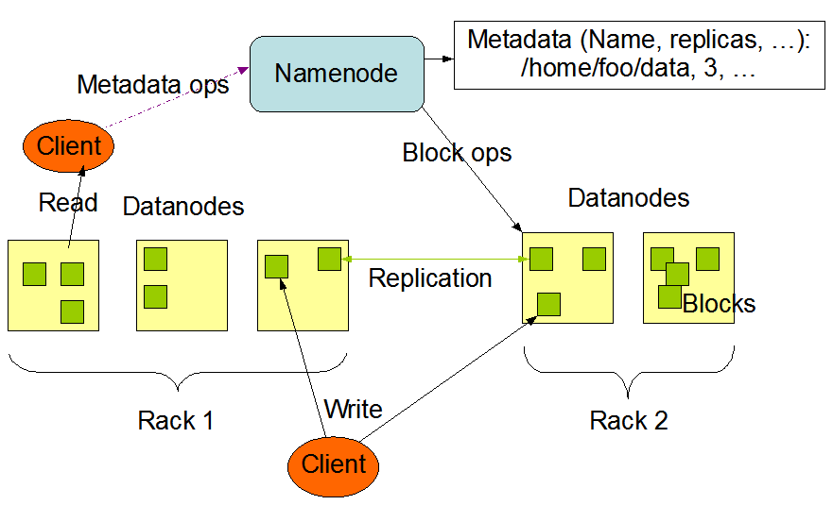
HDFS Architecture

Slide 24
HDFS Architecture
The NameNode and DataNode are pieces of software designed to run on commodity machines.
typically running the Linux OS
HDFS is built using the Java language
any machine that supports Java can run the NameNode or the DataNode software
Using Java makes the framework highly portable to a wide range of machines

Slide 25
HDFS - Typical Deployment
A dedicated machine runs only the NameNode software.
Each of the other machines in the cluster runs one instance of the DataNode software.
The architecture does not preclude running multiple DataNodes on the same machine but in a real deployment that is rarely the case.

Slide 26
NameNode
The NameNode maintains the file system namespace.
Any change to the file system namespace or its properties is recorded by the NameNode.
An application can specify the number of replicas of a file that should be maintained by HDFS.
The number of copies of a file is called the replication factor of that file.
This information is stored by the NameNode.
Having more replicas increases system reliability

Slide 27
NameNode EditLog
The NameNode uses a transaction log called the EditLog to persistently record every change that occurs to file system metadata
Creating a new file in HDFS causes the NameNode to insert a record into the EditLog indicating this
Changing the replication factor of a file causes a new record to be inserted into the EditLog

Slide 28
NameNode EditLog
The NameNode uses a file in its local host OS file system to store the EditLog.
The entire file system namespace, including the mapping of blocks to files and file system properties, is stored in a file called the FsImage
The FsImage is stored as a file in the NameNode’s local file system too

Slide 29
DataNode
The DataNode stores HDFS data in files in its local file system.
It has no knowledge about HDFS files.
It stores each block of HDFS data in a separate file in its local file system.

Slide 30
DataNode
The DataNode does not create all files in the same directory.
Uses a heuristic to determine the optimal number of files per directory and creates subdirectories appropriately.
It is not optimal to create all local files in the same directory because the local file system might not be able to efficiently support a huge number of files in a single directory.

Slide 31
DataNode
DataNode start up:
Scans through its local file system
Generates a list of all HDFS data blocks that correspond to each of the local files
Sends this report to the NameNode
this is called the Blockreport

Slide 32
Fault-Tolerance
Each DataNode sends a Heartbeat message to the NameNode periodically
A network partition can cause a subset of DataNodes to lose connectivity with the NameNode.
The NameNode detects this condition by the absence of a Heartbeat message.
The NameNode marks DataNodes without recent Heartbeats as dead and does not forward any new IO requests to them.
Notes:
Hint: Review slides 32 and 33 in detail.

Slide 33
Fault-Tolerance
Any data that was registered to a dead DataNode is not available to HDFS any more.
DataNode death may cause the replication factor of some blocks to fall below their specified value.

Slide 34
Fault-Tolerance
The NameNode constantly tracks which blocks need to be replicated and initiates replication whenever necessary.
The necessity for re-replication may arise due to many reasons:
A DataNode may become unavailable
A replica may become corrupted
A hard disk on a DataNode may fail
The replication factor of a file may be increased

Slide 35
Accessing the File Space
Access to the file system can be done using:
Java API
Web interface
Unix command tools
Examples using Unix commands:
Create a directory named /foodir | bin/hadoop dfs -mkdir /foodir
Remove a directory named /foodir | bin/hadoop dfs -rmr /foodir
View the contents of a file named /foodir/myfile.txt | bin/hadoop dfs -cat /foodir/myfile.txt

Slide 36
MapReduce

Slide 37
Map/Reduce Job
A Map/Reduce Job consists of files stored on the distributed file system (HDFS)
Data is split into independent datasets
Processed by map tasks (in parallel)
Outputs of maps are sorted and then input to the reduce tasks

Slide 38
Map/Reduce Framework Responsibilities
The framework takes care of:
Scheduling Tasks
Monitoring Tasks
Re-Executing Failed Tasks
Advantages:
Schedule tasks where the data exists
Easy to write programs, fast turn around

Slide 39
HDFS + Map/Reduce Configuration
Typically the compute nodes and the storage nodes are the same
i.e., the Map/Reduce framework and the Hadoop Distributed File System are running on the same set of nodes.
Allows the framework to effectively schedule tasks on the nodes where data is already present
Results in very high aggregate bandwidth across the cluster

Slide 40
Map/Reduce Framework
Consists of a single master JobTracker and one slave TaskTracker per cluster-node.
The master is responsible for:
Scheduling the jobs' component tasks on the slaves
Monitoring tasks on the slaves
Re-executing failed tasks
The slaves execute the tasks as directed by the master.

Slide 41
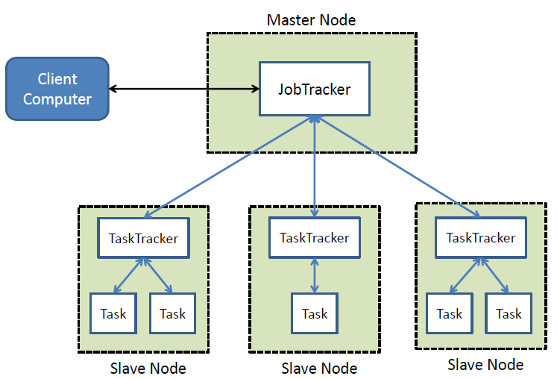
Map/Reduce Framework

Slide 42
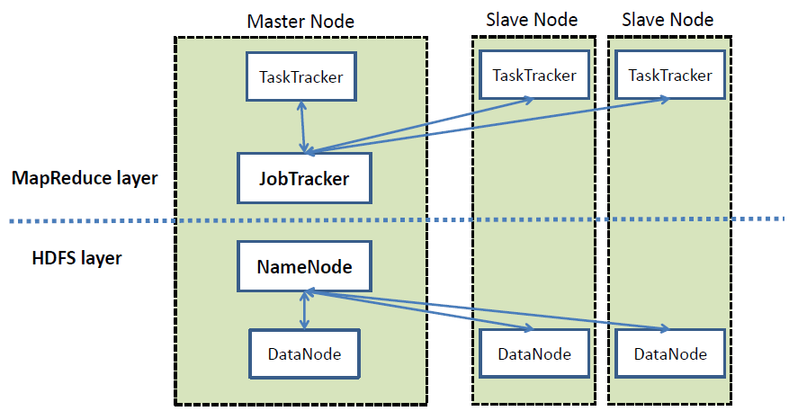
Map/Reduce w/ HDFS

Slide 43
Map/Reduce Applications
A Hadoop application consists of a Job client that submits a job by passing its job configuration
A job configuration consists of:
The input/output locations
Specification of map and reduce functions

Slide 44
Hadoop Applications
The Hadoop job client then submits the job (jar/executable etc.) and configuration to the JobTracker
The JobTrack then assumes the responsibility of:
distributing the software/configuration to the slaves
scheduling tasks and monitoring them
providing status and diagnostic information to the job-client.

Slide 45
Mapping and Reducing
MapReduce works using <key, value> pairs
The input to the job is a set of <key, value> pairs
The output produces a set of <key, value> pairs, possible of different types.

Slide 46
Map/Reduce Process
(input) <k_{i}, v_{i}>
-> map -> <k, v>
-> Group by k -> <k, [v₁, v₂, …]>
-> reduce -> <k_{o}, v_{o}> (output)

Slide 47
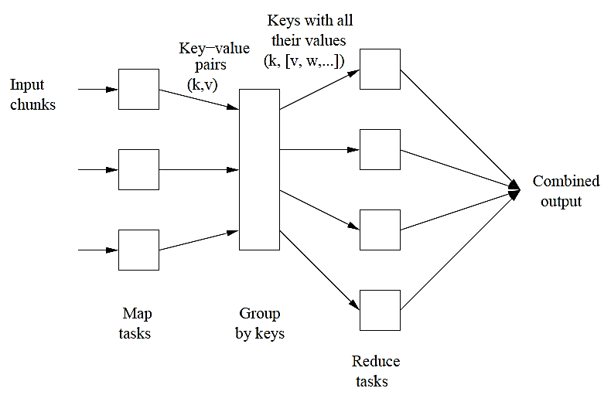
Map/Reduce Process

Slide 48
WordCount Example
Application: count the number of unique words in a set of documents
Input: <lineKey, lineText>
Mapper:
Splits the line into tokens (i.e. words)
Outputs < <word> , 1> for each word
Grouping:
Takes the < <word>, 1> pairs and outputs < <word>, [1,1,…]> pairs for each word
Reducer:
Takes the < <word>, [1,1,…]> pairs and outputs < <word>, count>

Slide 49
Example Mapper Outputs
Sample input:
File 1: “Hello World Bye World” (for mapper 1)
File 2: “Hello Hadoop Goodbye Hadoop” (for mapper 2)
First map emits:
< Hello, 1>
< World, 1>
< Bye, 1>
< World, 1>
Second map emits:
< Hello, 1>
< Hadoop, 1>
< Goodbye, 1>
< Hadoop, 1>

Slide 50
Example Reducer Outputs
Reducer input:
< Hello, [1 1]>
< World, [1 1]>
< Bye, [1]>
< Hadoop, [1 1]>
< Goodbye, [1]>
Reducer output:
< Hello, 2>
< World, 2>
< Bye, 1>
< Hadoop, 2>
< Goodbye, 1>

Slide 51





Real-Life Success Story
17,481 non-searchable
document
images
~30 mins
per document
to perform OCR
1,407 VM hrs
$144.62
Search Tool Internal: 9 hrs, Web: 26 hrs
Notes:
Washington Post: the Washington Post was able to convert 17,481 pages of scanned document images into a searchable database in about a day using Amazon EC2. On March 19th at 10am, Hillary Clinton’s ofﬁcial White House schedule from 1993-2001 was released to the public as a large collection of scanned images (in PDF format, but non-searchable). Washington Post engineer Peter Harkins used 200 Amazon EC2 instances to perform OCR (Optical Character Recognition) on the scanned ﬁles to create searchable text – “I used 1,407 hours of virtual machine time for a ﬁnal expense of $144.62. We consider it a successful proof of concept.”

Slide 52
Summary
Cloud computing is a cost-effective and efficient means of distributed computation
Hadoop/MapReduce is a distributed computing solution used for very large data sets
Hadoop provides a distributed file system (HDFS) and the MapReduce framework for computing

Slide 53
End of Session
Course Number: CPSC-24700
Instructor: Eric Pogue

