Slide 1

Web and Distributed Programming Instructor: Eric Pogue Session: 40
Agenda:
Friendly Conversation & Good Natured Banter
Quick Review of Assignments From Last Class
Review Schedule through the end of the Semester
Cloud Computing & Map Reduce Questions
Project 5 / Week 14 Lab Architecture Review
Today’s Assignment
Project 5 Review and Lab Time
Friday Class Presentations… Khaldoon, Daniel (Bewley) / Jimmy, and Ryan?
Signup for Friday private demo times before or after class
Discussion & Questions welcome at any time… please be present with no phones or email during our discussion time

Slide 2
Assignment by Wednesday, Dec 6
Assignment:
Verify the you can access Final Exam Study Guide… let’s do that now
Signup for a Project 5 review timeslot for Friday… if you are not already presenting in class
Continue to focus on Project 5… which is due one week from today
Review Cloud Computing and MapReduce slides

Slide 3
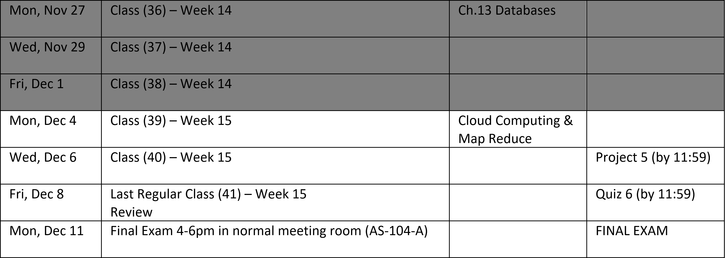
Schedule through the end of the Semester
Notes:
Database

Slide 4
Cloud Computing & Map Reduce

Slide 5
Project 5 / Week 14 Lab Architecture Review

Slide 6
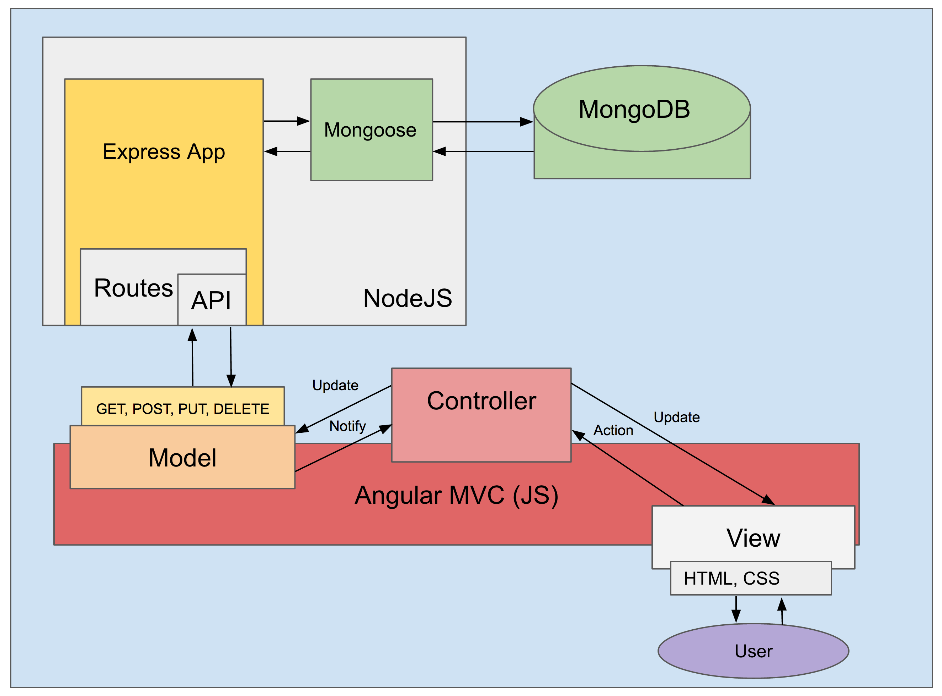
MEAN.JS
MongoDB,
ExpressJS,
AngularJS,
and Node.js
Model/View/Controller
Web Development Framework
Notes:
This is the developer/technology view… when talking with product managers or business people reverse the order and put the User at the top or left!

Slide 7
Development (Local Computer)
Test (Azure)…
Production (Azure)

Slide 8
Assignment by Friday, Dec 8
Assignment:
Review Final Exam Study Guide
Verify Project 5 review timeslots for Friday
Submit Project 5 today… you can continue to work on it up until your demo time on Friday
Review Cloud Computing and MapReduce slides

Slide 9
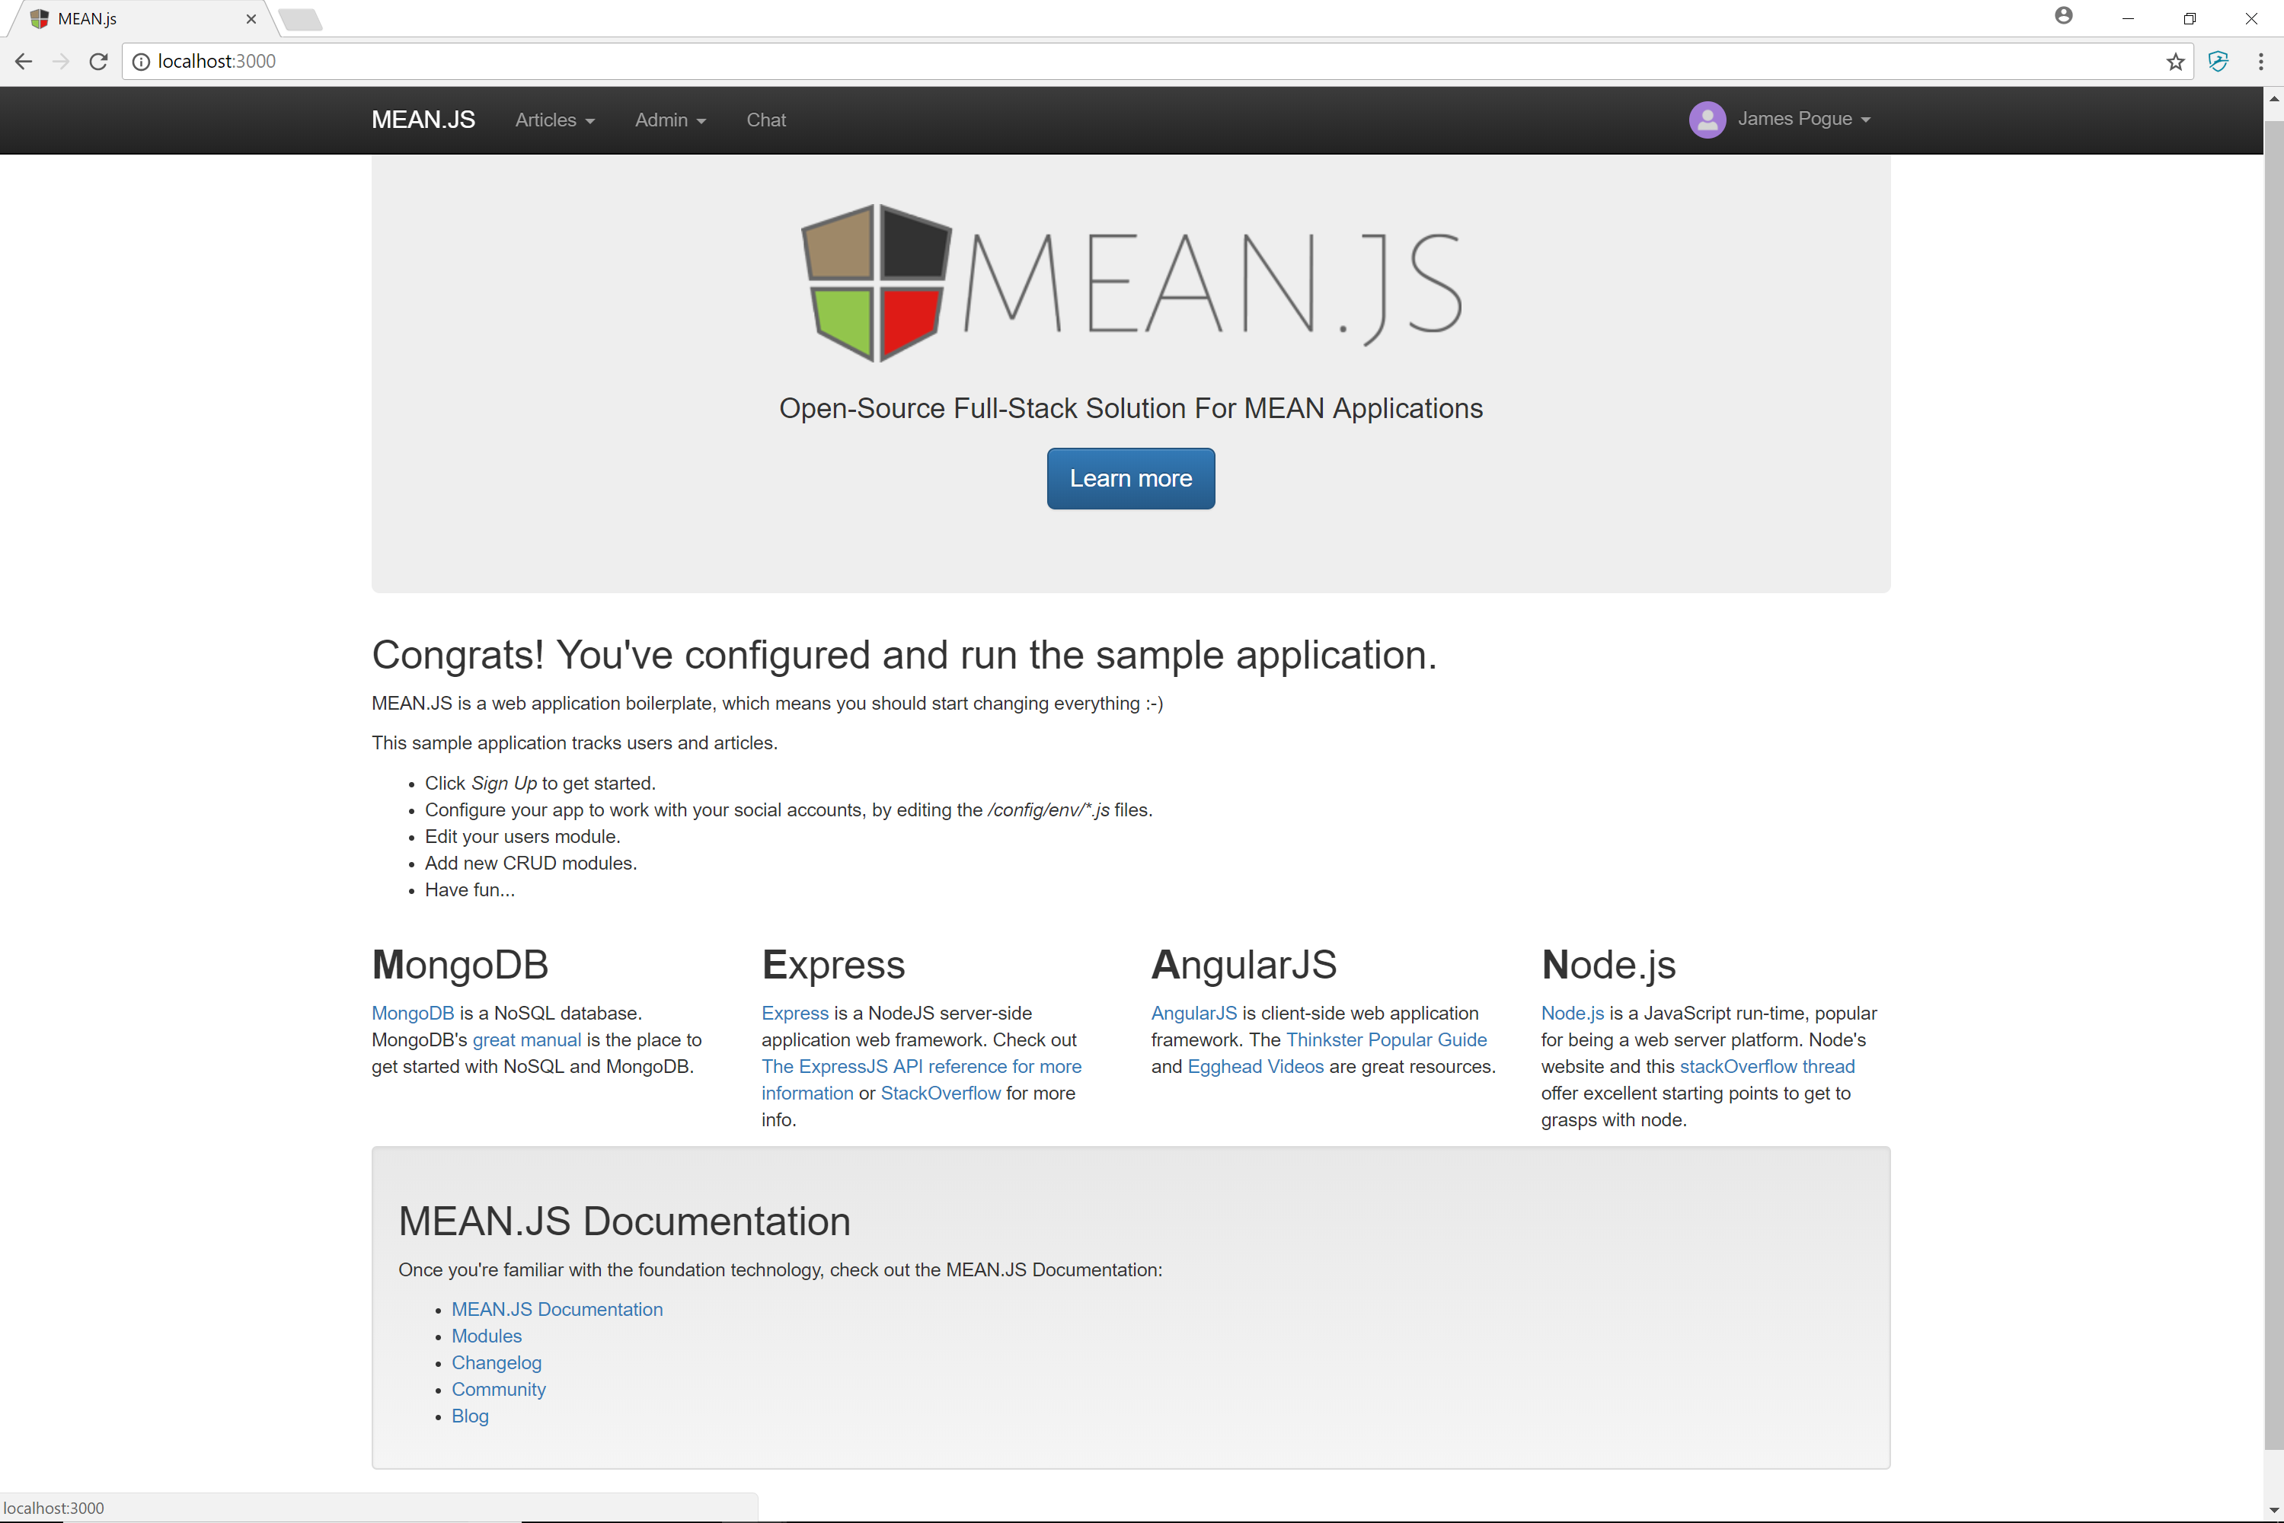
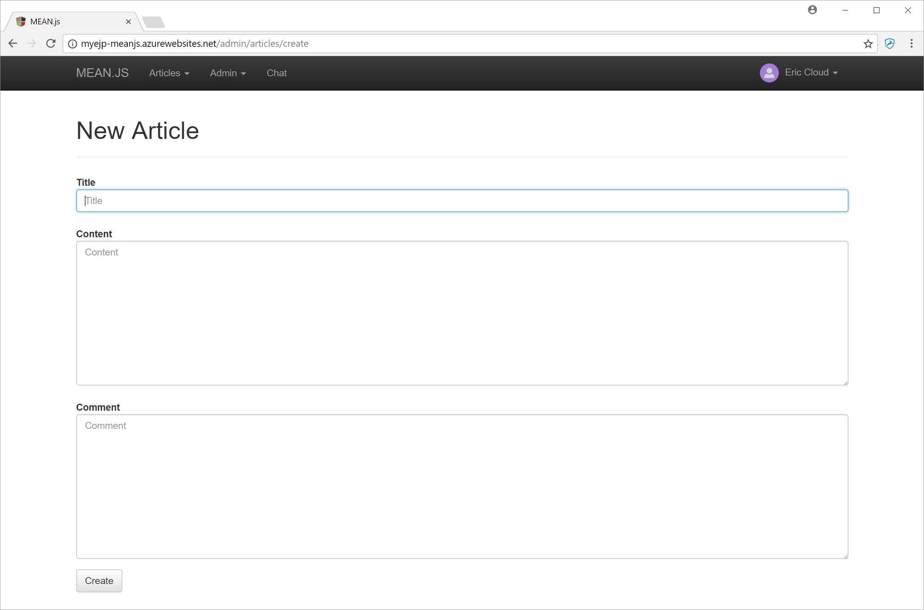
What does Project 5 Success Look Like
Plus something unique from your project…
Notes:
URL to sample implementation:
http://myejp-meanjs.azurewebsites.net/

Slide 10
Project 5 Lab

Slide 11
End of Session
Course Number: CPSC-24700
Instructor: Eric Pogue

