Slide 1

Object-Oriented Programming Discussion & Lecture: Week 1 Instructor: Eric Pogue
Agenda – Week 1 Discussion & Lecture (21 Mar 17 at 3pm CST)
Friendly Conversation & Good Natured Banter (~5 min)… let’s make sure that everyone can hear and speak in the virtual meeting
Welcome (~5 min)
Introductions (~10 min)
Review Course Syllabus (~15 min)
Review selected Learning Objectives from Week 1 (~50 min)
Additional Topics (~10 min)
Setters & Getters
Java Development Environment Overview
Wrap-up and Final Notes (~15 min starting no later than 4:15)
Question & Discussion Welcome at and Time
Notes:
Questions are welcome at any point!
I am not intending to review every part of documents that are out there.
If you have time this week. please get your Java development environment set up this week. That’s not something that you will want to be messing with next week when we are working on our first MVC assignment.

Slide 2
Welcome!
Welcome to Object-Oriented Programming at Lewis University (CPSC-24500)
I am looking forward to working with you during the coming eight weeks. Object-oriented programming is a sophisticated software development method that will enable you to create modern, professional-looking software. It is also an essential tool to manage the ever increasing complexity of modern software and information technology solutions.
Although it can be difficult to learn at first, you will eventually find that object-oriented programming techniques will greatly expand what you can do as a software developer. By the end of this course, I think you will be quite proud of how much you can implement as a software developer. My job is to help you get to that point.
Notes:
First off Welcome! I’m glad you are here. My goal is to get every one of you through this class and to help you learn some object oriented software development techniques along the way. Even if you don’t intend to be a professional software developer, many of the things that we learn will be valuable in related areas.
Object-oriented programming is the way that the industry develops modern complex sophisticate applications. There really isn’t a viable alternative to:
1 – Effectively leverage other peoples code… Graphical User Interfaces
2 – Develop, maintain, support, enhance large applications
3 – It will be a challenge at first to adjust your mindset… but I promise it will become easier and more natural
You live in the Golden Age of software development. Many good jobs, wonderful tools, interesting and valuable problems to solve.

Slide 3
Introductions… My Discussion Board Posting
Hello, my name is Eric Pogue. I am looking forward teaching this class and being part of your professional software development journey.
I have spent most of my career working in the software development industry in various developer, architecture, project management, and leadership roles. Object-oriented design and programming have always been a passion of mine … even before it was the “cool” way of developing software products.
The first part of my career was focused on developing commercial software products like PaintShop Pro, Quicken Family Lawyer, and Personal Tax Edge for companies like Jasc Software, Intuit, and Parsons Technology. The second part of my career was dedicated developing a variety of software products for John Deere customers. Precision farming and telematics were the areas that I enjoyed the most.
Recently my fiancé and I relocate to Lombard. She is an elementary school teacher in Lemont, and I am pursuing a startup venture developing interactive rendering solutions for the architects.
I enjoy triathlons and wilderness canoeing & camping with my children. Quetico (the Canadian side of the Boundary Waters) is my favorite place to adventure.
I’m looking forward to getting to know each of you, and I sincerely hope you will enjoy taking this class as much as I know that I will enjoy teaching it.
Notes:
Sooo… in a moment, I am going to go around on the phone and ask you to give at least a brief introduction of yourself. At least your name and where you are dialing in from today.
This is from my Discussion Board post… I am asking all of you to provide a discussion board introduction post of your-self this week.
Microsoft C/C++ 6… yes, this was before Visual C++ or Visual Studio. Mid-1990s. There was actually a lot of debate at that time as to if the benefits of C++ were sufficient to move from C.
Although I have taught multiple university level software development courses in the past, this is the first one I have taught at Lewis University.

Slide 4
Syllabus
Object-Oriented Programming (CPSC-24500)
Instructor: Eric Pogue, Adjunct Instructor, Computer and Mathematical Sciences
Office Hours: Wednesdays 3-5pm and by appointment
Email: epogue@lewisu.edu
Phone: (630) 613-7088
Course Description:
Students will learn to design and develop software using the object-oriented approach. Topics include encapsulation, inheritance, polymorphism, abstraction, and patterns. Students will learn how to use an SDK to develop desktop and web applications that provide data processing and visualization services. Students will also learn how to manage threads and networking connections in software they write.
Credits: 3
Prerequisites:
CPSC 21000 Programming Fundamentals or consent of instructor

Slide 5
Syllabus (continued)
Course Objectives:
Students will be use basic object-oriented constructs to write complex programs in multiple object-oriented languages. Additionally, students will be able to design and implement efficient data-intensive multi-threaded applications that interface with each other over networks.
Student Learning Outcomes:
On the successful completion of this course you will be able to:
Solve problems by writing programs using standard language elements such as data declarations, arithmetic operations, conditional statements, loops, and functions
List and explain the key concepts of object-oriented development: inheritance, abstraction, information hiding, and polymorphism.
Describe problems that typically plague software: rigidity, fragility, immobility
define the following object-oriented patterns: Factory, Singleton, Delegation, and Model-View-Controller
Define and provide examples for object-oriented design principles: Liskov Substitution Principle, Dependency Inversion Principle, Interface Segregation Principle, Open-Close Principle, Single-Responsibility Principle
Write class definitions and create objects from them
[And many more…]

Slide 6
Syllabus (continued)
Textbook:
No textbook is required for this course. The course notes will give serve as the text.
Recordings:
Because there is no required textbook, each session is recorded and posted online.
Course Materials:
Class notes, assignments, video recordings, and other course materials will be posted under the weekly links on our Blackboard site. Click on “Week 1” to see the recordings and other course materials for our first week of class. New materials will be made available each week.
Assignments:
All assignments must be submitted using the Blackboard assignment area. You must make sure that your email address is recorded on Blackboard, because Blackboard’s email facility will be utilized to send messages to the class.
Course Requirements:
Homework will be assigned weekly to help you keep your skills sharp. Each homework will include a requirement to post to the Discussion Board and respond to another student’s post. Your performance on the homework will determine your grade in the course.

Slide 7
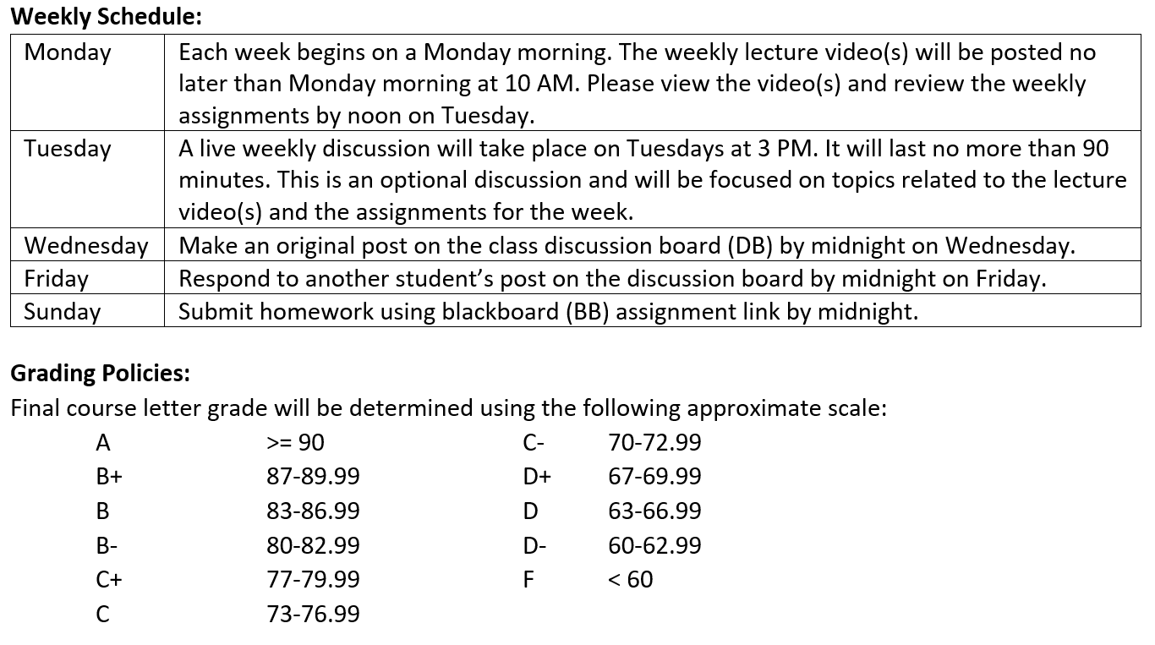
Syllabus (continued)
Notes:
Note that we are not planning on having formal exams.

Slide 8
Syllabus (continued)
Key Dates for Dropping or Withdrawing:
Before March 26, a student can drop the course, receive a full (100%) refund, and nothing will appear on their transcript
Between March 27 and April 2, a student can drop the course, they will receive a 50% refund, and nothing will appear on their transcript.
Between April 3 and April 18, a student can withdraw from the course and receive a “W” on their transcript (no refund will be received).
After April 18, a student cannot drop or withdraw from the class.
Participation:
You must participate consistently throughout the course by reading the notes, working on the examples from class, attending the class session or watching the class recordings, and working on the homework gradually rather than all at once. If you don’t, you won’t succeed in this course, because you won’t be building a deep understanding of the course material.

Slide 9
Learning Objectives
Define object-oriented programming
Position object-oriented programming within Software Development Lifecycle (SDLC)
Review object-oriented language and tool selection
Demonstrate object-oriented programming concepts with examples
Distinguish between a class and an object
Review object-oriented concepts… mostly focused on Encapsulation and Polymorphism
Identify the superclass and the subclass in an inheritance relationship
Demonstrate inheritance, ownership, and abstraction in snippets of Java code
Distinguish between aggregation and composition
Depict classes and their relationships using UML class diagrams
Define and discuss common object-oriented design patterns... MVC
Define and discuss common object-oriented design principles and characteristics of bad software… briefly if there is time
Recap: How is object-oriented programming different
Recap: Why did we choose to learn an object-oriented approach in developing software
Notes:
We have a lot of solid topics for our first week. You will quickly notice that three words are underlined. You will see references to object-oriented concepts, patterns, and principles throughout the week and throughout the class.
Concepts: Practices, standards, and tools the effectively support object-oriented design and programming… I need to do enhance the BMI class to provide better Encapsulation and hide the height and weight properties (hours).
Patterns: Well established templates for forging relationships between classes… I would like to generate the random Animal generator using a Factory pattern so it is more supportable (days)
Principles: Proven industry guidelines… Using a Factory Pattern is a good start; however, I think we should focus more on making sure that we follow the Open Close Principle throughout our product (weeks+)
If you take a look through the topics you will hopefully see a few that are familiar; however, I suspect that many will be new. Don’t be concern, by the end of the week you will have some familiarity with all of them. You should also have resources that will let you go back and refresh you memory when you need to do that.
I am going to divide the topics up into three or four sections so that we can focus and keep our energy.

Slide 10
Object-Oriented Programming [link]
Object-oriented programming (OOP) is a programming model based on the concept of "objects", which contain both Attributes (data) and Methods (procedures) that operate on that those attributes.
Most popular OOP languages are class-based, meaning that objects are instances of classes.
It includes concepts, patterns, and principles for designing and implementing modern software products.
Concepts – powerful features that prove indispensable to modern software development, brought to us automatically by object-oriented programming.
Patterns – tried-and-true templates for forging relationships between classes
Principles – guidelines that help you determine what classes are needed and how they should divide up the work
Notes:
I will often start with definitions from Wikipedia and other sources. If you are struggling with a topic and/or would like more information, it can often be valuable to review the references. You should be able to click on the [link] tag (possibly while holding the shift key down) in order open the reference in a browser. Please let me know if this is not working for you.
Walking through the slide, you will see that words and terminology will be important as we discuss and learn new concepts. During the course I am sure you will notice that at times I will struggle with the attribute/property vs. data and method vs. procedure distinction when I am talking. I would like for us to try to make that distinction in our work as we go through the term.
For the purposes of this class, “attributes” and “properties” will be used interchangeably to describe variable belonging to a class or object. Also “procedures” and “functions” will be used interchangeably.

Slide 11
Object-Oriented Concepts Example
Implementing the body mass index (BMI) calculation in Java and C should allow us to effectively demonstrate some object-oriented design and programming concepts (Java). We will also compare that to how we would have implemented the same calculation using procedural programming techniques.
Background: BMI is a statistic developed by Adolphe Quetelet in the 1900’s for evaluating body mass. It is not related to gender and age. It uses the same formula for men as for women and children.
The body mass index is calculated based on the following formula:
BMI = weight [kg] / (height [m] * height [m])
Procedural BMI (body mass index):
Data:
Height
Weight
Procedures (or functions):
CalcBMI
Object-Oriented BMI:
Class BMI
Attributes
Height
Weight
Methods
CalcBMI
Notes:
Well let’s get started on a real-world example that will allow us to see how OOP is used, and to learn some of the basic concepts like classes and objects. I’ve picked a body mass index (BMI) calculator as our first example. If retrospect, I wish I would have used something with shapes or animals. However, I assure you that there will be no shortage of shape and animal examples in the coming weeks.
Can you see how data and procedures/functions map directly to call attributes and methods? Even though it is a directly mapping, it is still good to get our terminology correct.

Slide 12
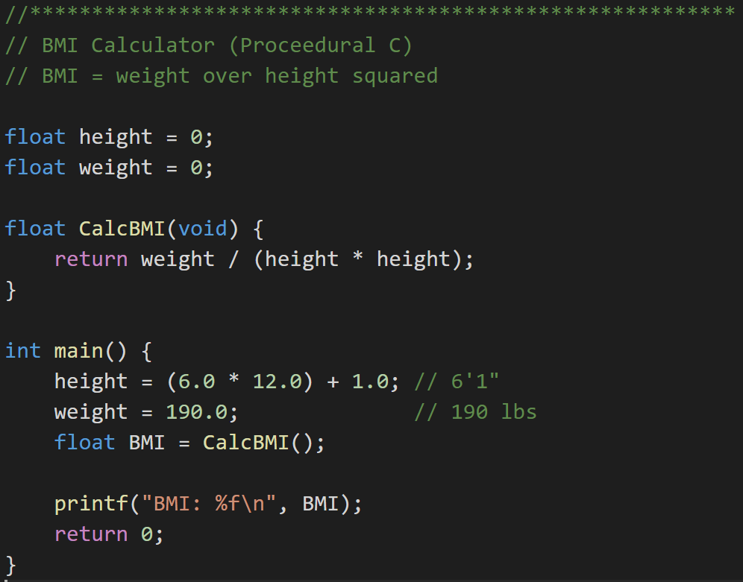
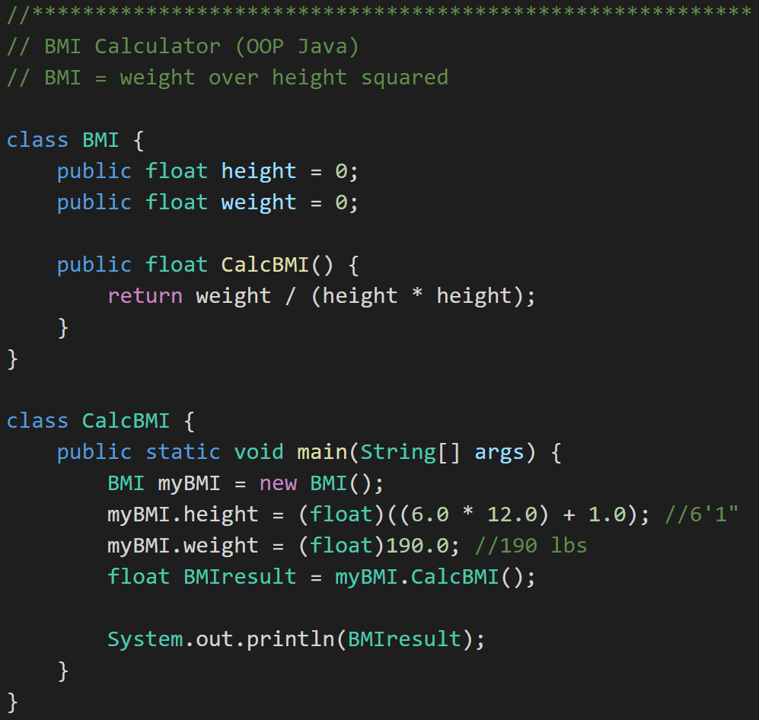
Example: Procedural vs. Object Oriented Programming
Procedural BMI (C):
“Object-Oriented” BMI (Java):
Notes:
Now let’s look at some real code examples. You will quickly notice that I like to use real code examples over philosophical discussion topics. I will try to make the more important coding examples available to you on my GitHub account. Let me know if you see something and would like a copy.
We have quite a lot of code to look at here. Let’s start with the procedural C code. We have data (height & weight) and procedures (CalcBMI)…
We have a pretty simple formula…
When I coded this the first time I used ‘int’ instead of ‘float’ for all my variables. That didn’t work very well.
If you look carefully you will see that we still have a logic problem in both of our implantations. Don’t worry we are going to get back to fix that using some of our OOP concepts.
For now let’s focus on looking through our first OOP Java implantation. We have our first class. Very nice, we will see many more of those.
Let’s go to the next slide to take a closer look at our class.

Slide 13
Distinguish Between a Class and an Object
Procedural BMI (C):
“Object Oriented” BMI (Java):
Notes:
There we have it, a class. It has attributes (height & weight) and a method (CalcBMI). Still has the same logic problem… but let’s wait on that.
Now we need to be able to use our class to do something. For that we need to create an instance of our class.

Slide 14
Distinguish Between a Class and an Object
Procedural BMI (C):
Object Oriented BMI (Java):
Notes:
Ahhhh… and we have an object “myBMI’ which is an instance off the class “BMI”.
We use or myBMI object to set some properties and then we have it calculate BMI by calling “my.BMI.CalcBMI()”
… and of course when we compile and run it, we get… the wrong answer. But it compiled and ran successfully. That’s something, right?
I know you can’t wait to see how this BMI story ends, so that will be our starting point for Section 2. How to fix BMI using object-oriented concepts/techniques.

Slide 15
The “six” (Three plus) Object-Oriented Concepts
Object-oriented concepts:
Encapsulation… and Information Hiding
Inheritance… and Abstraction
Polymorphism
Plus… Composition & Aggregation
Notes:
Helpful Interview Hint: Whenever you are asked a conceptual question about object-programming in an software development interview (and you will be), answer confidently “Encapsulation”, “Inheritance”, and “Polymorphism”.
When asked what is Encapsulation (or how would you implement it), say, “I would limit or minimize variable scope and keep data attributes private as often as possible.”
Now as we are going through our object-oriented examples, be thinking about how you would answer the “What is Inheritance?” and “What is Polymorphism?” interview questions. Note that answering them both with very brief examples can be very effective… and it is always best to use animals in you OOP interview examples.
Now we just need to make sure that we are able to effectively utilize these concepts after we get the job. Let’s start by walking through an example.

Slide 16
Encapsulation & Information Hiding
Encapsulation: Wrapping properties and methods into a class and minimizing the scope of those properties and methods.
Information Hiding: Minimize visibility/scope of data, attributes, functions, and methods.

Slide 17
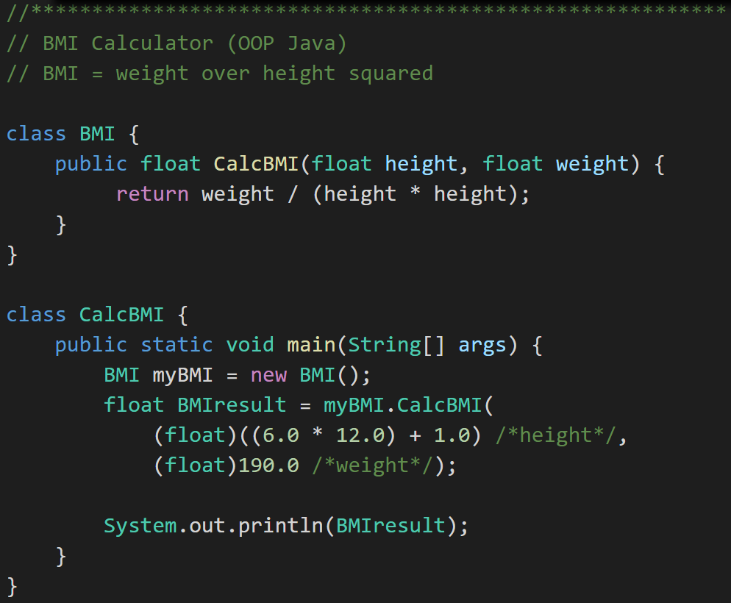
Encapsulation
Object -Oriented BMI:
Encapsulated Object-Oriented BMI:
Notes:
First, let’s Encapsulate our code.
#1 Rule for Encapsulation: Minimize class property and method scope and visibility: (1)none, (2)local, (3)method parameters, (4)private attribute, (5)protected attribute, and (6)public
In this case we can’t eliminate our height and width properties, and we can’t make them local to our method. However, we can make them parameters to our CalcBMI method. That’s a nice simplification. It also makes it very unlikely that future changes will impact users of our BMI class.
Consider: How would you add protective code around setting height to 0 in the initial code (height > 2ft & <9ft)? … How about in our second encapsulated example? Once again consider reuse, testing, and additional modification if this were thousands of lines off code.
This type of Encapsulation & Information Hiding is a feature of nearly all modern development languages… not just object-oriented languages.

Slide 18
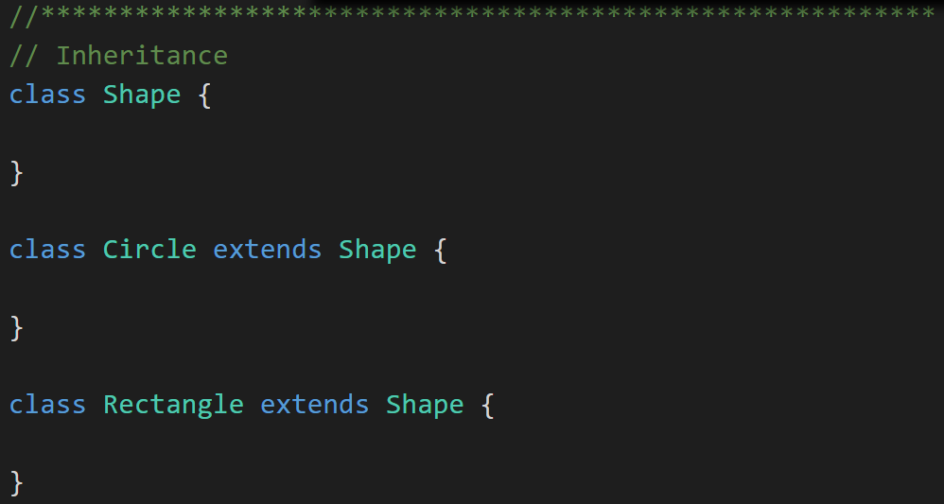
Inheritance & Abstraction
Inheritance: When one class acquires the properties and methods of another class it is called Inheritance.
Abstraction: Something is abstract when it is a concept but is not concrete or defined enough to actually be built. Generally, in OO design, we start with abstract things, and then we build on them through Inheritance.
Notes:
The first of many “Shape” examples. We will get to a Abstraction example in a few minutes.

Slide 19
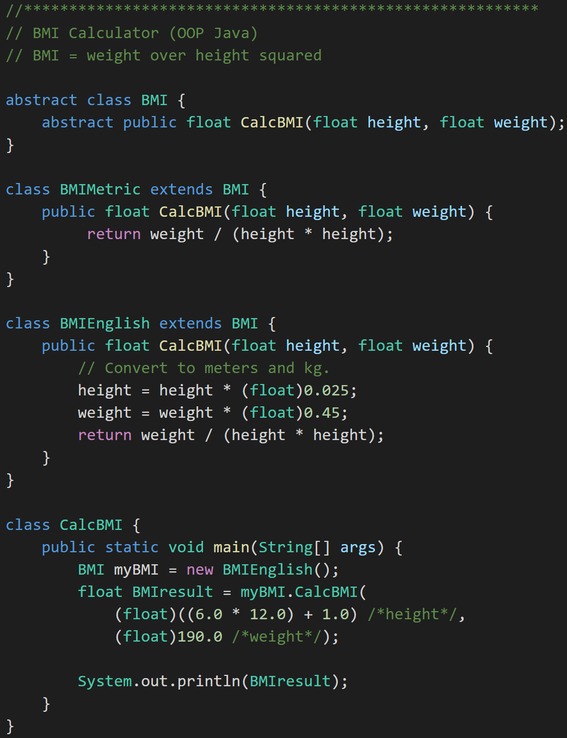
Abstraction
BMI
BMI Metric
BMI English
Abstraction
Notes:
And we have and example of Abstraction.
Abstraction
Abstraction is another key concept. Something is abstract when it is a concept but is not concrete or defined enough to actually be built. Generally, in OO design, we start with abstract things, and then we build on them through inheritance.
An abstract class is one that has one or more abstract methods.
An abstract method is a method / function that has no body – just a name, return type, and parameters.
An interface is the strictest interpretation of an abstract class – it is a data structure that consists entirely of abstract methods. In other words, none of its methods/functions have a body.
Abstraction is related to inheritance. Often, when we construct families of related objects, we start the family with an abstract class that represents the least common denominator for everyone in that family. In other words, what do all classes that are part of that family have in common? We often (not always, but often) put that in an abstract class.

Slide 20
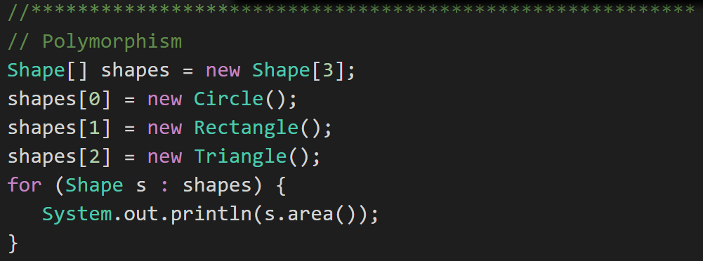
Polymorphism
Polymorphism: Polymorphism enables you to process collections of related things generically. This is particularly useful when you want to use a loop to march through a collection of items.
Notes:
Example of polymorphism: a for loop that moves through the entries of a list. The list might be of a collection of related kinds of object. We can refer to each of the objects in the list through a generic variable (whose data type matches the one that all are ultimately related to). But, when we invoke a particular function that all members of the family share, each will respond by performing that function in their own specific way. For example, we could have a collection of Shape objects. We could refer to each entry in the Shape list through a generic Shape variable, even though the actual entries in the list are specific kinds of shapes – Circle, Rectangle, etc. All Shape objects might have the ability to calculate their own area. When we refer to an object in the list through a generic Shape variable and tell it to calculate its area, thanks to polymorphism, the circle version of the area() function will be called when we’re dealing with a circle, and the Rectangle version of area() will be called when we’re dealing with a rectangle, etc.
The first time through the for loop, we’ll call the Circle.area() function – actually, we won’t; it will happen automatically. The next time through, we’ll call the Rectangle version, and then we’ll call the Triangle version.
Polymorphism is implemented behind the scenes using a Virtual Method Table (VMT). The VMT keeps track of where various related classes’ same-named functions are located in memory. Using the VMT, the operating system is able to figure out which code to implement when we tell each shape to fire its area() function.

Slide 21
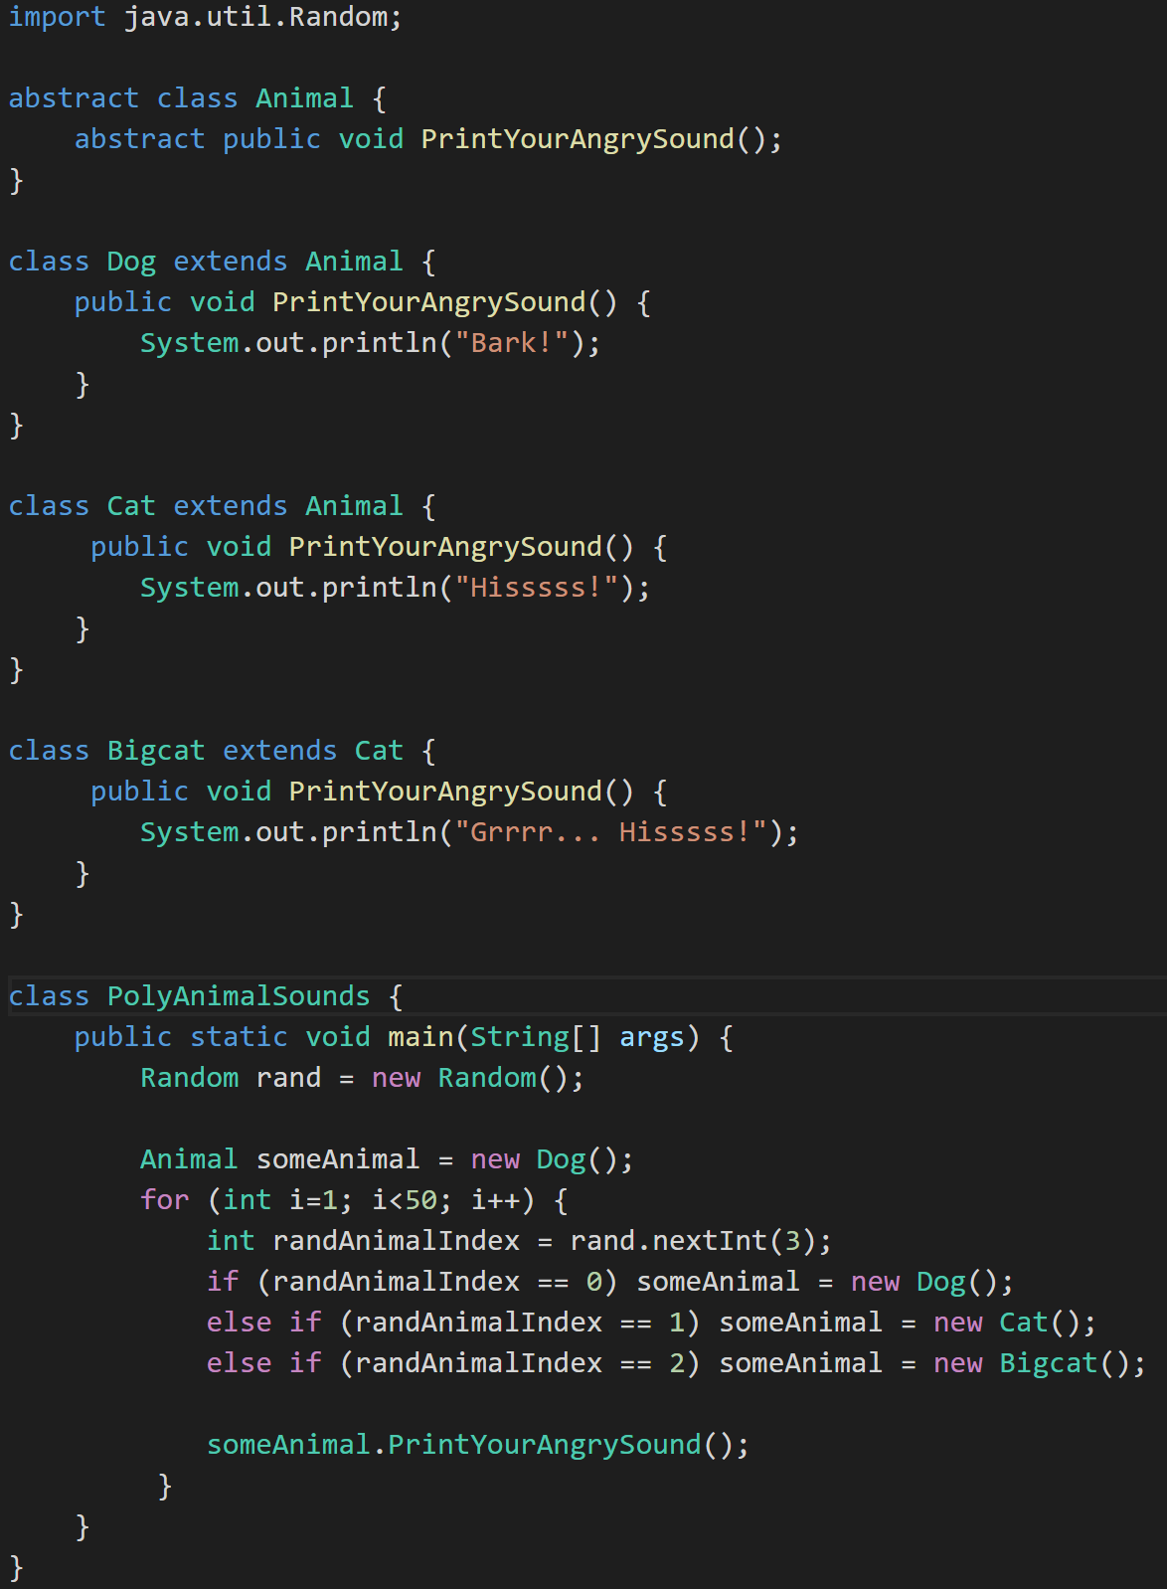
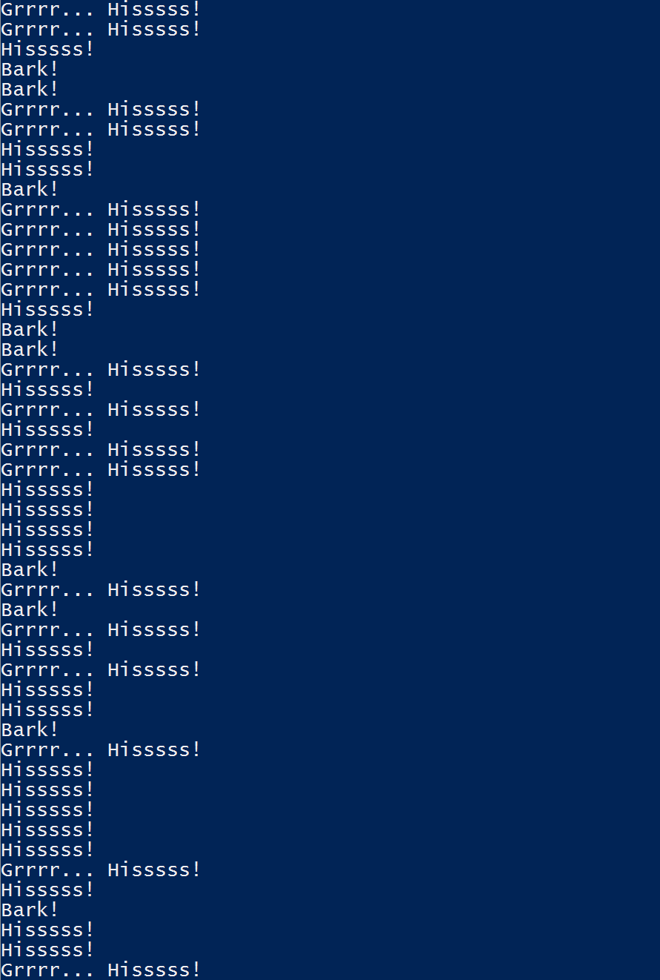
Polymorphism
Animal
Dog
Cat
Bigcat
Polymorphic
Notes:
Polymorphism? Let’s do something new. Let’s do something with Animals, Abstraction, Superclasses, and Subclasses. Take a look at the class hierarchy on the left. Can you track it to the code on the right?
We have and Abstract class Animal that provides the template for an Abstract method “PrintYourAngrySound()”. We have Subclasses Dog and Cat who both Override “PrintYour AngreeSound()” as required. Then we have a Bigcat class that Extends Cat. We have seen all of these things before.
Now we have added the idea of Random numbers. Let’s ignore that for now. It’s enough to know that the Random class that came from “java.util.Random” generates random numbers. Who would have guessed…
Now for the finalize… Notice how “someAnimal” can behave like “Dog”, “Cat”, or “Bigcat” depending the random number generated. This is Polymorphism.
Now can you come up with that brief animal based interview response for Polymorphism. Be sure to throw in “oh yes, Polymorphism is usually implemented with virtual methods and a virtual method table” to get full credit at the interview.
It may also be good to know what that actually means just in case one of the interviewers really know what a virtual method table is and has a follow up question.

Slide 22
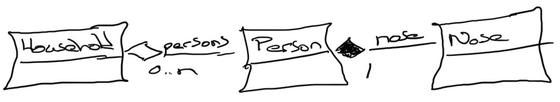
Composition & Aggregation
Composition: A relationship where an object will not exist without the parent object. For example, it is unlikely that the “Nose” object will exist after the “Person” object is gone.
Aggregation: A relationship where multiple objects will likely continue to exist independent of each other. For example, we might have a “Household” object and a “Person” object. It would be very reasonable to expect our “Person” object to continue to exist even if our “Household” object was deleted.
Our First UML:
Notes:
Composition: An example of composition: the relationship between Face and Nose, Mouth, and Eye
class Face {
Nose n;
Mouth m;
Eye le;
Eye re;
}
We probably wouldn’t let the Nose, Mouth, or Eye objects live beyond the Face. They are owned exclusively by the Face. That’s what composition is: exclusive ownership.
One clear sign that we are dealing with composition is if the owner (Face, for example) is responsible for actually creating the objects it owns. Then, clearly, the things that are owned – the Nose, Mouth, etc. – could not have existed on their own and are therefore exclusively owned by the owner object.
Aggregation: Aggregation is also a form of ownership, but it’s non-exclusive ownership. The owned objects can live on and perhaps existed prior to the owned object.
An example of aggregation: A library patron borrows a book. That’s not exclusive ownership, since several people can borrow a book over its lifetime.
The easy way to tell if something is composition or aggregation is to ask if the owner is responsible for creating and destroying the thing that is owned. If so, it’s a composition relationship.

Slide 23
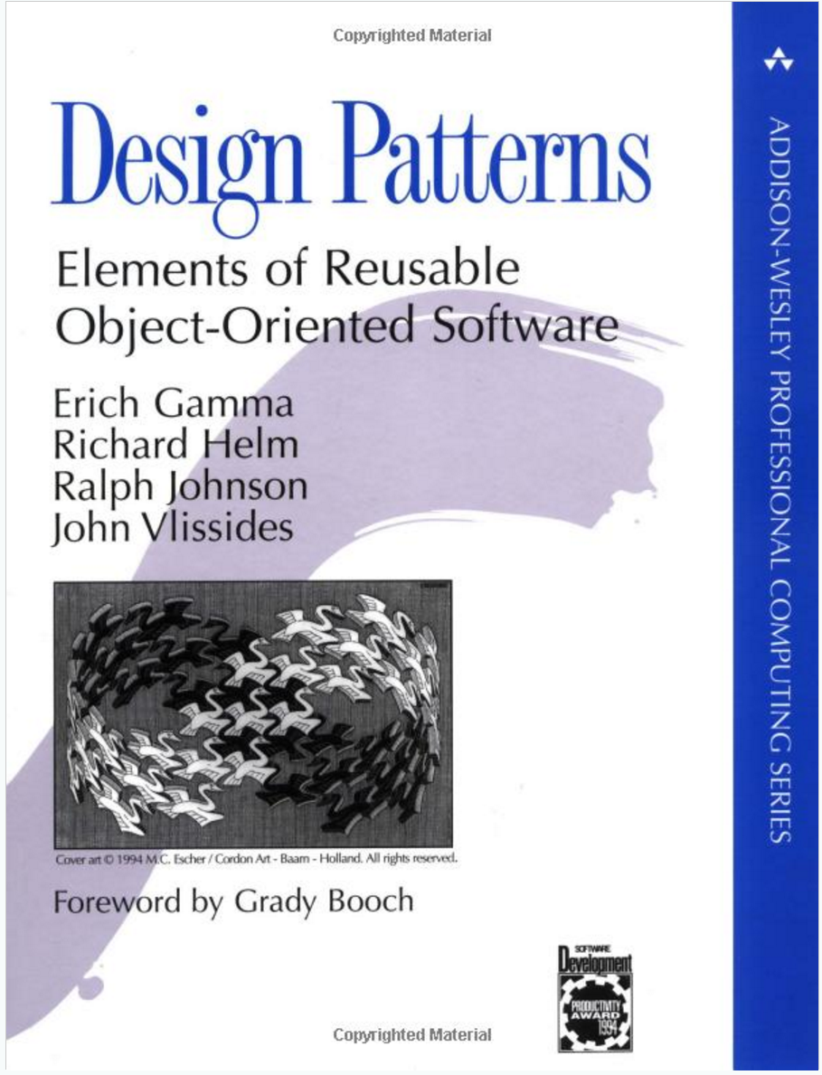
Object-Oriented Design Patterns
Definition: A software design pattern is a commonly repeated approach to constructing software. These approaches are commonly repeated because they consistently produce quality results.
Common Patterns Include:
Singleton
Factory
Delegation
Model-View-Controller
Others
Notes:
“Design Patterns: Elements of Reusable Object-Oriented Software” has been influential in defining software engineering patterns and is regarded as an important source for object-oriented design theory and practice. The authors are often referred to the “Gang of Four (GoF)”
Interview tip: The answer to any question that references design patterns should include “Gang of Four”, “Reusable Object-Oriented Software”, and “Model-View-Controller”. Now let’s learn what those are.
Why Use Patterns?
Using patterns helps us write good software more regularly, because they are tried-and-true approaches to writing it.

Slide 24
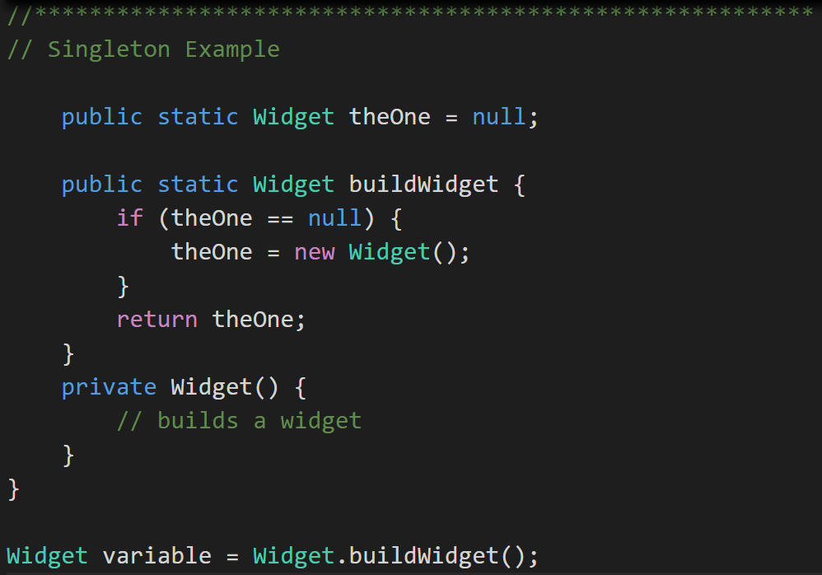
Singleton Design Pattern
Singleton Pattern: Utilized to make sure that only one instance of a class is in existence.
An example would include an application log files that needs to be synchronized across threads. [link]
Notes:
Singleton are pretty easy to understand and come in very handy. A application Logfile class or Configuration file manager are common examples of singletons.
Singleton (making sure there is just one instance of something to avoid conflicts - http://www.oodesign.com/singleton-pattern.html) These are great for coordinating activity across multiple threads of execution or making sure there is a single point of control for a limited resource like a file or printer.
A singleton can be written in Java by making the constructor for the class private and equipping the class with a static function that ensures that the constructor is called only if no other objects of that class already exist.

Slide 25
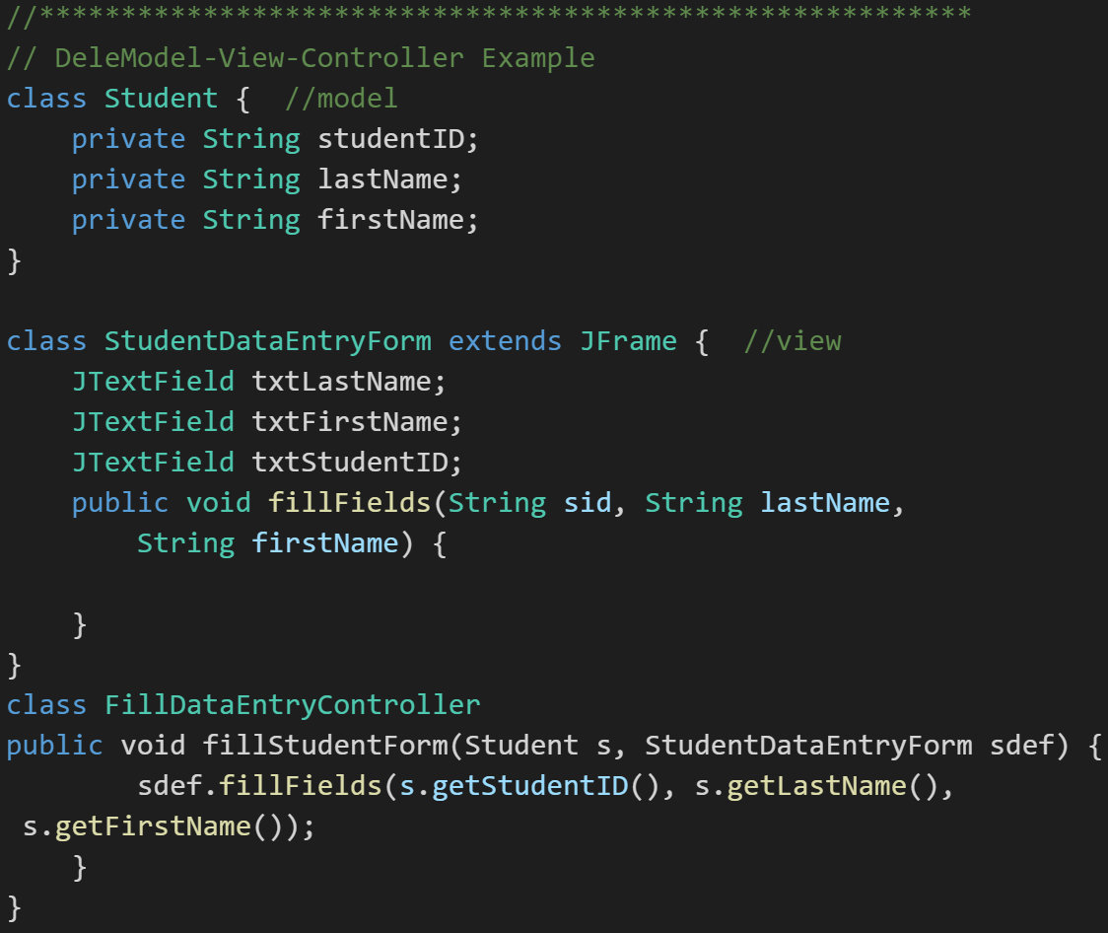
Model-View-Controller
Model-View-Controller (MVC): MVC is an important pattern, will be a primary focus of this course, and will be an important pattern for you to master in your career.
Segregation of our Model (data) from our View (user interface) is necessary to effectively develop, enhance, and maintain modern software.
Notes:
An example would be a system that manages student data. We would want to segregate the Model (data) from the View (UI) for several reasons including that there will likely be many different Views that access the same dataincluding:
student view
faculty view
administrator view,
Web student view,
mobile student view, etc.
Evolution of UI and Data segregation
Document-View (View was responsible for View-Controller functionality)
Model-View-Controller
Model–View–Viewmodel
Learn this Pattern!

Slide 26
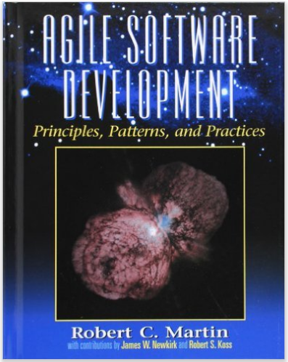
Object-Oriented Design Principles
Software design principles represent a set of guidelines that helps us to avoid having a bad design. The design principles are associated to Robert Martin who gathered them in "Agile Software Development: Principles, Patterns, and Practices".
Notes:
Our procedural (C) implementation of BMI would be a great example of Immobility… maybe a good example of all three of these.

Slide 27
Object-Oriented Design Principles
According to Robert Martin there are 3 important characteristics of a bad design that should be avoided:
Rigidity - It is hard to change because every change affects too many other parts of the system
Fragility - When you make a change, unexpected parts of the system break
Immobility - It is hard to reuse in another application because it cannot be disentangled from the current application
Notes:
Our procedural (C) implementation of BMI would be a great example of Immobility… maybe a good example of all three of these.

Slide 28
Object-Oriented Design Principles
Martin identifies the following Design Principles:
Open Close Principle
Dependency Inversion Principle
Interface Segregation Principle
Single Responsibility Principle
Liskov's Substitution Principle

Slide 29
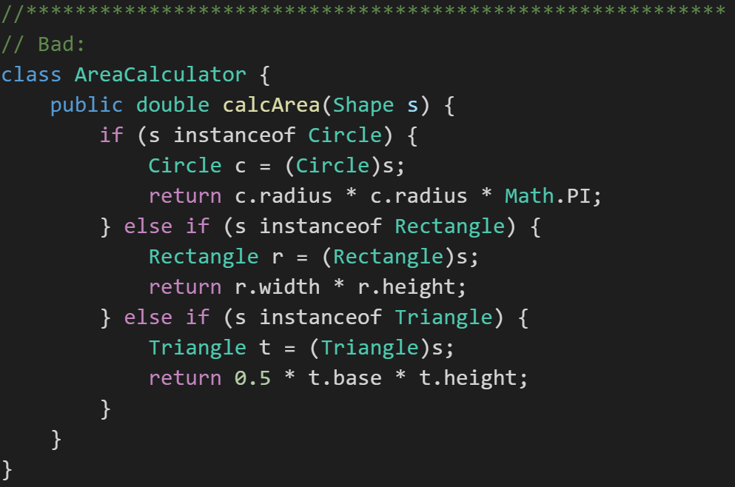
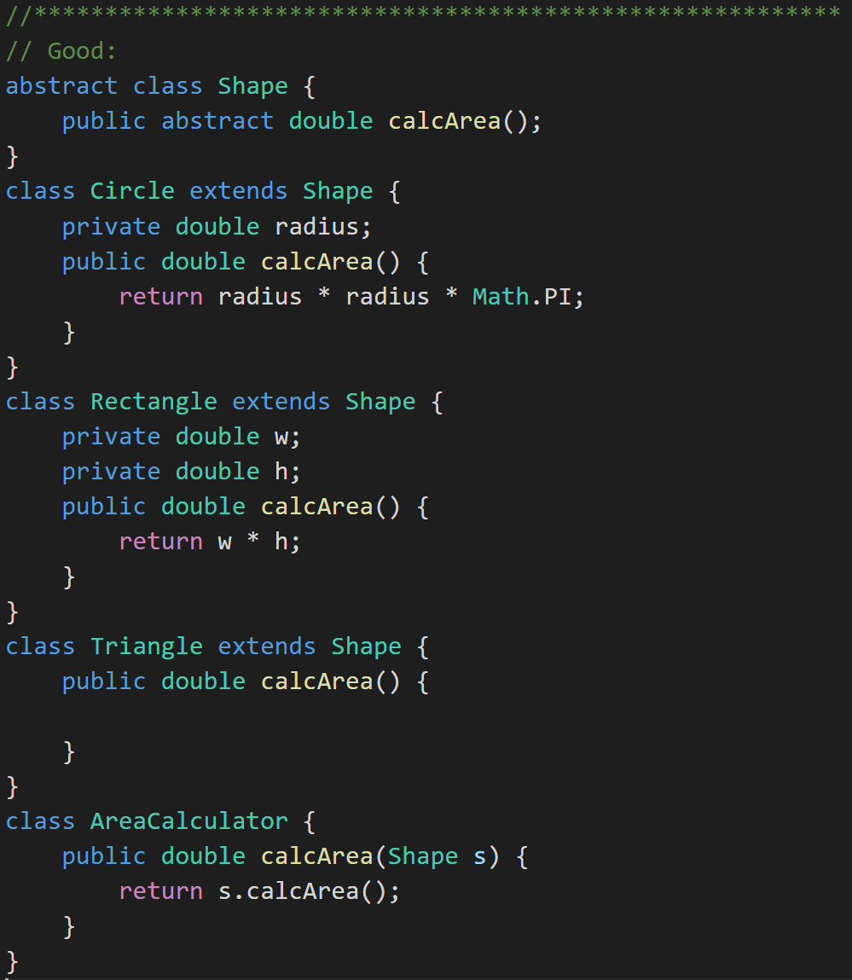
Open Close Principle
Software entities like classes should be open for extension but closed for modifications.
Notes:
Our example of BMI is C was a great example of NOT implementing this principle. We had to modify the core functionality in order to extend it. It take a long time to know if a class exhibits this principle. You only know after a class has been used by multiple other classes (preferably “owned” by other developers), the class has need to be extended (preferably multiple times), and the dependent classes have not had to change (and the dependent developers have not complained).

Slide 30
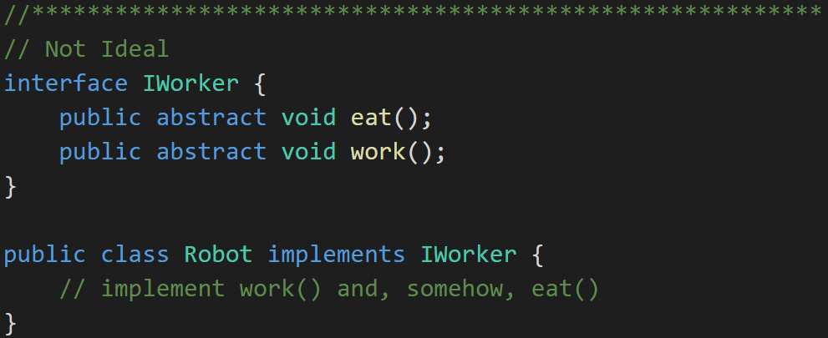
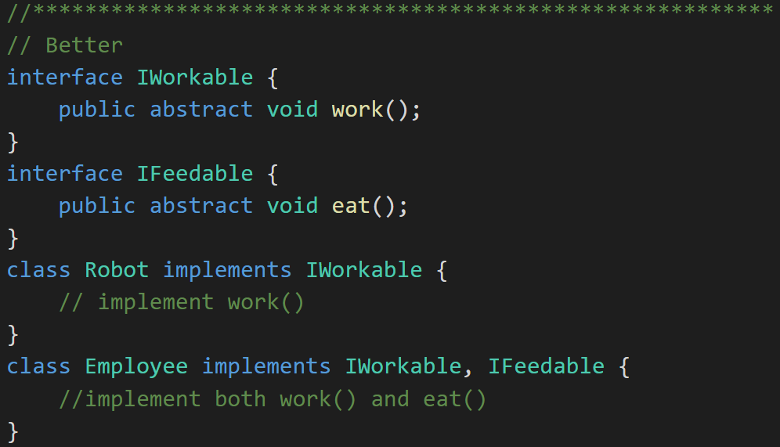
Interface Segregation Principle
Clients should not be forced to depend upon interfaces that they don't use.
Notes:
The previous example has a minor flaw. Consider the IWorker interface. It specifies that workers both eat lunch and do work. What if we end up building and using robotic workers? They don’t have to eat. So, our definition of Worker includes too much and therefore can only be clumsily applied to situations where our understanding of what a worker is might change.

Slide 31
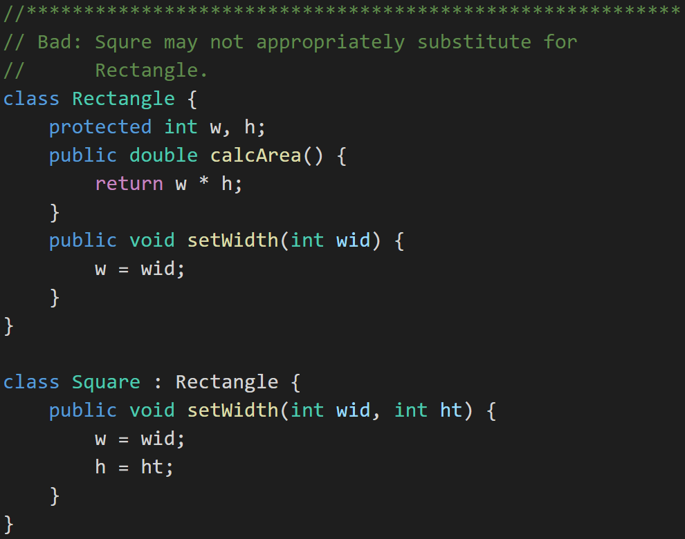
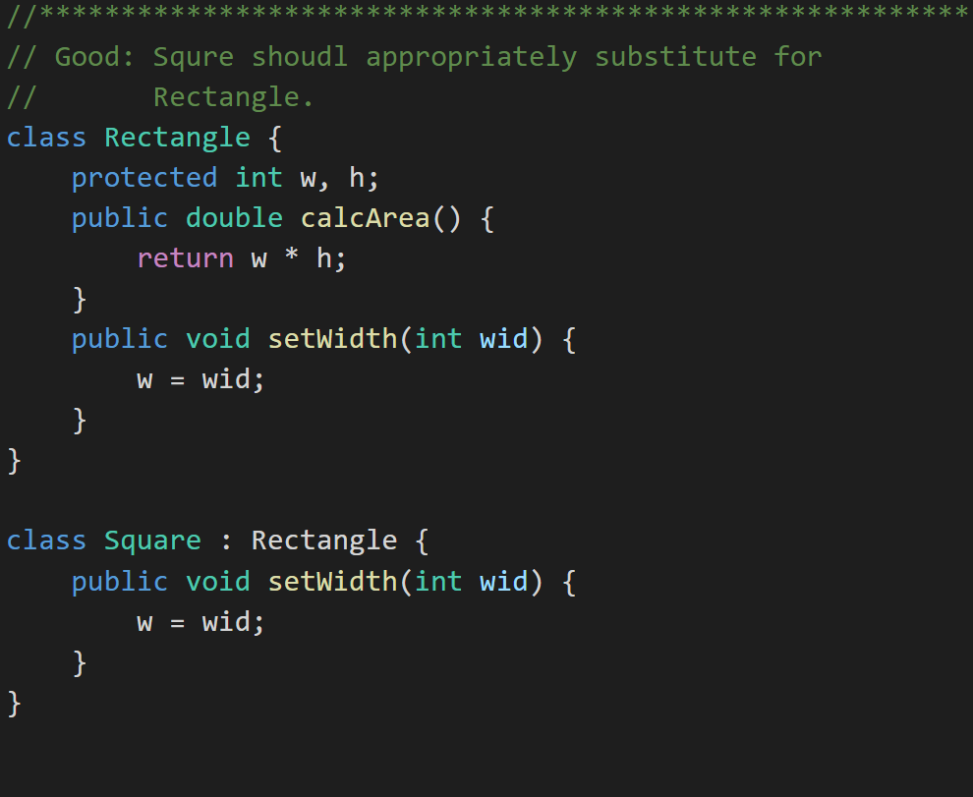
Liskov’s Substitution Principle
Derived classes must be completely substitutable for their base types. And similarly Subclasses should not break core functionality introduced by their parent.
Notes:
Bottom Line About These Principles
We’ll see these principles again as the course continues.
This course mixes theory and practice
We will learn and re-learn these concepts as we learn three object-oriented programming languages. The patterns and principles should remain (largely) consistent across languages and platforms.

Slide 32
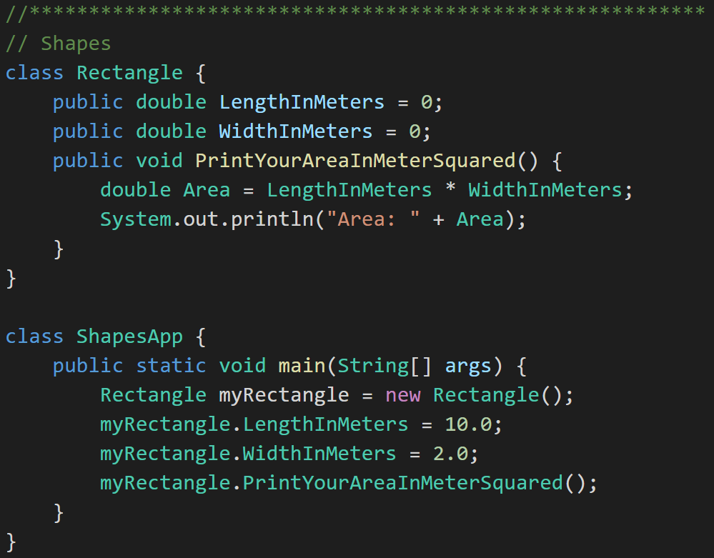
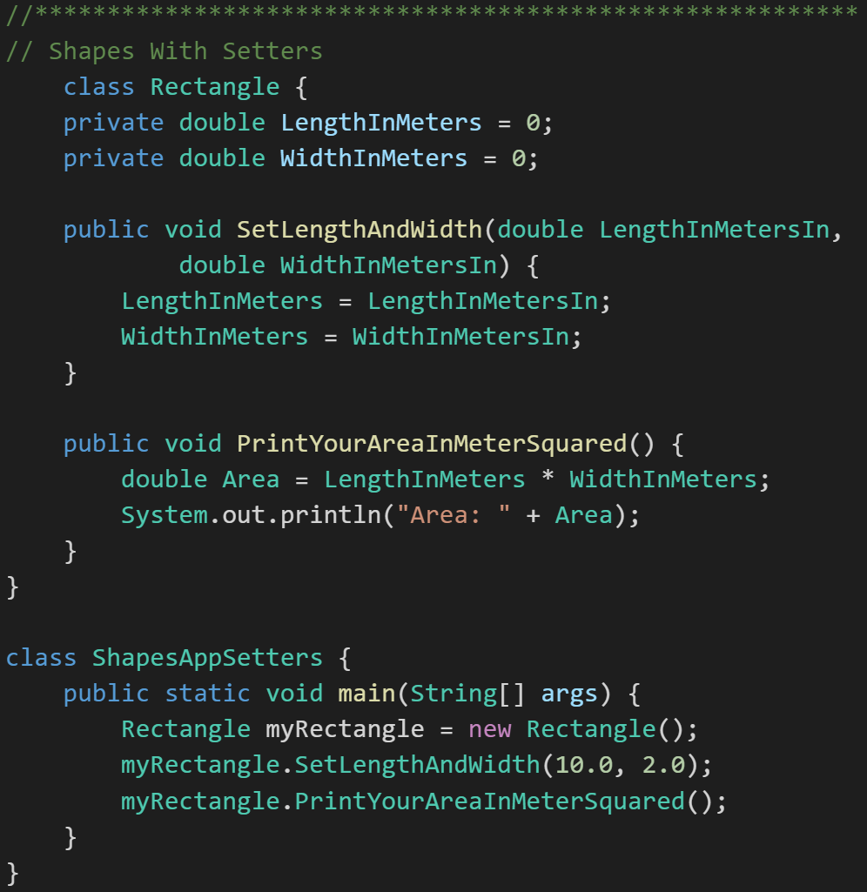
Encapsulation… and Setters & Getters
Rectangle:
Rectangle with Setters:
Notes:
It (mostly) doesn’t matter if all you are doing is setting (or getting) the values.
Why use Setters & Getters?
Because 2 weeks (months, years) from now when you realize that your setter needs to do more than just set the value, you'll also realize that the property has been used directly in 238 other classes.
Validation
Optimization
Change the values (English to metric)
Debugging breakpoint
Some libraries expect this

Slide 33
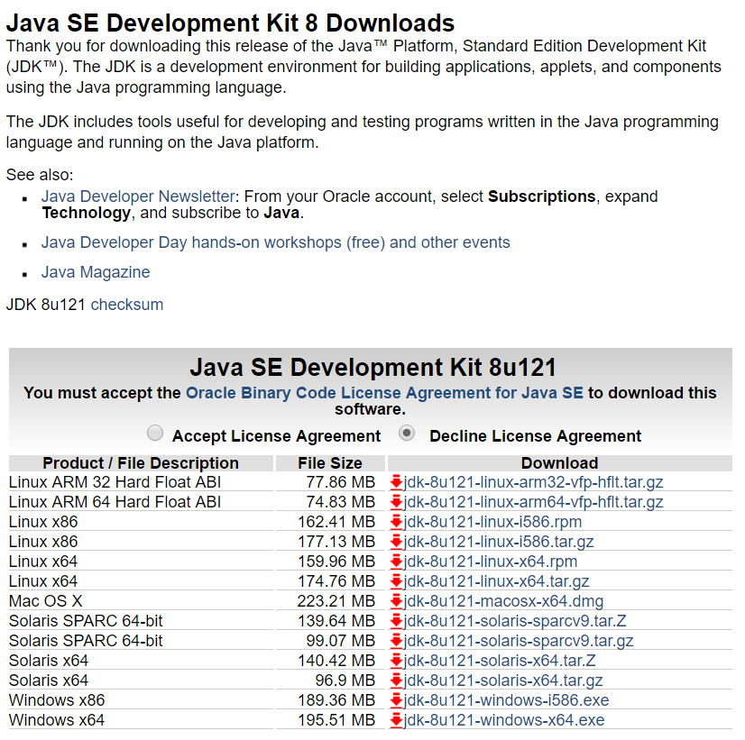
Java Development Environment Overview
Standard Java tools for this class include:
Java SE Development Kit (SDK) 8 from Oracle
Text Editor
Optional Tools:
Git and GitHub… let me know if you are interested in piloting this (highly recommended)
Eclipse
You are welcome to use addition tools, but please don’t make your assignments dependent on those tools.
Notes:
Getting ready for next week… Get this set up for yourself this week by compiling and running “HelloWorld”.
I will be using the Microsoft Code Editor and the command line Java JDK to review and grade your assignments. Make CERTAIN that the assignments you submit compile an run in these environments. Lets start by submitting a single .java file for at least the first two weeks. Then we will consider extending our practices.
I will be compiling your applications with the standard javac and java command line tools. For example, if you submitted a file named “ShapesApp.java”, I would expect:
To compile it with the command “javac .\ShapesApp.java”
To run it with the command “java -cp . ShapesApp”
You should test all assignments using this configuration BEFORE you turn them in for review and grading.

