Slide 1
Learning Objectives
Define object-oriented programming
Position object-oriented programming within Software Development Lifecycle (SDLC)
Review object-oriented language and tool selection
Demonstrate object-oriented programming concepts with examples
Distinguish between a class and an object
Identify and define “six” object-oriented concepts
Identify the superclass and the subclass in an inheritance relationship
Demonstrate inheritance, ownership, and abstraction in snippets of Java code
Distinguish between aggregation and composition
Depict classes and their relationships using UML class diagrams
Define and discuss common object-oriented design patterns
Define and discuss common object-oriented design principles and characteristics of bad software
Recap: How is object-oriented programming is different
Recap: Why did we choose to learn an object-oriented approach in developing software
Notes:
You will notice very quickly that I prefer examples and actual source code over more philosophical discussion. Please feel free to ask for more development philosophy and background if you desire more.

Slide 2
Learning Objectives (Section 1)
Define object-oriented programming
Position object-oriented programming within Software Development Lifecycle (SDLC)
Review object-oriented language and tool selection
Demonstrate object-oriented programming concepts with examples
Distinguish between a class and an object
Notes:
You will notice very quickly that I prefer examples and actual source code over more philosophical discussion. Please feel free to ask for more development philosophy and background if you desire more.

Slide 3
Object-Oriented Programming [link]
Object-oriented programming (OOP) is a programming model based on the concept of "objects", which contain both Attributes (data) and Methods (procedures) that operate on that those attributes.
Most popular OOP languages are class-based, meaning that objects are instances of classes.
It includes concepts, patterns, and principles for designing and implementing modern software products.
Concepts – powerful features that prove indispensable to modern software development, brought to us automatically by object-oriented programming.
Patterns – tried-and-true templates for forging relationships between classes
Principles – guidelines that help you determine what classes are needed and how they should divide up the work
Notes:
I will often start with definitions from Wikipedia and other sources. If you are struggling with a topic and/or would like more information, it can often be valuable to review the references.
Words and terminology our important as we discuss and learn new concepts. You will notice that I will often struggle with the attribute vs. data and method vs. procedure distinction when I am talking. I would like for us to try to make that distinction in our work as we go through the term.

Slide 4
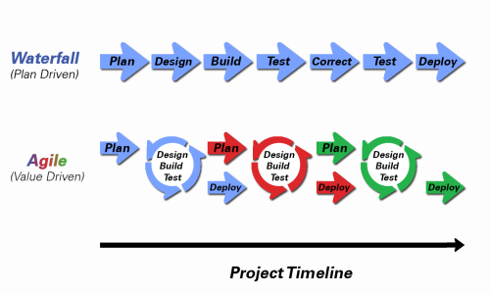
Object-Oriented Programming within Various Development Methodologies
Notes:
Development Methodology and Software Development Lifecycle (SDLC) are often used interchangeably.
The Iterative development methodology is not depicted here as even the mainstays and inventors of the Iterative development methodology seem to be moving toward agile. Plus as Waterfall “holdouts” move, they seem to be moving directly toward Agile.
Development Methodologies (SDLCs) are a future Bonus Topic. There is a optional slide and notes at the end of this deck.
Object oriented programming practices evolve and reprioritize depending on the development
In Waterfall (as well as in Iterative) object-oriented design often play a critical role in the (big upfront) design activities. UML diagrams and project artifacts are often important to the overall project success.
Practical reality has been that these design artifacts often do not reflect the actual implementation and are rarely maintained or updated.
The Agile practitioners do not reject these design artifacts. However, the focus on shorter time horizons, evolving architecture, and working code changes the value proposition for object-oriented practices to more focus on the build, test, enhance activities.
More later on Development Methodologies

Slide 5
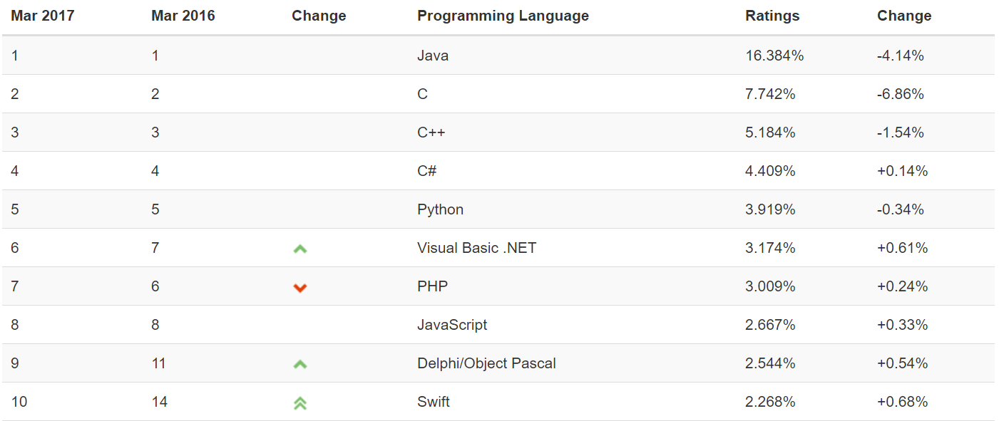
Object-Oriented Languages and Tools
The TIOBE index can be used to check whether your programming skills are still up to date or to make a strategic decision about what programming language should be adopted when starting to build a new software system. The full TIOBE is available online [link].
TIOBE Index for March 2017:
Non-OOP Examples
Notes:
We will utilize mostly Java and C# for our object-oriented programming examples. We may or may not do any Python work. Since it is often ‘unnatural’ to show procedural programming examples in Java, C#, or Python, we will implement programs in C to demonstrate procedure programming examples.
Note that our reluctance to utilize C++ as a OOP learning tool is does not diminish the value of the C++ toolset. However, C++ is generally considered a very powerful set of tools with a steep learning curve. It’s a sharp knife… use it carefully.

Slide 6
Object-Oriented Concepts Example
Implementing the body mass index (BMI) calculation in Java and C should allow us to effectively demonstrate some object-oriented design and programming concepts (Java). We will also compare that to how we would have implemented the same calculation using procedural programming techniques.
Background: BMI is a statistic developed by Adolphe Quetelet in the 1900’s for evaluating body mass. It is not related to gender and age. It uses the same formula for men as for women and children.
The body mass index is calculated based on the following formula:
BMI = weight [kg] / (height [m] * height [m])
Procedural BMI (body mass index):
Data:
Height
Weight
Procedures (or functions):
CalcBMI
Object-Oriented BMI:
Class BMI
Attributes
Height
Weight
Methods
CalcBMI

Slide 7
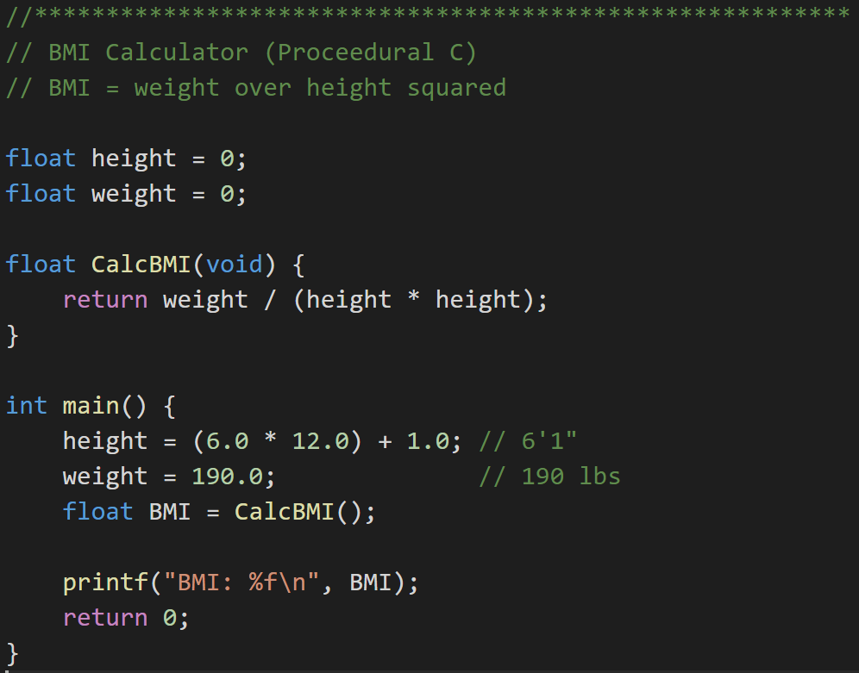
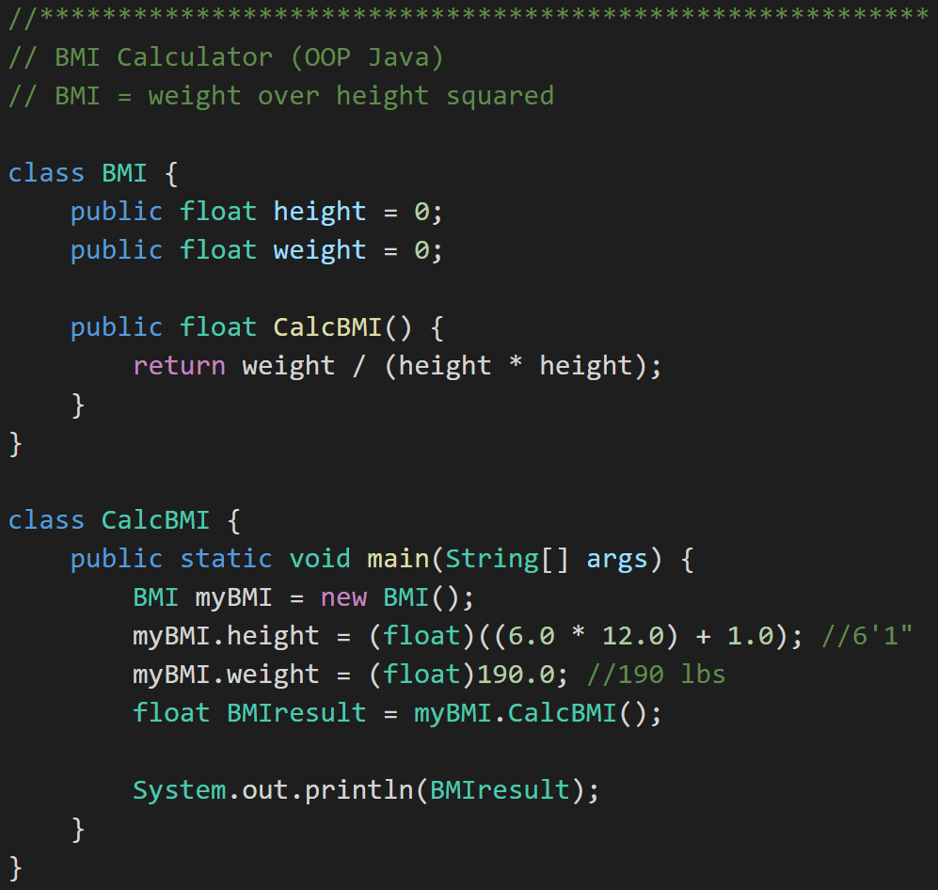
Example: Procedural vs. Object Oriented Programming
Procedural BMI (C):
“Object-Oriented” BMI (Java):
Notes:
We have quite a lot of code to look at here. Let’s start with the procedural C code. We have data (height & weight) and procedures (CalcBMI),
Do you see the logic issue? Hang onto that for a moment. Fixing that will be our coding exercise to demonstrate some object-oriented concepts.

Slide 8
Distinguish Between a Class and an Object
Procedural BMI (C):
“Object Oriented” BMI (Java):
Notes:
There we have it, a Class. It has attributes (height & weight) and a method (CalcBMI). Still has the same logic problem… but let’s wait on that.

Slide 9
Distinguish Between a Class and an Object
Procedural BMI (C):
Object Oriented BMI (Java):
Notes:
Ahhhh… and we have an object “myBMI’ which is an instance off the class “BMI”.

Slide 10
Learning Objectives
Define object-oriented programming
Position object-oriented programming within Software Development Lifecycle (SDLC)
Review object-oriented language and tool selection
Demonstrate object-oriented programming concepts with examples
Distinguish between a class and an object
Identify and define “six” object-oriented concepts
Identify the superclass and the subclass in an inheritance relationship
Demonstrate inheritance, ownership, and abstraction in snippets of Java code
Distinguish between aggregation and composition
Depict classes and their relationships using UML class diagrams
Define and discuss common object-oriented design patterns
Define and discuss common object-oriented design principles and characteristics of bad software
Recap: How is object-oriented programming is different
Recap: Why did we choose to learn an object-oriented approach in developing software
Notes:
You will notice very quickly that I prefer examples and actual source code over more philosophical discussion. Please feel free to ask for more development philosophy and background if you desire more.

Slide 11
Learning Objectives (Section 2)
Identify and define “six” object-oriented concepts
Identify the superclass and the subclass in an inheritance relationship
Demonstrate inheritance, ownership, and abstraction in snippets of Java code
Distinguish between aggregation and composition
Depict classes and their relationships using UML class diagrams
Notes:
You will notice very quickly that I prefer examples and actual source code over more philosophical discussion. Please feel free to ask for more development philosophy and background if you desire more.

Slide 12
The “six” (Three plus) Object-Oriented Concepts
Object-oriented concepts:
Encapsulation… and Information Hiding
Inheritance… and Abstraction
Polymorphism
Plus… Composition & Aggregation
Notes:
Whenever you are asked a conceptual question about object-programming in an software development interview (and you will be), answer confidently “Encapsulation”, “Inheritance”, and “Polymorphism”.
When asked what is Encapsulation (or how would you implement it), say, “I would limit or minimize variable scope and keep data attributes private as often as possible.”
Now as we are going through our object-oriented examples, be thinking about how you would answer the “What is Inheritance?” and “What is Polymorphism?” interview questions. Note that answering them both with very brief and succinct animal examples can be very effective.
Now it would exceptional if we were also able to effectively utilize these concepts after we get the job :-) Let’s start by walking through an example.

Slide 13
The Problem?
BMI formula assumes M (height) and KG (weight)
Procedural BMI (C):
Object Oriented BMI (Java):
Notes:
Let’s go back to where we left off in our example.
We have a problem in both our procedural (C) and object-oriented (Java) implementations. Our BMI formula assumes metric inputs only (kg & m) our interactions with the BMI procedures and methods are using English units (inches & lbs). So our implementations do work; however, they only work for metric. Let fix our BMI (C) implementation in our normal procedural way.
After that we will enhance our Java implementation using Encapsulation and Inheritance concepts.
Polymorphism will need a different example… one with animals.

Slide 14
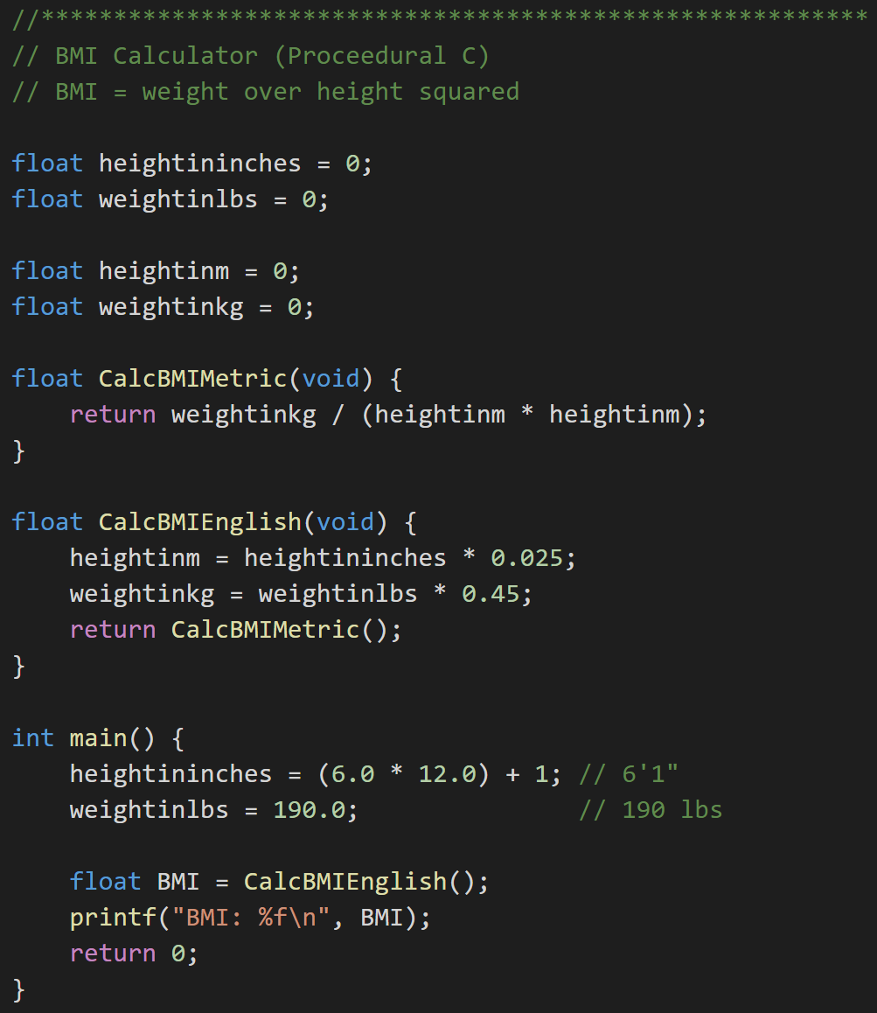
Revising Procedural (C) BMI Implementation
Procedural BMI (C):
Procedural BMI (C) - revised:
Notes:
Let’s go back to where we left off in our example.
We have a problem in both our procedural (C) and object-oriented (Java) implementations. Our BMI formula assumes metric inputs only (kg & m) our interactions with the BMI procedures and methods are using English units (inches & lbs). So our implementations do work; however, they only work for metric. Let fix our BMI (C) implementation (without losing what already works) and then let’s enhance our Java implementation using Encapsulation and Inheritance concepts. Polymorphism will need a different example… one with animals.

Slide 15
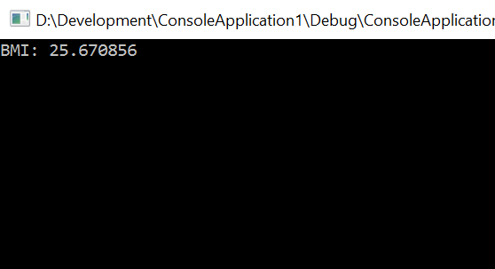
Revising Procedural (C) BMI Implementation
Procedural BMI (C):
Procedural BMI (C) - revised:
Notes:
Let’s go back to where we left off in our example.
We have a problem in both our procedural (C) and object-oriented (Java) implementations. Our BMI formula assumes metric inputs only (kg & m) our interactions with the BMI procedures and methods are using English units (inches & lbs). So our implementations do work; however, they only work for metric. Let fix our BMI (C) implementation (without losing what already works) and then let’s enhance our Java implementation using Encapsulation and Inheritance concepts. Polymorphism will need a different example… one with animals.

Slide 16

Revising BMI Implementations
Procedural BMI (C) - revised:
Object-Oriented BMI (revised):
Notes:
Now consider what it would be like to reuse this C procedural code. Important note: Object Oriented program is NOT necessarily optimized for writing new code. It IS optimized for reusing, supporting, testing, and enhancing code! How would this change if instead of ~20 lines of code, we have a thousand lines of code… or 10,000… or 1,000,000 lines? Software development and testing complexity grows exponentially as the size of the code grows.
Consider: : rigidity, immobility, fragility within the ongoing sdlc (software/systems development lifecycle)
Waterfall, Iterative, and Agile

Slide 17
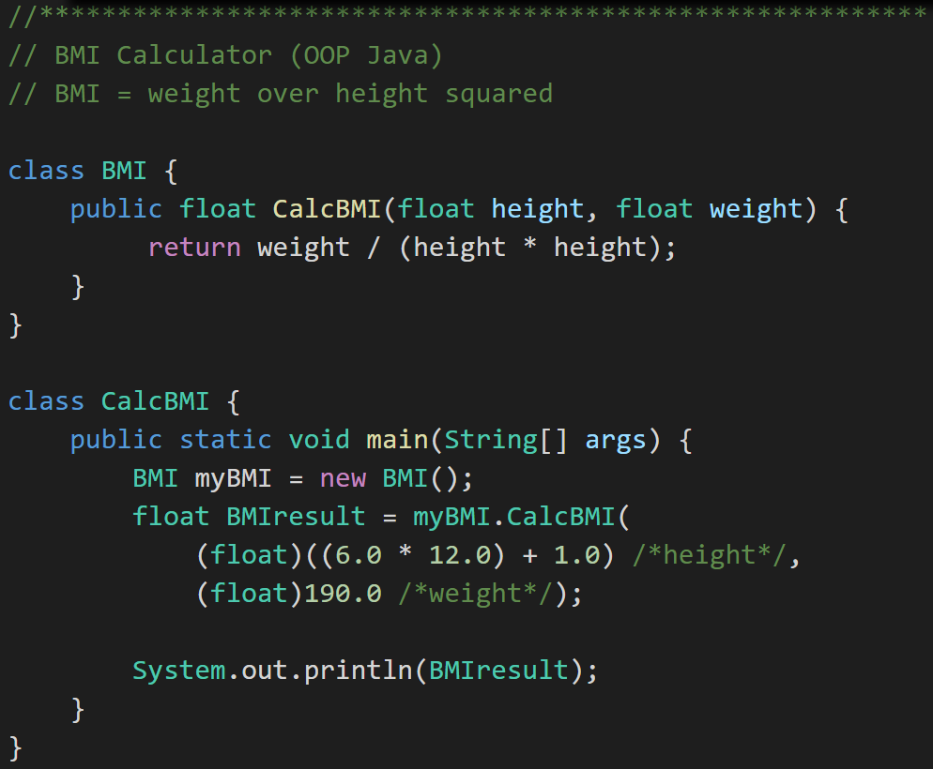
Encapsulation
Object -Oriented BMI:
Encapsulated Object Oriented BMI:
Notes:
The Encapsulation concept is not limited to is NOT limited to object-oriented languages and environments. Nearly every language and platform support Encapsulation. In my opinion Encapsulation is fundamental to all development. Object-oriented environments do add some wonderful tools to make Encapsulation elegant.
Consider: How would you add protective code around setting height to 0 in the first option (height > 2ft & <9ft)? … in the second encapsulated example? Once again consider reuse, testing, and additional modification in thousands of lines off code.
Encapsulation is a feature of nearly all modern development languages… not just object-oriented languages.
#1 Rule for Encapsulation: Minimize class property and method scope and visibility: (1)none, (2)local, (3)method parameters, (4)private attribute, (5)protected attribute, and (6)public

Slide 18
Inheritance… Options to Implement English Units
Option #1:
Option #2:
BMI (metric)
BMI
BMI English
BMI Metric
BMI English
Notes:
In the real world where not breaking existing code (causing a retest or potentially a defect) is a VERY high priority, we would have chosen Option #1. It is simpler, less risky, more practical, and can be done with less code. As we go through these examples, always try to imagine thousands of lines of code instead of tens of lines of code. Complexity grows exponentially as the number lines of code (and developers) grow.
For our Learning exercise we will implement Option #2. It is a more pure and elegant implementation where BMI Metric and BMI English are at the same level in the class hierarchy… which satisfies my artistic needs. It also will allow us to demonstrate Abstraction, Superclass, and Subclass at the same time we are demonstrating Inheritance.

Slide 19
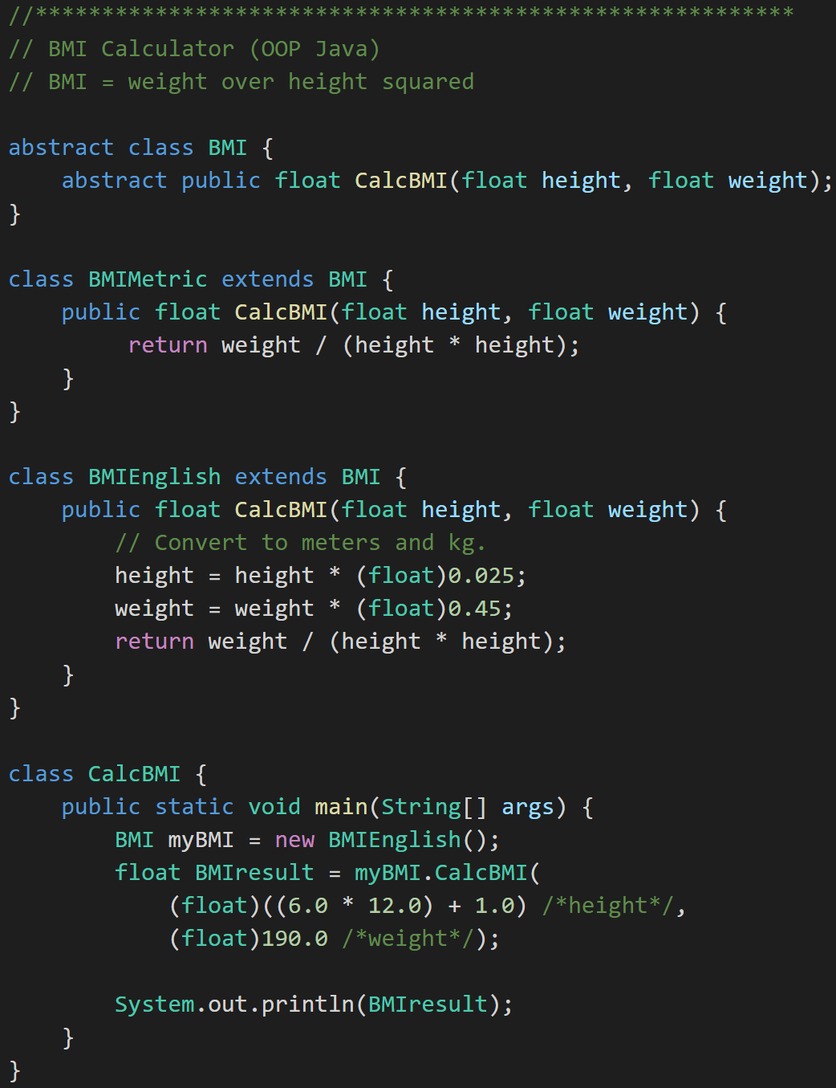
Inheritance to implement English units… And Abstraction
BMI
BMI Metric
BMI English
Notes:
Abstract class
Abstract method
Descendant classes

Slide 20
Superclass and Subclass
BMI
BMI Metric
BMI English
Superclass
Notes:
Consider: How would you add protective code around setting height to 0 in the first option? … in the second encapsulated example? Once again consider reuse, testing, and additional modification in thousands of lines off code.
Encapsulation is a feature of nearly all modern development languages… not just object-oriented languages.

Slide 21
Superclass and Subclass
BMI
BMI Metric
BMI English
Subclass
Notes:
Consider: How would you add protective code around setting height to 0 in the first option? … in the second encapsulated example? Once again consider reuse, testing, and additional modification in thousands of lines off code.
Encapsulation is a feature of nearly all modern development languages… not just object-oriented languages.

Slide 22
Abstraction
BMI
BMI Metric
BMI English
Abstraction
Notes:
Abstraction
Abstraction is another key concept. Something is abstract when it is a concept but is not concrete or defined enough to actually be built. Generally, in OO design, we start with abstract things, and then we build on them through inheritance.
An abstract class is one that has one or more abstract methods.
An abstract method is a method / function that has no body – just a name, return type, and parameters.
An interface is the strictest interpretation of an abstract class – it is a data structure that consists entirely of abstract methods. In other words, none of its methods/functions have a body.
Abstraction is related to inheritance. Often, when we construct families of related objects, we start the family with an abstract class that represents the least common denominator for everyone in that family. In other words, what do all classes that are part of that family have in common? We often (not always, but often) put that in an abstract class.

Slide 23
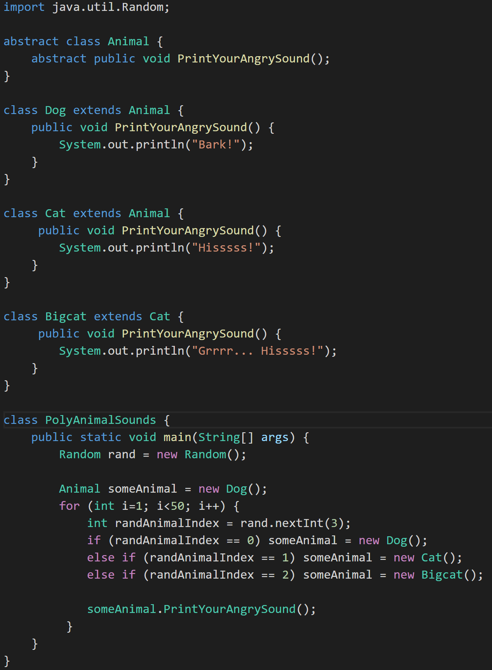
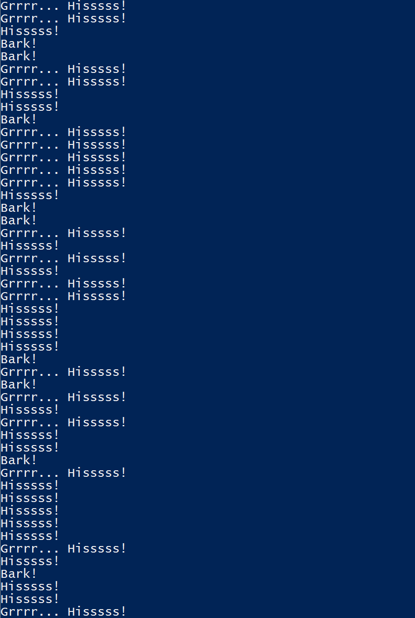
Polymorphism
Animal
Dog
Cat
Bigcat
Polymorphic
Notes:
Notice how “someAnimal” can behave like “Dog”, “Cat”, or “Bigcat” depending the random number generated. Can you come up with a brief animal based interview example for Polymorphism. Be sure to throw in “oh yes, Polymorphism is usually implemented with virtual methods and a virtual method table” to get full credit at the interview. It may also be good to know what that actually means just in case one of the interviewers really know what a virtual method table is and has a follow up question. Virtual methods are similar to abstract methods. The difference is that Virtual methods CAN be overridden in a Subclass where Abstract methods MUST be overwritten in a Subclass.
Polymorphism
Polymorphism enables you to process collections of related things generically. This is particularly useful when you want to use a loop to march through a collection of items.
Example of polymorphism: a for loop that moves through the entries of a list. The list might be of a collection of related kinds of object. We can refer to each of the objects in the list through a generic variable (whose data type matches the one that all are ultimately related to). But, when we invoke a particular function that all members of the family share, each will respond by performing that function in their own specific way. For example, we could have a collection of Shape objects. We could refer to each entry in the Shape list through a generic Shape variable, even though the actual entries in the list are specific kinds of shapes – Circle, Rectangle, etc. All Shape objects might have the ability to calculate their own area. When we refer to an object in the list through a generic Shape variable and tell it to calculate its area, thanks to polymorphism, the circle version of the area() function will be called when we’re dealing with a circle, and the Rectangle version of area() will be called when we’re dealing with a rectangle, etc.
Shape[] shapes = new Shape[3];
shapes[0] = new Circle();
shapes[1] = new Rectangle();
shapes[2] = new Triangle();
for (Shape s : shapes) {
System.out.println(s.area());
}
The first time through the for loop, we’ll call the Circle.area() function – actually, we won’t; it will happen automatically. The next time through, we’ll call the Rectangle version, and then we’ll call the Triangle version.
Polymorphism is implemented behind the scenes using a Virtual Method Table (VMT). The VMT keeps track of where various related classes’ same-named functions are located in memory. Using the VMT, the operating system is able to figure out which code to implement when we tell each shape to fire its area() function.

Slide 24
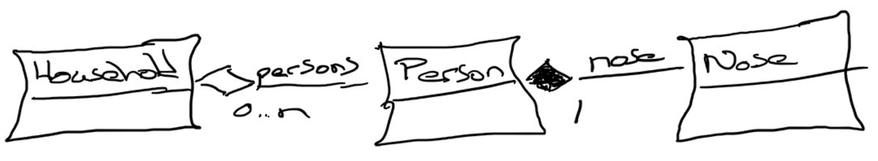
Composition & Aggregation
Composition: A relationship where an object will not exist without the parent object. For example, it is unlikely that the “Nose” object will exist after the “Person” object is gone.
Aggregation: A relationship where multiple objects will likely continue to exist independent of each other. For example, we might have a “Household” object and a “Person” object. It would be very reasonable to expect our “Person” object to continue to exist even if our “Household” object was deleted.
Our First UML:
Notes:
Composition
An example of composition: the relationship between Face and Nose, Mouth, and Eye
class Face {
Nose n;
Mouth m;
Eye le;
Eye re;
}
We probably wouldn’t let the Nose, Mouth, or Eye objects live beyond the Face. They are owned exclusively by the Face. That’s what composition is: exclusive ownership.
One clear sign that we are dealing with composition is if the owner (Face, for example) is responsible for actually creating the objects it owns. Then, clearly, the things that are owned – the Nose, Mouth, etc. – could not have existed on their own and are therefore exclusively owned by the owner object.
Aggregation
Aggregation is also a form of ownership, but it’s non-exclusive ownership. The owned objects can live on and perhaps existed prior to the owned object.
An example of aggregation: A library patron borrows a book. That’s not exclusive ownership, since several people can borrow a book over its lifetime.
The easy way to tell if something is composition or aggregation is to ask if the owner is responsible for creating and destroying the thing that is owned. If so, it’s a composition relationship.

Slide 25
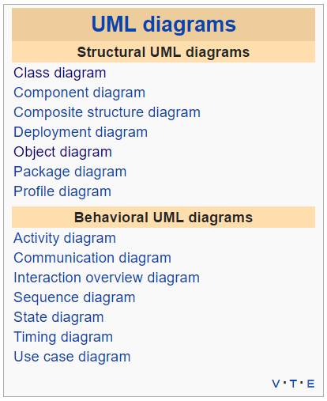
Unified Modeling Language [link]
The Unified Modeling Language (UML) is a general-purpose, developmental, modeling language in the field of software engineering, that is intended to provide a standard way to visualize the design of a system.
For our purposes we will limit our UML usage to diagrams where:
Classes as boxes with three sections, the top of which specifies the name of the class, the middle of which specifies the data, and the bottom of which specifies the functions.
Lines between the classes.
A line with an arrow / triangle pointing to the parent – inheritance
A line with a filled diamond next to the owner – composition
A line with an open diamond next to the owner – aggregation
A line with no decorations – just an association (a using kind of relationship)
Notes:
UML can describe many different things and become quite complex. There is some debate, particularly in the Agile development methodology circles, as to the benefits of this documentation outweigh the cost. Most developers agree that at least a basic understanding of UML diagrams aids greatly in the impromptu “chalkboard” design discussions that occur constantly during the design, implementation, and testing of a project.
UML helps us see the design without having to wade through lots of text to understand it.
UML reached its peak with Iterative Development methodologies like the Rational Unified Process (RUP) and OpenUp. It still is viewed as a critical part of Design for many Waterfall and Iterative organizations.

Slide 26
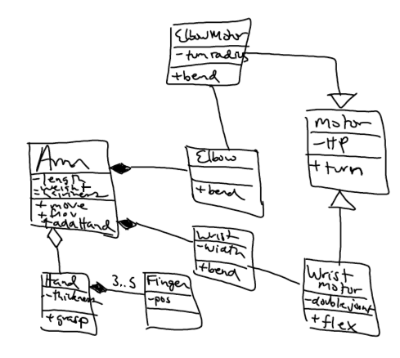
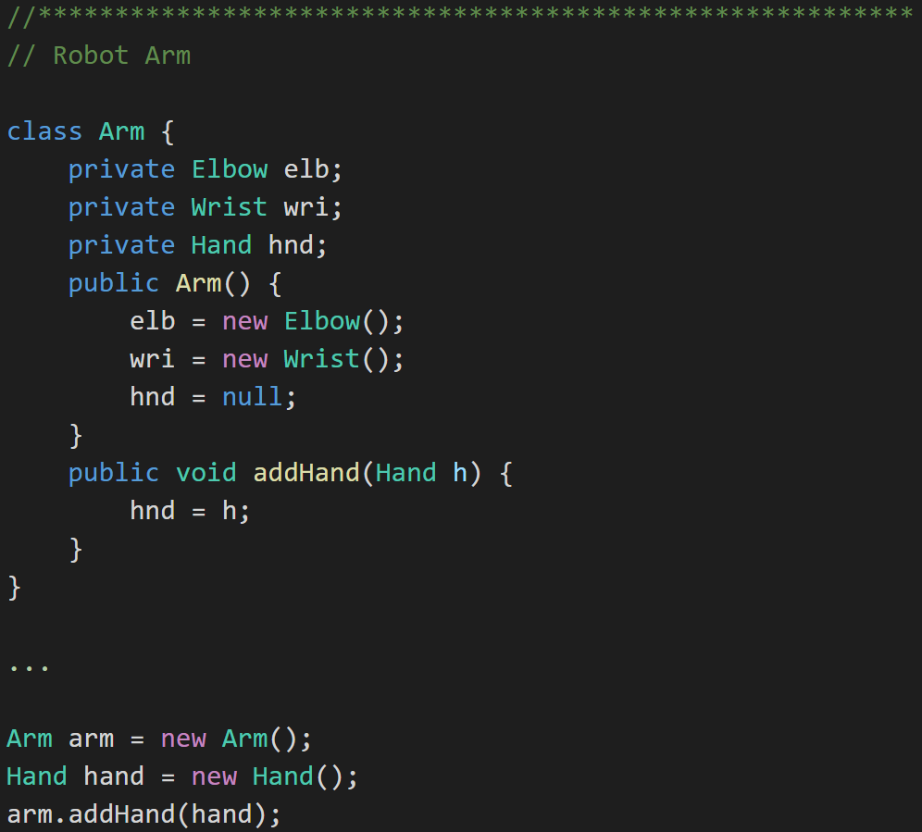
UML Example: Robot Arm
UML:
Java:
Notes:
UML can describe many different things and become quite complex. There is some debate, particularly in the Agile development methodology circles, as to the benefits of this documentation outweigh the cost. Most developers agree that at least a basic understanding of UML diagrams aids greatly in the impromptu “chalkboard” design discussions that occur constantly during the design, implementation, and testing of a project.
UML helps us see the design without having to wade through lots of text to understand it.
UML
UML, or Unified Modeling Language, is a way to show a system’s architecture in graphical form. UML represents
classes as boxes with three sections, the top of which specifies the name of the class, the middle of which specifies the data, and the bottom of which specifies the functions.
Lines between the classes.
A line with an arrow / triangle pointing to the parent – inheritance
A line with a filled diamond next to the owner – composition
A line with an open diamond next to the owner – aggregation
A line with no decorations – just an association (a using kind of relationship)
UML helps us see the design without having to wade through lots of text to understand it.

Slide 27
Learning Objectives
Define object-oriented programming
Position object-oriented programming within Software Development Lifecycle (SDLC)
Review object-oriented language and tool selection
Demonstrate object-oriented programming concepts with examples
Distinguish between a class and an object
Identify and define “six” object-oriented concepts
Identify the superclass and the subclass in an inheritance relationship
Demonstrate inheritance, ownership, and abstraction in snippets of Java code
Distinguish between aggregation and composition
Depict classes and their relationships using UML class diagrams
Define and discuss common object-oriented design patterns
Define and discuss common object-oriented design principles and characteristics of bad software
Recap: How is object-oriented programming is different
Recap: Why did we choose to learn an object-oriented approach in developing software
Notes:
You will notice very quickly that I prefer examples and actual source code over more philosophical discussion. Please feel free to ask for more development philosophy and background if you desire more.

Slide 28
Learning Objectives (Section 3)
Define and discuss common object-oriented design patterns
Define and discuss common object-oriented design principles and characteristics of bad software
Recap: How is object-oriented programming is different
Recap: Why did we choose to learn an object-oriented approach in developing software
Notes:
You will notice very quickly that I prefer examples and actual source code over more philosophical discussion. Please feel free to ask for more development philosophy and background if you desire more.

Slide 29
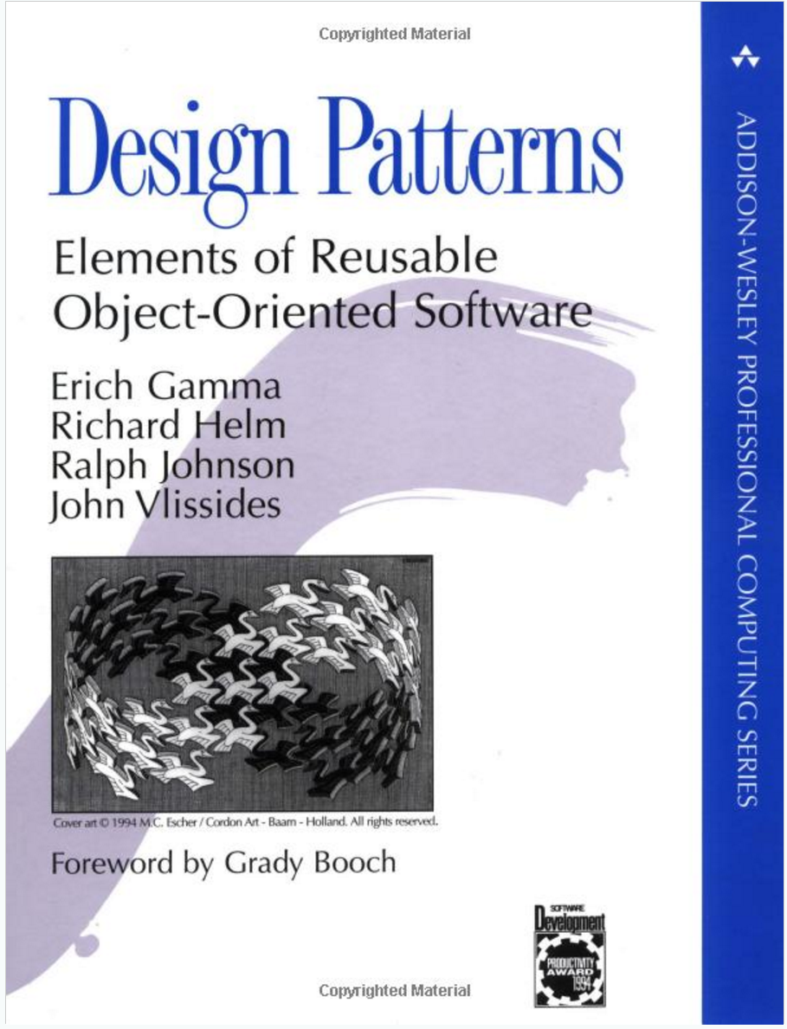
Object-Oriented Design Patterns
Definition: A software design pattern is a commonly repeated approach to constructing software. These approaches are commonly repeated because they have found to be useful.
Common Patterns Include:
Singleton
Factory
Delegation
Model-View-Controller
Others

Slide 30
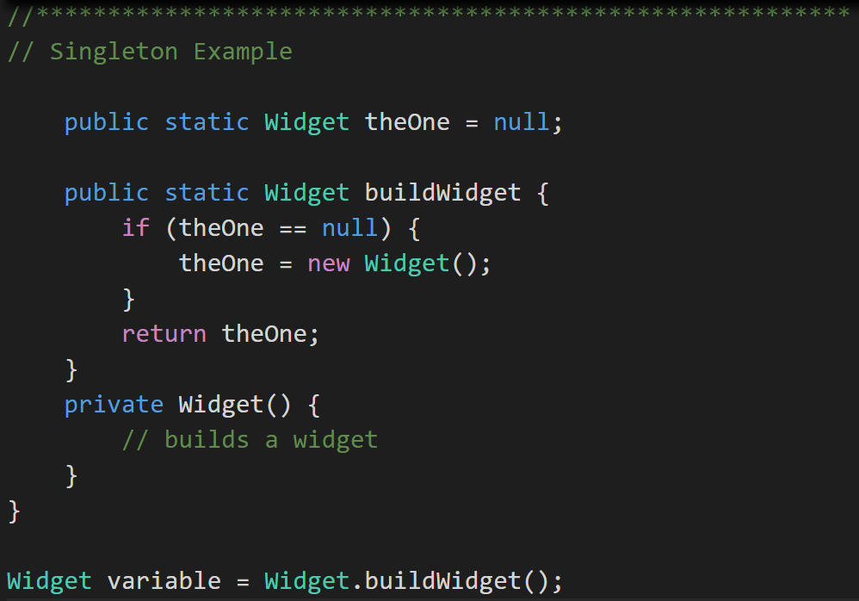
Singleton Design Pattern
Singleton Pattern: Utilized to make sure that only one instance of a class is in existence.
An example would include an application log files that needs to be synchronized across threads. [link]
Notes:
Singleton (making sure there is just one instance of something to avoid conflicts - http://www.oodesign.com/singleton-pattern.html) These are great for coordinating activity across multiple threads of execution.
A singleton can be written by making the constructor for the class private and equipping the class with a static function that ensures that the constructor is called only if no other objects of that class already exist.
Singleton Example
class Widget {
public static Widget theOne = null;
public static Widget buildWidget {
if (theOne == null) {
theOne = new Widget();
}
return theOne;
}
private Widget() {
// builds a widget
}
}
Widget variable = Widget.buildWidget();

Slide 31
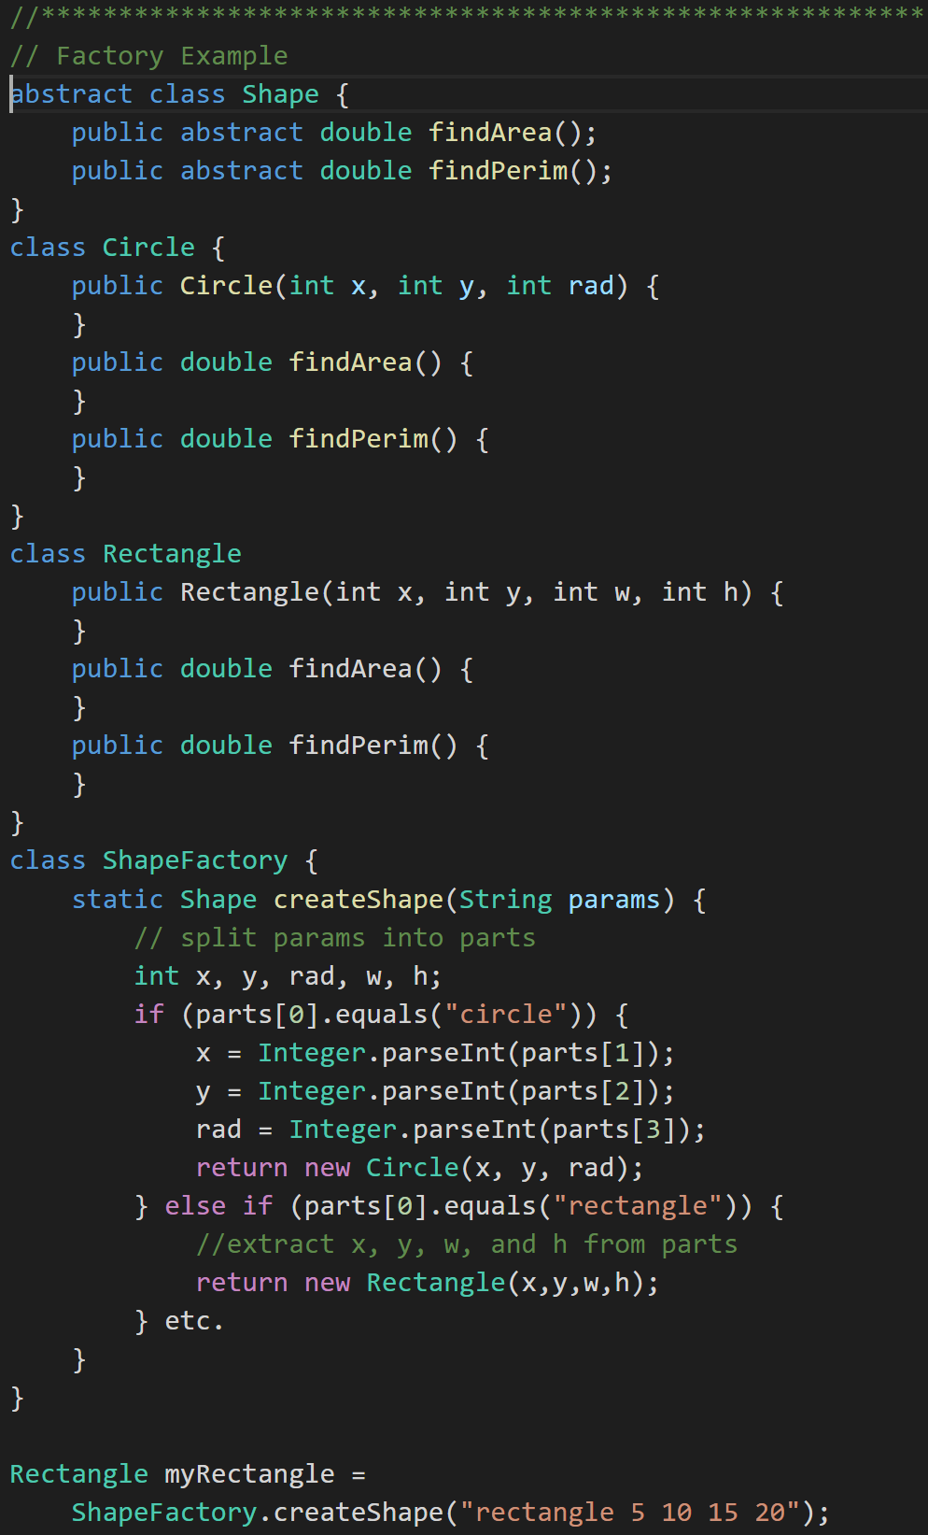
Factory Design Pattern
Factory Pattern: Utilized to create an object without exposing how it is created. [link]
An example would have been in our Polymorphic Animal. We could have made an Animal Factory that his the fact that we were just creating random Dogs, Cats, and Bigcats. Then if we wanted to change the ratios or add Animals, we could do it without forcing code changes outside of the Animal Factory.
Another example would be a Shape Factory that return shapes based on input, but does not expose how the shapes are created. See coding example.

Slide 32
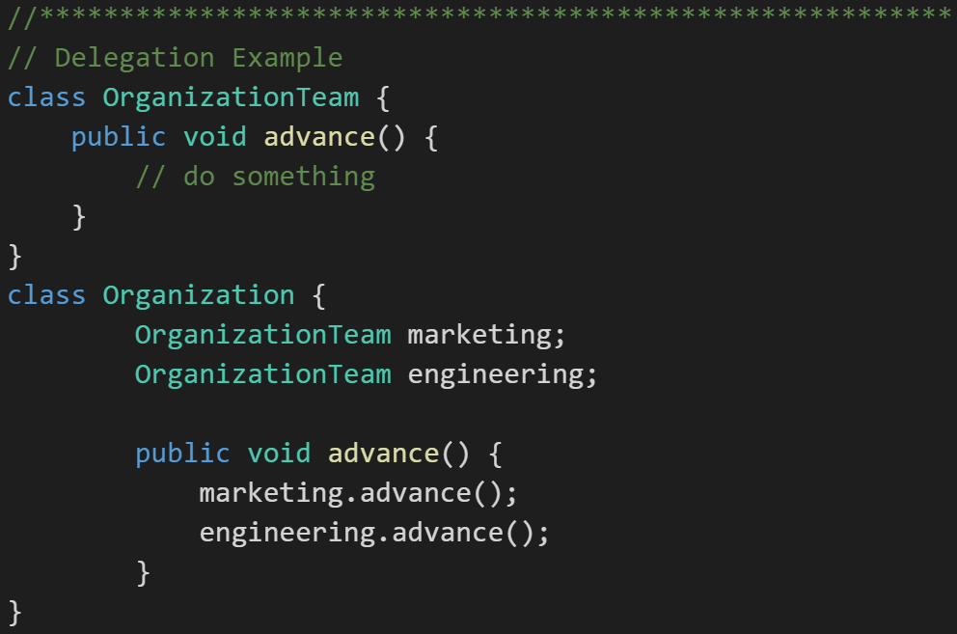
Delegation Design Pattern
Delegation Pattern: In delegation, an object handles a request by delegating to a second object (the delegate). [link]
An example would be an financial application that displays streaming stock prices at the bottom of its windows. We may decide to license an “object” (likely associated with an external service) that we then Delegate the responsibility for displaying on that portion of the screen. Since it may not be technically possible to directly Inherit the functionality from the purchased product, the Delegation pattern allows us to achieve much of the same reuse through an object composition relationship.
“Delegation is a way to make composition as powerful for reuse as inheritance” - Grady Booch
Notes:
Delegation (chain of command; ask an object to do something, which tells something else to do that thing)
Example:
class OrganizationTeam {
public void advance() {
// do something
}
}
class Organization {
OrganizationTeam marketing;
OrganizationTeam engineering;
public void advance() {
marketing.advance();
engineering.advance();
}
}
Another Example of the Delegation pattern
In this example, we have software for managing inventory for a manufacturer who makes classroom furniture. We have a variety of writing surfaces that consist of parts. We want to print out our inventory of parts.
class Part {
}
class WritingSurface {
private Part[] parts;
public Part[] listParts() {
}
}
class Podium extends WritingSurface {
}
class StudentDesk extends WritingSurface {
}
class PartsInventory {
// list all the components that comprise a factory's models
WritingSurface[] models;
public Part[] listParts() {
for (WritingSurface ws : models) {
ws.listParts();
}
}
}
PartsInventory pi = new PartsInventory();
pi.listParts();

Slide 33
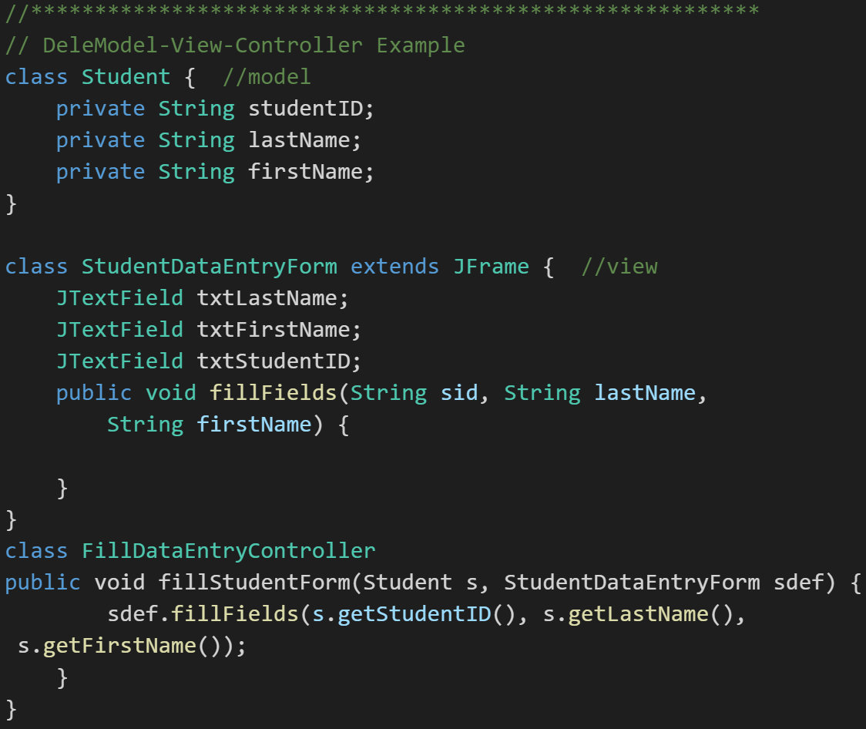
Model-View-Controller
Model-View-Controller (MVC): MVC is an important pattern, will be a primary focus of this course, and will be an important pattern for you to master in your career.
Segregation of our Model (data) from our View (user interface) is necessary to effectively develop, enhance, and maintain modern software.
An example would be a system that manages student data. We would want to segregate the Model (data) from the View (UI) for several reasons including:
There may be many different Views that access the same data potentially including:
student view
faculty view
administrator view,
Web student view,
mobile student view, etc.
Notes:
Evolution of UI and Data segregation
Document-View (View was responsible for View-Controller functionality)
Model-View-Controller
Model–View–Viewmodel
Why Use Patterns?
Using patterns helps us write good software more regularly, because they are tried-and-true approaches to writing it.
Each new level of abstraction adds complexity (and likely negatively impacts performance), and should be justified based on the additional value it provides.
Model-View-Controller – our primary focus this semester. It guides us to separate model – the data – from how we view the data – the view – using an intermediary called the controller.
Example of Model-View-Controller: Suppose we have a system that manages student data. The Student class would be the model; a StudentEntryForm could be the view, and a FillStudentEntryFormController could be the controller class responsible for populating a student data entry form with data.
class Student { //model
private String studentID;
private String lastName;
private String firstName;
}
class StudentDataEntryForm extends JFrame { //view
JTextField txtLastName;
JTextField txtFirstName;
JTextField txtStudentID;
public void fillFields(String sid, String lastName, String firstName) {
}
}
class FillDataEntryController
public void fillStudentForm(Student s, StudentDataEntryForm sdef) {
sdef.fillFields(s.getStudentID(), s.getLastName(),
s.getFirstName());
}
}

Slide 34
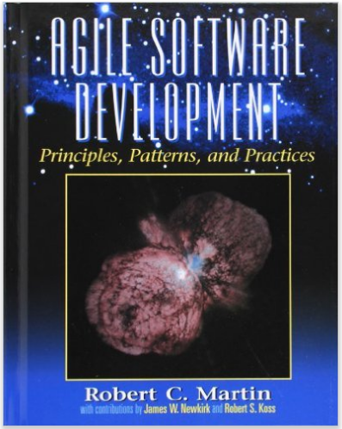
Object-Oriented Design Principles
Software design principles represent a set of guidelines that helps us to avoid having a bad design. The design principles are associated to Robert Martin who gathered them in "Agile Software Development: Principles, Patterns, and Practices".
According to Robert Martin there are 3 important characteristics of a bad design that should be avoided:
Rigidity - It is hard to change because every change affects too many other parts of the system.
Fragility - When you make a change, unexpected parts of the system break.
Immobility - It is hard to reuse in another application because it cannot be disentangled from the current application.
Notes:
Our procedural (C) implementation of BMI would be a great example of Immobility.

Slide 35
Object-Oriented Design Principles
Martin identifies the following Design Principles:
Open Close Principle
Dependency Inversion Principle
Interface Segregation Principle
Single Responsibility Principle
Liskov's Substitution Principle
Notes:
Our procedural (C) implementation of BMI would be a great example of Immobility.

Slide 36
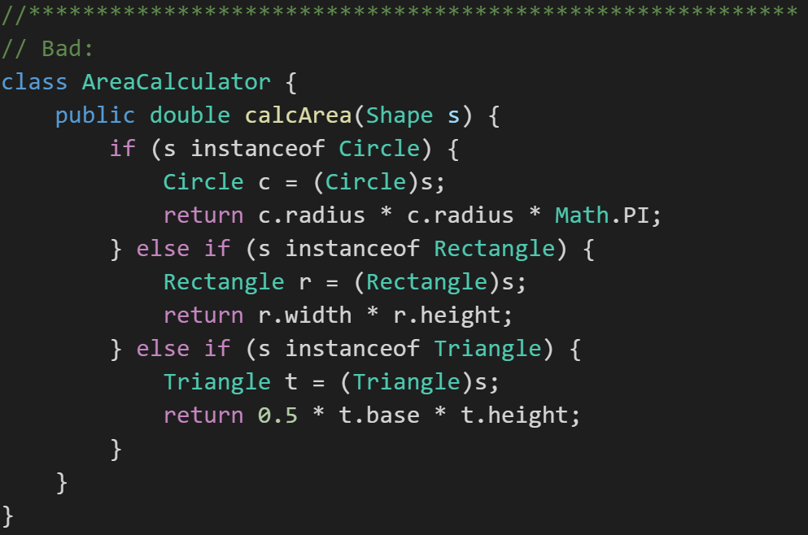
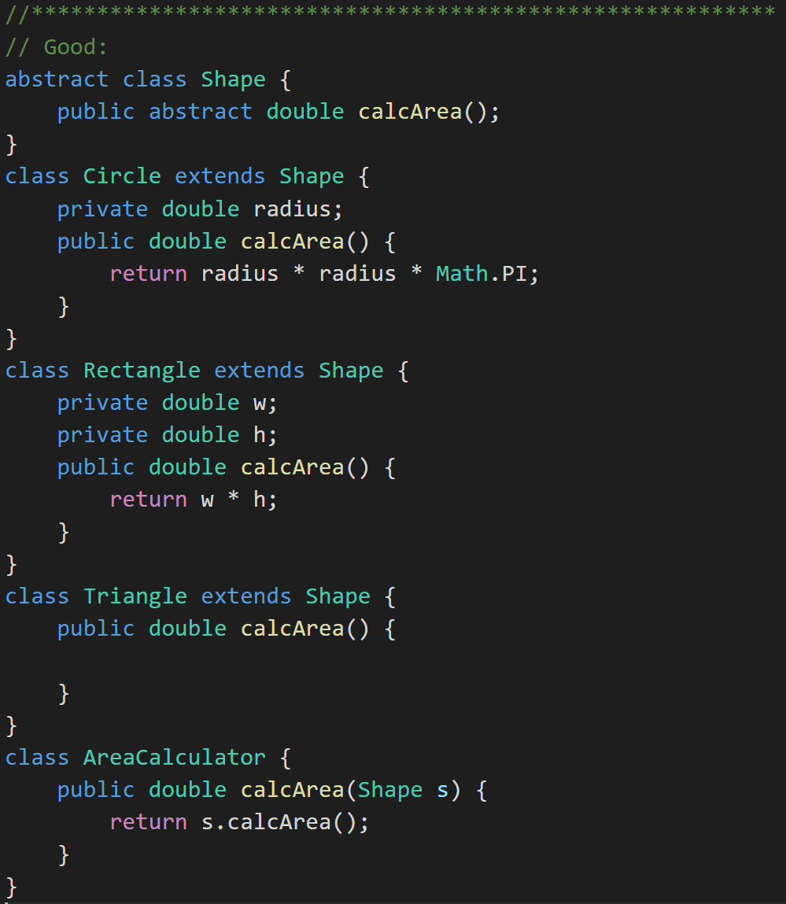
Open Close Principle
Software entities like classes should be open for extension but closed for modifications.
Notes:
Open-Closed Principle Example
Software should open to extension and closed to modification. You shouldn't have to change the code to have it handle new, related circumstances.
Bad:
class AreaCalculator {
public double calcArea(Shape s) {
if (s instanceof Circle) {
Circle c = (Circle)s;
return c.radius * c.radius * Math.PI;
} else if (s instanceof Rectangle) {
Rectangle r = (Rectangle)s;
return r.width * r.height;
} else if (s instanceof Triangle) {
Triangle t = (Triangle)s;
return 0.5 * t.base * t.height;
}
}
}
Good:
abstract class Shape {
public abstract double calcArea();
}
class Circle extends Shape {
private double radius;
public double calcArea() {
return radius * radius * Math.PI;
}
}
class Rectangle extends Shape {
private double w;
private double h;
public double calcArea() {
return w * h;
}
}
class Triangle extends Shape {
public double calcArea() {
}
}
class AreaCalculator {
public double calcArea(Shape s) {
return s.calcArea();
}
}

Slide 37
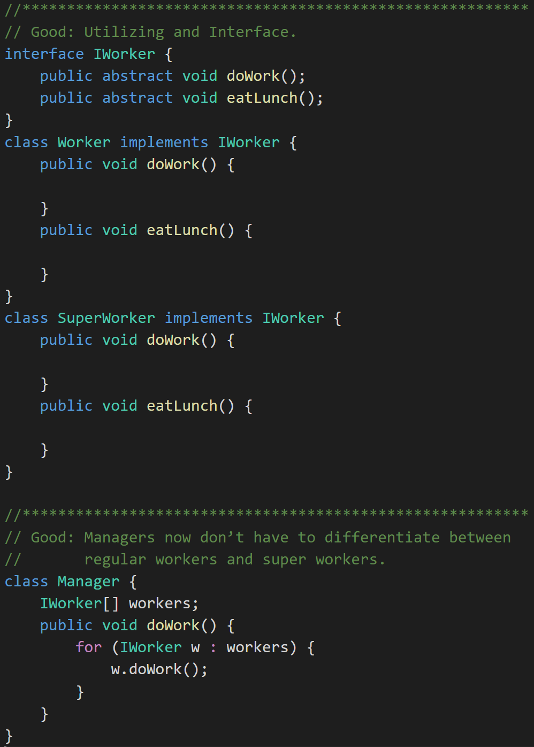
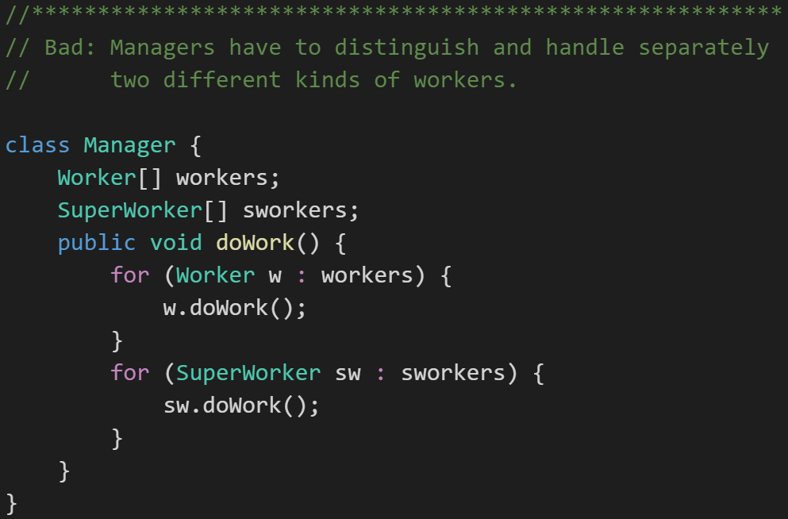
Dependency Inversion Principle
Don't let owners depend on the implementation of the things it owns.
For example a Manager class should not have to behave differently depending on if a what type of workers.
One way to comply with Dependency Inversion Principle is to use an interface. An interface is a class-like data type that prescribes behaviors rather than data.
Notes:
Dependency Inversion Principle
Don't let owners depend on the implementation of the things it owns.
Example: Manager and Worker
Bad: Managers have to distinguish and handle separately two different kinds of workers
class Manager {
Worker[] workers;
SuperWorker[] sworkers;
public void doWork() {
for (Worker w : workers) {
w.doWork();
}
for (SuperWorker sw : sworkers) {
sw.doWork();
}
}
}
One way to comply with Dependency Inversion Principle is to use an interface.
An interface is a class-like data type that prescribes behaviors rather than
data.
An interface a set of abstract functions.
Classes then *implement* that interface. In other words, they implement all
of the function that make up the interface.
Whereas you can you extend only one class, you can implement as many interfaces as you need.
interface IWorker {
public abstract void doWork();
public abstract void eatLunch();
}
class Worker implements IWorker {
public void doWork() {
}
public void eatLunch() {
}
}
class SuperWorker implements IWorker {
public void doWork() {
}
public void eatLunch() {
}
}
Good: Managers now don’t have to differentiate between regular workers and super workers.
class Manager {
IWorker[] workers;
public void doWork() {
for (IWorker w : workers) {
w.doWork();
}
}
}

Slide 38
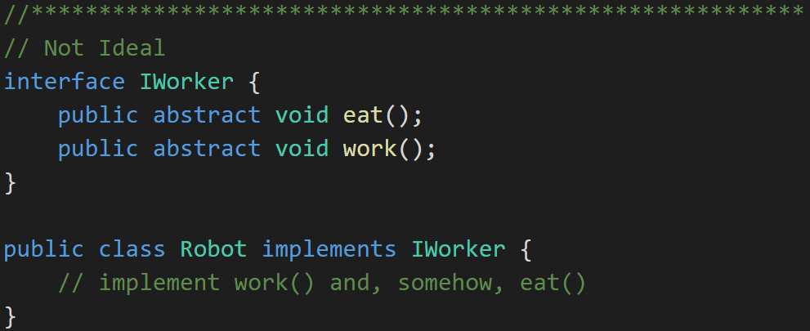
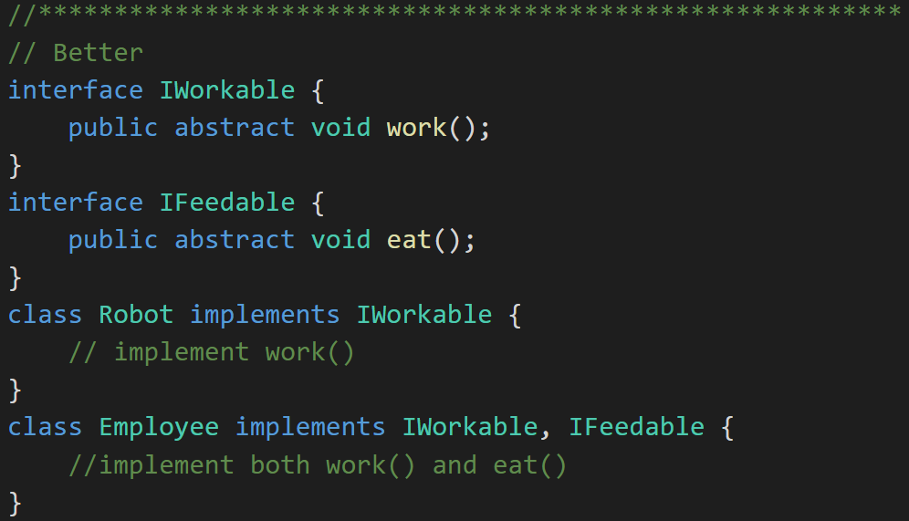
Interface Segregation Principle
Clients should not be forced to depend upon interfaces that they don't use.
The previous example has a minor flaw. Consider the IWorker interface. It specifies that workers both eat lunch and do work. What if we end up building and using robotic workers? They don’t have to eat. So, our definition of Worker includes too much and therefore can only be clumsily applied to situations where our understanding of what a worker is might change.
Notes:
Interface Segregation Principle
The example we just did has a teensy flaw. Consider the IWorker interface. It specifies that workers both eat lunch and do work. What if we end up building and using robotic workers? They don’t have to eat. So, our definition of Worker includes too much and therefore can only be clumsily applied to situations where our understanding of what a worker is might change.
NOT IDEAL:
interface IWorker {
public abstract void eat();
public abstract void work();
}
public class Robot implements IWorker {
// implement work() and, somehow, eat()
}
BETTER:
interface IWorkable {
public abstract void work();
}
interface IFeedable {
public abstract void eat();
}
class Robot implements IWorkable {
// implement work()
}
class Employee implements IWorkable, IFeedable {
//implement both work() and eat()
}

Slide 39
Single Responsibility Principle
A class should have only one reason to change.
An example might be a video player. If you build into the video player class both the responsibility to render the content and control the networking and buffering, you now have two reasons to have to change that VideoPlayer class. Instead, separate out the rendering and the networking/buffering among classes that the VideoPlayer class owns.

Slide 40
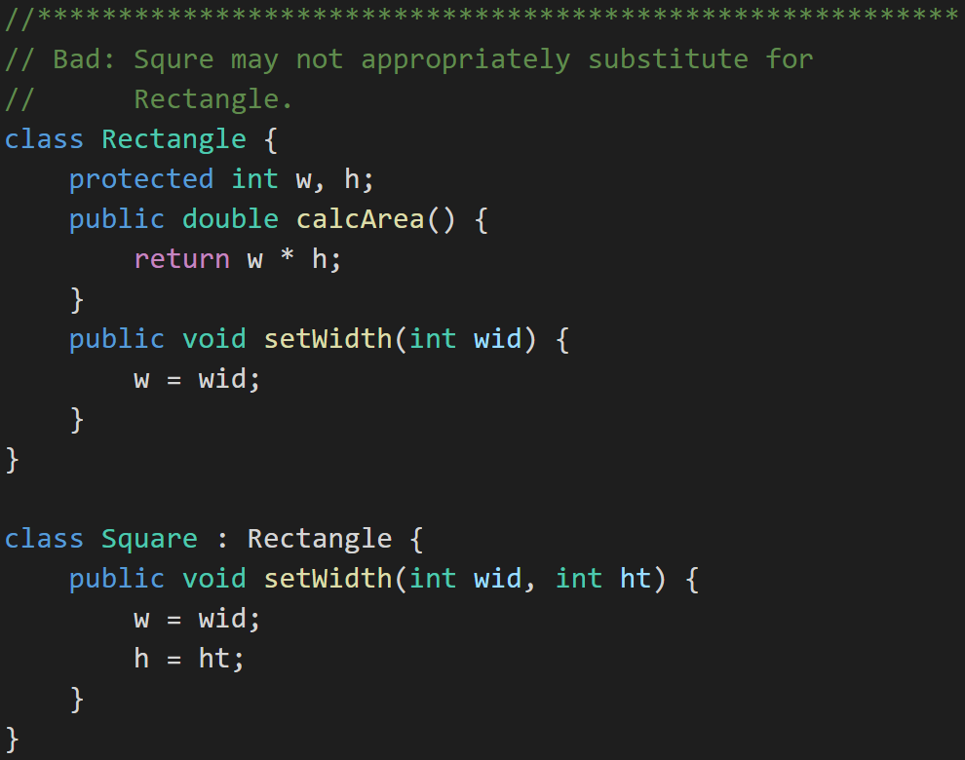
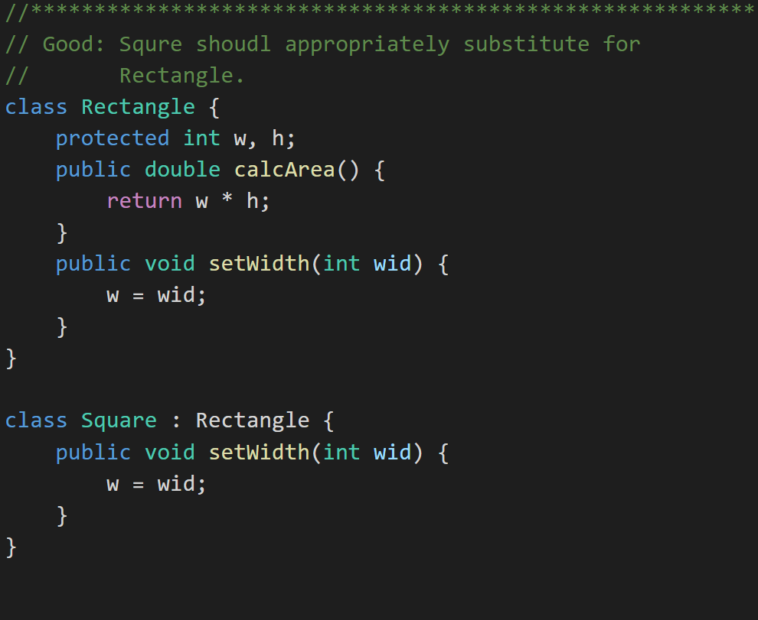
Liskov Substitution Principle
Derived classes must be completely substitutable for their base types. And similarly Subclasses should not break core functionality introduced by their parent.
Notes:
Liskov Substitution Principle
Subclasses should not break core functionality introduced by their parent.
For example: this is bad, because Square is not just setting its width in the setWidth function; it is also setting its height:
class Rectangle {
protected int w, h;
public double calcArea() {
return w * h;
}
public void setWidth(int wid) {
w = wid;
}
}
class Square : Rectangle {
public void setWidth(int wid, int ht) {
w = wid;
h = ht;
}
}
Not cool!
Bottom Line About These Principles
We’ll see these principles again as the course continues.
This course mixes theory and practice
We will learn and re-learn these concepts as we learn three object-oriented programming languages: Java and C#

Slide 41
Recap: Object-Oriented Programming
Rich is practice and theory with well accepted concepts, patterns, and principles
Consistent support for powerful concepts including features that support:
Encapsulation… and Information Hiding
Inheritance… and Abstraction
Polymorphism
Strong support for delivering extensible, maintainable, supportable, and scalable solutions
Long history of industry success in managing complexity and delivering solutions that minimize rigidity, fragility, and immobility.
Encompasses both design and programming activities
Provides benefit across various development methodologies

Slide 42
Recap: Why Choose an Object-Oriented Approach
#1 – This is the best way we know to consistently deliver high quality software products.
#2 – It is the approach demanded by the industry where we hope to be employed.
#3 – It’s an enjoyable way to build software solutions.

Slide 43
Bonus Slides
Waterfall vs Iterative vs Agile

Slide 44
Waterfall vs Iterative vs Agile
 | Waterfall | Iterative | Agile
References | United States Department of Defense: DOD-STD-2167A (1985) | Rational Unified Process (RUP) Open Unified Process | Scrum Kanban Scaled Agile Framework (SAFe)
Priorities | Planning and predictability | Architecture, modeling, and efficiency through early detection & fixing of issues | Responsiveness to feedback, efficiency through engineering practices, early detection & fixing of issues
Principles | Execute phases sequentially: Requirements Analysis Design Coding Testing and Operations Define and commit to Scope, Cost, and Timeline “early” Implement strict Change Control | Develop and test iteratively Manage requirements Use components Model visually Verify quality Control changes | Develop, test, deploy, and release iteratively Capture lightweight near term requirements Empower teams Allow requirements to evolve but maintain fixed timelines Apply engineering practices and systems thinking (e.g. TDD) Integrate early user feedback into remaining plan Maintain a collaborative approach between all stakeholders

Slide 45
Waterfall vs Iterative vs Agile (continued)
 | Waterfall | Iterative | Agile
Engineering Standards | None specified | Components and Modeling (UML) XP referenced periodically | XP DevOps
Optimization | Specialization & standardization based on skills, location, and/or technology | Architecture, modeling, and iterations | Fast customer feedback, small cross-functional teams, and working software
Planning Horizon Focus | Years – High Months – High Days – Low | Years – Medium Months – Medium Days – Medium | Years – Low Months – Medium Days – High
Scope and Requirements Management | Scope locked-in after Requirements Phase (approximately one-third through the project) | Requirements are stabilized during Elaboration Phase with smaller changes in later phases | Changes in requirements embraced utilizing lowest priority items as Scope buffer
Prevalent Issues | Timeline and cost overruns | Timeline and cost overruns | Reduced functionality release
Industry Success Rates | Low to Medium | Medium | Medium to High

Slide 46
Waterfall vs Iterative vs Agile (continued)
Optional
 | Waterfall | Iterative | Agile
Delivery Ownership | Ownership changes from role to role by phase with Project Manager being responsible for overall delivery | Project Manager responsible for completing iteration | Team centric with team responsible for delivery of working feature
Resource Utilization | Role and skill centric with tasks often being restricted to an individual or group | Role and skill centric with tasks often being restricted to an individual or group | Team centric with team members switching roles regularly
Status Reporting | Work progress (% complete) relative to plan | Work progress plus product features delivered by Iteration during Implementation | Product features demonstrated by Sprint and Iteration
Customer Feedback | At the end of the project when the product is released | At the end of the project plus internally with each iteration | At the end of each release and iteration plus internally with each sprint
Retrospection | After each release | After each iteration or milestone | After each sprint
Quality Control | Detection & fixing primarily last phase of project | Early detection & fixing in each iteration and in last phase of project | Early detection & fixing in each sprint followed by stabilization

