Slide 1

Object-Oriented Programming Session: Week 6 Session 1 Instructor: Eric Pogue
Agenda:
Review this week’s programming Assignment
Introduce the week’s Learning Objectives
Topics

Slide 2
FastPrime in C#
Write a performance optimized command line C# application that will programmatically find prime numbers and store those numbers sorted in an output file.
In FastPrime we will create a command line Java application that will:
Use multiple threads to find the prime numbers between two numbers
Sort those results and store them to a file
Perform some timings
… And do this all very fast
See the details in this week’s assignment

Slide 3
Learning Objectives – Week 6
Download and install Visual Studio... And implement Hello World in C#
Identify characteristics of Java, Python, and C#
Professional positioning
Write non-object-oriented programs that use sequence, selection, and repetition
Define a C# class, complete with properties, methods, and constructors
Use C# built-in text file objects to create and read text files
Use inheritance to create a hierarchy of classes that are related to each other
Create objects of classes and use them to carry out the work of your program
Work with C# lists
Deal with a list of related objects polymorphically

Slide 4
Microsoft Visual Studio
Microsoft Visual Studio is an integrated development environment (IDE) from Microsoft. It is used to develop computer programs for Microsoft Windows, as well as web sites, web apps, web services and mobile apps. It can produce both native code and managed code. [link]
Download and install Visual Studio and C# [link]
Download the Visual Studio Community 2017 edition with C# selected as your primary environment

Slide 5
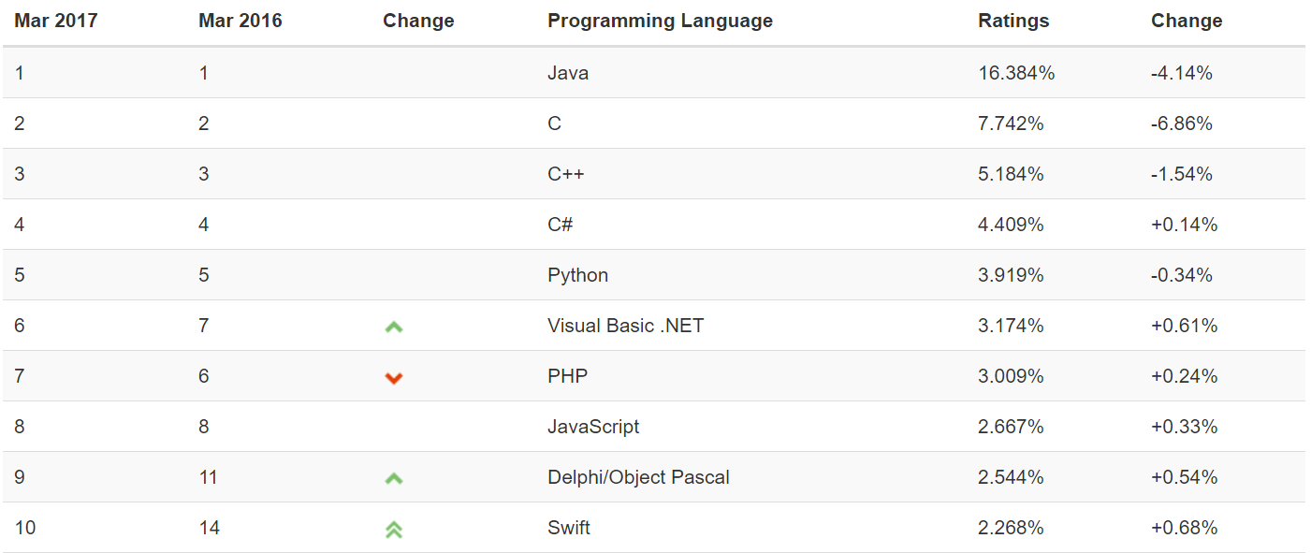
Object-Oriented Languages and Tools
The TIOBE index can be used to check whether your programming skills are still up to date or to make a strategic decision about what programming language should be adopted when starting to build a new software system. The full TIOBE is available online [link].
TIOBE Index for March 2017:
Notes:
We will utilize mostly Java and C# for our object-oriented programming examples. We may (or may not) do any Python work. Since it is often ‘unnatural’ to show procedural programming examples in Java, C#, or Python, we will implement programs in C to demonstrate procedure programming examples. Let me know if you have a desire to do some Python work… or work in another OOP language. If so, we can likely work something out.
Note that our reluctance to utilize C++ as a OOP learning tool is does not diminish the value of the C++ toolset. However, C++ is generally considered a very powerful set of tools with a steep learning curve. It’s a very sharp knife… use it carefully.

Slide 6
Java
Java is a general-purpose computer programming language that is concurrent, class-based, object-oriented, and specifically designed to have as few implementation dependencies as possible. [link]
Compiles to Java byte codes that run in the Java Virtual Machine (VM)
Achieved portability by running in VMs that exist on many platforms
Achieved dominance in the enterprise and for server side development
Plays a center role in Android development*
Served as a platform for multiple additional languages have been developed to compile to Java bytecode and run in the Java VM including Groovy and Scala
Achieved only minimal success in the development of commercial applications or applets
Syntax Notes: strongly typed, object-oriented, single inheritance, interface focused
Notes:
*The history of Google’s Android and Java is nothing short of a soap opera:
http://www.zdnet.com/article/the-real-history-of-java-and-android-as-told-by-google/
Android uses mostly the Java API but does not have the right to use the Java name. Be aware that Software and Legal Protections can be VERY complicated.

Slide 7
Python
An interpreted language, Python has a design philosophy which emphasizes code readability (notably using whitespace indentation to delimit code blocks rather than curly braces or keywords), and a syntax which allows programmers to express concepts in fewer lines of code than possible in languages such as C++ or Java. [link]
Achieves portability through interpreter running on various platforms
Achieved great success as a “quick-and-dirt” scripting tool
… and in the data sciences realm
Runs slower because it is interpreted
Shares a similar space to other scripting languages like Perl and PowerShell
Syntax Notes: loosely typed, indent sensitive (no brackets or semi-colons), object-oriented

Slide 8
C#... And .NET
C# (pronounced “see sharp”) is a general purpose programming language that implements strong typing, object-oriented (class-based), and component-oriented programming disciplines. It was developed by Microsoft within its .NET initiative. [link]
Compiles to .NET Common Language Runtime (CLR)
Portable between CLR implementations… but MS Windows focused
Portable between Windows desktop, cloud, XBOX, tablets, embedded, and phone
Focused on industrial strength client applications with a solid server-side presence
Syntax Notes: strongly typed, object-oriented, single inheritance

Slide 9
C#... And .NET (continued)
.NET Framework (pronounced dot net) is a software framework developed by Microsoft that runs primarily on Microsoft Windows. It includes a large class library and provides language interoperability (each language can use code written in other languages). Programs written for .NET execute in a software “managed code” environment named Common Language Runtime (CLR). [link]
Implementations for many languages are available for .NET and CLI including Python… but not “real” Java [link]
Provides and object-oriented platform that is language agnostic
ASP.NET is the “standard” .NET Web development environment
Achieving dominance on Windows desktop, competitive place in cloud (Azure), and XBOX

Slide 10
C#... And .NET (continued)
.NET Framework (pronounced dot net) is a software framework developed by Microsoft that runs primarily on Microsoft Windows. It includes a large class library and provides language interoperability (each language can use code written in other languages). Programs written for .NET execute in a software “managed code” environment named Common Language Runtime (CLR). [link]
Implementations for many languages are available for .NET and CLI including Python… but not “real” Java [link]
Provides and object-oriented platform that is language agnostic
ASP.NET is the “standard” .NET Web development environment
Achieving dominance on Windows desktop, competitive place in cloud (Azure), and XBOX

Slide 11
Professional Positioning
Become a professional software developer with depth in on or two areas (i.e. an expert in web application development in Java) and an understanding of several more (i.e. know a little system admin / devops and something about the healthcare industry).
Do NOT become the Java expert (only)
Languages and environments are tools, you will need to know several and be able to learn more
Branch out and play other related roles like business analyst, project manager, team leader, database analyst, product manager, architect, etc.
Know something about the domain
Get out and see your customers and business partners

Slide 12
End of Session
Course Number: CPSC-24500
Week: 6
Session: 1
Instructor: Eric Pogue

Slide 13
Object-Oriented Programming Session: Week 6 Session 2 Instructor: Eric Pogue
Download and install Visual Studio... And implement Hello World in C#
Identify characteristics of Java, Python, and C#
Professional positioning
Write non-object-oriented programs that use sequence, selection, and repetition
Use Visual Studio 2017 to define C# classes, complete with properties, methods, and constructors… and much more
Create classes and objects to carry out the work of your program
Use inheritance to create a hierarchy of classes that are related to each other
Use .Net (C#) built-in text file objects to create and read text files
Work with .Net (C#) lists
Deal with a list of related objects polymorphically

Slide 14
But First… FastPrime C#
Write a command line C# application in Visual Studio 2017 that will programmatically find prime numbers and store the numbers sorted in an output file.
In FastPrime we will create a command line C# application that will:
Utilize C#
Utilize Visual Studio and the integrated environment & debugger
Use multiple threads to find the prime numbers between two numbers
Sort those results and store them to a file
Perform some timings
Come to our Thursday lunch session with any questions… or email your questions head of time
See the details in this week’s assignment.
Notes:
This time we are primarily focused on using a familiar topic (performance, threading, and prime numbers) to learn a new environment and language.

Slide 15
Example: Visual Studio, C#, and Random Numbers
ThreadedRandomNumbers: Calculate 1,000,000,000 random numbers between 1 and 2,000,000. Print “We found number 1024!” to the console each time 1024 is generated. We would expect it to come up approximately 500 times.
Write a single threaded application
Divide the application into multiple threads and repeat
Consider the diminishing returns of adding additional threads
Progressing through:
HelloWorldCS
RandomNumbersCS
RandomNumbersThreadedCS
Notes:
Once again, this time we are primarily focused on using a familiar topic (performance, threading, and prime numbers) to learn the Visual Studio environment and C# language.

Slide 16
Visual Studio & C#
Let’s make sure that we understand:
Visual Studio 2017… embrace your IDE
Visual Studio New Application Wizard*… mixed blessings
Visual Studio Text Editor
Debugger!
Debug vs. Release builds
Project and source code files
C# Hello World
Command line arguments in debugger
Debug and Release configurations
Text formatting options ({)
Full screen text editing (shift+alt+enter)
Notes:
If you are going to adopt an IDE, understand how it works and embrace it’s preferences whenever possible.
New Application Wizard’s are great, but not nearly as great as they first appear. You must invest the time to understand their “magic” so that when there is a problem you know where to look.
*Important: For this week’s assignment you will want to start with File->New->Project->Visual C#->Console App (.NET Framework)… And name your project “FastPrimeCS”
Command Line Arguments: Right click “ConsoleApp1”and select Properties->Debug->Command line arguments.
Bracket Formatting: Tools->Options->Text Editor->C#->Code Style->Formatting->New Lines->Place open brace on new line for types (unmark all)
Hello World C#:
https://msdn.microsoft.com/en-us/library/aa288463(v=vs.71).aspx

Slide 17
Visual Studio & C# (continued)
System.Console.WriteLine
Classes
Methods
Properties, Setters, and Getters
Framework classes.. .NET classes and not C# classes*
Time & Duration
Threads
Notes:
Many Visual Studio languages other that C# (which grew up with .NET) have access to multiple (often competing) class libraries. This can be a substantial challenge as the implementations of similar classes are often not compatible with each other or other elements of their respective libraries. For example, there is at least four competing implementations of “string” that exists in C++ (C, C++, Windows API, MFC, .NET, etc.).
In many cases knowing a library or set of APIs has become more important than a given language.

Slide 18
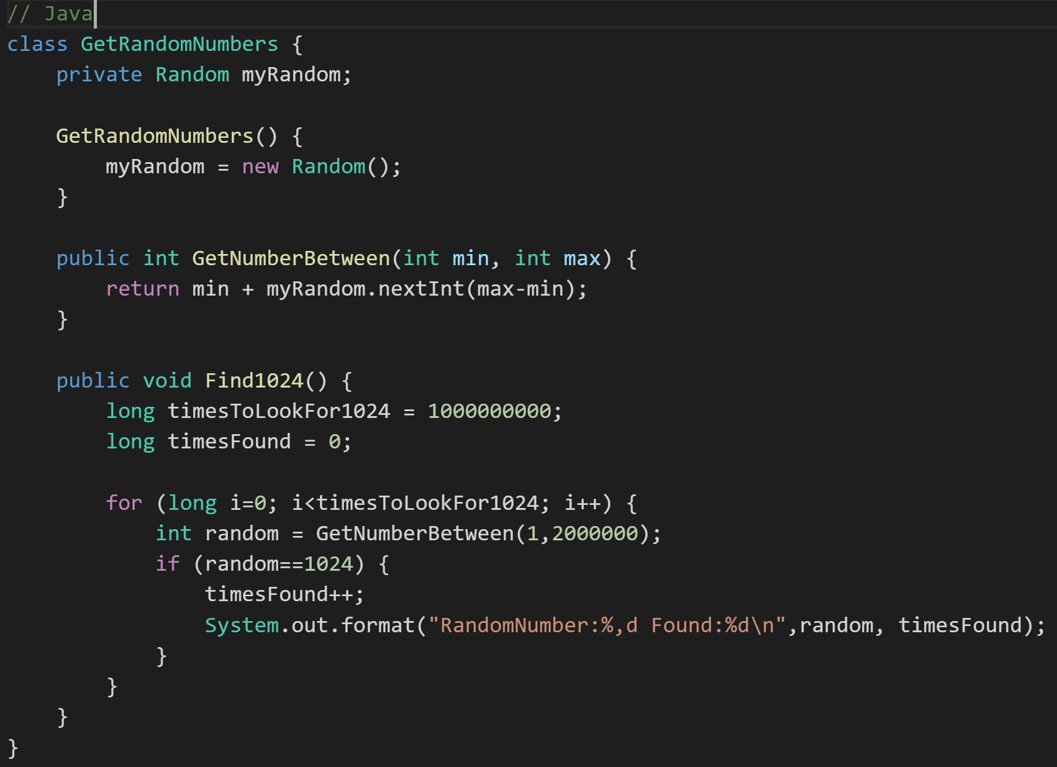
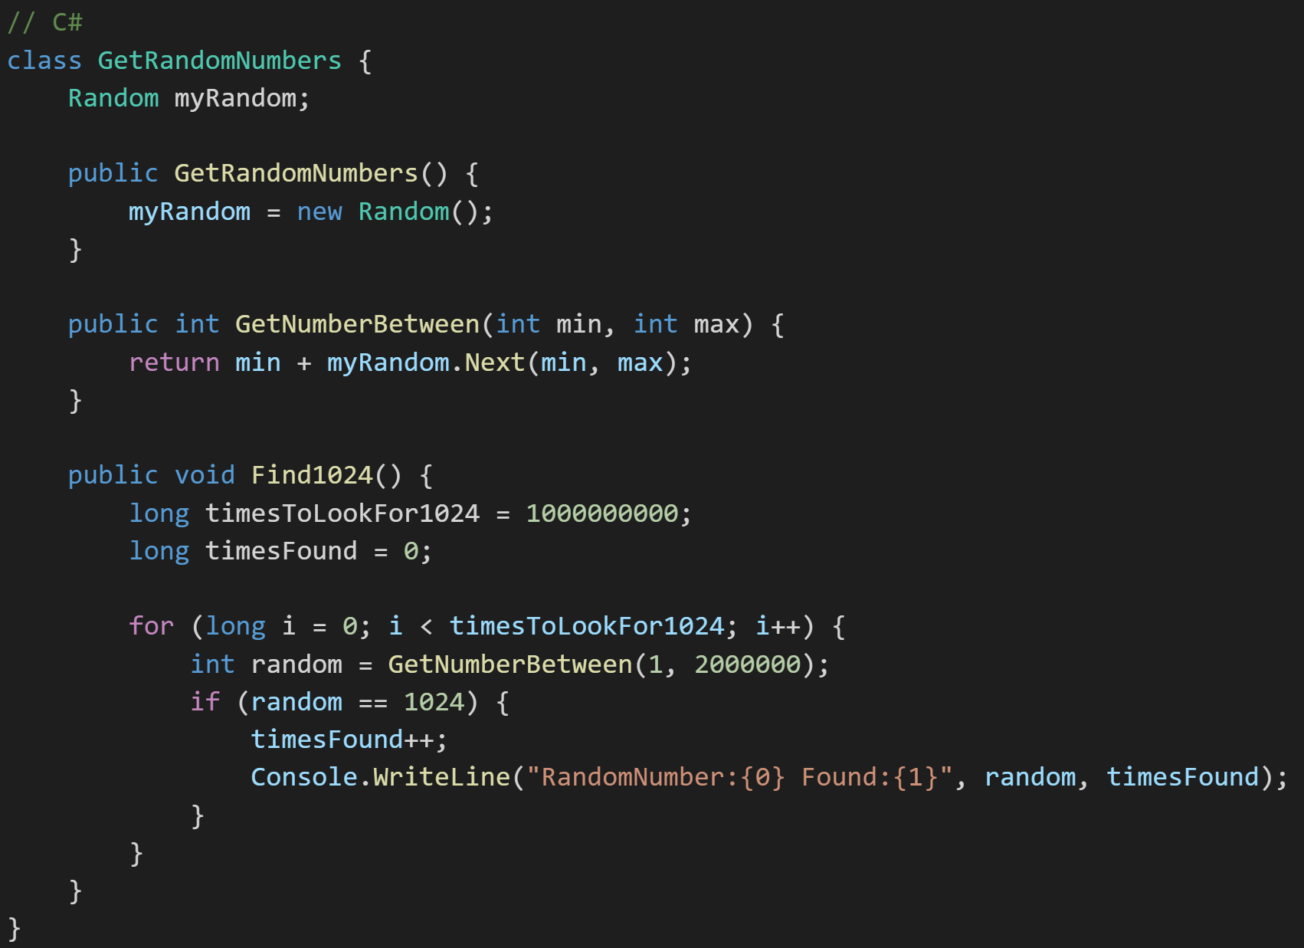
C# vs. Java GetRandomNumbers Class
Notes:
Shockingly similar code.

Slide 19
Object-Oriented Programming Session: Week 6 Session 2 Plus Instructor: Eric Pogue
Download and install Visual Studio... And implement Hello World in C#
Identify characteristics of Java, Python, and C#
Professional positioning
Write non-object-oriented programs that use sequence, selection, and repetition
Use Visual Studio 2017 to define C# classes, complete with properties, methods, and constructors… and much more
Create classes and objects to carry out the work of your program
Use inheritance to create a hierarchy of classes that are related to each other
Use C# built-in text file objects to create and read text files
Work with C# lists
Deal with a list of related objects polymorphically

Slide 20
Review: Serialization and Writing/Reading Text Files (IO)
When we were working with Java we learned that… Serialization is an object-oriented programming term that means converting an object to a byte steam usually to be written to or read from a text or binary file.
To write to a Java text file:
Create a File object, feeding the file’s path to the File class constructor
Create a FileWriter to access the File
Create a BufferedWriter to write data to the FileWriter efficiently
Use BufferedWriter’s write and newLine functions to commit the data to the file.
To read from a Java text file:
Create a File object, feeding the file’s path to the File class constructor
Attach a Scanner object to it
Use Scanner’s readLine and hasNextLine functions to read the file
Notes:
A buffered writer or buffered stream efficiently organization reads and writes for optimal disk performance. The danger is that if there is a power failure (or someone accidentally kicks your power strip) you could lose data. It is good to “flush the buffer” at critical times when using a buffered writer on mission critical projects. There is little or no danger in using a buffered reader.
Binary files versus text files.
XML – Text file format for structured data… HTML for data.
JSON – “Simplified” text file format for structured data.
Binary

Slide 21
.NET (C#) Writing & Reading Files
There a multiple C# classes and (static) methods that we can use to write and read files. We will be looking at several including:
System.IO.File.WriteAllLines
FileStream: Used to read from and write to any location in a file
File Class [link]… get used to looking these things up online

Slide 22
.NET (C#) Lists
The .NET framework offers multiple implementations of Collections and Collections.Concurrent including:
List [link]: Represents a strongly typed list of objects that can be accessed by index. Provides methods to search, sort, and manipulate lists.
ArrayList [link]: Implements the IList interface using an array whose size is dynamically increased as required.
ConcurrentQueue [link]: Represents a thread-safe first in-first out (FIFO) collection.
Notes:
Become comfortable in looking at the online documentation and examples… be aware of “reputable” sources and conflicting documentation.
.NET ArrayList Thread Safety: Any public static (Shared in Visual Basic) members of this type are thread safe. Any instance members are not guaranteed to be thread safe.
If you run into threading issues with ArrayaList in your assignment, you will need to switch over to a “Concerrent” collection list “ConcurrentQueue”.

Slide 23
End of Session
Course Number: CPSC-24500
Week: 6
Session: 2
Instructor: Eric Pogue

Slide 24
Object-Oriented Programming Session: Week 6 Session 3 (Lunch & Learn) Instructor: Eric Pogue
Agenda:
Review FastPrime C# Assignment
FastPrimeLite
Notes:
FastPrimeLite: I don’t want this week’s assignment to be difficult because of finding prime numbers and threading! This is intended to be an exercise in taking some things that we know like finding prime numbers and threading and becoming comfortable with implementing them in Visual Studio and C#. As such, my FastPrimeLite application that I am going to show today is going to be very much like what you will need to do from a logic perspective for this week’s assignment. You should feel free to copy (well type it in yourself, update the variable, and get the syntax correct) the code for you to become familiar with Visual Studio and C# editing, debugging, and updating.

Slide 25
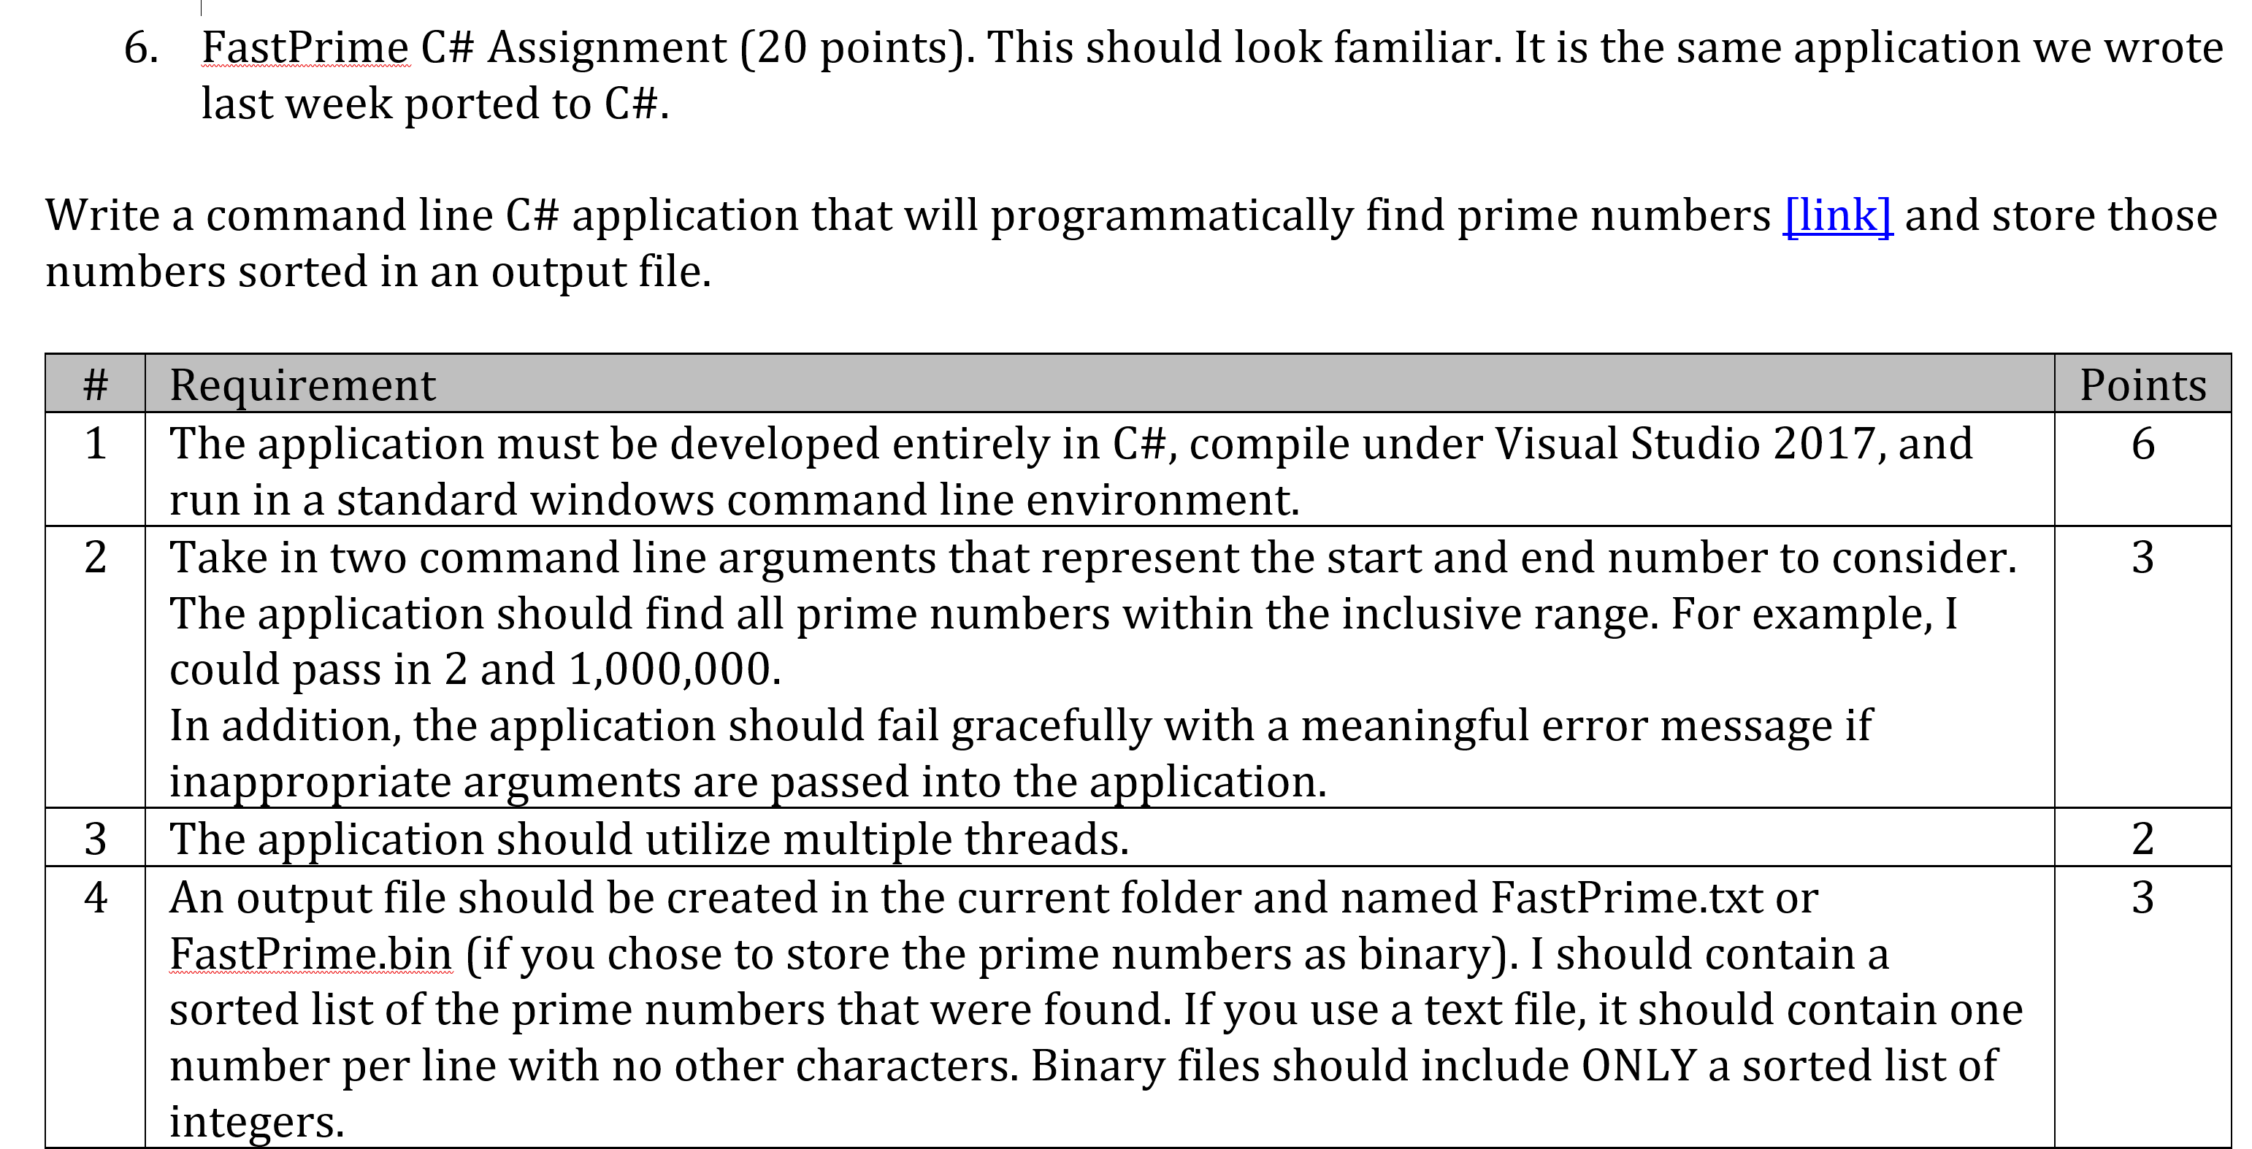
FastPrime C#

Slide 26
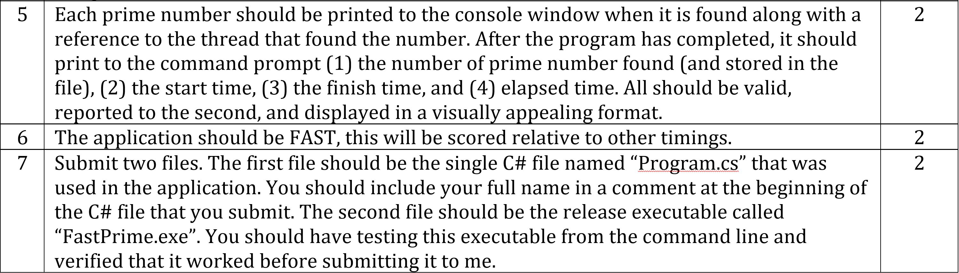
FastPrime C# (continued)

Slide 27
FastPrimeLite
Features:
Develop application entirely in Visual Studio 2017 and C#
Take in two command line arguments that represent the start and end number
Fail gracefully with a meaningful error message if inappropriate arguments are passed in
Find the prime numbers in the range
Add numbers to a list
Sort the list
Use multiple threads… I will use 3 and you should use at least 4
Each prime number should be printed to the console window
Write to the console (1) the number of prime number found (and stored in the file), (2) the start time, (3) the finish time, and (4) elapsed time
Output results to text file called FastPrimeLite.txt
Review the location of Program.cs and the release executable named “FastPrimeLite.exe
Notes:
I want you to be focused on learning the C# environment and syntax and not on reimplenting FastPrime to be better.
Your application should be your own; however, you’re welcome and encouraged to copy significant elements of FastPrimeLite in your assignment. You should type it in yourself, change the names of the classes and variables at a minimum, implement the missing features, use at least four threads, and generally enhance the implementation.
The crossed out items are items that will not be implemented if FastPrimeLite but that you will need to implement separately.
Please don’t forget the easy things like your name at the top and start/end times, etc

Slide 28
End of Session
Course Number: CPSC-24500
Week: 5
Session: 3
Instructor: Eric Pogue

Slide 29
End of Session
Course Number: CPSC-24500
Week: 5
Session: 4
Instructor: Eric Pogue

