Slide 1

Web and Distributed Programming Instructor: Eric Pogue Session: 39
Agenda:
Friendly Conversation & Good Natured Banter
Quick Review of Assignments From Last Class
Schedule through the end of the Semester
Quick Introduction to Cloud Computing & Map Reduce
Project 5 Discussion… do we need to make adjustments in scope/rubrics
Friday Class Presentations… Khaldoon, Daniel (Bewley) / Jimmy, and Ryan?
Today’s Assignment
Project 5 Lab time
Discussion & Questions welcome at any time… please be present with no phones or email during our discussion time

Slide 2
Assignment by Monday, Dec 4
Assignment:
Compete Ch.13 on Web Application access to Databases
Continue to focus on Project 5… which is due one week from today
Final Lab – Complete Either:
Week 14a: Build a Node.js and MongoDB web app in Azure [link] OR
Week 14b Lab: Build a PHP and MySQL web app in Azure [link]

Slide 3
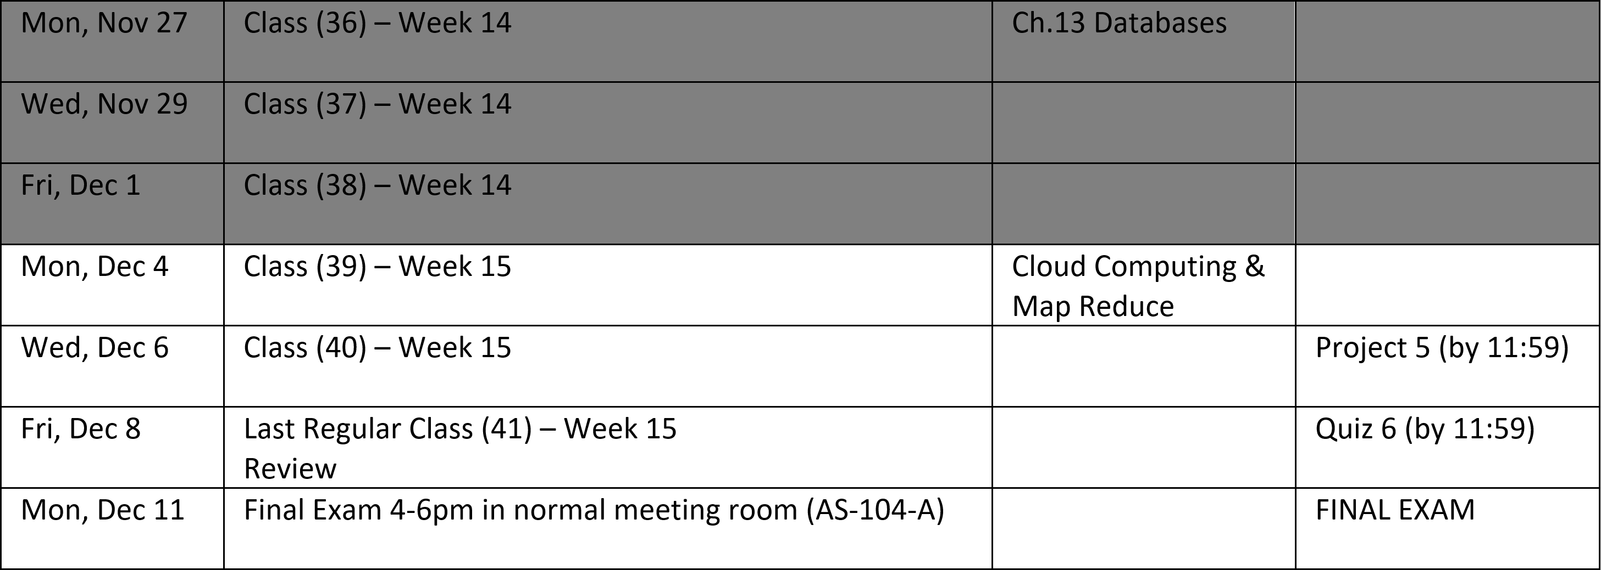
Schedule through the end of the Semester
Notes:
Database

Slide 4
Cloud Computing & Map Reduce

Slide 5
Project 5 Discussion… do we need to make adjustments in scope and/or rubrics
Notes:
Although our text book, lecture, quiz, and test materials were very consistent with previous classes… our projects have exposed us to subjects and materials that are substantially beyond what would be required… particularly in the area of Azure cloud, Git, Database deployment and implementation
Reward your for your efforts
I would like to include the work that you did on the Azure Labs 12, 13, and 14 in the Project 5 grade…
Suggestion: This type of work that requires precision on a short timeline and mistakes are difficult to recover from are good candidates for paired programming…. Feel free to work together.
Other ideas…

Slide 6
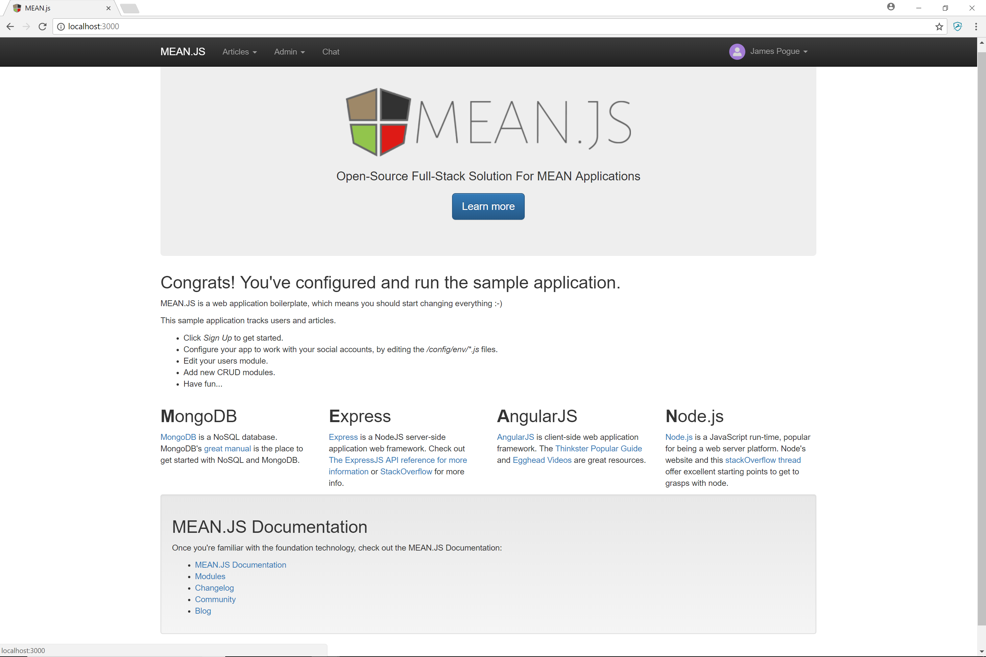
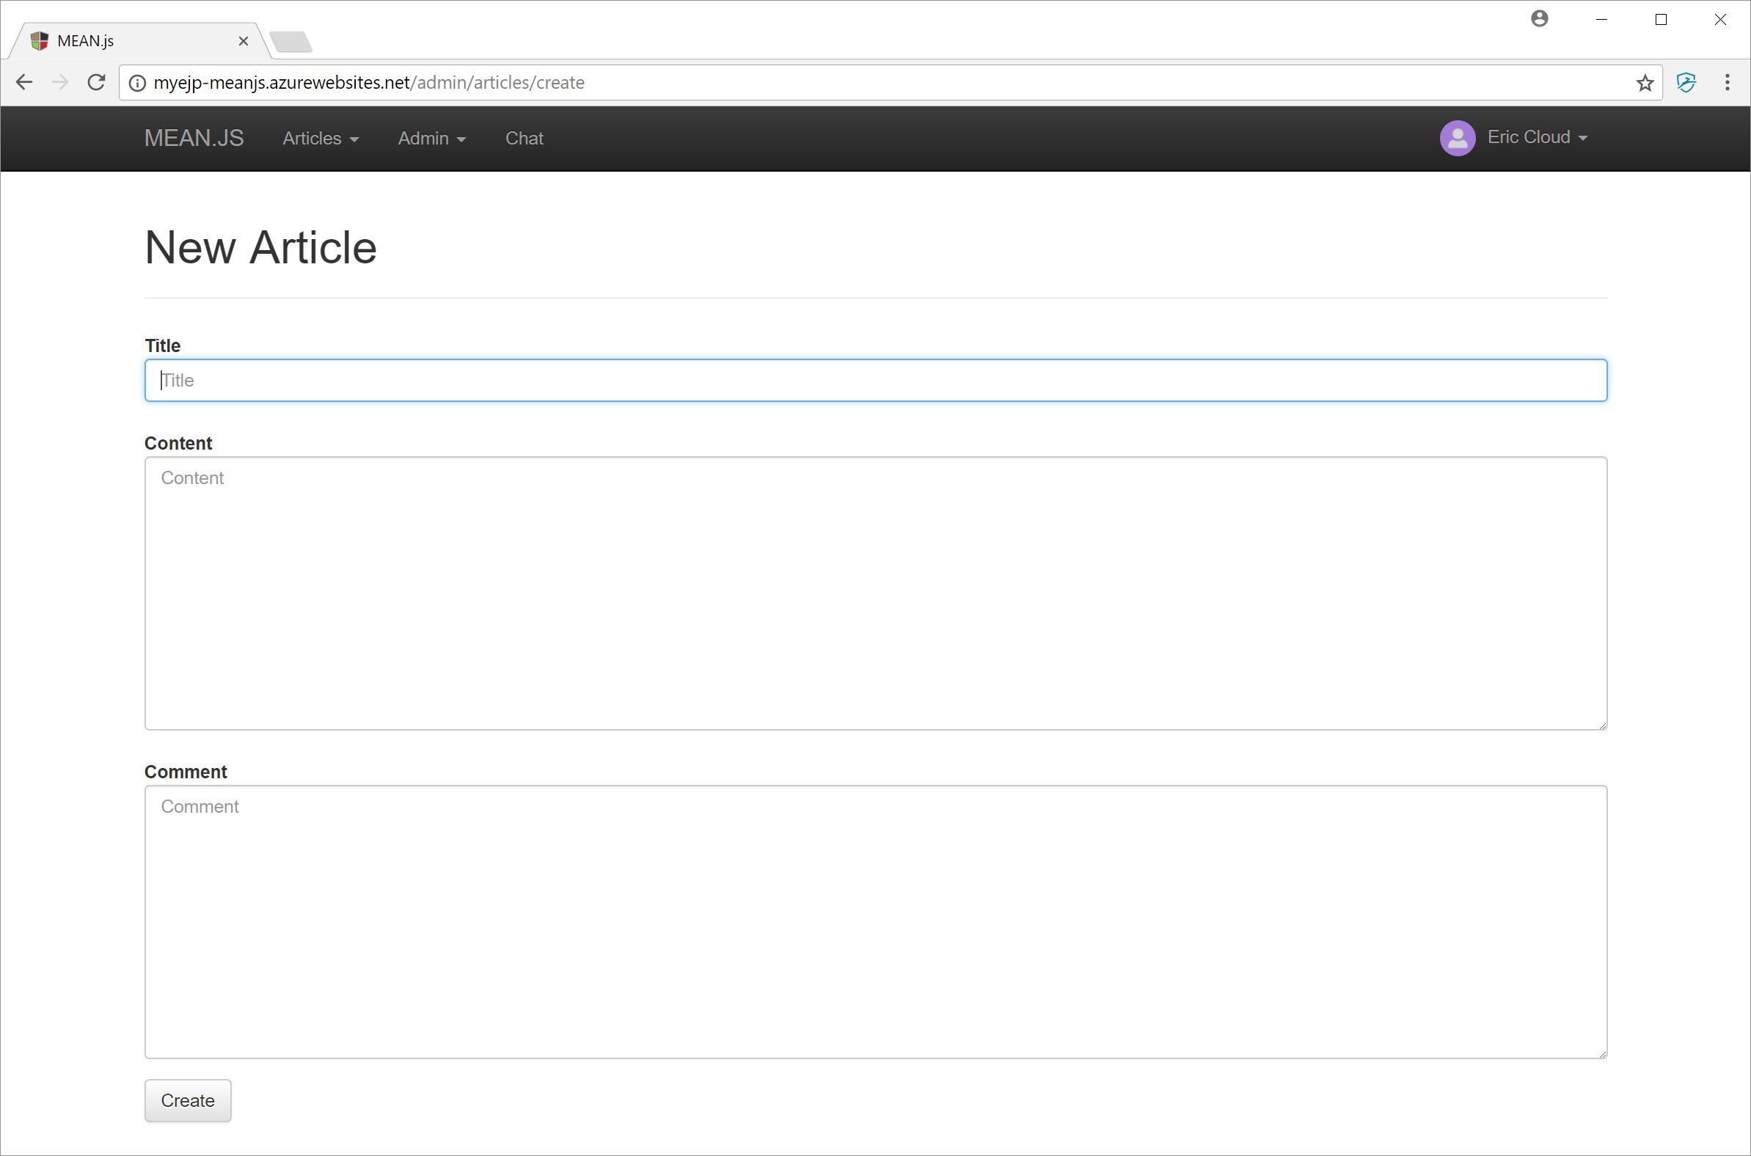
What does Project 5 Success Look Like… Proposed
Plus something unique from your project…
Notes:
Mean.js or PHP
Completed Labs 12, 13, and 14… running Lab 14 local and on Azure
Plus something unique from your contact manager project
Submit your project during class on Wednesday… however, I will not be reviewing/grading them on Friday/Monday.
Thoughts?
URL to sample implementation:
http://myejp-meanjs.azurewebsites.net/

Slide 7
Assignment by Wednesday, Dec 6
Assignment:
Verify the you can access Final Exam Study Guide… let’s do that now
Signup for a Project 5 review timeslot for Friday… if you are not already presenting in class
Continue to focus on Project 5… which is due one week from today
Review Cloud Computing and MapReduce slides

Slide 8
Lab

Slide 9
End of Session
Course Number: CPSC-24700
Instructor: Eric Pogue

Slide 10
Assignment by Friday, Dec 1
Assignment:
Ch.13.1 to 13.6 on Web Application access to Databases
Work on Project 5 & Labs
Complete
Week 12 Lab: Static Website in Azure
Week 13a Lab: Create a Node.js web in Azure OR
Week 13b Lab: Create a PHP web app in Azure

