Slide 1
AJAX

Slide 2
Objectives
Explain how modern websites use AJAX technology to provide a desktop like experience
Differences between AJAX and non-AJAX web pages
Using AJAX in JavaScript
Using JSON for handling AJAX responses
AJAX security issues

Slide 3
AJAX Introduction and History

Slide 4
Introduction
Sites like Gmail, Google Maps and Flickr behave more like desktop applications than web sites
These sites are powered by AJAX
AJAX is Asynchronous JavaScript and XML
Jesse James Garrett coined the term in 2005
Notes:
Asynchronous… like threading.
Performance is optimizing user interaction. Performance is ALWAYS a big deal in software development.

Slide 5
Ajax History
Goal of Ajax:
Provide Web-based applications with responsiveness approaching that of desktop applications
Web applications that benefit from Ajax:
Those that have frequent interactions between the client and the server

Slide 6
AJAX Technologies

Slide 7
AJAX Technologies
AJAX uses the XMLHttpRequest to transfer data between client and server
XML is used as the form for the data flowing between client and server
JavaScript is used to dynamically display and interact with all of the information

Slide 8
Traditional Web Applications vs. Ajax Applications
Traditional web applications user interactions:
Send data/queries to web servers
Wait for the server to respond
Refresh the page
Ajax Applications
The XMLHttpRequstObject sends requests to the server
The callback function updates the page with the requested data arrives

Slide 9
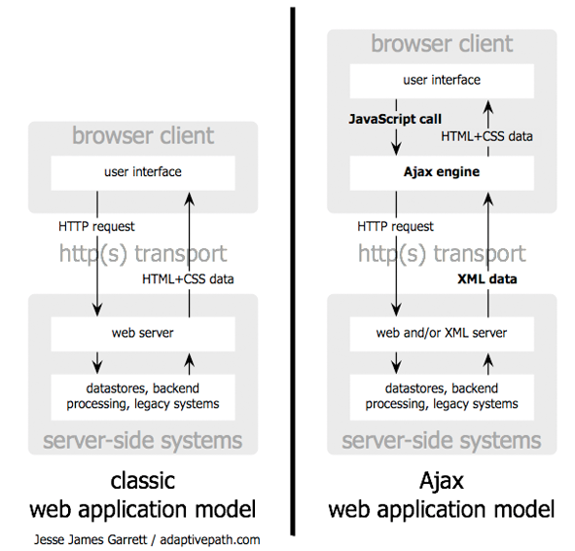
Traditional Web Applications vs. Ajax Applications

Slide 10
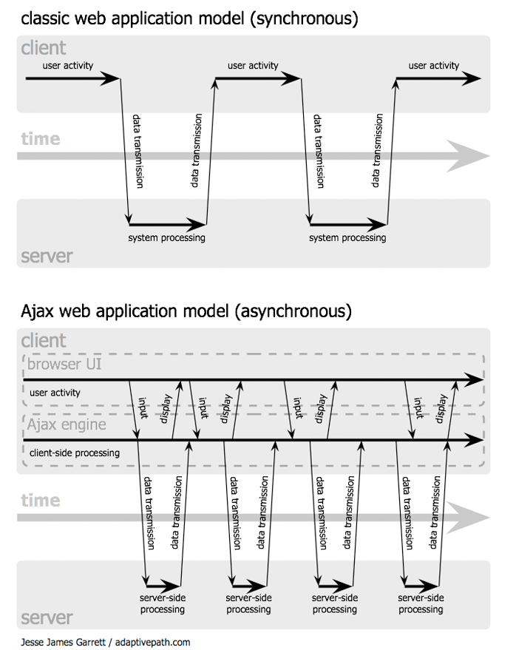
Traditional Web Applications vs. Ajax Applications

Slide 11
Programming using AJAX

Slide 12
Instantiating an asynchronous request
Create an instance of XMLHttpRequest object
xhr = new XMLHttpRequest();
Register its onreadystatechange event handler
xhr.onreadystatechange = showContents;
Use its open method to set up the request
xhr.open("GET", url, true);
Use its send method to initiate the request
xhr.send(null);

Slide 13
Callback function
Progress of the request is monitored by the readystate property
The status of the HTTP request is contained in the status property

Slide 14
readyState Property Values
0: Uninitiated; object contains no data
1: Loading: object is currently loading its data
2: Loaded; object has finished loading its data
3: Interactive; user may interact with the object even though its is not fully loaded
4: Complete; object has finished initializing

Slide 15
HTTP status codes
200: the request was successful
404: the requested resource was not found
500: there was an error while the server was processing the request

Slide 16
Properties of the XMLHttpRequest Object
onreadystate
readystate
responseText
responseXML
status
statusText

Slide 17
Methods of the XMLHttpRequestObject
open
send
setRequestHeader
getResponseHeader
getAllResponseHeaders
abort

Slide 18
Ajax Example
Example application: Help the user fill a form
The form gathers client information - asks for the zip code before the names of the city and state
As soon as the zip code is entered, the application sends a request to the server, which looks up the city and state for the given zip code and returns them to the form
Must register an event handler on the blur event of the zip code text box
Uses JavaScript to put the city and state names in the form
Uses PHP on the server to look up the city and state
Popcorn Example[link]
Notes:
Note that this example can NOT be executed locally because AJAX call must access that server that the html page loaded from originally.

Slide 19
Start Session 27
Course Number: CPSC-24700
Instructor: Eric Pogue

Slide 20
Handling Returned Data

Slide 21
Return Document Forms
The returned data from the asynchronous has to be integrated into the HTML document
If the data is HTML, then most common approach is to place an empty div element in the original document
The innerHTML property of the div element is assigned the new content

Slide 22
Return Document Forms
Example: <div id = "replaceable_list"> <h2> 2007 US Champion/Runnerup – baseball </h2> <ul> <li> Boston Red Socks </li> <li> Colorado Rockies </li> </ul> </div>
Now, if the user selects a different sport, say football, the HTML response fragment could have the following:
<h2> 2007 US Champion/Runnerup – football </h2>
<ul>
<li> New York Giants </li> <li> New England Patriots </li>
</ul>

Slide 23
Return Document Forms
The returned fragment can be inserted in the div element with
var divDom =
document.getElementById("replaceable_list"); divDom.innerHTML = xhr.responseText;
The disadvantage of using HTML for the return document is it works well only if markup is what is wanted.
However, oftentimes, it is data that is returned, in which case it must be parsed out of the HTML

Slide 24
Return Document Forms
The returned data could also be XML
For the previous example, the following would be returned:
<header> 2007 US Champion/Runnerup – football
</header>
<list_item> New York Giants </list_item>
<list_item> New England Patriots </list_item>
Problem: the XML returned must also be parsed.

Slide 25
Return Document Forms
Two approaches:
Use the DOM binding parsing methods
This has two disadvantages:
Writing the parsing code is tedious
Support for DOM parsing methods is a bit inconsistent over various browsers
Use XSLT style sheets

Slide 26
Using JSON

Slide 27
JSON
Due to the issues with having to parse HTML or XML, JavaScript Object Notation (JSON) is often used
Part of the JavaScript standard, 3rd edition
It is a method of representing objects as strings, using two structures:
Collections of name/value pairs
Arrays of values

Slide 28
JSON
Each object is represented as a list of property names and values contained in curly braces, e.g.:
{"propName1" : value1, "propName2" : value2}
Arrays are represented in JSON using square brackets, e.g.: [value1, value2, value2]
Values can be string, number, JSON representation of an object, true, false or null

Slide 29
JSON Example
Example
{"employees" :
[
{"name" : "Dew, Dawn", "address" :
"1222 Wet Lane"},
{"name" : "Do, Dick", "address" :
"332 Doer Road"},
{"name" : "Deau, Donna", "address" :
"222 Donne Street"}
]
}
This object consists of one property/value pair, whose value is an array of three objects, each with two property/value pairs

Slide 30
JSON Example
Array element access can be used to retrieve the data elements, e.g.:
var address2 = myObj.employees[1].address;
puts "332 Doer Road" in address2

Slide 31
Parsing JSON
JSON objects are returned in responseText
We can convert JSON strings into JavaScript objects with the eval function
Note: this creates a potential security risk
Use a JSON parser instead:
var response = xhr.responseText;
var myObj = JSON.parse(response);

Slide 32
Parsing JSON
Two reason JSON strings are commonly used to communicate in client/server interaction:
JSON strings are easier to create and parse than XML
JSON strings require fewer bytes

Slide 33
Parsing JSON
Example return document
{"top_two":
[
{"sport": "football", "team":
"New York Giants"},
{"sport": "football", "team":
"New England Patriots"},
]
}

Slide 34
Parsing JSON
The processing to put it in the HTML document:
var myObj = JSON.parse(response);
document.write("<h2> 2007 US Champion/Runnerup"
+ myObj.top_two[0].sport + "</h2>");
document.write("<ul> <li>" +
myObj.top_two[0].team + "</li>");
document.write("<li>" + myObj.top_two[1].team
+ "</li></ul>");

Slide 35
Ajax Toolkits
Writing Ajax applications can difficult - need to know a lot about the DOM, CSS, JavaScript…
Ajax toolkits are libraries of functions that make it easy for you to add Ajax functionality to your web pages
Ajax Tookits
Dojo
Yahoo! User Interface Library
Google Web Toolkit
JQuery
Prototype

Slide 36
End of Session 27
Course Number: CPSC-24700
Instructor: Eric Pogue

Slide 37
AJAX Security Issues

Slide 38
Security and Ajax
Some security issues to keep in mind when using Ajax:
Non-Ajax applications often have just one or only a few server-side sources of responses
Ajax applications often have many server-side programs that produce small amounts of data.
This increases the attack surface of the whole application

Slide 39
Security and Ajax
Therefore Ajax developers should put security code in the client code
Also, must include in the server code, because intruders can change the code on the client
The common problem comes from cross-site scripting

Slide 40
Security and Ajax
Cross-site scripting means servers providing JavaScript code as an Ajax response
Such code could be modified by an intruder before it is run on the client
All such code must be scanned before it is interpreted
Intruder code could also come to the client from text boxes used to collect return data
It could include script tags with malicious code

Slide 41
Summary
AJAX is Asynchronous JavaScript and XML
Goal of Ajax is to provide Web-based applications with responsiveness approaching that of desktop applications
AJAX uses the XMLHttpRequest to transfer data between client and server
The callback function updates the page with the requested data arrives
Due to the issues with having to parse HTML or XML, JavaScript Object Notation (JSON) is often used
JSON objects are returned in responseText which are then parsed by a JSON parser
Ajax toolkits are libraries of functions that make it easy for you to add Ajax functionality to your web pages
Cross-site scripting is a security vulnerability that involves servers providing JavaScript code as an Ajax response

