Slide 1

Object-Oriented Programming Session: Week 3 Session 1 Instructor: Eric Pogue
Agenda:
Discuss last week’s Assignment
Review this week’s Assignment
Introduce the week’s Learning Objectives
Review Learning Objectives will be covered in this session
Present Topics
Closing Comments and Next Steps

Slide 2
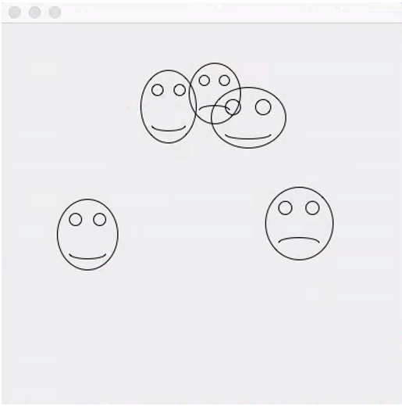
Discuss FaceDraw Assignment
FaceDraw and Learning Objectives: FaceDraw will be a challenging assignment this week. Our Learning Objects, Discussion, Lecture, and Examples will all be focused on helping you complete the assignment and learn the key concepts through delivering a concrete example.
In FaceDraw we will:
Create an application in Java that draws random faces on a window
Generate a random number between 3 & 10 and draw that many faces
Randomly generate reasonable and visually appealing face
Position itself to a reasonable size and location
Draw all faces so they are entirely within the window.
Draw each face with two eyes and a mouth.
The mouth should be randomly smiling, frowning, or in-between
Notes:
I’m looking for your feedback!

Slide 3
Review Week 4 Assignment
FaceDraw and Learning Objectives: FaceDraw will be a challenging assignment this week. Our Learning Objects, Discussion, Lecture, and Examples will all be focused on helping you complete the assignment and learn the key concepts through delivering a concrete example.
In FaceDraw we will:
Create an application in Java that draws random faces on a window
Generate a random number between 3 & 10 and draw that many faces
Randomly generate reasonable and visually appealing face
Position itself to a reasonable size and location
Draw all faces so they are entirely within the window.
Draw each face with two eyes and a mouth.
The mouth should be randomly smiling, frowning, or in-between
Notes:
Less theory and more practical development

Slide 4
Learning Objectives – Week 4
Implement a menu system that enables the user to trigger a variety of actions in a familiar way
Implement code that responds to a variety of events, including clicking the mouse on a frame or panel, moving or dragging the mouse, and typing a key on the keyboard
Design multiple intuitive ways for a user to perform a particular task
Implement animation using a timer and a corresponding event handler
Understand how Java achieves speedier input and output (IO) through a hierarchy file IO classes
Design and implement a controller class that outputs data to a text file
Design and implement a controller class that inputs data from a text file and builds a collection of objects from the data read data
Create interactive applications that adhere to the Model-View-Controller pattern

Slide 5
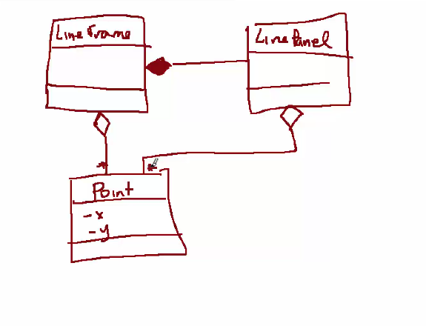

Slide 6
Learning Objectives – Week 3 / Session 1
Explain the difference between lightweight and heavyweight components
Identify lightweight and heavyweight components
Describe how lightweight and heavyweight components render themselves
Identify layout managers for heavyweight and lightweight components
Explain what a layout manager does and identify and describe three of them
Explain how to achieve true Model-View-Controller architecture by removing any reference from the view to the model and from the model to the view
Distinguish between extending a class and implementing an interface
Explain multiple ways to implement an event handler for a particular object and event (anonymous inner classes vs. named classes vs. having the frame itself serve as the handler)
Create an event handler that implements the ActionListener interface to respond to the user clicking on a button
Use paint and paintComponent's Graphics object to draw a variety of shapes

Slide 7
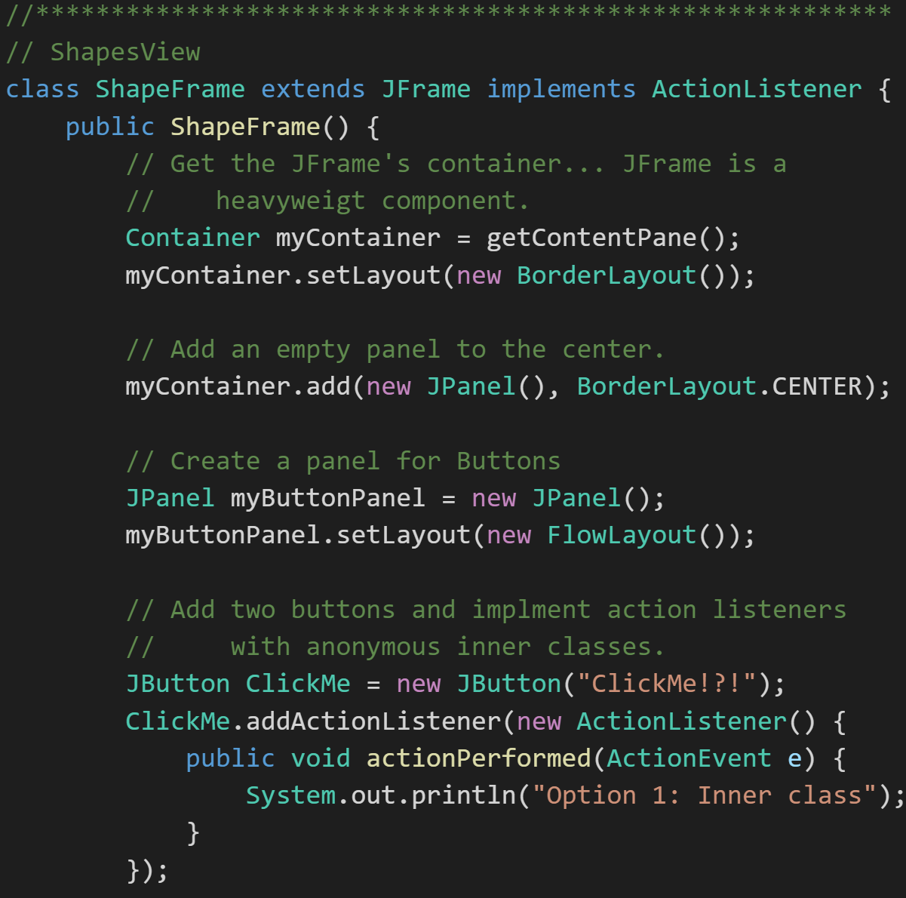
Lightweight and Heavyweight User Interface Components
UI Components: There are two kinds of graphics components in the Java programming language: heavyweight and lightweight.
A heavyweight component is associated with its own native screen resource. AWT Components from the java.awt package, such as Button and Label, are heavyweight components.
Lightweight components such as Swing components depend less on the target platform and use less native GUI resource. They also look less native.
Notes:
These notes are from the Oracle site. There is also a nice article about on the Oracle site about mixing heavyweight and lightweight components at:
http://www.oracle.com/technetwork/articles/java/mixing-components-433992.html
Java platform graphics have been the Achilles heel of the Java platform since the mid-1990s. Programmers used to joke that AWT stood for Awful Windows Toolkit because the resulting applications were so slow to function and unpleasant to look at. AWT actually stands for Abstract Window Toolkit.
IBM’s Standard Widget Toolkit (SWT) toolkit is an alternative to AWT and Swing that has taken root in the Eclipse Integrated Development Environment (IDE) world.
https://en.wikipedia.org/wiki/Standard_Widget_Toolkit
AWT and Swing are excellent learning tools; however, nearly all commercial user interface development has moved on to other tools and libraries. Native user interfaces or Web type interfaces using Java Script is seem to be the direction. Note: Java and Java Script have NOTHING to do with each other! It was completely a marketing ploy to give Java Script the Java name.
Java Applets are Java applications that run in a browser. They never really did work… The “write once and run everywhere” philosophy never did play out very well in the industry when it comes to leading edge client applications. Browser based applications seem to have filled that gap while native applications have filled the “rich client” areas. I suspect that trend will continue.
java.awt.*: Graphics, Color, Font
Java.swing: JFrame, JPanel, JButton

Slide 8
Heavyweight Components
Paint themselves using their “paint(Graphic g)” method.
Provide methods associate with “Graphic g” such as: drawOval(), fillOval(), drawRect(), fillRect(), and drawstring()
Own a Content Pane, which is a type of Container
Implement “getContentPane()” method to access their Content Pane
Can implement a Layout Manager via their Container
Notes:
The Graphics class is defined in package java.awt.
A window in Java is called a JFrame. JFrames are heavyweight components: graphical components that communicate directly with the operating system and show up directly on the desktop. Heavyweight components contain what are called lightweight components. Lightweight components include panels and buttons. In Java, panels are implemented as JPanels, and buttons are implemented as JButtons.

Slide 9
Lightweight Components
Paint themselves using their “paintComponent(Graphics g)” method
Provide methods associate with “Graphic g” such as: drawOval(), fillOval(), drawRect(), fillRect(), and drawstring()
Are a Container… so no need to call a method to get a Container
Can implement a Layout Manager via their Container
Notes:
Specifically, a JFrame, a heavyweight component …
Can setDefaultCloseOperation(JFrame.EXIT_ON_CLOSE) to make the program vanish from memory (i.e. free resources) when closed.
Can set size and location using setBounds(x,y,width,height)
Can show itself using setVisible(true) and hide itself using setVisible(false)
Can give you a reference to its Container through its getContentPane() function. Once you have access to its Container object, you can set the layout of that container so that you can arrange lightweight components in it.
Popular Lightweight Swing UI components include:
Jbutton
JTextArea
JPanel

Slide 10
Layout Managers
Layout Managers arrange controls on the screen so they are visually appealing. The allow developers to be able to focus less on layout details. Both AWT and Swing provide general purpose Layout Managers including:
BorderLayout
BoxLayout
CardLayout
FlowLayout
GridBagLayout
GridLayout
GroupLayout
SpringLayout
Notes:
This is different from environments where developers (or designers) layout screens pixel by pixel (like Visual Basic for example). With modern UIs that need to fit in all types of sizes and orientations, layout managers are a necessity.

Slide 11
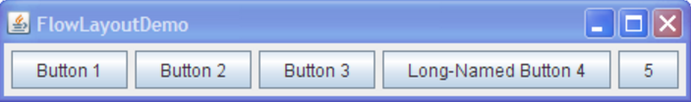
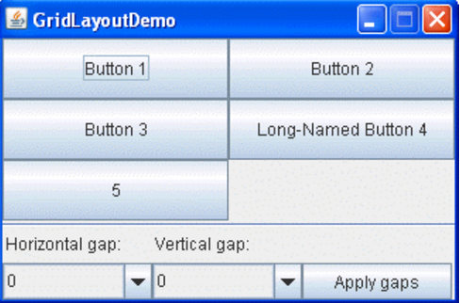
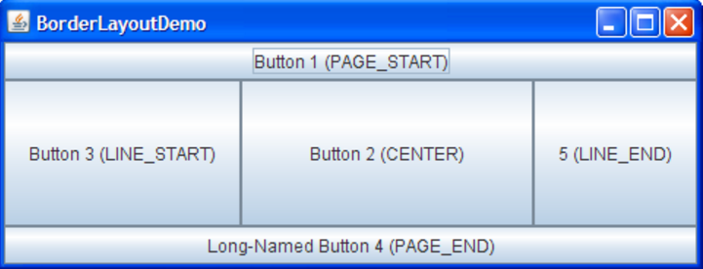
Layout Managers (continued)
Layout Managers arrange controls on the screen so they are visually appealing. We will be focusing on three very common Layout Managers:
FlowLayout: Arranges components left to right, top to bottom. When a FlowLayout runs out of room horizontally on a row, it places the next component as far left as it can go on the row below.
BorderLayout: Arranges components in NORTH, SOUTH, EAST, WEST, and CENTER sections.
GridLayout: Arranges components in an Excel-like table of rows and columns.
Notes:
This is different from environments where developers (or designers) layout screens pixel by pixel (like Visual Basic for example). With modern UIs that need to fit in all types of sizes and orientations, layout managers are a necessity.
Several AWT and Swing classes provide layout managers for general use:
BorderLayout
BoxLayout
CardLayout
FlowLayout
GridBagLayout
GridLayout
GroupLayout
SpringLayout

Slide 12
Model-View-Controller
Model-View-Controller (MVC): This week are focus will be in creating our first Graphical view. Specifically we will:
Implement our first graphical view using Java AWT and Swing graphics
Demonstrate a view that you will be able to build off of for our assignment
Implement a more sophisticated view to draw smiling and frowning faces as our assignment for the week
Discuss why our command line interface is also a view
Discuss how we “render” our data to the command line using the toString() method
Discuss pros and cons of “rendering” our data to our graphical view via a “toGraphic()” method
Notes:
We will be focuses on the View this week, and will keep our references to Models and Controllers to a minimum.
MVC is an important pattern, will be a primary focus of this course, and will be an important pattern for you to master in your career.
Segregation of our Model (data) from our View (user interface) is necessary to effectively develop, enhance, and maintain modern software.
An example would be a system that manages student data. We would want to segregate the Model (data) from the View (UI) for several reasons including that there will likely be many different Views that access the same data including:
student view
faculty view
administrator view,
Web student view,
mobile student view, etc.
Evolution of UI and Data segregation
Document-View (View was responsible for View-Controller functionality)
Model-View-Controller
Model–View–Viewmodel

Slide 13
Interface Implementation vs. Class Extension
Differences include:
Interfaces are implicitly abstract and cannot have implementations
An interface specifies one or more abstract methods that a class that implements the interface must implement
Abstract classes can have both abstract methods and concrete methods
A class can descend (extends) only one Class but can implement many interfaces
Note: Interfaces are Java’s way of avoiding the significant complexities of multiple inheritance while providing most of the benefits.
Notes:
A little history:
Some languages including C++ implemented multiple inheritance in order to allow Classes to inherit from multiple parent classes. That solution has pros and cons beyond the scope of this course.
Other languages including Java only support single inheritance, but also implemented Interfaces in order to allow class to act like multiple things. An example that we will be discussing this week is our OvalFrame that we would like to be a JFrame but may also want it to act like an ActionHandler to respond to buttons being pushed.

Slide 14
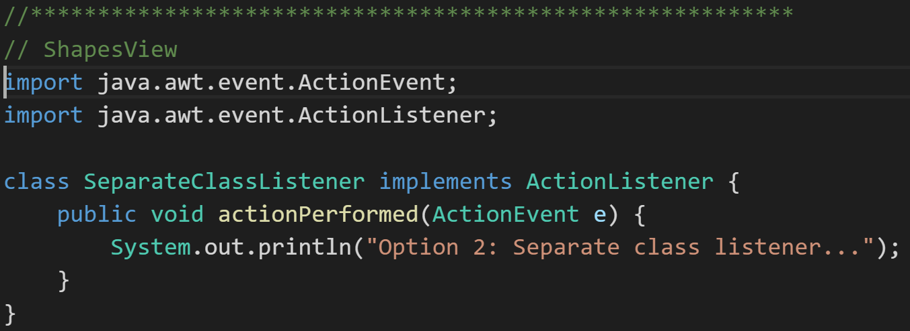
Interface Implementation
Interface implementation is basically agreeing to a contract to implement a given set of methods.
The ActionalListener Interface is a good example of an interface that a class must implement in order to receive notification that a button has been pushed by the user.

Slide 15
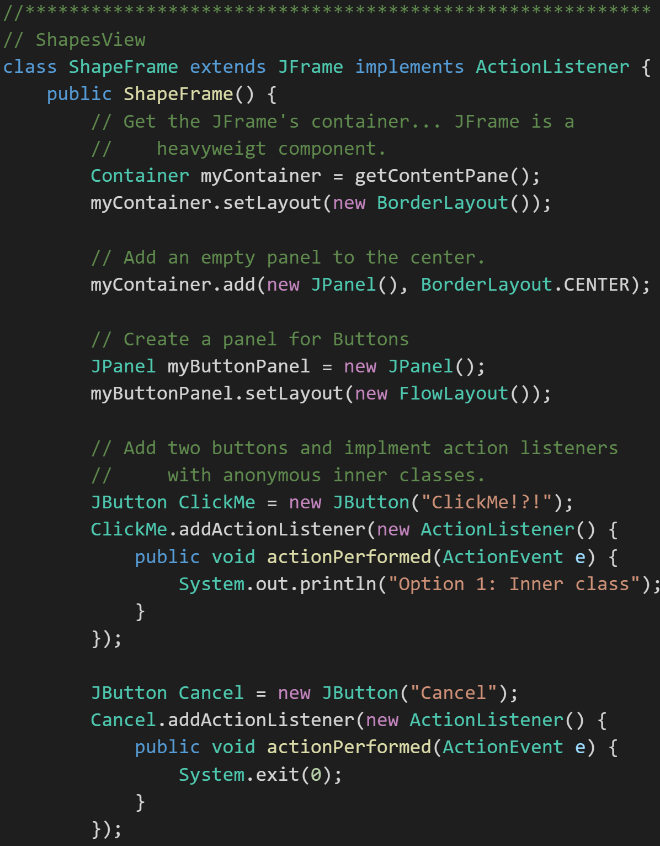
Class Extension
Class Extension is Inheritance. Enough said?
In Java a class can extend from only one parent class, but can implement multiple interfaces.
The code to the right demonstrates ShapeFrame:
Extending from JFrame so that it can “be a” JFrame and hold lightweight UI components
Implementing ActionionListener so that it can “act like” a ActionListener and receive notification that a button has been pressed.

Slide 16
Event Handling
Clicking Event Handling is the way that all graphic user interface environment allow an application to respond to user (or system) events. Possible events include:
Keyboard strokes
Clicking buttons
Dragging a mouse
Low power warning or automatic system hibernation
Attaching to an overhead projector
And many, many others

Slide 17
Event Handling – ActionListener
We will specifically need to implement Java ActionListeners to respond to button clicks. To do that we will need to:
Understand that ActionListener, like other listeners, are an interface… not a class
Implement a Java ActionListeners Interface
Utilize our ActionListener to receive notifications of an event and respond appropriately
Understand the three ways we could implement an ActionListener to respond to a user pressing a button contained in a our JFrame:
Implement an ActionListener interface in our JFrame
Utilize an external class that implements ActionListener
Implement an ActionListener utilizing an Anonymous Inner Class

Slide 18
Learning Objectives – Closing Comments
Explain the difference between lightweight and heavyweight components
Identify lightweight and heavyweight components
Describe how lightweight and heavyweight components render themselves
Identify layout managers for heavyweight and lightweight components
Explain what a layout manager does and identify and describe three of them
Explain how to achieve true Model-View-Controller architecture by removing any reference from the view to the model and from the model to the view
Distinguish between extending a class and implementing an interface
Explain multiple ways to implement an event handler for a particular object and event (anonymous inner classes vs. named classes vs. having the frame itself serve as the handler)
Create an event handler that implements the ActionListener interface to respond to the user clicking on a button
Use paint and paintComponent's Graphics object to draw a variety of shapes

Slide 19
FaceDraw Assignment - Closing Comments
FaceDraw and Learning Objectives: FaceDraw will be a challenging assignment this week. Our Learning Objects, Discussion, Lecture, and Examples will all be focused on helping you complete the assignment and learn the key concepts through delivering a concrete example.
In FaceDraw we will:
Create an application in Java that draws random faces on a window
Generate a random number between 3 & 10 and draw that many faces
Randomly generate reasonable and visually appealing face
Position itself to a reasonable size and location
Draw all faces so they are entirely within the window.
Draw each face with two eyes and a mouth.
The mouth should be randomly smiling, frowning, or in-between
Notes:
Read the details in the assignment. Keep these in mind as you watch the examples. Start working on this early. It is unlikely to go well if you try to do this at the last minute.

Slide 20
End of Session
Course Number: CPSC-24500
Week: 3
Session: 1
Instructor: Eric Pogue

Slide 21
Object-Oriented Programming Session: Week 3 Session 2 Instructor: Eric Pogue
Agenda:
Review where we left off is session 1
Identify the goal of session 2
Implement ShapesLibrary.class
Get ready for Graphics drawing session
Notes:
While everyone is getting logged in an set up for our virtual discussion, I wanted to thank those of you who have posted their background and/or responded to other people’s discussion board posting. I have enjoyed reading through your comments.
I am going to stat recording so that other can watch later; however, if I think that is impacting our ability to have a good discussion, I will stop the recording and just send out notes later.

Slide 22
Learning Objectives – Session 1
Explain the difference between lightweight and heavyweight components
Identify lightweight and heavyweight components
Describe how lightweight and heavyweight components render themselves
Identify layout managers for heavyweight and lightweight components
Explain what a layout manager does and identify and describe three of them
Explain how to achieve true Model-View-Controller architecture by removing any reference from the view to the model and from the model to the view
Distinguish between extending a class and implementing an interface
Explain multiple ways to implement an event handler for a particular object and event (anonymous inner classes vs. named classes vs. having the frame itself serve as the handler)
Create an event handler that implements the ActionListener interface to respond to the user clicking on a button
Use paint and paintComponent's Graphics object to draw a variety of shapes

Slide 23
Learning Objectives – Session 2
Explain the difference between lightweight and heavyweight components
Identify lightweight and heavyweight components
Describe how lightweight and heavyweight components render themselves
Identify layout managers for heavyweight and lightweight components
Explain what a layout manager does and identify and describe three of them
Explain how to achieve true Model-View-Controller architecture by removing any reference from the view to the model and from the model to the view
Distinguish between extending a class and implementing an interface
Explain multiple ways to implement an event handler for a particular object and event (anonymous inner classes vs. named classes vs. having the frame itself serve as the handler)
Create an event handler that implements the ActionListener interface to respond to the user clicking on a button
Use paint and paintComponent's Graphics object to draw a variety of shapes

Slide 24
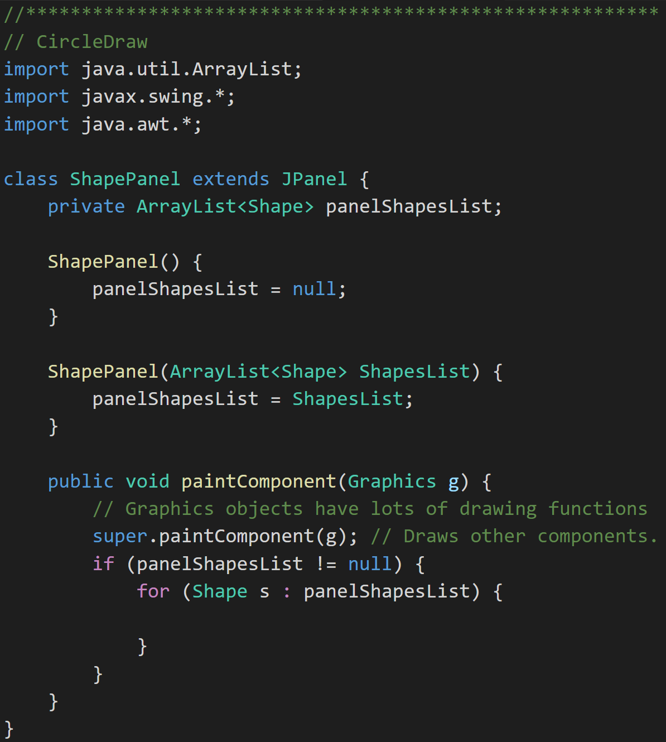
Graphics Objects
Graphics Objects [link]: We will generally see the Graphics object as part of overriding paintComponent(Graphics g). The “g” object has many useful methods including:
drawOval(x,y,width,height)
fillOval(x,y,width,height)
setColor(Color.BLUE)
drawRect()
drawArc() [link]… You will want to use this draw your smiling faces in the assignment this week.
drawString()
setFont()
Notes:
JavaDoc:
https://docs.oracle.com/javase/7/docs/api/java/awt/Graphics.html
Java Graphics Tutorial:
https://docs.oracle.com/javase/tutorial/2d/basic2d/
drawArc:
http://www.java2s.com/Code/JavaAPI/java.awt/GraphicsdrawArcintxintyintwidthintheightintstartAngleintarcAngle.htm
drawArc Example:
http://www.java-examples.com/draw-arc-applet-window-example
Repaint Sequence:
OS -> Frame -> Frame’s paint function -> each LW component paintComponent function

Slide 25
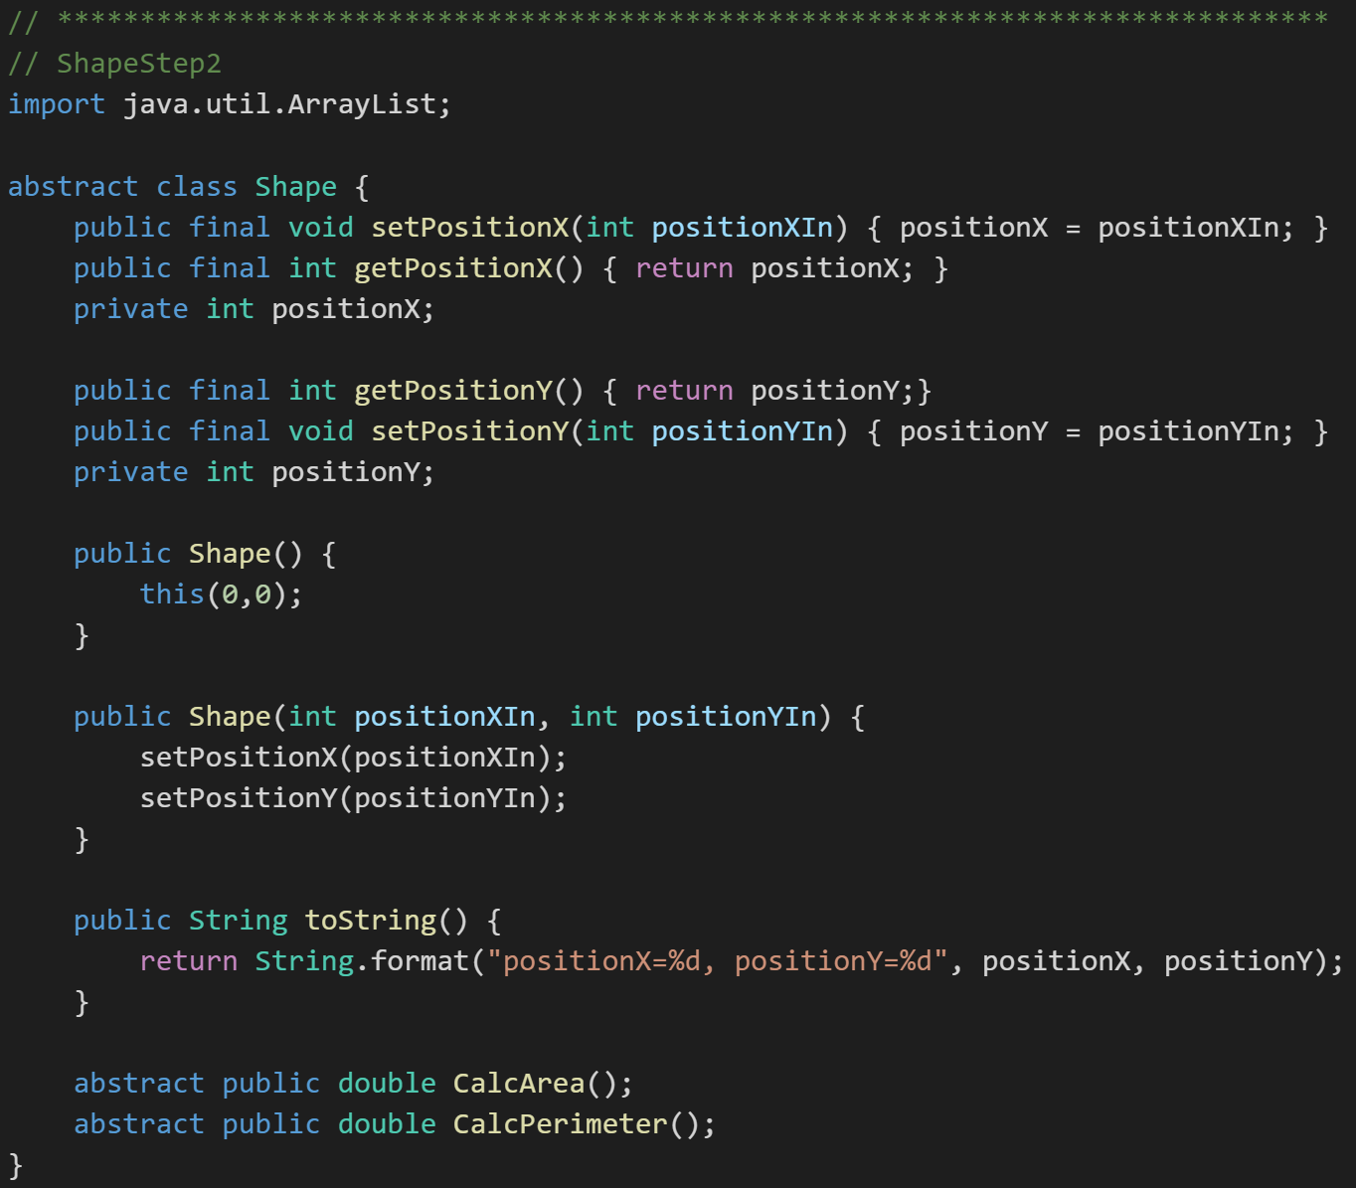
Code Sharing, Package Visibility, and ShapesLibray.class
Sharing or reusing source code is a fundamental practice in object-oriented programming. In this session we are going to demonstrate creating ShapesLibrary.java by:
Creating a new ShapesLibrary from our ShapesStep2 project from last week
Separating the reusable Shapes code into a separate ShapesLibrary.java file
Making a few enhancements to make the code more reusable including:
Demonstrate static “helper functions”
Creating a separate test Test application
Demonstrate assert
Compiling ShapesLibrary.java to ShapesLibrary.class
Notes:
The is a fundamental issue with most teams and organizations related to code sharing. Developing and maintaining shared code is more difficult than developing and maintaining non-shared code. I think that it at least 50% more difficult and more likely twice as difficult. Therefore, in order for making the creation and maintenance of code sharing economically beneficial the ratio of creating shared code versus using other peoples code needs to be 2 or 3 to one. In other words, for every hour you spend writing shared code, you should be spending 2 or 3 hours working to effectively utilize other people‘s code. The reality is most developers spend most of there time working diligently to develop reusable code, but they very rarely reuse code from other people on their team.
Using asserts is an important defensive coding tactic. The idea is that you “assert” things to be true in the code which serves as both a forceful comment and a developer notification mechanism. Then when developers are testing their code, the environment will automatically warn them when their assumptions are not valid.
http://docs.oracle.com/javase/7/docs/technotes/guides/language/assert.html
Static methods are methods that we can associate with a class, but do not require a class instance to execute. They can be very helpful with writing small helper functions.
The command line flag for enabling asserts is:
java -enableassertions ShapesStep2

Slide 26
End of Session
Course Number: CPSC-24500
Week: 3
Session: 2
Instructor: Eric Pogue

Slide 27
Object-Oriented Programming Session: Discussion & Lecture (Week 3 Session 3) Instructor: Eric Pogue
Agenda:
Review where we left off after sessions 1 and 2… and what to expect in session 4
Graphics Object and drawing and Layout Manager review
Update ShapesLibrary
Implement ShapeDraw application
Possible next steps for implementing FaceDraw
Questions & Answers
Closing Comments
Notes:
While everyone is getting logged in an set up for our virtual discussion, I wanted to thank those of you who have posted their background and/or responded to other people’s discussion board posting. I have enjoyed reading through your comments.
**Start Recording
Comments:
I will post our week 1 assignment review via a separate video. I think it will take away from our current discussion if we try to intermix the topics today. I want of to have laser focus on our programming assignment today.

Slide 28
Discussion & Lecturession 3 (Discussion
Explain the difference between lightweight and heavyweight components
Identify lightweight and heavyweight components
Describe how lightweight and heavyweight components render themselves
Identify layout managers for heavyweight and lightweight components
Explain what a layout manager does and identify and describe three of them
Explain how to achieve true Model-View-Controller architecture by removing any reference from the view to the model and from the model to the view
Distinguish between extending a class and implementing an interface
Explain multiple ways to implement an event handler for a particular object and event (anonymous inner classes vs. named classes vs. having the frame itself serve as the handler)
Create an event handler that implements the ActionListener interface to respond to the user clicking on a button
Use paint and paintComponent's Graphics object to draw a variety of shapes

Slide 29
Layout Managers (continued)
Layout Managers arrange controls on the screen so they are visually appealing. We will be focusing on three very common Layout Managers:
FlowLayout: Arranges components left to right, top to bottom. When a FlowLayout runs out of room horizontally on a row, it places the next component as far left as it can go on the row below.
BorderLayout: Arranges components in NORTH, SOUTH, EAST, WEST, and CENTER sections.
GridLayout: Arranges components in an Excel-like table of rows and columns.
Notes:
This is different from environments where developers (or designers) layout screens pixel by pixel (like Visual Basic for example). With modern UIs that need to fit in all types of sizes and orientations, layout managers are a necessity.
Several AWT and Swing classes provide layout managers for general use:
BorderLayout
BoxLayout
CardLayout
FlowLayout
GridBagLayout
GridLayout
GroupLayout
SpringLayout

Slide 30
Graphics Objects
Graphics Objects [link]: We will generally see the Graphics object as part of overriding paintComponent(Graphics g). The “g” object has many useful methods including:
drawOval(x,y,width,height)
fillOval(x,y,width,height)
setColor(Color.BLUE)
drawRect()
drawArc() [link]… You will want to use this draw your smiling faces in the assignment this week.
drawString()
setFont()
Notes:
This is your second or third time seeing this. After today, you should mostly “get it”.
JavaDoc:
https://docs.oracle.com/javase/7/docs/api/java/awt/Graphics.html
Java Graphics Tutorial:
https://docs.oracle.com/javase/tutorial/2d/basic2d/
drawArc:
http://www.java2s.com/Code/JavaAPI/java.awt/GraphicsdrawArcintxintyintwidthintheightintstartAngleintarcAngle.htm
drawArc Example:
http://www.java-examples.com/draw-arc-applet-window-example
Repaint Sequence:
OS -> Frame -> Frame’s paint function -> each LW component paintComponent function

Slide 31
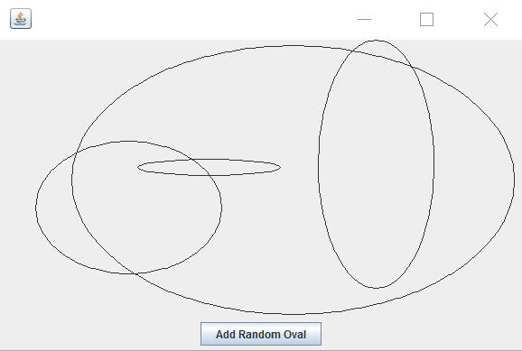
Graphical Views & Drawing Shapes
Our Discussion & Lecture Session will be focuses on giving you some insights in methods you may want to use in implementing FaceDraw including:
Update ShapesLibrary to:
Include width & height in the base Shapes class so that we can use them Polymorphically
Define the specifics for position x & y… lower left corner of shape
Updating Circle so that it utilizes width & height instead of radius
Create Oval which can now more easily be descended from Circle
Create a new ShapeDraw application that will leverage the new Oval class from ShapesLibrary
Create OvalDraw application
Implement JFrames, JPanels, and ArrayLists
Add new code to GitHub
Discuss how you might enhance OvalDraw to FaceDraw
Notes:
You can imagine that we are going to need JFrames, Jpanels (x2), Border Layouts, Flow Layouts, JButton, Action Listeners, Action Events, Containers, Random, Graphics, ArrayLists, and more…

Slide 32
Object-Oriented Programming Session: Discussion & Lecture (Week 3 Session 3) Instructor: Eric Pogue
Closing Comments:
Build something that you can take pride in delivering!
If you do something special in this assignment, let me know

Slide 33
End of Session
Course Number: CPSC-24500
Week: 3
Session: Discussion & Lecture (Session 3)
Instructor: Eric Pogue

Slide 34
Object-Oriented Programming Week 3 Session 4 Eric Pogue
Agenda:
Explain multiple ways to implement an event handler for a particular object and event (anonymous inner classes vs. named classes vs. having the frame itself serve as the handler)
Create an event handler that implements the ActionListener interface to respond to the user clicking on a button
Wrap-up Session 4 with our original week 3 Learning Objectives and our original overview of our FaceDraw programming assignment
Notes:
While everyone is getting logged in an set up for our virtual discussion, I wanted to thank those of you who have posted their background and/or responded to other people’s discussion board posting. I have enjoyed reading through your comments.
I am going to stat recording so that other can watch later; however, if I think that is impacting our ability to have a good discussion, I will stop the recording and just send out notes later.

Slide 35
Learning Objectives – Week 3
Explain the difference between lightweight and heavyweight components
Identify lightweight and heavyweight components
Describe how lightweight and heavyweight components render themselves
Identify layout managers for heavyweight and lightweight components
Explain what a layout manager does and identify and describe three of them
Explain how to achieve true Model-View-Controller architecture by removing any reference from the view to the model and from the model to the view
Distinguish between extending a class and implementing an interface
Explain multiple ways to implement an event handler for a particular object and event (anonymous inner classes vs. named classes vs. having the frame itself serve as the handler)
Create an event handler that implements the ActionListener interface to respond to the user clicking on a button
Use paint and paintComponent's Graphics object to draw a variety of shapes

Slide 36
Quick Review: Event Handling
Clicking Event Handling is the way that all graphic user interface environment allow an application to respond to user (or system) events. Possible events include:
Keyboard strokes
Clicking buttons
Dragging a mouse
Low power warning or automatic system hibernation
Attaching to an overhead projector
And many, many others

Slide 37
Quick Review: Event Handling – ActionListener
We will specifically need to implement Java ActionListeners to respond to button clicks. To do that we will need to:
Understand that ActionListener, like other listeners, are an interface… not a class
Implement a Java ActionListeners Interface
Utilize our ActionListener to receive notifications of an event and respond appropriately
Understand the three ways we could implement an ActionListener to respond to a user pressing a button contained in a our JFrame:
Implement an ActionListener interface in our JFrame
Utilize an external class that implements ActionListener
Implement an ActionListener utilizing an Anonymous Inner Class

Slide 38
Live Demo: Event Handlers & Action Listener
Let’s implement a new Java application to demonstrate a graphic application that responds to clicking a button. To demonstrate this we will:
Create a Java graphic application
Create a JFrame and JPanel
Implement a Layout Manager (BorderLayout) on our JFrame
Create and insert JButtons in our JPanel
Insert our JPanel into the SOUTH section of our BorderLayout Layout Manager
Create Action Listeners that can respond to our Buttons being clicked
Each of our three buttons will utilize one of the ActionListener implementation practices:
Implement an ActionListener interface in our JFrame
Utilize an external class that implements ActionListener
Implement an ActionListener utilizing an Anonymous Inner Class

Slide 39
Learning Objectives – Week 3
Explain the difference between lightweight and heavyweight components
Identify lightweight and heavyweight components
Describe how lightweight and heavyweight components render themselves
Identify layout managers for heavyweight and lightweight components
Explain what a layout manager does and identify and describe three of them
Explain how to achieve true Model-View-Controller architecture by removing any reference from the view to the model and from the model to the view
Distinguish between extending a class and implementing an interface
Explain multiple ways to implement an event handler for a particular object and event (anonymous inner classes vs. named classes vs. having the frame itself serve as the handler)
Create an event handler that implements the ActionListener interface to respond to the user clicking on a button
Use paint and paintComponent's Graphics object to draw a variety of shapes

Slide 40
FaceDraw Assignment & Learning Objectives
FaceDraw and Learning Objectives: FaceDraw will be a challenging assignment this week. Our Learning Objects, Discussion, Lecture, and Examples will all be focused on helping you complete the assignment and learn the key concepts through delivering a concrete example.
In FaceDraw we will:
Create an application in Java that draws random faces on a window
Generate a random number between 3 & 10 and draw that many faces
Randomly generate reasonable and visually appealing face
Position itself to a reasonable size and location
Draw all faces so they are entirely within the window.
Draw each face with two eyes and a mouth.
The mouth should be randomly smiling, frowning, or in-between
Notes:
I intentionally list our assignment first and our learning objectives second. This week our intent is to support our assignment through our learning objectives, discussion, lecture, and examples… and not the other way around.
It is important to understand the concepts, practices, and principles; however, it is essential that we can utilize them to deliver solutions.
The details of FaceDraw are provided in this week’s assignment.

Slide 41
End of Session
Course Number: CPSC-24500
Week: 3
Session: 4
Instructor: Eric Pogue

