Slide 1

Object-Oriented Programming Session: Week 5 Session 1 Instructor: Eric Pogue
Agenda:
Review this week’s programming Assignment
Introduce the week’s Learning Objectives
Topics & Examples

Slide 2
FastPrime… plus Questions
Write a performance optimized command line Java application that will programmatically find prime numbers [link] and store those numbers sorted in an output file.
In FastPrime we will create a command line Java application that will:
Use multiple threads to find the prime numbers between two numbers
Sort those results and store them to a file
Perform some timings
… And do this all very fast
See the details in this week’s assignment
Notes:
Application performance is ALWAYS a challenge. Learn how to optimize, test, and enhance the performance regularly. It can’t be built in at the end of a project!

Slide 3
Learning Objectives – Week 5
Understand how Java uses files for input and output (IO)
Design and implement a controller class to serialize (reads & writes) data to a text file
Understand threads and how to develop and optimize multi-treaded Java applications
Understand Java packages and compile a class so that it belongs to a particular package
Import a class you write that belongs to a particular package.
Identify reasons for using JAR (Java ARchive) files to group together related java classes
Create a JAR file that stores the contents of a particular package
Explain software testing terms including unit, integration, user acceptance, performance testing, manual, automated, verification, validation, etc.
Understand the importance of testing and the criticality of finding/fixing defects early
Explain the purpose, syntax, and annotations of the various assert statements JUnit supports
Install JUnit onto your machine and execute a JUnit test on your application

Slide 4
Serialization and Writing/Reading Text Files (IO)
Serialization is an object-oriented programming term that means converting an object to a byte steam usually to be written to or read from a text or binary file.
To write to a text file:
Create a File object, feeding the file’s path to the File class constructor
Create a FileWriter to access the File
Create a BufferedWriter to write data to the FileWriter efficiently
Use BufferedWriter’s write and newLine functions to commit the data to the file.
To read from a text file:
Create a File object, feeding the file’s path to the File class constructor
Attach a Scanner object to it
Use Scanner’s readLine and hasNextLine functions to read the file
Notes:
A buffered writer or buffered stream efficiently organization reads and writes for optimal disk performance. The danger is that if there is a power failure (or someone accidentally kicks your power strip) you could lose data. It is good to “flush the buffer” at critical times when using a buffered writer on mission critical projects. There is little or no danger in using a buffered reader.
Binary files versus text files.
XML – Text file format for structured data… HTML for data.
JSON – “Simplified” text file format for structured data.
Binary

Slide 5
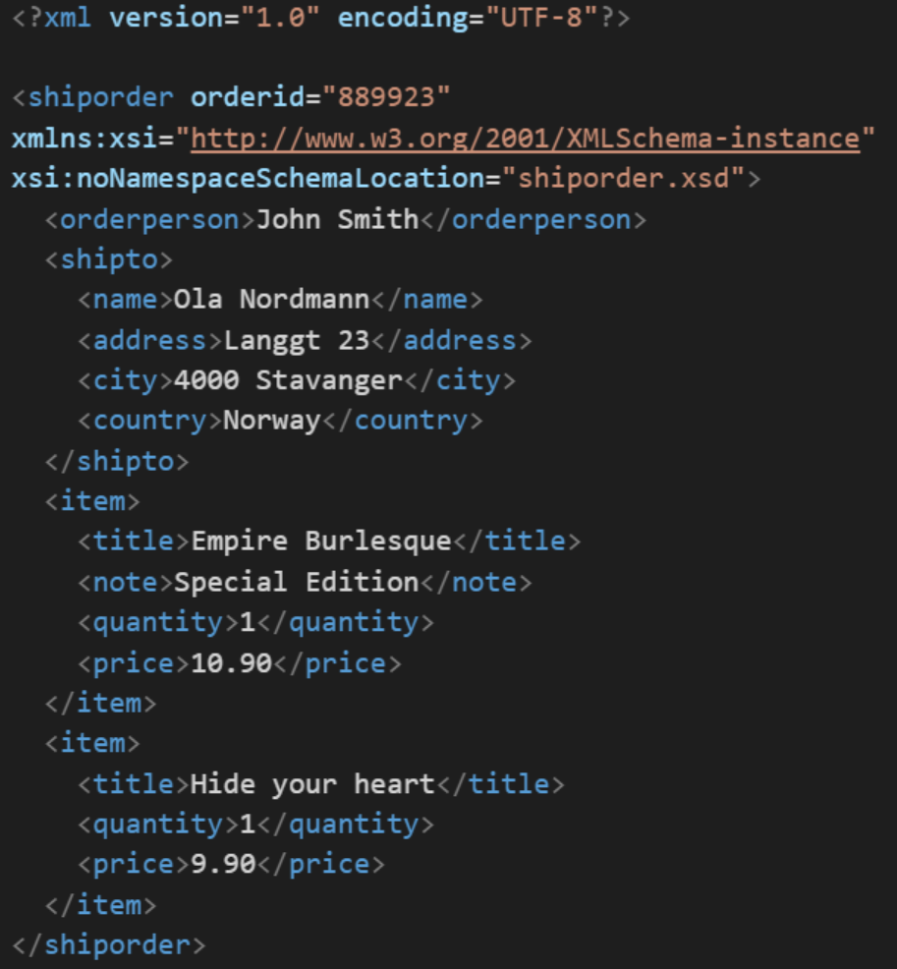
XML Example
In computing, XML (Extensible Markup Language) is a markup language that defines a set of rules for encoding documents in a format that is both human-readable and machine-readable. It is an open standard that:
Supports nearly all development languages and platforms
Allows us to cross between many applications
Can result in large files
Supports schema to validate data

Slide 6
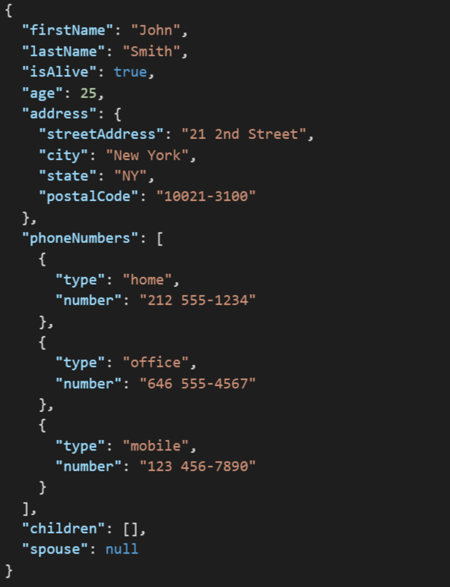
JSON Example
JSON (JavaScript Object Notation) is a lightweight data-interchange format. It is easy for humans to read and write. It is easy for machines to parse and generate. It is an open standard that:
Supports nearly all development languages and platforms
Allows us to cross between many applications
Can result in large files
Notes:
JSON is an open-standard format that uses human-readable text to transmit data objects consisting of attribute–value pairs. It is a very common data format used for asynchronous browser/server communication, including as a replacement for XML in some web service style systems.

Slide 7
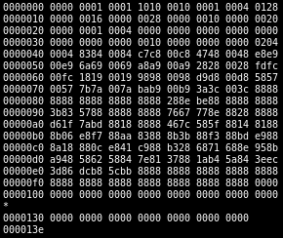
Binary Files
A binary file is a computer file that is not a text file. The term "binary file" is often used as a term meaning "non-text file". The can be open or closed formats that are generally:
Fast, small, and efficient*
Often not very portable across applications and platforms
Difficult to maintain backward compatibility
Notes:
Some people would say that binary files include all files, and that text files are just binary files that are being interpreted in a specific way.

Slide 8
Serialization Example
We are going to demonstrate Writing and Reading OvalDraw data to a proprietary text file by:
Starting with the OvalDraw application
Hooking up the “Open” and “Save” menu events
Teaching our OvalDraw class to Write and Read itself
Saving our session
Loading our session
Notes:
A buffered writer or buffered stream efficiently organization reads and writes for optimal disk performance. The danger is that if there is a power failure (or someone accidentally kicks your power strip) you could lose data. It is good to “flush the buffer” at critical times when using a buffered writer on mission critical projects. There is little or no danger in using a buffered reader.
Binary files versus text files.
XML – Text file format for structured data… HTML for data.
JSON – “Simplified” text file format for structured data.
Binary

Slide 9
End of Session
Course Number: CPSC-24500
Week: 5
Session: 1
Instructor: Eric Pogue

Slide 10
Object-Oriented Programming Session: Week 5 Session 2 Instructor: Eric Pogue
Agenda:
Very briefly review FastPrime assignment
Review the week’s Learning Objectives
Performance optimization
Threads and more Threads… and more Threads

Slide 11
FastPrime… plus Questions
Write a performance optimized command line Java application that will programmatically find prime numbers [link] and store those numbers sorted in an output file.
In FastPrime we will create a command line Java application that will:
Use multiple threads to find the prime numbers between two numbers
Sort those results and store them to a file
Perform some timings
… And do this all very fast
See the details in this week’s assignment
Notes:
Application performance is ALWAYS a challenge. Learn how to optimize, test, and enhance the performance regularly. It can’t be built in at the end of a project!

Slide 12
Learning Objectives – Week 5
Understand how Java uses files for input and output (IO)
Design and implement a controller class to serialize (reads & writes) data to a text file
Understand performance optimization, threads, and how to develop and optimize multi-treaded Java applications
Understand Java packages and compile a class so that it belongs to a particular package
Import a class you write that belongs to a particular package.
Identify reasons for using JAR (Java ARchive) files to group together related java classes
Create a JAR file that stores the contents of a particular package
Explain software testing terms including unit, integration, user acceptance, performance testing, manual, automated, verification, validation, etc.
Understand the importance of testing and the criticality of finding/fixing defects early
Explain the purpose, syntax, and annotations of the various assert statements JUnit supports
Install JUnit onto your machine and execute a JUnit test on your application

Slide 13
Performance Optimization and Threading
Performance is critical in application development… the focus of performance optimization continues to evolve, but the criticality remains very high! Multithreading is one very important way that we can optimize CPU performance; however, there are many other performance bottlenecks and optimization techniques:
CPU… threading
Memory… optimize disk usage, buy more memory
Disk IO… buffering, file size, or faster (more expensive) disks
Network bandwidth… “file” or package size
Network latency… pray for a miracle!
User Interaction and Capabilities
Notes:
Consider mobile phone networks and satellite networks… and latency.
User experience.
Know the difference between latency and bandwidth and how it impacts network and application performance:
https://en.wikipedia.org/wiki/Network_performance
The following measures are often considered important:
Bandwidth commonly measured in bits/second is the maximum rate that information can be transferred
Latency the delay between the sender and the receiver decoding it, this is mainly a function of the signals travel time, and processing time at any nodes the information traverses
Throughput is the actual rate that information is transferred
Jitter variation in packet delay at the receiver of the information
Error rate the number of corrupted bits expressed as a percentage or fraction of the total sent
You can usually buy more bandwidth. Fixing a latency issue might require you to change the speed of light.

Slide 14
Threads & Multithreaded Applications
Multithreading: A technique by which a single set of code can be used by several processors or cores at different stages of execution.
Threads and application performance are becoming nearly synonymous
Moore’s law [link] only remains achievable if we can effectively utilize multi-processor, multi-core, and multi-threaded applications
Our performance principles that we discuss will be applicable across platforms and environments
Our practical focus will be on Java multi-threading
Parallel processing has become the focus of the computing and software development industry
The rise of big data, artificial intelligence, virtual/augmented reality, and dedicated graphical processing units (GPUs) have made that a nearly guaranteed trend for years to come
Notes:
The difference between user perceived (real or perceived) is as important as actual performance. Optimizing application performance to reflect user capabilities is challenging and necessary. It doesn’t matter if you optimize an application to be 10 times faster if the bottleneck is how fast the user.
Multithreading is the primary method of optimizing CPU performance. It is unlikely to be of benefit if the bottleneck is elsewhere. For example, if you are disk bound, splitting your process into multiple threads is unlike to be of benefit.

Slide 15
Processors, Cores, and Threads
Computers have one or more Processors (CPUs)
Processors each have one or more Cores
Cores can create one or more Threads
An application running only on one thread of a dual cpu, quad-core, single thread can utilize only a portion of 1/8th of the processing power of that machine
Notes:
For this discussion we will using multithreading and multiprocessing terms synonymously for our purposes.
Modern central processing units (CPUs) are made up of cores. A core is like a mini-processor that works with its fellow cores to perform the work that applications request of the CPU. In the old days, a CPU had just one core, a single channel through which all requests would pass. This was how we optimized applications… CPU, memory, fast disk, slow disk. Today, though, with multiple CPUs and multiple cores, a CPU can pay attention to and do many things at once.
This architecture, in turn, allows today’s applications to perform multiple tasks at once. This ability is called multitasking. Multitasking enables an

Slide 16
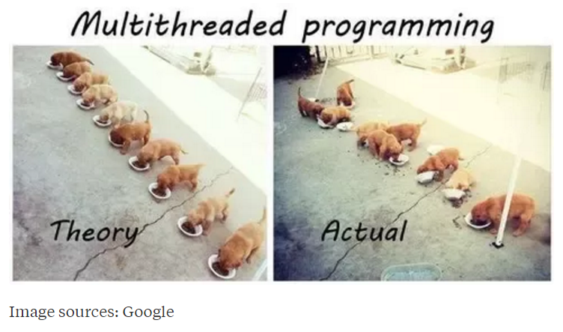
Multi-Threaded Development
Now for the bad news. Multi-Threaded Development is really hard!
Notes:
Rigidity - It is hard to change because every change affects too many other parts of the system
Fragility - When you make a change, unexpected parts of the system break
Immobility - It is hard to reuse in another application because it cannot be disentangled from the current application
Stadia add-in example.
Deadlock describes a situation where two or more threads are blocked forever, waiting for each other. Deadlock occurs when multiple threads need the same locks but obtain them in different order.

Slide 17
Multi-Threaded Development
Now for the bad news. Multi-Threaded Development is really hard!
Developing commercial quality multi-threaded applications makes Rigidity, Fragility, and Immobility much harder to avoid
Many of the 3rd party professional libraries that the industry had come to rely on came into question as multi-threading application became required
Testing becomes harder when a sequence of events becomes variable
What if your automated unit test results might be different depending on which thread finishes first?
What about deadlock?
Performance is so important that we will need to understand be able to effectively utilize, test, and deploy effective multi-threaded applications
Notes:
Rigidity - It is hard to change because every change affects too many other parts of the system
Fragility - When you make a change, unexpected parts of the system break
Immobility - It is hard to reuse in another application because it cannot be disentangled from the current application
Increased complexity is the primary disadvantage for developing multithreaded applications.
Some languages have come into existence in order to try to reduce the complexity of writing, enhancing, and supporting multithreaded applications. For example, Scala has implemented specific parallelization features in the core language that make it a first class threading language. Note that Scala also targets the Java runtime environment.
C++ would be an example of a language that has implemented a plethora of threading mechanisms for various platforms and implementations. Recent versions have introduced more common approaches.
Stadia add-in example.
Deadlock describes a situation where two or more threads are blocked forever, waiting for each other. Deadlock occurs when multiple threads need the same locks but obtain them in different order.
Interesting threading article:
http://blog.smartbear.com/programming/why-johnny-cant-write-multithreaded-programs/
When reviewing libraries look for something like “This class is immutable and thread-safe.” before you use it in multithreaded development.

Slide 18
Multi-Threaded Example
ThreadedRandomNumbers: Calculate 1,000,000,000 random numbers between 1 and 2,000,000. Print “We found number 1024!” to the console each time 1024 is generated. We would expect it to come up approximately 500 times.
Write a single threaded application
Divide the application into multiple threads and repeat
Consider the diminishing returns of adding additional threads

Slide 19
End of Session
Course Number: CPSC-24500
Week: 5
Session: 2
Instructor: Eric Pogue

Slide 20
Object-Oriented Programming Session: Week 5 Session 3 Instructor: Eric Pogue
Agenda:
Discuss FastPrime… bring your questions
Other topics as time allows

Slide 21
FastPrime… plus Questions
Write a performance optimized command line Java application that will programmatically find prime numbers [link] and store those numbers sorted in an output file.
In FastPrime we will create a command line Java application that will:
Use multiple threads to find the prime numbers between two numbers
Sort those results and store them to a file
Perform some timings
… And do this all very fast
See the details in this week’s assignment
Notes:
Application performance is ALWAYS a challenge. Learn how to optimize, test, and enhance the performance regularly. It can’t be built in at the end of a project!

Slide 22
Learning Objectives – Week 5
Understand how Java uses files for input and output (IO)
Design and implement a controller class to serialize (reads & writes) data to a text file
Understand threads and how to develop and optimize multi-treaded Java applications
Understand Java packages and compile a class so that it belongs to a particular package
Import a class you write that belongs to a particular package.
Identify reasons for using JAR (Java ARchive) files to group together related java classes
Create a JAR file that stores the contents of a particular package
Explain software testing terms including unit, integration, user acceptance, performance testing, manual, automated, verification, validation, etc.
Understand the importance of testing and the criticality of finding/fixing defects early
Explain the purpose, syntax, and annotations of the various assert statements JUnit supports
Install JUnit onto your machine and execute a JUnit test on your application

Slide 23
Testing
Notes:
We test to find defects and/or to validate that we have not introduced new defects.
Defects are exponentially more expensive to fix the longer the exist.
Performance issues are often the most difficult and expensive defects to fix. They are often not found until the application if running under production load… which is often only when it is in production.
Unit - $200
Integration - $600
User Acceptance - $6,000
Production - $100,000+
The permutations of modern software features, data, tools, environments, etc. quickly becomes unmanageable. Testability needs to be goal of nearly all non-trivial applications.
Integration (or Functional) Test: Another kind of test. These test whether the functionality of the entire application works as it should, or that the entire application behaves as expected.
Performance Test: Still another kind of test. These benchmark the performance of an application, especially under high load.
Behavior vs. State Testing: Behavior testing focuses on verifying that the correct functions were called with the correct parameters. In other words, are the various pieces interacting correctly? State testing focuses on the results of those calls. We will focus on state testing.

Slide 24
Unit testing can be done in two ways − manual testing and automated testing.
Manual Testing | Automated Testing
Executing a test cases manually without any tool support is known as manual testing. | Taking tool support and executing the test cases by using an automation tool is known as automation testing.
Time-consuming and tedious − Since test cases are executed by human resources, it is very slow and tedious. | Fast − Automation runs test cases significantly faster than human resources.
Huge investment in human resources − As test cases need to be executed manually, more testers are required in manual testing. | Less investment in human resources − Test cases are executed using automation tools, so less number of testers are required in automation testing.
Less reliable − Manual testing is less reliable, as it has to account for human errors. | More reliable − Automation tests are precise and reliable.
Non-programmable − No programming can be done to write sophisticated tests to fetch hidden information. | Programmable − Testers can program sophisticated tests to bring out hidden information.
Notes:
False positives versus valid defects found.
Manual Testing and Automated Testing can be supportive of each other.

