Slide 1
第一章 概述
http://blog.csdn.net/crazycoder2010/article/details/78414448

Slide 2
现状
Ip1:8080
client
Springcloud-message

Slide 3
使用nginx来做负载均衡
Ip1:8080
nginx
Ip2:8080
client
HA
nginx
Ip3:8080
Springcloud-message

Slide 4
使用Eureka来做负载均衡
Ip1:8080
Erueka
Ip2:8080
client
Cluster
Erueka
Ip3:8080
Springcloud-message

Slide 5
Eureka
127.0.0.1:8081
服务注册
服务发现
Message
User
服务调用
127.0.0.1:8080
127.0.0.1:8082

Slide 6
第二章 微服务之间调用
http://blog.csdn.net/crazycoder2010/article/details/78426381
https://github.com/kwang2003/springcloud-study-ch02.git

Slide 7
Controller
Service
DAO
DB

Slide 8

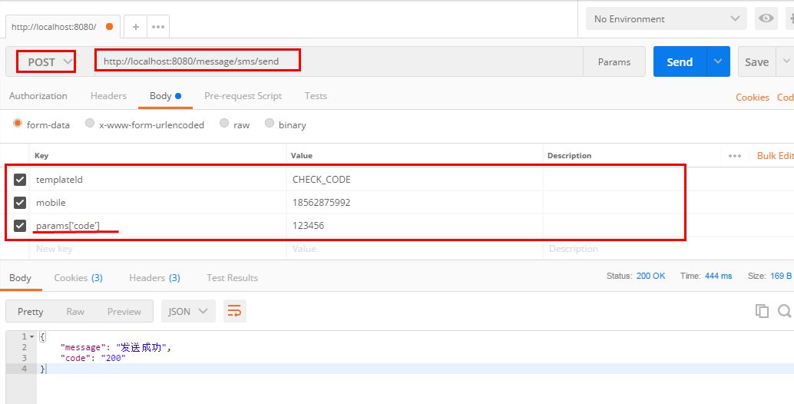
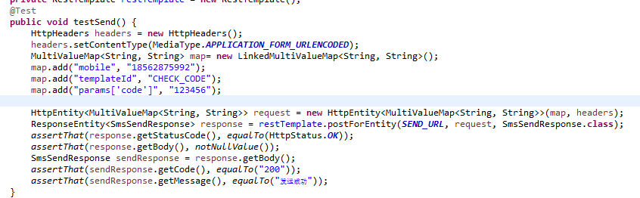
RestTemplate的两种调用方式—方式1
服务器端接收一个SmsSendRequest参数
客户端调用
Postman测试

Slide 9

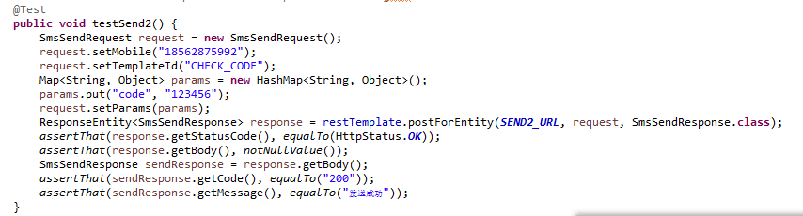
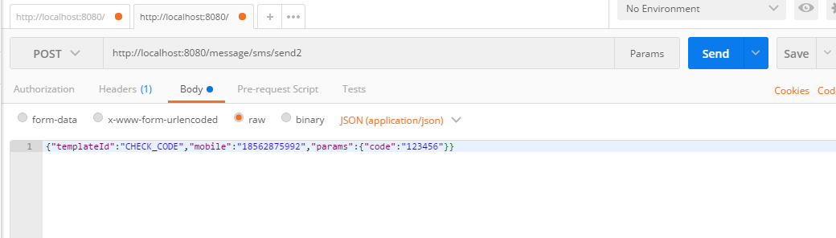
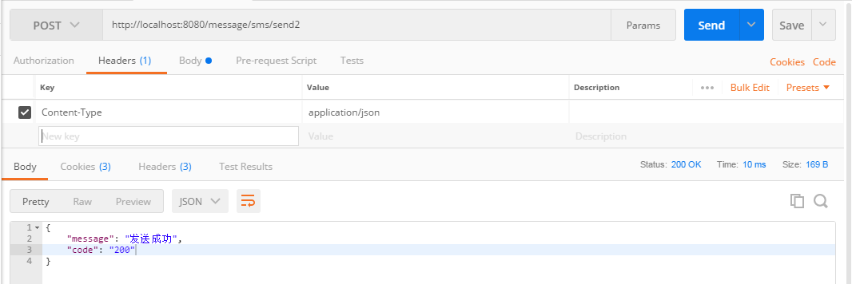
RestTemplate的两种调用方式—方式2使用@RequestBody
服务器端接收一个SmsSendRequest参数
客户端调用
Postman测试

Slide 10
第四章 Eureka注册中心集群
http://blog.csdn.net/crazycoder2010/article/details/78453970
https://github.com/kwang2003/springcloud-study-ch04.git

Slide 11
Eureka
Host绑定：
127.0.0.1 eureka1 eureka2 eureka3
eureka1:8081
Eureka
eureka2:7081
Eureka
服务注册
eureka3:6081
服务发现
Eureka集群
Message
User
服务调用
127.0.0.1:8080
127.0.0.1:8082

Slide 12
第六章 Zuul网关
http://blog.csdn.net/crazycoder2010/article/details/78457832
https://github.com/kwang2003/springcloud-study-ch06.git

Slide 13
毫无优化的架构
UI
http://Ip1:port1
http://Ip2:port2
http://Ip3:port3
http://Ip4:port4
User-Service
User-Service
User-Service
User-Service
Ip1:port1
Ip2:port2
Ip3:port3
Ip4:port4

Slide 14
通过nginx代理转发
UI
http://api.xxx.com
Nginx
Nginx
http://Ip1:port1
http://Ip2:port2
http://Ip3:port3
http://Ip4:port4
User-Service
User-Service
User-Service
User-Service
Ip1:port1
Ip2:port2
Ip3:port3
Ip4:port4

Slide 15
通过zuul代理转发
UI
http://api.xxx.com
Eureka集群
Eureka
Nginx
Nginx
eureka1:8081
Eureka
http://ip5:port5
http://ip6:port6
eureka2:7081
Zuul
Zuul
Eureka
eureka3:6081
http://Ip1:port1
http://Ip2:port2
http://Ip3:port3
http://Ip4:port4
User-Service
User-Service
User-Service
User-Service
Ip1:port1
Ip2:port2
Ip3:port3
Ip4:port4

Slide 16
第七章 OAuth2认证
http://blog.csdn.net/crazycoder2010/article/details/78457832
https://github.com/kwang2003/springcloud-study-ch07.git

Slide 17
通过oauth2进行安全认证
UI
http://api.xxx.com
Eureka集群
Eureka
Nginx
Nginx
eureka1:8081
Eureka
http://ip5:port5
http://ip6:port6
eureka2:7081
Oauth2
Zuul
Zuul
Eureka
eureka3:6081
http://Ip1:port1
http://Ip2:port2
http://Ip3:port3
http://Ip4:port4
User-Service
User-Service
User-Service
User-Service
Ip1:port1
Ip2:port2
Ip3:port3
Ip4:port4

