Slide 1

Presented by: Eric Kachikian
Date: 12/1/2025
CSUCI
COMP 499

Slide 2
Introduction
Project Context:
Modern networks face increasing internal & external cyber threats
Traditional perimeter security is no longer enough
Zero Trust (“Never Trust, Always Verify”) improves internal security
Problem Addressed:
How to design a segmented, secure enterprise network
How to prevent lateral movement & rogue devices
How to simulate Zero Trust using Cisco Packet Tracer
Objectives:
Build segmented VLAN network
Enforce Zero Trust microsegmentation with ACLs
Implement secure management (AAA + SSH)
Deploy DMZ, port security, DHCP snooping
Validate controls through structured testing

Slide 3
Background / Problem Statement
Issues in Traditional Networks:
Flat networks allow attackers free movement
Poor segmentation increases breach impact
Unverified devices can join the network
Industry Shift:
Zero Trust (NIST 800-207) requires identity & device verification
Least privilege and visibility are now required
Why This Project Matters:
Demonstrates modern security concepts
Shows practical Zero Trust in Cisco IOS
Provides a repeatable secure network design

Slide 4
Literature Review / Technology Framework
Key Technologies: VLAN segmentation, ACLs, microsegmentation, Port Security, DHCP Snooping, AAA authentication (local), NAT, DMZ architecture and Syslog monitoring
Related Work:
Cisco SAFE Architecture
NIST Zero Trust Model
Basic Packet Tracer VLAN labs
Gap Filled:
Most PT projects stop at VLANs.
This project implements a full Zero Trust architecture, including DMZ, rogue device defense, secure management, and logging.

Slide 5
Project/design Requirements & Specifications
Functional Requirements:
VLANs for each department, Secure Inter-VLAN routing, DMZ for public services, AAA + SSH authentication, NAT to Internet, Syslog logging,
Rogue device prevention
Non-Functional Requirements
Security
Scalability
Maintainability
Realistic enterprise design
Constraints
Packet Tracer limitations:
No full RADIUS
No VPN endpoints
Port security unreliable

Slide 6
Methodology / Design Approach
Architecture
Cisco 2911 router (routing + NAT)
Dual 2960 switches (access + trunking)
Zero Trust segmentation per VLAN
Approach
Cisco design principles
Iterative build-test-improve cycle
Threat modeling (rogue DHCP, lateral movement)
Tools
Cisco Packet Tracer 8.x
IOS CLI
Syslog Server

Slide 7
Implementation
Key Components
8 VLANs (Users, HR, Finance, Guest, Mgmt, Servers, DMZ, Native)
Router-on-a-stick with subinterfaces
ACLs applied inbound to each VLAN
NAT overload
Syslog on all devices
Port security
DHCP snooping
AAA Local + SSH
DMZ Web Server
Technical Challenges
DHCP Snooping + trunk complexity
Packet Tracer limitations

Slide 8
Testing & Validation
Testing Conducted
Ping gateway tests
Allowed/blocked VLAN communication
DMZ access rules
Rogue DHCP attack
ACL enforcement
SSH login
Syslog event capture
Results
Segmentation successful
Microsegmentation enforced
DMZ isolated correctly
Rogue DHCP blocked
SSH secure access works

Slide 9
Results / Demonstration
Achievements
Fully functional Zero Trust network
Complete segmentation of all departments
Enforced least privilege
Functional DMZ
Secure admin access (SSH + AAA)
Rogue DHCP prevented
Syslog capturing events
Screenshots Presented
Final topology
Syslog logs
NAT table
ACL tests
DHCP snooping bindings
SSH login

Slide 10
Discussion
Performance
All major Zero Trust goals achieved
ACLs + Snooping validated
DMZ and management zones secured
Issues Faced
No RADIUS or VPN options
Security Evaluation
Lateral movement prevented
Rogue devices blocked
All VLANs isolated
Least privilege enforced

Slide 11
Future Work
Add Cisco ASA firewall
Implement external RADIUS
Add site-to-site IPsec

Slide 12
Conclusion
Summary
Built a complete Zero Trust architecture
Implemented DMZ, NAT, ACLs, Snooping, Syslog, AAA
Validated segmentation and access rules
Successfully blocked rogue devices
Personal Learning
Stronger understanding of Cisco security
Improved troubleshooting
Hands-on Zero Trust experience

Slide 13
Acknowledgments
Dr Reza Abdolee
Online Cisco documentation

Slide 14
References
Cisco SAFE Design Guide
Cisco IOS Documentation
NIST SP 800-207 Zero Trust
CCNA Official Cert Guide
Cisco Networking Academy

Slide 15
Q&A Session

Slide 16
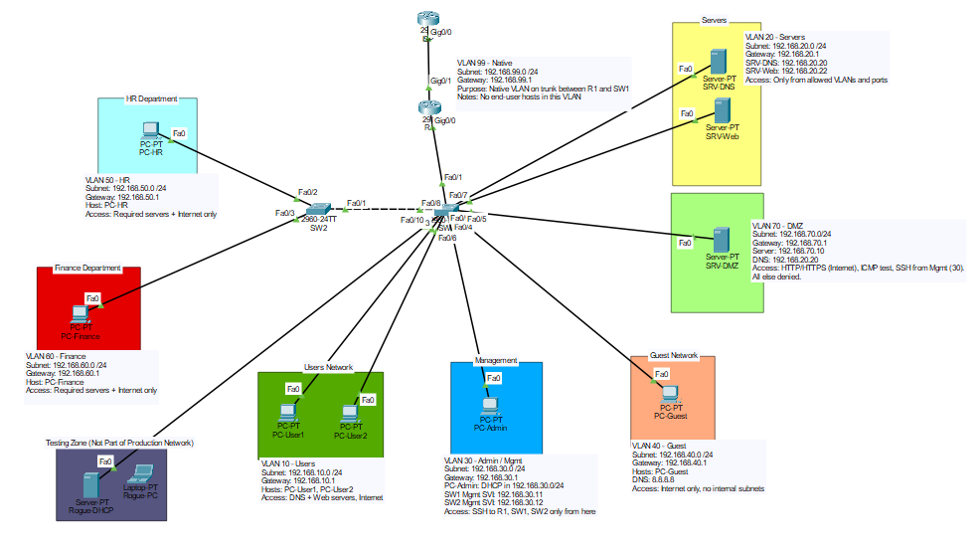
Supplementary Material

