Slide 1
MODULE 1
AI Concepts & Getting Started with AI in Azure
Workloads · Responsible AI · Azure · Microsoft Foundry · Endpoints
AI-901 Faculty Study Kit · original content from public Microsoft Learn documentation

Slide 2
What is artificial intelligence?
• Software that imitates human capabilities:
– predict outcomes and recognize patterns from historic data
– evaluate content, make decisions, take appropriate action
– understand language and hold conversations
– interpret visual input
– extract information from sources to gain knowledge
• Machine learning — models mapping input to output, f(x) = y — underpins all of it

Slide 3
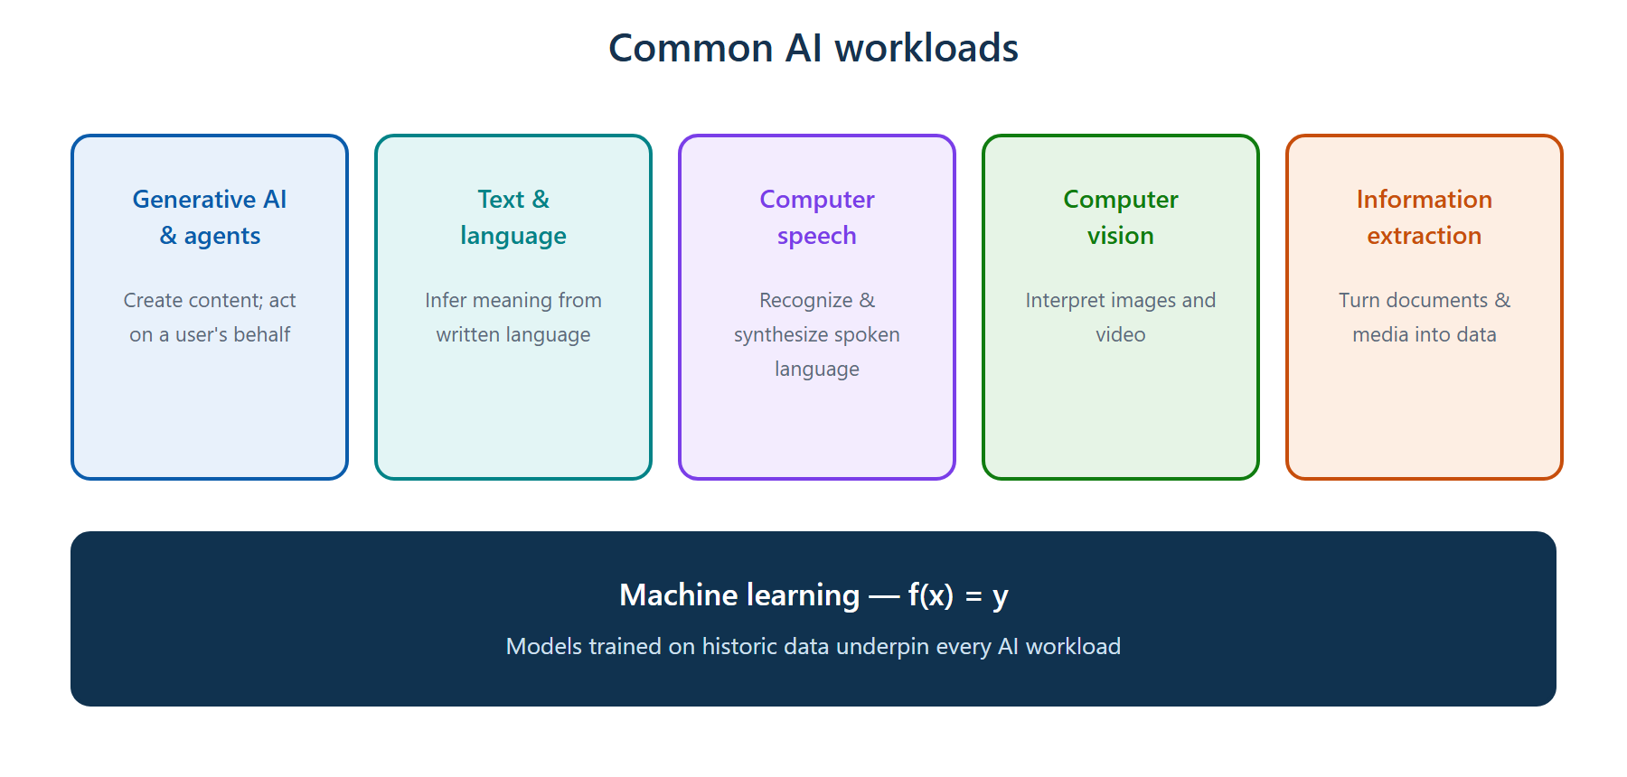
Five common AI workloads
Generative AI & agents · text & language · speech · vision · information extraction

Slide 4
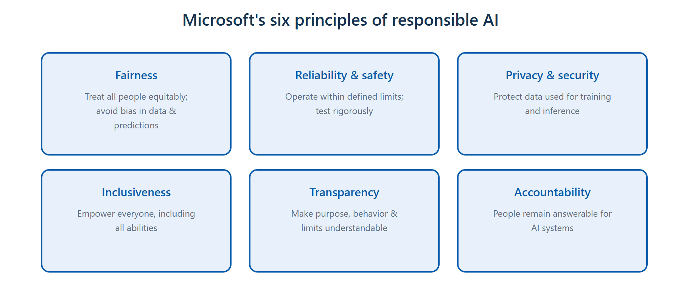
Responsible AI — six principles
Fairness · Reliability & safety · Privacy & security · Inclusiveness · Transparency · Accountability

Slide 5
Responsible AI — scenario keywords
• Bias against a group of people → Fairness
• Rigorous testing; safe operation within limits → Reliability & safety
• Personal / sensitive data protection → Privacy & security
• Serving people of all abilities → Inclusiveness
• Users understand purpose, behavior, limitations → Transparency
• Humans remain answerable; governance & override → Accountability

Slide 6
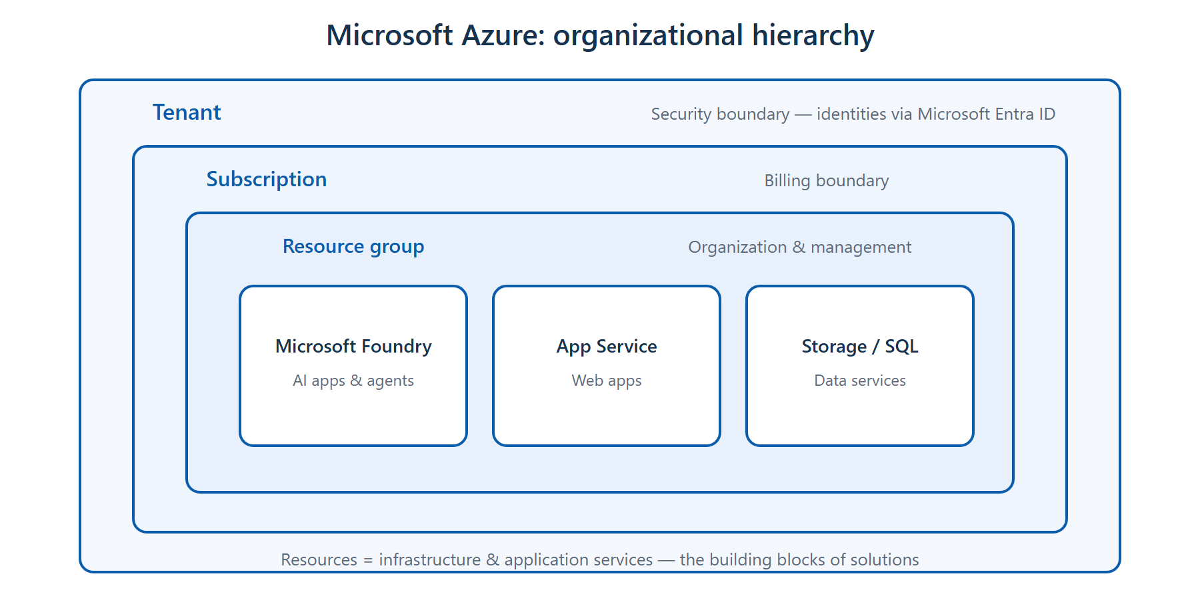
Microsoft Azure — organizational hierarchy
Tenant (security, Entra ID) → Subscription (billing) → Resource group → Resources

Slide 7
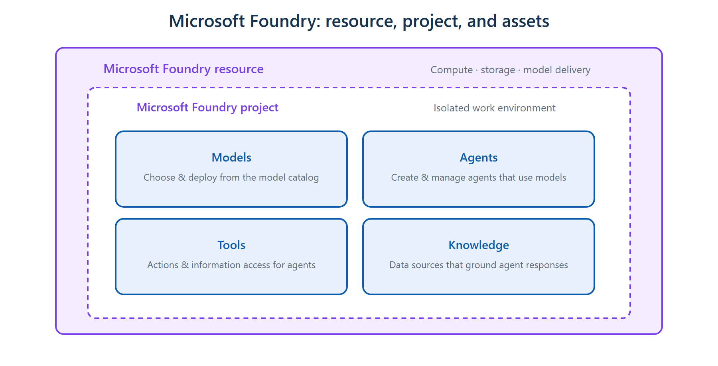
Microsoft Foundry — resource, project & assets
Projects are isolated work environments containing Models, Agents, Tools and Knowledge

Slide 8
Foundry is built on Azure
• Foundry uses Azure compute, networking, identity and security to host AI applications
• It does not run independently of Azure, and it does not replace Azure services
• A Foundry resource provides compute, storage and model delivery
• Projects isolate development work; assets = models, agents, tools, knowledge

Slide 9
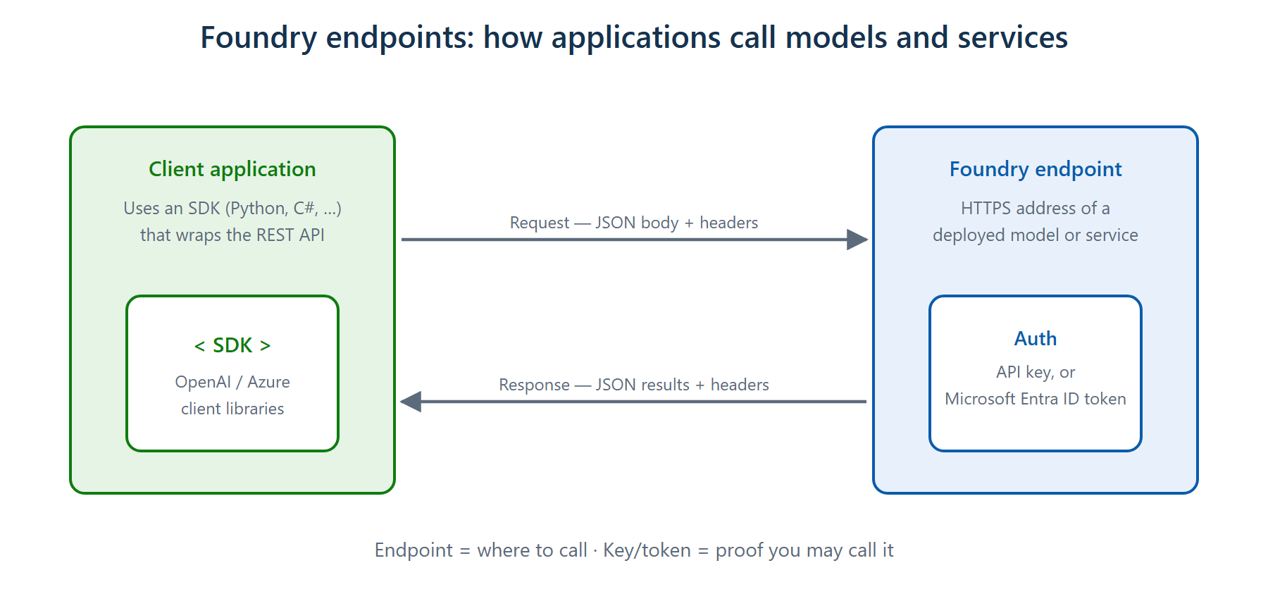
Endpoints, keys and SDKs
Endpoint = URL to call a deployed model · key or Entra ID token authenticates the request

Slide 10
Summary & exam pointers
• Tenant = security boundary; subscription = billing boundary
• Generative AI = language model creating original content from a prompt
• AI agent = an application that performs tasks on behalf of a user
• Endpoint answers 'where'; key/token answers 'may I' — keys never store data
➜ Next: Module 2 — Generative AI and agents

