Slide 1
MODULE 2
Generative AI and Agents
LLMs · transformers · model catalog · playgrounds · Foundry Agent Service
AI-901 Faculty Study Kit · original content from public Microsoft Learn documentation

Slide 2
What is generative AI?
• Generates responses from natural-language prompts
• Output types: natural language (text/speech), images & video, code (Python, C#, SQL, …)
• Applications: smart chatbots, creative assistants, and the foundation for agentic AI
• Powered by large language models (LLMs); small language models (SLMs) fit devices and constrained environments

Slide 3
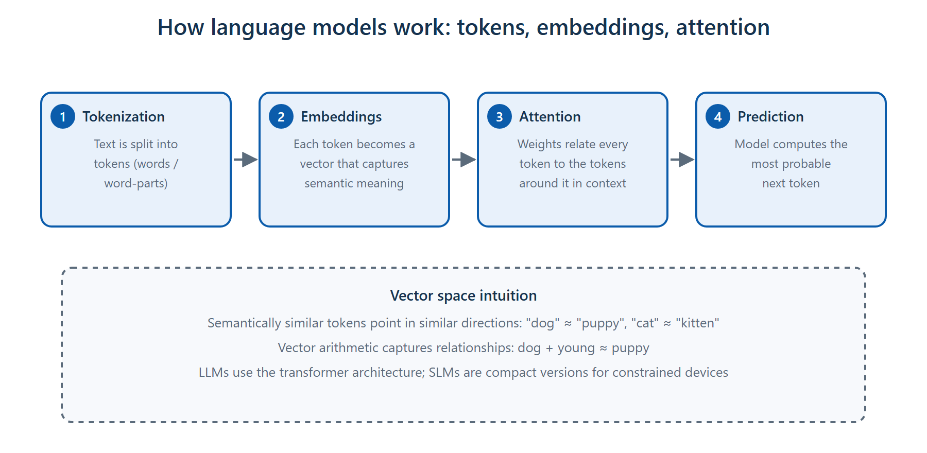
How language models work
Transformer architecture: tokens → embeddings → attention → next-token prediction

Slide 4
Transformer vocabulary — exam anchors
• Token — unit of text (word / word-part) the model processes
• Embedding — vector representation of a token capturing semantic meaning
• Attention — weighs relationships between each token and the tokens around it
• Semantically similar tokens have similar vector directions (dog + young ≈ puppy)
• The model repeatedly predicts the most probable next token

Slide 5
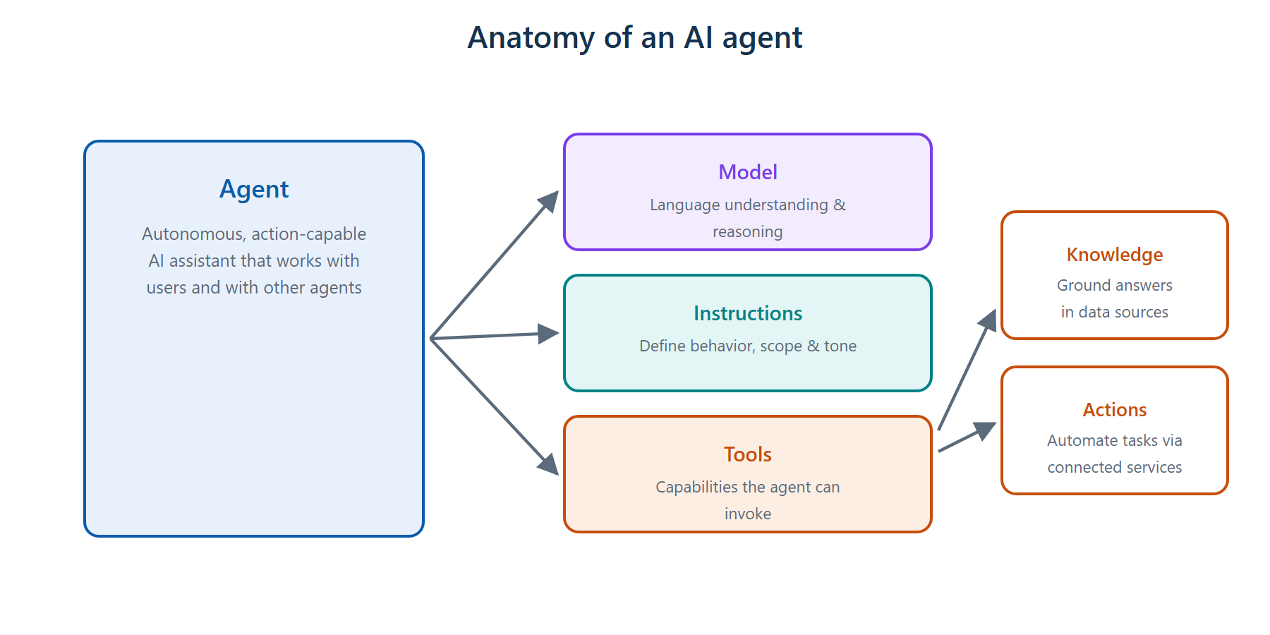
What are agents?
Model + instructions + tools — tools provide knowledge (grounding) and actions (automation)

Slide 6
Foundry Models — the catalog
• Central hub to discover, filter, compare and deploy models from multiple providers
• Sold directly by Microsoft (billed via your Azure subscription) — includes Azure OpenAI models
• Partner & community models from trusted third-party providers
• Deployment considerations:
– Deployment type — where data is processed and how you pay
– Version — model version and auto-update policy
– Rate limits — maximum tokens-per-minute (TPM)
– Guardrails — responsible-AI content policies

Slide 7
Using a generative model
• Model playground — test prompts, compare models, capture working settings before coding
• OpenAI-compatible APIs / SDKs — consume the model from application code
• Shape behavior with three levers:
– Instructions (system prompt) — context and guidelines
– Input (user prompt) — explicit, detailed requests
– Parameters — temperature ('creativity'), response length
• Pattern: OpenAI(base_url=endpoint, api_key=key) → client.responses.create(model=deployment, input=prompt)

Slide 8
Creating agents — Foundry Agent Service
• Save a model configuration as a named agent, or build one directly
• Add tools — knowledge (file search, web, data) and actions (connected services, code)
• Experiment and test in the agent playground
• Connect from code with the Foundry Project API:
– AIProjectClient(endpoint, DefaultAzureCredential()) — project connection
– project.agents.get('name') — fetch the agent definition
– openai_client.responses.create(input=…, extra_body={'agent': …}) — THIS submits the prompt

Slide 9
Summary & exam pointers
• LLM = model designed to generate human-like text; embeddings = semantic vectors
• Playground helps you experiment — it does not replace deployment or the API
• Know all four deployment considerations: type, version, rate limits, guardrails
• responses.create() is the line that actually sends a prompt to a model or agent
➜ Next: Module 3 — NLP & text analysis

