Slide 1
MODULE 3
Natural Language Processing & Text Analysis
NLP tasks · pre-processing · statistical vs semantic · Azure Language
AI-901 Faculty Study Kit · original content from public Microsoft Learn documentation

Slide 2
What is NLP?
• Inferring meaning from text
• Core tasks: key-term extraction, named entity recognition, text classification (incl. sentiment), summarization
• Azure Language adds: PII extraction & redaction, language detection, Text Analytics for Health
• Use cases: search indexing, PII redaction, chatbot intent prediction, spam filtering, social media analysis

Slide 3
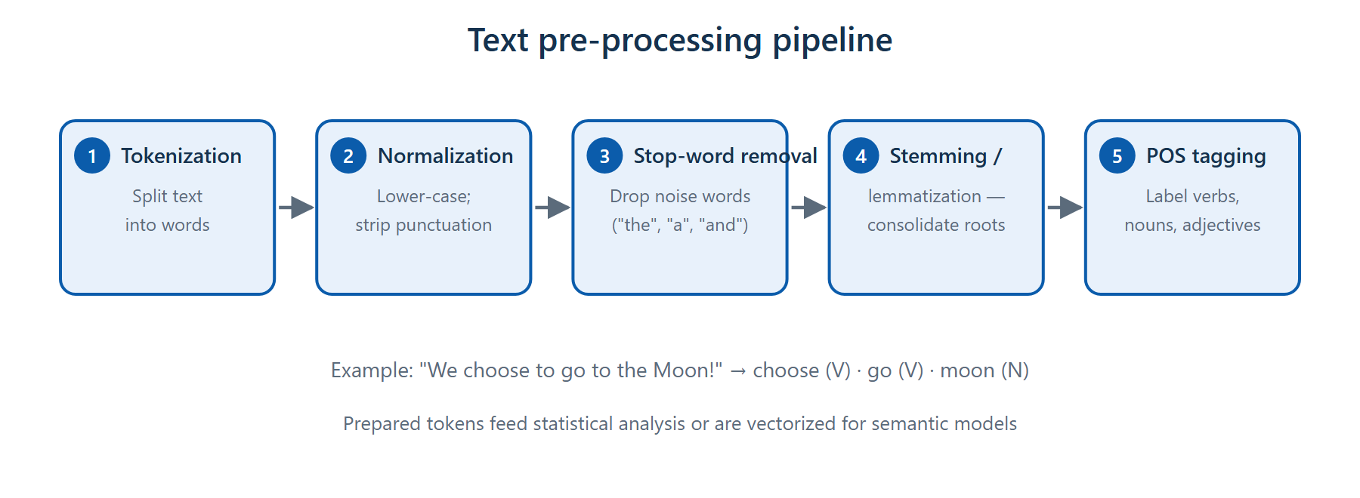
Text pre-processing pipeline
Tokenization → normalization → stop-word removal → stemming/lemmatization → POS tagging

Slide 4
Statistical text analysis
• Term Frequency (TF) — the most common tokens indicate key topics
• TF-IDF — importance of a word in one document relative to the whole collection
• Bag-of-Words — word-set frequencies drive classification (happy/great/fantastic → positive)
• TextRank — sentence relevance scoring (PageRank idea); powers extractive summarization
• Semantic models vectorize tokens as embeddings — the basis of modern LLMs

Slide 5
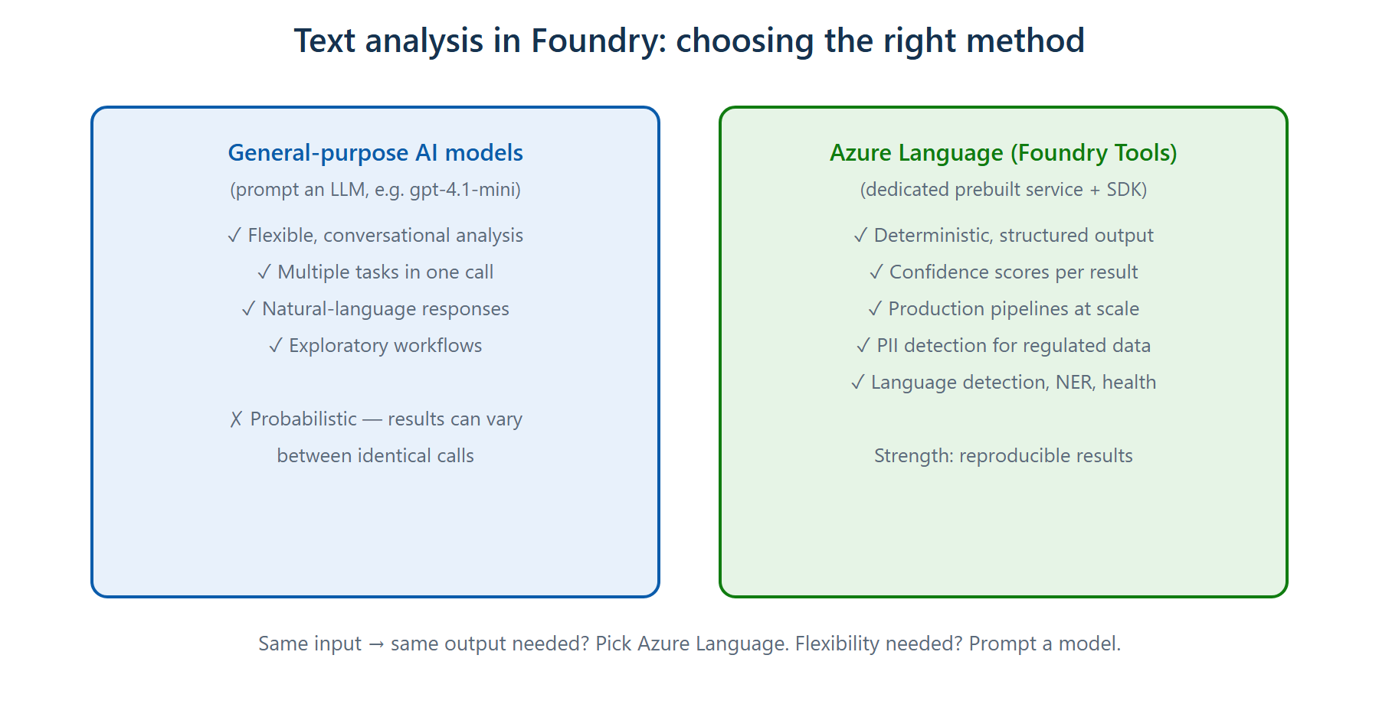
Choosing the right method in Foundry
Flexible prompting vs deterministic structured output with confidence scores

Slide 6
Azure Language SDK — the pattern
• TextAnalyticsClient(endpoint, AzureKeyCredential(key)) — the client object lets code talk to the service
• Submit a collection of documents for analysis
• detect_language() → language name + ISO 639-1 code + confidence score
• recognize_pii_entities() → redacted text + entities + confidence per entity
• recognize_entities(), extract_key_phrases(), analyze_sentiment()
• Deterministic: the same input returns the same structured result

Slide 7
Azure Language in an agent (MCP)
• Model Context Protocol (MCP) exposes Azure Language capabilities to agents as tools
• Connect the MCP server to your agent — specify the Foundry resource and credentials
• Approve tool access: one-time, always for this tool, or always for all tools
• The MCP server complements the agent's model — it does not replace it

Slide 8
Summary & exam pointers
• TF-IDF = importance of a word in a document vs the collection
• Deterministic structured output + confidence scores → Azure Language, not an LLM prompt
• PII redaction for regulated data is an Azure Language strength
• MCP = the bridge that lets agents call Azure Language
➜ Next: Module 4 — AI speech

