Slide 1
MODULE 4
AI Speech
Speech-to-text · text-to-speech · Speech SDK · Voice Live agents
AI-901 Faculty Study Kit · original content from public Microsoft Learn documentation

Slide 2
Speech-enabled solutions
• Speech recognition = speech-to-text (STT): audio file / stream / microphone → transcription
– Customer support, voice assistants, automatic subtitles, meeting transcription, clinical notes
• Speech synthesis = text-to-speech (TTS): text → audio waveform
– Conversational AI, screen readers, notifications, e-learning, game character voices
• Accessibility appears on both sides: captions = STT, screen readers = TTS

Slide 3
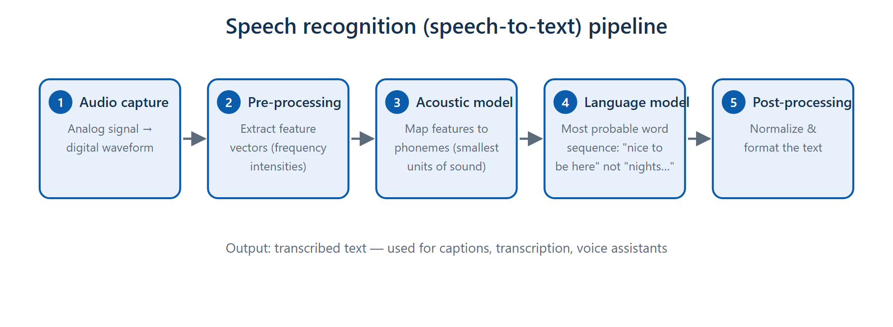
Speech recognition pipeline
Capture → feature extraction → acoustic model (phonemes) → language model (words) → post-processing

Slide 4
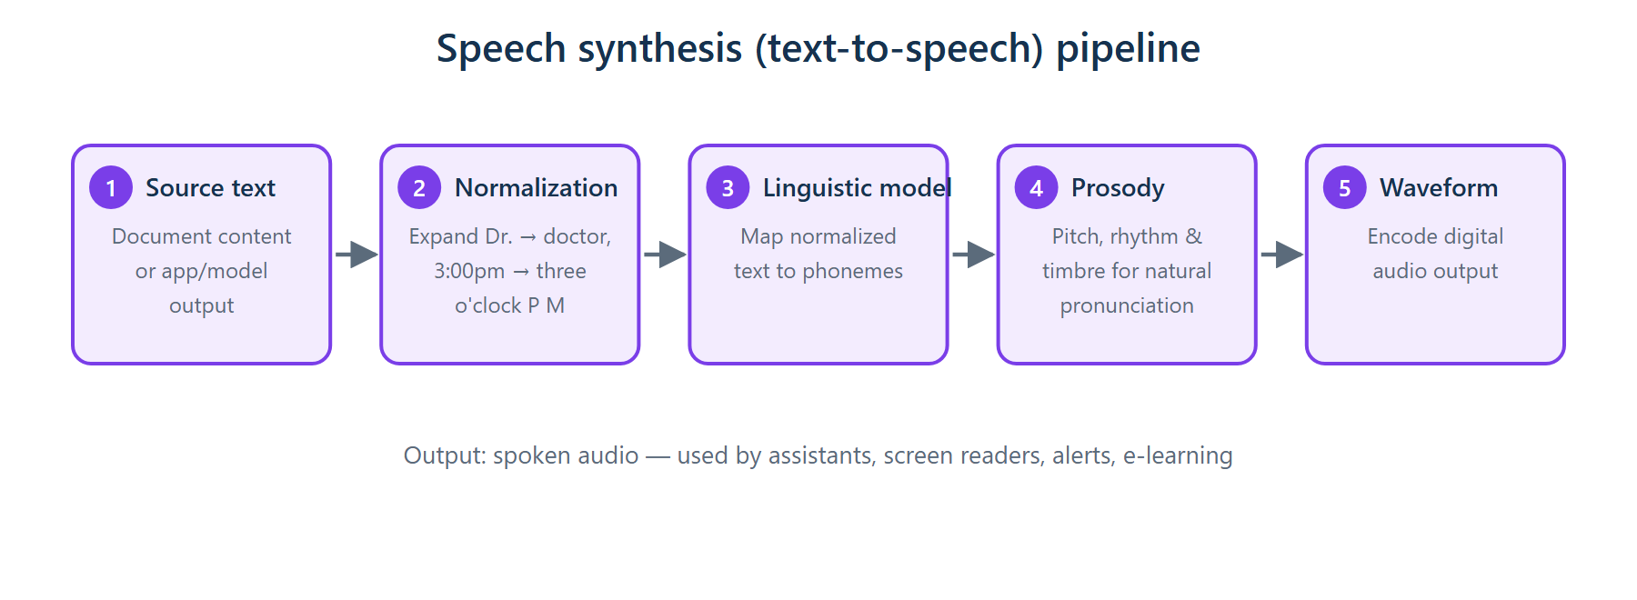
Speech synthesis pipeline
Text → normalization → phonemes → prosody (natural cadence) → waveform encoding

Slide 5
Pipeline vocabulary — exam anchors
• Pre-processing extracts feature vectors from the waveform (noise removed, never added)
• Phoneme — the smallest unit of sound in speech
• Acoustic model maps features → phonemes; language model picks the most probable words
• Normalization (TTS) expands 'Dr.' → 'doctor', '3:00pm' → 'three o'clock P M'
• Prosody = pitch, rhythm, timbre → natural pronunciation and cadence (not volume, not translation)

Slide 6
Azure Speech in Foundry Tools
• Portal playground — real-time transcription, language ID, speaker diarization; voice tuning for TTS
• Azure Speech SDK — put speech recognition/synthesis directly into application code
– STT: SpeechConfig(key, endpoint) + AudioConfig(file) → SpeechRecognizer → recognize_once_async()
– TTS: set speech_synthesis_voice_name → SpeechSynthesizer → speak_text_async()
– No AudioConfig needed for default speaker output (use one for file output)
• SDK handles authentication, network communication and audio generation
• MCP server exposes speech capabilities to agents

Slide 7
Voice Live — speech-capable agents
• Real-time spoken conversation with a generative model that has instructions and tools
• Continuous conversation flow with interruption handling and background-noise reduction
• Experiment in the Foundry portal playground
• Build clients with the Voice Live SDK (azure-ai-voicelive): opens a real-time connection, streams audio, handles spoken responses & interruptions

Slide 8
Summary & exam pointers
• STT pipeline order: capture → features → acoustic → language → post-processing
• Phonemes = smallest units of sound; prosody = natural cadence
• SDK vs playground: the SDK is how speech gets into your application code
• Voice Live = real-time voice agents with interruption support
➜ Next: Module 5 — Computer vision

