Slide 1
MODULE 5
Computer Vision
Vision tasks · CNNs & ViTs · multimodal analysis · image & video generation
AI-901 Faculty Study Kit · original content from public Microsoft Learn documentation

Slide 2
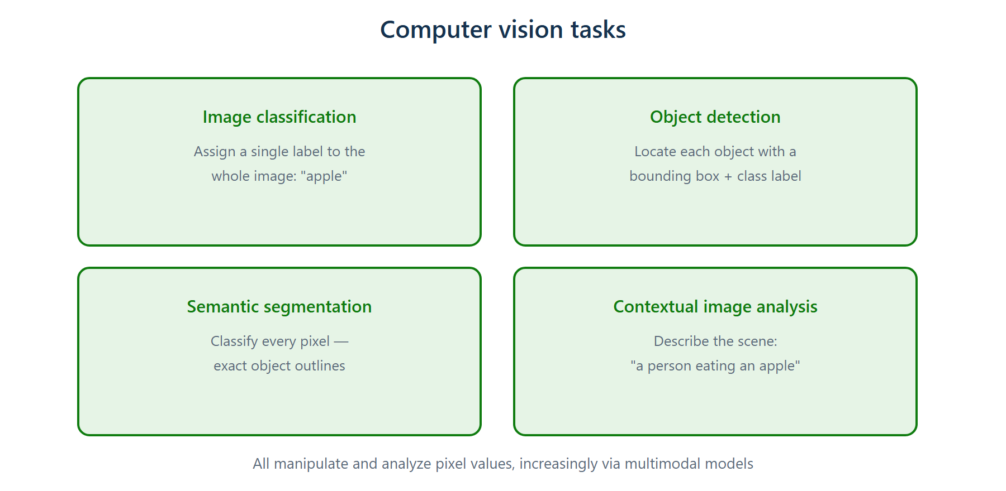
Computer vision tasks
Classification (one label) · detection (boxes) · segmentation (pixels) · contextual analysis (description)

Slide 3
Vision fundamentals
• Computer vision manipulates and analyzes pixel values — not metadata or file names
• Classification: one label for the whole image
• Object detection: bounding box + class for each object
• Semantic segmentation: classify every pixel — exact outlines
• Contextual analysis: natural-language description of the scene

Slide 4
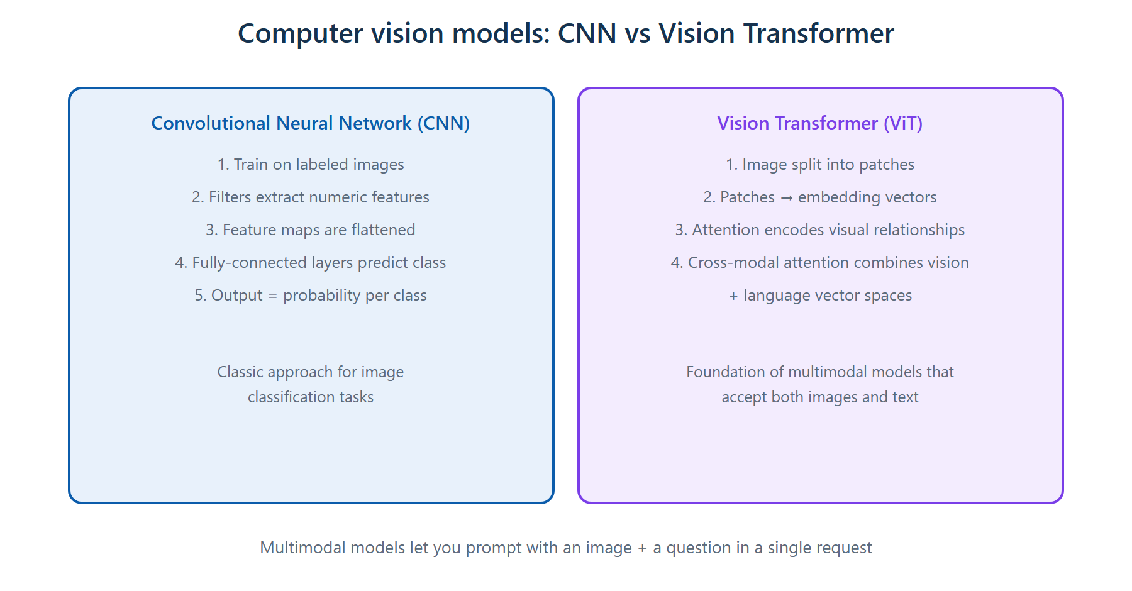
Vision models — CNN vs Vision Transformer
CNN filters extract numeric features; ViTs apply attention to image patches

Slide 5
Multimodal models
• Understand and work with more than one data type — e.g. an image plus a text question
• ViTs use cross-modal attention to combine visual and language vector spaces
• Analyze images through the OpenAI API multi-part content structure:
– content = [{type: input_text, …}, {type: input_image, image_url: …}]
– images can be URLs or base64-encoded data

Slide 6
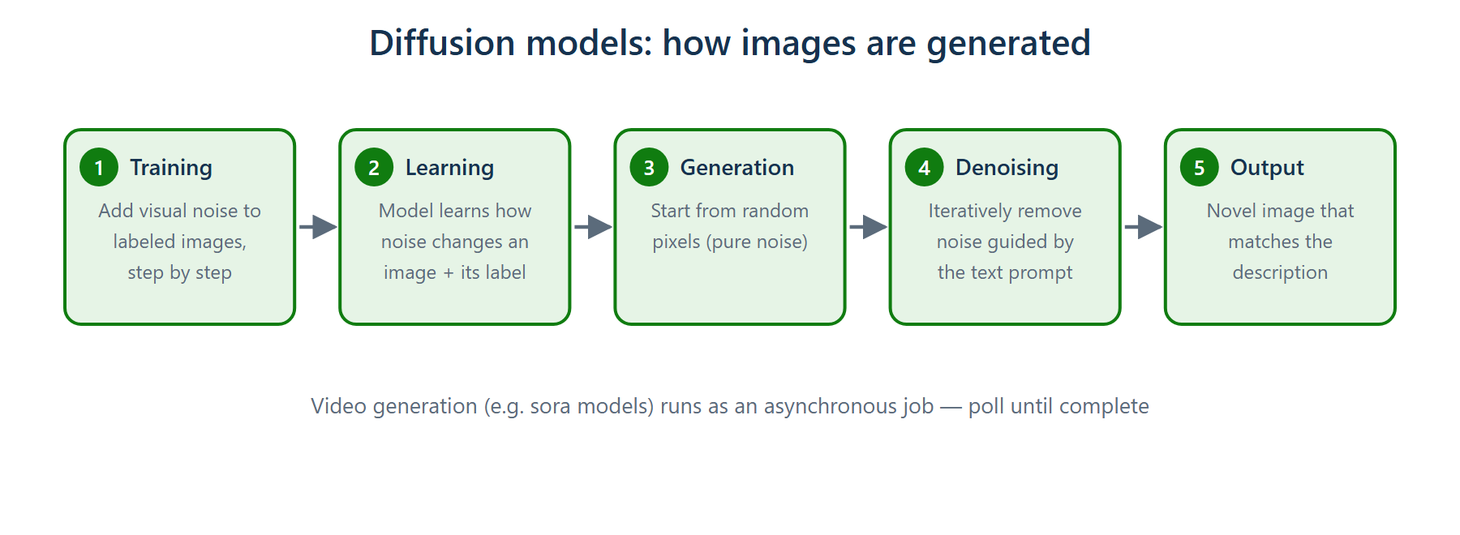
Image generation — diffusion models
Train by adding noise to labeled images; generate by denoising random pixels toward the prompt

Slide 7
Image & video generation in Foundry
• Image generation: search the catalog for 'text to image' inference-task models (e.g. gpt-image family)
• Generate programmatically by sending prompts through the OpenAI Responses API to your deployed model
• Video generation: 'video generation' task models (e.g. sora family)
• Video runs as an asynchronous job — resource-intensive and slow, so you submit then poll for completion

Slide 8
Summary & exam pointers
• Task discriminators: locate → detection; per-pixel → segmentation; describe → contextual
• CNN filters extract numeric features (not visual effects)
• Multimodal = multiple input types in one prompt; images via URL or base64
• sora video jobs are asynchronous because generation takes time and resources
➜ Next: Module 6 — Information extraction

