Slide 1
MODULE 6
Information Extraction
OCR · field mapping · Azure Content Understanding · audio & video analysis
AI-901 Faculty Study Kit · original content from public Microsoft Learn documentation

Slide 2
What is information extraction?
• Analyzing unstructured content to identify and extract relevant fields and values
• Sources: documents & emails, business cards & receipts, invoices & contracts, images, audio, video
• Example: photo of a receipt → vendor, date and amount pre-filled into an expense claim
• Not the same as querying a database or copying files — the content starts unstructured

Slide 3
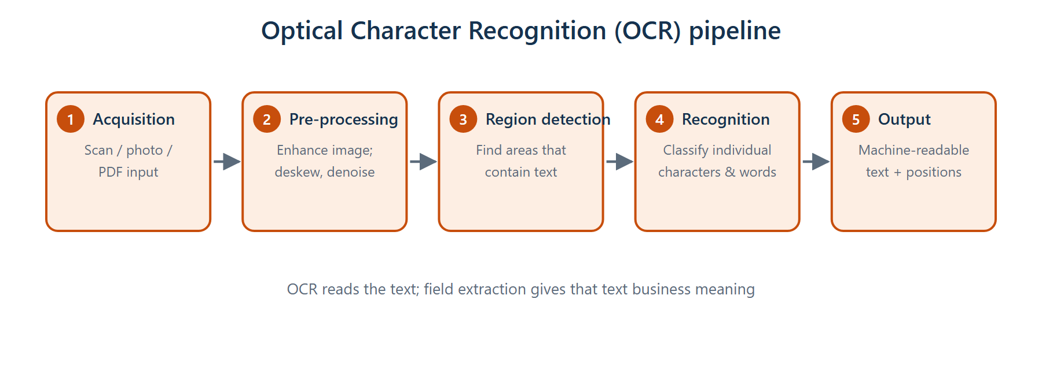
OCR pipeline
Acquisition → pre-processing → text-region detection → character recognition → text output

Slide 4
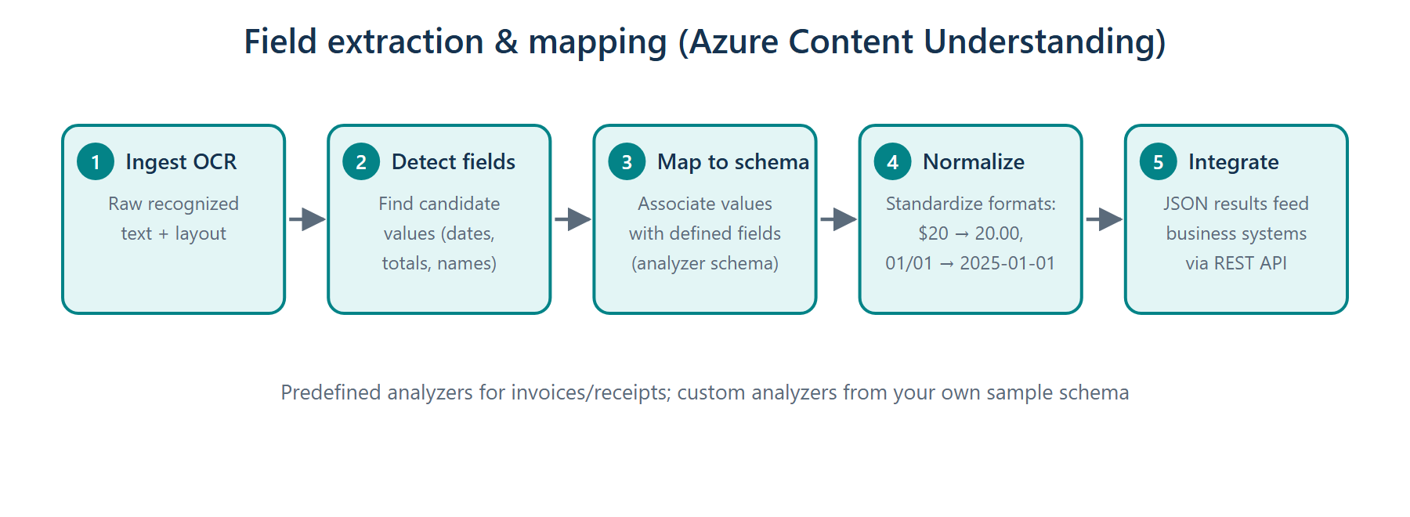
Field extraction & mapping
OCR ingestion → field detection → schema mapping → normalization → business integration

Slide 5
Generative AI in extraction
• Semantic language models match extracted values to data fields accurately
• Replaces hand-coded extraction rules per document type
• Normalization standardizes values: $20 → 20.00, 01/01/2025 → 2025-01-01

Slide 6
Azure Content Understanding in Foundry Tools
• Key advantage over plain OCR: understands document structure and maps data to a defined schema
• Analyzer = defines how content is processed and what structured data is returned
– Predefined analyzers — invoices, receipts, contracts, post-call recordings
– Custom analyzers — define your own schema from sample documents
• Results returned as JSON via the REST API
• Python SDK flow is asynchronous: submit content → poll a URL until the job completes

Slide 7
Audio & video scenarios
• Post-call analysis for contact centers (topics, sentiment, speakers)
• Voice-message automation
• Video call transcription and summary
• Video recording analysis
• Same analyzer concept — predefined or custom — applied to media

Slide 8
Summary & exam pointers
• OCR = images of text → machine-readable text; Content Understanding adds schema & structure
• Analyzer defines processing + output schema; confidence scores per field
• SDK results are polled, not returned inline
• You have now covered 100% of the AI-901 syllabus — go take the mock exams!
➜ Finish: run Quiz 6A/6B, then Final Mock Exams 1 & 2 in the portal

