Slide 1
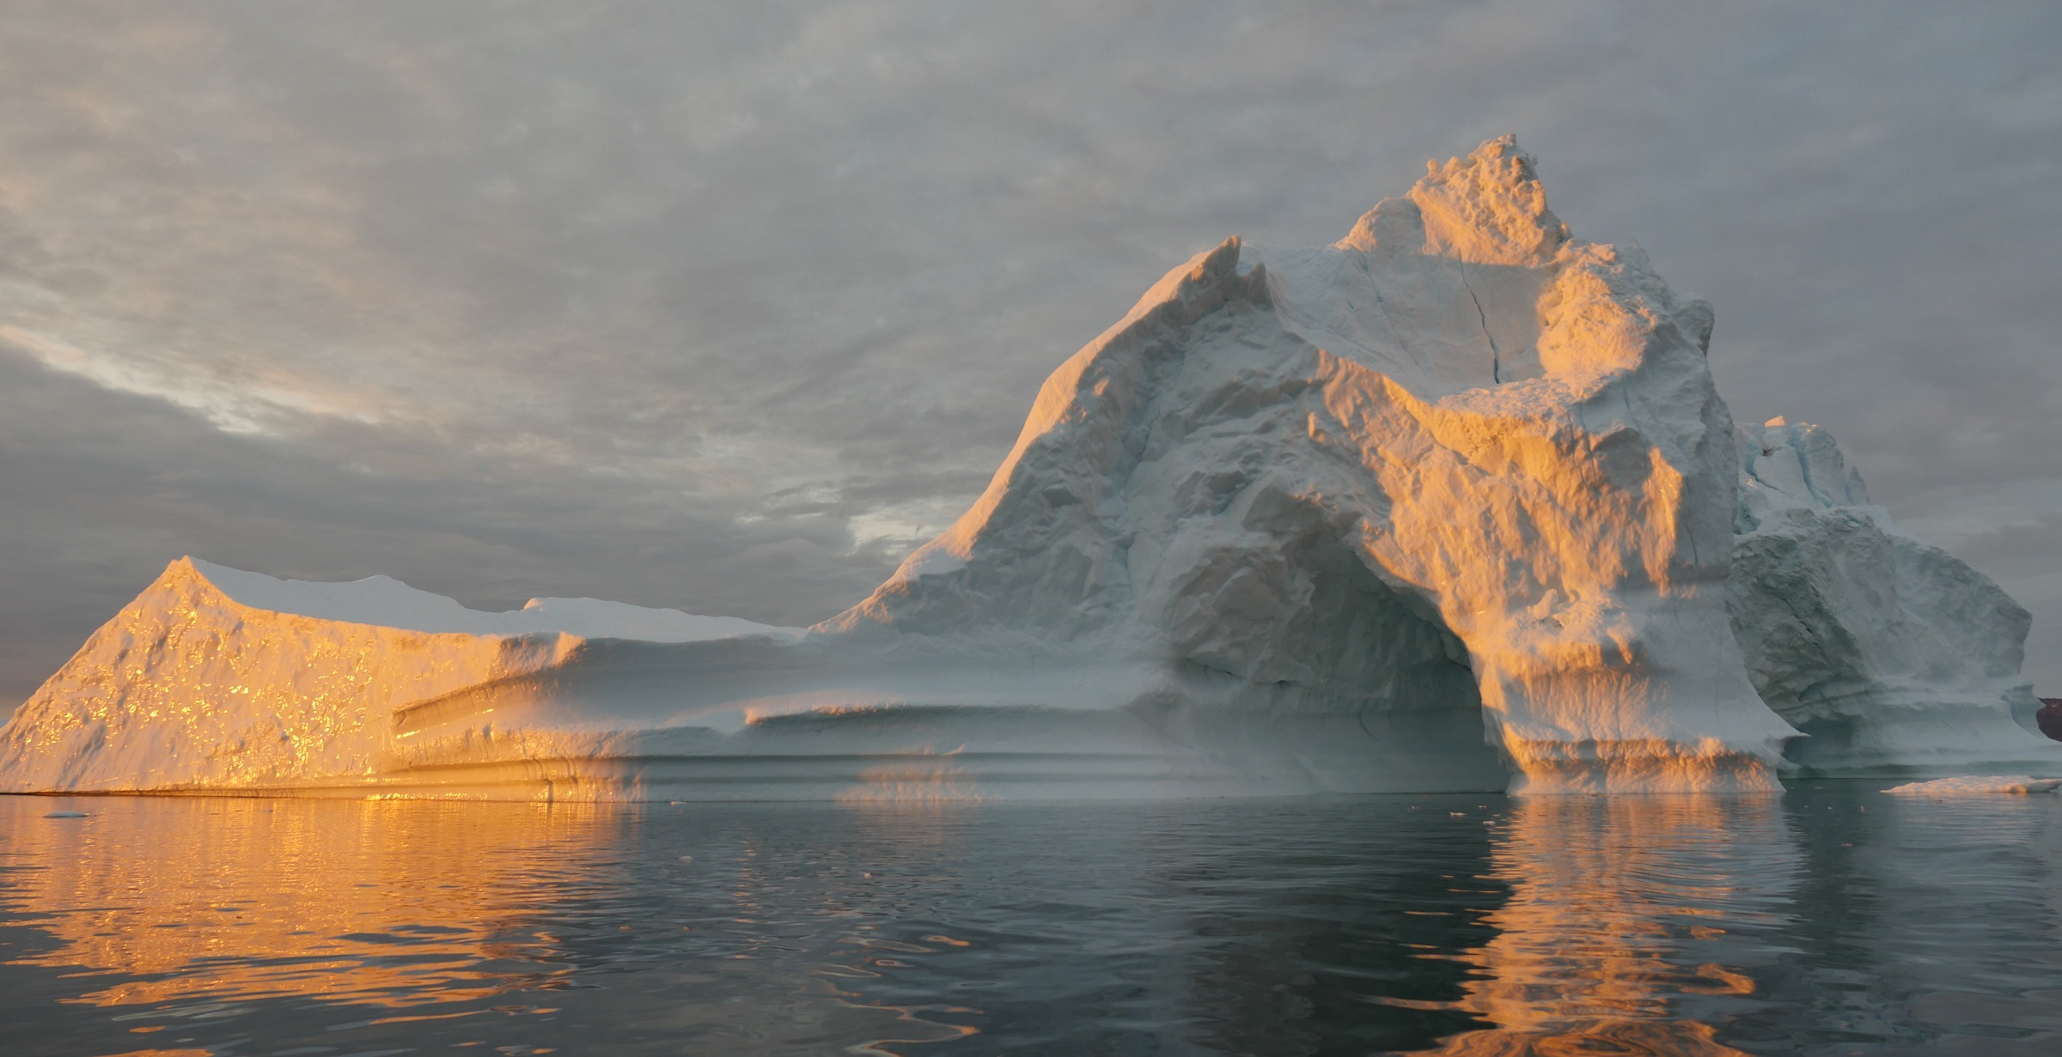
Ice Sheets & Climate
ATOC 4500/7500 - Spring 2020 - Prof. Jan Lenaerts

Slide 2
Ice Sheets & Climate
Lab 1: Reconstructing climate and ice sheets
a.k.a. Solving the 𝜹¹⁸O mystery
ATOC 4500/7500 - Spring 2020 - Prof. Jan Lenaerts

Slide 3
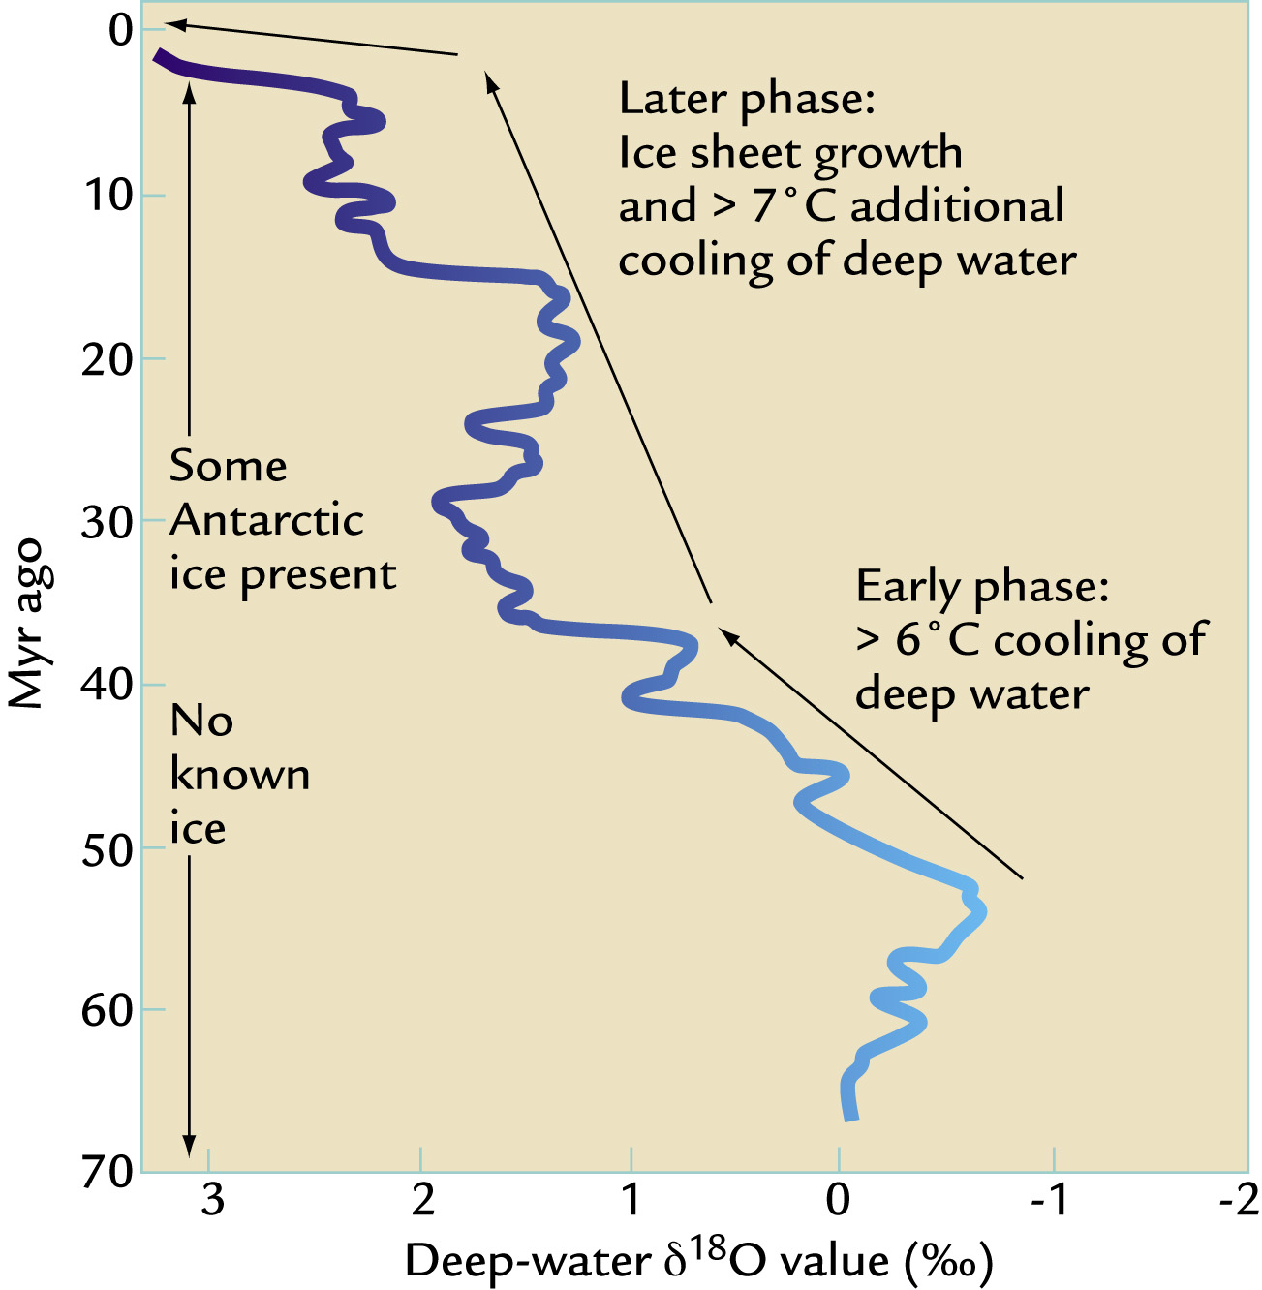
𝜹¹⁸O increases towards the present, as ice sheets grow and climate cools
But we also learned that 𝜹¹⁸O is temperature dependent, with higher values at higher temperatures.
How do we reconcile this?

Slide 4
𝜹¹⁸O increases towards the present, as ice sheets grow and climate cools
But we also learned that 𝜹¹⁸O is temperature dependent, with higher values at higher temperatures.
How do we reconcile this?
In precipitation (i.e. from the atmosphere)

Slide 5
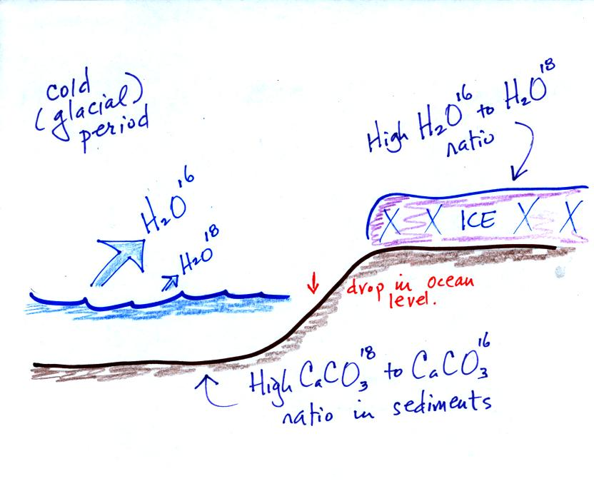
‘Heavy oxygen’ is harder to evaporate, especially in cold climate (little energy available)
Charles Weidman (U Arizona)

Slide 6
‘Heavy oxygen’ is harder to evaporate, especially in cold climate (little energy available)
Snow stored on ice sheets is depleted with ¹⁸O
Charles Weidman (U Arizona)

Slide 7
‘Heavy oxygen’ is harder to evaporate, especially in cold climate (little energy available)
Snow stored on ice sheets is depleted with ¹⁸O
Surface oceans are enriched in ¹⁸O
Charles Weidman (U Arizona)

Slide 8
‘Heavy oxygen’ is harder to evaporate, especially in cold climate (little energy available)
Snow stored on ice sheets is depleted with ¹⁸O
Low 𝜹¹⁸O
Surface oceans are enriched in ¹⁸O
High 𝜹¹⁸O
Charles Weidman (U Arizona)

Slide 9
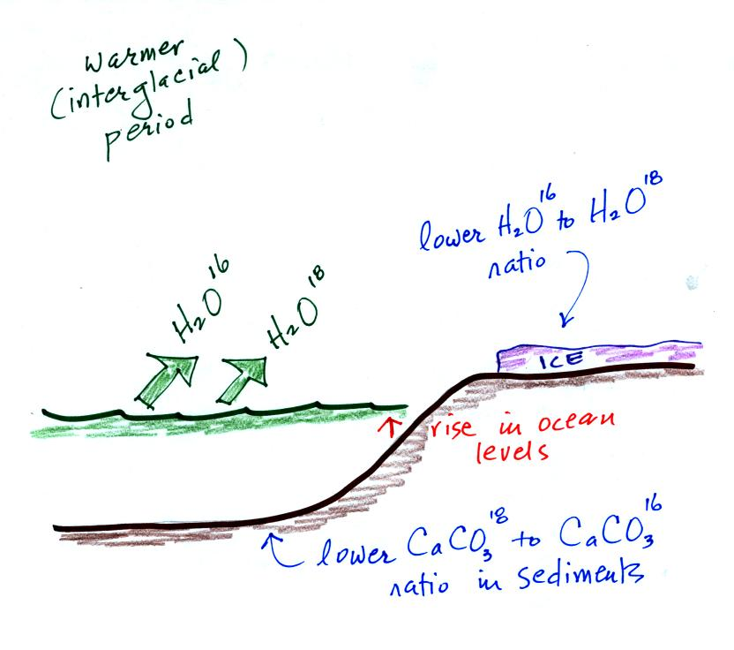
Precipitation on ice sheets is (relatively) enriched in ¹⁸O
High 𝜹¹⁸O
Surface oceans are (relatively) depleted in ¹⁸O
Low 𝜹¹⁸O
Charles Weidman (U Arizona)

Slide 10
Melting ice sheets affect 𝜹¹⁸O
Even higher 𝜹¹⁸O
Even more H₂O¹⁶ input
Even lower 𝜹¹⁸O
Charles Weidman (U Arizona)

Slide 11
Summary
¹⁸O evaporates less easily and precipitates more easily than ¹⁶O
At any time, 𝜹¹⁸O of precipitation decreases from equator to poles
At any place, 𝜹¹⁸O of precipitation is lower in cold climates than in warmer climate
𝜹¹⁸O in marine sediments (benthic 𝜹¹⁸O) lower, 𝜹¹⁸O in ice sheets higher in warmer climates.
Benthic 𝜹¹⁸O is combined result of changing temperatures and ice volume changes.
𝜹¹⁸O is a proxy for climate change, but many other factors are important

Slide 12
Analysis of oxygen isotopic ratios of ocean and atmospheric water oxygen isotopes has shown that ocean surface sea water becomes enriched in heavy oxygen due to the temperature-dependent evaporation process. It follows that sea creatures living in these waters will possess shells containing more heavy oxygen. The proportion of heavy oxygen in sea shells (consisting of calcium carbonate -- CaCO₃) will go up in years when the temperature is colder and will go down in years when the temperature is warmer (exactly the opposite behavior to the heavy oxygen in glacial ice discussed above).
https://globalchange.umich.edu/globalchange1/current/lectures/kling/paleoclimate/index.html

Slide 13
Lab 1: reconciling 𝜹¹⁸O records
Source 1: marine-based (benthic) global ‘stacked’ record of 𝜹¹⁸O (from calcite shells from forams) from ~67.5 million years ago to present.
Source 2: GISP2 record (Greenland) of 𝜹¹⁸O (from ice isotopic composition) from ~120,000 years ago to present.
Source 3: Dome Fuji record (East Antarctica) of 𝜹¹⁸O (from ice isotopic composition) from ~360,000 years ago to present.

Slide 14
Some tips to facilitate group work
Create and use a group Slack channel
Back up your files/code/etc. – use Google Drive, Dropbox, etc.
Ask questions to group and discuss respectfully
Explaining something to your group/another student can be super helpful, not only for them, but also for you!
Don’t hesitate to ask questions to me!
Lab = group work // Homework = individual work

