Slide 1
JSHint
Brian Reynolds

Slide 2
JSHint
JSHint is a program that flags suspicious usage in programs written in JavaScript. The core project consists of a library itself as well as a CLI program distributed as a Node module.
JSHint is a community-driven tool that detects errors and potential problems in JavaScript code. Since JSHint is so flexible, you can easily adjust it in the environment you expect your code to execute. JSHint is open source and will always stay this way.
Since it is community-driven, it is designed to be more flexible for the user. Its use of flags, directives, and configuration files give the user more control over their results.

Slide 3
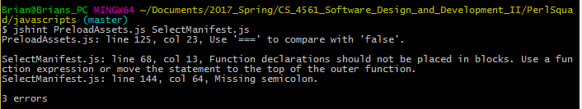
JSHint - Command Line Analysis - PreloadAssets.js SelectManifest.js

Slide 4
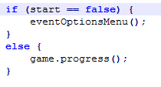
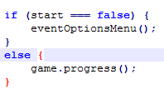
PreloadAssets.js - Fixes

Slide 5
SelectManifest.js - Fixes

Slide 6
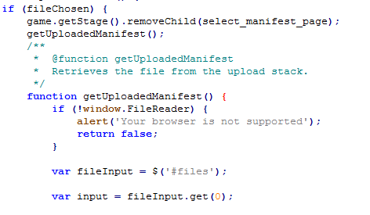
SelectManifest.js - Fixes (Cont.)

Slide 7
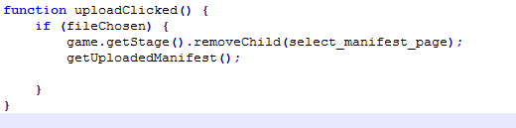
SelectManifest.js - Fixes (Cont.)

Slide 8
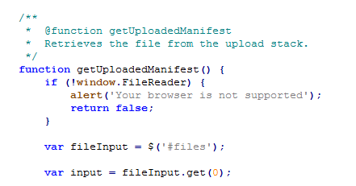
SelectManifest.js - Fixes (Cont.)

Slide 9

JSHint - Command Line Analysis Complete - PreloadAssets.js SelectManifest.js

Slide 10
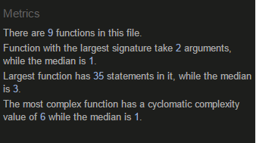
JSHint - Module Analysis - PreloadAssets.js

Slide 11
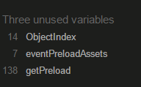

JSHint - Module Analysis - PreloadAssets.js (Cont.)

Slide 12
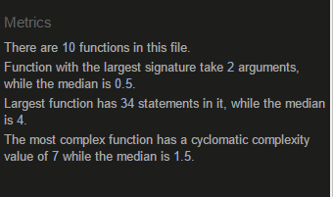
JSHint - Module Analysis - SelectManifest.js

Slide 13
Reflection - Static Analysis with Javascript
Performing static analysis on javascript is inherently different from most other static analysis. Javascript is a dynamically typed language, and as such, getting non-trivial feedback from any static analysis tool can prove difficult.
Still, trivial mistakes, while often overlooked, can pile up over time. If there are too many, it can cause unexpected and potentially uncaught errors and put a huge dent in performance.
JSHint provides a great way to analyze javascript for problematic code.

