Slide 1
CreateJS (EaselJS, PreloadJS)
PerlSquad (Game)

Slide 2
CreateJS
A suite of modular libraries (EaselJS, PreloadJS, TweenJS, and SoundJS) and tools which work together or independently to enable rich interactive content on open web technologies via HTML5.

Slide 3
EaselJS
A JavaScript library that makes working with the HTML5 Canvas element easy.
http://createjs.com/easeljs

Slide 4
PreloadJS
A JavaScript library that lets you manage and co-ordinate the loading of assets.
http://createjs.com/preloadjs

Slide 5
TweenJS
A JavaScript library for tweening and animating HTML5 and JavaScript properties.
Have not utilized this library as of yet, because there has not been much need for animation
http://createjs.com/tweenjs

Slide 6
SoundJS
A JavaScript library that lets you easily and efficiently work with HTML5 audio.
Have not utilized this library as of yet, because adding sound to the game is very low on our priority list.
http://createjs.com/soundjs

Slide 7
Other Tools - Zoë
An AIR application for exporting SWF animations as EaselJS spritesheets for use in Canvas and CSS. Maintain frame labels, reuse similar frames, and more
http://createjs.com/zoe

Slide 8
Other Tools - Adobe Animate
Helps build interfaces, animations, and asset libraries, and export directly to CreateJS.
https://helpx.adobe.com/animate/using/creating-publishing-html5-canvas-document.html

Slide 9
Alternate Considerations - Scratch
Scratch - A visual programming language developed by MIT Media Lab to create animations, games, etc. with sprites.
https://scratch.mit.edu/projects/editor/?tip_bar=home

Slide 10
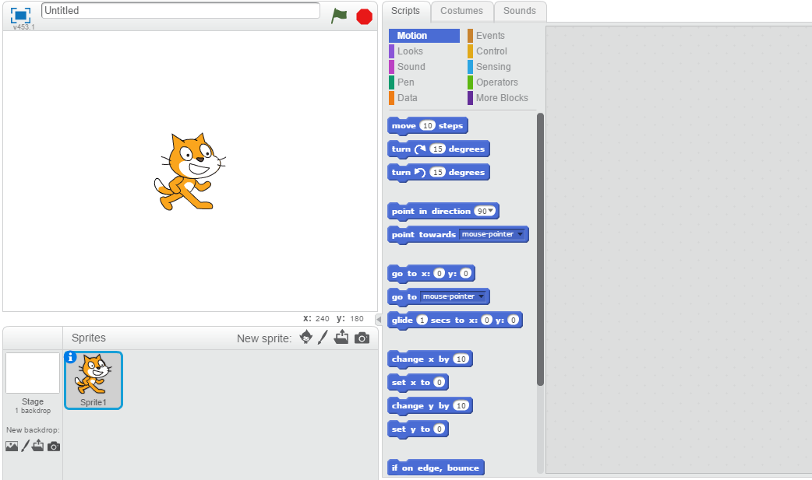

Slide 11
Why Not Scratch?
Scratch is a purely visual programming language
Would be difficult to integrate with learning the principles of software design as well as the requirements of the class

Slide 12
Alternate Considerations - Phaser
Phaser - Desktop and Mobile HTML5 game framework
https://phaser.io/

Slide 13
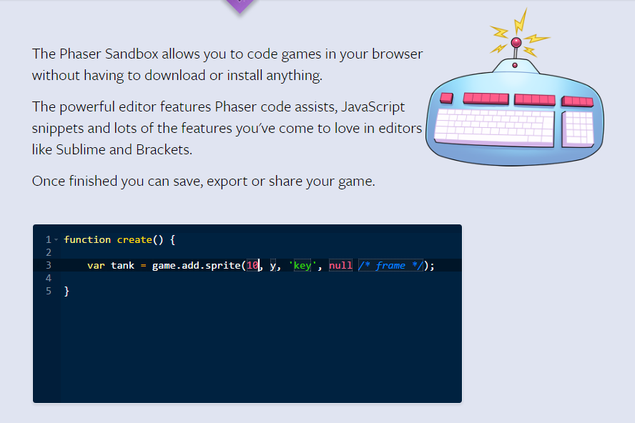

Slide 14
Why Not Phaser?
It is a lot
How long will it take to learn?
CreateJS has better documentation

Slide 15
Alternate Considerations - Pixi.js
Pixi.js - A rendering library that will allow you to create rich, interactive graphics, cross platform applications, and games without having to dive into the WebGL API or deal with browser and device compatibility.

Slide 16

http://pixijs.github.io/examples/

Slide 17
Why Not Pixi.js
Very comparable in terms of power; however, relatively weak in terms of documentation
http://www.pixijs.com/

Slide 18
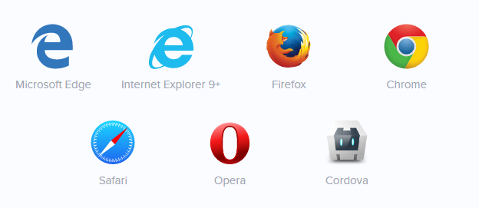
Why CreateJS?
CreateJS…
Is heavily documented
Is highly supported
Has a large user community
Covers most of our needs without extra complexity

Slide 19
How to Access
CreateJS is easy to access
Libraries can be downloaded to a hard drive (recommended) and referenced by file path or accessed by URL from a <src> HTML tag

Slide 20
PreloadJS Classes Used
AbstractLoader
LoadQueue

Slide 21
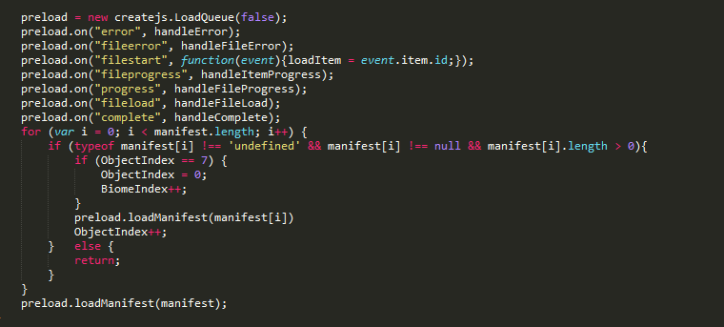
LoadQueue Usage
Tells javascript that it wants to start a new loading queue to be processed with tag loading.

Slide 22
LoadQueue Usage
Tells javascript how to process different events.

Slide 23
LoadQueue Usage
Tells javascript that the queue should use the manifest array as its loading manifest.

Slide 24
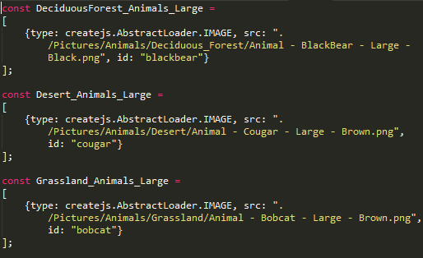
AbstractLoader Usage
Tells javascript that the object being preloaded is an image (supports most standard formats)

Slide 25
EaselJS Classes Used
DisplayObject
Draw things
Text, Bitmap, Shape, etc…
Ticker
Make things move

Slide 26
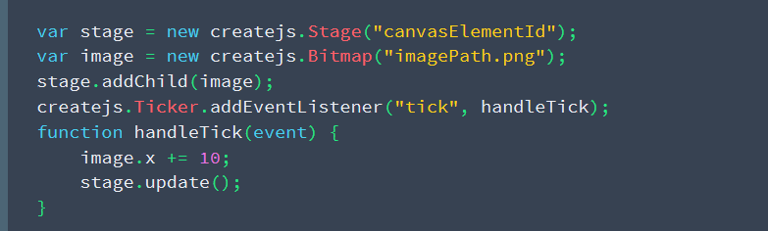
DisplayObjects (Text, Bitmap, etc…)
Abstract the HTML5 canvas to a Stage object

Slide 27
DisplayObjects (Text, Bitmap, etc…)
Add an image to the screen

Slide 28
Ticker (Making things move)
Assign a function to execute every “tick”

Slide 29
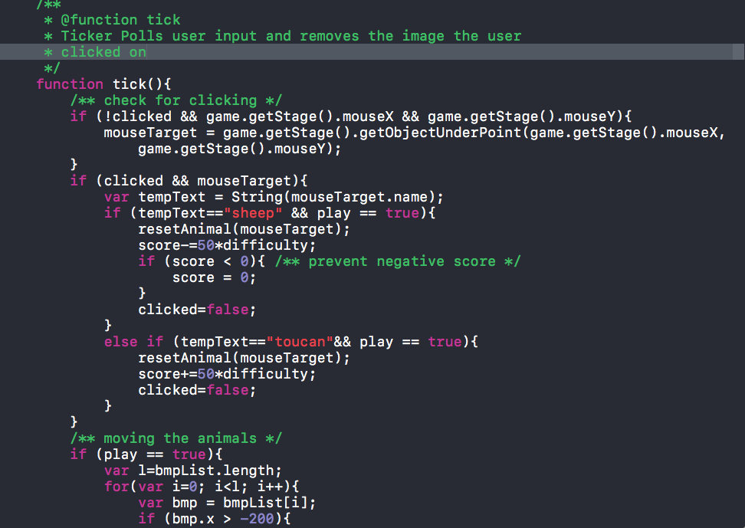

Slide 30
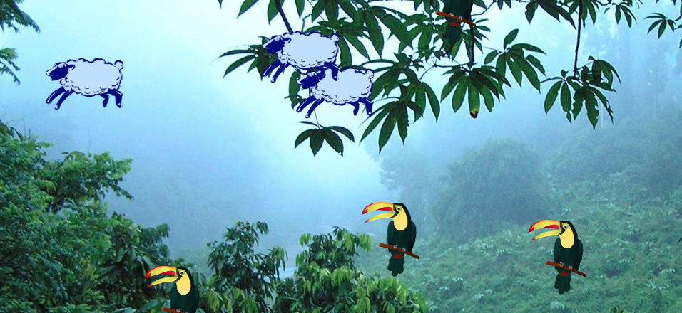

Slide 31
Ticker (Making things move)
Implement that function

Slide 32
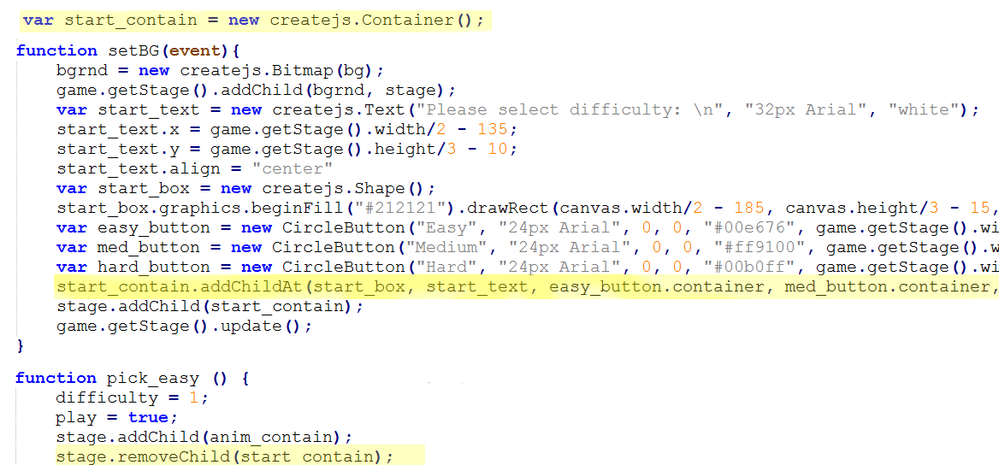
Container Usage
Containers useful for keeping track of and adding/removing game objects from the stage/canvas (what you see on the screen).
Ex: Minigame buttons - removed when game starts

Slide 33

Graphics Usage
Tells javascript that we want to draw a rectangle of specific size at specific coordinates and fill it with a specific color.

Slide 34

Text Usage
Tells javascript that we want to create specific text of a specific color with specific font and size.

Slide 35
Text Usage
Tells javascript the alignment, which makes the next part more accurate and simpler

Slide 36
Text Usage
Tells javascript the coordinates. If the text is not centered and in the middle, then this is harder to guess, because it’s offset.

Slide 37
Drawbacks
While CreateJS is supported across all major browsers, certain features aren’t supported in certain browsers
Shape class does not support automatic boundary getting
Some other HTML5 display objects don’t cooperate well with canvas

