Slide 1
Jasmine
PerlSquad (Game)

Slide 2
Jasmine
Jasmine is a behavior-driven development framework for testing JavaScript code. It does not depend on any other JavaScript frameworks. It does not require a DOM. And it has a clean, obvious syntax so that you can easily write tests.
Very lightweight. Standalone requires no installation

Slide 3
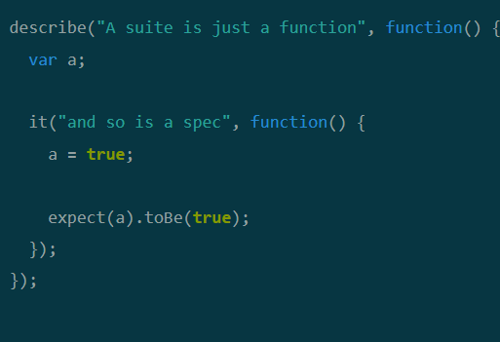
A very basic test suite in Jasmine
Describe functions can be used to group related specs together
Provides more organized feedback when tests are ran
Supports nesting of describe functions

Slide 4
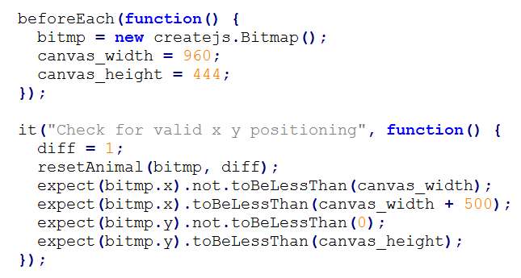
Expectations & Matchers
The expect function takes an actual value of a variable in JavaScript and uses one of several matchers to compare it to an expected value given by the tester.
Ex: resetAnimal

Slide 5
Pre-defined matchers (not an exhaustive list):
toBe - compares structural equality (===)
toEqual - compares equality of values (==)
toContain - checks if array contains expected value/item
(also supports checking strings for substrings)
toBeLessThan/toBeGreaterThan - mathematical > or < comparison
toBeCloseTo - takes an additional argument specifying range of acceptable values near expected value
toThrow - expects an exception to be thrown
toMatch - compares result to a regular expression

Slide 6
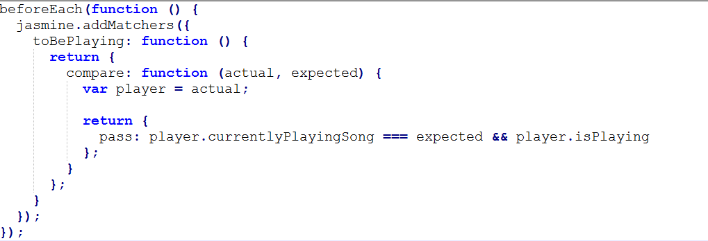
Jasmine also supports custom matchers

Slide 7
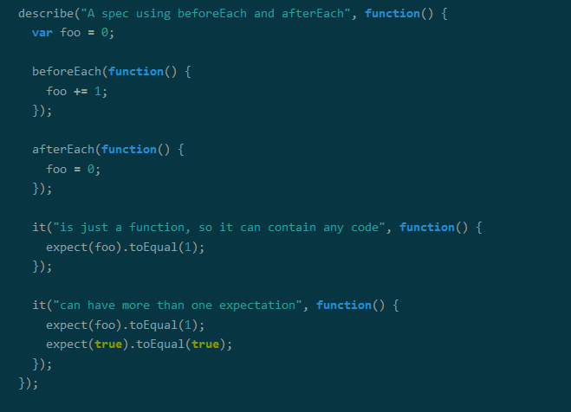
“Setup” and “Teardown” functionality
Jasmine also contains functions that can be ran before and after each test to “set up” certain variables and to reset or “tear them down” afterwards

Slide 8
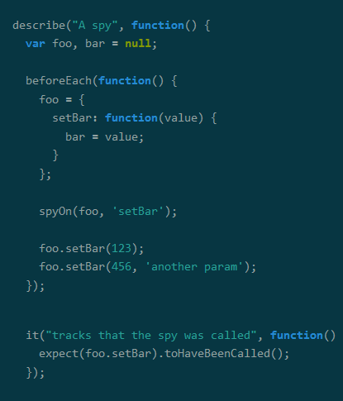
Spies
“Spies” can track functions to see if they have been called, as well as how many times they may have been called, and what arguments, if any, they were called with

Slide 9
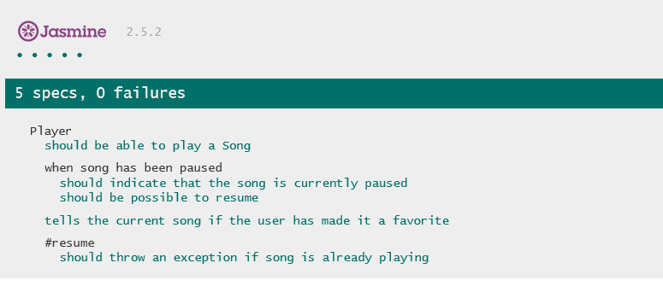
Testing framework
Jasmine includes a Spec Runner HTML file that provides feedback on what specs passed or failed, as well as additional options, such as running the tests in random order, or stopping as soon as a test fails

Slide 10
Unit tests in EaselJS/PreloadJS
Normally Jasmine can’t compare images, which is fine if used to check values of variables/return values in code, but jasmine in itself can’t tell if the code is displaying the expected image
Fortunately, the developers of CreateJS made a test suite to use with EaselJS using js-imagediff in addition to jasmine to compare images drawn in EaselJS to what the image is expected to look like

Slide 11
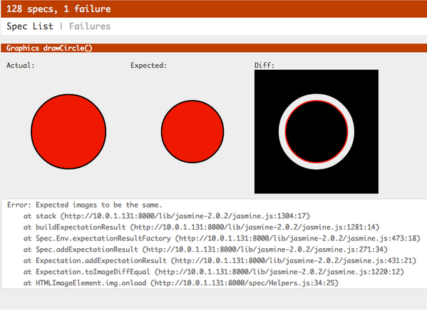
Unit tests in EaselJS/PreloadJS

Slide 12
Jasmine alternatives
Mocha
Runs on Node.js in a web browser
Powerful, but requires installation through Node.js
QUnit
Can be used without downloading by linking the framework in a HTML file
Can also be downloaded as a standalone, but requires a bit more setup
Linking to framework makes offline testing difficult
Overall, fairly similar to Jasmine

Slide 13
How can I use Jasmine for my project?
https://jasmine.github.io/
Has standalone with sample specs and sample JavaScript files that can be immediately ran in a web browser once downloaded - no installation
Support for various languages and environments:
Python
Ruby
Node.js

