Slide 1
Analytics using Segment
Alex Mayle - PerlSquad

Slide 2
What is Segment?
http://segment.com
“Collect all of your customer’s data, and send it anywhere.”
Can be used to collect data from within web, desktop, or mobile apps using any popular language
This talk will particularly be about collecting data from web apps using javascript

Slide 3
What Kind of Data Can be Collected?
Metadata such as timestamps and page hits are automatically tracked, similarly to Google Analytics
Easily identify users using the identify() call
Keep track of arbitrary events and data using the track() call
For mobile apps
Track when a user switches between screens (iOS) / activites (Android)
Automatically tracks when users open / close / use the app

Slide 4
Where Does the Data Go?
To Segment’s servers
From here you can send it almost anywhere
Dump into a full fledged database (Postgres, AWS red shift, etc…)
Send to Keen.IO or others for easy visualization
Send to other 3rd party analytics tools like Heap
Send to performance tracking tools
Many more options...

Slide 5
Use Case: Identifying Users Anonymously & Keeping Track of their Data
Sometimes you want to tie data to a particular user, but we really don’t know much about the user.
Solution: Give them an anonymous user ID and use it to associate other data with the user.
This is easy with Segment

Slide 6
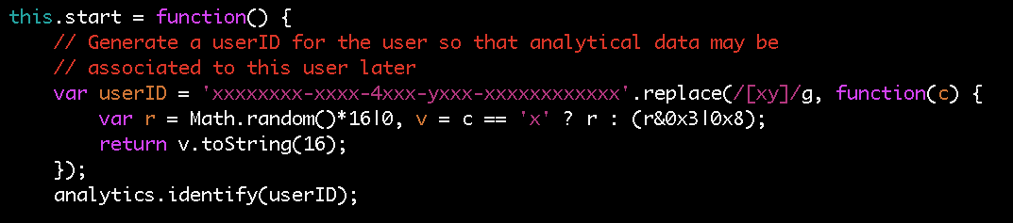
The Code: Identifying the User
Let’s walk through it

Slide 7
The Code: Identifying the User
This function is called when the game is started, which is when we want to start tracking user data

Slide 8
The Code: Identifying the User
Generate a UUID (Universal User ID) so we may identify this user anonymously and keep their data together

Slide 9
The Code: Identifying the User
Send this identity to Segment’s servers so that all following data is associated with this user

Slide 10
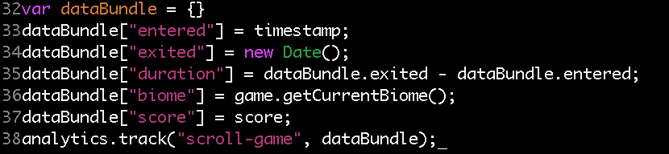
The Code: Gathering the Data
Now we have to send the particular data we want to Segment’s servers. This will automatically be tied to user ID

Slide 11
The Code: Gathering the Data
Create an empty JSON object to put data in

Slide 12
The Code: Gathering the Data
Fetch the data you would like to report from the various sources within your application and add them to the JSON object

Slide 13
The Code: Gathering the Data
Sent it to Segment’s servers with an event identifier. Here, it is “scroll-game,” so we know what the user was doing when this data was sent.

Slide 14
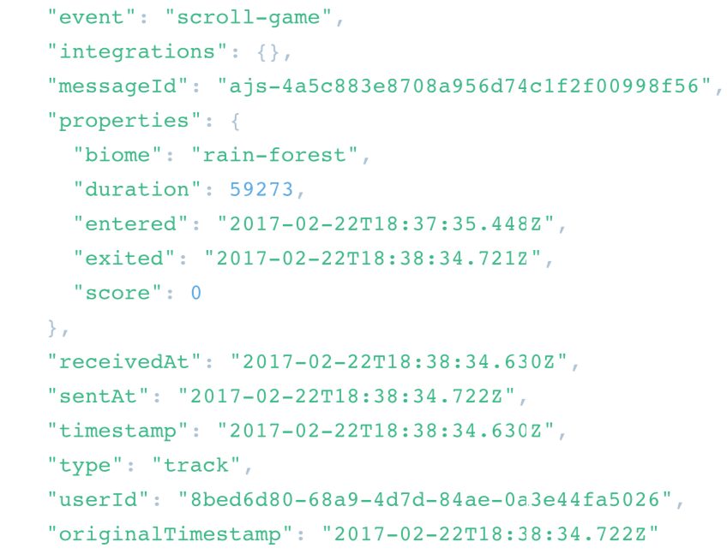
Looking at the Data on Segment.com
Event Name
Data We Sent
Metadata (excerpt)
Anonymous user ID

Slide 15
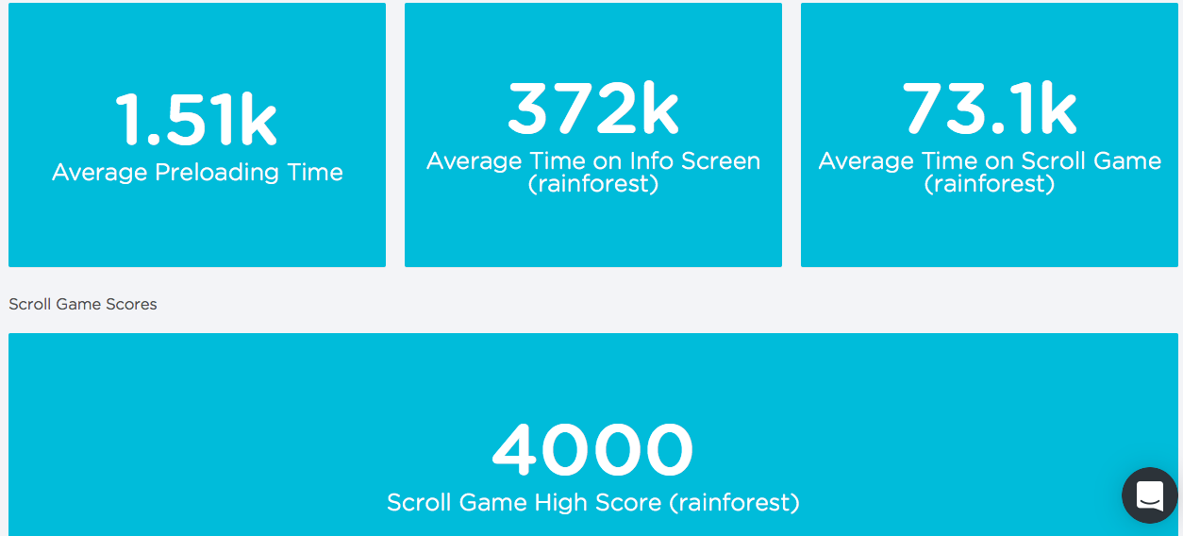
Visualization
Easily send data to other 3rd party tools for visualization
We used keen.IO to set up a visualization dashboard, no extra code required.

Slide 16
Comparison to other Technologies
Lightweight compared to Google Analytics, etc…
Very flexible, if you want to do something with your data, just send it from Segment to another service or database
Easy: It took one evening to fully deploy
Free
Not a standalone solution. A fully featured analytics suite will most likely combine Segment with other services (i.e. keen.IO)

Slide 17
How to Use With Your Project
Visit http://segment.com
Pick the API that is right for your project (iOS, Android, Web, Desktop…)
Follow the easy installation instructions and begin sending your data
Finally, choose where you want to send your data from Segment, be it a database or some other 3rd party app

