Slide 1
Support IT
Eric Kiennemann
Notes:
1) Who I am
2) Goal of today
Last year experience show me that you can loose time dealing with software
For the first 6 months if you are familiar with software you will win time
For your internship, you will be supposed to be familiar with IT environment
You must have time to focus on DataScience/Data Engineer / DataAnalyst subjects
You will see that there is always 2/3/4 different ways to do somethings : different tools, different libraries, different technology ….
My view is that is it important to master one way of doing things but to be open to other ways because on your intership / futur job you won’t be able to choose.
When I say master it is not « use » it means « understand how it works »

Slide 2
Github : to show your work
https://github.com/
Create a repository with the same name as your account
Describe yourself in the README.md file
Create a repository for each of your projects
Always take care of the README.md file : This is the entrypoint of your work
Select your most interesting projects and « pin » them in your first page
Notes:
Créer avec kiennemann.eric@orange.fr

Slide 3
Github : create a new repository
Choose “Public”
Check “Add a Readme file”
Edit the “About” of your repository with
A description
Add / remove a file
No “Save” button but “Commit” … ?
Create sub folders in your repository (not so easy !)
Try then to remove subfolders !

Slide 4
Github : basics about Readme.md file
Markdown language
Titles # / ## / ###
Lists “*”
Bold “**<text>**”
Code `<text>`
….
Notes:
Check FirstRepository on HyperV

Slide 5
Github : advanced about Readme.md file
Link to a folder or web site ….
“## [Word Document](Word/Readme.md)”
Inserting images
Create a folder for “Images”
Import an image (jpg/png) in it
“![Nice Image](.//Images/Emerging-job-roles-in-artificial-intelligence.jpg)”
Tables
Use “|” and “-” symbols to build your table
Look on google to find Markdown tables generator (plugin in Visual code for instance)
Notes:
Use Preview to see the result

Slide 6
Github : advanced about Readme.md file
Run a jupyter notebook
Github can display your notebook
But Github can’t run your notebook
A solution : you can use “Binder” for instance
Upload your jupyter notebook file in github
Go to “Binder” web site : https://mybinder.org/
Try to fill the parameters to get an url from binder (cheetpage, next slide !)
Insert this url in your readme.md file
Does it works ? why ?
Notes:
Pip freeze > requirements.txt
Put it on « binder » folder
Survey do not work : no input file
Calibration is ok

Slide 7
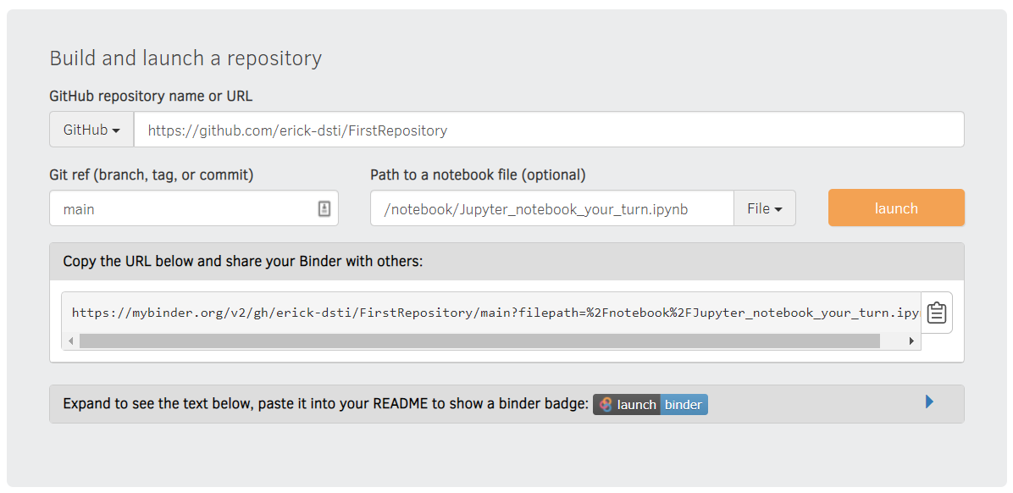
Github : advanced about Readme.md file

Slide 8
Github : advanced about Readme.md file
Using Microsoft Word and convert it to md file
Install pandoc : https://github.com/jgm/pandoc/releases/tag/2.13
Create a small script to run the conversion
chcp 65001
pandoc --extract-media ./ -s %1.docx -t gfm -w gfm -o %1.md
Create a small word (docx) file with images and convert it to md file
Import it on github and look at the result
Notes:
https://github.com/jgm/pandoc/releases/download/2.13/pandoc-2.13-windows-x86_64.msi
Installed in c:\users\eric\Appdata\local\pandoc
Script file FromWordToMd.bat
chcp 65001
pandoc --extract-media ./ -s %1.docx -t gfm -w gfm -o %1.md
Exec dans cmd : FromWordToMd WordDocument
Ou depuis windows mais mettre à jour le .bat avec le nom du fichier
Everything is in c:\users\eric\pandoc on hyper eric/07077oek

Slide 9
GIT : Basis – local installation
Definition : Git is a software for tracking changes in any set of files
Installation for windows :
https://gitforwindows.org/
Visual Studio as default editor or other
Overide with “main” default branch name (what is used in github now)
Use default console windows
Type “git” on a CMD windows to confirm setup is ok

Slide 10
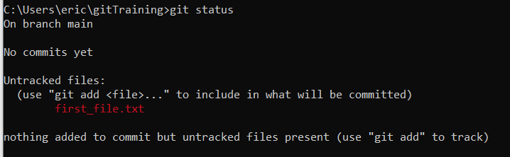
GIT : Basis – first steps
git config --global user.name "Mon Nom" git config --global user.email "votreemail@votreemail.com"
Define your name and email (mandatory)
git config --global user.name "<your name>"
git config --global user.email "<your email>"
git config --list
“Follow” a folder with GIT
Create a folder and get in it
Execute “git init”
Check the folder “.git” that has been created (size 23.3kb)
Create a file in this folder and execute “git status”
Notes:
In c:\users\eric
Name : Eric Kiennemann
Email : kienkai0511@free.fr
Mkdir gitDsti
Cd gitDsti
Git init
Systeminfo > first_file.txt

Slide 11
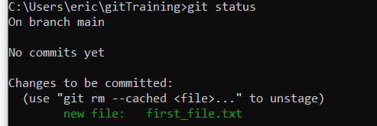
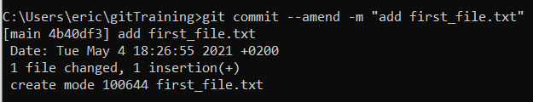

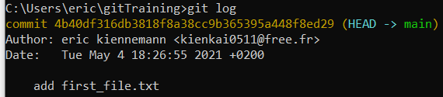
GIT : Basis – first steps
git config --global user.name "Mon Nom" git config --global user.email "votreemail@votreemail.com"
Track a file (stage)
git add <file, repositary, wild card>
Commit a file
git commit –m <message>
See the history of commit
Git log
Notes:
Git add first_file.txt (« git add . », add all the files
Git commit –m « add first_file.txt »
Git commit : open visual code and enable to type the message
« git commit –a » addand commit at the same time
Git log
Modify the last(=first) commit :
git commit --amend -m "add first_file.txt“
Attention : not possible to reset the first commit

Slide 12
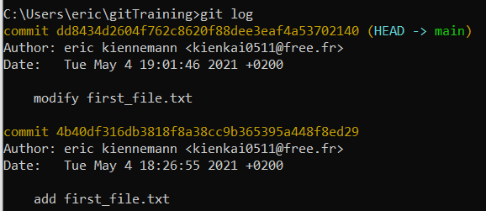
GIT : Basis – first steps
git config --global user.name "Mon Nom" git config --global user.email "votreemail@votreemail.com"
Modify the file / stage the file / commit the file
“reset” your last commit = cancel the modification you have done to the file
git reset --soft HEAD~1
Check the “status”, check the “log”, check your file
Try “reset” (without soft) and “reset --hard”
Test “git revert <commit id>” what is the difference ?
Notes:
Modify the file
Git add …
Git commit …
Git reset --soft HEAD~1 : back to staged, stay in index
Git reset HEAD~1 : back to unstaged, remove from index
Git reset --hard HEAD~1 : suppress modification
~1 : un en arrière
~2 : 2 en arrière
Git checkout <commit id> mais le HEAD sur ce commit : raffraichit en fonction
Git log –all to see all the commits, even the next ones --- « git checkout main » to come back to the end of the branch
Git revert <commit>, add a new commit with the deletion of the previous => change the file
To unstage :
Git restore –staged . Or <file>
Git reset HEAD .

Slide 13
GIT : branches
git config --global user.name "Mon Nom" git config --global user.email "votreemail@votreemail.com"
Use branches when you wan to add a new feature to your work
« git branch <branch name> »
Classical use case : “you are asked to work on a new feature, it will take you at least 2 weeks. Two days later, an urgency in production, you have to fix it quickly, when finished you go back to your feature work”
main
When the feature is finished : Merge your file with main !!
Keep on working on your feature : modify the file and commit it
Modify the file and commit modification
Create a branch for the hot fix in production
Modifiy the same file for the hot fix !
And commit it
Merge with the main branch
Your feature branch is merged : you can suppress the branch
When the branch is merged into main, you can suppress it
Git initialisation with one file in the folder
Init
Modify file & commit
Merge two modification
Create a new branch for your new feature
Prod_fix
Modify file & commit
Modify file & 2nd commit
New_feature
Notes:
Git branch first_branch
Git checkout first_branch or git checkout –b first_branch
Git branch to see where I am
Modify the file
The file is modified in both main / first_branch
Stage the file
The file is modified in both main / first_branch
Commit the file in first_branch
The file is modified in first_branch
The file is NOT modified in main
Use « git bash » tool to see your branch
Git branch –d <branch> to remove locally
Git checkout main / Git branch second_branch /git checkout second_branch
Modifiy file => no more possible to go back to « first_branch »
Git commit –m « commit second branch » => again possible to go to first_branch
=> validate your work before changing branch
git log --graph –oneline --all

Slide 14
GIT : the merge process
git config --global user.name "Mon Nom" git config --global user.email "votreemail@votreemail.com"
Your turn
Reproduce this on your git folder
And try « git merge <branch> » command.
What happens when you want to merge the new_feature branch ?
Notes:
Do git log --graph –oneline –all, at different step
Git checkout, change the HEAD pointer from a branch to another
other thing to do : 1 file
prod.txt
add line in new_feature and hot_fix
On new_feature modify an existing line
git add .
git commit -m "first commit 2 files"
git branch new_feature
git checkout new_feature
<modify file>
git add .
git commit -m "modify 2 files in my_feature"
git checkout main
git branch hot_fix
git checkout hot_fix
<modify file>
git add .
git commit -m "modify 2 files en hot_fix"
git checkout main
git merge hot_fix
git branch -d hot_fix
git checkout new_feature
<modify prod.txt>
git add .
git commit -m "second change prod.txt from new_feature"
git checkout main
git merge new_feature
* everything ok
* conflict
+ git status, pour contrôler
+ look at the files
+ do it manually or with "git mergetool"
git add .
git commit # run vscode
git log --graph --oneline
git branch -d new_feature

Slide 15
GIT : with VisualCode
git config --global user.name "Mon Nom" git config --global user.email "votreemail@votreemail.com"
Create a new repository to follow and get in it
Run vscode from this repository
All the process we have done can be done inside Vscode in a more friendly way
File « grades.py » from moodle
Branch new_feature
Add a congratulation text when grade is A
Add a “E” grade from 40 to 49, “D” from 50 to 69
At the same time correct the error “65” instead of 60 for “D” grade
Create a “hot_fix” branch
Notes:
other thing to do : 3 files
Take file
prod.txt
* add line in new_feature and hot_fix
override.txt
overide the line : This text will be modified by the new feature and the hot fix
git add .
git commit -m "first commit 2 files"
git branch new_feature
git checkout new_feature
<modify two files>
git add .
git commit -m "modify 2 files in my_feature"
git checkout main
git branch hot_fix
git checkout hot_fix
<modify two files>
git add .
git commit -m "modify 2 files en hot_fix"
git checkout main
git merge hot_fix
git branch -d hot_fix
git checkout new_feature
<modify prod.txt>
git add .
git commit -m "second change prod.txt from new_feature"
git checkout main
git merge new_feature
* everything ok
* conflict
+ git status, pour contrôler
+ look at the files
+ do it manually or with "git mergetool"
git add .
git commit # run vscode
git log --graph --oneline
git branch -d new_feature

