Slide 1
Support IT
Eric Kiennemann
Notes:
1) Who I am
2) Goal of today
Last year experience show me that you can loose time dealing with software
For the first 6 months if you are familiar with software you will win time
For your internship, you will be supposed to be familiar with IT environment
You must have time to focus on DataScience/Data Engineer / DataAnalyst subjects
You will see that there is always 2/3/4 different ways to do somethings : different tools, different libraries, different technology ….
My view is that is it important to master one way of doing things but to be open to other ways because on your intership / futur job you won’t be able to choose.
When I say master it is not « use » it means « understand how it works »

Slide 2
GIT / GITHUB : Publish your code
git config --global user.name "Mon Nom" git config --global user.email "votreemail@votreemail.com"
Why ?
A way to show what you have done
A way to have a backup of your code
How ?
Create an empty repository on github and get its « address »
Connect your local git repository to this Github repository
On your local PC : «
Git remote add origin <git-address>
« origin » : the name of your connection to your github repository (in theory, you can have several connections to several github repository)
To send (push) your code from local (your PC) to remote (github) :
Git push –u origin main
Notes:
Git remote or git remote –v to see the parameters (attention it do not check the connection)

Slide 3
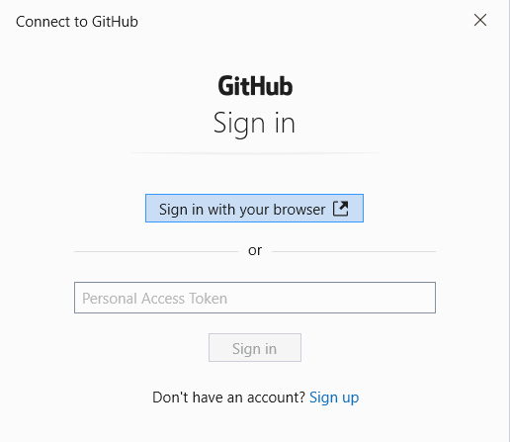
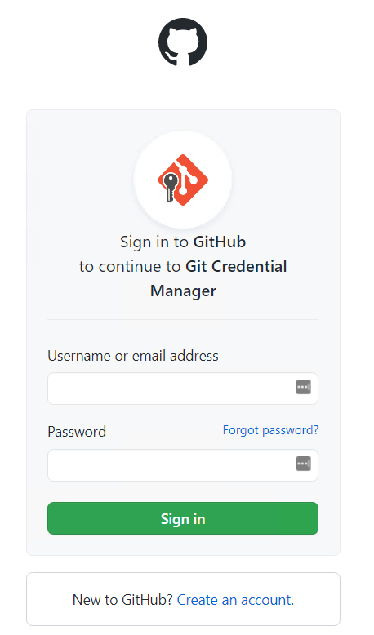
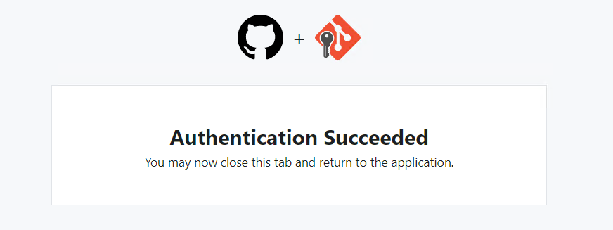
GIT / GITHUB : Publish your code
git config --global user.name "Mon Nom" git config --global user.email "votreemail@votreemail.com"
Windows Credential
Security layer to connect your local PC to your github account
When doing your first « push »
Check your windows credentials
Notes:
Git remote or git remote –v to see the parameters (attention it do not check the connection)

Slide 4
GIT / GITHUB : Publish your code
git config --global user.name "Mon Nom" git config --global user.email "votreemail@votreemail.com"
Check your github repository
Check the files
Check the commit « folder »
Now, after each local commit you can do a « push » to store your local data on github.
If you have local branches you can also push them to github ….
Usually you don’t modify files directly on Github (it’s always local -> remote), but for instance if you add a readme.md file on github
Go a « git fetch » and « git status » … what is the result ?
Get it on your local computer with « git pull origin main »
Notes:
Git remote or git remote –v to see the parameters (attention it do not check the connection)

Slide 5
GIT / GITHUB : Use Case
git config --global user.name "Mon Nom" git config --global user.email "votreemail@votreemail.com"
You find a nice DataScience development on Github and you decide to improve it. For this you build a DSTI team to work on it
Your project team menber Git Repository
Your project team menber Git Repository
Your project team menber Git Repository
Your project team menber Git Repository
Public Github Repository
Your Github Repository
Your Local Git Repository
1. Fork the project on your Github repository and add your team members as contributors
4. When your project is done. Send a Pull Request to the Public Github Repository that accepte it and Merge it to his project
3. Each member of the team modify locally the project and Push its modifications to Github
2. Each member of the team Clone the project from your Github to his/her local git repository
Notes:
If the remote reposory is yours, you are in the same situation as with a git remote, you can modify locally your files, commit, push ….
If the remote repository is not yours you can’t do push … only authorized to work locally
That’s why “git fork”

Slide 6
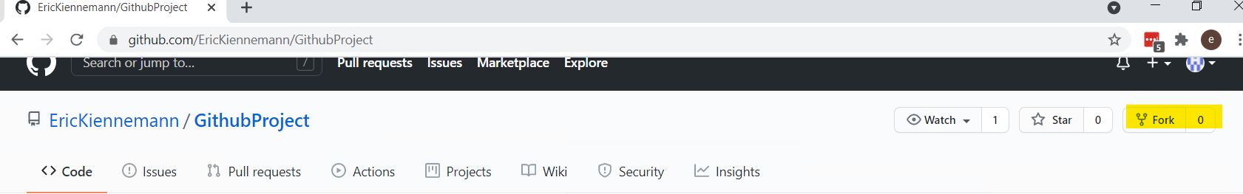
GIT / GITHUB : Fork
git config --global user.name "Mon Nom" git config --global user.email "votreemail@votreemail.com"
Your Github Repository
Public Github Repository
Why ?
To copy a github repository from someone else (public) to your github account
… most of the time you want to copy the code of someone else to modify / improve it
How ?
I will fork this repository : https://github.com/EricKiennemann/GithubProject
Notes:
After Fork, the repository becomes yours : you can do whatever you want on it.
Protect main and ask for one review

Slide 7
GIT / GITHUB : Clone
git config --global user.name "Mon Nom" git config --global user.email "votreemail@votreemail.com"
Yur project team menber Git Repository
Your project team menber Git Repository
Your project team menber Git Repository
Your project team menber Git Repository
Your Github Repository
Why ?
To copy a github repository (one of yours or a public one) locally
… most of the time you want to use the code of someone else
… in a company / team , to get the first version of the company code
How ?
Go to the Repository that I have just forked and get its « https adress »
Clone the repository with https (ssh out of scope) in a new folder
git clone <myRepository> (no need to git init, git remote … your local repository)
Execute locally the program
« python generate_analysis.py »
Your Local Git Repository
Notes:
Check git remote, git remote -vf
Virtualenv .venv
.\.venv\Scripts\activate
Pip install –r requirements.txt

Slide 8
GIT / GITHUB : Work locally and push
git config --global user.name "Mon Nom" git config --global user.email "votreemail@votreemail.com"
Your project team menber Git Repository
Proposed modifications
Add PyQT5 library in the requirements.txt file ( I will do it)
Add a « print » that confirms if printing to screen or printing to file
If printing to file give the link to the index.html file
Modify index.py to have a nicer html file
Modify code to remove the warning message on the console
…..
Your Local Git Repository
Notes:
Modify requirements.txt
pip install PyQt5
Modify index.html to make it nice
Modify launcing to print what is happening : print on screen or print on file ang give the html link to see the file
Ek do the modification and ask them to do a « git pull »

Slide 9
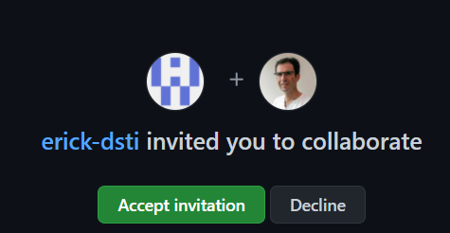
GIT / GITHUB : Work locally and push
git config --global user.name "Mon Nom" git config --global user.email "votreemail@votreemail.com"
Your project team menber Git Repository
How ?
Create a local branch with your name for instance
Modify the code or try to add some code.
Try to « push » this code « git push ». What happens ?
The remote (github) repository is not yours (it’s mine) so you are not allowed to modify it
For this, I have to add you as contributors
Accept to be a contributor (you should receive an email) … now you should be able to push your code to my github repository
In a way the list of your contributors is the list of your project members
Before stating to work on the project, don’t forget to create a virtual environment dedicated to the project and to install the libraries from the file requirements.txt
Your Local Git Repository
Notes:
Modify requirements.txt
pip install PyQt5
Modify index.html to make it nice
Modify launcing to print what is happening : print on screen or print on file ang give the html link to see the file

Slide 10
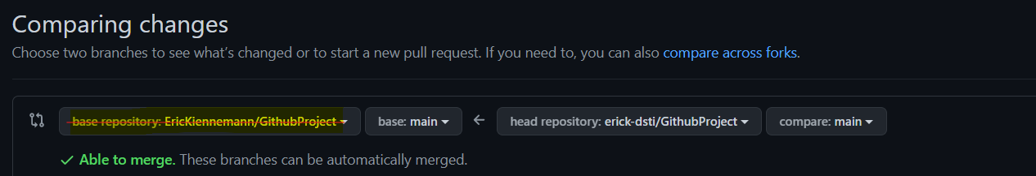
GIT / GITHUB : Merge into main
git config --global user.name "Mon Nom" git config --global user.email "votreemail@votreemail.com"
My Github Repository
How ?
Create a Pull Request
Take care at source and destination of the pull request
Go to the repository on github
Add a description and create the pull request
And « Merge pull request » to main branch
« pull » on your « main » local branch to update it
Delete your branch
And if there are conflicts :
Resolve them in github directly
Resolve them locally ….

Slide 11
GIT / GITHUB : Pull request to the initial repository
git config --global user.name "Mon Nom" git config --global user.email "votreemail@votreemail.com"
Public Github Repository
My Github Repository
How ?
Create a pull request manually
This « pull request » will appear in the initial repository the one you have forked
The owner of the repository will decide to accept or not your modifications (pull request)

