Slide 1
Support IT
Eric Kiennemann
Notes:
1) Who I am
2) Goal of today
Last year experience show me that you can loose time dealing with software
For the first 6 months if you are familiar with software you will win time
For your internship, you will be supposed to be familiar with IT environment
You must have time to focus on DataScience/Data Engineer / DataAnalyst subjects
You will see that there is always 2/3/4 different ways to do somethings : different tools, different libraries, different technology ….
My view is that is it important to master one way of doing things but to be open to other ways because on your intership / futur job you won’t be able to choose.
When I say master it is not « use » it means « understand how it works »

Slide 2
Introduction
I will show you the tools I use … and the way I work
BUT
Lots of different tools … and lots of different ways of working
Take from this course what interest you … and trust you !
Notes:
Today : try to understand how things work on some subjects
If you are not yet familiar with tools : a good way to see some in details
If you are familiar with other tools : keep them but this course will show you some others … do not hesitate to share your experrience during this course.

Slide 3


Don’t EVER forget
Google
Qwant https://www.qwant.com/
Ecosia ….. https://www.ecosia.org/
ARE YOUR BEST FRIENDS
&
Notes:
DS : load csv file / parameter / structure / manipulate
DE + DA : plot multiple graph / plot pie chart , bar plot ..
All : to run R code into jupyter notebook.

Slide 4
Summary
Python in Google Colab
Python local install
Python virtual environment
Use of an IDE : vscode
Python Jupyter Notebook
R local install
R in Jupyter Notebook
Notes:
10:25

Slide 5
Python in Google Colab
Create a Google Account : https://accounts.google.com/signup?hl=en
Use interface (Demo) : https://colab.research.google.com/
https://colab.research.google.com/notebooks/basic_features_overview.ipynb (Overview of colaboratory Features)
https://colab.research.google.com/notebooks/io.ipynb
The three « environments » used in Google Colab
GoogleColab – Linux virtual machine hosted by Google
Lost when you leave or restart Google Collab
Google Drive :
where you can store « permanently » your notebooks
Where you can store your dataset
Your local PC
Enable GPU : « runtime / Change runtime type »
Sessions : « runtime / manage sessions »
Notes:
erick.dsti
Vb327pAZm5dp
Impact of restart and factory restart
Save notebook to google drive

Slide 6
Python in Google Colab
Pros
Easy to launch
Collaborative
Free
Gpu
Cons
Data are lost if not saved on local disk / GoogleDrive
Long process (several hours) are killed
Limit in the usage of GPU

Slide 7
Google Colab : Your turn
Get the « survey 1 » file on Moodle
Copy it on Google Colab
Write a short Python code that
Import the file
Plot a Pie Chart with the « Os ? » column
Save your notebook on your goolgle drive
And share it with others …. Links on the chat ….
Notes:
11:10

Slide 8
Python Local install
Check your system : echo %PROCESSOR_ARCHITECTURE%
From :
https://www.python.org/downloads/windows/
https://www.python.org/ftp/python/3.8.8/python-3.8.8-amd64.exe
Version 3.8 is a good compromise
Where is my python executable : « where » command
Understand « path » variable
« set PATH »
« edit the system environment variable »
Practice with « Python console » = « Python shell »
Notes:
Check
Add to path
Explain : launcher to all users
Explain : librairies installes
Copy of the screen on the blackboard
« Disable path length limite » : yes
Where python
Echo %PATH%
« edit the system environment variable »

Slide 9
Python Local install
Look at python folder
Use « py » windows tool installed with python executable :
« py -0 » : know the active « py » version and the list of versions
Install other version of python
Customize the installation
Change version using path
Change version using py launcher
Notes:
Python install in C:\Users\eric\AppData\Local\Programs\Python\Python38
or in C:\Program Files\Python38 if "installed for all user" is selected in "custom install"
python --version
where python
set path # to see path value
Ek : install 2 version 3 and 1 version 2
Py -2 to run version 2
Py to run highest version
Py -0 to see all versions
Py -3.8 to run 3.8 version
Python 2 put thepath on the system not user so always on top !!! => launcher is easier

Slide 10
Python Library / Packages / Modules
Definition
The Standard Library comes with Python and is installed along with it, making its modules reliably available to any Python code :
Once the pieces of code are in a somewhat standard form and directory layout, one can call it a package
A Python module is simply a Python source file
The Standard Library
Have a look in https://docs.python.org/3/library/
Packages installed by default with Python
Pip : package installer
Tkinter : standard graphical interface
The standard library test suite
Python IDLE (one Interface Development Environment for Python)
Notes:
Import math
math.sin(math.pi/4) = math.sqrt(2)/2
Import random
Random.random()
Show the random.py file
Run idle
in C:\Users\eric\AppData\Local\Programs\Python\Python38\Lib\site-packages

Slide 11
Python Library / Packages / Modules
There are two main tools to install packages :
pip tool : which is already installed with python windows version
Conda tool : which need another install
I will show you « pip tool »
pip list / pip freeze
pip install package_name
For i.e « pip install numpy » (don’t do it)
in C:\Users\eric\AppData\Local\Programs\Python\Python38\Lib\site-packages
To use it in your code : « import numpy »
Notes:
Pip list : ok for version 3.9
For version 3.8: py -3.8 -m pip list (run library module)
Install new verion of pip as asked

Slide 12
Python library / Packages / Modules : Your turn
Print a number between 0 and 1 using standard library
Can you find the python code of the used module ?
Update your version of « pip » to the latest version

Slide 13
Python Virtual environment
What is it ?
“A virtual environment is a Python environment such that the Python interpreter, libraries and scripts installed into it are isolated from those installed in other virtual environments, and from the “system” Python
Python Virtual env 1
Python Virtual env 2
Python SYSTEM
Python Virtual env 3
Python Virtual env 4

Slide 14
Python Virtual environment
Why ?
When working on different projects at the same time
Some librairies might be incompatible
We want to use different version of libraries
We want to use different python interpreter
….
How ?
Several products exists : virtualenv, venv, conda ….
They each have their pros and cons
You can mix them even if it is not always simple
I will use « virtualenv » with you
Notes:
Do a « pip freeze » after pip install virtual env

Slide 15
Build Python Virtual environment
Install virtualenv at the « system level »
« pip install virtualenv » And it should be the only one installed here
Create first virtual environment (other option : create your virtual environment in your project)
Create a directory where you will put all your virtual environment
« mkdir C:\Users\eric\virtual_environment » or « mkdir c:\Users\eric\<my_project> »
« cd C:\Users\eric\virtual_environment » or « cd c:\Users\eric\<my_project> »
Create the virtual environment
« virtualenv my_first_env » or « virtualenv .venv »
Look at the result : « pip==21.0.1, setuptools==53.0.0, wheel==0.36.2 »
Look at the folder structure …
Create a virtual environment with another python version
« cd C:\Users\eric\virtual_environment »
« virtualenv my_pythonXX_env -p=pythonX.X»
Notes:
Either in the project folder
Or in a specific folder where you put all your env …
« py -m virtualenv my_first_env »
« virtualenv env_v2 -p=python2 » to have a version 2 python interpreter

Slide 16
Start Python Virtual environment
Start to a Virtual environment
Run « activate » function
« .\my_first_env\scripts\activate »
Look at your prompt
Check the python interpreter that is used and the « pip » that is used and the python version
« where python », « where pip », « python –version » : Explain ….
Stop a Virtual environment
Run « deactivate » function
« deactivate»
Look at your prompt
Check the python interpreter that is used and the « pip » that is used
Notes:
Add requirements.txt in a « binder » subfolder of the repository

Slide 17
Python Virtual environment : Your turn
Go back to system python
Create a new virtual environment and start it
Find a library that help you calculate the mean of : ( 4, 7.8, 12, 47.3)
Install this library and run python script
Calculate the mean using the library you find
Stop your virtual environment
List the libraries installed in your system. Check the installed library is not there anymore ?
Notes:
Pip install statistics
Import statistics
statistics.mean([4,5,8,79])
Or
Import statistics as stat
Stat.mean([1,3,5,9])
Or
From statistics import mean
Mean([1,3,5,9])
Or sum([5,8,9,7])/len([5,8,9,7])
Import numpy as np
np.mean([4,5,8,9])

Slide 18
Use of an IDE
What is it ?
IDE : Integrated Development Environment
Helps you write code
Not mandatory ! But really helpfull
Available IDE for python
A lot !
Idle, PyCharm, Visual Code, Sublime Text, Atom ….
I will show you Visual Code
But others are also Ok

Slide 19
Use of an IDE : vscode
Install it from :
https://code.visualstudio.com/
Run it
Folder : same meaning as in Windows
For instance : create a folder for each of your project
Workspace : optional
Interesting when working with several folder
Can be run from command line « code . » : automatically open the current folder

Slide 20
Use of an IDE : vscode setup for python
Select autosave option
Be carefull, no code history or backup … use of your OneDrive to store your project is a VERY good idea
Change default shell : ctrl+shift+p (palette) + « Terminal : select default profile»
Select « command prompt »
install extension :
Python microsoft
« ctrl + shift + P » : « python select interpreter »
Run a terminal inside vscode : « terminal / new terminal »
Usefull short cuts … a lot
Ctrl + shift + p
Ctrl f
Ctrl p

Slide 21
Use of an IDE : vscode, activation of virtual env
Add « python.venvPath » to your virtual environment path
look at your .vscode/settings.json or first_workspace.code-workspace ... settings
Run a terminal inside vscode : « terminal / new terminal »
If you have a « .venv » folder in your project the virtual environment will be detected automatically
Notes:
Open file / preferences/settings : find “venv” path (not folder)
and put it in User / not : workspace
=> explain the difference
ATTENTION : if not visible at the beginning, create a py file and / or quit / reload vscode
Find the vscode file for user in c:\users
C:\Users\eric\AppData\Roaming\Code\User
"python.venvPath": "C:\\Users\\eric\\virtual"

Slide 22
Use of an IDE : vscode and virtual environment
Install Linter « pylint »
Switch to an env to another
What happens to your terminal ?
Test debugger
Create a launch.json file
Notes:
Pip install pylint
Restart vscode if needed to see pylint

Slide 23
Ide: Your turn
Create a new project folder
Create a virtual environment for this project
Open this project in vcode
Get the « Debug Python program » in Moodle and put it in your project
Use Linter to detect « syntax errors » and correct it
Use « Run / start without debugging » to see the result
Use « Run / start debugging » to try to correct it

Slide 24
Jupyter Notebook
pip install ipykernel
What is it :
« IDE » that makes it possible to execute blocks of codes and add comments in a nice way
Installation :
Create a new virtual environment called « jupyter » in your « virtual environment folder » :
Activate your virtual environment
« pip install jupyter »
Test your installation : « jupyter notebook »
Use Jupyter Notebook in one of your virtual environment
Activate the virtual environment
« pip install ipykernel » (just the kernel not all the jupyter library)
« python -m ipykernel install --name=<your_env_name> --user»
Back to your « jupyter » virtual environment:
Run « jupyter notebook » : you can see the virtual environment you just added
Notes:
Kernel in : C:\ProgramData\jupyter\kernels\env_v2 (if not –user)
C:\Users\eric\AppData\Roaming\jupyter\kernels\ (if –user)
import sys
sys.executable
Ok
!where python : not ok => do not do !pip install !!

Slide 25
Jupyter Notebook
Test Python Code
Test MarkDown
# : Title 1
## : Title 2 ….
** …. ** : Bold
Other important commands
New block
Exécute a block
Auto completion …
Jupyter notebook « magic commande » :
%whos, %history
« ! » to run an Os command : « !dir » BUT DO NOT USE « !pip install »

Slide 26
Jupyter Notebook : Your turn
Go back to Google Colab
Download your work on the survey into a .ipynb file
Open this file on your Jupyter Notebook
Keep on working on it
Display other graphs for the other columns : version, virtual, ide, R

Slide 27
R local installation
From :
https://cran.r-project.org/bin/windows/base/
https://cran.r-project.org/bin/windows/base/R-4.0.4-win.exe
For Rstudio
https://www.rstudio.com/products/rstudio/download/#download
https://download1.rstudio.org/desktop/windows/RStudio-1.4.1106.exe
Setup
Check : session / set working directory

Slide 28
R different environment
Console
R script
R Notebook / R Markdown : needs package installation
Let’s install it
New buttons are added
Knit to pdf : fail !
tinytex::install_tinytex() and try again

Slide 29
R libraries
Check for « median » function
??median
“stats” is a standard library : you can use the function directly
Standard functions are in :
C:\Program Files\R\R-4.0.4\library for standard libraries
Check for “ggplot2”
This is a library that must be installed
The first time : install.packages(“ggplot2”)
Then to use it each time : library(ggplot2)
Your libraries are in
C:\Users\<your_name>\Documents\R\win-library\4.0 for the libraries you install
Check the folder with your libraries
Notes:
median(c(1,3,78,456,12))
library(ggplot2)
data(mpg)
mpg
ggplot(data = mpg) + geom_histogram(aes(x = hwy))
hist(mpg$hwy,col='lightblue')

Slide 30
R : your turn
Can you do R programming inside a Jupyter Notebook ?
Hint : rather use Rx64 then R Studio to install the needed package
… and work on « survey 2 », using R

Slide 31
R : use it with Jupyter Notebook
RUN the Rx64 tool
Install the IRkernel library
install.packages(“IRkernel”)
Make the kernel available
IRkernel::installspec(user = TRUE)
Notes:
C:\Users\eric\AppData\Roaming\jupyter\kernels\

Slide 32
Github : to show your work
https://github.com/
Create a repository with the same name as your account
Describe your self in the README.md file
Create a repository for each of your projects
Always take care of the README.md file : This is the entrypoint of your work
Select your most interesting projects and « pin » them in your first page

Slide 33
Github : create a new repository
Choose “Public”
Check “Add a Readme file”
Edit the “About” of your repository with
A description
Try to create sub folders in your repository (not so easy !)
Try them to remove subfolders !
Put on the chat the link to your New or already existing Github Repository
Edit the README.md file

Slide 34
Github : basics about Readme.md file
Markdown language
Titles # / ## / ###
Lists “*”
Bold “**<text>**”
Code `<text>`
….

Slide 35
Github : advanced about Readme.md file
Link to a folder or web site ….
“## [Word Document](Word/Readme.md)”
Inserting images
Create a folder for “Images”
Import an image (jpg/png) in it
“![Nice Image](.//Images/Emerging-job-roles-in-artificial-intelligence.jpg)”
Tables
Use “|” and “-” symbols to build your table
Look on google to find Markdown tables generator (plugin in Visual code for instance)

Slide 36
Github : advanced about Readme.md file
Run a jupyter notebook
Github can display your notebook
But Github can’t run your notebook
But you can use “Binder” for instance
Upload your jupyter notebook file in github
Go to “Binder” web site : https://mybinder.org/
Try to fill the parameters to get an url from binder (cheetpage, next slide !)
Insert this url in your readme.md file
Does it works ? why ?
Notes:
Pip freeze > requirements.txt
Put it on binder folder
Survey do not work : no input file
Calibration is ok

Slide 37
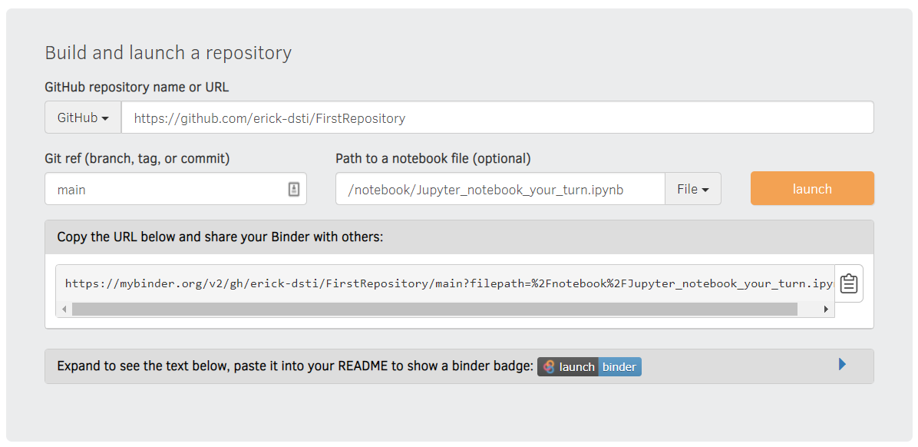
Github : advanced about Readme.md file

Slide 38
Github : advanced about Readme.md file
Using Microsoft Word and convert it to md file
Install pandoc : https://github.com/jgm/pandoc/releases/tag/2.13
Create a small script to run the conversion
chcp 65001
pandoc --extract-media ./ -s %1.docx -t gfm -w gfm -o %1.md
Create a small word (docx) file with images and convert it to md file
Import it on github and look at the result
Notes:
Installed in c:\users\eric\Appdata\local\pandoc
Script file FromWordToMd.bat
chcp 65001
pandoc --extract-media ./ -s %1.docx -t gfm -w gfm -o %1.md
Exec : FromWordToMd WordDocument
Everything is in c:\users\eric\pandoc on hyper eric/07077oek

Slide 39
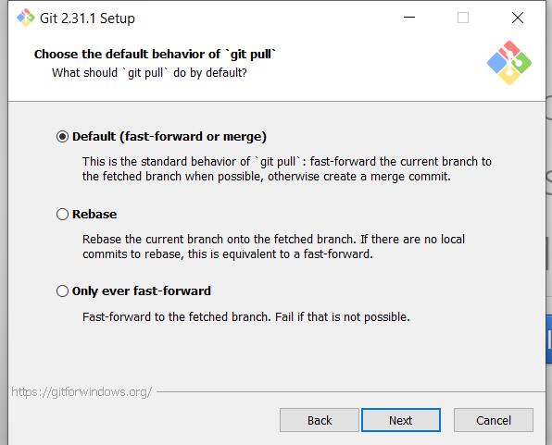
GIT : Basis – local installation
Definition : Git is a software for tracking changes in any set of files
Installation for windows :
https://gitforwindows.org/
Visual Studio as default editor or other
Overide with “main” default branch name (what is used in github now)
Use default console windows
Type “git” on a CMD windows to confirm setup is ok

Slide 40
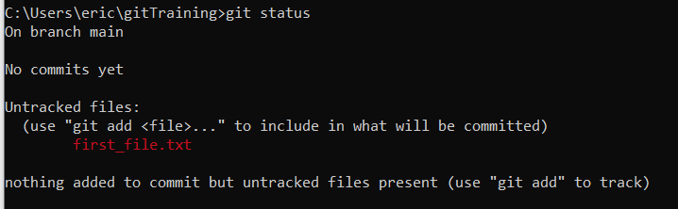
GIT : Basis – first steps
git config --global user.name "Mon Nom" git config --global user.email "votreemail@votreemail.com"
Define your name and email (mandatory)
git config --global user.name "<your name>"
git config --global user.email "<your email>"
Git config –list
“Follow” a folder with GIT
Create a folder and get in it
Execute “git init”
Check the folder “.git” that has been created (size 23.3kb)
Create a file in this folder and execute “git status”
Notes:
In c:\users\eric
Name : Eric Kiennemann
Email : kienkai0511@free.fr
Mkdir gitTraining
Cd gitTraining
Git init
"c:\Program Files\Git\usr\bin\nano.exe" first_file.txt

Slide 41
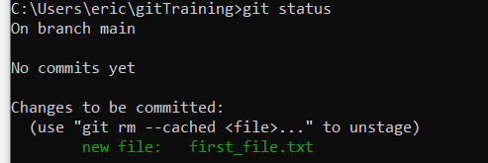
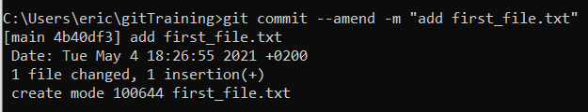

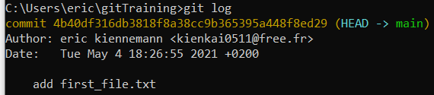
GIT : Basis – first steps
git config --global user.name "Mon Nom" git config --global user.email "votreemail@votreemail.com"
Track a file (stage)
git add <file, repositary, wild card>
Commit a file
git commit –m <message>
See the history of commit
Git log
Notes:
Git add first_file.txt (« git add . », add all the files
Git commit –m « add first_file.txt »
Git commit : open visual code and enable to type the message
« git commit –a » addand commit at the same time
Modify the last(=first) commit :
git commit --amend -m "add first_file.txt“
Attention : not possible to reset the first commit

Slide 42
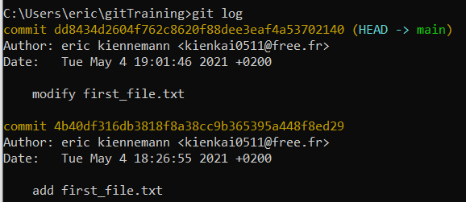
GIT : Basis – first steps
git config --global user.name "Mon Nom" git config --global user.email "votreemail@votreemail.com"
Modify the file / stage the file / commit the file
“reset” your last commit = cancel the modification you have done to the file
git reset --soft HEAD~1
Check the “status”, check the “log”, check your file
Try “reset” (without soft) and “reset --hard”
Test “git revert” what is the difference ?
Notes:
Modify the file
Git add …
Git commit …
Git reset –soft HEAD~1 : back to staged, stay in index
Git reset HEAD~1 : back to unstaged, remove from index
Git reset –hard HEAD~1 : suppress modification
Git revert <commit>, add a new commit with the deletion of the previous => change the file
To unstage :
Git restore –staged . Or <file>
Git reset HEAD .

Slide 43
GIT : branches
git config --global user.name "Mon Nom" git config --global user.email "votreemail@votreemail.com"
Use branches when you wan to add a new feature to your work
« git branch <branch name> »
Classical use case : “you are asked to work on a new feature, it will take you at least 2 weeks. Two days later, an urgency in production, you have to fix it quickly, when finished you go back to your feature work”
Modify file & commit
main
When the feature is finished : Merge your file with main !!
Keep on working on your feature : modify the file and commit it
Modify the file and commit modification
Create a branch for the hot fix in production
Modifiy the same file for the hot fix !
And commit it
Merge with the main branch
Your feature branch is merged : you can suppress the branch
When the branch is merged into main, you can suppress it
Git initialisation with one file in the folder
Init
Modify file & commit
Merge two modification
Create a new branch for your new feature
Prod_fix
Modify file & commit
Modify file & 2nd commit
New_feature
Notes:
Git branch first_branch
Git checkout first_branch or git checkout –b first_branch
Git branch to see where I am
Modify the file
The file is modified in both main / first_branch
Stage the file
The file is modified in both main / first_branch
Commit the file in first_branch
The file is modified in first_branch
The file is NOT modified in main
Use « git bash » tool to see your branch
Git branch –d <branch> to remove locally
Git checkout main / Git branch second_branch /git checkout second_branch
Modifiy file => no more possible to go back to « first_branch »
Git commit –m « commit second branch » => again possible to go to first_branch
=> validate your work before changing branch
git log --graph --oneline –all
Git checkout first_branch / git push

Slide 44
GIT : the merge process
git config --global user.name "Mon Nom" git config --global user.email "votreemail@votreemail.com"
Your turn
Reproduce this on your git folder
And try « git merge <branch> » command.
What happens when you want to merge the new_feature branch ?
Notes:
other thing to do : 3 files
1 for new_feature
1 for hot_fix
1 common
prod.txt
* add line in new_feature and hot_fix
override.txt
overide the line : This text will be modified by the new feature and the hot fix
git add .
git commit -m "first commit 2 files"
git branch new_feature
git checkout new_feature
<modify two files>
git add .
git commit -m "modify 2 files in my_feature"
git checkout main
git branch hot_fix
git checkout hot_fix
<modify two files>
git add .
git commit -m "modify 2 files en hot_fix"
git checkout main
git merge hot_fix
git branch -d hot_fix
git checkout new_feature
<modify prod.txt>
git add .
git commit -m "second change prod.txt from new_feature"
git checkout main
git merge new_feature
* everything ok
* conflict
+ git status, pour contrôler
+ look at the files
+ do it manually or with "git mergetool"
git add .
git commit # run vscode
git log --graph --oneline
git branch -d new_feature

Slide 45
GIT : with VisualCode
git config --global user.name "Mon Nom" git config --global user.email "votreemail@votreemail.com"
Create a new repository to follow and get in it
Run vscode from this repository
All the process we have done can be done inside Vscode in a more friendly way
Notes:
other thing to do : 3 files
1 for new_feature
1 for hot_fix
1 common
prod.txt
* add line in new_feature and hot_fix
override.txt
overide the line : This text will be modified by the new feature and the hot fix
git add .
git commit -m "first commit 2 files"
git branch new_feature
git checkout new_feature
<modify two files>
git add .
git commit -m "modify 2 files in my_feature"
git checkout main
git branch hot_fix
git checkout hot_fix
<modify two files>
git add .
git commit -m "modify 2 files en hot_fix"
git checkout main
git merge hot_fix
git branch -d hot_fix
git checkout new_feature
<modify prod.txt>
git add .
git commit -m "second change prod.txt from new_feature"
git checkout main
git merge new_feature
* everything ok
* conflict
+ git status, pour contrôler
+ look at the files
+ do it manually or with "git mergetool"
git add .
git commit # run vscode
git log --graph --oneline
git branch -d new_feature

Slide 46
GIT / GITHUB : Publish your code
git config --global user.name "Mon Nom" git config --global user.email "votreemail@votreemail.com"
Why ?
A way to show what you have done
A way to have a backup of your code
How ?
Create an empty repository on github and get its « adress »
Connect your local git repository to this Github repository
On your local PC : «
Git remote add origin https://github.com/erick-dsti/gitMerge.git
To send (push) your code from local (your PC) to remote (github) :
Git push –u origin main
Now, after each local commit you can do a « push » to store your local data on github.
« git status » tell you if yor local branch is up to date with « origin/main » : Can tell you that your branch is « ahead » of one commit from « origin/main »
If you have local branches you can also push them to github ….
Notes:
Git remote or git remote –v to see the parameters (attention it do not check the connection)

Slide 47
GIT / GITHUB : Use Case
git config --global user.name "Mon Nom" git config --global user.email "votreemail@votreemail.com"
I find a nice DataScience development on Github and I decide to improve it. For this I build a DSTI team (you) to work on it
Your project team menber Git Repository
Your project team menber Git Repository
Your project team menber Git Repository
Your project team menber Git Repository
Public Github Repository
Your Github Repository
Your Local Git Repository
1. Fork the project on your Github repository and add your team members as contributors
4. When your project is done. Send a Pull Request to the Public Github Repository that accepte it and Merge it to his project
3. Each member of the team modify locally the project and Push its modifications to Github
2. Each member of the team Clone the project from your Github to his/her local git repository
Notes:
If the remote reposory is yours, you are in the same situation as with a git remote, you can modify locally your files, commit, push ….
If the remote repository is not yours you can’t do push … only authorized to work locally
That’s why “git fork”

Slide 48
GIT / GITHUB : Use Case
git config --global user.name "Mon Nom" git config --global user.email "votreemail@votreemail.com"
You find a nice DataScience development on Github and you decide to improve it. For this you build a DSTI team to work on it
Your project team menber Git Repository
Your project team menber Git Repository
Your project team menber Git Repository
Your project team menber Git Repository
Public Github Repository
Your Github Repository
Your Local Git Repository
1. Fork the project on your Github repository and add your team members as contributors
4. When your project is done. Send a Pull Request to the Public Github Repository that accepte it and Merge it to his project
3. Each member of the team modify locally the project and Push its modifications to Github
2. Each member of the team Clone the project from your Github to his/her local git repository
Notes:
If the remote reposory is yours, you are in the same situation as with a git remote, you can modify locally your files, commit, push ….
If the remote repository is not yours you can’t do push … only authorized to work locally
That’s why “git fork”

Slide 49
git config --global user.name "Mon Nom" git config --global user.email "votreemail@votreemail.com"
Your project team menber Git Repository
Your project team menber Git Repository
Your project team menber Git Repository
Your project team menber Git Repository
Public Github Repository
My Github Repository
Your Local Git Repository
4. When your project is done. Send a Pull Request to the Public Github Repository that accepte it and Merge it to his project
3. Each member of the team modify locally the project and Push its modifications to Github
2. Each member of the team Clone the project from your Github to his/her local git repository
Notes:
If the remote reposory is yours, you are in the same situation as with a git remote, you can modify locally your files, commit, push ….
If the remote repository is not yours you can’t do push … only authorized to work locally
That’s why “git fork”

Slide 50
GIT / GITHUB : Fork
git config --global user.name "Mon Nom" git config --global user.email "votreemail@votreemail.com"
Your Github Repository
Public Github Repository
Why ?
To copy a github repository from someone else (public) to your github account
… most of the time you want to copy the code of someone else to modify / improve it
How ?
I will fork this repository : https://github.com/EricKiennemann/GithubProject
Notes:
After Fork, the repository becomes yours : you can do whatever you want on it.

Slide 51
GIT / GITHUB : Clone
git config --global user.name "Mon Nom" git config --global user.email "votreemail@votreemail.com"
Yur project team menber Git Repository
Your project team menber Git Repository
Your project team menber Git Repository
Your project team menber Git Repository
Your Github Repository
Why ?
To copy a github repository (one of yours or a public one) locally
… most of the time you want to use the code of someone else
… in a company / team , to get the first version of the company code
How ?
Go to the Repository that I have just forked and get its « https adresse »
Clone the repository with https (ssh out of scope) in a new folder
Create a new local folder and open it
git clone <myRepository> (no need to git init your local repository)
Realize the windows authentification
Check credential manager to see your github credential
Your Local Git Repository
Notes:
After Fork, the repository becomes yours : you can do whatever you want on it.

Slide 52
GIT / GITHUB : Work locally and push
git config --global user.name "Mon Nom" git config --global user.email "votreemail@votreemail.com"
Your project team menber Git Repository
How ?
Create a local branch with your name for instance
Modify the code or try to add some code.
Try to « push » this code « git push ». What happens ?
The remote (github) repository is not yours (it’s mine) so you are not allowed to modify it
For this, I have to add you as contibutors
Accept to be a contibutor … now you should be able to push your code to my github repository
In a way the list of your contributors is the list of your project menbers
Before stating to work on the project, don’t forget to create a virtual environment dedicated to the project and to install the libraries from the file requirements.txt
Your Local Git Repository
Notes:
After Fork, the repository becomes yours : you can do whatever you want on it.

Slide 53
GIT / GITHUB : Merge into main
git config --global user.name "Mon Nom" git config --global user.email "votreemail@votreemail.com"
My Github Repository
How ?
Create a Pull Request
Go to the repository on github
Add a description and create the pull request
And « Merge pull request » to main branch
« pull » on your « main » local branch to update it
Delete your branch
And if there are conflicts :
Resolve them in github directly
Resolve them locally ….

Slide 54
GIT / GITHUB : Pull request to the initial repository
git config --global user.name "Mon Nom" git config --global user.email "votreemail@votreemail.com"
Public Github Repository
My Github Repository
How ?
Create a pull request manually
This « pull request » will appear in the initial repository the one you have forked
The owner of the repository will decide to accept or not your modifications (pull request)
Notes:
After Fork, the repository becomes yours : you can do whatever you want on it.

