Slide 1
Paper Presentation: Reviewing qualitative GIS research – current trends and promoting interdisciplinary, reproducible research with open-source software.
Presentation: Eric Krüger
Moderators: Dr. Susann Schäfer, Dr. Jannes Münchow

Slide 2
Content
Filling the Gap
Data
Methodology
Results
Discussion
Conclusion
Literature

Slide 3
1 Filling the Gap
What is qualitative GIS?
Critical GIS as alternative GIS research since 1990 (Openshaw, 1991; Schuurman, 2000
→ Alignment and reorientation of GIS
Change of perspective since 2000
Qual. GIS as toolbox to understand social phenomenas
(Elwood, 2006; O’Sullivian, 2006; Schuurmann 2000)
Research fields: Social and political decision making, urban- and community management, ecosystem services …
Notes:
Kritische Sicht auf gis da militärisch genutzt, ins besonders quantitative methoden unterstützt, unreflektierte Verarbeitung der Daten (vor allem Daten getriebene Methoden, welcher qualitativen forschung oft nicht gerecht werden)
Vom kritischen Gegenspieler zum mitspieler
capacity to share, manage, analyse, and visualize large spatial data
GIS influences social and political decision-making
new software & technology developments
emerging of new subdisciplines (VGI, PPGIS)
VGI and PGIS → Web 2.0

Slide 4
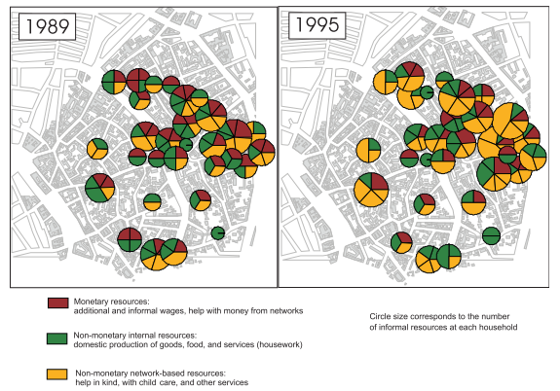
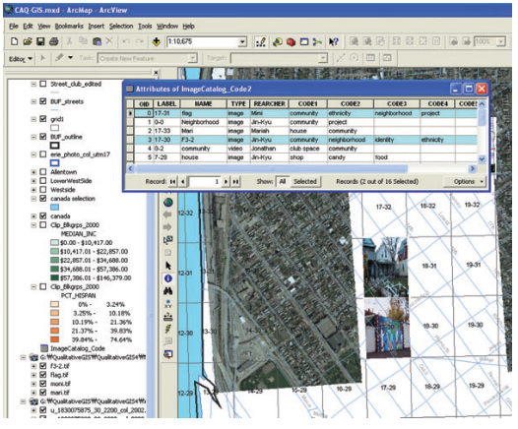
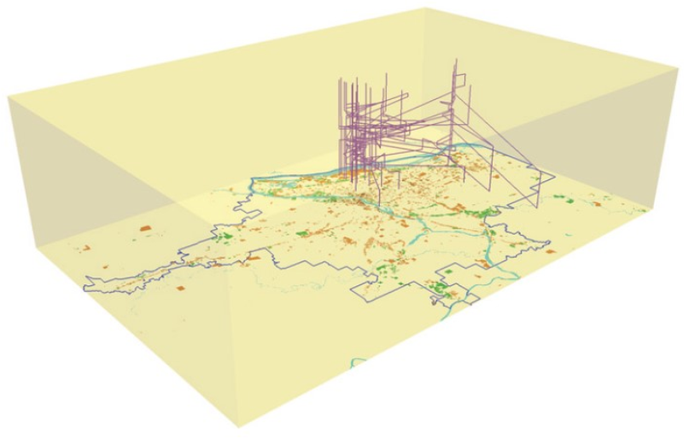
1 Filling the Gap
Qualitative GIS as mixed method approach.
Analysis of qualitative data in combination with spatial information (Sui, 2015)
vector & raster representation← → qualitative Data
Transformation into a spatial data format
Hyperlinks – linking multiple data types to a location
Software-Extension - extending data types and methods of a GIS
(Jung & Elwood, 2010)
(Pavlovskaya, 2004)
(Jung & Elwood, 2010)
(Kwan, 2002)
Notes:
Anwendung von qual. Und quant. Methoden innerhalb einer GIS-Struktur

Slide 5
1 Filling the Gap
Qualitative GIS agrees on the reorientation of GIS
individual perceptions of geographical places and regions (Agnew 2011).
But we suspect:
qualitative GIS is inhomogeneous and fragmented
research objects, qualitative methodology, software type (Garnett & Kanaroglou, 2016)
technical versus theoretical papers
One sided use of propriety software
What we want to fill in the Gap:
comprehensive literature review
Example of open source data/software for qual. GIS
Notes:
Idee Buchbeitrag Jannes und Susann -> Bachelorarbeit ->
Social science ist sich einig das qual. Gis wichtig und relevant ist als werkzeug dieser Forschung → aber die Anwendung von GIS ist eher unstrukturiert und heterogen
Lack of reproducibility and transparency Nutzung von oopen sources data/software

Slide 6
1. Filling the Gap
Research Questions:
1. What is the current state of qualitative GIS?
2. Is the field of qualitative GIS dominated by proprietary Software?
3. Reproducible Approach to qualitative GIS.

Slide 7
2 Filling the Gap
Challenges:
Lack of clear information about used Methodology
Dominant use of proprietary software
→ Accessibility Limitations: Data, Methodology & Software
(Dennis 2006)
Aims:
Portray the current status of qualitative GIS
reproducible approach
→ public accessible data, open-source software

Slide 8
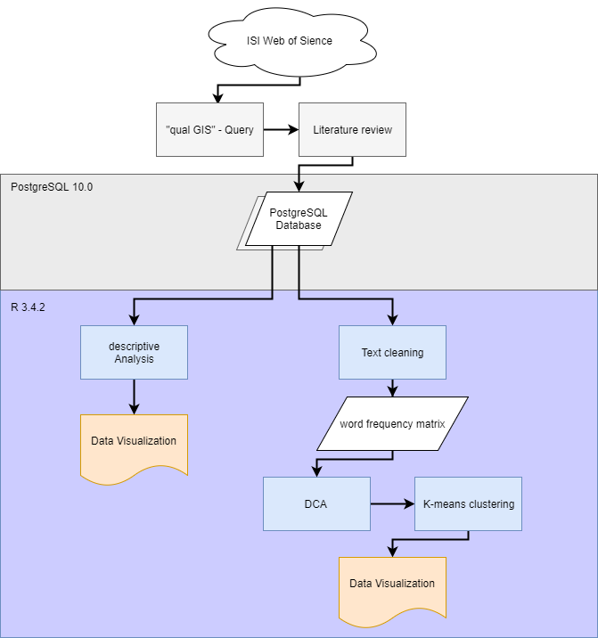
Notes:
Beantwortung der research questions

Slide 9


2 Data
Literature database
Key word query on the ISI web of knowledge
468 publications were retrieved
Extraction of 14 variables on each publication
Open Data
all project data is stored on github - github.com/EricKrg/qual_gis
Literature Database is online accessible
(UCM, 2017)
(PostgreSQL-Dev., 2017)
Notes:
27 keywords feminist gis, qual GIS usw…
Var. GIS Trans, Software, Visual., qual.Data
Ev. Erwähnen das postgresql datenbank auf den server verschoben wird

Slide 10
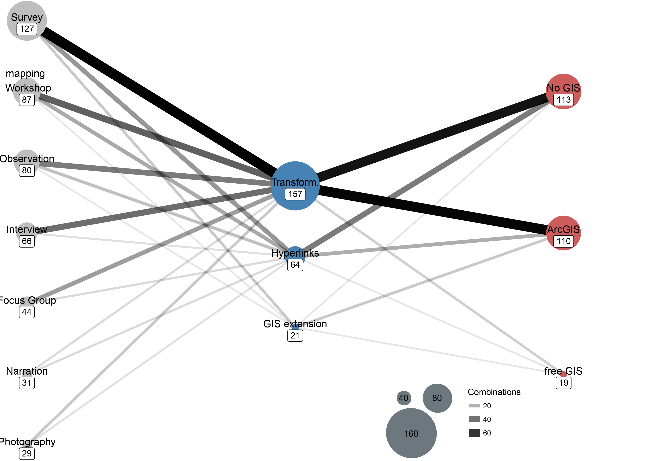
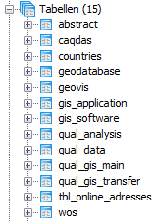
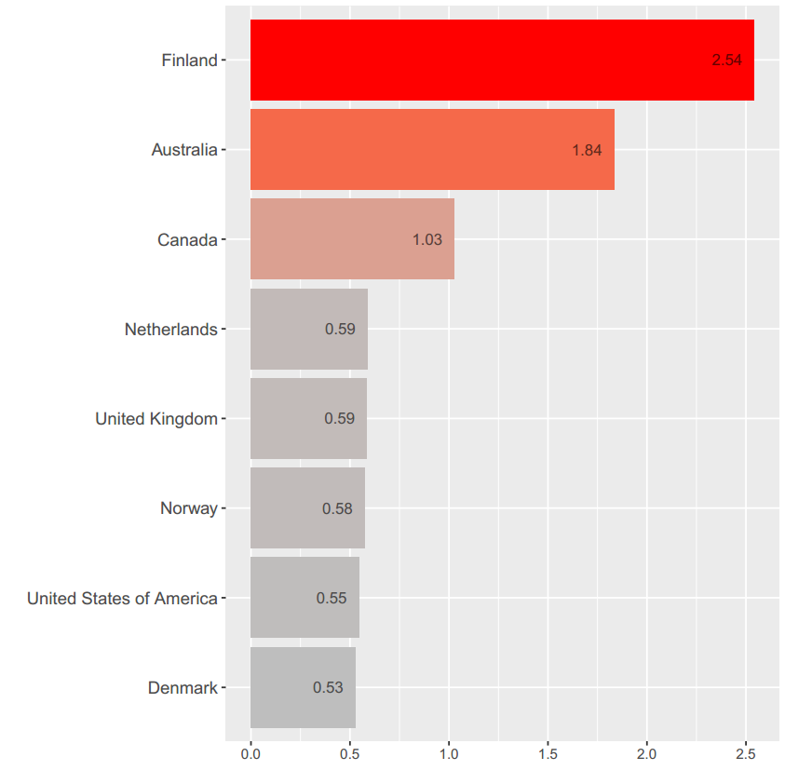
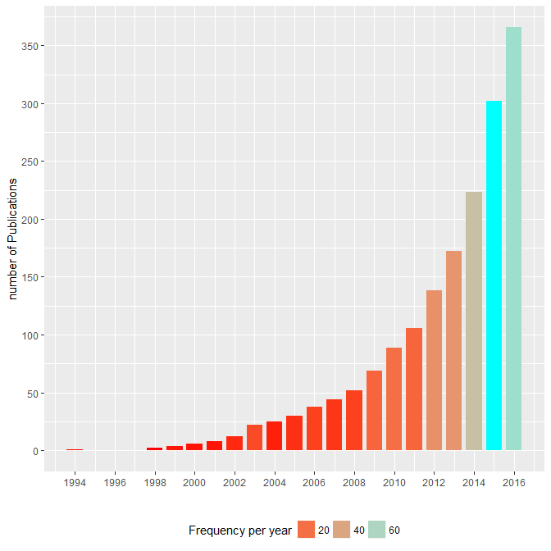
3 Methodology
Database conception
reviewing & cleaning
summary statistics, bar plots, network diagrams
Literature review & descriptive Analysis
Notes:
468 matches. We dismissed 87 publications
Retrieved 14 var. Location, qual. Data, Analysis method, Software

Slide 11

3 Methodology
Word Matrix & Ordination:
 | area | caus | distanc | facilt | prarticip | technolog.
61 | 0 | 1 | 0 | 0 | 0 | 0
62 | 0 | 0 | 0 | 0 | 0 | 0
63 | 0 | 0 | 0 | 0 | 0 | 0
64 | 0 | 0 | 0 | 0 | 0 | 0
65 | 1 | 0 | 1 | 0 | 0 | 1
66 | 0 | 0 | 0 | 0 | 0 | 0
67 | 1 | 0 | 0 | 0 | 0 | 0
68 | 0 | 0 | 0 | 0 | 1 | 0
69 | 0 | 1 | 0 | 0 | 1 | 0
70 | 0 | 1 | 0 | 0 | 1 | 0
Notes:
Wie kommt man dahin → Word preperation: cleaning (no stopwords, and special char) word stemming
Matrix 440 x 4800 Wörtern

Slide 12

3 Methodology
Word Matrix & Ordination:
 | Achse1 | Achse2
61 | -1.2 | 0.1
62 | 2 | 1
63 | 1.2 | 1.2
64 | 0.4 | 1.3
65 | 0.8 | -0.2
66 | 0.6 | 0.3
67 | -1 | 1.5
68 | -0.5 | -0.7
69 | 1.1 | 0.9
70 | 2.2 | 2.1
 | area | caus | distanc | facilt | prarticip | technolog.
61 | 0 | 1 | 0 | 0 | 0 | 0
62 | 0 | 0 | 0 | 0 | 0 | 0
63 | 0 | 0 | 0 | 0 | 0 | 0
64 | 0 | 0 | 0 | 0 | 0 | 0
65 | 1 | 0 | 1 | 0 | 0 | 1
66 | 0 | 0 | 0 | 0 | 0 | 0
67 | 1 | 0 | 0 | 0 | 0 | 0
68 | 0 | 0 | 0 | 0 | 1 | 0
69 | 0 | 1 | 0 | 0 | 1 | 0
70 | 0 | 1 | 0 | 0 | 1 | 0
Notes:
Wie kommt man dahin → Word preperation: cleaning (no stopwords, and special char)

Slide 13
Results

Slide 14
Results

Slide 15
Discussion

Slide 16
Discussion

Slide 17
Discussion

Slide 18
Discussion

Slide 19
Discussion

Slide 20
Conclusion

Slide 21
Literature

