Slide 1
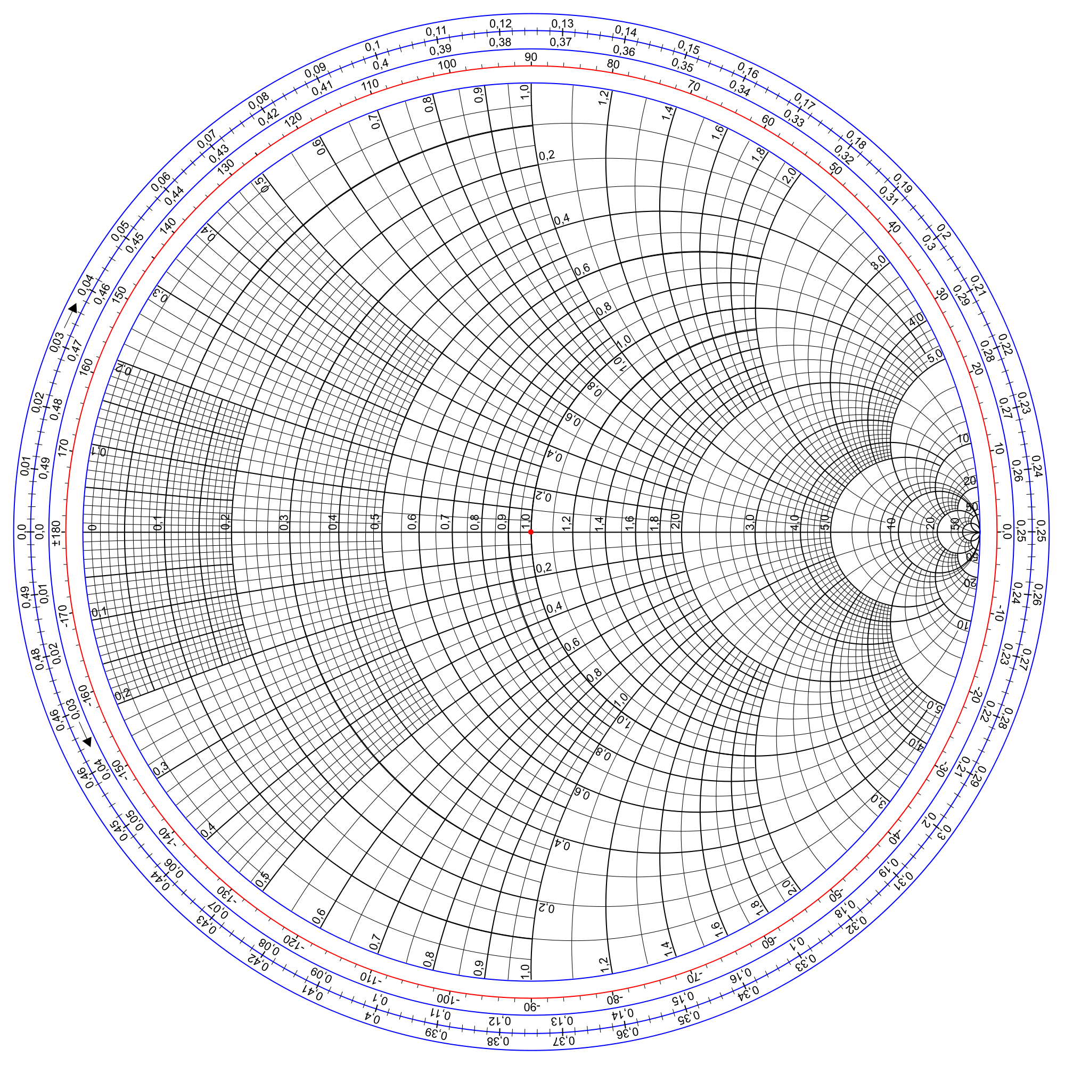
A

Slide 2
A
B

