Slide 1
DEEP LEARNING with Python

Slide 2
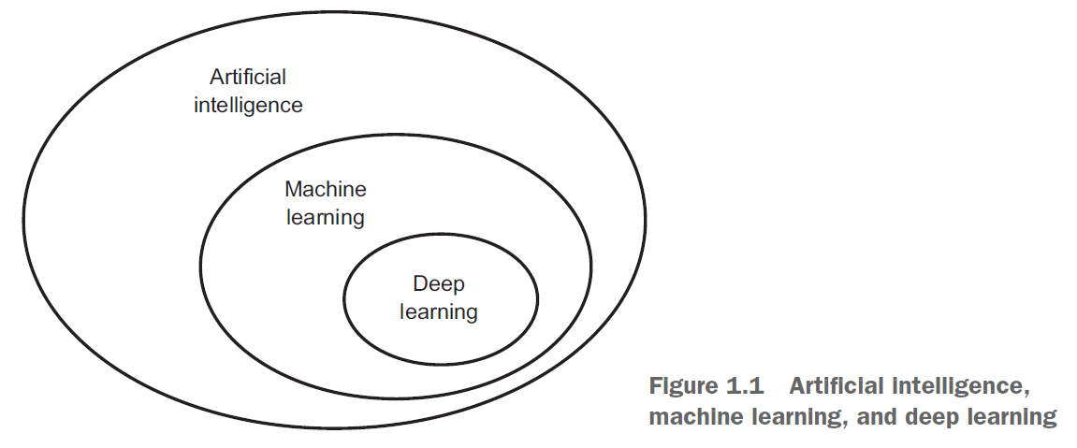
Part 1, Fundamentals of deep learning

Slide 3
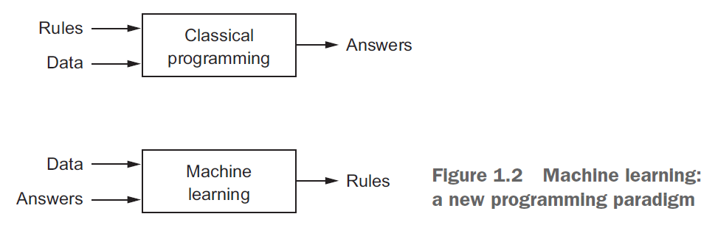
Classical Programming vs. Machine Learning

Slide 4
What is deep learning?
Layered representations learning
Hierarchical representations learning
NOT shallow learning

Slide 5
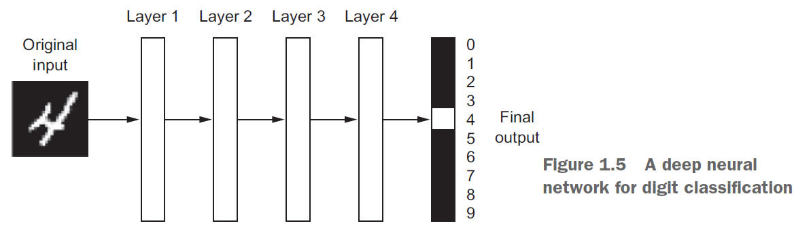
What is deep learning?

Slide 6
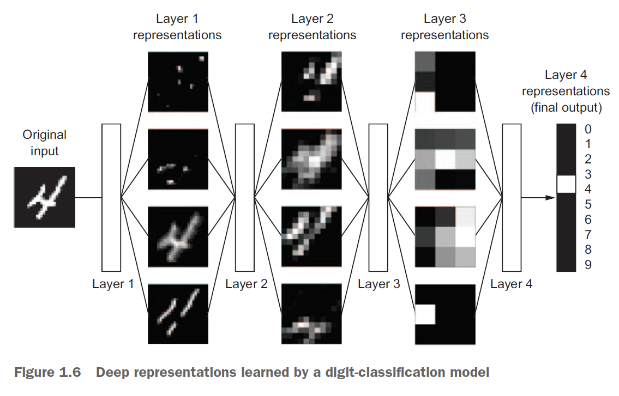
What is deep learning?

Slide 7
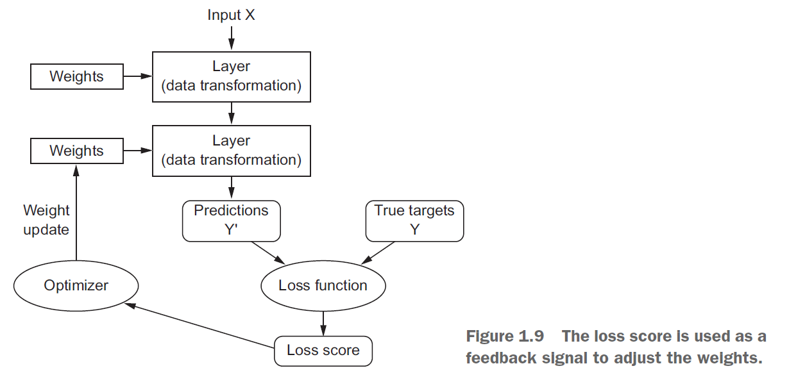
What is deep learning?

Slide 8
Breakthroughs in deep learning
Near-human-level image classification
Near-human-level speech recognition
Near-human-level handwriting transcription
Improved machine translation
Improved text-to-speech conversion
Digital assistants such as Google Now and Amazon Alexa
Near-human-level autonomous driving
Improved ad targeting, as used by Google, Baidu, and Bing
Improved search results on the web
Ability to answer natural-language questions
Superhuman Go playing

Slide 9
What is driving deep learning?
Hardware
NVIDIA and AMD
GPUs
Highly parallelizable
Datasets and benchmarks
Internet
Algorithmic advances
Better gradient propagation algorithms
Notes:
AI started in 1950s

Slide 10
Will it last?
Simplicity
Removes feature engineering
Scalability
GPUs & TPUs
Tensor Processing Unit
Versatility and reusability

Slide 11
Book Forum
https://forums.manning.com/forums/deep-learning-with-python

Slide 12
Quiz/Assignment

