Slide 1
JAX-FEM
GEOMECHANICS
DIFFERENTIABLE DRUCKER-PRAGER PLASTICITY // ADJOINT SINGULARITY
LISHIYAO @ 2025-12-26

Slide 2
00 // INTRODUCTION
CORE OBJECTIVE:
  ● Establish & verify nonlinear plastic constitutive model.
  ● Within fully differentiable computational graph.
KEY CHALLENGE:
  ● Ensuring numerical stability of gradients (AD).
JOURNEY:
  ● Forward Simulation -> CONVERGED
  ● Backward Propagation -> DIVERGED
  ● Status -> SOLVED (Mathematical Root Cause Identified)

Slide 3
00 // INTRODUCTION
CORE OBJECTIVE:
  ● Establish & verify nonlinear plastic constitutive model.
  ● Within fully differentiable computational graph.
KEY CHALLENGE:
  ● Ensuring numerical stability of gradients (AD).
JOURNEY:
  ● Forward Simulation -> CONVERGED
  ● Backward Propagation -> DIVERGED
  ● Status -> SOLVED (Mathematical Root Cause Identified)

Slide 4
0. 引言 (INTRODUCTION)
核心目标：在完全可微计算图框架内，建立并验证岩土材料非线性塑性本构模型。
难点：
  ● 保证自动微分（AD）计算的梯度具有数值稳定性和数学精确性。
研究历程：
  ● 正向模拟收敛 (Forward Simulation Converged)
  ● 反向传播发散 (Backward Propagation Diverged)
  ● 系统的假设-验证排查，最终定位数学根源。

Slide 5
01 // BACKGROUND
LIMITATIONS OF TRADITIONAL FEM:
  ● Commercial Soft (Abaqus/Plaxis) -> BLACK BOX.
  ● Inverse Problems -> Finite Difference (Cost: N+1).
ADVANTAGE OF DIFFERENTIABLE PHYSICS:
  ● JAX AD (Reverse Mode) -> O(1) Gradient Calculation.
  ● Enables: Data-Driven Constitutive Modeling.

Slide 6
02 // THEORY: DRUCKER-PRAGER
MODEL SELECTION: Drucker-Prager (Pressure Dependent).
NUMERICAL SINGULARITY:
  ● Apex Singularity at J2 -> 0.
  ● Derivative explodes.
SOLUTION: HYPERBOLIC SMOOTHING
  ● f = sqrt(J2 + a^2) + alpha*I1 - k
  ● Parameter a = 2.5 MPa (1% of Cohesion).

Slide 7
02 // IMPLEMENTATION
ALGORITHM: Implicit Backward Euler.
WORKFLOW:
1. Compute Trial Stress.
2. Evaluate Smooth Yield Function.
3. Return Mapping (Plastic Multiplier).
TECH STACK:
  ● JAX vmap -> Parallelize 1M+ integration points.
  ● Branchless programming for differentiability.

Slide 8
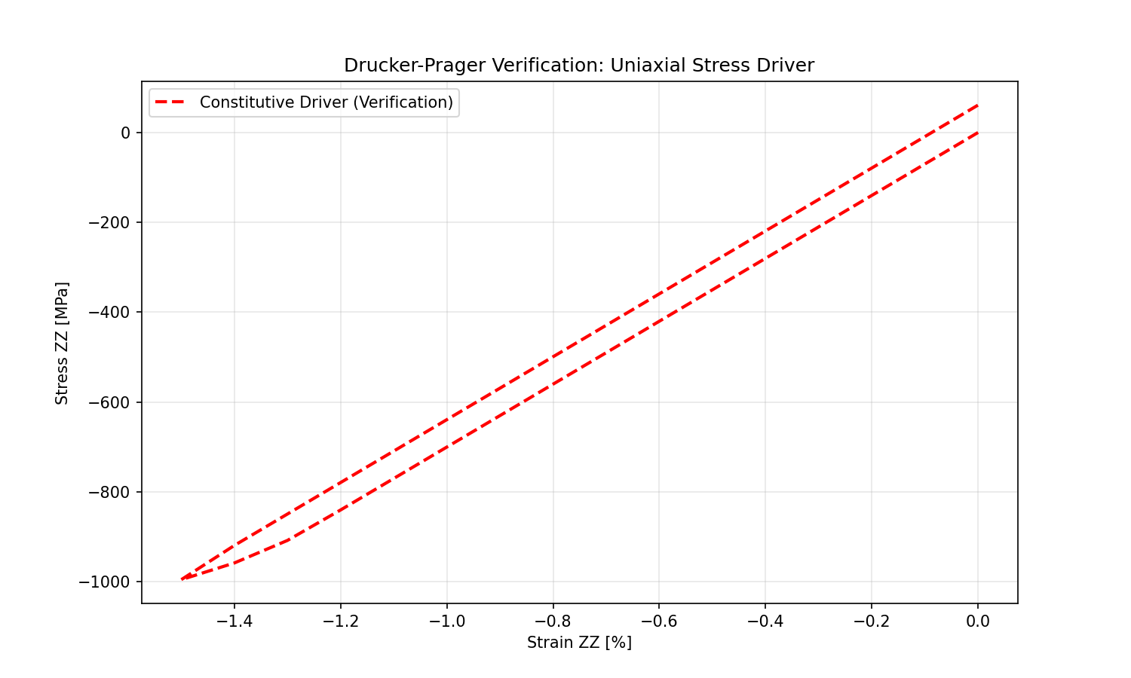
03 // FORWARD VERIFICATION
METHOD: Semi-analytical Constitutive Driver.
  ● Grid-independent single point test.
RESULTS:
  ● Elastic Modulus: 70 GPa (MATCH).
  ● Plastic Tangent: Error 0.00%.
CONCLUSION: Correct Stress Update & Tangent Operator.

Slide 9
04 // THE CHALLENGE
PHENOMENON:
  ● Case A (Small Elastic): Gradient Error 1e-19.
  ● Case B (Large Plastic): Forward OK, Backward FAILS.
ERROR:
  ● Linear solver failed: DIVERGED_DTOL.
  ● Adjoint residual explodes.
INFERENCE: Forward convergence != Adjoint Well-posedness.

Slide 10
05 // DIAGNOSIS (PART 1)
HYPOTHESIS 1: NON-SMOOTHNESS
  ● Test: Perzyna Viscoplasticity.
  ● Result: FAIL.
HYPOTHESIS 2: ZERO HARDENING
  ● Test: Strong Linear Hardening.
  ● Result: FAIL.
HYPOTHESIS 3: SOLVER LIMITATION
  ● Test: MUMPS Direct Solver.
  ● Result: ZERO PIVOT ERROR (Singular Matrix).

Slide 11
05 // DIAGNOSIS (PART 2)
HYPOTHESIS 4: RIGID BODY MODES [ROOT CAUSE]
  ● Analysis: BCs constrained Uz=0 only. Ux, Uy free.
  ● Forward: Symmetric load avoided rigid modes.
  ● Backward: Gradient noise triggered X/Y rigid body motion.
FINAL FIX (STRATEGY 5):
  ● Action: Fully Clamp Bottom Face.
  ● Result: CONVERGED. Gradient Error 1e-16.

Slide 12
06 // CONCLUSION
CORE DISCOVERY:
  ● Adjoint Equation is the strictest test of well-posedness.
  ● AD exposes ALL unconstrained DOFs.
STIFFNESS MATRIX SINGULARITY:
  ● Plasticity reduces stiffness -> Exposes Rank Deficiency.
  ● Eigenvalue analysis is mandatory.

Slide 13
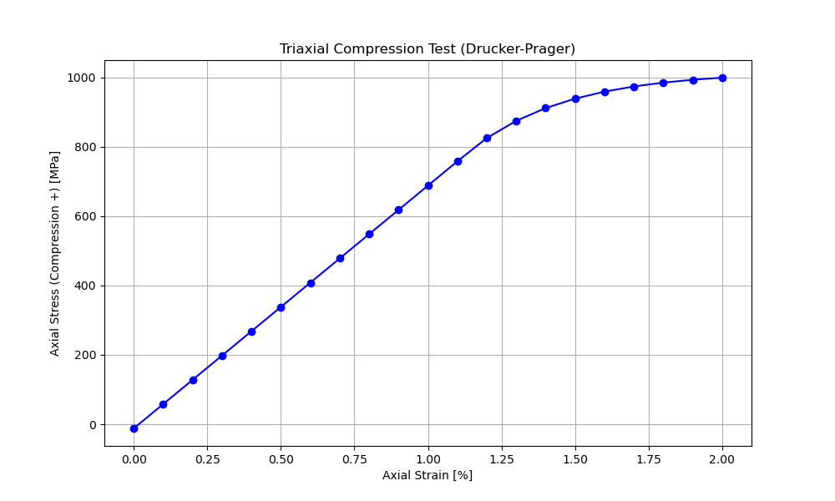
07 // FUTURE WORK
TRIAXIAL DATA INVERSION:
  ● Inverse material params (E, nu, k, phi).
  ● Fit simulation to exp curves.
GPU ACCELERATION:
  ● JAX JIT Compilation.
  ● Orders of magnitude speedup vs CPU.

