Slide 1
Project 1
In essence:
Use libpcap to examine packet captures
Parse packet headers in software to understand the packets
Create lists of data based on what was in the packet captures

Slide 2
Welcome to The Datalink Layer!

Slide 3
Key Concepts
Framing
Sentinel, Counter-Based, Clock-Based
Medium Access
Ethernet, Wireless, Token Ring
Switching and Forwarding
Datagrams, Source Routing, Spanning Tree
Switch Design
Shared bus/memory, Crossbar, Self-routing
Error Detection
CRC, Parity, Checksum

Slide 4
Framing
Breaking bits into manageable units called frame
Implemented by network adaptor
Main approaches
Sentinel-based
Counter-based
Clock-based

Slide 5

Sentinel-based Framing
Delineate frames with a special pattern (e.g., 01111110)‏
Ethernet
Problem: special pattern is in the payload
Solution: Bit stuffing
Sender: insert 0 after 5 consecutive 1s
Receiver: delete 0 that follows 5 consecutive 1s
Commonly used in the Ethernet

Slide 6

Counter-based Framing
Include a payload length field in the header
Problem: count field corrupted
Solution: corruption caught by CRC calculation
This example is from a protocol called Digital Data Communication Message (DDCM)
Commonly used in TCP and IP header

Slide 7
Medium Access
Ethernet (bus)
Wireless (802.11)
Token Ring (FDDI)

Slide 8

Ethernet
Developed by Xerox PARC mid 1970s
Similar to IEEE 802.3 standard
CSMA/CD
Carrier Sense
Multiple Access
Collision Detection
Frame Format
Notes:
CS: able to listen to see if anyone else is transmitting at the same time.
MA: multiple ppl are trying to communicate over the bus at the same time. It will guarantee that they can transmit at the same time but help with error recovery
CD:

Slide 9
Ethernet
Addresses
unique, 48 bit addresses assigned to each NIC
Example: 08:00:E4:B1:02:01 6 bytes
Broadcast: all 1s
Multicast: first bit is 1
Bandwidth: 10Mbps, 100Mbps, 1Gbps
Length: 2500m (500m segments with 4 repeaters)
Problem: fair distributed resource management
Notes:
Repeaters simply broadcasted info to all the other three repeaters. To go over 500m, we needed to use a repeater.
2500 is just length of ethernet segment. It doesn’t mean that Ethernet only supports 2500 length
If multiple stations transmit at the same time, so long the length is under 2500, it can detect collision.
Now ethernets use switches. Can have 2500m upto a switch.

Slide 10
Transmit Algorithm
If line is idle
Send immediately
Upper bound of 1500 bytes
Must wait 9.6 microsecs between frames
If line is busy
Wait until idle, transmit immediately

Slide 11
Collisions
Source A
Source B
Protocol
Violation
Communication
Channel
Unintelligible
Receiver

Slide 12

Collisions
If there is a collision...
Send JAM for 32 bits, then stop transmitting
(Continue sending from a collision so the other will stop)
Minimum frame: 64 bytes (header, plus 46 data)
Delay and try again:
1st time: 0 or 51.2 microseconds
2nd time: 0, 51.2, or 102.4 microseconds
n^{th} time: k * 51.2 microsecs, random k = 0...2^{n-1}
Give up after a lot of tries (usually 16)
Exponential back-off
Doubling the amount of wait time
Notes:
Continue sending from a collision so the other will stop

Slide 13
Ethernet
Ethernet is lousy at fairness and collisions
Why do we still use it?
Cheap
Easy to administer
Multiple access is actually less common
Ethernet hub/repeater are not popular anymore; instead, Ethernet switches are seen more commonly

Slide 14
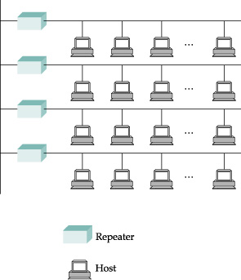
Ethernet Networks
Bus topology, multiple hosts connected to each other
Repeater devices attach segments together
"Hubs" commonly used for this (see notes)
Is this what is used in Ethernet networks today?
NO. Switch based topologies using these old hubs
Notes:
A repeater with more than two ports was commonly called a hub; hubs allowed branching and thus much more complex topologies.
It was the rise of hubs that enabled star topologies in which each host connects directly to the hub rather than to one long run of coax. This in turn enabled twisted-pair cable: while this supported maximum runs of about 100 meters, versus the 500 meters of thick coax, each run simply had to go from the host to the central hub in the wiring closet
While repeaters act at the bit layer, a switch reads in and forwards an entire packet as a unit, and the destination address is consulted to determine to where the packet is forwarded. Except for possible collision-related performance issues, hubs and switches are interchangeable. Eventually, most wiring-closet hubs were replaced with switches.

Slide 15
Wireless
Can use radio or infrared
Infrared diffused, but only about 10m
11Mbps, 54Mbps
With 5G (current), you are transmitting faster than that
Avoiding interference (Spread Spectrum)
Frequency hopping
Direct sequence (chipping code)
Medium Access
Same thing as Ethernet?
Answer on the next slide

Slide 16
Ad-hoc Wireless
Multiple Access Collision Avoidance (MACA)
Request to Send (RTS)
Recipient sends Clear to Send (CTS)
What do you do if
You see a CTS and RTS, someone is communicating with you so you should listen
you see a CTS, but you're not the sender?
you see an RTS, but no corresponding CTS?
The other party is not authorized to send
Or you are not able to hear other party replying (out-of-range)
Other features
ACK signal
Mangled RTS messages?

Slide 17
Wireless with Access Points
Handshaking process:
Mobile device sends Probe
Base station replies with Probe Response
Mobile device sends Association Request
Base station sends Association Response
Active scanning
During an active scan, the client radio transmits a probe request and listens for a probe response from an AP.
Beacons
short, regular transmissions from access points that inform user devices about available Wi-Fi services and nearby access points.

Slide 18
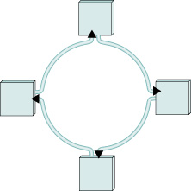
Token Ring
IBM Token Ring (802.5)
Ring of computers
Data travels either clockwise or counter-clockwise, but not both
Not a series of point links
Token allows possessor to speak on the ring
Sent data collected by speaker
Round-robin, limited quantum

Slide 19
Token Ring (2)
Node failure breaks the ring?
Electromechanical Relay can fix it
Multi-station access unit (MSAU)
Dynamic relays, makes it look like a star topology
Access control?
Token: 24 bits
Seize the token, send preamble
Token Holding Time: 10ms
Reservation bits in frame header
Early release vs. delayed release
Confirmed delivery (A bit, C bit)

Slide 20
Token Ring Monitors
Distributed Election
Candidates run (claim token), highest address wins
Monitor must:
Add delay when needed
Ensuring a token exists
Timer used to notice missing token
Reaping checksum errors and orphans
Monitor bit
Detecting subtle breaks with beacons

Slide 21
FDDI (optic fiber) vs. Token Ring
Changes due to fiber instead of copper
Relays not the same
Dual ring structure
4B/5B encoding vs. differential Manchester
Uses control signals instead of illegal encoding

Slide 22
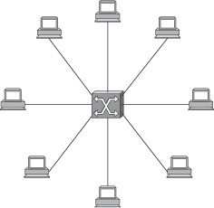
Packet Switching

Slide 23
Switching and Forwarding
Large networks can be constructed with switches
Can connect hosts/switches via point-to-point links
Adding hosts to a switch may not decrease performance for other hosts

Slide 24
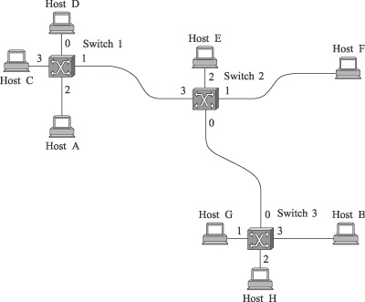
Datagram Switching
Destination | Port
A | 3
B | 0
C | 3
D | 3
E | 2
F | 1
G | 0
H | 0

Slide 25
Datagram Switching (2)
Connectionless / Immediate service
Think of looking at one envelope at a time and forwarding it to its destination
Host never knows if the network can handle the traffic
Packets traverse independently
Even if they are part of the same message
Failures may not bring the network down

Slide 26
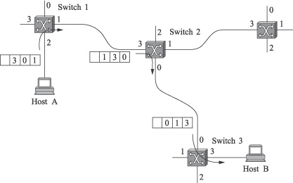
Source Routing
Source provides full switching information in header of packet
Header size?
Become very large
Large networks?
Not great for large n/ws

Slide 27
Implementation and Performance
Commodity machines with several network cards
Direct memory access, CPU header inspection
I/O and memory bandwidth limiting component
Packets copied twice
Small packets require more header lookups
Specially designed switches avoid this contention with hardware

Slide 28
Switch Design
Input/Output Ports, Switching Fabric (n/w topology)
Fabric has big impact on the performance
Fabric very simple: takes packet from input port to output port
Self-routing fabrics do the heavy lifting themselves
FIFO queue can lead to head-of-line blocking
Traffic bottlenecks like in Worcester
Pure output buffering

Slide 29
Switching Fabric
Shared Bus
Shared Memory
High speed memory, avoids I/O bus
Crossbar
Every input has direct channel to every output
Self-routing
Hierarchy of cross-bar switches

Slide 30
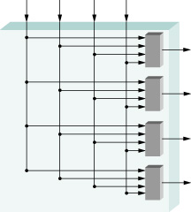
Crossbar Switching

Slide 31
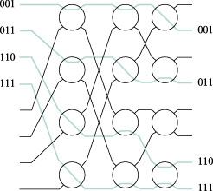
Self-Routing Fabric

Slide 32
Circuit Switching
Seeking out and establishing a physical copper path from end-to-end [historic definition] .
Circuit switching implies the need to first set up a dedicated, end-to-end path for the connection before the information transfer takes place.
Once the connection is made, the only delay is propagation time.

Slide 33
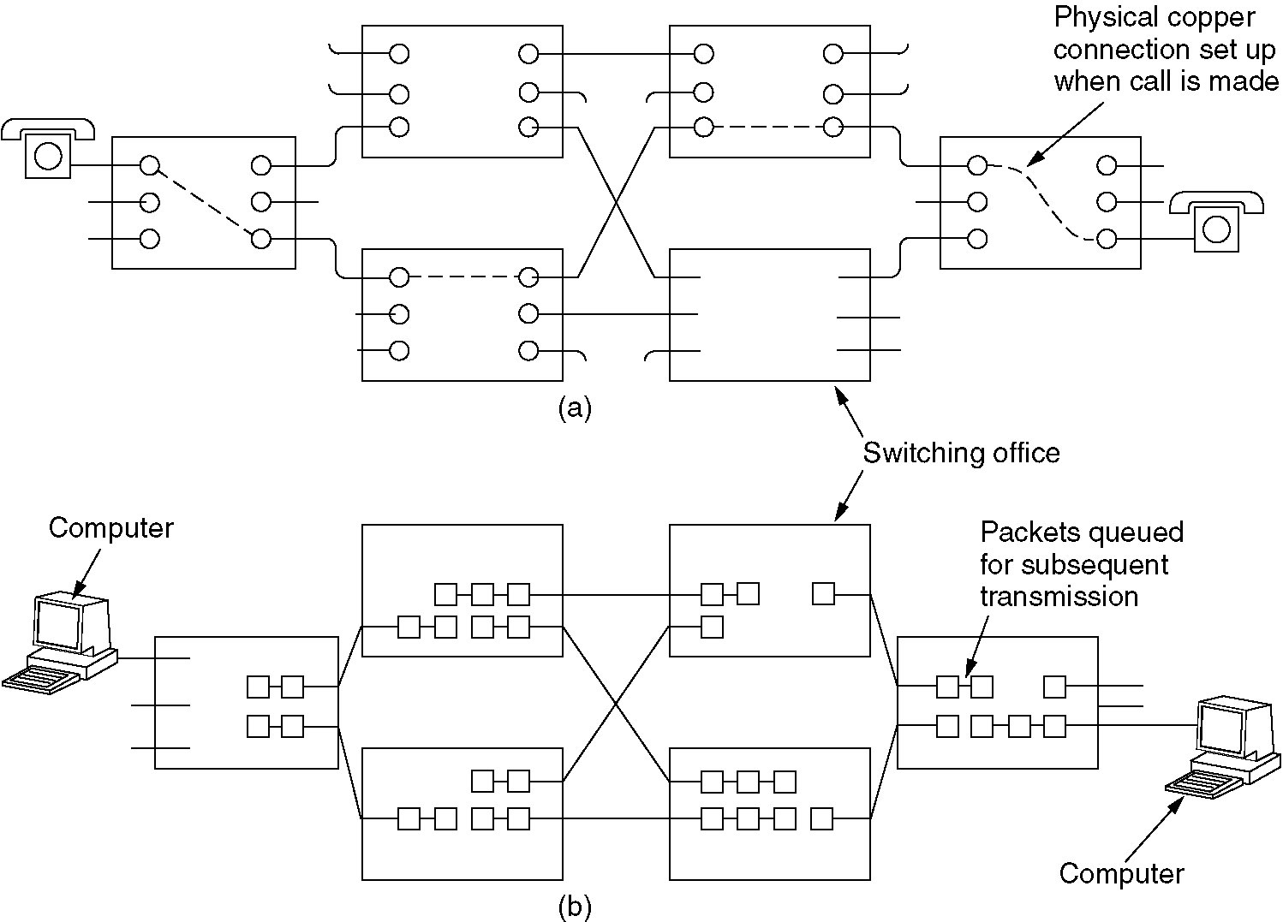
Circuit Switching
Figure 2-38. (a) Circuit switching. (b) Packet switching.
Tanenbaum

Slide 34

Network Core: Circuit Switching
End-end resources reserved for “call”
link capacity, router buffer space
dedicated resources: no sharing
circuit-like (guaranteed) performance
call setup required

Slide 35
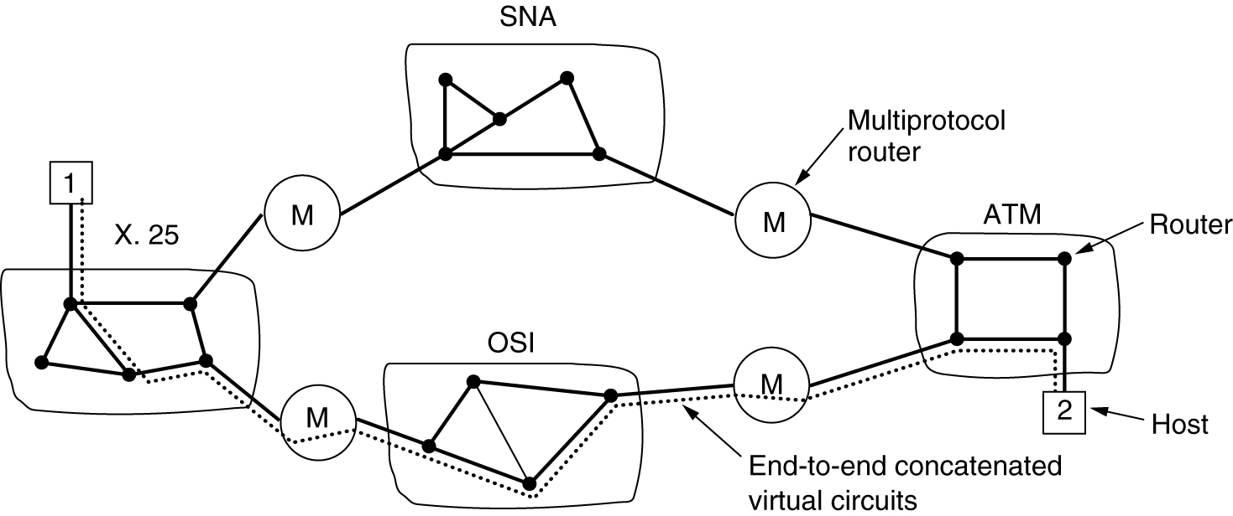
Connection-Oriented Virtual Circuits
Figure 5-45.Internetworking using concatenated
virtual circuits.
Tanenbaum

Slide 36
Store-and-Forward Networks
Intermediate processors (IMPS, nodes, routers, gateways, switches) along the path store the incoming block of data.
Each block is received in its entirety at the router, inspected for errors, and retransmitted along the path to the destination.
This implies buffering at the router and one transmission time per hop.

Slide 37
Message Switching
A store-and-forward network where the block of transfer is a complete message.
Since messages can be quite large, this can cause:
buffering problems at the router.
high mean delay times.

Slide 38
Packet Switching
A store-and-forward network where the block of transfer is a complete packet.
A packet is a variable length block of data with a fixed upper bound.
**Using packets improves mean message delay.

Slide 39
Packet Switched Networks
Connection-Oriented Protocols
A setup stage is used to determine the end-to-end path before a connection is established.
Data flow streams are identified by some type of connection indicator (e.g. OSI, X.25, SNA, ATM).

Slide 40
Packet Switched Networks
Connectionless Protocols
No set up is needed.
Each packet contains information which allows the packet to be individually routed hop-by-hop through the network.
Split and adaptive routing techniques are possible.

Slide 41
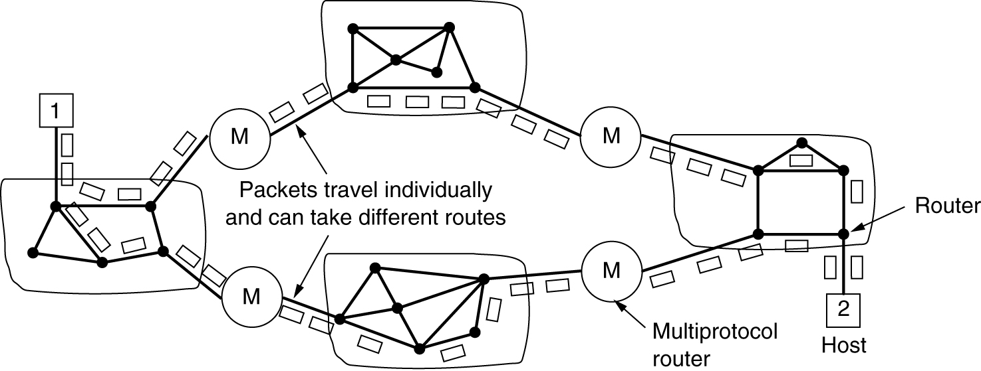
Connectionless Internetworking
Figure 5-46. A connectionless internet.
Tanenbaum

Slide 42
Datagram vs Virtual Circuit
Datagram Routing
Each datagram packet may be individually routed.
Virtual Circuit Routing
In virtual circuit, set up is required.
All packets in a virtual circuit follow the same path through the network.

Slide 43
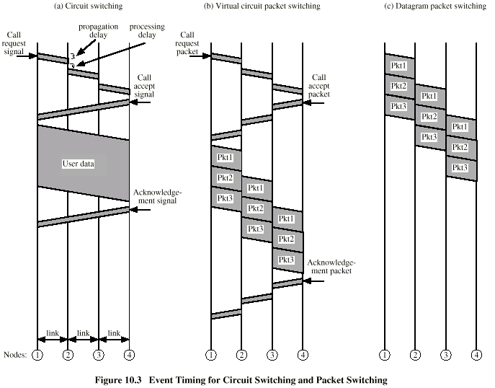
Transmission Event Timing
DCC 6th Ed., W. Stallings, Figure 10.3

Slide 44
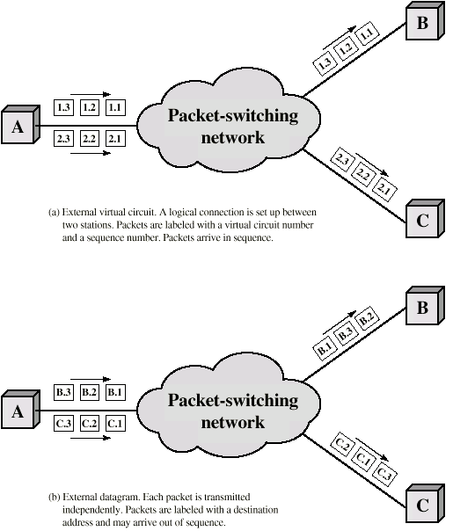
Virtual Circuit and
Datagram Operation
DCC 6th Ed.,
W. Stallings,
Figure 10.4

Slide 45
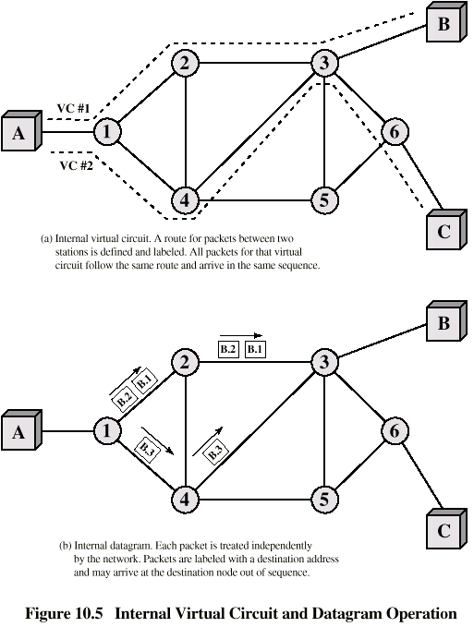
Virtual Circuit and Datagram Operation
DCC 6th Ed.,
W. Stallings,
Figure 10.5

Slide 46
Networking Switching Summary
Circuit-switching and message switching are now obsolete.
Store-and- forward, datagram packet switching (IP routers) dominates the Internet.
Cell switching and virtual circuits (ATM switches) still exists in ATM networks.
The external protocol abstraction to the subnet may differ from the internal subnet view.
e.g., TCP is a connection-oriented protocol that runs on top of a datagram IP protocol.

