Slide 1

The Mighty Physical Layer
Notes:
Talks about rest of the layers now.
Physical layer encodes information to send from one party to the next.
Physical layer consists of devices and means of transmitting bits across networks. 1s and 0s are sent over the wires through modulation (varying the voltage of charge across the cable)

Slide 2
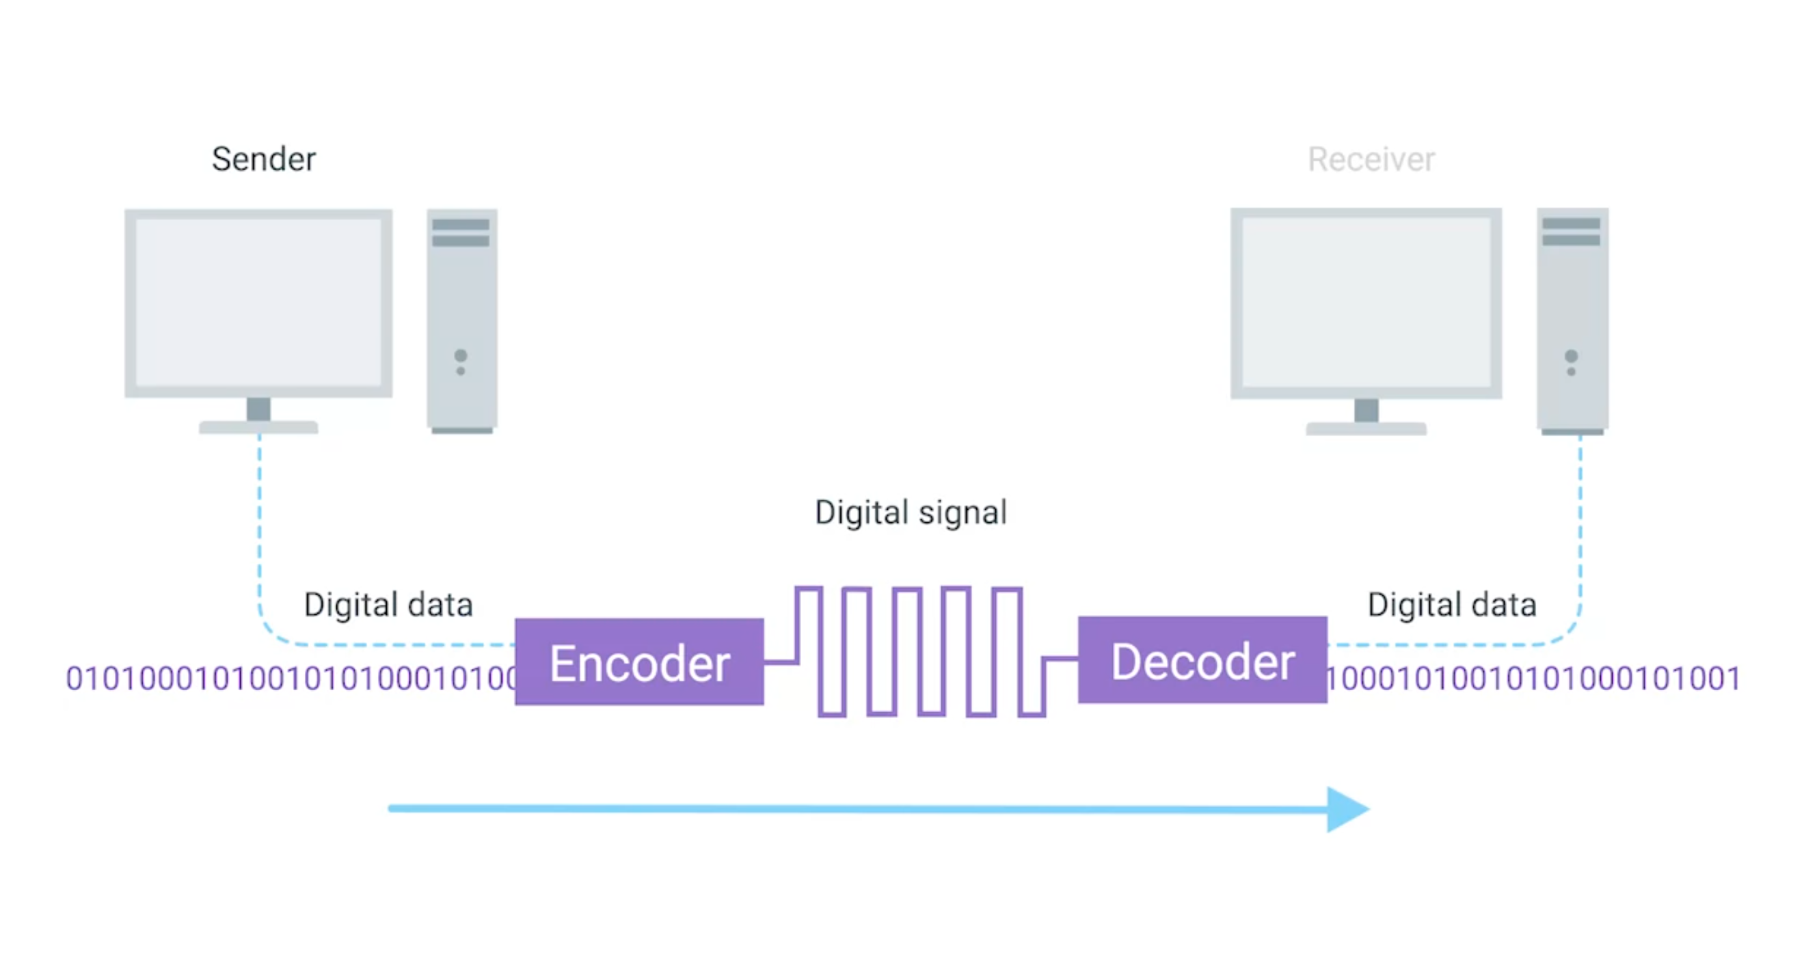
Moving bits across the wire
Source: Google Images
Notes:
Modern networks are able to move 10 billion 0s and 1s per second over the network simply by using modulation

Slide 3
Physical Layer Definitions
The time required to transmit a character depends on both the encoding method and the signaling speed (i.e., the modulation rate - the number of times/sec the signal changes its voltage).
baud (D) - the number of changes per second.
bandwidth (H) - the range of frequencies that is passed by a channel. The transmitted signal is constrained by the transmitter and the nature of the transmission medium in cycles/sec (hertz).
channel capacity (C) – the rate at which data can be transmitted over a given channel under given conditions.{This is also referred to as data rate (R).}

Slide 4
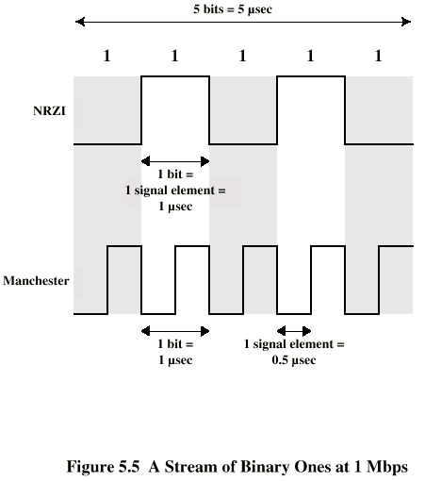
Modulation Rate
modulation rate
is doubled
DCC 6th Ed.
Stallings
There will be either 1 or 2 transitions per unit time based on the encoding scheme.

Slide 5
Analog and Digital Signaling
signals:: electric or electromagnetic encoding of data.
signaling:: is the act of propagating the signal along a suitable medium.
Analog signal – a continuously varying electromagnetic wave that may be propagated over a variety of medium depending on the spectrum (e.g., wire, twisted pair, coaxial cable, fiber optic cable and atmosphere or space propagation).

Slide 6
Analog and Digital Signaling
digital signal – a sequence of voltage pulses that may be transmitted over a wire medium.
Note – analog signals to represent analog data and digital signals to represent digital data are not the only possibilities.
There is where modems (mux-demux) and codecs (compression-decompression) come into the picture.
Notes:
Modem: computer hardware device that converts data from a digital format into a format suitable for an analog transmission medium such as telephone or radio

Slide 7
Multiplexing
Multiplexing {general definition} :
Sharing a resource over time.
(a) Dedicated channels
(b) Sharing the comm link b/w processes
A
A
A
Trunk
group
A
B
B
B
MUX
MUX
B
C
C
C
C
Really needed when a client and server have multiple processes running.
Leon-Garcia & Widjaja:
Communication Networks

Slide 8
Frequency Division Multiplexing (FDM) vs Time Division Multiplexing (TDM)
Example:
FDM
4 users
frequency
time
TDM
frequency
K & R
time
Notes:
Two simple multiple access control techniques. When we divide in half (look at the dotted line) called DUPLEX channel, we are able to allows hosts to transmitting at the same time. Say party A is communicating with party B using FDM, both are able to transmit at the same time just at different frequencies. In TDM, we do the same, we divide each time units into half giving it even less time to transmit but allowing it to receive in the next timestamp.
https://www.linkedin.com/advice/3/how-do-you-choose-between-tdm-fdm-circuit-switched
Each mobile’s share of the bandwidth is divided into portions for the uplink and the downlink. Also, possibly, out of band signaling.
As we will see, used in AMPS, GSM, IS-54/136

Slide 9
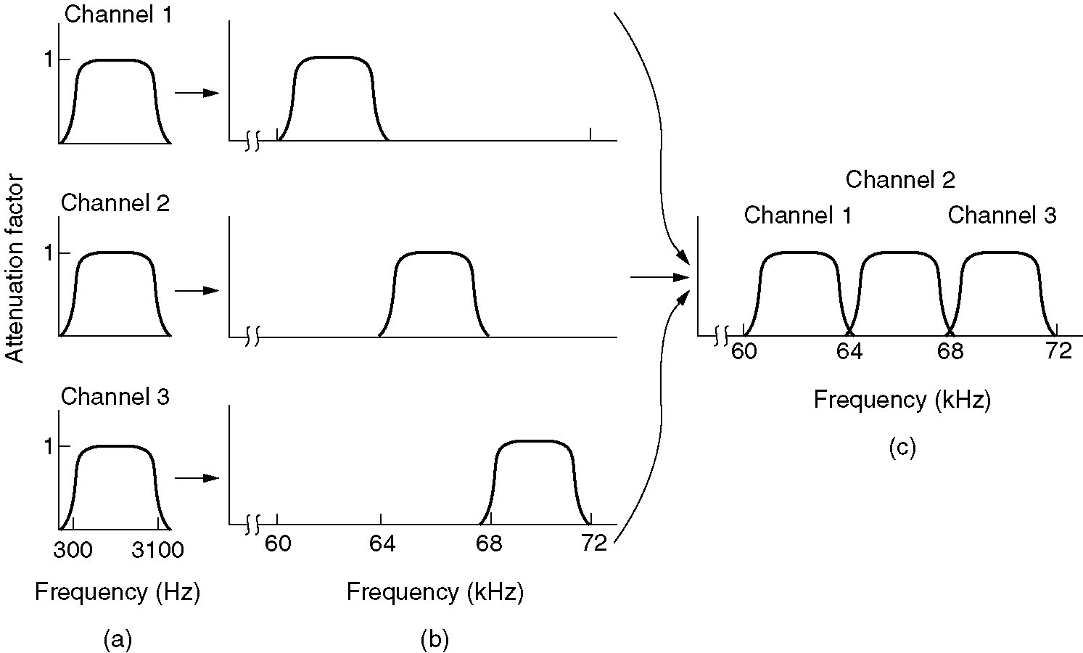
Frequency Division Multiplexing
Figure 2-31. (a) The original bandwidths. (b) The bandwidths raised in frequency. (c) The multiplexed channel.
Tanenbaum

Slide 10
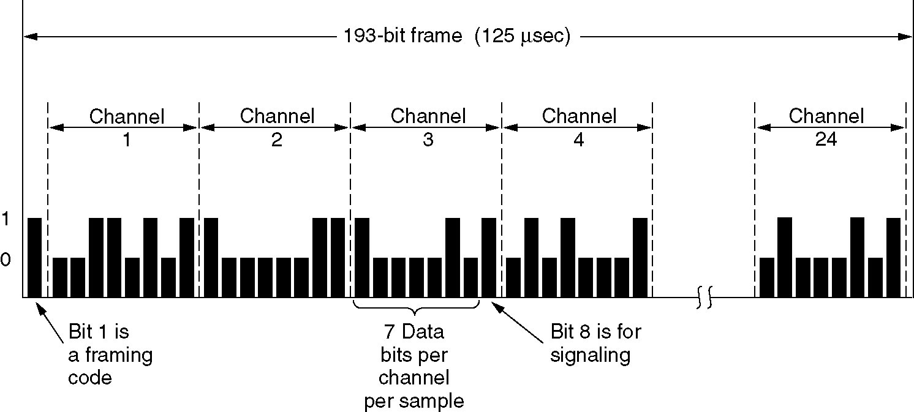
T1 - TDM Link
TDM: each host gets a fixed slot in revolving TDM frame
TDM: each host gets same slot in revolving TDM frame
Figure 2-33.T1 Carrier (1.544Mbps)
Tanenbaum

Slide 11
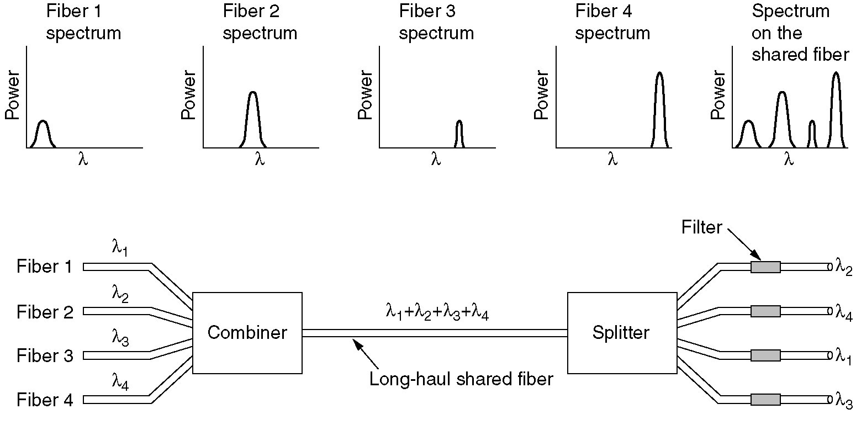
Wavelength Division Multiplexing
Wavelength division multiplexing.
Figure 2-32.
Tanenbaum
This is basically FDM typically using light waves

Slide 12
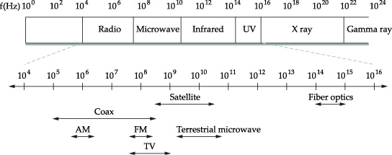
Electromagnetic Spectrum
As freq increases, number of bit changes increases => high freq lets you send more bits/time unit

Slide 13
Cabling
Fiberoptic
Category 5/5e/6 twisted pair
Pulling wire is the most expensive part
Leased lines
Purchased through the telephone company
Not really a new line run for you
Provisioned so that it should appear that way

Slide 14
Common Local Link Cabling
CAT 5 10-100Mbps 100m
Thin-net coax 10-100Mbps 200m
Thick-net coax 10-100Mbps 500m
Multimode fiber 100Mbps 2km
Single-mode fiber 100-2400Mbps 40km
Check out: https://learning.oreilly.com/videos/comptia-network-certification/9781803249797/9781803249797-video2_2/

Slide 15
Twisted Pair Cable
Most common type of cabling used for connecting computing devices
It features pairs of copper wires that are twisted together. These pairs act as a single conduit for information and their twisted nature helps protect against electromagnetic interference and cross-talk from neighboring pairs.
Duplex vs. simplex (unidirectional) communication
https://learning.oreilly.com/videos/comptia-network-certification/9781803249797/9781803249797-video2_3/
Notes:
A standard Cat six cable has eight wires
consisting of four twisted pairs inside a single jacket.
Exactly how many pairs are actually in
use depends on the transmission technology being used.
But in all modern forms of networking,
it's important to know that
these cables allow for duplex communication.
Duplex communication is the concept that
information can flow in both directions across the cable.
On the flip side, a process called
simplex communication is unidirectional.
The way networking cables ensure that
duplex communication is possible
is by reserving one or two pairs
for communicating in one direction.
They then use the other one or two pairs
for communicating in the other direction.

Slide 16
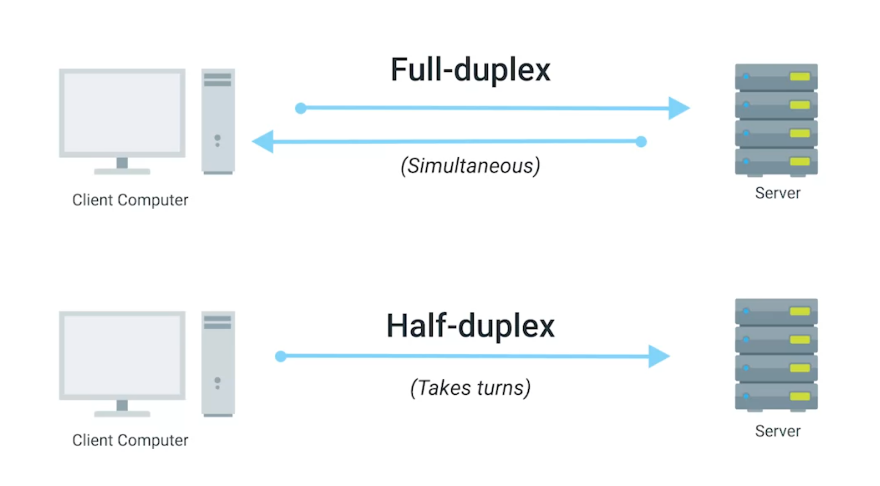
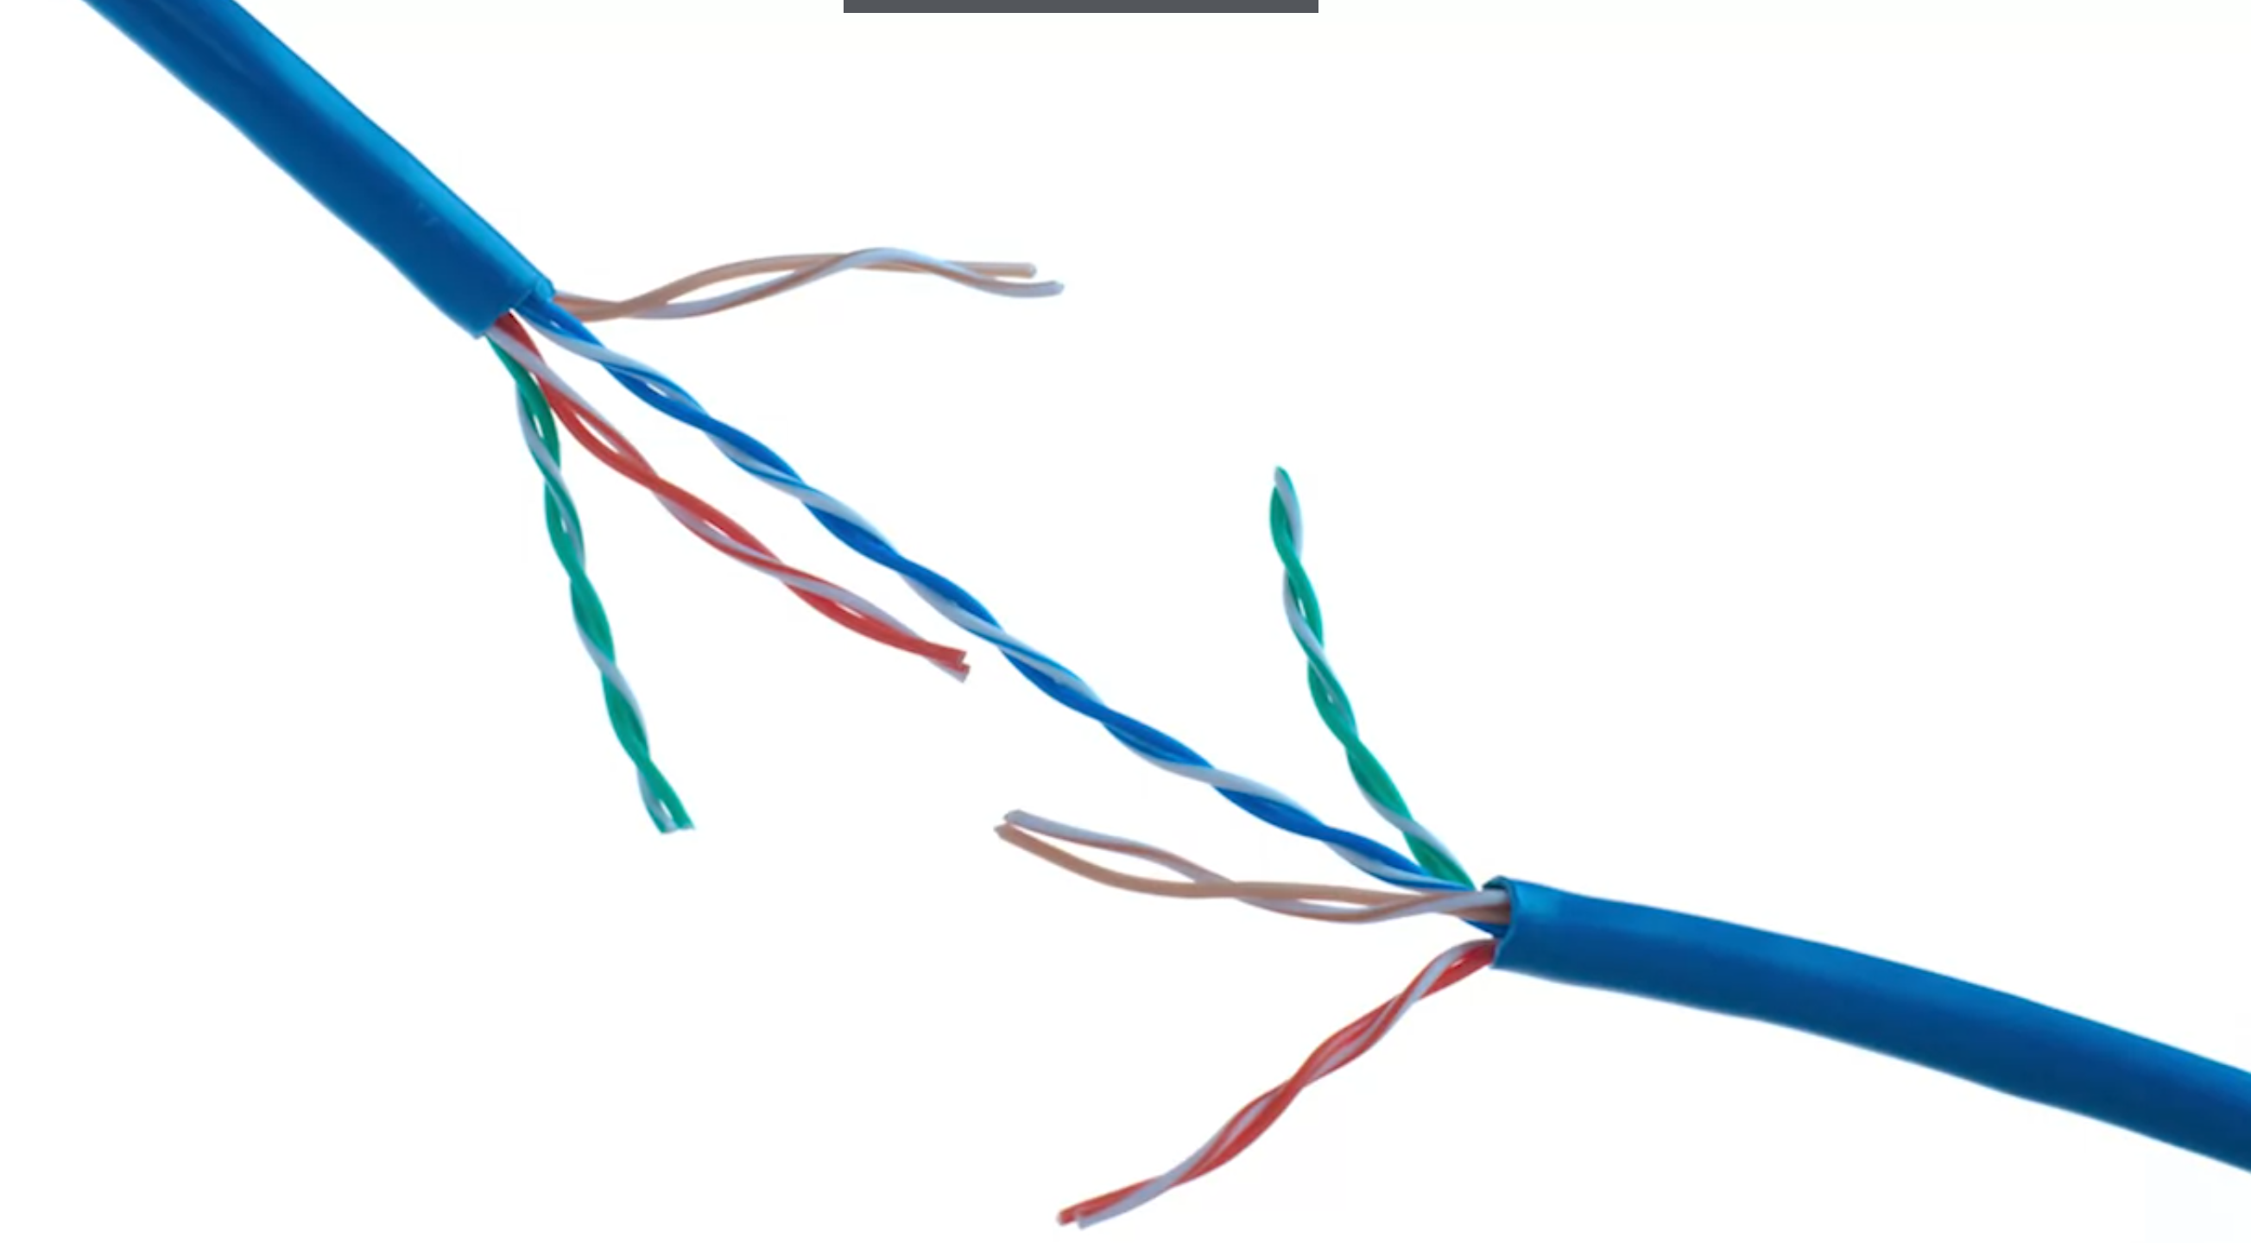
Duplex Communication
The concept that information can flow in both directions across the cable.
CAT6 cable: 8 wires with 4 twisted pairs

Slide 17
Carrier Bandwidths
DS1/T1 1.544 Mbps
DS3/T3 44.736 Mbps
STS1/OC1 51.840 Mbps
STS3/OC3 155.250 Mbps
STS12/OC12 622.080 Mbps
STS48/OC48 2.49 Gbps
STS192/OC192 9.95 Gbps

Slide 18
Other Services
POTS 28.8-56 Kbps
ISDN 64-128 Kbps
xDSL 16 Kbps-55.2 Mbps
CATV 20-40 Mbps
Wireless Links?
3G
4G

Slide 19

Encoding Bits on a Wire
Signals propagate over a physical medium
Modulating electromagnetic waves (vary voltage)‏
Encode binary data into the signals
0 = low; 1 = high
Non-Return to Zero (NRZ) encoding

Slide 20
NRZ Problems
Sequence of consecutive zeros or ones
Baseline wander
Receiver averages line voltage to estimate high vs. low signal
Consecutive 0s/1s pushes the average around
Clock recovery broken
Sender/receiver clocks must be synchronized
High/low bits help make resynching possible

Slide 21
NRZ Inverted (NRZI)‏
Stay at the current signal to send a 0
Transition from high to low (or low to high) to send a 1
Helps with consecutive 1s
What about consecutive 0s?

Slide 22
Manchester Encoding
Merges clock with exclusive-OR of the data being transmitted using NRZ.
Clock goes from low to high once each clock cycle.
A zero is a low-to-high transition and a one is a high-to-low transition
Doubles rate of signal transitions on the wire
50% efficiency

Slide 23
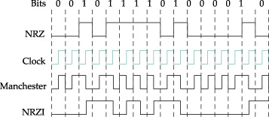
Encoding Diagram

Slide 24
4B/5B Encoding
Translation table from original bits into bit pattern with some variation in the bits.
Examples:
0000 → 11110 1111 → 11101
No more than 1 leading 0, no more than 2 trailing 0s. Therefore, no more than 3 0's in a row.
Sent using NRZI
What about consecutive 1s? Taken care of BY NRZI!
80% efficiency

Slide 25
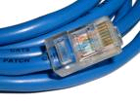
Physical Media: Twisted Pair
Bit: propagates between transmitter/receiver pairs.
physical link: what lies between transmitter & receiver.
guided media:
signals propagate in solid media: copper, fiber, coax.
unguided media:
signals propagate freely, e.g., radio.
Unshielded Twisted Pair (UTP)
two insulated copper wires
Category 3: traditional phone wires, 10 Mbps Ethernet
Category 5 : 100Mbps Ethernet

Slide 26


Physical Media: Coaxial Cable and Optical Fiber
Coaxial cable:
two concentric copper conductors
bidirectional
baseband:
single channel on cable
High speed w/o modulation
legacy Ethernet
broadband:
multiple channels on cable
Fiber optic cable:
glass fiber carrying light pulses, each pulse a bit
high-speed operation:
point-to-point transmission (e.g., 10’s-100’s Gps)
low error rate: repeaters spaced far apart ; immune to electromagnetic noise.

Slide 27
Physical Media: Radio Signals
signal carried in electromagnetic spectrum.
no physical “wire”
bidirectional
propagation environment effects:
reflection
obstruction by objects
interference
Radio link types:
terrestrial microwave
e.g. up to 45 Mbps channels
LAN (e.g., Wifi)
11Mbps, 54 Mbps
wide-area (e.g., cellular)
3G cellular: ~ 1 Mbps
satellite
Kbps to 45Mbps channel (or multiple smaller channels)
270 msec end-end delay
geosynchronous versus low altitude

Slide 28
Dial-up Modem
central office
telephone
network
Internet
home
PC
home dial-up
modem
ISP modem
(e.g., AOL)
Uses existing telephony infrastructure.
Home is connected to central office (analog signals).
up to 56Kbps direct access to router (often less)
Can’t surf and phone at same time: not “always on”.

Slide 29
Digital Subscriber Line (ADSL)
Existing phone line: 0-4KHz phone; 4-50KHz upstream data; 50KHz-1MHz downstream data
Internet
home
phone
DSLAM
Asymmetric DSL
telephone
network
splitter
DSL
modem
central
office
home
PC
Uses existing telephone infrastructure (uses modems)
up to 1 Mbps upstream (today typically < 256 kbps)
up to 8 Mbps downstream (today typically < 1 Mbps)
dedicated physical line to telephone central office
Limited range; need to be close to the recipient

Slide 30
Residential Access: Cable Modems
Modem – modulator and demodulator
Does not use telephone infrastructure
Instead uses cable TV infrastructure.
HFC: hybrid fiber coax
asymmetric: up to 30Mbps downstream, 2 Mbps upstream
network of cable and fiber attaches homes to ISP router:
homes share access to router
unlike DSL, which has dedicated access.

Slide 31
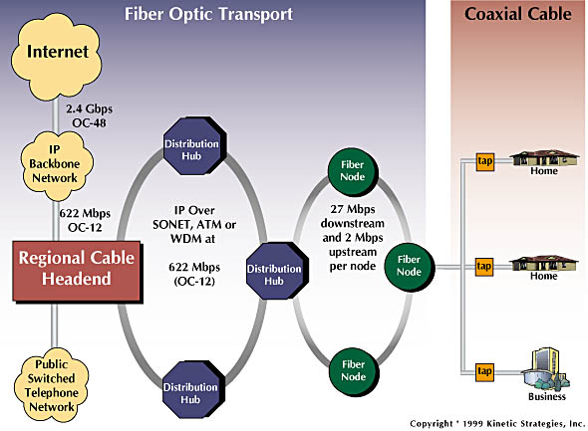
Residential Access: Cable Modems
Diagram: http://www.cabledatacomnews.com/cmic/diagram.html
Notes:
Coaxial cable of a cable modem network is the neighborhood scale of communication. A neighborhood where multiple residences are using a cable modem from the same provider, they will each tap into the coax network and receiving shared broadcast from cable moder provider from an ISP -> modem at ISP -> fiber communication

Slide 32

Cable Network Architecture: Overview
Typically 500 to 5,000 homes
cable headend
cable distribution
network (simplified)
home

Slide 33
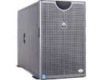
Cable Network Architecture: Overview
server(s)
cable headend
cable distribution
network
home

Slide 34
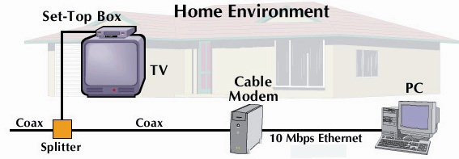
Cable Network Architecture: Overview
cable headend
cable distribution
network (simplified)
home

Slide 35
Cable Network Architecture: Overview
FDM
C
O
N
T
R
O
L
V
I
D
E
O
V
I
D
E
O
V
I
D
E
O
V
I
D
E
O
V
I
D
E
O
V
I
D
E
O
D
A
T
A
D
A
T
A
1
2
3
4
5
6
7
8
9
Channels
cable headend
cable distribution
network
home

Slide 36
Fiber to the Home
ONT
Internet
optical fibers
optical fiber
ONT
OLT
optical
splitter
central office
ONT
Optical links from central office to the home
Two competing optical technologies:
Passive Optical network (PON)
Active Optical Network (AON)
Higher Internet rates. Fiber also carries television and phone services.

Slide 37
Ethernet Internet Access
100 Mbps
Institutional
router
Ethernet
switch
To Institution’s ISP
100 Mbps
1 Gbps
100 Mbps
server
Typically used in companies, universities, etc
10 Mbs, 100Mbps, 1Gbps, 10Gbps Ethernet
Today, end systems typically connect into Ethernet switch.

Slide 38
Wireless Access Networks
Shared wireless access network connects end system to router
via base station aka “access point”.
Wireless LANs:
802.11b/g/n (WiFi): 11, 54, 200 Mbps
Range becomes an issue due to obstacles like buildings
Wider-area Wireless Access
provided by telco operator
~1Mbps over cellular system (EVDO, HSDPA) 3G and 4G, 5G coming
Higher throughput over a longer range
next up (?): WiMAX (10’s Mbps) over wide area
Fixed 5G (a lot of access points, possibly linked by fiber b/w access points)
router
base
station
mobile
hosts
Notes:
Higher frequency is good but shorter distance

Slide 39
Residential Networks
Typical Residential Network Components:
DSL or cable modem
router/firewall/NAT
Ethernet
wireless access point (AP)
wireless
laptops
to/from
cable
headend
cable
modem
router/
firewall
wireless
access
point
Ethernet

Slide 40
Physical Layer Summary
Definitions (analog versus digital)
Multiplexing (FDM, TDM, statistical)
Transmission Media (UTP, Coax, Fiber, Radio, Satellite)
End System Choices (Dial-Up, ADSL, Cable, Ethernet, Wireless AP, Fiber-to-the Home)
Residential Configurations

