Slide 1
Recap: Layer 2 Addressing
Devices on the network have 2 addresses:
MAC address: layer 2 address
IP address – layer 3 address (future lessons)
Devices need both addresses to reach a destination:
MAC address identifies a device on the local network
IP addresses identifies a device outside the local network

Slide 2
MAC addresses
Stands for Media Access Control
48-bit address that is burned on the network interface 6 bytes.
It is the physical address of the device, also known as the real address
Example: 00:CC:34:D3:B4:23
Represented as 6 groups of 2 hexadecimal digits, separated by colons
When converted to binary, every hex character is represented by four bits, resulting in a 48-bit address

Slide 3
Activity
Try this for your own hardware:
https://www.wireshark.org/tools/oui-lookup.html
The first three groups are together known as OUI – Organization Unit Identifier
OUI identifies the manufacturer of the n/w equipment
Broadcast MAC address: all F’s FF:FF:FF:FF:FF:FF (reaches all hosts on the same network)

Slide 4
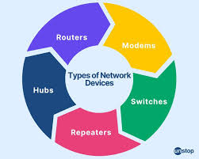
Network Devices

Slide 5
Repeater & Hub
Repeater is a Layer 1 device, used to repeat signals
It receives a signal and retransmit it
Hub is a Layer 1 device that operates in half duplex mode – this means you can send or receive data at any time.
Has multiple input and output ports allowing multiple devices to connect
Data received on one port is forwarded out all other ports (single broadcast domain)
Has no intelligence of its own so it cannot learn MAC addresses
Not great from a security standpoint because everyone receives a copy of the data.

Slide 6
Bridge
Layer 2 device that learns MAC addresses
Uses a Content Addressable Memory (CAM) table to store port and MAC address information
Frame forwarding is s/w based
Working of bridges and switches is thoroughly discussed in Lab 2
When a frame is received for the first time the source port and MAC address is added to CAM table
The frame is then forwarded out all ports other than on which it was received because it is not known on which port the destination is connected
Once a response is received, the dest port and the MAC address is added to the CAM table
Next time a frame is received for which the port is known, its only forwarded out that port.

Slide 7
Switch
Layer 2 device similar to bridge – learns MAC addresses
Single broadcast domain – every connected device gets broadcast messages. Every port on a switch is the same LAN
Specialized chips are used for frame forwarding, resulting in better performance
Supports VLANs

Slide 8
Router
Layer 3 device that routes packets b/w different networks
Uses routing tables to make routing decisions
On a router, each port is its own broadcast domain
More in future lessons when we discuss Layer 3
Routing Table
192.168.1.0/24 | Interface 0
10.1.1.0/24 | Interface 1

Slide 9
Broadcast and Multicast
Broadcast is pretty simple
Send to all but sender
Multicast could be (and is) done the same way
Better trick would be to use learning bridge method
A learning bridge listens to all frames in two LAN segments and learns the location of each physical address. It also operates similarly to layer 2 switches, learning which computers are on each side of the bridge.

Slide 10
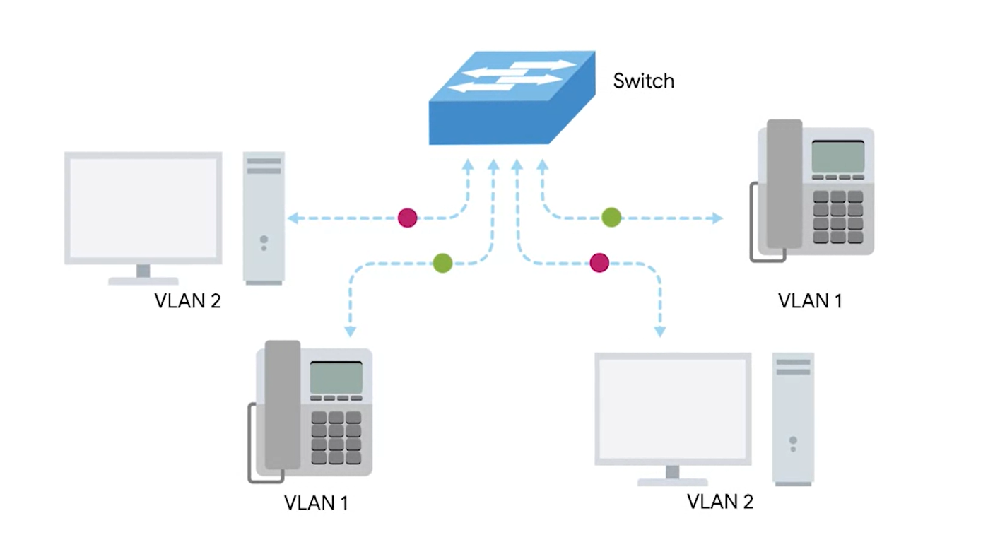
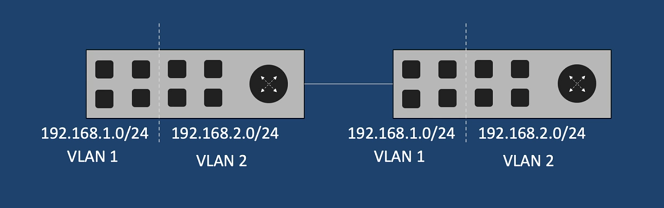
SOLUTION: Virtual LAN (VLAN)
Solution to the problem with broadcasting
A technique that lets you have multiple logical LANs operating on the same physical equipment
Example: you can isolate security cameras in your organization by putting them on a VLAN protected by a firewall so not intruder can port scan and get access to this isolated VLAN

Slide 11
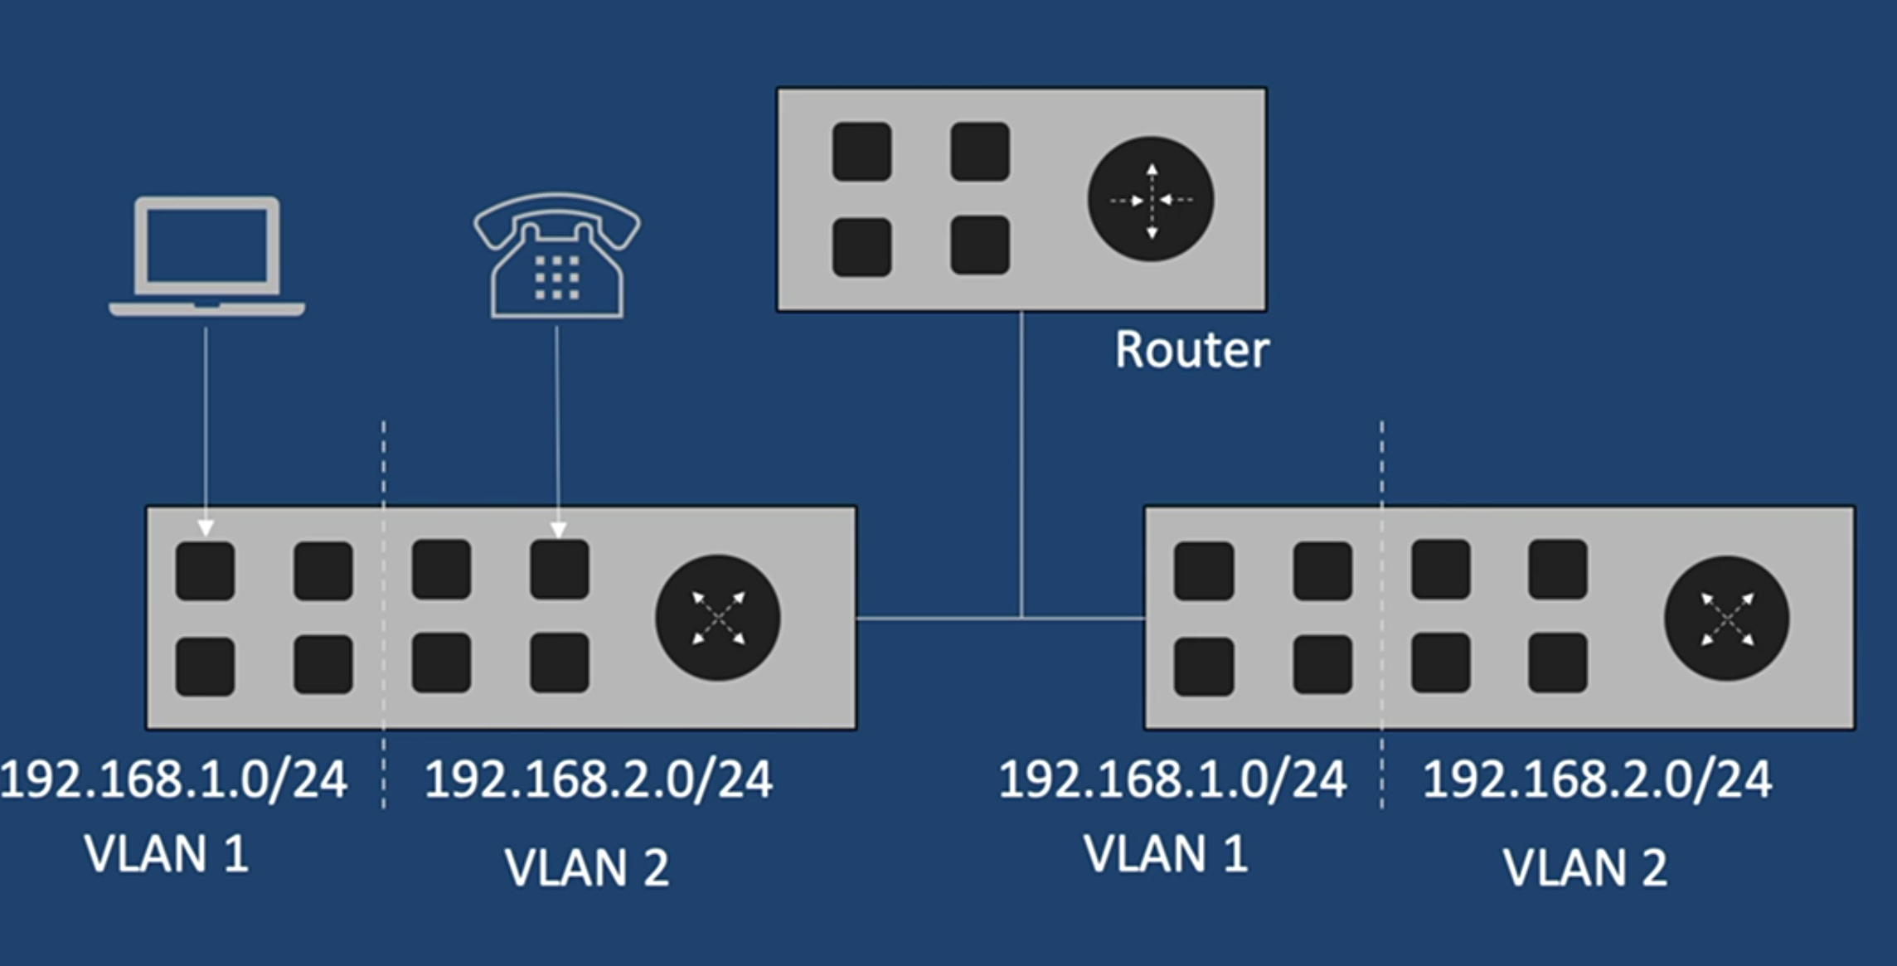
VLAN
By default, VLANs do not talk to each other
Layer 3 device is needed for the communication
Different policies can be applied to traffic coming from different VLANs
Say, prioritizing voice traffic over data
Prioritizing data for customers paying more $$ vs those who have cheaper internet packages

Slide 12
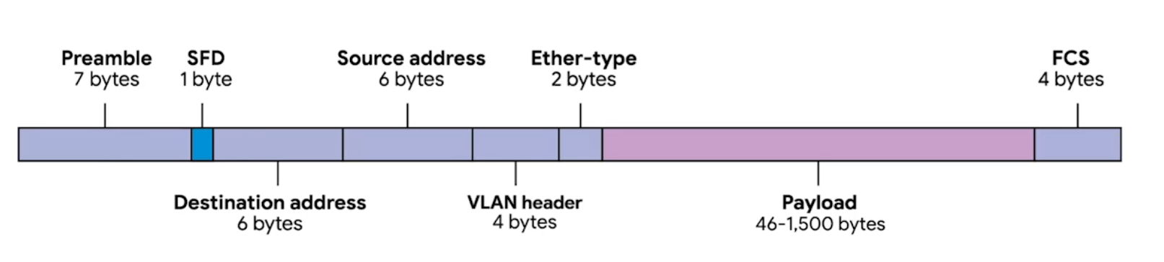
Dissecting an Ethernet Frame
An Ethernet Frame is a highly structured collection of information presented in a specific order.
network interfaces at the physical layer can convert a stream of bits traveling across a link into meaningful data or vice versa.
Almost all sections of an Ethernet frame are mandatory, and most of them have a fixed size.
Keeping in mind, each MAC address is 48 bits
Notes:
An Ethernet frame is
a highly structured collection of
information presented in a specific order.
This way, network interfaces
at the physical layer can convert a stream
of bits traveling across
a link into meaningful data or vice versa.
Almost all sections of an Ethernet frame are mandatory,
and most of them have a fixed size.
The first part of an Ethernet frame
is known as the preamble.
A preamble is eight bytes or 64 bits long,
and can itself be split into two sections.
The first seven bytes are a series
of alternating ones and zeros.
These act partially as a buffer
between frames and can also be used by
the network interfaces to
synchronize internal clocks they
use to regulate the speed at which they send data.
This last byte in the preamble is known as the SFD,
or start frame delimiter.
This signals to a receiving device that the preamble is
over and that the actual frame contents will now follow.
Immediately following the start frame delimiter,
comes the destination MAC address.
This is the hardware address of the intended recipient,
which is then followed by the source MAC
address or where the frame originated from.
Don't forget that each MAC address is
48 bits or six bytes long.
The next part of an Ethernet frame
is called the Ether-type field.
It's 16 bits long and used to
describe the protocol of the contents of the frame.
We'll be doing a deep dive on what
these protocols are a little later.
It's worth calling out that
instead of the Ether-type field,
you can also find what's known as a VLAN header.
It indicates that the frame
itself is what's called a VLAN frame.
If a VLAN header is present,
the Ether-type field follows it.
VLAN stands for virtual LAN.
It's a technique that lets you have
multiple logical LANs operating
on the same physical equipment.
Any frame with a VLAN tag will only be delivered out of
a switch interface configured to relay that specific tag.
This way, you can have
a single physical network that
operates like its multiple LANs.
VLANs are usually used to
segregate different forms of traffic.
You might see a company's IP phones operating on
one VLAN while all desktops operate on another.
After this, you'll find
the data payload of an Ethernet frame.
A payload in networking terms
is the actual data being transported,
which is everything that isn't a header.
The data payload of a traditional Ethernet frame
can be anywhere from 46-1500 bytes long.
This contains all of the data from higher layers,
such as the IP, transport,
and application layers that actually being transmitted.
Following that data, we have what's
known as a frame check sequence.
This is a four-byte or 32-bit number
that represents a checksum value for the entire frame.
This checksum value is calculated by performing
what's known as a cyclical
redundancy check against the frame.
A cyclical redundancy check, or CRC,
is an important concept for
data integrity and is used all over computing,
not just network transmissions.
A CRC is basically
a mathematical transformation that uses
polynomial division to create
a number that represents a larger set of data.
Anytime you perform a CRC against a set of data,
you should end up with the same checksum number.
The reason it's included in an Ethernet frame is so that
the receiving network interface can
infer if it received uncorrupted data.
When a device gets ready to send an Ethernet frame,
it collects all the information we just covered,
like the destination and originating MAC addresses,
the data payload, and so on.
Then it performs a CRC against that data and attaches
the resulting checksum number as
the frame check sequence at the end of the frame.
This data is then sent across
a link and received at the other end.
Here, all the various fields
of the Ethernet frame are collected,
and now the receiving side
performs a CRC against that data.
If the checksum computed by the receiving end
doesn't match the checksum
in the frame check sequence field,
the data is thrown out.
This is because some amount of data
must have been lost or corrupted during transmission.
It's then up to a protocol at
a higher layer to decide
if that data should be retransmitted.
Ethernet itself only reports on data integrity,
it doesn't perform data recovery.

Slide 13
Preamble
The preamble in an Ethernet frame is a 64-bit sequence of 1s and 0s that allows the receiver to synchronize with the signal. It is the first 8 bytes of an Ethernet frame. The preamble is a "digital handshake" that ensures the recipient is on the same page about what will be sent. Without a preamble, the recipient would not understand the data, leading to failure.
informs the receiving system that a frame is starting and enables synchronization.
SFD (Start Frame Delimiter) – signifies that the Destination MAC Address field begins with the next byte

Slide 14
Payload
In networking terms, is the actual data being transported, which is everything that isn’t a header (46 – 1500 bytes)
Contains all of the data from higher layer

Slide 15
Frame Check Sequence
A 4-byte (32 bit) number that represents a checksum value for the entire frame
CRC: an important concept for data integrity and is used all over computing, not just network transmission.
A CRC is basically a mathematical transformation that uses polynomial division to create a number that represents a larger set of data. Anytime you perform a CRC against a set of data, you should end up with the same checksum number.

Slide 16
Collision Domain
A collision domain refers to how many devices can send data at the same time.
When packets collide => data loss
On a hub, if more than one device sends data, then collision will occur. Hub is a single collision domain
On a switch, number of collision domains = number of ports
On a router, number of collision domain = number of ports (same as a switch)

Slide 17
Bridges and LAN switches
Promiscuous forwarding
Learning bridges
Empty table?
TTLs for entries
LAN Loops
Spanning Tree Algorithm

Slide 18
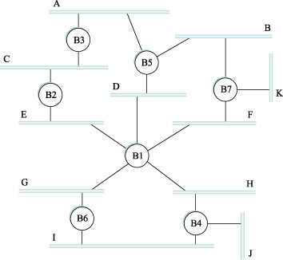
Spanning Tree Algorithm
Loops must be broken
Smallest ID = root
Shortest path to root wins
Ties broken by node ID
Messages
ID of sender
ID of the root
Distance from sender to root

Slide 19
Limitations of Bridges
Spanning tree algorithm scales linearly
Broadcasts don't scale
Virtual LANs
Artificial associations between switch ports
Requires additional header (and pruning)
Bridges can only connect networks with similar addressing schemes
Bridges introduce delay, loss, and reordering can happen

Slide 20
Error Detection
Detect and correct errors when possible
CRC (cyclic redundancy check) commonly used
Simpler approaches
2D parity
Checksums
Basically adding redundant information to packets to make error detection possible
These bits are "error-detecting codes"

Slide 21
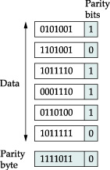
Two Dimensional Parity
Even parity bits to 7 bit codes
Extra byte (row) at end of frame to do parity across columns

Slide 22
Internet Checksum
Not link layer, but relevant anyway
One's complement arithmetic
-x is the complement of x
All the bits are exactly flipped in their representation
When numbers added, carries must be added to the result
Example:
-5 + -3 in ones complement arithmetic (4 bit nums.)
+5 is 0101, so -5 is 1010; +3 is 0011, so -3 is 1100
1010 + 1100, ignoring carry, is 0110
When carry occurs, must increment the result, giving 0111, which is the one's complement of -8 (which is 1000)

Slide 23
Internet Checksum
View message as sequence of 16 bit integers
Sum using 16-bit ones complement arithmetic
Take one's complement of the result
u_short chksum(u_short *buf, int count) {
register u_long sum = 0;
while (count--) {
sum += *buf++;
if (sum & 0xFFFF0000) {
// A carry occurred, so wrap around
sum &= 0xFFFF;
sum++;
}
}
return ~(sum & 0xFFFF);
}

Slide 24
Internet Checksum
Not so great against errors
Example: an error that increments by 2 can be missed if a later error decrements by 2
Benefits:
Small number of redundant bits
Easy to implement in software
Last line of defense: adequate?

Slide 25
Cyclic Redundancy Check (CRC)
Strong protection against errors
Uses finite fields branch of mathematics
Sounds scary, but basic ideas not bad
(n+1) bit message represented by an n-degree polynomial (highest order term is xn)
Each bit is the coefficient to each term in the polynomial, starting with highest order term
10011010 corresponds to the polynomial, M(x)=1*x⁷+0*x⁶+0*x⁵+1*x⁴+1*x³+0*x²+1*x¹+0*x⁰ M(x) = x⁷+ x⁴ + x³+ x¹

Slide 26
If you are interested in diving deep into how CRC works, read the next 6-7 slides.

Slide 27
Cyclic Redundancy Check (CRC)
Sender and receiver exchanging polynomials with each other
To calculate CRC, must agree on a divisor polynomial, C(x), of degree k.
Suppose C(x) = x³+ x² + 1
In this case, k = 3
Where did C(x) come from?
A book. It's important to get right. Good choices provided.
Ethernet uses a well-known polynomial of degree 32

Slide 28
CRC Message Checking
Sender sends M(x), n+1 bits long
Actually sends message, plus k redundant bits
We call the message, plus redundant bits P(x)
Work hard to make sure P(x) is exactly divisible by C(x)
If receiver does division and gets 0 remainder, the receiver knows there were no errors
Polynomial arithmetic modulo 2

Slide 29
Polynomial Arithmetic
Any polynomial, B(x) can be divided by C(x) if B(x) is higher degree than C(x)
B(x) can be divided once by C(x) if B(x) is same degree as C(x)
Remainder when B(x) divided by C(x) is obtained by subtracting C(x) from B(x)
To subtract C(x) from B(x), we simply do an exclusive-OR (XOR) on each pair of matching coefficients

Slide 30
Creating P(x)
Multiply M(x) by xk (adds k zeros at the end). Call this T(x).
Divide T(x) by C(x) and find the remainder.
Subtract the remainder from T(x).
This result is exactly divisible by C(x)
Looks like M(x) followed by remainder from T(x) divided by C(x)

Slide 31
An Example
Consider message 10011010, or polynomial M(x) = x⁷+ x⁴ + x³+ x¹
Multiply by x³ since C(x) polynomial is degree 3.
This gives us 10011010000
Divide this by C(x), which is 1101 in this case

Slide 32
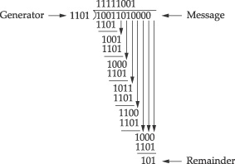
Example Division
Result (at top) doesn't really matter
Only the remainder at bottom (101) is used

Slide 33
So what do we send?
10011010000 (our shifted value) XOR 101
10011010101 is sent. When the recipient divides this, they will get 0
CRC seems really complex, but is easily implemented in hardware with bit shifting and XOR'ing

Slide 34
Performance Metrics Outline
Introduce Queueing Model
Generic Performance Metrics
Components of Hop and End-to-End Packet Delay
Traceroute Tool
Other Performance Measures
Packet Loss Rate

Slide 35
Computer Networks
T
X
Z
W1
W2
W
Y
Host
L
AP
W3
Host
M
Host
A
2
3
W4
4
Host
B
1
5
nodes
14
16
11
Host
J
Host
C
12
17
15
6
10
13
7
Host
H
Host
D
9
8
Host
G
Host
E
Host
F

Slide 36
How do Loss and Delay occur?
packets queue in router buffers
when the sum of the arriving packets at the router exceeds the output link capacity.
packet being transmitted (delay)
15
17
14
12
packets queueing (delay)
free (available) buffers: arriving packets
dropped (loss) if no free buffers

Slide 37
Simple Queueing Model
Customer
Arrivals
Queue
Server

Slide 38
Router Node
node 15
packet
packet
17
Incoming Link
Outgoing Link
Server
Router Buffer

Slide 39
Generic Performance Metrics
Utilization ::
the percentage of time a device is busy servicing a “customer”.
Throughput ::
the number of jobs processed by the “system” per unit time.
Response time ::
the time required to receive a response to a request (round-trip time (RTT) ).
Delay ::
the time to traverse from one end to the other of a system.

Slide 40
Network Performance Measures
Channel utilization:: the average fraction of time a channel is busy [e.g. Util = 0.8]
when overhead is taken into account (i.e., it is excluded from the useful bits sent), channel utilization is often referred to as channel efficiency.
Throughput:: bits/sec. successfully sent
[e.g. Tput = 10 Mbps]

Slide 41
Throughput
throughput:: rate (bits/time unit) at which bits transferred between sender/receiver
instantaneous: rate at given point in time
average: rate over longer period of time
server, with
file of F bits
to send to client
pipe that can carry
fluid at rate
R_{s} bits/sec)
pipe that can carry
fluid at rate
R_{c} bits/sec)
server sends bits
(fluid) into pipe
link capacity
R_{s} bits/sec
link capacity
R_{c} bits/sec

Slide 42
Throughput (more)
R_{s} < R_{c} What is average end-end throughput?
R_{s} bits/sec
R_{c} bits/sec
R_{s} > R_{c} What is average end-end throughput?
R_{s} bits/sec
R_{c} bits/sec
bottleneck link
link on end-end path that constrains end-end throughput

Slide 43
Throughput: Internet Scenario
per-connection end-end throughput: min(R_{c},R_{s},R/10)
in practice: R_{c} or R_{s} is often the bottleneck
The last mile link has capacity Rc.
R_{s}
R_{s}
R_{s}
R
R_{c}
R_{c}
R_{c}
10 connections (fairly) share backbone bottleneck link R bits/sec

Slide 44
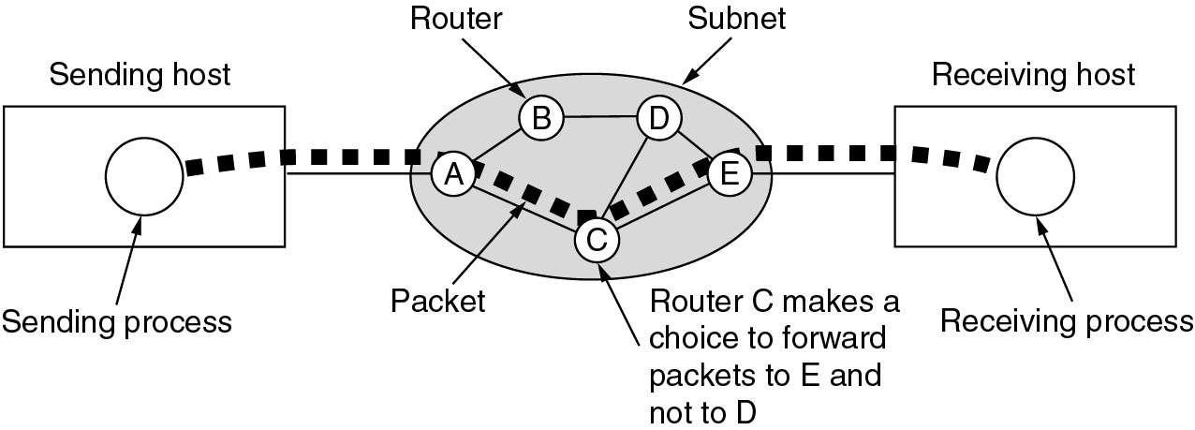
End-to-End Packet Delay
End-to-end delay includes multiple hop link delays.
Tanenbaum

Slide 45
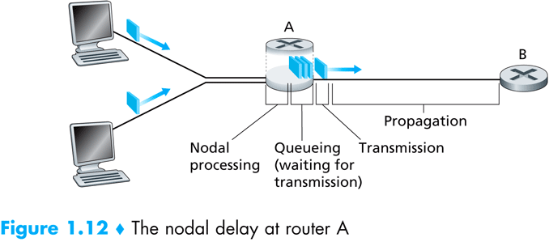
Hop Delay Components

Slide 46
Four Sources of Packet Delay
1. Processing at node:
Checking for bit errors
Determine output link
Moving packet from input queue to output queue
Table lookup time (see routing algorithms)
2. Queuing delay
time waiting at output link for transmission
depends on congestion level of router
transmission
A
propagation
B
nodal
processing
queueing

Slide 47
Delay in packet-switched networks
3. Transmission delay:
R=link bandwidth (bps)
L=packet length (bits)
time to send bits into link = L/R
4. Propagation delay:
d = length of physical link
s = propagation speed in medium (~2x10⁸ m/sec)
propagation delay = d/s
transmission
A
Note
s and R are
very different
quantities!
propagation
B
nodal
processing
queueing

Slide 48
End-to-end Packet Delay
End-to-end packet delay
the time to deliver a packet from source to destination Host (or node).
{Most often, we are interested in the packet delay within the communications subnet.} This delay is the sum of the delays on each subnet link traversed by the packet.

Slide 49
Link Packet Delay
Processing delay [PROC]
Queuing delay [QUEUE]
Transmission delay [TRANS]
Propagation delay [PROP]
d_{proc} = processing delay
typically a few microsecs or less
d_{queue} = queuing delay
depends on congestion
d_{trans} = transmission delay
= L/R, significant for low-speed links
d_{prop} = propagation delay
a few microsecs to hundreds of msecs

Slide 50
End-to-End Packet Delay
Link packet delay = PROC + QD
+ TRANS + PROP
end-to-end packet delay = sum of ALL link packet delays.
end-to-end can be defined either:
from Host-to-Host
or only from end-to-end nodes within the subnetwork.
B & G

Slide 51
End-to-End Packet Delay
End-to-end delay includes multiple hop link delays.
Tanenbaum

Slide 52
“Real” Internet Delays and Routes
What do “real” Internet delay & loss look like?
Traceroute program: provides delay measurement from source to router along end-end Internet path towards destination. For all i:
sends three packets that will reach router i on path towards destination
router i will return packets to sender.
sender times interval between transmission and reply.
3 probes
3 probes
3 probes

Slide 53
“Real” Internet delays and routes
traceroute: gaia.cs.umass.edu to www.eurecom.fr
Three delay measurements from
gaia.cs.umass.edu to cs-gw.cs.umass.edu
1 cs-gw (128.119.240.254) 1 ms 1 ms 2 ms
2 border1-rt-fa5-1-0.gw.umass.edu (128.119.3.145) 1 ms 1 ms 2 ms
3 cht-vbns.gw.umass.edu (128.119.3.130) 6 ms 5 ms 5 ms
4 jn1-at1-0-0-19.wor.vbns.net (204.147.132.129) 16 ms 11 ms 13 ms
5 jn1-so7-0-0-0.wae.vbns.net (204.147.136.136) 21 ms 18 ms 18 ms
6 abilene-vbns.abilene.ucaid.edu (198.32.11.9) 22 ms 18 ms 22 ms
7 nycm-wash.abilene.ucaid.edu (198.32.8.46) 22 ms 22 ms 22 ms
8 62.40.103.253 (62.40.103.253) 104 ms 109 ms 106 ms
9 de2-1.de1.de.geant.net (62.40.96.129) 109 ms 102 ms 104 ms
10 de.fr1.fr.geant.net (62.40.96.50) 113 ms 121 ms 114 ms
11 renater-gw.fr1.fr.geant.net (62.40.103.54) 112 ms 114 ms 112 ms
12 nio-n2.cssi.renater.fr (193.51.206.13) 111 ms 114 ms 116 ms
13 nice.cssi.renater.fr (195.220.98.102) 123 ms 125 ms 124 ms
14 r3t2-nice.cssi.renater.fr (195.220.98.110) 126 ms 126 ms 124 ms
15 eurecom-valbonne.r3t2.ft.net (193.48.50.54) 135 ms 128 ms 133 ms
16 194.214.211.25 (194.214.211.25) 126 ms 128 ms 126 ms
17 * * *
18 * * *
19 fantasia.eurecom.fr (193.55.113.142) 132 ms 128 ms 136 ms
trans-oceanic
link
* means no response (probe lost, router not replying)

Slide 54
Network Performance Measures
Latency
usually implies the minimum possible delay. Latency assumes no queuing and no contention encountered along the path.
Goodput
{measured at the receiver} the rate in bits per second of useful traffic received. Goodput excludes duplicate packets and packets dropped along the path.
Fairness
either Jain’s fairness or max-min fairness are used to measure fair treatment among competing flows.
Quality of Service (QoS)
a QoS measure accounts for importance of specific metric to one type of application [e.g. jitter and playable frame rate for streaming media].

Slide 55
Wireless Performance Metrics
WLANs and WSNs are concerned with
packet loss and employ additional metrics:
Delivery ratio
the ratio of packets received to packets sent {excluding duplicates and retransmissions}.
Packet loss rate
the percentage of packets lost or dropped.
Link layer retransmission rates
the percentage of DL layer frames that are retransmitted.

Slide 56
Packet Loss
queue (aka buffer) preceding link in buffer has finite capacity.
packet arriving to full queue is dropped (aka lost) [FIFO Drop Tail router].
lost packet may be retransmitted by previous node, by source end system, or not at all.
buffer
(waiting area)
A
packet being transmitted
B
packet arriving to
full buffer is dropped.

Slide 57
Performance Metrics Summary
The three most general performance measures are: utilization, throughput and response time.
In computer networks, end-to-end delay is an important performance metric.
Queuing models are used to analyze and estimate computer network performance.

Slide 58
Performance Metrics Summary
Other useful metrics include: latency, goodput, fairness and QoS metrics such as jitter or playable frame rate.
In wireless networks, delivery ratio, packet loss rate and link layer retransmission rates are valuable network measures.

Slide 59
Thinking Questions
What are VLANs useful for? Could they be used to enable unexpected functionality?
Can we fix errors as we go? Should we? Why don’t we?
Does end-to-end delay even matter? What types of protocols would be affected by it?

