Slide 1
Welcome to the Network Layer!

Slide 2
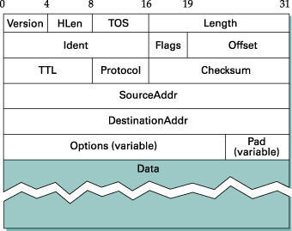
Internet Protocol – IP

Slide 3
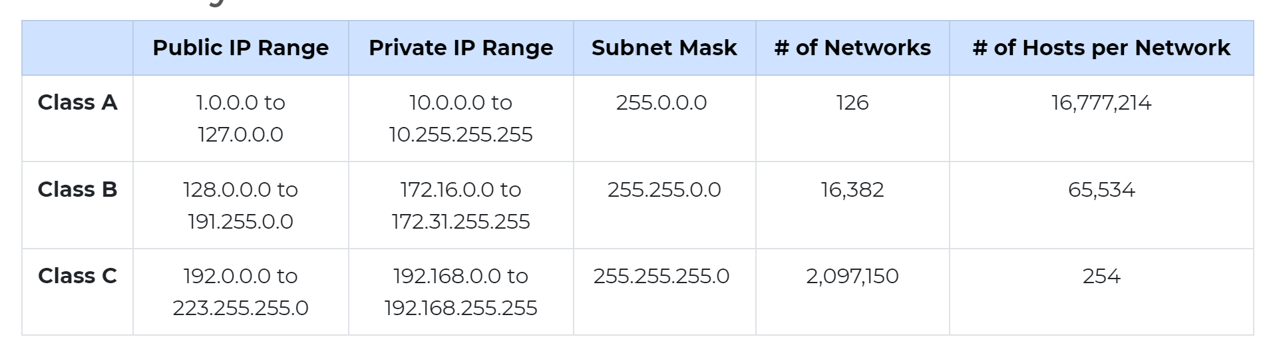
The Internet was Once Classy…
Ethernet addresses globally unique, but flat
IP addresses are hierarchical
Network identifier portion, host identifier portion
Addresses are 32 bits
Divided into "classes" based on number of associated hosts
Most common:
Notes:
https://www.meridianoutpost.com/resources/articles/IP-classes.php

Slide 4
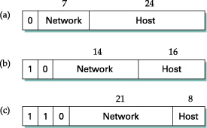
Class Schemes

Slide 5
The Internet is now Classless
Classless Interdomain Routing (CIDR)
Class-based routing is not all that efficient
Class A address range can't be subdivided
Everything happens on an 8 bit boundary
Wastes usable address space
CIDR allows you to specify length of network part:
1.2.0.0/16 = 16 bits are network, 16 for hosts
Same division as a Class B network
Need not divide on byte boundary

Slide 6
Subnet Mask
A subnet mask is a 32-bit number used to divide an IP address into a host portion and network portion.
A subnet mask defines the range of hosts available within the network. The IP address network portion identifies the network on which a host resides.
The IP address host portion identifies the host within the network. Together, the host and network portion make up the host's unique IP address.

Slide 7
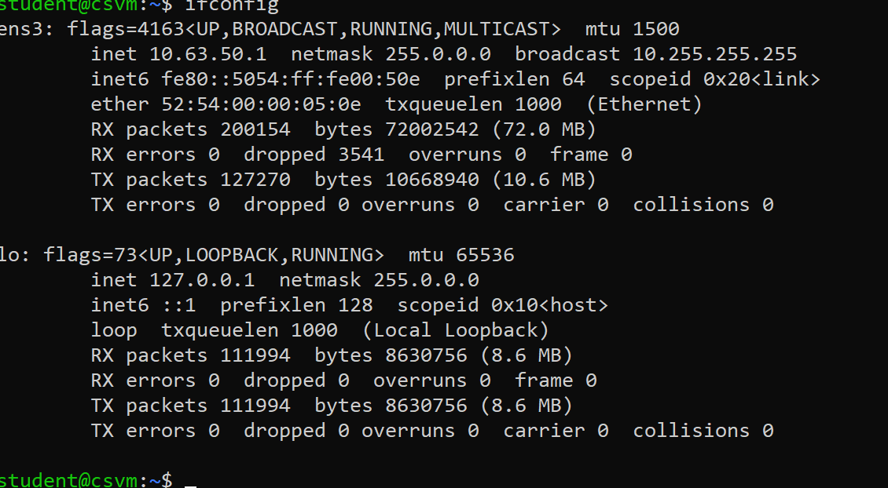
Subnet Example
Two hosts:
1.2.3.4 0000 0001 0000 0010 0000 0011 0000 0100
1.2.3.150 0000 0001 0000 0010 0000 0011 1001 0110
Subnet Mask: 255.255.255.0 1111 1111 1111 1111 1111 1111 0000 0000
Are they in the same network?
Binary AND operation between each host and the subnet
Same result for both hosts?
Notes:
/24 and subnet mask 255:255:255:0 are equivalent. Both mean that last 8 bits are used for host identification; rest are for network group identification

Slide 8
CIDR vs. Subnetting
CIDR lets routers determine which network is associated with a set of hosts
Hosts within a network have to figure out if they are in the same network or not
Can bypass a router if they are
They use subnets to figure it out
How does subnetting work?
Given a subnet mask and perform a binary AND

Slide 9
Fragmentation and Reassembly
Maximum Transmission Unit (MTU)
Recall that ethenrt packet had a lmit of 1500 bytes
Routers can split packets into pieces for hosts to reassemble
Breaking up of info into smaller chunks at the end system is called segmentation. And the same thing when performed at the router is called fragmentation (a lot of work for routers)
Routers do not reassemble => end hosts would need to
Identifier, Flags (MF), Offset (/8) fields involved
Notes:
https://www.linkedin.com/pulse/easy-explanation-how-fragmentation-works-hemil-aquino/
Identifier – original packet being sliced and diced
More fragments field – more fragments fo this packet coming along
Offset – let you know which fragment within that packet is being dealt with

Slide 10
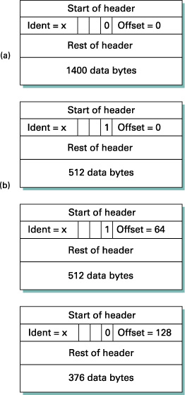
Fragmentation Example
MTU = 512 bytes
Offsets must be divisible by 8
Do routers reassemble?
Well, you may try don’t fragment option to see if you can avoid fragmentation. If not possible -> packet will be dropped
Notes:
No. End points do the reassembly

Slide 11
If I were implementing a router, how would I handle prefixes?
Efficient lookups for forwarding packets has made some companies billions
It’s proprietary.
It’s a trade secret.
And nobody is telling.
But don’t over-think it.
Hash tables
A table for prefix length 8, one for 9, one for 10...
Look them up in parallel (easy in hardware)
Tries

Slide 12
Longest Prefix Matching
Convert IP addresses into binary
Use Trie Data Structure
0
1
Prefix: 96.0.0.0/3
Interface: 50
Binary:
0110 0000
0000 0000
0000 0000
0000 0000
Prefix: 128.0.0.0/1
Interface: 25
Binary:
1000 0000
0000 0000
0000 0000
0000 0000
Prefix: 0.0.0.0/1
Interface: 75
Binary:
0000 0000
0000 0000
0000 0000
0000 0000
IP: 64.2.3.4
Binary:
0100 0000
0000 0010
0000 0011
0000 0100
75
25
0
1
1
50

Slide 13
Longest Prefix Matching
Class-based Lookups
Exact matches, no longest prefix
Different table for each of 3 lengths
CIDR prefixes can vary

Slide 14
Longest Prefix Matching
Given two prefixes, which do you choose?
208.12.21/24
208.12.16/20
If you match both, you select the longest prefix
Allows you to carve out regions of the address space, rather than subdivide
How do you handle this?

Slide 15
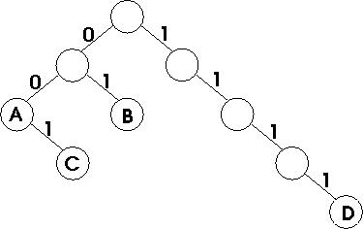
Classical Binary Trie
Trie is tree-based structure with bits encoded on the edges of the trie
Each node traversal, a bit consumed
Each node can store network information
Store before looking up next bit
Abort on null child branch
Example
A: 00*, B: 01*, C: 001*, D: 1111*

Slide 16
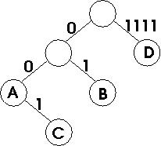
Path Compressed Trie
Same idea, but you can store multiple identical bits on the same link
What benefit could this scheme have?

Slide 17
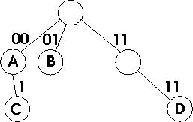
Multi-bit Tries
Each step consumes multiple bits ("stride")
Why does this help?
What if the prefix is odd length and your stride is even?
Notes:
Q- old value and even stride? 2 ways – (1) treat as special case and allow odd number or (2) expand the trie to fill out two even value of it

Slide 18
Prefix Expansion
Remember, shorter prefixes can be rewritten as multiple longer prefixes
001* can also be
0010* and 0011*
00100*, 00101*, 00110*, 00111*
etc.
Why would we want to do this?
What are the costs?
Notes:
Always add a bit to expand the tree -> avoid the need for extra special cases
Multi-bit trie – this allows you to have a trie of size 2

Slide 19
Parallel Hash Tables
For each prefix length, 1...32, create hash table
Add prefix in appropriate table
When doing a lookup, create hashes and do lookups under each table for best match
Prefix expansion may let us get by with fewer tables

Slide 20
What's used in modern routers?
A fancy multi-bit trie (Tree Bitmaps)
Uses a bit vector to indicate present children and adjacent memory allocation
Parent Node
Bit Vector:
1101
Next Hop:
A
Child Node
Child Node
Child Node
Bit Vector:
0000
Next Hop:
B
Bit Vector:
0000
Next Hop:
C
Bit Vector:
0000
Next Hop:
D
00 01 11
Notes:
1101 -> I have three children – one is missing. The one that is missing has a pattern 10. So three children are 00, 01, 10(missing, so third child is 11

