Slide 1

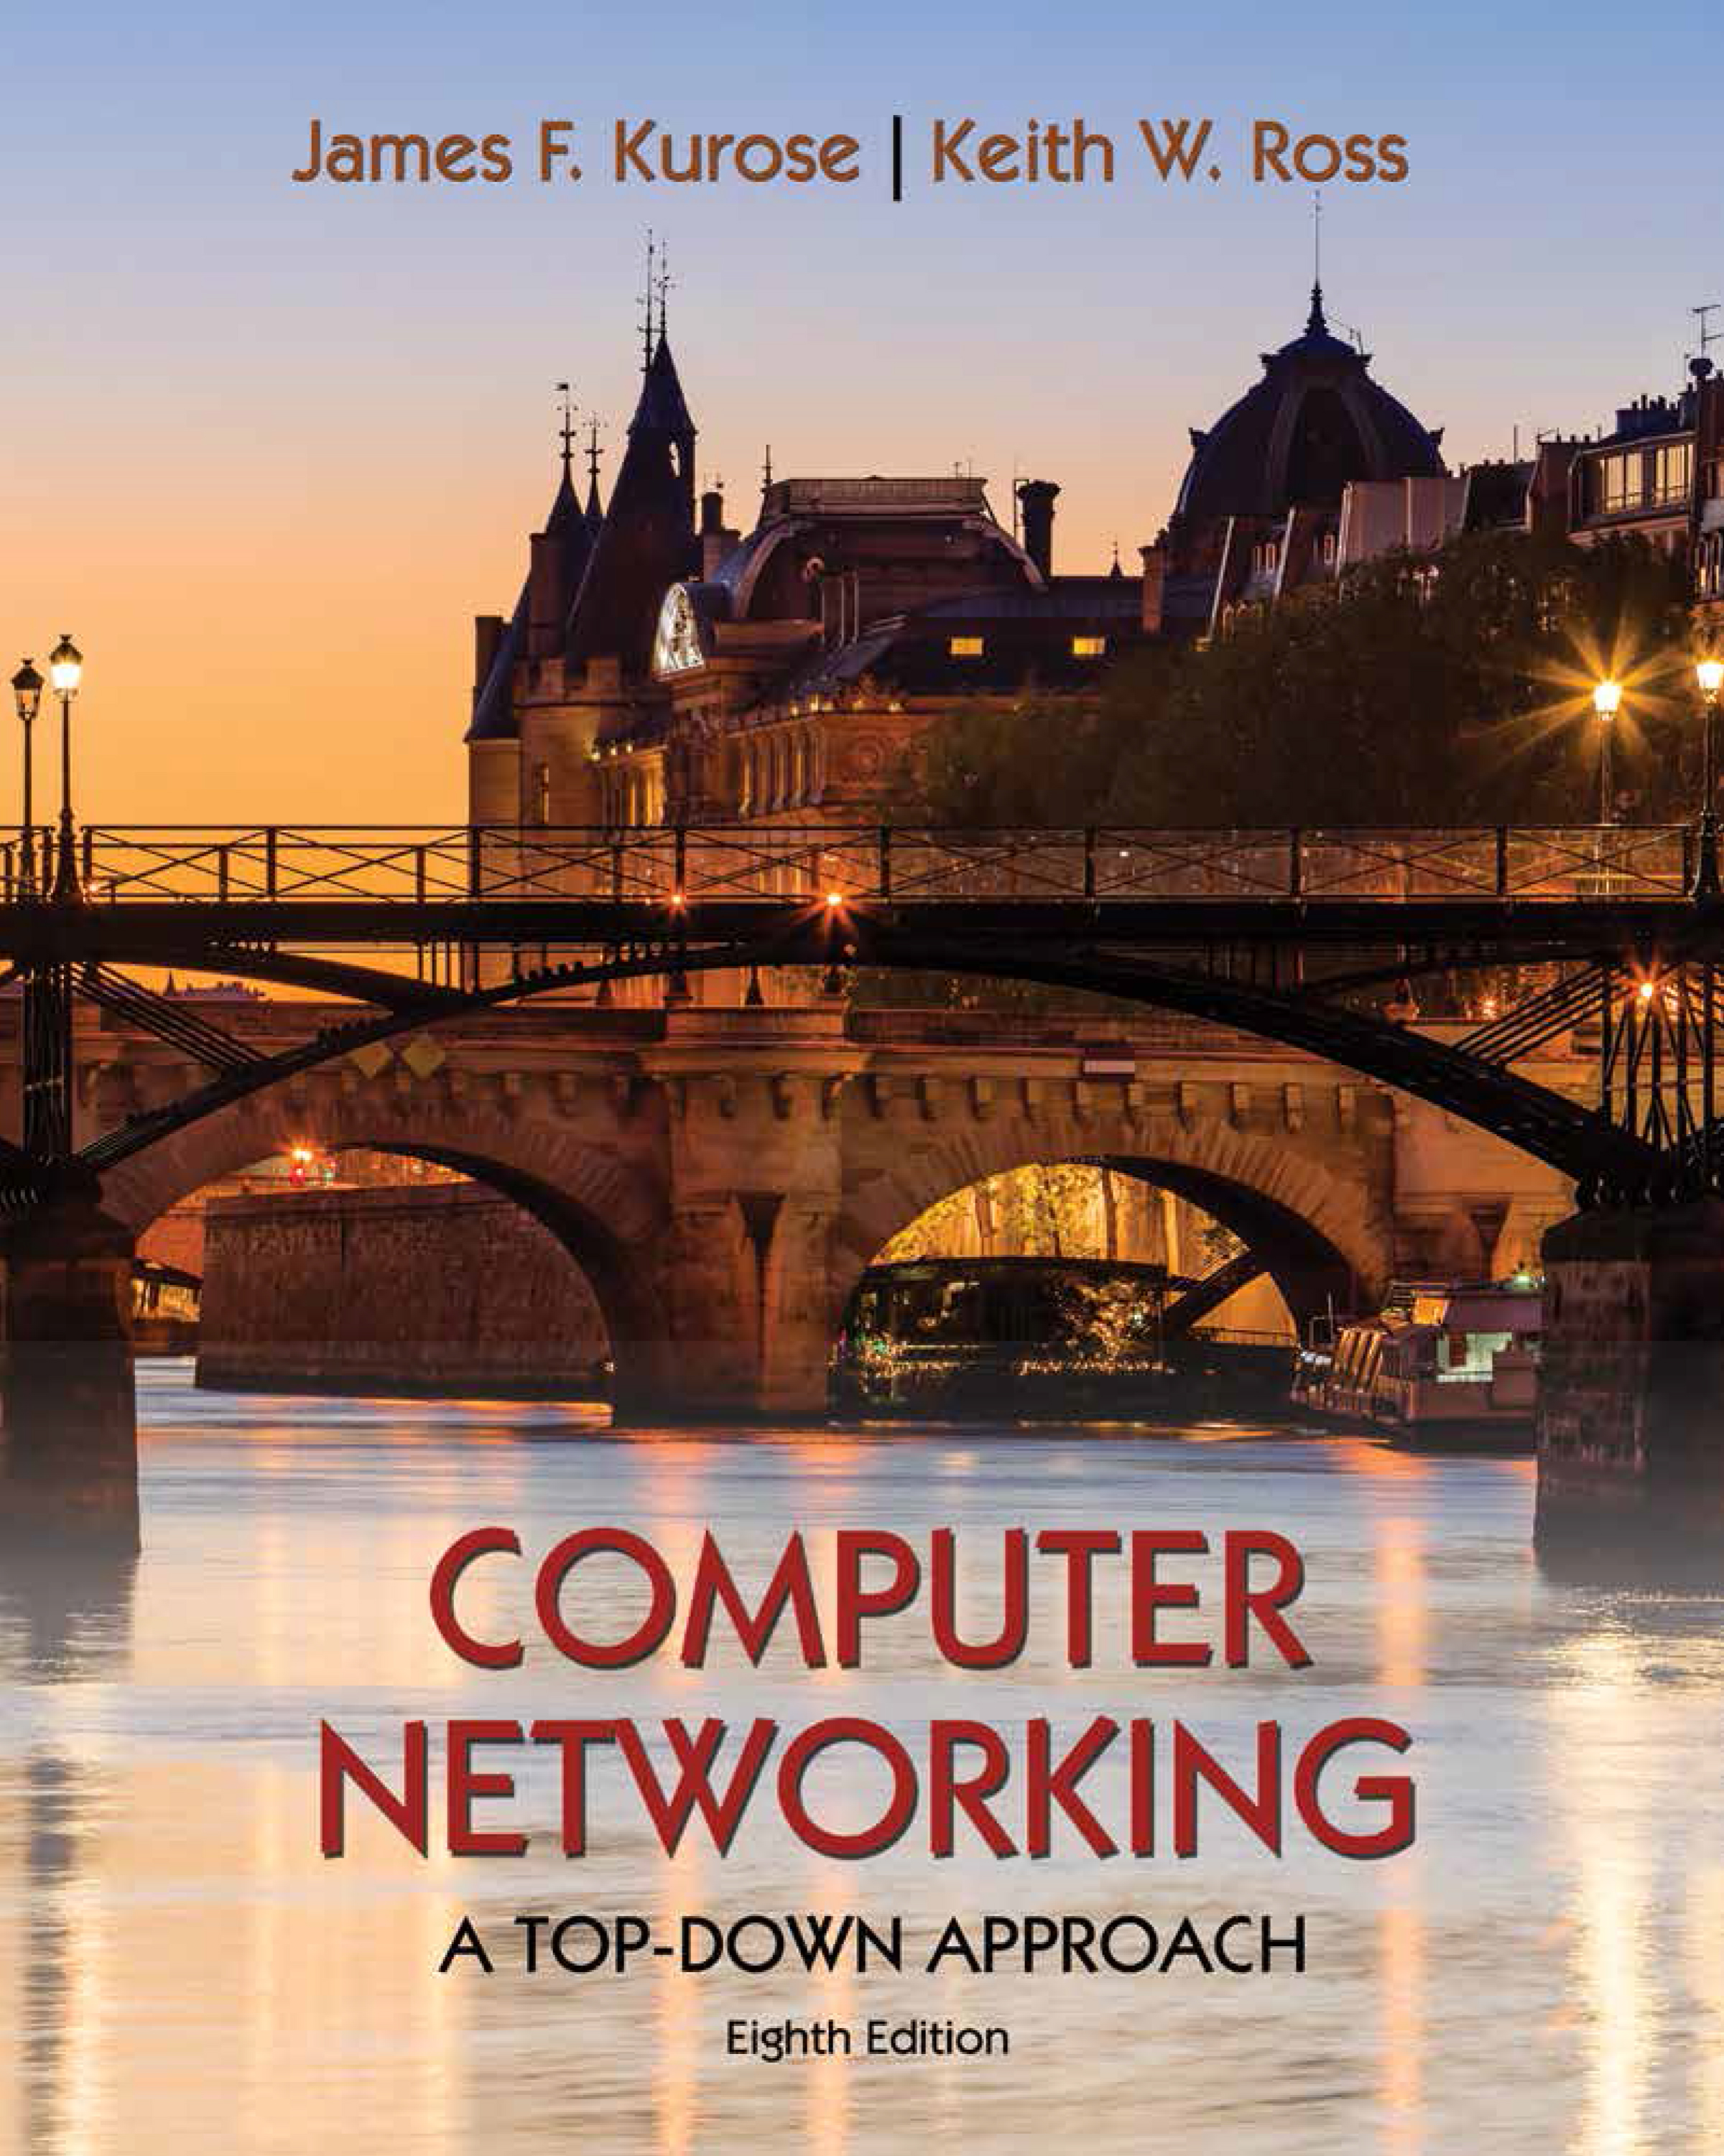
Transport Layer
COMPSCI 453 Computer Networks
Professor Jim Kurose
College of Information and Computer Sciences
University of Massachusetts
Transport-layer services
Multiplexing and demultiplexing
Connectionless transport: UDP
Principles of reliable data transfer
Connection-oriented transport: TCP
Principles of congestion control
TCP congestion control
Evolution of transport-layer functionality
Class textbook:
Computer Networking: A Top-Down Approach (8th ed.)
J.F. Kurose, K.W. Ross
Pearson, 2020
http://gaia.cs.umass.edu/kurose_ross

Slide 2
UDP: User Datagram Protocol
Why is there a UDP?
“no frills,” “bare bones” Internet transport protocol
“best effort” service, UDP segments may be:
lost
delivered out-of-order to app
no connection establishment (which can add RTT delay)
simple: no connection state at sender, receiver
small header size
no congestion control
UDP can blast away as fast as desired!
can function in the face of congestion
connectionless:
no handshaking between UDP sender, receiver
each UDP segment handled independently of others

Slide 3
UDP: User Datagram Protocol
UDP use:
streaming multimedia apps (loss tolerant, rate sensitive)
DNS
SNMP
used to monitor and manage network devices connected over an IP. SNMP is used for communication between routers, switches, firewalls, load balancers, servers, CCTV cameras, and wireless devices.
HTTP/3
if reliable transfer needed over UDP (e.g., HTTP/3):
add needed reliability at application layer
acc congestion control at application layer

Slide 4
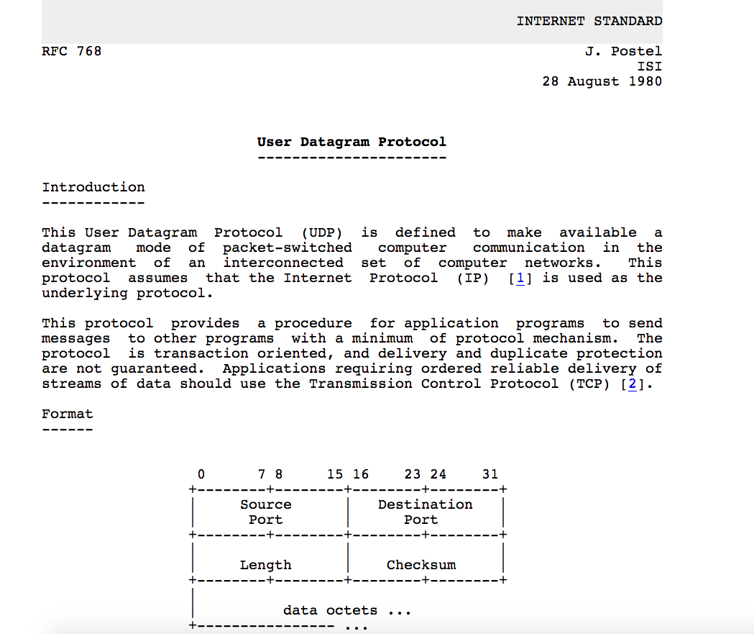
UDP: User Datagram Protocol [RFC 768]
Notes:
read this RFC – it’s only 2.5 pages!

Slide 5
UDP: Transport Layer Actions
SNMP client
SNMP server
application
application
transport
(UDP)
transport
(UDP)
network (IP)
network (IP)
link
link
physical
physical

Slide 6
UDP: Transport Layer Actions
SNMP client
SNMP server
UDP sender actions:
application
application
is passed an application-layer message
SNMP msg
transport
(UDP)
transport
(UDP)
determines UDP segment header fields values
UDP_{h}
SNMP msg
UDP_{h}
creates UDP segment
network (IP)
network (IP)
passes segment to IP
link
link
physical
physical

Slide 7
UDP: Transport Layer Actions
SNMP client
SNMP server
UDP receiver actions:
application
receives segment from IP
application
checks UDP checksum header value
transport
(UDP)
transport
(UDP)
SNMP msg
extracts application-layer message
network (IP)
network (IP)
SNMP msg
UDP_{h}
demultiplexes message up to application via socket
link
link
physical
physical

Slide 8
UDP segment header
32 bits
source port #
dest port #
length
checksum
application
data
(payload)
length, in bytes of UDP segment, including header
data to/from application layer
UDP segment format

Slide 9

UDP checksum
Goal: detect errors (i.e., flipped bits) in transmitted segment
1st number
2nd number
sum
Transmitted: 5 6 11
Received: 4 6 11
receiver-computed
checksum
=
sender-computed
checksum (as received)

Slide 10
UDP checksum
Goal: detect errors (i.e., flipped bits) in transmitted segment
sender:
treat contents of UDP segment (including UDP header fields and IP addresses) as sequence of 16-bit integers
checksum: addition (one’s complement sum) of segment content
checksum value put into UDP checksum field
receiver:
compute checksum of received segment
check if computed checksum equals checksum field value:
Not equal - error detected
Equal - no error detected. But maybe errors nonetheless? More later ….

Slide 11
Internet checksum: an example
example: add two 16-bit integers
1 1 1 0 0 1 1 0 0 1 1 0 0 1 1 0
1 1 0 1 0 1 0 1 0 1 0 1 0 1 0 1
wraparound
1 1 0 1 1 1 0 1 1 1 0 1 1 1 0 1 1
sum
1 0 1 1 1 0 1 1 1 0 1 1 1 1 0 0
Checksum
FLIP SUM
0 1 0 0 0 1 0 0 0 1 0 0 0 0 1 1
Note: when adding numbers, a carryout from the most significant bit needs to be added to the result
* Check out the online interactive exercises for more examples: http://gaia.cs.umass.edu/kurose_ross/interactive/
Notes:
USES ALL THINGs in header BESIDES CHECKSUM FIELD
Checksum to flip

Slide 12
Internet checksum: weak protection!
example: add two 16-bit integers
0 1
1 1 1 0 0 1 1 0 0 1 1 0 0 1 1 0
1 0
1 1 0 1 0 1 0 1 0 1 0 1 0 1 0 1
wraparound
1 1 0 1 1 1 0 1 1 1 0 1 1 1 0 1 1
Even though numbers have changed (bit flips), no change in checksum!
sum
1 0 1 1 1 0 1 1 1 0 1 1 1 1 0 0
checksum
0 1 0 0 0 1 0 0 0 1 0 0 0 0 1 1

Slide 13
Summary: UDP
“no frills” protocol:
segments may be lost, delivered out of order
best effort service: “send and hope for the best”
UDP has its plusses:
no setup/handshaking needed (no RTT incurred)
can function when network service is compromised
helps with reliability (checksum)
build additional functionality on top of UDP in application layer (e.g., HTTP/3)

Slide 14

Transport Layer
COMPSCI 453 Computer Networks
Professor Jim Kurose
College of Information and Computer Sciences
University of Massachusetts
Transport-layer services
Multiplexing and demultiplexing
Connectionless transport: UDP
Principles of reliable data transfer
Connection-oriented transport: TCP
Principles of congestion control
TCP congestion control
Evolution of transport-layer functionality
Class textbook:
Computer Networking: A Top-Down Approach (8th ed.)
J.F. Kurose, K.W. Ross
Pearson, 2020
http://gaia.cs.umass.edu/kurose_ross
Video: 2020, J.F. Kurose, All Rights Reserved
Powerpoint: 1996-2020, J.F. Kurose, K.W. Ross, All Rights Reserved

Slide 15
Internet checksum: an example
example: add two 16-bit integers
1 1 1 0 0 1 1 0 0 1 1 0 0 1 1 0
1 1 0 1 0 1 0 1 0 1 0 1 0 1 0 1
1 1 0 1 1 1 0 1 1 1 0 1 1 1 0 1 1
* Check out the online interactive exercises for more examples: http://gaia.cs.umass.edu/kurose_ross/interactive/

Slide 16
UDP: User Datagram Protocol
UDP sender/receiver actions
UDP segment format
Internet checksum

