Slide 1
Start here
http://unixwiz.net/techtips/iguide-kaminsky-dns-vuln.html

Slide 2
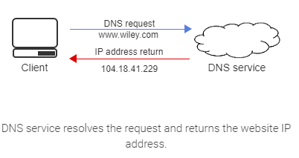
What is DNS?
Translate names to IP address
Also IP address to names
Distributed System
Each domain manages its own DNS records

Slide 3
Domain Namespace
Domain namespace is the organized hierarchy of DNS administrative domains throughout the world.
A DNS zone is a distinct domain namespace part which is delegated to a legal entity.
Ex: A person, organization, or company.

Slide 4
Why do we need DNS?
Routing is done on IP addresses
Great for computers, longest prefix match
Bad for people, not easy to remember
People like names
Not so great for computers

Slide 5
Why a distributed system?
Historically names managed by hosts.txt file
File was sent to every host online
Large and difficult to manage
Lack of hierarchical structure leads to name collisions
Centralized systems have single point of failure

Slide 6
URL Structure
DNS defines a domain namespace, which specifies top-level domains, second-level domains, and lower-level domains (subdomains). Each level can be a DNS zone.

Slide 7
URL structure
Root domain is the highest internet hierarchical level. Example: Level above .com which is displayed as a period ".". Note: When referencing individual/company websites, root domain also refers to the second-level domain concatenated with the top-level domain. Ex: wiley.com
Uniform resource locator (URL), also known as web address, specifies the location of an internet's web reference. Ex: wiley.com/support and wiley.com can point to the same IP server address, but different server directories' locations.
Hostname is a domain name with at least one associated IP address. Ex: mycompany.com or www.mycompany.com.
Fully qualified domain name (FQDN) is a domain name specifying the exact location in the DNS tree hierarchy. Ex: www.mycompany.com
Top-level domain (TLD) is the domain name's right-most label. Ex: com is the TLD of www.mycompany.com
Ex: com is the TLD for www.mycompany.com. Displayed in a top-down structure, the TLD is directly below the root domain.
Second-level domain (SLD) is the subdomain TLD left label. Ex: wiley is the SLD of www.mycompany.com. Displayed in a top-down structure, the SLD is directly below the TLD.
Subdomain is an additional domain's hostname. Ex: Help is a subdomain of help.mycompany.com. Displayed in a top-down structure, a subdomain is below the SLD.

Slide 8
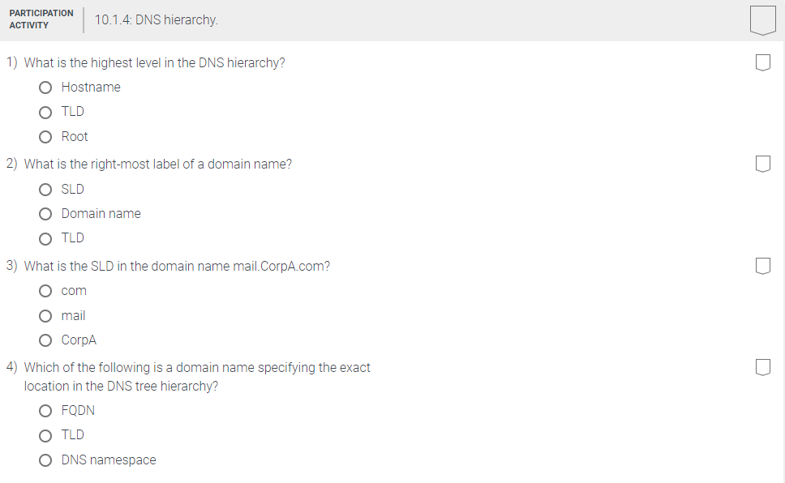
Activity Time
Notes:
Ans. Root, TLD, corpA, FQDN

Slide 9
DNS Structure
.(root)
us
jp
org
com
net
edu
info
google
google
google
cnn
indiana
wpi
www
informatics
cs
www
maps
batman
whale
www
images
superman

Slide 10
Structure requirements
Each zone (those colored rectangles on the previous slide) must have at least 2 DNS servers
These servers should be in different domains

Slide 11
Record Types
A (IPv6: AAAA)
Address of the host asked about.
CNAME
A canonical host name for the host name asked about.
E.g. ds-grads.cs.wpi.edu is a cname for grads.cs.wpi.edu (same server)
NS
Nameserver that knows about a domain
MX
Name (and priority) of host handling mail for a domain
E.g. mail.wpi.edu or mx.wpi.edu
Many other types (most used less often)

Slide 12
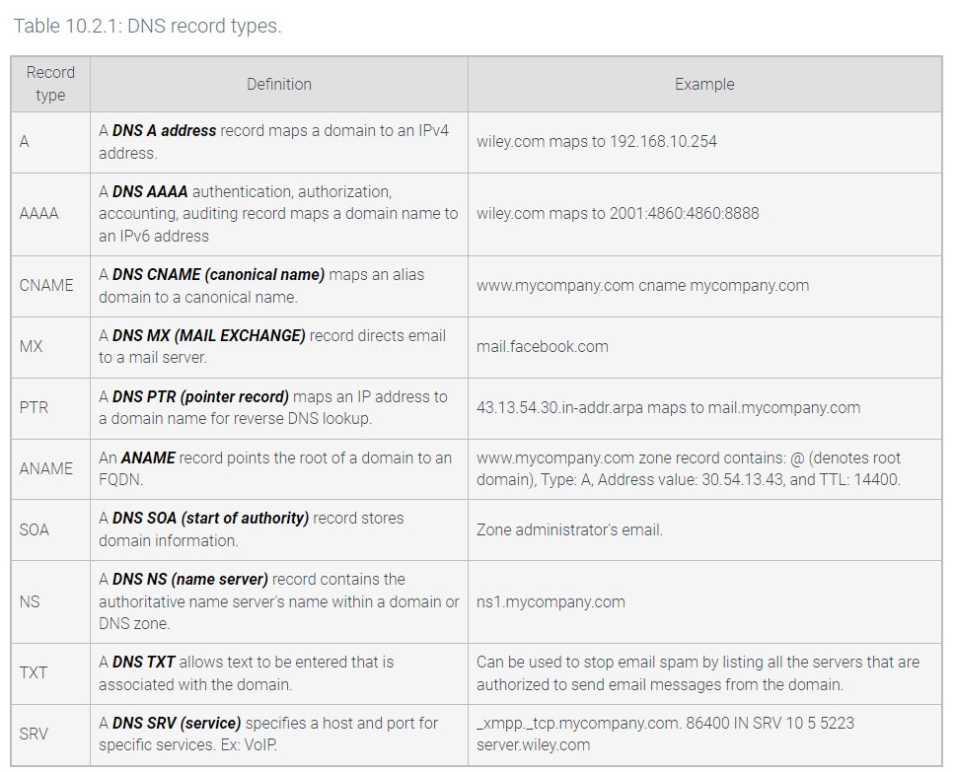

Slide 13
DNS server types
A DNS recursor receives queries from a client and starts the process to resolve the domain name to an IP address. The recursive resolver is the device that responds to a recursive request from a client and, through a series of requests, retrieves the DNS record.
A root name server is a DNS nameserver that operates in the root zone, answering queries for records stored or cached within the root zone and referring other requests to the appropriate top-level domain (TLD) server.
A top-level domain (TLD) name server is responsible for maintaining the information about the domain names sharing a common extension. Ex: com, gov, edu, or net. The TLD name server points the query to the authoritative DNS name server associated with the query's domain.
An authoritative name server answers DNS questions about names in a DNS zone.

Slide 14
DNS Query Resolution
Recursion
Ask a DNS server, get an answer
The server asks for information it does not have on your behalf
E.g. asking wpi.edu server about google.com that it doesn’t know about by default
Iteration
Server gives you an answer if it knows it
Otherwise gives a hint on where to look
E.g. asking root server for www.wpi.edu and it tells you to look under .edu
Recursion and Iteration both involved in a typical query

Slide 15
A DNS Query
Client
. (root)
NS
1
3
2
.com
NS
4
5
Local
NS
10
6
Google.com
NS
8
7
l.google.com
NS
9

Slide 16
A DNS Query (Cached)
Client
. (root)
NS
1
.com
NS
Local
NS
2
Google.com
NS
l.google.com
NS

Slide 17
How it works
Operates at the application layer
Most queries and responses operate over UDP
How do we deal with being connectionless? ID field in DNS header
Zone transfer (receive all records from zone) operates over TCP

Slide 18
DNS Packet
Header
Question Section
Answer Section
Answers to questions (initially blank)
Authority Section
Who is the authority for these answers
Additional Section
Such as location of Authority servers

Slide 19
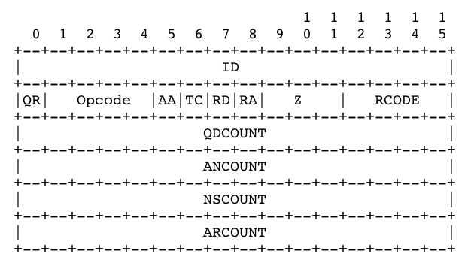
DNS Header Format
12 bytes long
Notes:
http://www.tcpipguide.com/free/t_DNSMessageHeaderandQuestionSectionFormat.htm

Slide 20
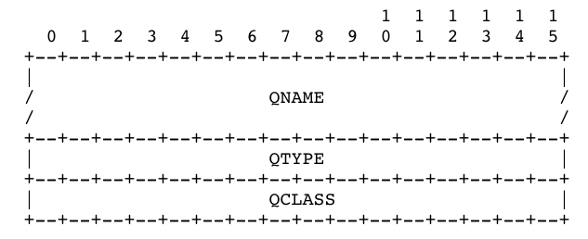
Question Format
QNAME: What do we want to know about? Domain name usually
QTYPE: What type of records we want (e.g., A, CNAME, MX)
QCLASS: IN (Internet)

Slide 21
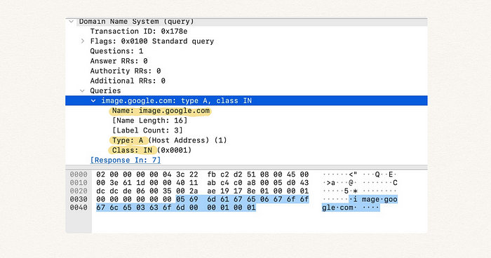
Example
QUESTION SECTION:
www.cs.indiana.edu. A
ANSWER SECTION:
www.cs.indiana.edu. 24589 CNAME grouchy.cs.indiana.edu.
grouchy.cs.indiana.edu. 24589 A 129.79.247.195
AUTHORITY SECTION:
cs.indiana.edu. 18900 NS moose.cs.indiana.edu.
cs.indiana.edu. 18900 NS dns1.iu.edu.
cs.indiana.edu. 18900 NS dns2.iu.edu.
ADDITIONAL SECTION:
dns1.iu.edu. 24885 A 134.68.220.9
dns2.iu.edu. 50031 A 129.79.8.50
moose.cs.indiana.edu. 18900 A 129.79.247.191

Slide 22
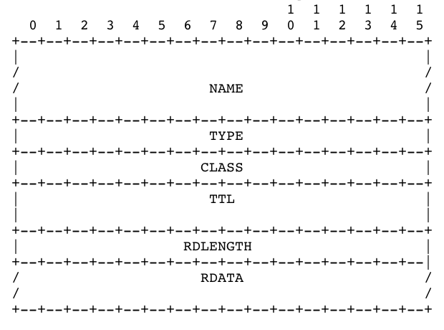
Resource Record Format
Name: What is this record about?
TTL: How long is this record valid?
RDATA: The value of this record, content depends on type
Notes:
https://docs.oracle.com/cd/E19683-01/806-4077/dnsintro-130/index.html

Slide 23
Name format
255 total characters
Up to 10 labels, 63 characters each separated by “.”
In DNS packet, labels separated by length fields
Example:
www.google.com
3www6google3com0

Slide 24
DNS Reverse Lookup
Reverse DNS lookup is the querying technique connecting the domain name with an IP address.
Ex: An email server uses reverse DNS to validate the authenticity of an email. Many email servers reject messages not supported by reverse lookups.
Notes:
IP-> NAME

Slide 25
Reverse DNS
Look up a name, given IP address
Opposite of normal DNS
Requires additional DNS entries to work
PTR record type
A pointer that gives us the value
are stored in a specific zone as an "arpa". A reverse DNS lookup is performed, functioning as an additional layer of email authentication.
Reverse IP address, and append in-addr.arpa domain (ip6.arpa for IPv6)A

Slide 26
Example
Ex: Original IPv4 address 23.221.222.250 reversed is 250.222.221.23.
The new reversed IP address is concatenated to the domain in-addr.arpa, producing the PTR record 250.222.221.23.in-addr.arpa.
Ex: The PTR record 250.222.221.23.in-addr.arpa points to dns.wiley
If the A record for dns.wiley points back to 23.221.22.250 (the original IPv4 address), the reverse DNS lookup is considered forward-confirmed.

Slide 27
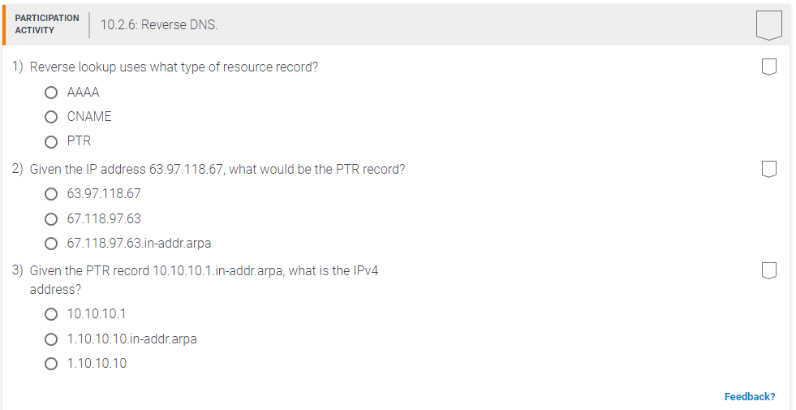
Activity Time
Notes:
C, c,c

Slide 28
Cache Poisoning (simple attacks)
Unrelated data attack
Just put any records you want in DNS packet - other DNS servers will believe them and cache them
Related data attack
Make the other records somehow related
If I say google.com is my mail server, then it is valid for me to give you an address for it

Slide 29
Cache Poisoning (recursion based attacks)
ID guessing
With previous few IDs, guess next one
I query server S for www.google.com recursively, causing it to query the google.com nameserver. I send a response to S with the correct ID before the real google.com server does.
Notes:
https://security.stackexchange.com/questions/260178/how-does-the-attacker-guess-the-domain-name-in-a-dns-query-for-dns-cache-poisoni

Slide 30

The Birthday Paradox
Does anyone in the group have the same birthday (month and day) as anybody else in the group?
( )
n
2
Number People | Probability Overlap
10 | 11.7%
20 | 41.1%
30 | 70.6%
50 | 97.0%
100 | 99.99997%

Slide 31
Cache Poisoning (recursion-based attacks)
Birthday attack
With enough simultaneous queries and enough guesses, can get ID correct with no previous information
50% success rate with only 300 queries and guesses
90% success rate with less than 600

Slide 32
Kaminsky Attack
Solves the Birthday Attack defenses
URL: https://youtu.be/B-v_wJIJUI4
Source: https://duo.com/blog/the-great-dns-vulnerability-of-2008-by-dan-Kaminsky

Slide 33
Try this lab out
https://teaching-on-testbeds.github.io/blog/dns-spoof

Slide 34
Address Resolution Protocol (ARP)
Map between Internet address and hardware address
Example: IPv4 to Ethernet MACs
Static Address Binding
Create list of (IP, MAC) bindings and distribute
Dynamic Address Binding
Use network to obtain and store these bindings

Slide 35
Address Resolution Protocol
Allows A to find B’s MAC when A only knows B’s IP address
ARP is only for a local network
Fails miserably for larger networks
Requestor uses hardware broadcast
Responder replies via unicast

Slide 36
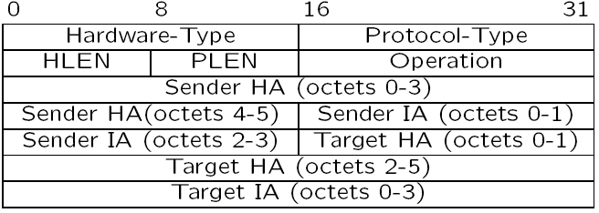
ARP Header

Slide 37
ARP Cache
ARP table is a simple cache
Entries should be expired eventually
Problems
What if nobody answers?

Slide 38
Reverse Address Resolution Protocol (RARP)
NOT to be confused with an ARP reply
RARP allows a requestor to find an Internet address given a hardware address
Why bother?
Diskless machines seeking their identities
Pretty much just legacy protocol now

Slide 39
Host Configuration
Hosts can have MAC addresses hardcoded in their interface cards
Why not do the same for IP addresses?
Do hosts need to be configured with anything other than their IP addresses?

Slide 40
Host Configuration
Static
Real geeks use static configurations
Error prone
High administrative overhead
Mere mortals cannot hack static configuration
Dynamic
Central administration
Allows rapid updates
Allows address reusage (time multiplexing)

Slide 41
DHCP
Dynamic host configuration protocol (DHCP) is a network management protocol used for automating the assignment of an IP address and network configuration parameters to devices on an IP network. DHCP components are:
A DHCP scope is an IP address range and network configuration parameters a DHCP server makes available to a DHCP client.
A DHCP server is a server configured to distribute a DHCP scope to a DHCP client.
A DHCP client is any device configured to receive a DHCP scope from a DHCP server.
DHCP saves network administrative resources compared to manually setting a networked device's configuration. Common DHCP scope components are:
IP address
Subnet mask
Default gateway
DNS server address

Slide 42
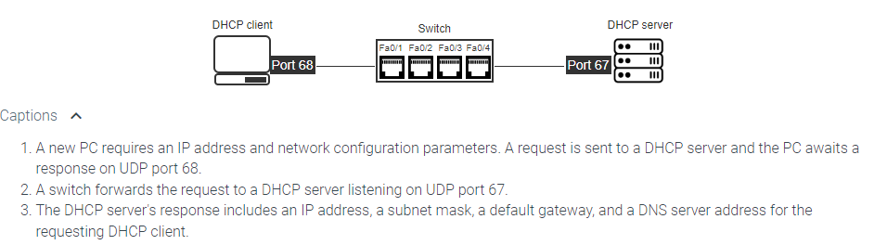
Example

Slide 43
Dynamic Host Control Protocol
Server responds to client requests and sends configuration information
Static DHCP
Uses MACs and deterministically provides IP
Great for servers
DHCP Pool
Uses a pool of addresses and assigns a free one to the requestor
Great for clients

Slide 44
Dynamic Host Control Protocol
Configure clients with DHCP server address?
Broadcast instead:
Issue a DISCOVER to find all DHCP servers
Some server OFFERs some configuration
Client REQUESTs a configuration it liked
The server ACKNOWLEDGEs the request

Slide 45
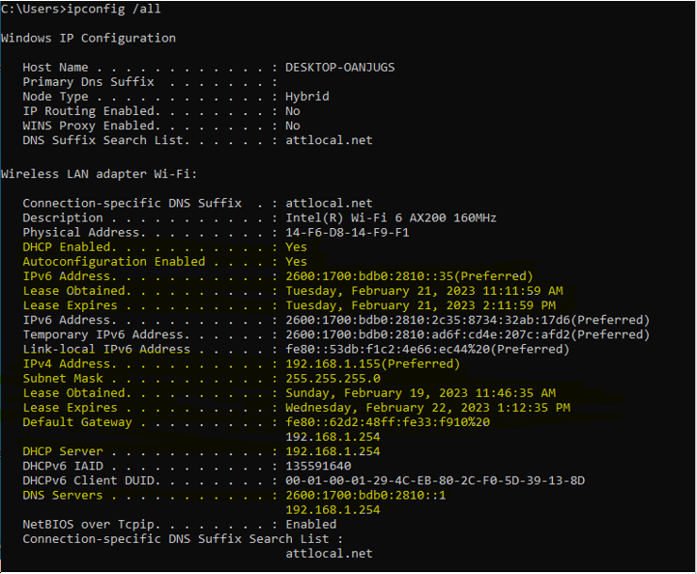

Slide 46
Dynamic Host Control Protocol
DHCP sits on top of UDP (port 67 for the server, 68 for the client)
Any good reason why?
DHCP allocations are “leased” to allow reuse
Half way to expiration, client attempts to renew

Slide 47
Internet Control Message Protocol (ICMP)
Mainly used for error reporting in IP
Can be issued by hosts or routers
Sits on top of IP at the transport layer
Some consider it a security risk
It may be blocked
Some participants may just not use it

Slide 48
ICMP Examples
Host unreachable
Fragment reassembly failure
Checksum failure
Router redirections
TTL value exceeded
Remember a utility that exploits this?
Echo Request
What could this be used for?

Slide 49
Thinking Questions
Is DNS all that useful anymore? Can’t we just use search engines to find servers instead?
Does DNS have to use UDP and suffer from these ID guessing issues? Would it have the same problem under TCP?
Do we need DHCP? Couldn’t hosts just auto-configure addresses for themselves? What advantage are we getting out of this hassle?

