Slide 1
IP: The Next Generation
The address space has become an issue
4 billion addresses with 100% efficiency
Mobile devices, etc.
Requires a change to IP address headers
Non-trivial, changes software everywhere (routers, end points, firewalls etc)
Everyone wanted to fix as many other things as they could in the new version

Slide 2
Bad news
The world have run “out” of IPv4 addresses.
Most networks will still use IPv4 addresses in some capacity
Notes:
we're out, meaning that you cannot go to your country's numbering authority and say, "Hey, I would like to get a block of IPv4 addresses for my company." They're simply not available. However, most every network that you work on today is going to to use IPv4 addressing, but we're starting to see more and more IPv6 addressing, and we will not run out of IPv6 addresses

Slide 3
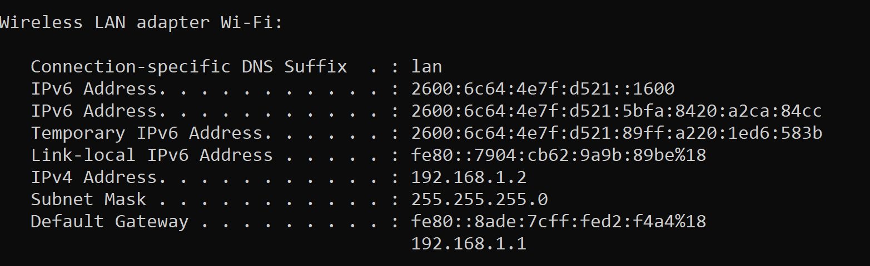
Output: Ifconfig on my office laptop

Slide 4
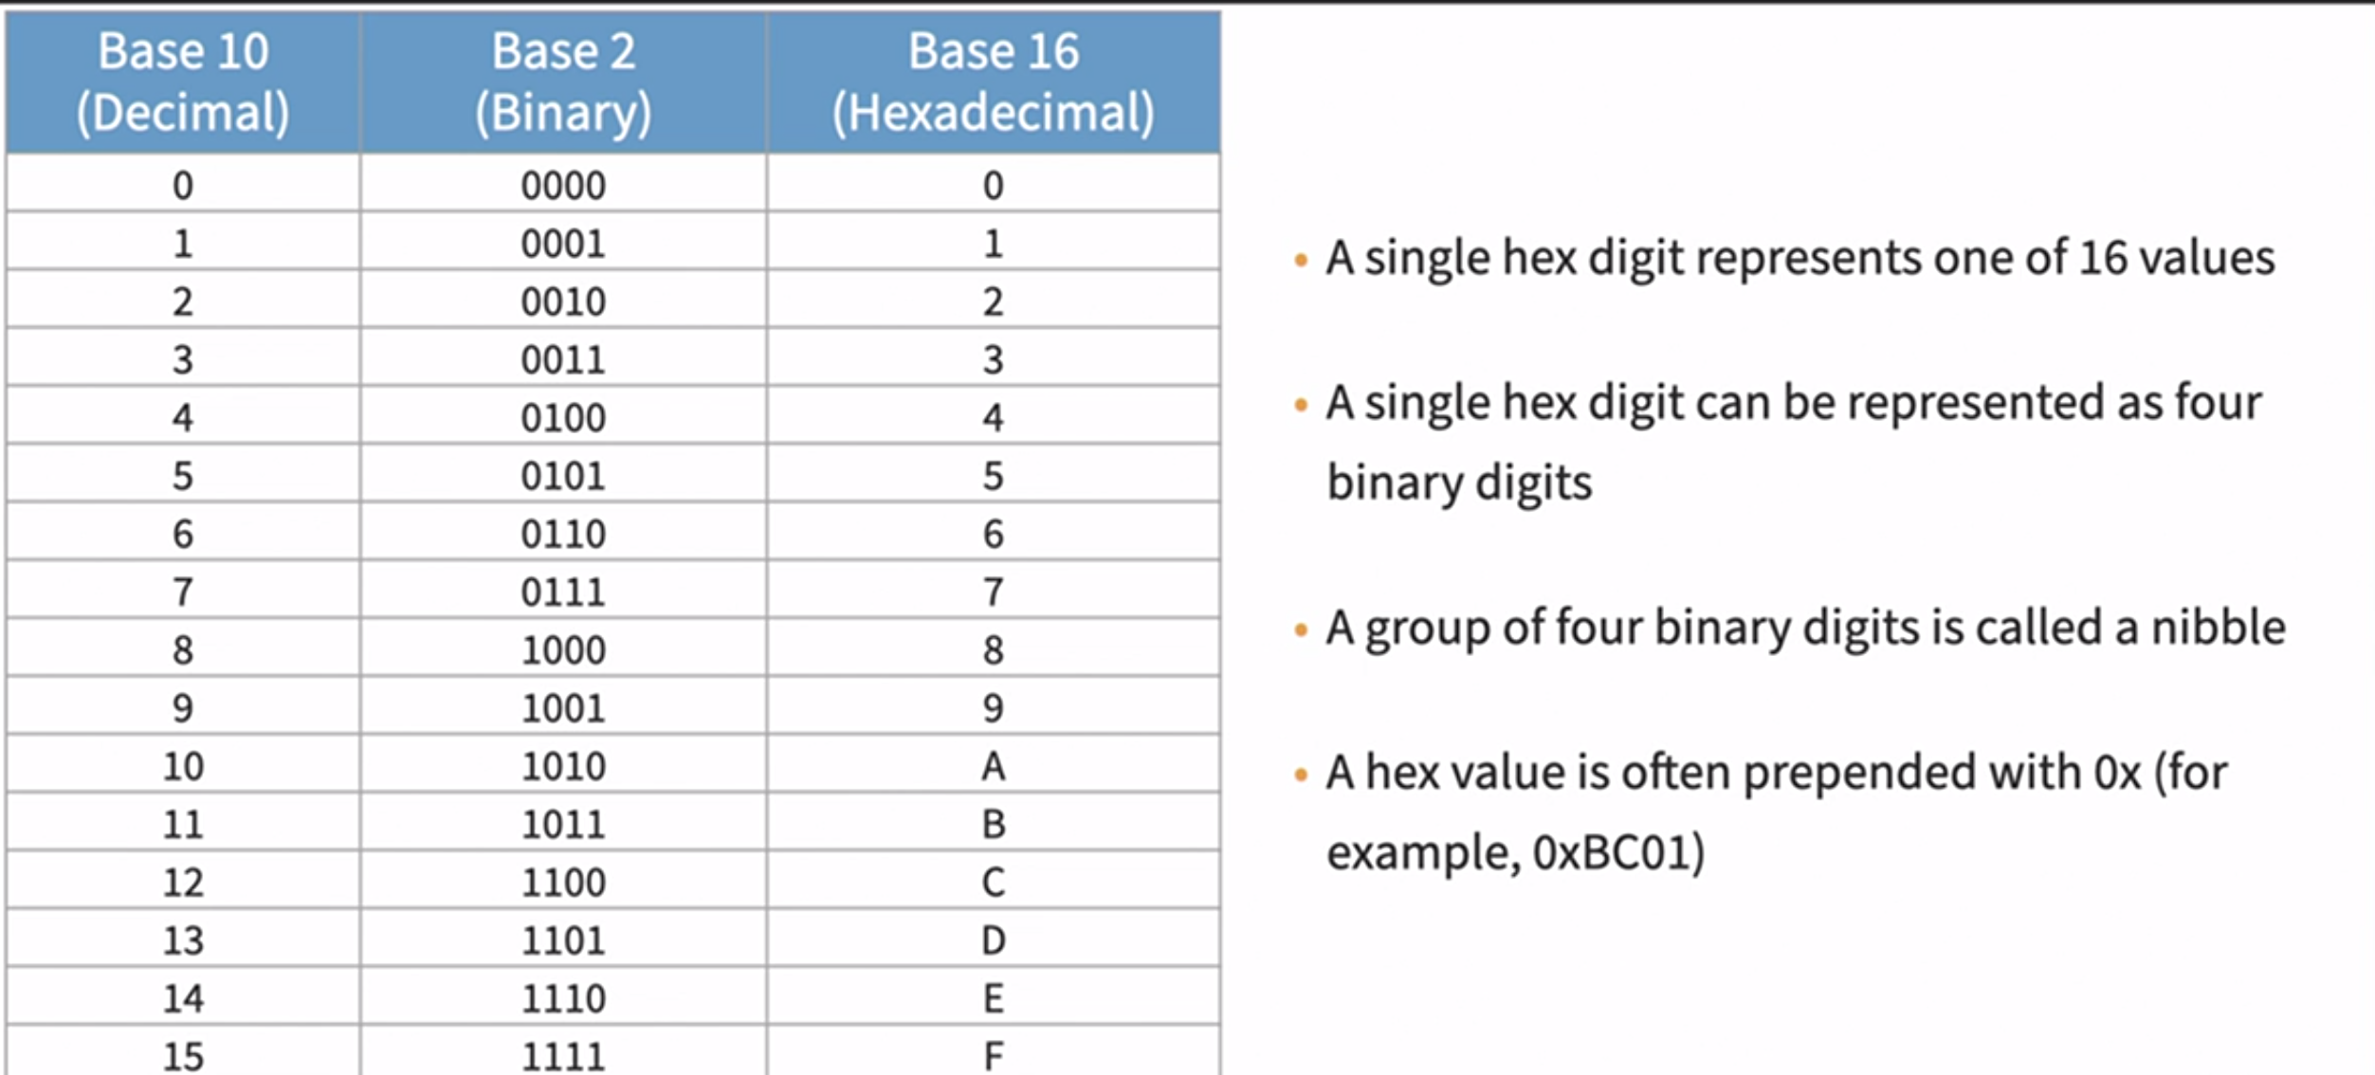
0x removes the ambiguity whether number is decimal or hex

Slide 5
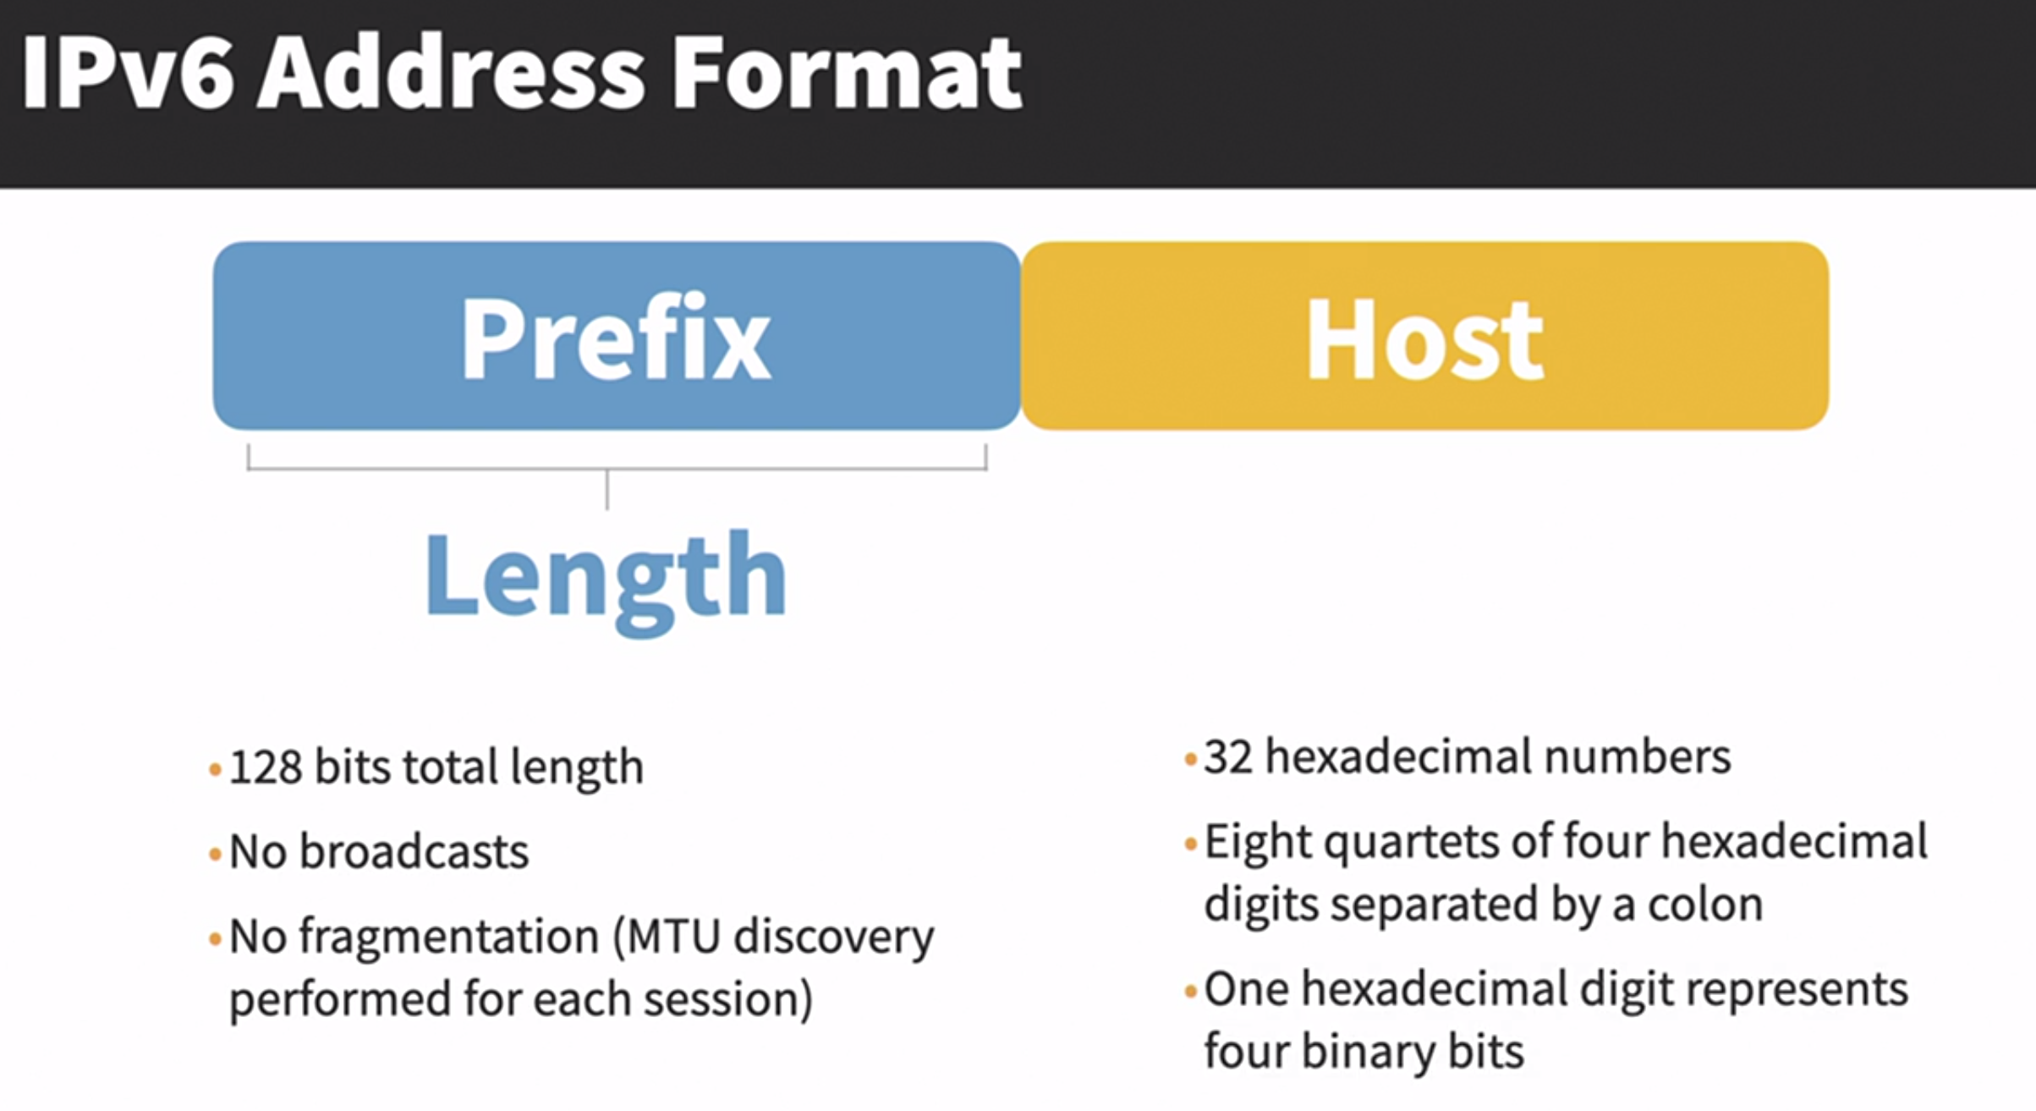
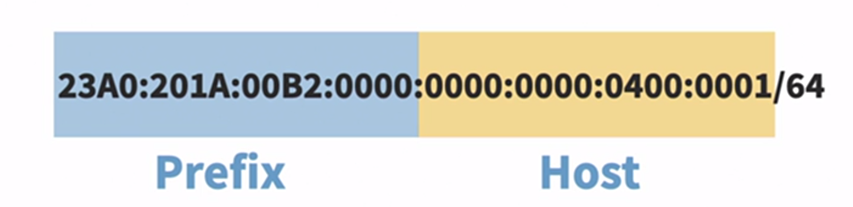

Slide 6
Internet Protocol, Version 6
What happened to IPv5?
Connection oriented experiment
Parts of it ended up in MPLS
What does IPv6 do well?
Addresses. And lots of them… 2128
Auto-configuration
Take MAC address and figure out your unique Ipv6 address
Jumbograms
Better options processing
MPLS stands for Multiprotocol Label Switching, a networking technology that uses labels to direct data between nodes instead of network addresses. MPLS is a common way to connect local area networks (LANs) to wide area networks (WANs). It uses specialized routers to send packets along predetermined paths, which improves the speed of network connections. MPLS is superior to regular Internet Protocol (IP) routing because it sends data directly to its destination, instead of bouncing it all over the internet

Slide 7
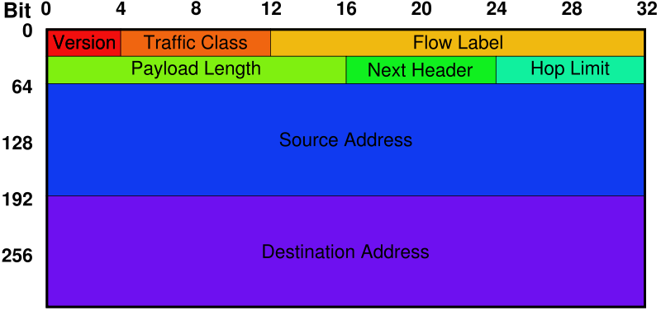
IPv6 Header

Slide 8
IPv6 Header
Version field, which is set to 6 for Ipv6. . The Version field is in the same place relative to the start of the header as IPv4’s Version field so that header-processing software can immediately decide which header format to look for.
The TrafficClass and FlowLabel fields both relate to quality of service issues.
The PayloadLen field gives the length of the packet, excluding the IPv6 header, measured in bytes.
The NextHeader field cleverly replaces both the IP options and the Protocol field of IPv4. If options are required, then they are carried in one or more special headers following the IP header, and this is indicated by the value of the NextHeader field.
If there are no special headers, the NextHeader field is the demux key identifying the higher-level protocol running over IP (e.g., TCP or UDP); that is, it serves the same purpose as the IPv4 Protocol
Also, fragmentation is now handled as an optional header, which means that the fragmentation-related fields of IPv4 are not included in the IPv6 header

Slide 9
IPv6 Addresses
Dotted decimal? Make room for hex!
2001:0db8:85a3:08d3:1319:8a2e:0370:7334
Special notation rules
Drop leading zeros
Drop largest group of 0, replace with “::”
All of these are valid: 2001:0db8:0000:0000:0000:0000:1428:57ab 2001:0db8:0000:0000:0000::1428:57ab 2001:0db8:0:0::1428:57ab 2001:0db8::1428:57ab 2001:db8::1428:57ab

Slide 10
Shortening an IPv6 address
Example: 23A0:201A:00B2:0000:0000:0000:0400:0001/64
23A0:201A:B2::400:1/64 (shortened IPv6 address)

Slide 11
Exercise
Q. Can you shorten the following IPv6?
1.) 23A0:201A:00B2:0000:0000:0000:0400:0001/64
2.) 2000:0000:000:0000:1234:0000:0000:000B/64
Notes:
2000::1234:0:0:B/64

Slide 12
IPv6 Address Space Allocation
Vast majority is reserved for future use
Aggregatable Global Unicast Addresses make up 1/8 of all addresses
“Link local use” addresses are usable on local network, but not globally unique
Autoconfiguration
“Site local use” is used by private networks

Slide 13
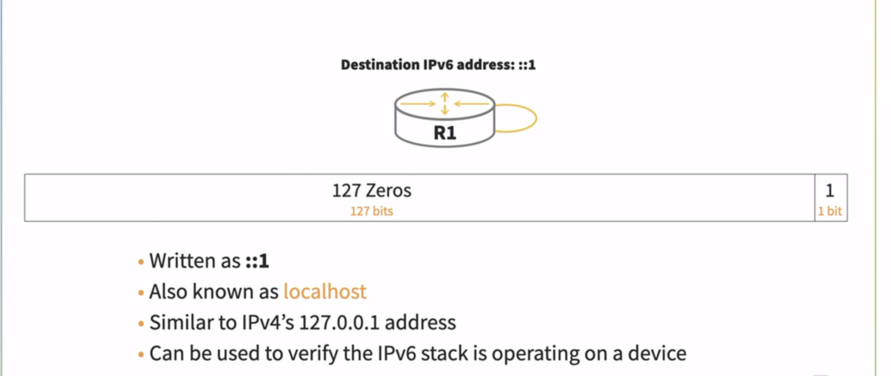
IPv6 Loopback

Slide 14
More IPv6 Address Allocation
3 bits for “Global Unicast Address”: 001
Registry ID – Various registrars per country/continent
Provider ID – Transit network provider (e.g. MCI, ATT, Sprint)
Subscriber ID – Smaller ISP (e.g. Insight)
Subnet ID – Identifies smaller networks
Interface ID – Used to identify hosts, routers, etc.

Slide 15
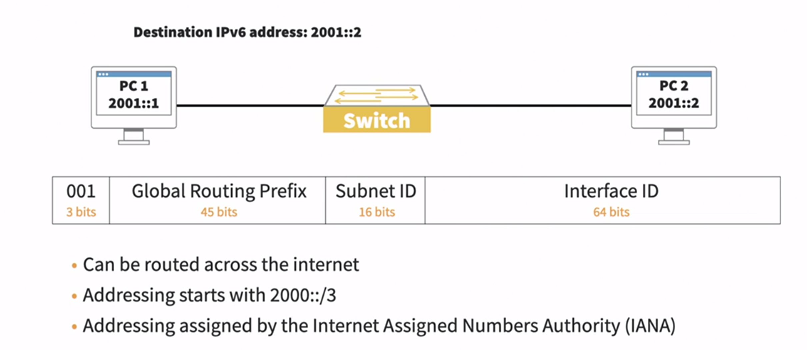
IPv6 Global Unicast (example)

Slide 16
IPv6 OS Support
Microsoft Windows XP, SP1; 2003; Vista
Apple OS X from v10.3 onward
Linux
BSD

Slide 17
Advanced Capabilities
https://book.systemsapproach.org/scaling/ipv6.html#advanced-capabilities

Slide 18
IPv6 Deployment
Who uses it?
Nobody?
Adoption is very slow, but Africa, Japan, China and US governments are switching to it
Why isn’t it being used more?
NAT
CIDR
Unequal distribution leaves the US in good shape

Slide 19
Internet2
What is Internet2?
The Internet on steroids?
The Internet running IPv6?
Just a media term like “information super-highway”?
A great place for p2p software?
No. Well, maybe the last one...

Slide 20
Internet2
A coalition of 208 universities and partners in industry and government
Isn’t there a network though?
Yes, previously the Abilene Backbone Network, now simply “Internet2”
Indiana University manages Internet2

Slide 21
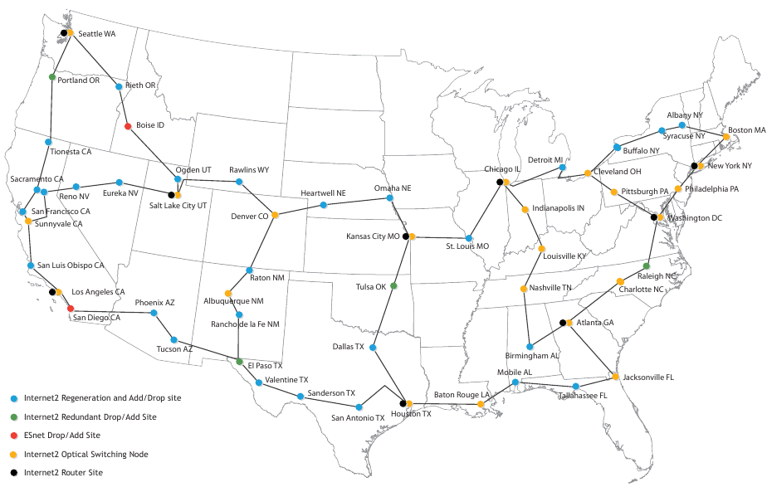
Internet2 Network – 10 Gbps

Slide 22
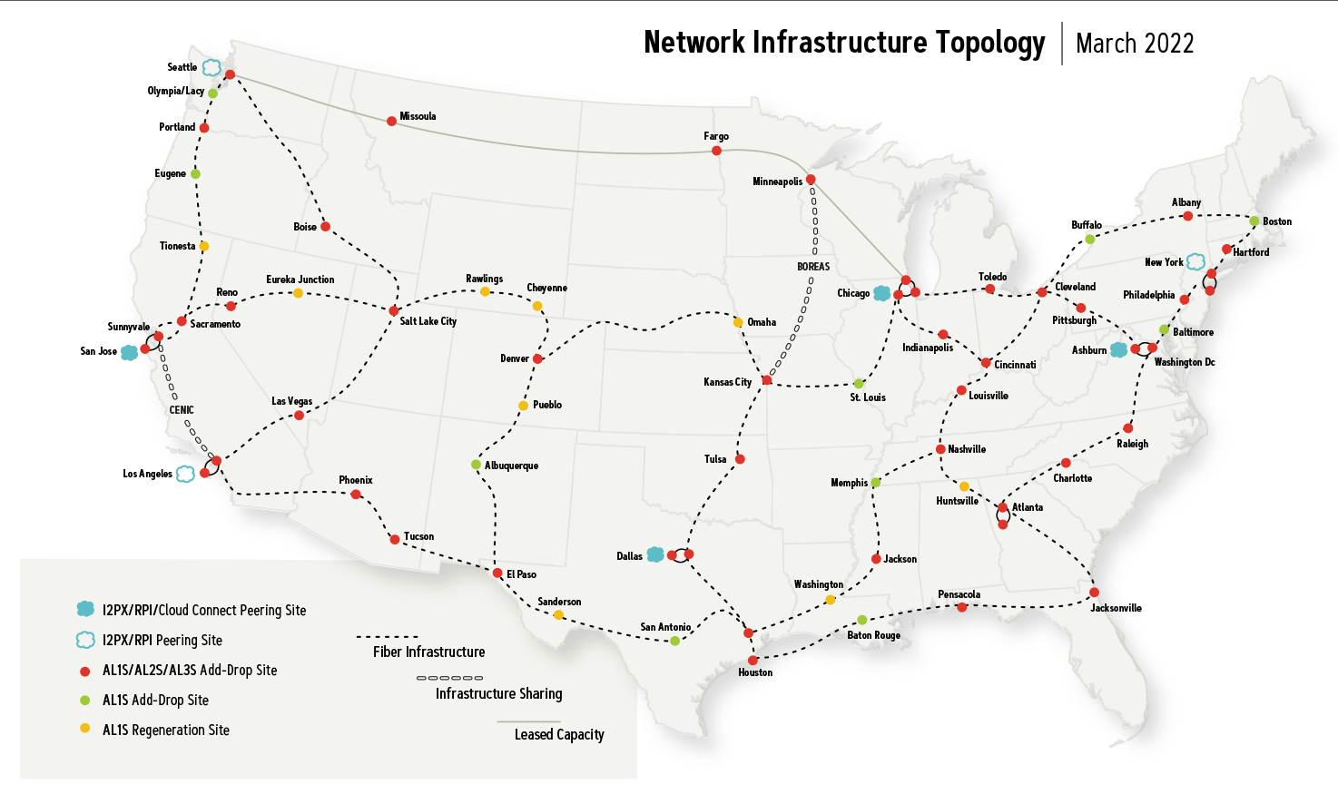
A more recent Internet2 Map

Slide 23
Routing
"Routing" vs. "Forwarding"
Control Plane – Routing (finding the appt path to reach the destination – populate the table to forward a packet)
Data Plane – Forwarding (which interface to forward the data out of – using a lookup table)
Analogy: Assembly line
Does it scale?
Intra-domain – Small network
Inter-domain – Links networks together

Slide 24
Routing among ISPs: BGP
https://youtu.be/2rV4tJkP-CQ

Slide 25
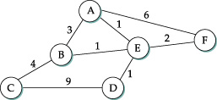
Network Routing or Graph Theory?
Network as a graph
Nodes = routers
Edges have cost
Calculate shortest path and store it
Node/Link Failures?
New nodes/links?
No changes in cost to reflect load
Distributed routing algorithms
Centralized doesn't scale, but distributed is hard
Convergence/agreement essential. Why?

Slide 26
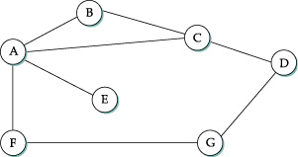
Distance Vector (RIP)
Nodes create an array/vector with costs to all other nodes, then share this with neighbors
Stored at node | Distance to reach node
 | A | B | C | D | E | F | G
B | 1 | 0 | 1
C | 1 | 1 | 0 | 1
D |  |  | 1 | 0 |  |  | 1
E | 1 |  |  |  | 0
F | 1 |  |  |  |  | 0 | 1

Slide 27
A's Routing Table
Destination | Cost | Next Hop
B | 1 | B
C | 1 | C
D | INFINITY | -
E | 1 | E
F | 1 | F
G | INFINITY | -
Initial Table
Destination | Cost | Next Hop
B | 1 | B
C | 1 | C
D | 2 | C
E | 1 | E
F | 1 | F
G | 2 | F
Final Table

Slide 28
Global Final View
Stored at node | Distance to reach node
 | A | B | C | D | E | F | G
A | 0 | 1 | 1 | 2 | 1 | 1 | 2
B | 1 | 0 | 1 | 2 | 2 | 2 | 3
C | 1 | 1 | 0 | 1 | 2 | 2 | 2
D | 2 | 2 | 1 | 0 | 3 | 2 | 1
E | 1 | 2 | 2 | 3 | 0 | 2 | 3
F | 1 | 2 | 2 | 2 | 2 | 0 | 1
G | 2 | 3 | 2 | 1 | 3 | 1 | 0

Slide 29
Distance Vector
Periodic updates (seconds to minutes)
Triggered updates (update causes a change)
Cascades to neighbors (and recalculate)
Detecting failures
Soft-state (pings), inactivity (misses update cycles)
What happens when link F to G fails?
What happens when link A to E fails?
Count to infinity!

Slide 30
Count to Infinity
Bound infinity to 16
Any problems?
Split Horizon
Don't include advertisements of a route back to its source (e.g., if you learned from A, don't tell A)
Split Horizon with Poison Reverse
Include the route back, but poison with infinity
Split horizons only work with two node loops
Drastic measures: Simply delay after failures
Slows down convergence

Slide 31
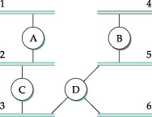
Routing Information Protocol (RIP)
Uses distance vector routing
Instead of calculating costs to nodes, calculates costs to reach attached networks
<Network-address, distance> pairs
RIP advertisements every 30 secs
Can support more than just IPv4
RIPv2 adds scalability features
Each link has a cost of 1; 16 = infinity

Slide 32
Thinking Questions
Why doesn’t everyone just use IPv6 now? What are the obstacles?
What are the key considerations for routing? What do we need to assure?
Can the routing techniques we’ve learned so far be directly applied to Internet-scale routing? Why or why not?

