Slide 1
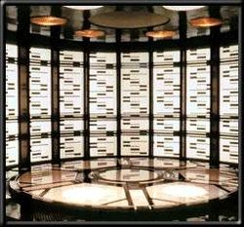
Welcome to the Transport Layer!

Slide 2
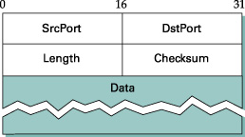
User Datagram Protocol (UDP)
Provides applications with ability to send and receive datagrams
Provides for multiple concurrent applications on a single machine
Includes an optional checksum field
Unreliable, connectionless protocol

Slide 3
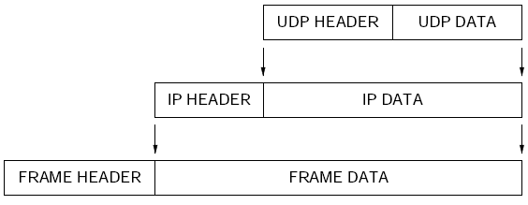
UDP Layering

Slide 4
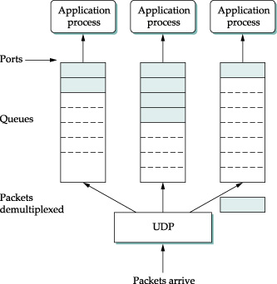
UDP Details
Defines format of messages sent
Message includes small integer ports to demultiplex
Messages encapsulated in IP

Slide 5
Transmission Control Protocol
Major transport service in the TCP/IP suite
Reliable transfer
Stream paradigm
Full duplex connections
Flow control
Uses IP for transmission

Slide 6
TCP Details
Allows sender to generate a stream of bytes in convenient chunks
Divides stream into small segments for transmission
Sends each segment in IP datagram
Receiving TCP returns acknowledgment upon successful receipt of data
Sender starts timer after segment sent and retransmits unless positive acknowledgment arrives

Slide 7
TCP Retransmission
Designed for Internet environment
Delays on one connection vary over time
Delays vary widely between connections
Fixed value for timeout will fail
Waiting too long introduces needless delay
Not waiting long enough means unnecessary retransmissions
Retransmission must be adaptive

Slide 8
Adaptive retransmission
TCP keeps estimates of round-trip time on each connection
This estimate derived from observed delay between sending a segment and receiving of the acknowledgment
Timeout for retransmission based on current round-trip estimate
These are heuristics and can sometimes fail

Slide 9
TCP details
Segment contains checksum for data being sent
Receiver acknowledges highest byte received, not each specific segment
Protocol port numbers used to distinguish multiple applications
Receiver controls flow by telling the sender the size of the available buffer (a window advertisement)
Each segment contains the advertisement

Slide 10
TCP Details – continued
Receiver can send additional acknowledgments whenever buffer space becomes available
Data flow may be shut down in one direction
Connections started reliably and terminated gracefully

Slide 11
Waging War
Two generals, two armies, one city
Encamped on hills outside city
City is in valley and defended by own troops
Can only communicate via messengers
These messengers must pass through the valley
The messengers may be intercepted
Both generals agree to attack, but haven't decided when to attack
Attack must be synchronous or it will fail
Now, solve the problem.
Go.

Slide 12
You can't win this war.
The Byzantine Generals Problem cannot be solved with certainty.
Mathematical proof from 1975
Why the heck does this have to do with computer networking?
Given the problem can't be solved, what do we do?

Slide 13
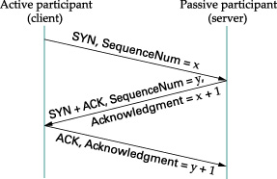
Three Way Handshake for Connection Start-up

Slide 14
https://youtu.be/aOLxQGLJouI?si=ULpZNduoEF2wrf3d

Slide 15
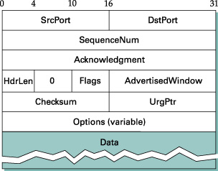
TCP Segment Format

Slide 16
Details
The SrcPort and DstPort fields identify the source and destination ports, respectively, just as in UDP. These two fields, plus the source and destination IP addresses, combine to uniquely identify each TCP connection. That is, TCP’s demux key is given by the 4-tuple
(SrcPort, SrcIPAddr, DstPort, DstIPAddr)
The Acknowledgement, SequenceNum, and AdvertisedWindow fields are all involved in TCP’s sliding window algorithm.
Because TCP is a byte-oriented protocol, each byte of data has a sequence number. The SequenceNum field contains the sequence number for the first byte of data carried in that segment, and the Acknowledgement and AdvertisedWindow fields carry information about the flow of data going in the other direction.

Slide 17
The 6-bit Flags field is used to relay control information between TCP peers. The possible flags include SYN, FIN, RESET, PUSH, URG, and ACK.
The SYN and FIN flags are used when establishing and terminating a TCP connection, respectively.
The ACK flag is set any time the Acknowledgement field is valid, implying that the receiver should pay attention to it.
The URG flag signifies that this segment contains urgent data. When this flag is set, the UrgPtr field indicates where the nonurgent data contained in this segment begins. The urgent data is contained at the front of the segment body, up to and including a value of UrgPtr bytes into the segment.
The PUSH flag signifies that the sender invoked the push operation, which indicates to the receiving side of TCP that it should notify the receiving process of this fact.
Finally, the RESET flag signifies that the receiver has become confused—for example, because it received a segment it did not expect to receive—and so wants to abort the connection.

Slide 18
The Checksum field is used in exactly the same way as for UDP—it is computed over the TCP header, the TCP data, and the pseudoheader, which is made up of the source address, destination address, and length fields from the IP header.
The checksum is required for TCP in both IPv4 and IPv6. Also, since the TCP header is of variable length (options can be attached after the mandatory fields), a HdrLen field is included that gives the length of the header in 32-bit words. This field is also known as the Offset field, since it measures the offset from the start of the packet to the start of the data.

Slide 19
Assignment of Protocol Ports
Need globally fixed ports for globally-known services
Need dynamically allocated ports for other services
Accommodate with two port types
Statically assigned ports
Dynamically assigned ports
Note: servers use statically assigned ports; clients use dynamically assigned ports

Slide 20
Statically Assigned Ports
Called "well-known"
Used for services like e-mail
Fixed by Internet Assigned Numbers Authority
Use "small" values
In UNIX, values less than 1000 reserved for privileged programs

Slide 21
Dynamically Assigned Ports
Available for user applications
Operating system chooses when application begins
Programmer responsible for devising mechanism to inform other programs
Use "large" values

Slide 22
Program Interface to Port Assignment
Port numbers should not be encoded in programs as literal constants
Most systems provide
Database of service names
Library routines that use the database to map names into protocol port numbers (e.g., getservbyname)
Site can add local definitions to the database

Slide 23
Example Service Mapping DB
echo 7/tcp
echo 7/udp
ftp 21/tcp
telnet 23/tcp
smtp 25/tcp
time 37/tcp
time 37/udp
nameserver 53/tcp
nameserver 53/udp

Slide 24
Example Mapping DB
Program contains literal constants for name of service and name of protocol
Program calls library routine to obtain port number
Port mapping can be changed without recompiling program

Slide 25
TCP Formal Specification (finite state machine)
TCP behavior specified by finite state machine
At any instant, each side of TCP connection is in one state
Think of the state machine as controlling response to input
Arrival of a segment can cause a state transition
A local operation can also cause a state transition (e.g.,close)

Slide 26
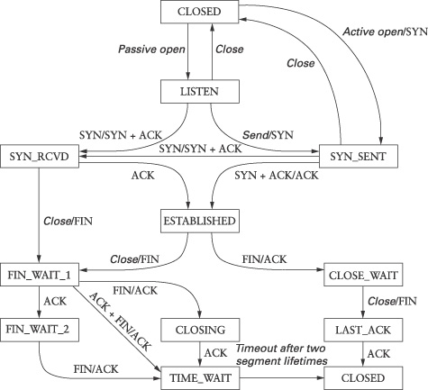

Slide 27
Transition: Opening a Connection
Both sides create TCP endpoint (e.g., using socket calls)
TCP software on both sides record that connection is initially in CLOSED state
Server side issues passive open and waits in LISTEN state
Client issues active open, sends SYN segment, and moves to SYN SENT state
Server side receives SYN, sends SYN plus ACK, and moves to SYN RECVD state
Client receives SYN plus ACK, sends ACK, and moves to ESTABLISHED state
Server receives ACK and moves to ESTABLISHED state
Now both sides agree that connection is open

Slide 28

TCP 3-way handshake
client state
server state
LISTEN
LISTEN
choose init seq num, x
send TCP SYN msg
SYNSENT
SYNbit=1, Seq=x
choose init seq num, y
send TCP SYNACK
msg, acking SYN
SYN RCVD
SYNbit=1, Seq=y
ACKbit=1; ACKnum=x+1
received SYNACK(x)
indicates server is live;
send ACK for SYNACK;
this segment may contain
client-to-server data
ESTAB
ACKbit=1, ACKnum=y+1
received ACK(y)
indicates client is live
ESTAB

Slide 29
TCP 3-way handshake: FSM
closed
Socket connectionSocket = welcomeSocket.accept();
Λ
Socket clientSocket =
newSocket("hostname","port number");
SYN(x)
SYNACK(seq=y,ACKnum=x+1)
create new socket for
communication back to client
listen
SYN(seq=x)
SYN
rcvd
SYN
sent
SYNACK(seq=y,ACKnum=x+1)
ACK(ACKnum=y+1)
ESTAB
ACK(ACKnum=y+1)
Λ

Slide 30
TCP: closing a connection
client state
server state
ESTAB
ESTAB
clientSocket.close()
FIN_WAIT_1
can no longer
send but can
receive data
FINbit=1, seq=x
CLOSE_WAIT
ACKbit=1; ACKnum=x+1
can still
send data
FIN_WAIT_2
wait for server
close
LAST_ACK
FINbit=1, seq=y
TIMED_WAIT
can no longer
send data
ACKbit=1; ACKnum=y+1
timed wait
for 2*max
segment lifetime
CLOSED
CLOSED

Slide 31
Maximum Segment Size
TCP endpoints use the MSS option to exchange the maximum segment that they are willing to receive
Improves efficiency
Is a function of the networks between the hosts
TCP tries to avoid sending segments that will have to be fragmented
Fragmentation decreases efficiency
Fragmentation decreases throughput
Normal sizes are network MTU for local connections and 576 for non-local

Slide 32
Adaptive Retransmission
The problem is knowing when to retransmit
TCP keeps estimate of round-trip time for each connection
Round-trip estimate computed from observing difference in times when segment transmitted, and time when ACK arrives
Timeout for retransmission is function of round trip estimate

Slide 33
TCP round trip time, timeout
Q: how to set TCP timeout value?
longer than RTT
but RTT varies
too short: premature timeout, unnecessary retransmissions
too long: slow reaction to segment loss
Q: how to estimate RTT?
SampleRTT: measured time from segment transmission until ACK receipt
ignore retransmissions
SampleRTT will vary, want estimated RTT “smoother”
average several recent measurements, not just current SampleRTT

Slide 34
Difficulties in Adaptive Retransmit
Segments or ACKs can be lost or delayed, making round trip estimation difficult or inaccurate
Round trip times vary over several orders of magnitude between different connections
Traffic is bursty, so round trip times fluctuate wildly on a single connection
Load imposed by a single connection can congest gateways or networks
Retransmission can cause congestion
Because an Internet contains diverse network hardware technologies, there may be little or no control for intra-network congestion

Slide 35
Solution: Smoothing
Adaptive retransmission schemes keep a statistically smoothed round trip estimate
Smoothing keeps running average from fluctuating wildly and keeps TCP from overreacting to change
Difficulty: choice of smoothing scheme

Slide 36
Original Smoothing Scheme
Let RTT be current (old) overage round trip time
Let NRT be the new sample
Compute RTT = a * RTT + b * NRT, where a+b=1
Example: a = 0.8, b = 0.2
Large a makes estimate more stable
Large b makes estimate track RTT changes more quickly (more responsive)

Slide 37
Problems with the Original Scheme
Associating ACKs with transmissions
TCP acknowledges receipt of data, not receipt of transmission
Assuming ACK corresponds to most recent transmission can cause instability in round trip estimate (Cypress syndrome)
Assuming ACK corresponds to first transmission can cause unnecessarily long timeout
Both assumptions lead to lower throughput

Slide 38
Changes in Delay
Original smoothing scheme tracks the mean but not changes
Track changes: compute DIFF = SAMPLE – RTT RTT = RTT + d * DIFF DEV = DEV + d (|DIFF| - DEV)
DEV estimates mean deviation
d is fraction between 0 and 1 that weights new sample
Retransmission timer is weighted average of RTT and DEV: RTO = u*RTT + p*DEV
Typically, u = 1 and p = 4

Slide 39
TCP round trip time, timeout
EstimatedRTT = (1- α)*EstimatedRTT + α*SampleRTT
exponential weighted moving average
influence of past sample decreases exponentially fast
typical value: α = 0.125
RTT: gaia.cs.umass.edu to fantasia.eurecom.fr
RTT (milliseconds)
sampleRTT
EstimatedRTT
time (seconds)

Slide 40

TCP round trip time, timeout
timeout interval: EstimatedRTT plus “safety margin”
large variation in EstimatedRTT -> larger safety margin
estimate SampleRTT deviation from EstimatedRTT:
DevRTT = (1-β)*DevRTT +
β*|SampleRTT-EstimatedRTT|
(typically, β = 0.25)
TimeoutInterval = EstimatedRTT + 4*DevRTT
estimated RTT
“safety margin”

Slide 41
TCP: retransmission scenarios
Host A
Host B
Host A
Host B
SendBase=92
Seq=92, 8 bytes of data
Seq=92, 8 bytes of data
timeout
timeout
Seq=100, 20 bytes of data
ACK=100
X
ACK=100
ACK=120
Seq=92, 8 bytes of data
Seq=92, 8
bytes of data
SendBase=100
SendBase=120
ACK=100
ACK=120
SendBase=120
lost ACK scenario
premature timeout

Slide 42
(Revisit)TCP: retransmission scenarios
Host A
Host B
Seq=92, 8 bytes of data
Seq=100, 20 bytes of data
timeout
ACK=100
X
ACK=120
Seq=120, 15 bytes of data
cumulative ACK

Slide 43
(Revisit) TCP fast retransmit
Host A
Host B
Seq=92, 8 bytes of data
Seq=100, 20 bytes of data
X
ACK=100
timeout
ACK=100
ACK=100
ACK=100
Seq=100, 20 bytes of data
fast retransmit after sender
receipt of triple duplicate ACK

Slide 44
Partridge/Karn Scheme
Solves the problem of associating ACKs with correct transmission
Specifies ignoring round trip time samples that correspond to retransmissions
Separates timeout from round trip estimate for retransmitted packets
Starts (as usual) with retransmission timer as a function of round trip estimate
Doubles retransmission timer value for each retransmission without changing round trip estimate

Slide 45
Partridge/Karn Scheme
Resets retransmission timer to be function of round trip estimate when ACK arrives for non-retransmitted segment
Works well for occasional packet loss
Provides exponential backoff from completely saturated network
Does not solve the problem of flow control or congestion

Slide 46
Flow Control vs. Congestion
Flow control involves preventing senders from over-running the capacity of receivers.
Congestion control involves preventing too much data from being injected into the network, thereby causing switches or links to become overloaded.
Thus, flow control is an end-to-end issue, while congestion control is concerned with how hosts and networks interact.

Slide 47
Flow control and congestion
Receiver advertises window that specifies how many additional bytes it can accept
Window size of zero means sender must not send normal data (ACKs and urgent data allowed)
Receiver can never decrease window beyond previously advertised point in sequence space
Sender chooses effective window smaller than receiver's advertised window if congestion detected

Slide 48
TCP flow control
application
process
application may
remove data from
TCP socket buffers ….
application
TCP socket
receiver buffers
OS
… slower than TCP
receiver is delivering
(sender is sending)
TCP
code
flow control
IP
code
receiver controls sender, so sender won’t overflow receiver’s buffer by transmitting too much, too fast
from sender
receiver protocol stack

Slide 49
TCP flow control
receiver “advertises” free buffer space by including rwnd value in TCP header of receiver-to-sender segments
RcvBuffer size set via socket options (typical default is 4096 bytes)
many operating systems autoadjust RcvBuffer
sender limits amount of unacked (“in-flight”) data to receiver’s rwnd value
guarantees receive buffer will not overflow
to application process
RcvBuffer
buffered data
rwnd
free buffer space
TCP segment payloads
receiver-side buffering

Slide 50
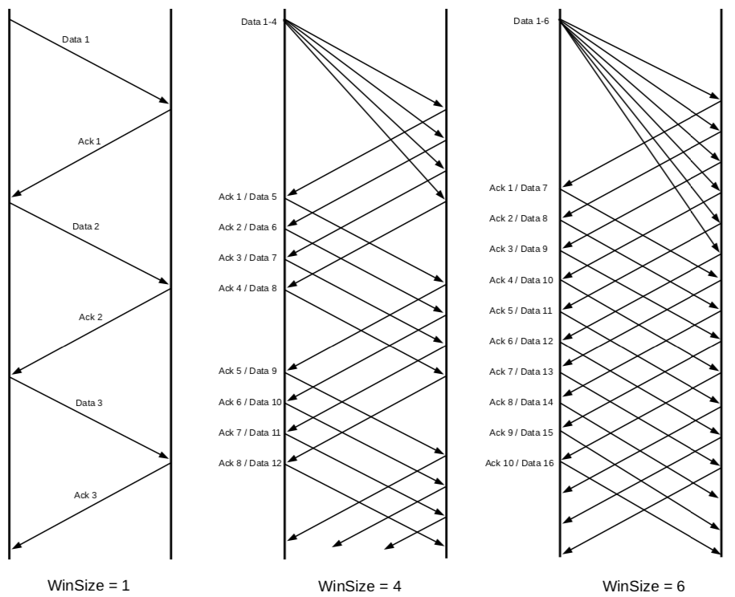
Sliding Windows

Slide 51
Jacobson/Karels Congestion Control
Assumes long delays (packet loss) due to congestion
Uses successive retransmissions as measure of congestion
Reduces effective window as retransmissions increase
Effective window is minimum of receiver's advertisement and computed quantity known as the congestion window

Slide 52
Multiplicative Decrease
In steady state (no congestion) the congestion window is equal to the receiver's window
When segment lost (retransmission timer expires), reduce congestion window by half
Never reduce congestion window to less than one maximum sized segment

Slide 53
Slow Start
Used when starting traffic or when recovering from congestion
Self-clocking startup to increase transmission rate rapidly as long as no packets are lost
When starting traffic, initialize the congestion window to the size of a single maximum sized segment
Increase congestion window by size of one segment each time an ACK arrives without retransmission

Slide 54
Congestion Avoidance
When congestion first occurs, record one-half of last successful congestion window size in a threshold variable (ssthresh in the code)
During recovery, use slow start until congestion window reaches threshold
Above threshold, slow down and increase congestion window by one segment per window (even if more than one segment was successfully transmitted in that interval)

Slide 55
Congestion Avoidance
Increment window size on each ACK instead of waiting for complete window
increase = segment / window
Let N be segments per window, or N = congestion window/max segment size
so increase = segment / N = (MSS bytes / N) = MSS / (congestion win/MSS)
or increase = (MSS*MSS)/congestion win

Slide 56
Urgent Data
Segment with urgent bit set contains pointer to last octet of urgent data
Urgent data occupies part of normal sequence space
Urgent data can be retransmitted
Receiving TCP should deliver urgent data to application "immediately" upon receipt
E.g. Ctrl+C

Slide 57
TCP Futures: TCP over “long, fat pipes”
example: 1500 byte segments, 100ms RTT, want 10 Gbps throughput
requires W = 83,333 in-flight segments
throughput in terms of segment loss probability, L [Mathis 1997]:
➜ to achieve 10 Gbps throughput, need a loss rate of L = 2·10⁻¹⁰ – a very small loss rate!
new versions of TCP for high-speed
1.22
.
MSS
TCP throughput =
RTT
L

Slide 58
TCP Fairness
fairness goal: if K TCP sessions share same bottleneck link of bandwidth R, each should have average rate of R/K
TCP connection 1
bottleneck
router
capacity R
TCP connection 2

Slide 59
Why is TCP fair?
two competing sessions:
additive increase gives slope of 1, as throughout increases
multiplicative decrease decreases throughput proportionally
R
equal bandwidth share
loss: decrease window by factor of 2
Connection 2 throughput
congestion avoidance: additive increase
loss: decrease window by factor of 2
congestion avoidance: additive increase
Connection 1 throughput
R

Slide 60
Fairness (more)
Fairness and UDP
multimedia apps often do not use TCP
do not want rate throttled by congestion control
instead use UDP:
send audio/video at constant rate, tolerate packet loss
Fairness, parallel TCP connections
application can open multiple parallel connections between two hosts
web browsers do this
e.g., link of rate R with 9 existing connections:
new app asks for 1 TCP, gets rate R/10
new app asks for 11 TCPs, gets R/2

Slide 61
Thinking Questions
Are there other transport layers than UDP and TCP? What might they do?
What does it mean for retransmission to be “adaptive” and why is this a goal?
In TCP, do both communicating participants need to be in the same state in the TCP state machine? Why or why not?

